Slide 1




Solomon Islands National Tsunami Ready Stakeholder Workshop
1.2 Logistics, Introductions
Solomon Islands
UNESCO-IOC
International Tsunami Information Centre (ITIC)

Slide 2
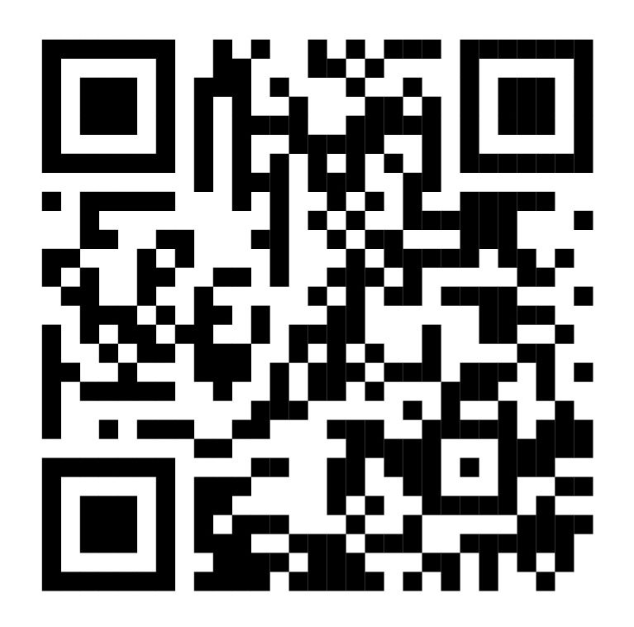
Workshop Details
Meeting Materials – Folder, Awareness
Meeting web site – presentations reference documents.
https://oceanexpert.org/event/4368
      Participant Registration – for official attendance, please register https://oceanexpert.org/registerEvent/4368

Slide 3
THANK YOU
For more information:
web: tsunamiready.org
e-mail: itic@unesco.org

