Slide 1

ICG/PTWS WG3 Task Team on Tsunami Ready July 2024
PTWS WORKING GROUP 3
ON DISASTER RISK MANAGEMENT AND PREPAREDNESS (WG 3)
TASK TEAM ON TSUNAMI READY
WELCOME & INTRODUCTIONS
Co-Chairs:
Ashleigh Fromont, NZ NEMA
Laura Kong, ITIC

Slide 2
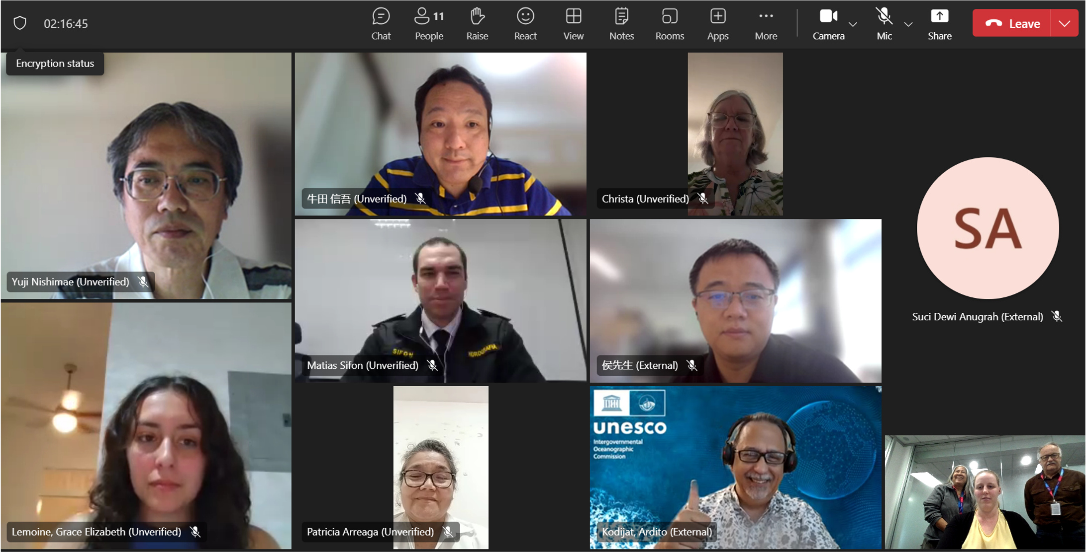
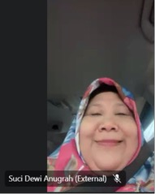
ICG/PTWS WG3 Task Team on Tsunami Ready July 2024
Missing from photo):
Jiuta Korovulavula
Missing from photo):
Jiuta Korovulavula
Laura Kong David Coetzee
Ashleigh Fromont
Laura Kong. David Coetzee
Ashleigh Fromont

Slide 3
ICG/PTWS WG3 Task Team on Tsunami Ready July 2024
AGENDA
1. Welcome
2. Status Review (ICG/PTWS-XXX & TOWS-WG)
3. Standardized Training – Ocean Teacher Global Academy
4. Implementation challenges
4. The Equivalency Guidance
5. Next Steps

