Slide 1

ICG/PTWS WG3 Task Team on Tsunami Ready July 2024
PTWS WORKING GROUP 3
ON DISASTER RISK MANAGEMENT AND PREPAREDNESS (WG 3)
TASK TEAM ON TSUNAMI READY
ISSUES RELATING TO TR IMPLEMENTATION
PTWS
Other ICGs (NEAMTWS, IO, CARIBE-EWS)
PTWS Tsunami Ready Implementation Survey

Slide 2
ICG/PTWS WG3 Task Team on Tsunami Ready July 2024
See separate files for additional information - Fiji, Indonesia, North Pacific Tsunami Ready
presented at PICT Tsunami Ready workshop, 14 May 2024, https://oceanexpert.org/event/4245
PTWS PICT TR Workshop May 2024
Lessons learned from recent ITIC implementation support to FSM, Fiji, Marshall Islands, Palau:
Stagger effort through through regular process meetings – don’t concentrate work at the beginning or end of the process
The NDMO should be a main focal point, but so far, most focal points have been NTWC
Hazard assessment – inundation modelling takes the longest. Biggest challenge is near shore high resolution bathymetry.
Evacuation map requires GIS capacity (often another agency) and available data layers
The Tsunami Ready application process is cumbersome. This may be improved by the Tsunami Ready toolkit being developed with TIC lead
https://oceanexpert.org/event/4245

Slide 3
ICG/PTWS WG3 Task Team on Tsunami Ready July 2024
Discussion: other Pacific
Costa Rica (by Christa)
Implementation has been done at a very local level (11 done) so although great progress has been made there is a significant scale up needed (200+ more to do) – which will be difficult for implementation (lots of work) and administratively (lots of paperwork). Reconsidering the size of community to use (bigger, comprised of several smaller). It’s important to make sure those smaller entities retain their sense of accomplishment (not get lost within the big community).
NTWC is the lead.
Noted that since renewal every 4 yrs, turnover in interim so new people. Want to implement annual feedback process to ensure contacts up to date, and activities and momentum maintained.
Reported benefits include increase in local disaster response management capacity, improvements to infrastructure such as school access, new warning systems, and relationships / collaboration.
Fiji (by Jiuta)
Due to successful effort for TRRP recognition in 2 communities last year, Fiji now allocated $ in the budget to support TR. This is positive for the sustainability
They will also need continued collaboration and support from stakeholders such as NGOs at the national and local level to drive implementation.

Slide 4
ICG/PTWS WG3 Task Team on Tsunami Ready July 2024
Discussion: CARIBE Comments
Introduction to the survey context:
TR has been implemented in some format since 2011 (started as US NWS TR, then transition to pilot of UNESCO-IOC indicators).
This survey is designed to be conducted at the culmination of Tsunami Ready implementation, at both the national and community level.
This survey is a pilot survey, and the results are preliminary.

Slide 5
Pilot Feedback Survey On The Implementation Of The UNESCO-IOC Tsunami Ready Recognition Programme In ICG/CARIBE-EWS
July 2024
PRELIMINARY RESULTS AND ANALYSIS
Grace Lemoine, NOAA/NWS Lapenta Scholar
Fabian Hinds
Alison Brome
Christa von Hillebrandt-Andrade
Öcal Necmioğlu

Slide 6
Sample Profile
PRELIMINARY
The pilot survey was developed for administration among communities who have received or renewed their Tsunami Ready recognition since 2019. It was designed with the intent to obtain two responses from each Tsunami Ready community. Respondents were prompted to submit one response that reflected the opinion of the National/Regional Tsunami Ready Board (NTRB/RTRB) and another of the corresponding Local Tsunami Ready Committees (LTRC).
Out of the 19 Tsunami Ready communities who received the survey, 16 submitted at least one response, but only 6 submitted both responses requested. The six communities in question were:
Shermans/St. Lucy to Mullins/St. Peter, BB (recognized 2020)
Carriacou and Petite Martinique, GD (recognized 2019)
Old Harbour Bay, JM (recognized 2021)
Corn Island, Nicaragua (recognized 2019)
Saint Kitts and Nevis (recognized 2022)
Laborie, Saint Lucia (recognized 2024)
In addition, there were 3 communities from which no responses were received:
Tornabé/Tela, HN (recognized 2019)
Saint George Parish, VC (recognized 2023)
Union Island, VC (recognized 2020)
Engagement Rate: 84.21% (16 of 19 communities)
Responses Expected: 38
Total Responses Received: 22
# of NTRB/RTRB Responses: 11
# of LTRC Responses: 11
July 2024

Slide 7
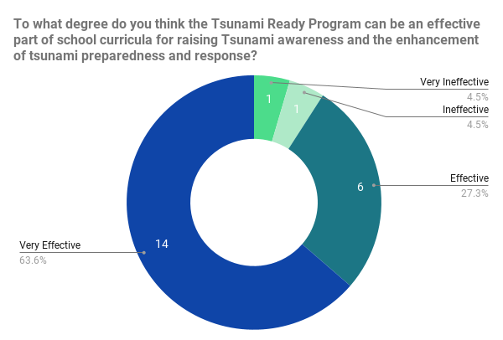
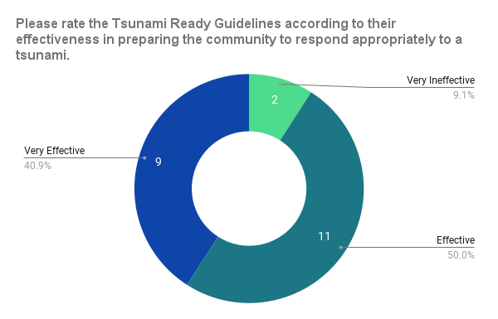
PRELIMINARY
On Tsunami Education
On Tsunami Response Prep
Ineffective for NTRB Shermans/St. Lucy to Mullins/St. Peter, Very Ineffective for NTRB Laborie
Very Ineffective for NTRB St. John’s– “The community is not aware and therefore needs more educational awareness.”
July 2024

Slide 8
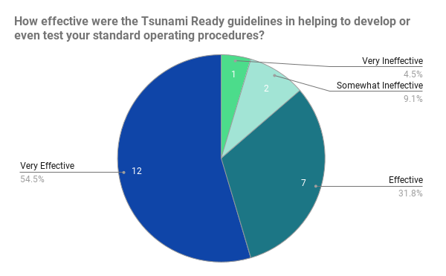
PRELIMINARY
On Standard Operating Procedures
Somewhat Ineffective for LTRC Deshaies– “In France, municipalities are already required to have crisis management plans that meet several TR criteria. What is particularly interesting about the recognition is that it mandates compulsory prevention activities and emphasizes the importance of redundancy in communication methods.”

Slide 9
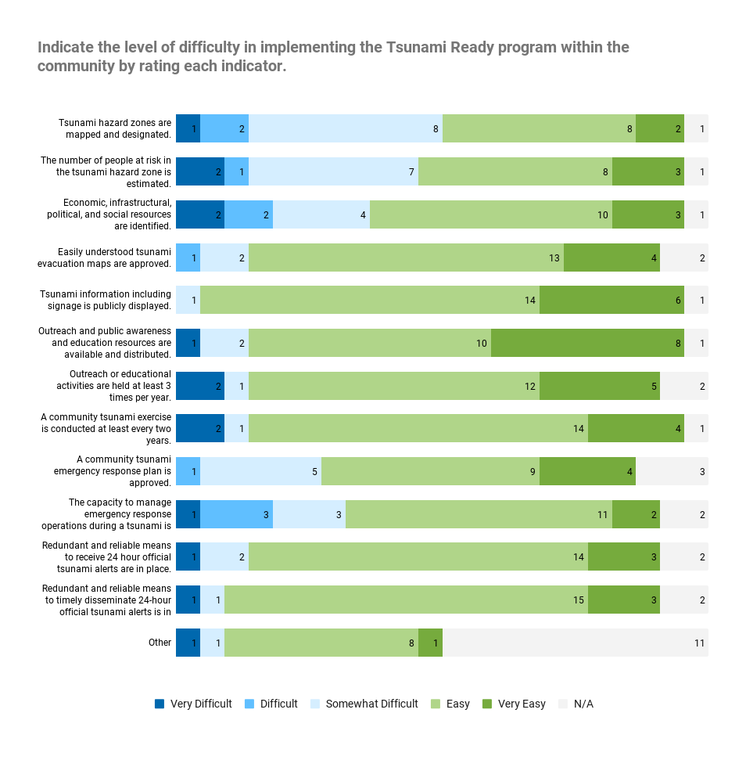
Feedback on Implementation Difficulty
PRELIMINARY
Most Difficult Indicator: ASSESS-1
Respondents noted moderate difficulty due to limited bathymetric data, resources, expertise, mapping capacity, and funds. Emphasized the need of external support for successful map development.
Easiest Indicator: PREP-2
Most thought this was easy because of (1) external support and (2) good reception from the community. However, several comments also cited concerns about vandalism, sign installation difficulties, and process complexity.
July 2024

Slide 10
Feedback on Implementation Difficulty
PRELIMINARY
S T R E N G T H S
W E A K N E S S E S
Strong culture of outreach programs
Opportunities for community involvement in the ASSESS indicators
Support system building with municipal authorities and corresponding institutions
Information transfer of GIS, census, and hazard data
Effective methodology and standard procedures
Regular participation and engagement, as made possible with CARIBE WAVE and other annual hazard drills
Lengthy process
Requires considerable funds, resource mobilization, and training for technical staff
Communication challenges between local/national level and authorities/first responders
Reliance on external experts and technical support
Difficult to pursue or maintain in unstable socio-political climates (e.g. Haiti)
Loss of information about implementation process with community administration changes
Limited mechanisms to address changes in community contact information after recognition
July 2024

Slide 11
General Comments About TRRP
PRELIMINARY
Useful in preparing for hurricane seasons
Strengthens community preparedness for tsunami response, equipping members with necessary evacuation knowledge
Supports continued capacity building, particularly in writing Standard Operating Procedures (SOPs) for key agencies
New guidelines are better and easy to comprehend
Enhances awareness of community vulnerabilities
Contributes to the overall well-being of residents and tourists by providing sufficient knowledge about natural disasters
Major hurdle in resource mobilization and fiscal planning for Small Island Developing States
Difficult to realize certain indicators, such as creating tsunami evacuation maps and preventing vandalism of tsunami signs
Needs more localized efforts and community involvement
Need for documenting successes and challenges/lessons learned to aid implementation
Challenge to maintain continuous readiness
July 2024

Slide 12



* See separate file for full presentation, shown are only slides 11 and 12
UNESCO IOC / ICG / NEAMTWS XVIII Session 6-8 February 2024
ICG NEAMTWS
Task Team on Tsunami Ready
Co-chairs
Ignacio Aguirre Ayerbe (Spain)
Elena Daskalaki (Greece)
UNESCO IOC/ICG/NEAMTWS XVIII Session
6 - 8 February 2024. Paris, France

Slide 13

CHALLENGES TRRP NEAM REGION
4
GENERAL BARRIERS
Some stakeholders (tourism, commerce etc.) are difficult to brought in because they are worried that acknowledging and actioning upon tsunami risk may harm their business, due to international and sectoral competition.
Difficulties to get local officials to accept the signage because it materializes the tsunami risk (especially for municipalities oriented towards the tourism economy).
Reluctance from local authorities to officially endorse the evacuation plan because they are worried about legal liabilities in case of human losses during the evacuation.
General populations’ lack of knowledge and education about coastal hazards and especially tsunamis. Some coastal communities may underestimate the tsunami risk. Distress and fear among exposed population may also contribute to this underestimation.
Difficulties in public awareness due to special conditions (summer time, temporary population etc.).

Slide 14
CHALLENGES TRRP NEAM REGION
4
INSTITUTIONAL, ORGANIZATIONAL, TECHNOLOGICAL BARRIERS
Establishment of NTRB/ establishment of the TRLC.
Institutional Coordination between different organizations at all spatial scales and administrative divisions.
Existing national Governance structures imply the integration of local tsunami emergency plans (slow down the process, depending on the political will of each community etc.).
Dependency on only one mean of dissemination for alerting the population.
International signage is not always easily acceptable by local decision makers - Need for adapting the tsunami signage and facilitating its integrations into the urban environment (fear…..).
Alerting Devices Issues: Maintenance / Expensive.
Financial, technical, human resources, and time demands.
Sustainability of TRRR. Continuous support by scientific and distaster/emergency experts.

Slide 15
ICG/PTWS WG3 Task Team on Tsunami Ready July 2024
See separate file for full information – Indonesia Tsunami Ready, presented at PICT Tsunami Ready workshop, 14 May 2024
https://oceanexpert.org/event/4245
Indian Ocean comments (Suci, Ardito):
A lot of effort and advocacy goes into ensuring that the momentum and initiative comes from the community itself. It is essential that the community itself is \ motivated to develop the implementation programme. Then it is more likely they will sustain it as well.
It is also a lot of work to find the community leaders or champions. A best practice is to always conduct a workshop for the leaders/champions first, before going to the the community. Educate those who will lead the efforts to develop Tsunami Ready for the community (‘train-the-trainer’)

Slide 16
ICG/PTWS WG3 Task Team on Tsunami Ready July 2024
Summary of TR implementation challenges:
Key challenges reported across ICGs include:
Hazard assessment, esp. Inundation Modelling (+near shore bathymetry) and GIS capacity (+ data layers)
TR Application and process is cumbersome / time consuming
Community size that is targeted can’t be too small. However, while it is administratively a huge effort to roll out across the entire country, it may be in the end be more meaningful or effective socially since the community size is smaller.
Sustainability in effort, insufficient expertise and funding to do ‘quickly’
TR Programme awareness & education essential both in community and government

Slide 17
ICG/PTWS WG3 Task Team on Tsunami Ready July 2024
Action: PTWS Tsunami Ready Implementation Survey
We propose running a PTWS-wide survey on the progress of the Tsunami Ready Recognition Programme to inform overall progress and identify where efforts might be most impactful. It should be regularly done to document progress. Questions may include:
Are you implementing the UNESCO/IOC Tsunami Ready Recognition Programme.
If yes, where, when and how many more?
If not, are you planning to? (+details)
If not, why? [check box]
What else should be asked?
How often should this be run?

Slide 18
ICG/PTWS WG3 Task Team on Tsunami Ready July 2024
Meeting Discussion:
Survey would support monitoring & reporting on TR across the Pacific, and also ensure that TT TR activities are representative of the whole Pacific needs (we are only a small Task Team)
Want to keep it straightforward, stream-lined and simple.
Some additional questions that should be considered are:
If you are implementing it, what barriers are you finding to implementation (to try and capture active barriers that may be frustrating progress)
Do you have an equivalent national programme ?
CARIBE-EWS: Survey presented took a lot of effort to get engagement – lots of emails, WhatsApp etc and still did not have as high return rates as would ideally want, so important to keep that in mind. Happy to share their question set with Pacific.
CARIBE-EWS does TR status survey every year as part of the CARIBE-WAVE survey, which has close to 100% response rate – can we take advantage of PacWave? (but Pacific does exercise every 2 yrs)
IOTWMS did capacity assessment which included a TR chapter. Happy to share with PTWS.

