Slide 1

ICG/PTWS WG3 Task Team on Tsunami Ready July 2024
PTWS WORKING GROUP 3
ON DISASTER RISK MANAGEMENT AND PREPAREDNESS (WG 3)
TASK TEAM ON TSUNAMI READY
STATUS REVIEW
Co-Chairs:
Ashleigh Fromont, NZ NEMA
Laura Kong, ITIC

Slide 2
ICG/PTWS WG3 Task Team on Tsunami Ready July 2024
Status of Actions & Decisions – ICG/PTWS-XXX
ICG/PTWS-XXX in September 2023 established the WG3 Task Team: Tsunami Ready to facilitate and coordinate efforts relating to the Tsunami Ready Recognition Programme and within the ICG/PTWS, in support of the UN Ocean Decade Goals (ICG/PTWS-XXX.1)
Also, through ICG/PTWS-XXX.5, the ICG:
Encouraged member states to continue to share outcomes and progression towards “100% Tsunami Ready Goal” with WG3, including communities already considered compliant through national standards
Mandated the ITIC to continue to facilitate implementation and data collection regarding TR in the PTWS
Noted & Endorsed the proposed Tsunami Ready Equivalency Approach that seeks to enable reporting of tsunami preparedness in a manner compatible with the UNESCO/IOC Tsunami Ready Recognition Programme
Recommends the TT TR to develop formal guidance for the application of this approach, in consultation with the Regional Working Groups.
Please see full recommendation in ICG/PTWS-XXX.5
https://oceanexpert.org/event/3920

Slide 3
ICG/PTWS WG3 Task Team on Tsunami Ready July 2024
TASK TEAM ON TSUNAMI READY - TERMS OF REFERENCE
This expert Task Team will facilitate and coordinate efforts relating to the Tsunami Ready Recognition Programme and within the ICG/PTWS, in support of UN Ocean Decade Goals.
Develop formal PTWS guidelines following the 'Tsunami Ready Equivalency Approach’ for recognition of tsunami readiness of communities not implementing the IOC Tsunami Ready Recognition Programme,
Monitor Tsunami Ready campaigns and outcomes, and report results,
Ensure the advocacy for Tsunami Ready is aligned with other PTWS and IOC documents,
Advise on the Tsunami Ready workflow as it pertains to the PTWS and regions,
Support ITIC in its efforts to facilitate the implementation of Tsunami Ready in PTWS Member States,
Support ITIC’s efforts to develop standardized training supporting Tsunami Ready under the framework of OTGA, such as through feedback on content and helping to test trainings before officially deployed,
Help to identify sources of funding in support of the implementation of Tsunami Ready,
Report progress on encouraging the standard text in the UNESCO-IOC Tsunami Ready signage for vertical evacuation, such as “Go to the designated building for vertical evacuation”,
Report progress toward informing the public on the validity of the recognition, to be indicated on Tsunami Ready signage and on the certificate under the UNESCO-IOC Tsunami Ready logo.
The Group will be composed of members nominated by the Member States, representative of ITIC, with two co-chairs to be elected by the ICG.

Slide 4
ICG/PTWS WG3 Task Team on Tsunami Ready July 2024
Status of Actions & Decisions – TOWS-WG-XVII
The WG encourages synergy with Making Cities Resilient (2030), and recommended ICGs advocate for member states implementing Tsunami Ready to link with this (such as agency representation on NTRB).
The WG recommended text for signage for locations that will not feel the earthquake, such as ‘In case of any official tsunami message, go to high ground or inland’.
(PTWS ITIC recommendation from working with Micronesia (Chuuk, Pohnpei) that has distant threat)
ICG/IOTWMS have established National Tsunami Ready Focal Points to facilitate coordination and communication.
TT-DMP have been asked to consider the introduction of a Tsunami Ready Evaluation Form, as currently run in ICG/CARIBE.
There is an ISO 22328-3 which is targeting the large-scale private sector to be tsunami ready
Please see full recommendation in the TOWS-WG-XVII report.

Slide 5
ICG/PTWS WG3 Task Team on Tsunami Ready July 2024
Status of Actions & Decisions – TOWS-WG-XVII
Progress on Tsunami Ready implementation was presented at the TOWS TT-DMP and TOWS-WG-XVII.
The Group noted “the progress made by ICG/PTWS concerning exploring mechanisms of how to include national tsunami preparedness and readiness programmes and initiatives in the UN Ocean Decade Programme, and that the Tsunami Ready Equivalency Approach framed under similar initiatives seeks to enable reporting on tsunami preparedness in a manner compatible with the TRRP”
And recommended that ICG/PTWS Task Team Tsunami Ready share the ICG/PTWS guidance on Tsunami Ready Equivalency for further consideration by TT-DMP, as a potential mechanism for reporting toward this goal;
The Groups also requested that the Secretariat, led by TICs, develop and share a Tsunami Ready Toolkit to assist Member States with implementation, such as standard procedure for the submission of an application, and clarification on the definition of ‘community’ .
Please see full recommendation in the TOWS-WG-XVII report.

Slide 6
ICG/PTWS WG3 Task Team on Tsunami Ready July 2024
Tsunami Ready Toolkit - contents so far
.
TR Application and NTRB approval process
Efficient Application Submission – enable online, automated, std file-naming
Language requirements / flexibility for application / supporting documents
Accompanying Letter templates for required submitted documents
NTRB Tsunami Ready Application Review process – guidance for verification and approval with examples
How to start Tsunami Ready - what to do 1st, 2nd, etc
Guidance how to define Community
Use of baseline survey to document what is available and/or done
Confirm/obtain data for Inundation Modeling (bathymetry, topography, sources)
Confirm/obtain data for Evacuation Mapping – GIS data layers
TR Work flow (between country and IOC Secretariat)
Signage guidelines (std colors, size, fonts, words, etc for common signs)

Slide 7

ICG/PTWS WG3 Task Team on Tsunami Ready July 2024
Standardized Training supporting Tsunami Ready – ITIC
IOC Ocean Teacher Global Academy (OTGA)
Intl Oceanographic Data and Information Exchange (IODE) programme
Implements IOC Capacity Development Strategy
Online, global platform; 17 regional and specialized centres around the world
ITIC is OTGA Specialized Training Centre (STC) for Tsunamis
UNESCO-IOC Tsunami Awareness (foundational) - live Aug 1
ITIC with Tsunami TRS (Bernardo Aliaga)
UNESCO-IOC Tsunami Ready (requires Tsunami Awareness) - live Sept 1
ITIC and IOTIC (Ardito Kodijat)
UNESCO-IOC Tsunami Warning Center Staff Competencies – 2025/2026
Implement PTWS NTWC Minimum Staff Competency Framework(2023)
ITIC and PTWS Member States, request from PICT
Series of self-paced and Hybrid pre-requisites, culminate in in-person course

Slide 8
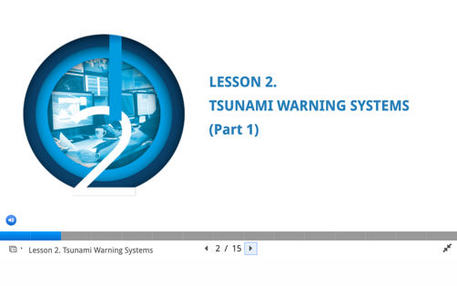
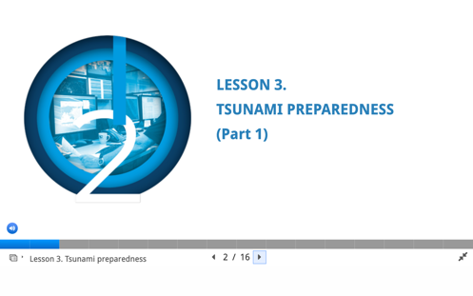
UNESCO-IOC Tsunami Awareness
ITIC and IOC TSR Joint work
Self-paced, no instructor – 6 hrs
UNESCO-IOC Tsunami Awareness certificate required for later UNESCO-IOC courses
Pre-Quiz
Lesson 1: Tsunami Basics (Parts 1 and 2)
Lesson 2: Tsunami Warning Systems (Parts 1 and 2)
Lesson 3: Tsunami Ready Preparedness (Parts 1 and 2)
Post-Test
Tsunami
Awareness
2 parts (18, 23 Slides)
2 parts (14, 18 Slides
2 parts (15, 23 Slides
All Lessons have Activities, Knowledge review checks, Narration

Slide 9
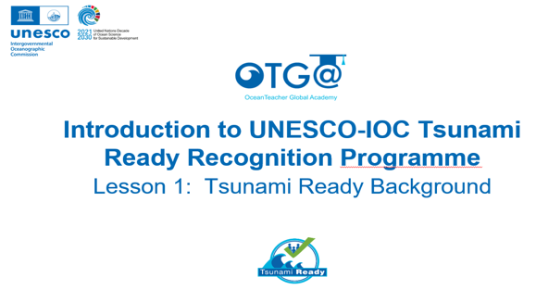
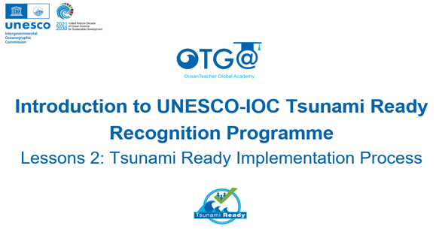
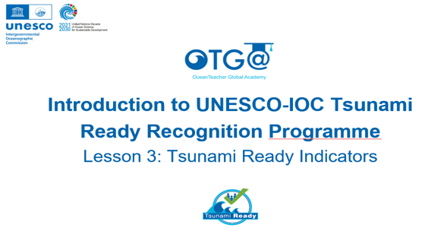
UNESCO-IOC Tsunami Ready
ITIC and IOTIC Joint work
Self-paced, no instructor
Course 1
Introduction to UNESCO-IOC Tsunami Ready Recognition Programe
Lessons 1: Tsunami Ready Background
Lessons 2: Tsunami Ready Implementation Process
Lessons 3: Tsunami Ready Indicators
Course 2
Facilitating Tsunami Ready
Lessons 1: Approach to Tsunami Ready Community Capacity Building
Lessons 2: Assessment Indicators
Lessons 3: Preparedness Indicators
Lessons 4: Response Indicators
planned
Course 1
23 Slides
19 Slides
22 Slides
All Lessons have Activities, Knowledge review checks, Narration

Slide 10


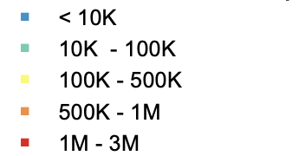

At-risk population - Pacific
Tsunami evacuation zone | Population to evacuate
Less than 30 m elevation and within 3 km of coast | 83,413,677
Local Tsunami
Source Zones
with Population
Coastal Population
(1 deg aggregate)
April 2024
Gridded Population of the World, Version 4 (GPWv4) (https://sedac.ciesin.columbia.edu/binaries/web/sedac/collections/gpw-v4/gpw-v4-documentation-rev11.pdf).
30 sec resolution aggregated to 1 deg
Shallow Earthquakes
Magnitude (threat proxy)
B. Fry, GNS Science, NZ

Slide 11
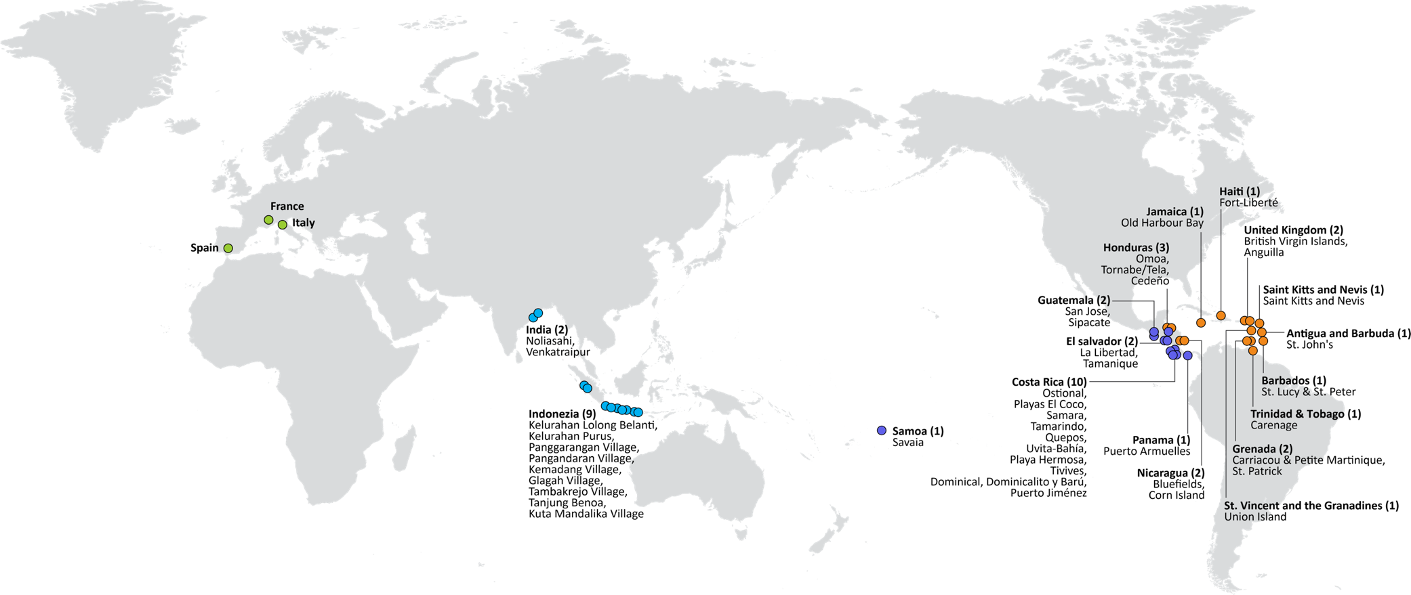


UNESCO/IOC TSUNAMI READY RECOGNITION PROGRAMME (TRRP)
54
TSUNAMI READY COMMUNITIES
11 – IOTWMS
20 – PTWS (16/46 countries)
20 – CARIBE-EWS
3 – NEAMTWS
Türkiye
United Kingdom (2)
British Virgin Islands, Anguilla
Dominica (1): Portsmouth
Saint Lucia (1): Laborite
Greece
Israel
– in progress (next yr)
Egypt
MAJOR ACTIVITIES IN 2021-2024+
Kiribati (1)
Tarawa
Ramp-up for Tsunami Ready
Development of a global Tsunami Ready Interactive Map Viewer
Hosting by ITIC of the Tsunami Ready web site
Development of a new Tsunami Ready Board Game
Publication of the IOC Manuals and Guides 74 «Standard Guidelines for Tsunami Ready Recognition Programme»
Palau (1)
RMI (1)
Majuro
FSM (4)
Yap, Chuuk, Pohnpei, Kosrae
Barbados (2)
St. Lucy & St. Peter
Christ Church West
Vanautu (10)
Efate, Santo
Ecuador (3) Galapagos
Solomon Islands (9)
Western Provinces
Honiara
Samoa (1+)
Savaia
New Caledonia
Fiji (2)
Naevuevu
Sila
Tonga
Cahuita
St. Vincent and the Grenadines (2)
Union Island
Saint George
Frolov, 2023; ITIC, June 2024

