Slide 1
Africa and the Adjacent Island States
OIH Progress Report
John Ngatia Ndarathi
IOC’s Sub Commission for Africa and the Adjacent Island States (IOCAFRICA).
Final OIH Project meeting 16th May

Slide 2
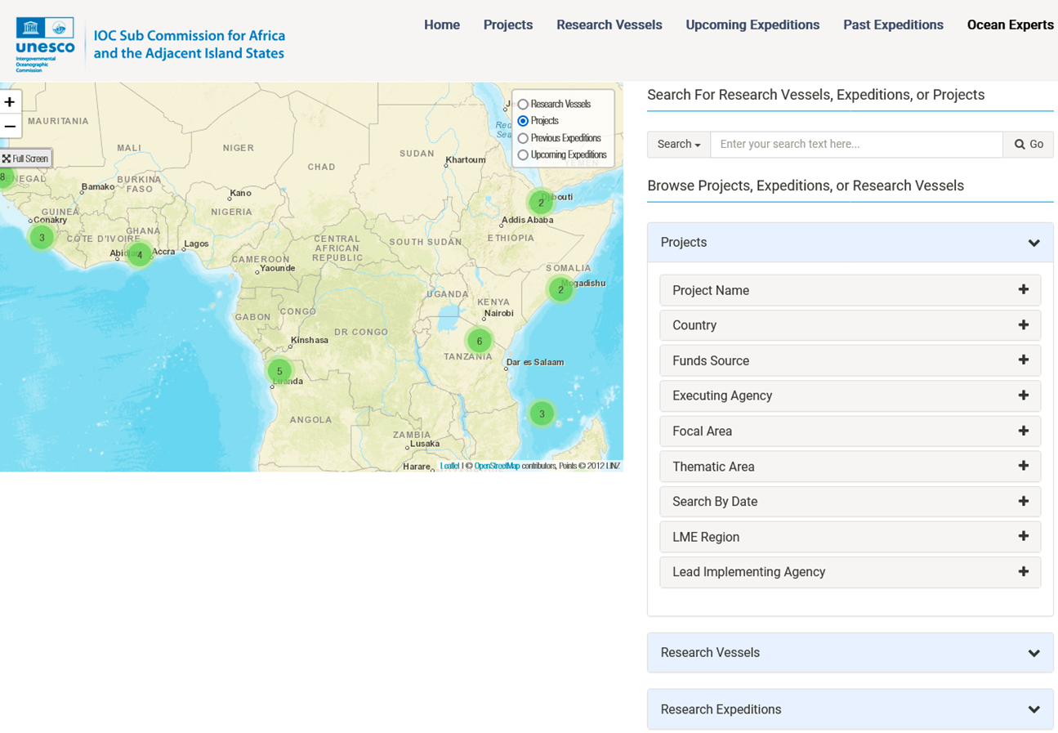
Regional Node: DATA /WEB / DATA INTERCHANGE https://ioc-africa.org/dbs/displayData.php
INDEX PAGE:
Ocean-related Projects
Past research expeditions
Upcoming expeditions
Research vessels
Link to OceanExpert
Notes:
I will begin by highlighting key activities and achievements of the OIH project in the region. Most notable is the development of the regional node for the OIH.
The data interchange portal has links to 4 key databases
However, in total, the OIH has assisted in developing databases or region-specific links to 9 thematic areas which I will highlight in my next slides
The database

Slide 3
Progress so Far
Data | Entries | Source
Marine-related projects | 240 | IOCAFRICA-OIH Portal https://ioc-africa.org/dbs/displayData.php
Research vessels | 28 | IOCAFRICA-OIH Portal
Past Expeditions | 127 | IOCAFRICA-OIH Portal
Upcoming Expeditions | 2 | IOCAFRICA-OIH Portal
OceanExpert: Experts Institutions | 2702 628 | Link to OceanExpert https://oceanexpert.org/
Documents | 5252 | ODINAFRICA Link to Aquadocs https://aquadocs.org/handle/1834/1337
Ocean Observation Platforms | - | ODINAFRICA Linked to JCOMMOPS and GLOSS
Training and research opportunities | 278 | https://africa.marinetraining.org/map
Spatial Data | 218 | ACMA https://acma.africanmarineatlas.org/catalogue/#/search/?f=dataset
Notes:
ICAN, together with a summer scholar (Russell) imported all the old ACMA records into the updated GEONODE (and thank Tanya Haddad who is in this OIH meeting). The ODINAfrica network will be checking the old data and importing new records over time.
Over 210 data sets from 7 countries have been imported to date, with several hundred additional data sets being organized for further contribution. .

Slide 4
End-User Engagements
Share information on regional initiative for data and information management and data infrastructure development in Africa
Identify existing data and information infrastructures that could be potential partners with the Ocean Info Hub
Identify existing data and information infrastructure that address these requirements and can partner in the development of the regional hub
Identify some initial end user needs/knowledge products not yet covered by existing OIH initiatives
Discuss way forward for collaboration mechanisms, and review progress in implementation
Notes:
The Objectives of the end-user engagements are:
For the purposes of this presentation, I will categorize OIH-AFRICA end-user engagements into two sections:
With member states, majorly through NODCs
With other end-users (research organisations, academia, experts etc)

Slide 5
End-User Engagements
Enhancing Linkages and Interoperability of Marine Data in Africa with NODCs
In line with the OIH mandate, we aim to:
Enhance data flows through developing requisite structures within national oceanographic data and information centres among and within member states
Strengthen the capacity of NODCs and AIUs to collect, analyse and interpret the data so as to develop products required for integrated management of the coastal areas of Africa, and increase the delivery of services to end users.
Last Webinar for NODCs, AIUs organized on 30 May 2023:
Present the new IOCAFRICA Data Portal (ODINAFRICA Node) including its features i.e. existing data and information infrastructure;
Identify existing data / database infrastructure within NODCs
Deliberate on the data-sharing and access needs of NODCs and how the OIH and ODINAFRICA can help address these needs
Identify other NODC data needs needs/knowledge products not yet covered by the OIH
Notes:
I will now outline OIH engagement with member states, via NODCs
In line with the OIH mandate, we aim to:
Last Webinar for NODCs, AIUs organized on 30 May 2023: In total, 13 NODCs participated

Slide 6
Enhancing Linkages and Interoperability of Marine Data in Africa NODCs
Outcomes of the Session
Outline of diverse data themes among NODCs –
Documents,
Experts,
Ocean Observations – Physical, Chemical and Biological parameters
Marine Species including fish
Geospatial Data
2. Description of existing data sharing practices (opportunities and challenges)
Active exchange with other NODCs and other institutions
Specific metadata formats.
Sharing protocols (use of persistent and unique DOIs).
Use of standardized classifications and vocabularies.
Open data formats and standard interfaces.
Many databases are hosted and backed up on local PCs and servers
Notes:
We had two key achievements from the session

Slide 7
End-User Engagements : OIH REGIONAL PARTNERS
Enhancing Linkages and Interoperability of Marine Data in Africa: Open Sessions
Three open information sessions organized between 2022-2023, targeting research institutions, academia and students
Last Session in 8 August 2023 - Attended by 150 participants
Lessons learnt:
Reaching out to a broader scope of the data community especially students and researchers by engaging them in future meetings.
Mapping of stakeholders – ocean data stakeholders in the region, focusing on data generators, managers and users in the region
Data networks to reflect on the opportunities offered by the ongoing decade of Ocean Science. The Africa Ocean Decade Roadmap particularly flags data as high priority in the development of a regional knowledge hub.
Notes:
Some of the key lessons we took from these open sessions include:
3. As such, the region should identify ways through which it can use the decade as a platform to strengthen NODCs and enhance their participation in the OIH project.

Slide 8
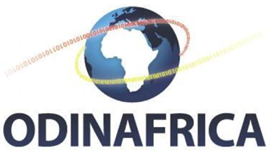
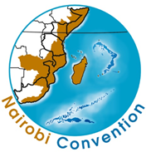
End-User Engagements :OIH REGIONAL PARTNERS
MarCoSouth, CORDIO, Benguela Current Commission, IUCN, Regional Remote Sensing Centre, UNEP Nairobi Convention Secretariat etc.
Partners have submitted documentation on data sources / architecture / vocabularies / ontologies / standards to the OIH GitHub Project
Representatives added to WP2 for the development of the ODIS-architecture
Notes:
Our current partners include:

Slide 9
Next Steps
Build on past engagements with NODCs and other end users:
Explore additional themes of data to include and link to the ODINAFRICA Node
Continuously and direct engagement with NODCs – Capacity development (both infrastructural and human). Including development of interoperable databases and linking them to ODIS
Continuous Assessment of the status of the National Oceanographic Data and Information Centers
More cross-programme (UNESCO-IOC) engagement – e.g. with MSPGlobal, GOOS-AFRICA to identify gaps and emerging end-user requirements

