Slide 1
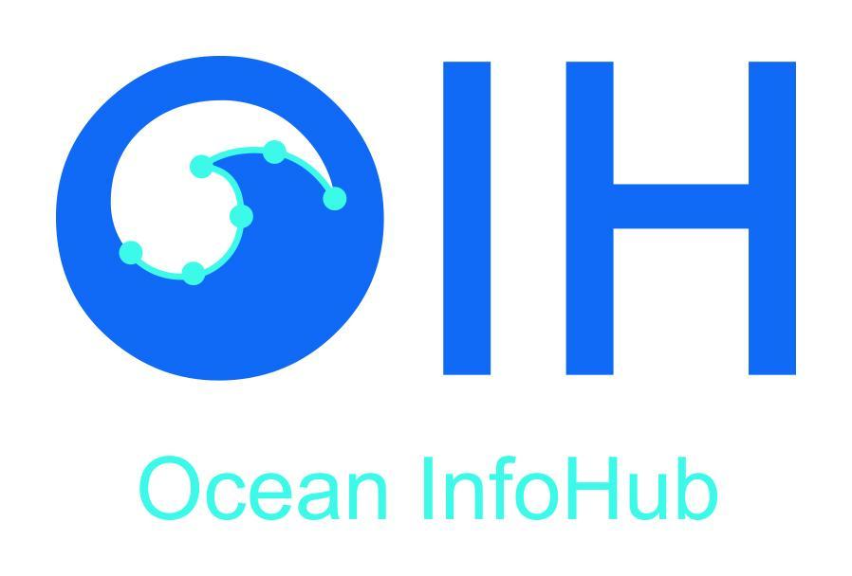
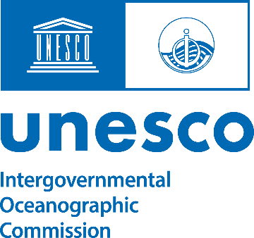
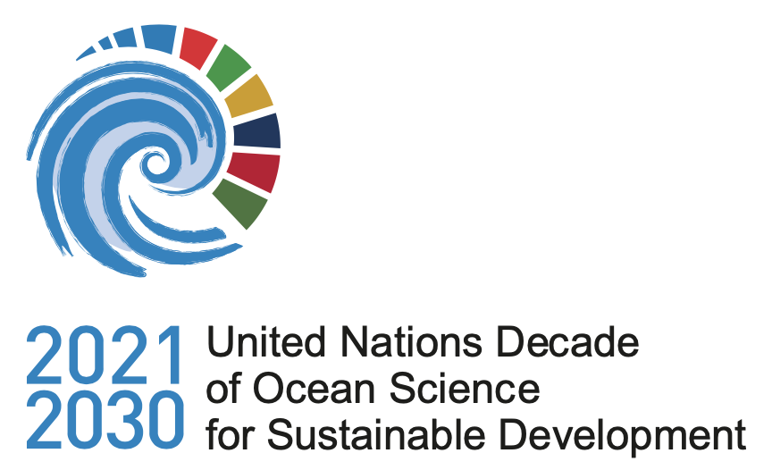
The Ocean InfoHub Project
Overview and final report
16 May 2024
Lucy Scott
L.Scott@unesco.org

Slide 2
Pre-2020 Challenges identified
A proliferation of online sources of data and information (ODISCat currently contains over 3100 records https://catalogue.odis.org/)
A diversity of online data systems
Global data and information resources have useful content, but local users might not know about them
Challenges of trust in some regions
ODISCat is now an integral part of ODIS, and registering with ODISCat will be the first step in the workflow for joining the ODIS federation.

Slide 3
In response to these challenges, the Ocean InfoHub Project had a number of objectives:
To develop interoperability between existing information systems, thus improving the flow of information to end users.
Improve discoverability & access to marine and coastal data for multiple purposes, but especially to inform sustainable management and informed policy development.
Facilitate equitable access to Ocean information and knowledge products
Connect independent digital initiatives to form a diverse, but interoperable and inclusive, Ocean Data and Information System.

Slide 4
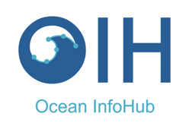
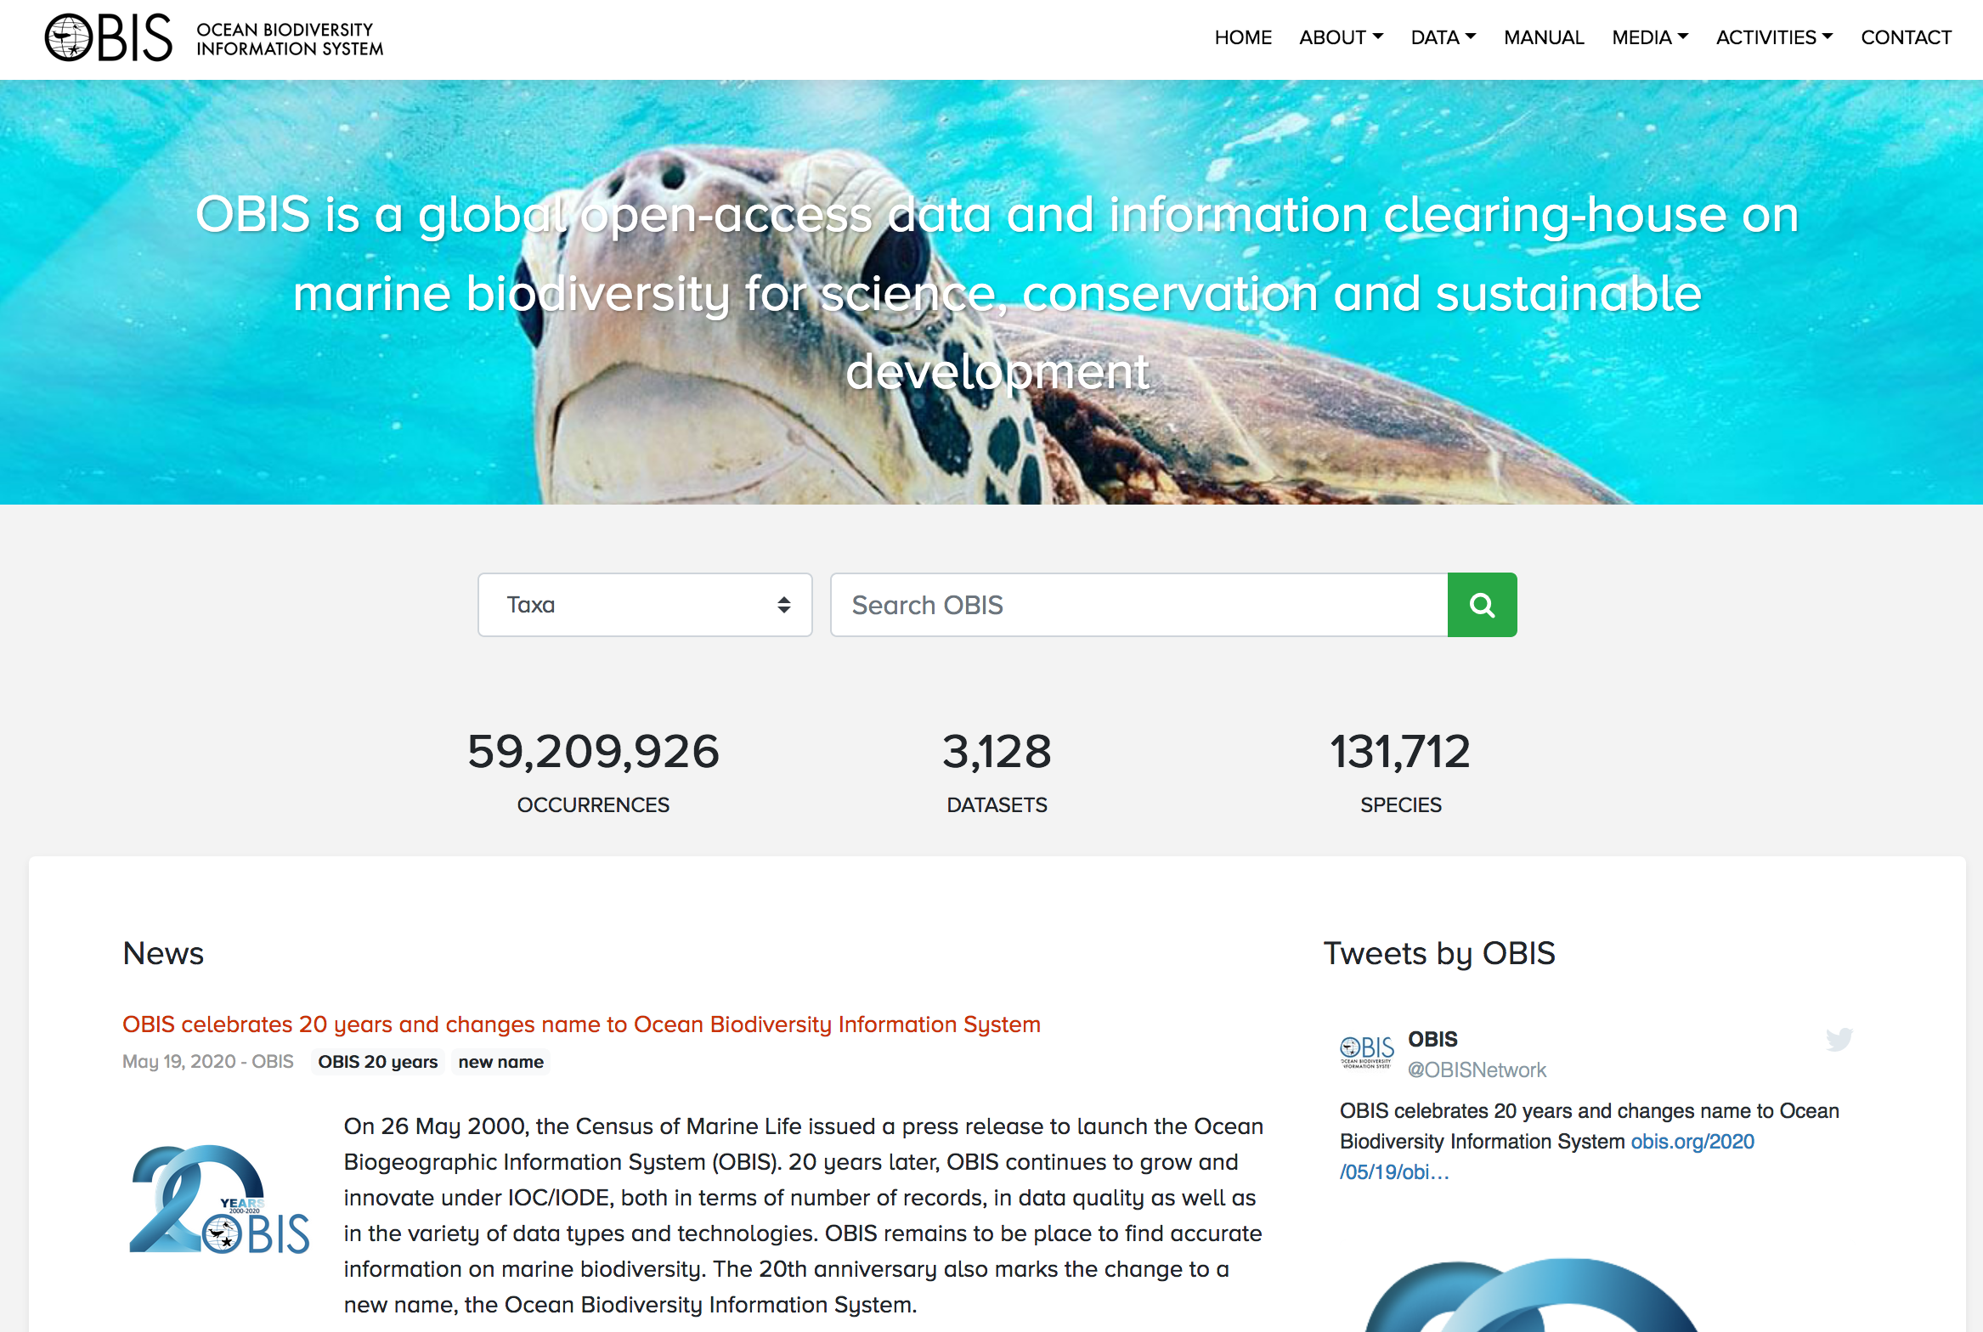
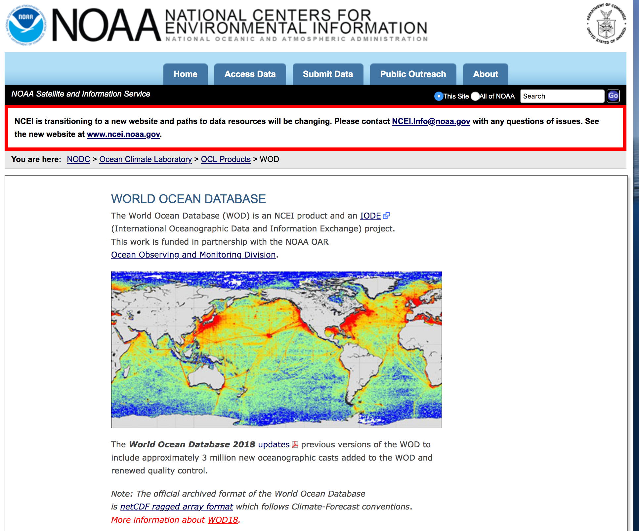
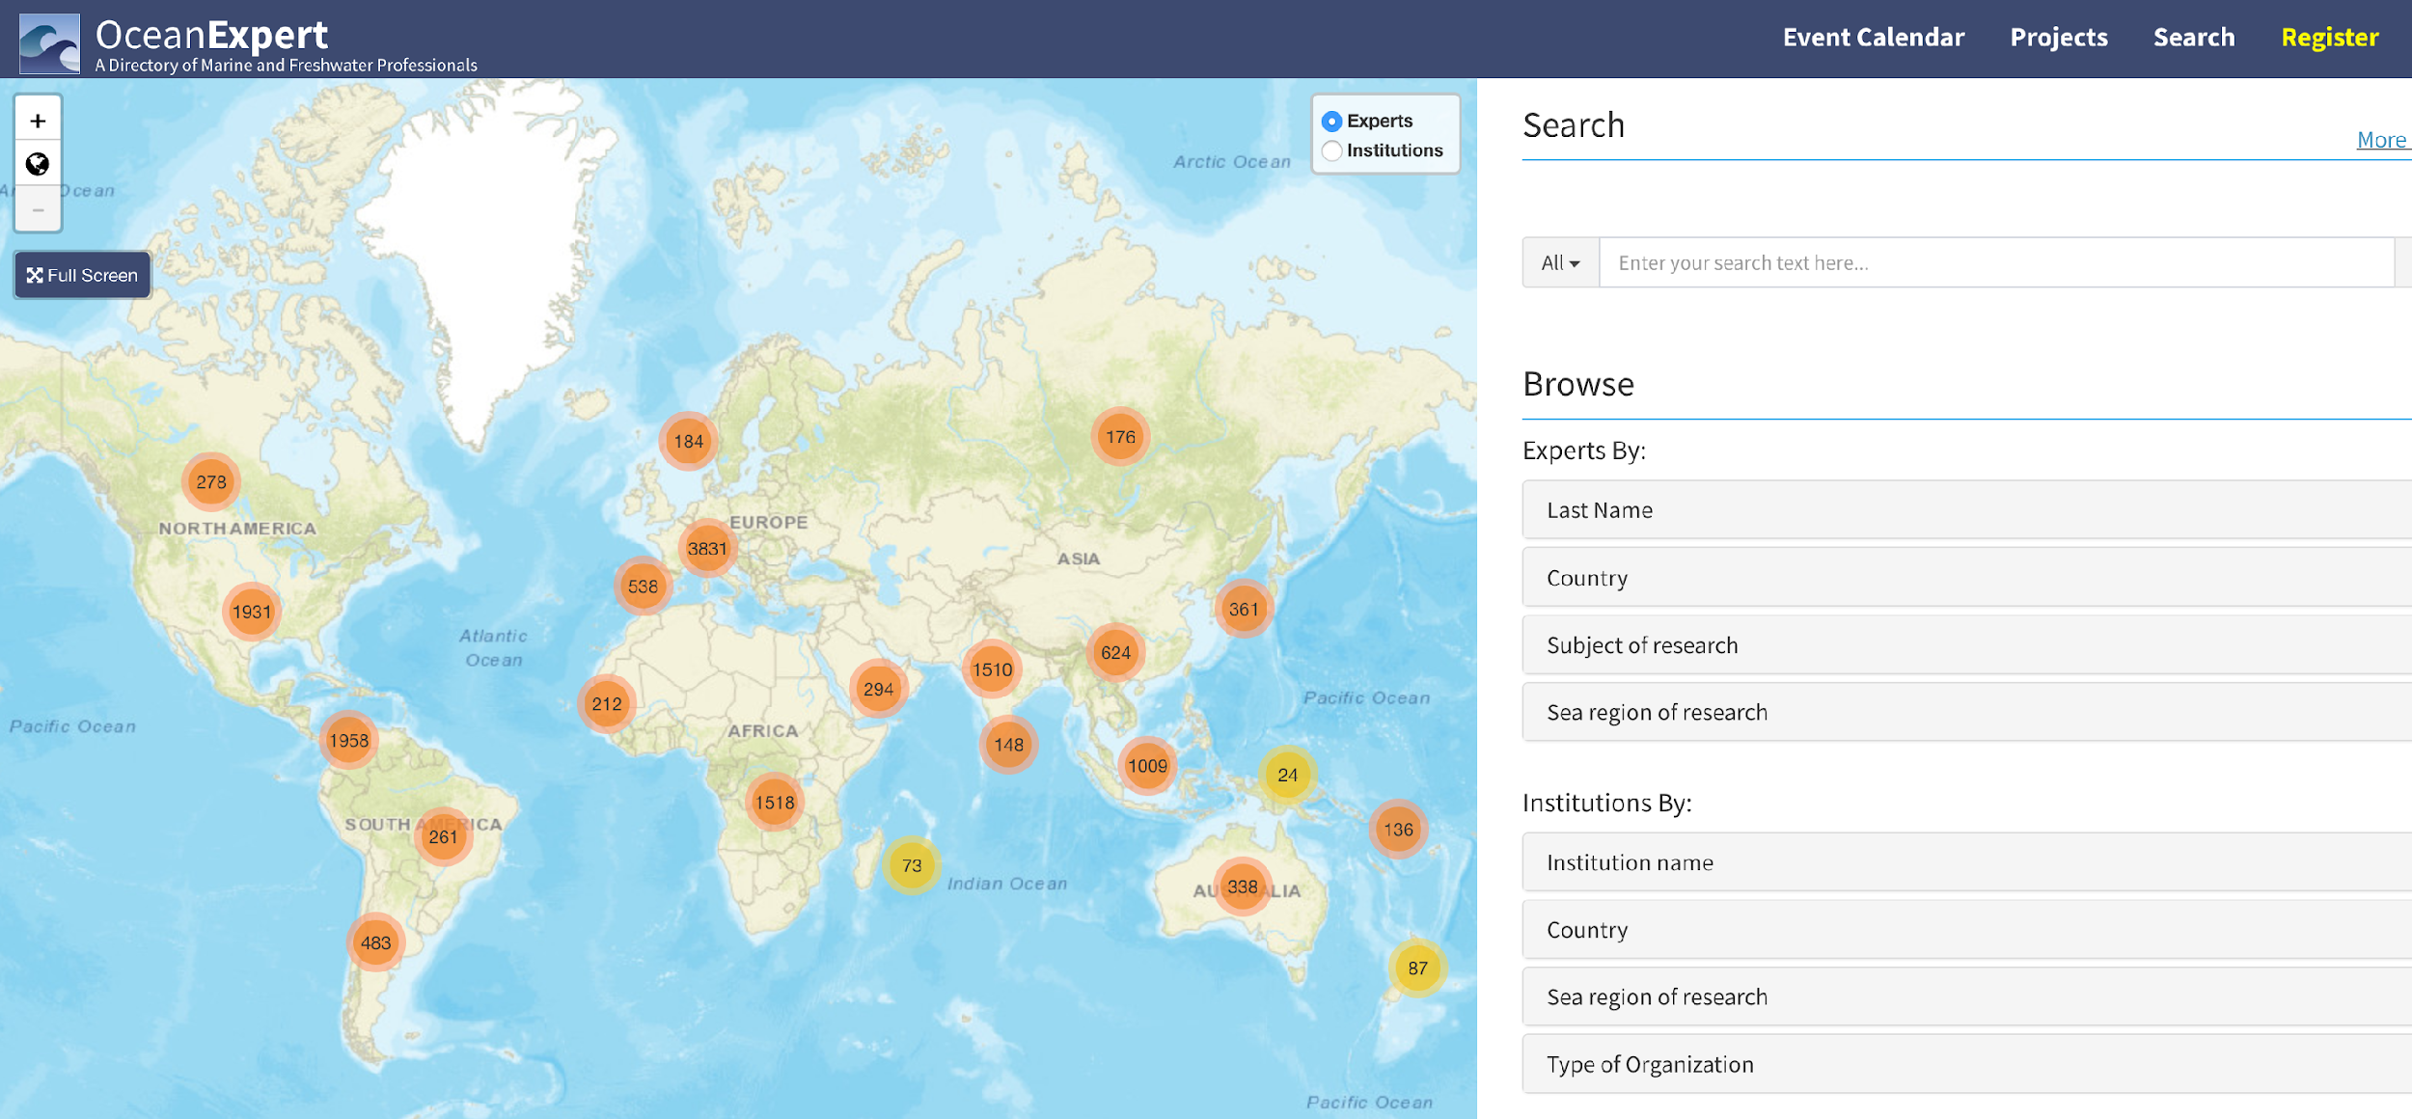
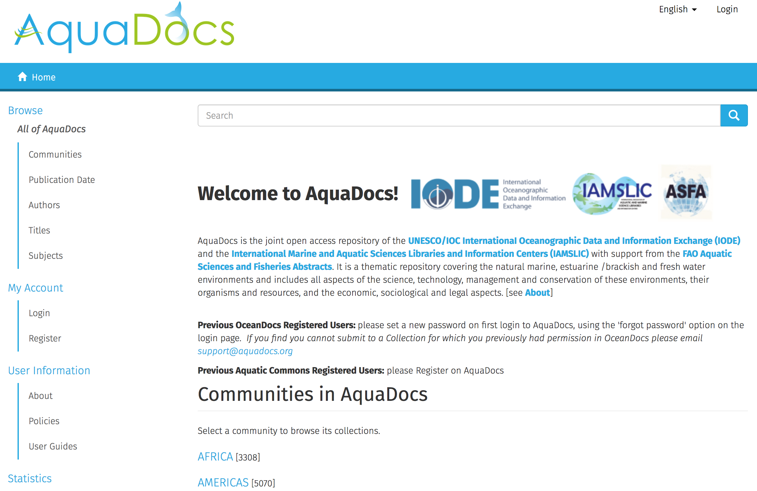
Approach
The Ocean InfoHub Project worked with a number of founding partners including the University of Ghent, WIOMSA, SPREP, SPC, EUROCEAN, EMODnet and other sister projects within IODE, including:
Ocean and Data information system Catalogue of data sources (ODISCAT)
OceanExpert : People, institutions and events
AquaDocs : Documents and Publications
The GOOS/IODE Ocean Best Practices System (OBPS)
The Ocean Biodiversity Information System (OBIS)
The World Ocean Database (WOD)

Slide 5
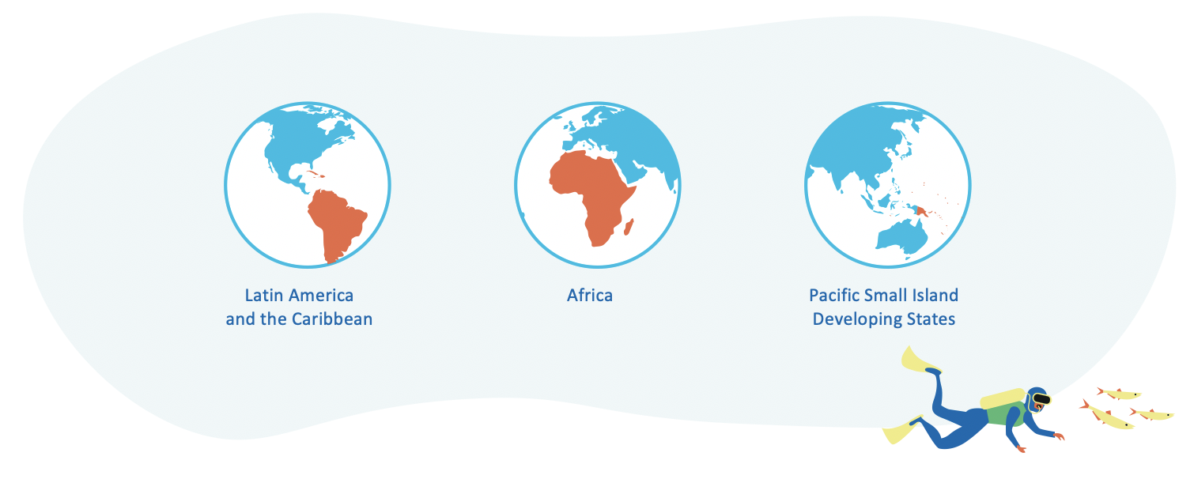
Three pilot regions
Approach: Three pilot regions
We also worked initially within three pilot regions

Slide 6
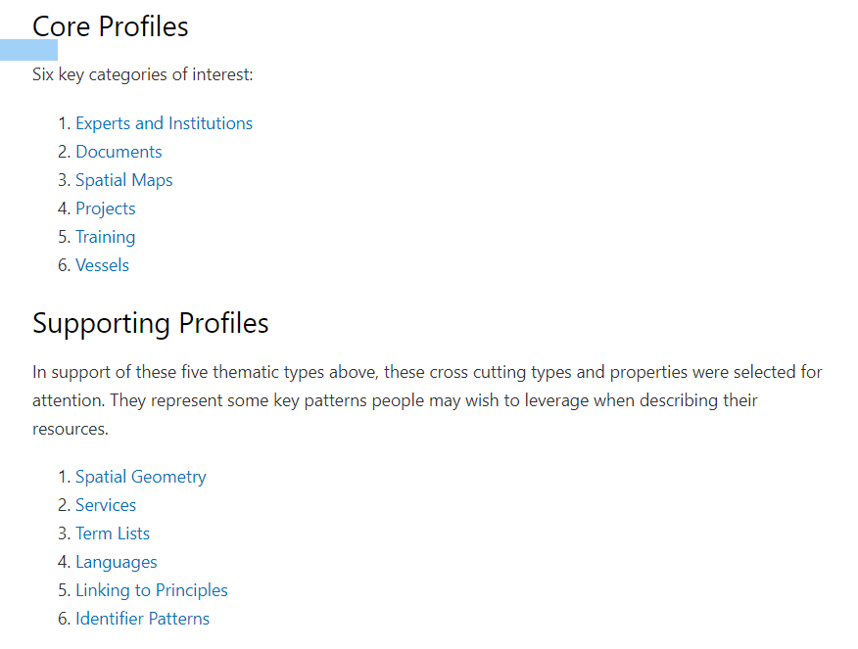
Results 1. The ODIS architecture
OIH developed the first phase of the
Ocean Data and Information System architecture.
that can help any organisation or individual to share their ocean (meta)data with the world, as well as to access a growing ecosystem of Ocean data.
The system is lightweight, easy to implement, and resilient to gain/loss of parts. Partners aligned to ODIS are also discoverable by Google Dataset search and others.
Partners retain their own data and complete control over what they share through their node or nodes.
All documentation is online, free and open
https://book.oceaninfohub.org/index.html

Slide 7
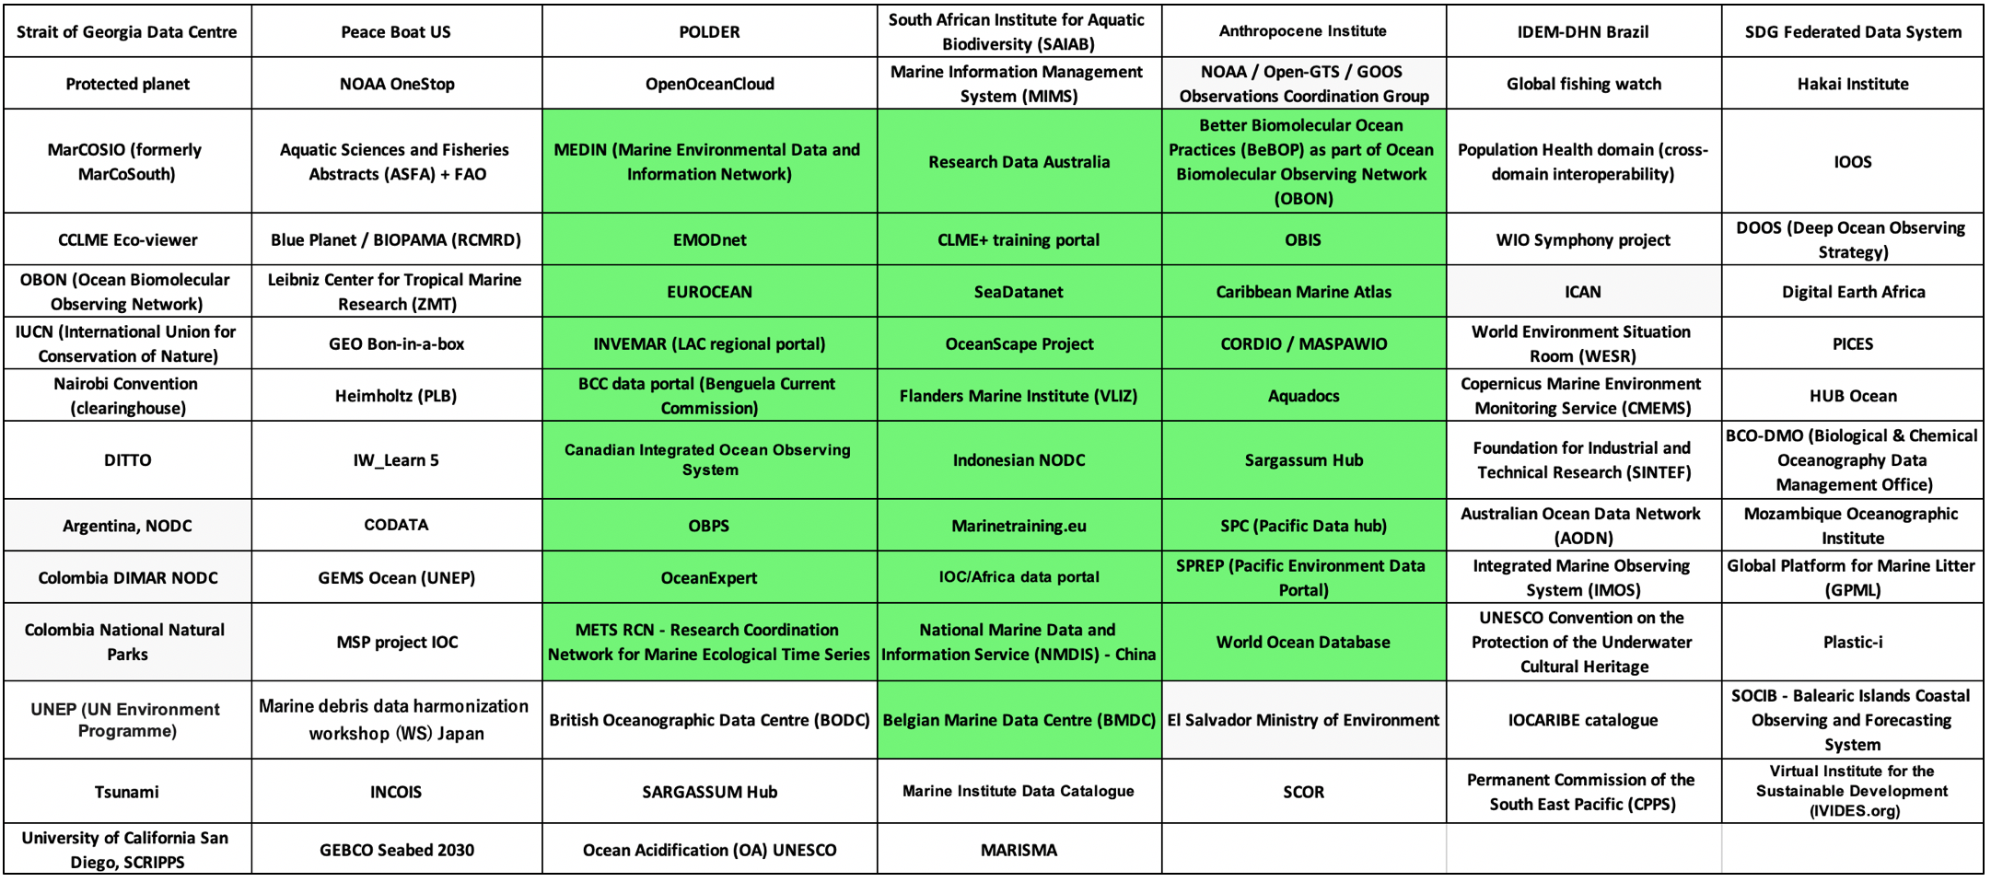
Results 2. A partner network
developing in white, indexed in green
We currently link 32 databases from 28 partner organisations. These 32 nodes are contributing openly discoverable content.

Slide 8
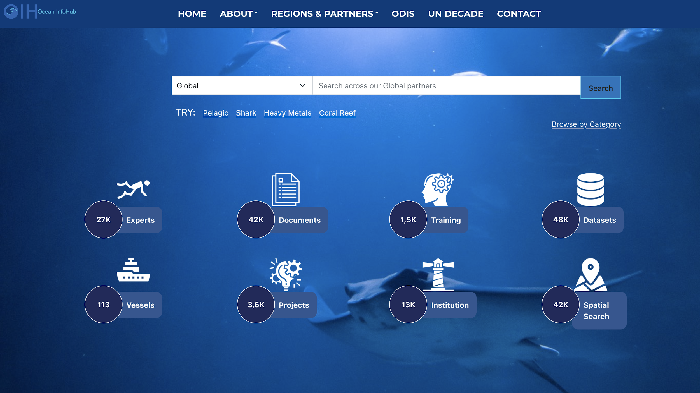
Results 3. An OIH Global Search portal
A Global Search portal has been developed as a demonstration of ODIS (https://oceaninfohub.org). The portal currently contains over 130,000 content items in seven content categories: (i) Experts (27,000); (ii) Institutions (13,000; (iii) Documents (42,000); (iv) Training (1,500); (v) Vessels (113); (vi) Projects (3,600); and (vii) Datasets (48,000).

Slide 9
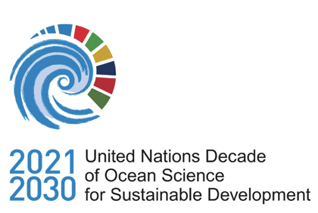
We now have four initiatives that work very closely together:
OIH brought user communities together, developed ODIS and a global demonstration
ODIS-Cat catalogued systems pre-ODIS, now part of ODIS
ODIS is the Ocean Data and Information System (ODIS)
Ocean Data 2030 is a Programme, to expand ODIS, support the Ocean Decade and connect more widely to Ocean Data systems.
Ocean Data 2030
A registered Programme of the UN Decade for Ocean Science for Sustainable Development
The ODIS catalogue of sources
The Ocean Data and Information System
The Ocean InfoHub Project

Slide 10
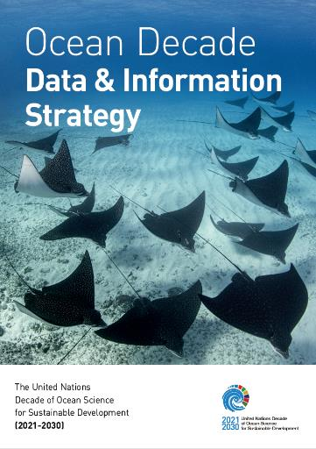
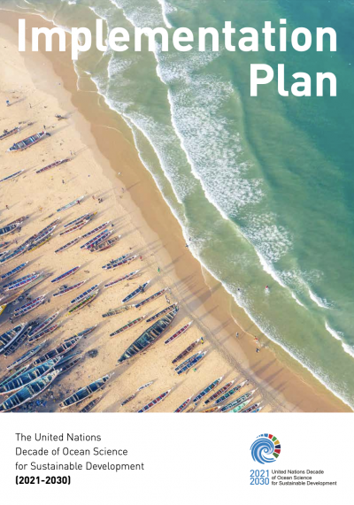
The Ocean Decade D&I Strategy & Action Plan
OceanData 2030 will assist in the implementation of the Ocean Decade D&I Strategy & Implementation Plan

Slide 11
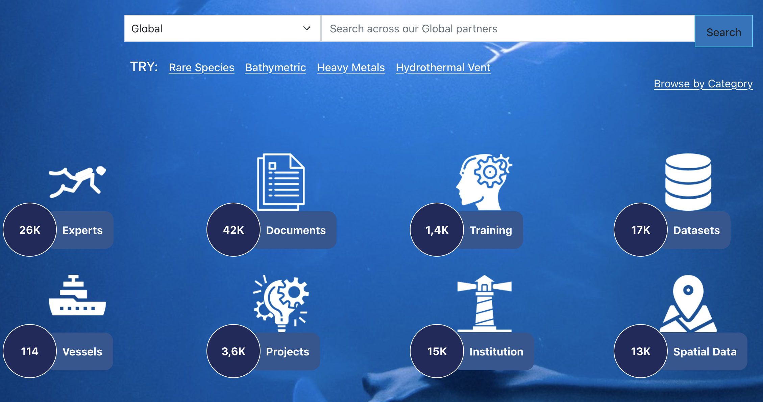
Two main types of users:
Users of content. Over 130,000 content items discoverable
Access via global search or regional pilot hubs
Examples: MSP: spatial data; Students: training opportunities; Literature reviews; Peer-to-peer expertise; Analysis of current / past projects.

Slide 12
Two main types of users:
Users of content. Over 130,000 content items discoverable
Access via global search or regional pilot hubs
Examples: MSP: spatial data; Students: training opportunities; Literature reviews; Peer-to-peer expertise; Analysis of current / past projects.
Users of technology. Open access and free to adopt by anyone.
ODIS patterns can be used to make metadata discoverable to this network and to others (Google Dataset Search etc).
All the records in the ODIS knowledge graph can be accessed by anyone – shared to existing information systems (eg SPREP)
ODIS can be used to create new regional or thematic portals (eg IOCAfrica).
All records link back to the original authoritative source, and the source keeps control over the sharing action.

Slide 13
User testimonials
Our interactions with the OIH and ODIS have been very smooth and informative. A part of the CIOOS mandate is to improve the discoverability of ocean data in Canada. In three oceans and lots of territory, we have a lot of data - and knowing who had what was an issue. With very little effort on our part, all of CIOOS data holdings are now indexed and available via ODIS and OIH. The whole process validated our infrastructure choices to focus on federation. We have a system that works from local to sub-region to National and federation is at all levels. OIH’s design has allowed us to integrate very well and smoothly - and it helps us to fulfil our core mandate. It has been great working with OIH and ODIS so far and we look forward to collaborating in future.
Scott Bruce, Canadian Integrated Observing System - CIOOS, Canada
“The solution proposed by the Ocean InfoHub project directly supports several key objectives of the Ocean Decade’s data and information strategy. This strategy aims to transform the way we discover, access and use ocean data and information within the Ocean Decade and beyond, thus unleashing its power for the benefit of science and sustainable development solutions.”
Louis Demargne
Data & Knowledge Management Officer
Ocean Decade Coordination Unit
We used OIH to to search for publications of MSP-related projects in East Africa (currently a very important management tool for marine areas) as well as performance of Marine Protected Areas. We also searched for projects on fisheries management in the Northern coast of Kenya.
Harrison Ong’Anda, Kenya Marine and Fisheries Research Institute
We used the OIH-AFRICA portal to search for ocean observation data, specifically Sea Surface Temperature (SST) to inform a research paper focusing on Sea Surface Temperature variability along the northern coast of the Gulf of Guinea that we will be publishing.
Dr Sohou, Institut de Recherches Halieutiques et Océanologiques du Bénin
NIOMR has used OIH to search for documents / research papers on Coastal erosion and ocean dynamics monitoring at Seme, Yovoyan, Olomometa, Lekki and Orimedu beaches, Lagos state, Nigeria. They are using this information in a study aimed at developing a coastal erosion and flood monitoring system for the region.
Regina Folorunsho, Nigerian Institute for Oceanography and Marine Research

Slide 14
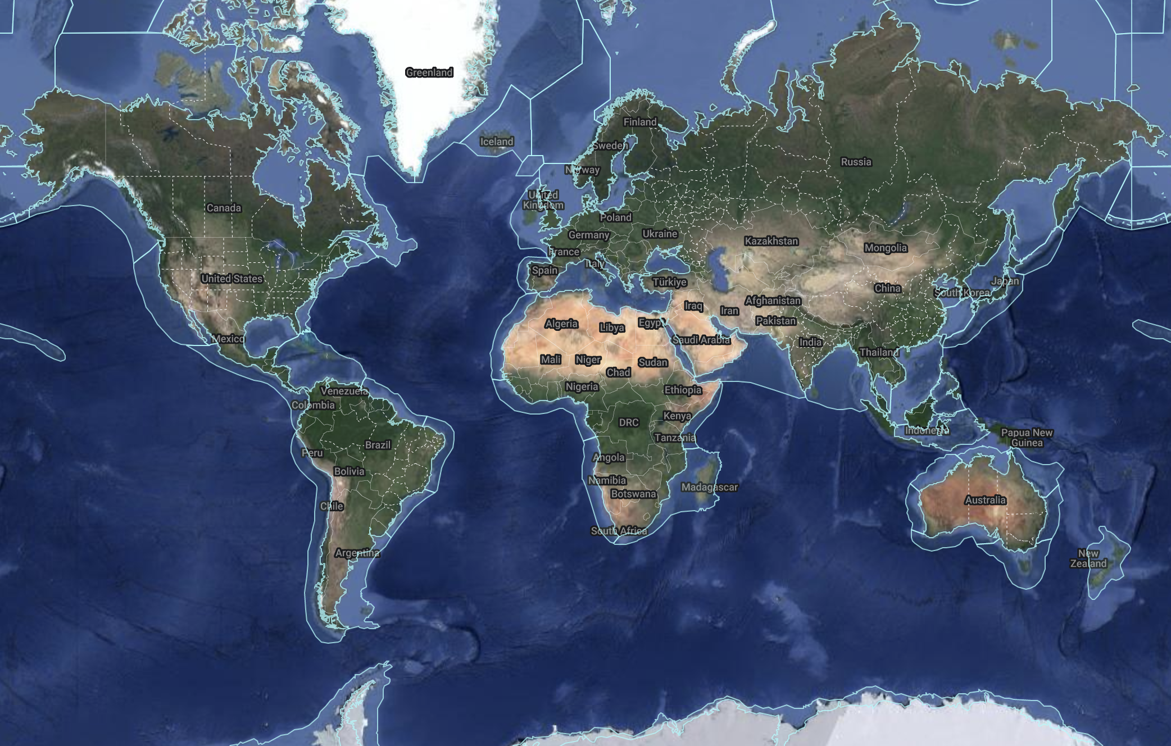
OIH/ODIS Support for MSP and SOP communities of practice
Find relevant information quickly and easily
Identify data sources, expertise, reviews of literature – fast
Portals can be established on any website, using this technology and accessing the full knowledge graph
For those projects generating new data, enable discovery and FAIR compliance.
Examples of our partners supporting MSP:
Benguela Current Commission GeoNode
CORDIO, MarCoSIO and WIO Symphony in the WIO region
Caribbean Marine Atlas
International Coastal Atlas Network (ICAN)

Slide 15
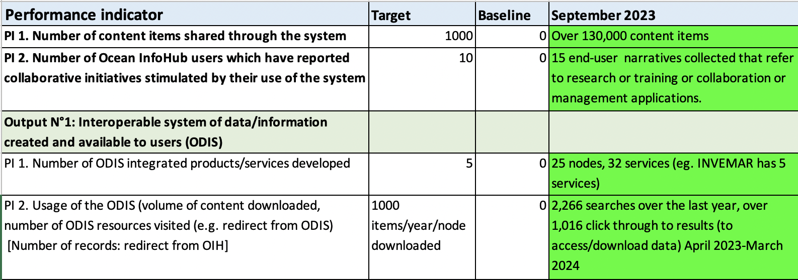
Final Monitoring Results Framework
All project targets are fully achieved

Slide 16
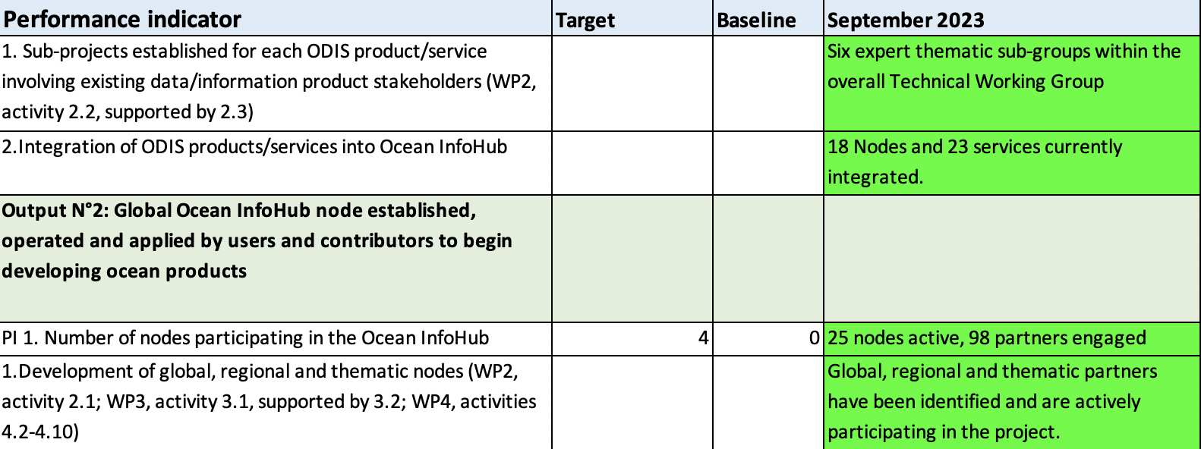
Final Monitoring Results Framework

Slide 17
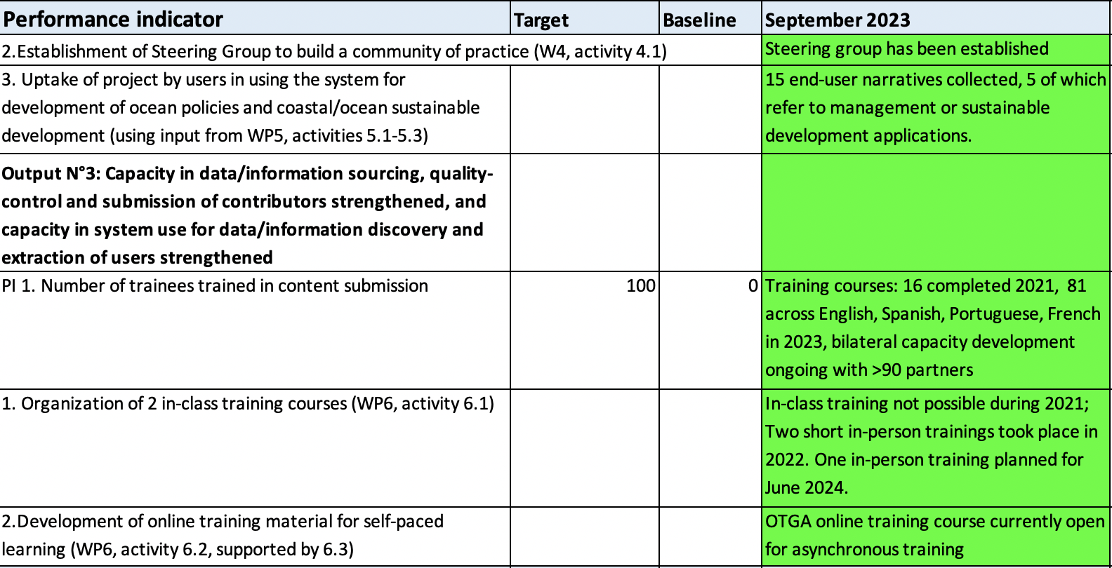
Final Monitoring Results Framework

Slide 18
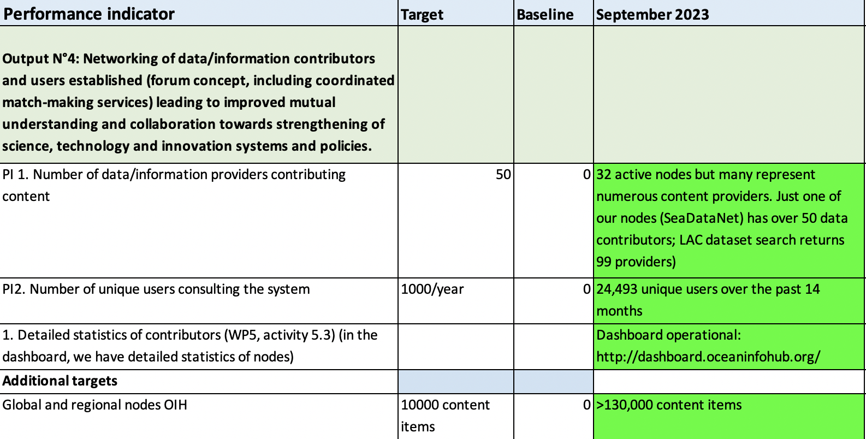
Final Monitoring Results Framework

Slide 19
Final Month activities
Finalisation of this meeting report
Five contracts will be completed and signed off
PSIDS engagement (workshop on 27th May)
Doug Fils
Jeff McKenna
Sciencecrunchers outreach, updated video and content
Trust-IT front end development
Online participation in:
IMDIS conference
23rd Annual Large Marine Ecosystems (LME23) Consultative Meeting
OTGA Steering Group meeting + workshop
DSIG activities

Slide 20
Thank you
Thank you for your contributions to the OIH Project!
In reaching our milestones, grateful thanks are due to the IODE PO team, funder (Government of Flanders, Kingdom of Belgium), WP2 secretariat and contractors, WP2 working group, three regional coordination teams (Africa, LAC and PSIDS), implementation partners and other project partners.
The legacy of OIH will be maintained by IODE and expanded through the ODIS Programme component, adding functionality as requested by end users, linking partners from new regions around the world and also to develop OceanData 2030 in support of the UN Decade of Ocean Science for Sustainable Development.
ODIS will be actively looking for funding opportunities, particularly to support activities in pilot regions and communities of practice.
This is not the end, but just the end of the beginning; ODIS will maintain channels of communication and the team looks forward to staying in touch and sharing some exciting updates over the next few months.

Slide 21
Resources
OIH Website https://oceaninfohub.org/
ODIS Documentation https://book.oceaninfohub.org/index.html
Video: https://drive.google.com/file/d/1YvEMcETZlt-E4aHTad4K1jopbF6ODi4u/view?usp=share_link
Brochure: https://drive.google.com/file/d/1TeWhcciX6UVcQMh9HAsfxG-jKd-3BOlj/view?usp=share_link

