Slide 1


OceanOPS 3
OCG-15 Session, 13-17 May, 2024
ONC, Victoria, British Columbia, Canada
Notes:
Ann

Slide 2
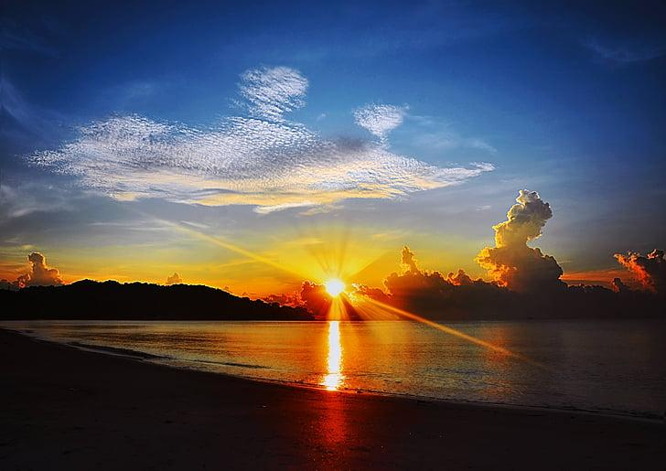
Opening Thoughts
OceanOPS has demonstrated value, crystallized much of the GOOS observing system, and enabled efficient management of expensive ocean observing activities.
This morning we will begin to identify some of the issues/questions about a future OceanOPS and steps necessary to appropriately support its future functions.
Notes:
Ann

Slide 3
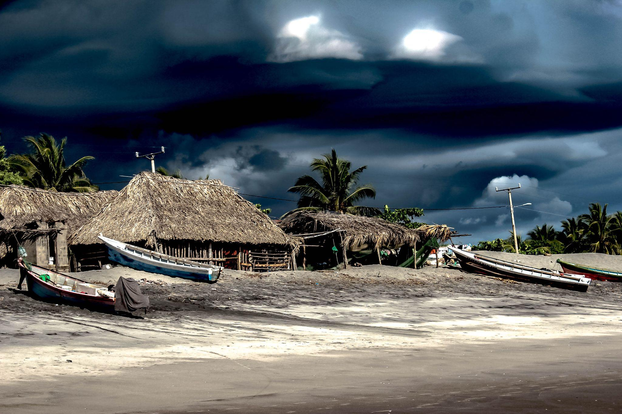
OceanOPS services
What are the most unique and valuable services that OceanOPS provides to the networks?
Notes:
Ann

Slide 4
Argo notification scheme - fundamental, legal requirement, IOC resolution
Argo - Collecting metadata, monitoring the health of the array, assess gaps, age, and management of the array ($ cost efficiency, value for money to funders of network)
DBCP - Integrated dashboard - platform status, visualise the network, know what to do (network management?)
Aggregation of metadata - reduction of work (DBCP) ($ save cost at each network level - efficiency for the ‘system’)
SOT - unique ID - critical for function , fundamental to operation
SOT - metadata,
SOT - Documentation (centralized place for documentation), historical knowledge ($ system memory, save reinventing the wheel, explain what things are as are
SOT - Enabling countries to utilize the system and use existing platforms/processes to contribute e.g., metadata
Gliders - Visibility through the dashboard, contributing to a global program ( $ people deploying the vehicules, people doing the work, funders realise part of global system, safety of investment?)
GLOSS - no direct services, when providing reporting e.g., network status reports (centralized reporting what ‘GOOS’ want to know), currently working on metadata which could lead to increased needs/benefits
AniBOS - not as well engaged yet, visualization and accessibility to real time observations is a big benefit and facilitates guidance of operations in the field that are reliant on other programs and activities ($ visibility to other programs of the validity of the AniBOS work - validation of the network to others)
FVON - Provide critical guidance and lessons learned ($ advice, knowledge sharing, strategic/practical advice),
FVON - knowledge and visibility of the data that is provided and accessible in different regions ($ validation of need for observations, due to coverage gaps)
UK Argo - Critical for deployment planning (reduce duplication);
UK Argo - Statistics and mapping provided yo funders ($ justification of investment, visibility of funder UK?)
GO-SHIP - technical coordinators are the point person for adding additional data points to the network ($ focal point for organisation)
GO-SHIP - unique ID, fundamental ($ operational service)
GO-SHIP - maps and visualization,
GO-SHIP -data use and statistics?
GO-SHIP - reporting on status of the networks (centralized point), cruise tracking,
GO-SHIP - coordination of meetings ($ direct network organisation support)
Argo - satisfying reporting to IOC and WMO
GLOSS - knowing what i need to report
Notes:
Ann

Slide 5
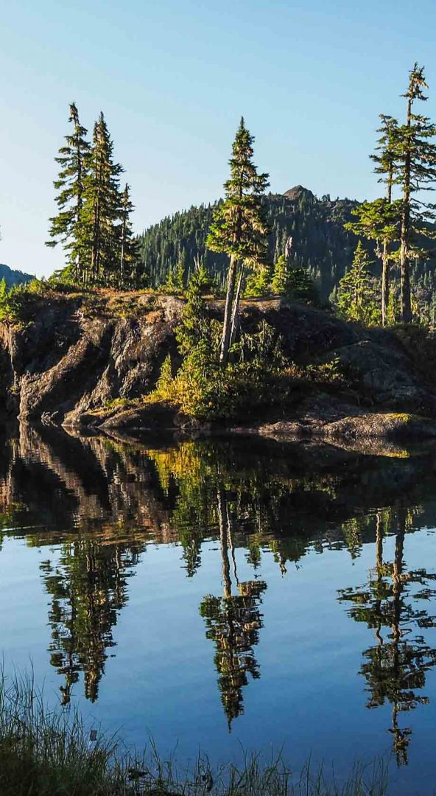
OceanOPS priority services 2
Are there services that you would like to see OceanOPS provide - networks and GOOS?
Would you be willing to pay for them?
Notes:
Congratulations on making it through this year. Largely recovered, except ship-based activities where we WILL see a COVID gap in our records.
Despite the limitations from COVID, the community has responded and demonstrated dedication to ocean observing
OCG too
UN Decade (Wed)
Work and collaboration with UN Decade Programmes as they initiate
Time consuming endeavour. UN Decade activities are a pathway to change. Opportunity for more engagement (eventually resourcing???)
Things are becoming more clear, still need to be vigilant for duplication, efficiency, opportunity and developing and implementing the system.
How best for OCG to support networks with this?
EH Notes
What do we need this to do at the start of the meeting
Lay out some excitement about the agenda and aims
Show progress and good work across the year, responding to circumstances, focus on foci and actions from last year, acknowledge people's work, commitment, progress, ideas of exec (Vice Chairs) and networks - real successes we ahev had - we should be very clear on this - OCG, the networks gains recognition for efforts - in turn support our work to develop observing system
Other work to make OCG meaningful for OO - WMO IP etc
Challenges ahead
How our discussions this week will help guide OCG

Slide 6
Services you would like to see?
EOV view - Integrated Struggle to report on network contributions on EOVs - tracking tool to enable this capability
Information services - projections of characterisation of e.g., MHW that impact Suite of information services. Integrate with GRAs who might do this - scale up from GRAs to global, think there are funds out there for that, Start with test cases (low hanging fruit). Think this is fundable - would help funding of other things. Others think this is going into the data product space - consider carefully. However this is a what people might pay for, understood that this is a change - OceanOPS 2.0. GOOS needs some services - Copernicus does not do what is required, whether OceanOPS does it, GOOS needs it.
Improve our communication on OceanOPS - to enhance understanding of OceanOPS and its work (help fundraise) , both OceanOPS and the networks highlight what they do
Rebuild Win software, collaboration between countries, broker this, central point for this
Better coordination with network reps - help make connections bottom up and top down, connection from the IOC and WMO requirements, help/aid the networks in making these connections
Coordinate OONJ observations, might make it easier - ease regional collaboration in this space
Notes:
Ann

Slide 7
Notional Timeline
June
July
August
September
October
November
Dec+
Task Team for OceanOPS
Define core services
Complete services survey, OceanOPS synthesize
Identify network specific (SLA).
Develop conceptual approach to distribution of services (OceanOPS, others).
Assess and define Oceanops
Assess desired core services
Assess OceanOPS ability to meet core and SLA needs.
Assess OceanOPS ability to meet service needs (needed costs for 2025, 2026, 2027)
Define/refine value proposition and messages
Collect input
Refine value proposition and messages
Marketing plan
Develop articles, materials etc as required
IOC Assembly in 2025
Roundtables

Slide 8

Notes:
Ann

Slide 9
OCG Executive Members
David Legler (Chair) [To be filled through circular letter]
Jon Turton (Vice-Chair WMO)
Juliet Hermes (Vice-Chair OBPS) [Needs to be filled, will help outline description - via GOOS email, decided by Exec]
Kevin O'Brien (Vice-Chair Data)
Champika Gallage (Ex officio - WMO Rep)
Zulfikar Begg (Vice-Chair Capacity Development) [Needs to be filled - Not immediately filled, more conversation with GOOS]
Emma Heslop (GOOS)
Mathieu Belbeoch (Vice Chair OceanOPS Manager)
Ann-Christine Zinkann (NOAA support to GOOS, ECOP)
YU Ting (China support to GOOS) [new secondment from China to be identified]
– OTHER AREAS: Environmental Stewardship [Network level], more coordination activity, communicate with networks on e.g., exemplar work, higher level conversations around observing system items, representation of ECOP to the exec, emerging network vice chair,

Slide 10









OCG Executive Members
David Legler (Chair)
Jon Turton (Vice-Chair WMO)
Juliet Hermes (Vice-Chair OBPS)
Kevin O'Brien (Vice-Chair Data)
Champika Gallage (Ex officio - WMO Rep)
Zulfikar Begg (Vice-Chair Capacity Development)
Emma Heslop (GOOS)
Mathieu Belbeoch (Vice Chair OceanOPS Manager)
Ann Christine Zinkann (NOAA support to GOOS, ECOP)
YU Ting (China support to GOOS)
Mature Networks
Argo
Breck Owens
Susan Wijffels
Brian King
GLOSS
Gary Mitchum
Bernado Aliaga
SOT
Huai-min ZHANG (John)
Elizabeth Kent
Henry Kleta
Joel Cabrie
Justine Parks
Tammy Morris
Francis Bringas
Henry Kleta
OceanSITES
Raquel Somavilla
Johannes Karstensen
AniBOS
Clive Mcmahon
Fabien Roquet
HFR
Hugh Roarty
Manman Wang
GO SHIP
Elaine MCDONAGH
Leticia Barbero
DBCP
Lance Braasch
Nelly Florida Riama
OceanGliders
Pierre Testor
Brad DeYoung
Emerging Networks
Under Consideration Networks
SMART Cables
Bruce Howe
Ceci Rodriguez Cruz
Chris Barnes
William Wilcock
FVON
Cooper Van Vranken
SOCONET
Adrienne Sutton
Maciej Telszweski
USVs
Ruth Gwynneth Patterson

