Slide 1

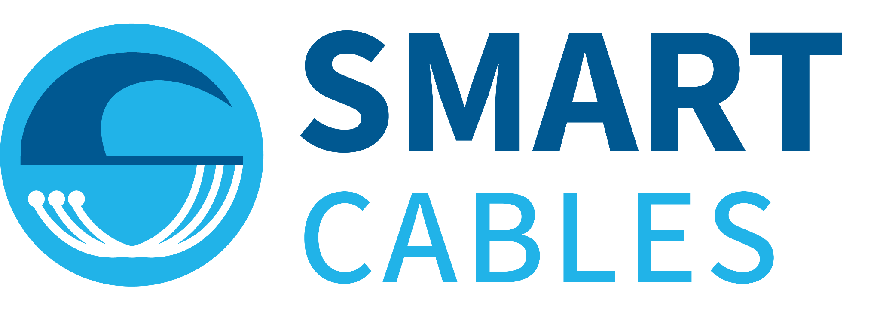
SMART Cables Emerging Network
Observing the Ocean and Earth with
Objective for OCG-15:
Formal Endorsement as Emerging Network
Embed SMART Cables in OCG structure.
From GOOS Project to ‘sustained’ network infrastructure
.
Chris Barnes
William Wilcock
15th Observation Coordination Group (OCG-15)
Victoria, British Columbia, Canada
13-17 May 2024
Notes:
SMART = Science Monitoring And Reliable Telecommunications
The Objective for this OCG is to obtain the
Formal Endorsement of SMART Cables as an Emerging Network.
This will start the process of Embedding SMART Cables into the OCG structure.
and
Begin the transitions from a GOOS Project to being one element of the GOOS ‘sustained’ network infrastructure
1

Slide 2
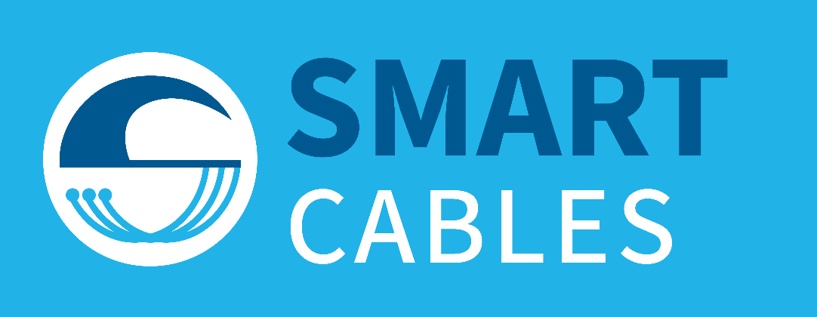




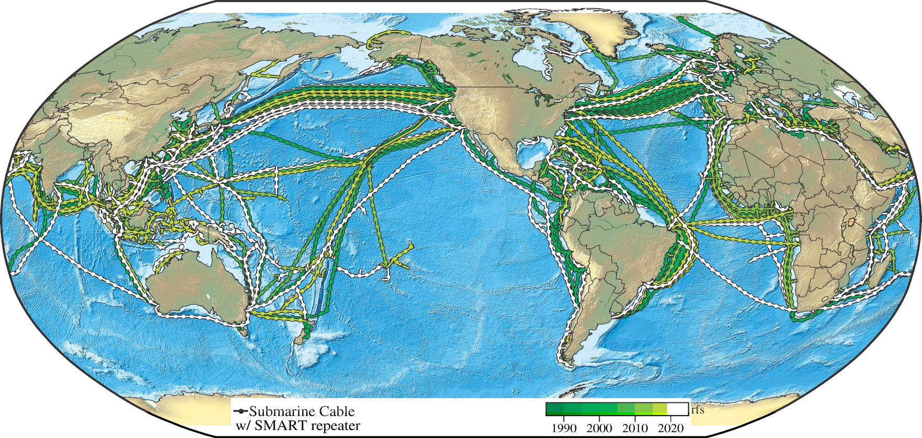
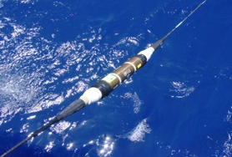


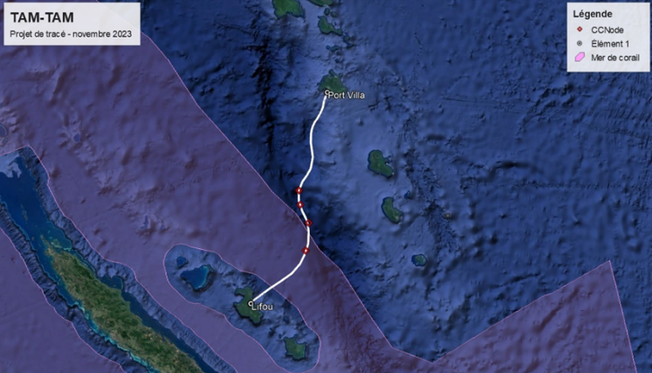
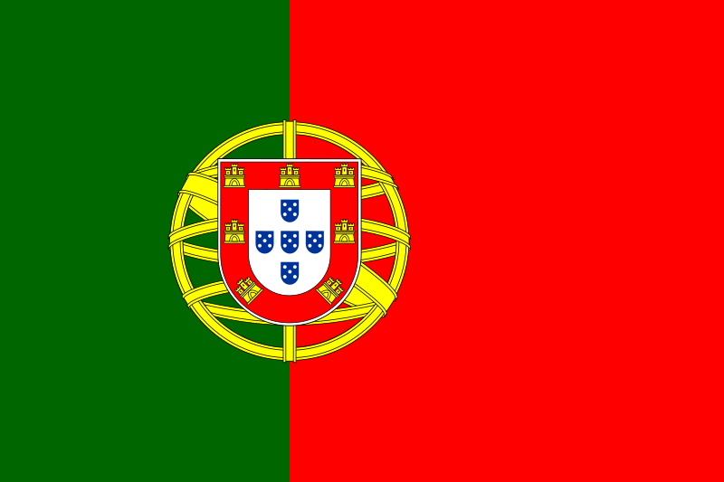

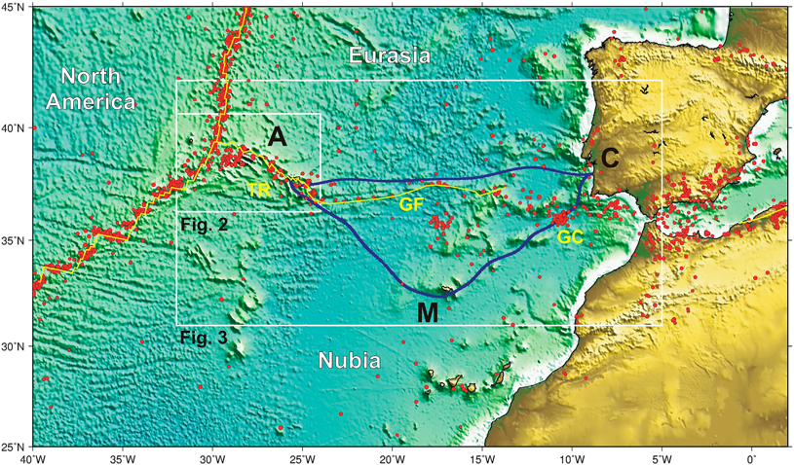


SMART Subsea Cables Network update
Global Array: Climate, Oceans, Sea Level, Earthquakes, Tsunamis
Create a Planetary sensor, power, Internet network
Sensors:
Temperature
Pressure
Seismic Motion
Key point:
Essential Ocean Variables of the Global Ocean Observing System
Green circles, systems funded. Orange and light green circles, future systems.
TAMTAM SMART Cable System
SHARED INFRASTRUCTURE TELECOM + SCIENCE
Portugal SMART Atlantic CAM
RFS 2026
Lisbon
Azores
Governments, commercial, develop banks
\
25+ year life, reliable, low lifetime cost
Leverage $5B/y industry, 170 yr
ATLANTIC CAM: 20 modules, 3800 km long
TAMTAM: 4 modules, 450 km long
Madeira
Gov’t €154M. EU support €40M
Notes:
We are addressing the challenge of climate monitoring and hazard early warning by
Integrating environmental sensors into commercial telecommunication cables,
For affordable, global, sustained, real time, reliable, ocean observing.
The Joint Task Force, consisting of roughly 300 volunteers, was formed in 2011 by the 3 UN agencies – ITU, WMO, UNESCO IOC.
The ITU is important, as the whole SMART concept rests on the concept of shared and multi-use infrastructure – the submarine cable network. The ITU hosts our Secretartiat.
We are an endorsed Project of the UN Ocean Decade, and part of the Global Ocean Observing System (a GOOS Project) and the Tsunami Programme, within IOC and WMO.
Intro Map
Now lets take the telecom only map and conceptually add smart sensors along all the cables, represented by the dots, To obtain a planetary scale sensor, power, and internet network that can observe climate oceans sea level, earthquakes and tsunamis.
*We will share the submarine telecommunications network that links countries and continents together, enabling our society and civilization.
Telecom is the primary mission with SMART secondary.
*The basic sensors are ocean bottom temperature, pressure and seismic motion.
*These sensors can improve our knowledge of the cable’s environment, and thus the cable integrity.
*A number of systems are in various stages of planning, requests for proposals, and implementation (symbols)
The green circles represent two funded systems underway: the CAM system with SMART capability in Portugal’s Atlantic domain. And the Tamtam system connecting Vanuatu and New Caledonia.
*We expect SMART cables to evolve into a major addition to the ocean and earth observing system.
Intro Map
SMART stands for
Science Monitoring And Reliable Telecommunications
With the purpose to observe the ocean and earth with high reliability, providing data to save lives.
The basic idea is to add environmental sensors to the global network of submarine telecom cables.
On this map, we have taken the current telecom cable map and conceptually added smart sensors along all the cables, represented by the dots,
To obtain a planetary scale sensor, power, and internet network that can observe climate, oceans, sea level, earthquakes and tsunamis.
Symbols indicate systems under consideration for including SMART; the two green symbols are for Portugal and Vanuatu-New Caledonia – underway.
The two green symbols indicate funded projects – see below.
Medusa is already underway, but it may still be possible to incorporate SMART in the eastern portion.
MISTS, also in the Med (Mediterranean Integrated Science and Telecom System) will include SMART, connecting secondary cities, to complement Medusa. Proposed.
Drake passage – proposed by Chile but funding very unclear.
NZ-Chathams Islands – proposed within the NZ government – under consideration (science community strong support)
NZ-McMUrdo – NSF proposed as SMART cable, for needed connectivity and science associated with SMART – Antarctic Circumpolar Current, Antarctica Deep water formation, etc. VERY strong science, but US govt, slow.
Hawaii – proposed interisland system, hon hold for now.
Indonesia – they need it but have been working for 6 years with just a little progress.
Arctic Cables
Far North Fiber through Canadian NW passage.
Polar Connect crossing near North Pole.
Tusass, connecting Greenland and Denmark, Newfoundland.
NORDUnet research and education network coordinating many aspects of all of these including SMART. These are 3 year earliest – Polar Connect will require a cable ready icebreaker that Sweden will build, ready in 2029.
Other systems, such as Humboldt connecting Chile and Tahiti are also being considered.
Two SMART subsea cables are funded, with both to be ready for service in 2026.
The system will have 4 SMART modules between Vanuatu and New Caledonia.
This will be the second international cable for Vanuatu – extremely important for economic resilience, and improving earthquake, tsunami, and volcano early warning.
Funding will come from France, the Asian Development Bank, and commercial sources.
The Portuguese SMART Atlantic CAM system, replacing an old system, will link the Continent to the Azores and Madeira in a ring - CAM.
The government is bearing the cost for reducing disaster risk with the prime motivator being the very destructive 1755 earthquake and tsunami.
Funded by the Portuguese government with the EU making a significant contribution.
SMART capability will have an incremental cost about 15% of the cost of the telecom system.
For the Portuguese government, this means 2 euros per citizen per 25 years.
We are leveraging this $5 billion per year industry to our advantage - and theirs.

Slide 3
Status on OCG Attributes
 | Global scale | We are working with Regional and National focal points (ITU, WMO, and UNESCO-IOC) and other relevant stakeholders to ensure their understanding and ownership of systems developed in their waters.
 | EOVs or ECVs | Essential Ocean Variables Subsurface Temperature and Ocean Bottom Pressure. (Analogous Variables for the solid earth would be seismic motion).
 | Sustained Obs. | Truly real-time, high reliability network that will provide temperature, pressure, and seismic data to the Global Ocean Observing System (GOOS).
 | Community of Practice | The ITU/WMO/UNESCO-IOC’s Joint Task Force on SMART Cables has been advocating in the subsea telecom industry, ocean and earth science community, and governments around the globe to provide guidance on setting up standard practices to develop SMART Cables locally and internationally.
 | Maintains network mission and targets | Will develop a defined role and track and assess progress of the network within GOOS.
 | FAIR Data | Establish an advanced data management infrastructure through data centers and/or standard services including the WMO Global Telecommunications System/WIS2.0 and web-based services that will operate under FAIR principles
 | Metadata quality and delivery | Ensure metadata quality and delivery - Complete platform metadata is submitted to OceanOPS in a timely manner.
 | Standards and Best Practices | Will develop Standards and Best Practices, in the following two years before deployment, during the commissioning phases (~1 year) and thereafter. These will reflect the continually evolving and expanding SMART Cable Observing Network.
 | Capacity development and tech transfer | SMART Cables enables new (developing and disadvantaged) communities of ocean observers and supports inclusivity and diversity in its members.
 | Environmental stewardship awareness | SMART Cables advocates to minimize environmental footprint and contributes positively towards a healthy ocean

