Slide 1
Advancing OCG Networks
Emma Heslop, David Legler & Ann-Christine Zinkann
OCG-15 Session, 13-17 May, 2024
ONC, Victoria, British Columbia, Canada
Notes:
Ann

Slide 2
Advancing our understanding OCG networks
OCG and & BioEco Networks (for the record)
Thematic Networks (some considerations)
It’s a numbers game - how far does OCG expand, what does this mean
Responsibilities

Slide 3
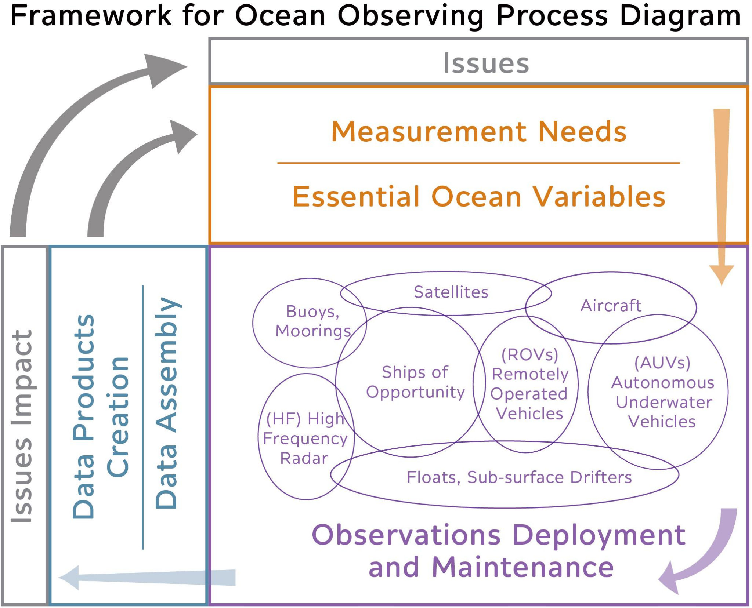
FROM THE FOO
An observing element as ‘any ocean sensing system – based on a specific platform, region, or ocean characteristic – that is driven by agreed requirements, has broad scientific support and adheres to global, common standards for data sharing’.

Slide 4
Networks - definitions
In practice, the term network is used by the ocean observing community to describe organizational groups with a wide range in scale and scope.
Moltmann et al. and AtlantOS framed descriptions to differentiate between networks and systems
OCG effectively created its definition through the ‘network attributes’ of OCG networks - stating that networks need to be at least pilot in all areas to be an OCG observing network
Answers in part GOOS SC (SC-9) request that needs clear “standards of acceptance” for being “part of GOOS” as a network, project or a regional system
The work with regard to metrics/maturity will further develop these

Slide 5
Example 1: OCG & BioEco Networks
The BioEco panel adapted the OCG network attributes w/ few difference
scale (global vs. local / national / regional networks with intent to develop into a global network)
mission addresses scientific questions relevant to national and regional science, policy and management need
The differences do not look insurmountable
Notes:
There are more similarities than differences between the OCG and BioEco Panel - e.g. best practices, FAIR data, mission, sustainability etc.

Slide 6
Recommendations
Craft definitions for the attributes that work for both OCG and BioEco
GOOS less complicated and more understandable
In line with common data/metadata standards, metrics and tracking
Cost savings
Suggest GOOS adopt the term network for both OCG and BioEco

Slide 7
Example 2: Thematic Networks
SOCONET is an emerging EOV network, others exist e.g. GOA-ON
OCG Attributes do not preclude observing networks based around EOVs or phenomena
How do thematic networks compare in function with the platform based networks;
Platform - multiple phenomena (multiple EOVs), best practices for observing, calibrating, quality control, data processing ensure that quality controlled EOV/ECV data flow into open data systems
Thematic networks run across several (limited number of) platforms. Focus on sampling protocols, data to identify trends, with additional attention to products

Slide 8
Recommendations
Be aware different responsibilities between platform and themed networks
Consider a different view in OceanOPS - how represent this layer on existing networks?

Slide 9
It’s a numbers game - Future of OCG
Issues to consider by OCG
Will OCG continue to add emerging networks, Is there a limit?
How can OCG support more networks with no additional resources?
What about useful networks that do not make the grade to be global? E.g. coastal buoys and moorings, smaller R/V regular transects (multiple purposes)
Currently there does not seem to be a need to place a limit, new emerging networks engaged with existing networks to assess fit and connections, fulfill unique roles, have found support for their work.
3 emerging networks adopted at OCG-15 are using existing infrastructure, rather than being new platform per se.

Slide 10
It’s a numbers game - what do we miss?
What do we miss?
Just emerging networks: OCG has adopted emerging networks OceanGliders, AniBOS, HF Radar and now FVON and Smart Cables - ask about experience is this functioning and clear?
Platforms not connected to networks, e.g. Coastal buoys amd moorings that are not in our existing networks, smaller R/V observing lines, some taking bioeco measurements (IGMETS) - why nt in DBCP, OceanSITES, and GO-SHIP
For observing platforms that are regional e.g. in Europe EMSO and EMBRIC
Citizen Science platforms…. (FVON, racing sailing, CoastPredict)

Slide 11
It’s a numbers game - Recommendations
OCG and OceanOPS resources - OCG to articulate its ask to GOOS
How do we communicate on new 14 + 3 networks - by platform group or other? Develop a new graphic to represent the networks
To capture unconnected elements
Can existing networks be more flexible, support integration?
Work with GRAs - map types of elements?
Find host or support, like IRSO?
Is it the role of the OCG to evolve to support more regional networks? What are the limits? Do some networks remain at a GRA level (with attributes from OCG) hybrid-associated networks?

Slide 12
It's a numbers game - responsibilities
9th Session of the GOOS Steering committee:
stressed the importance of establishing criteria for GOOS networks to create a coherent global system
As GOOS transforms from a primarily science-driven implementation activity to one that grows to be more responsive to societal needs, GOOS should ensure that it is not only soliciting voluntary contributions, but also driving standards and principles to be a part of GOOS
The OCG and BioEco network attributes are an example of such principles… they could be driven to requirements rather than guidelines.

Slide 13
It's a numbers game - responsibilities
As we seek to expand the observing system, it is important that GOOS both meets societal needs, is a more operational efficient ‘system’, and is seen as investable
From the GOOS Session during the Ocean Science Meeting in New Orleans this year - GOOS should stress the operational nature of the system
OCG has the aim of increasing maturity/operational level of the networks
More visibility of the meaning/status/tracking of the mature network?
Does OCG need to be more ‘strict’ about the responsibilities as networks increase
Can we highlight needs that are holding back maturing of networks - health index?
What are we missing?
Data/metadata flow that is understood and tracked?
Articulated connection to international requirements, products?
Accessibility/use of data,
Communications that the networks can use?
Tracking accessibility/use of data?
More visibility as a market?
Does OCG need to be more vocal about its work?

Slide 14
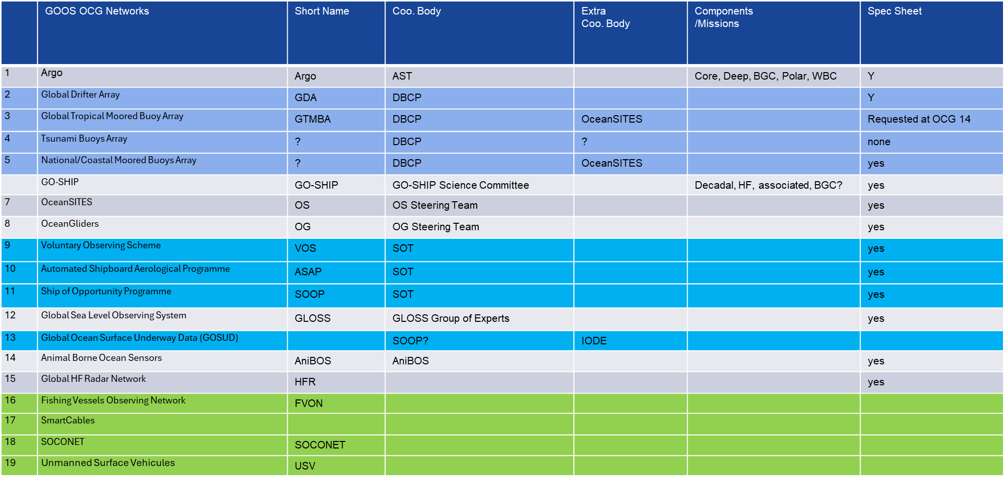
OCG Networks List - TO REVIEW

Slide 15
It’s a numbers game - Recommendations
Tidy and tighten up maturity/pilot, responsibilities (attributes document), list of networks
‘Health index’ means of highlighting needs that are holding back maturity of networks
Should those networks that reach maturity have a more visible status?
Could the OCG identify and focus on 1 or 2 of these priorities to mature as 2-year plan?
Data/metadata flow that is understood and tracked?
Articulated connection to international requirements, products?
Accessibility/use of data,
Communications that the networks can use?
Tracking accessibility/use of data?
More visibility as a market?
Does OCG need to be more vocal about its work?

Slide 16
Summary - Recommendations
Craft definitions for the attributes that work for both OCG and BioEco
Suggest GOOS adopt the term network for both OCG and BioEco
EOV networks a different view in OceanOPS - represent this layer on existing networks
OCG and OceanOPS resources - OCG to articulate its ask to GOOS
How do we communicate on new 14 + 3 networks - by platform group or other? Develop a new graphic?
Seek to capture unconnected elements
Can existing networks be more flexible, support integration?
Work with GRAs - regional/map types of elements?
Tidy and tighten up maturity/pilot, responsibilities (attributes document), list of networks
‘Health index’ means of highlighting needs that are holding back maturity of networks
Should those networks that reach maturity have a more visible status?
Could the OCG identify and focus on one or 2 priorities to mature over a 2-year plan?

Slide 17
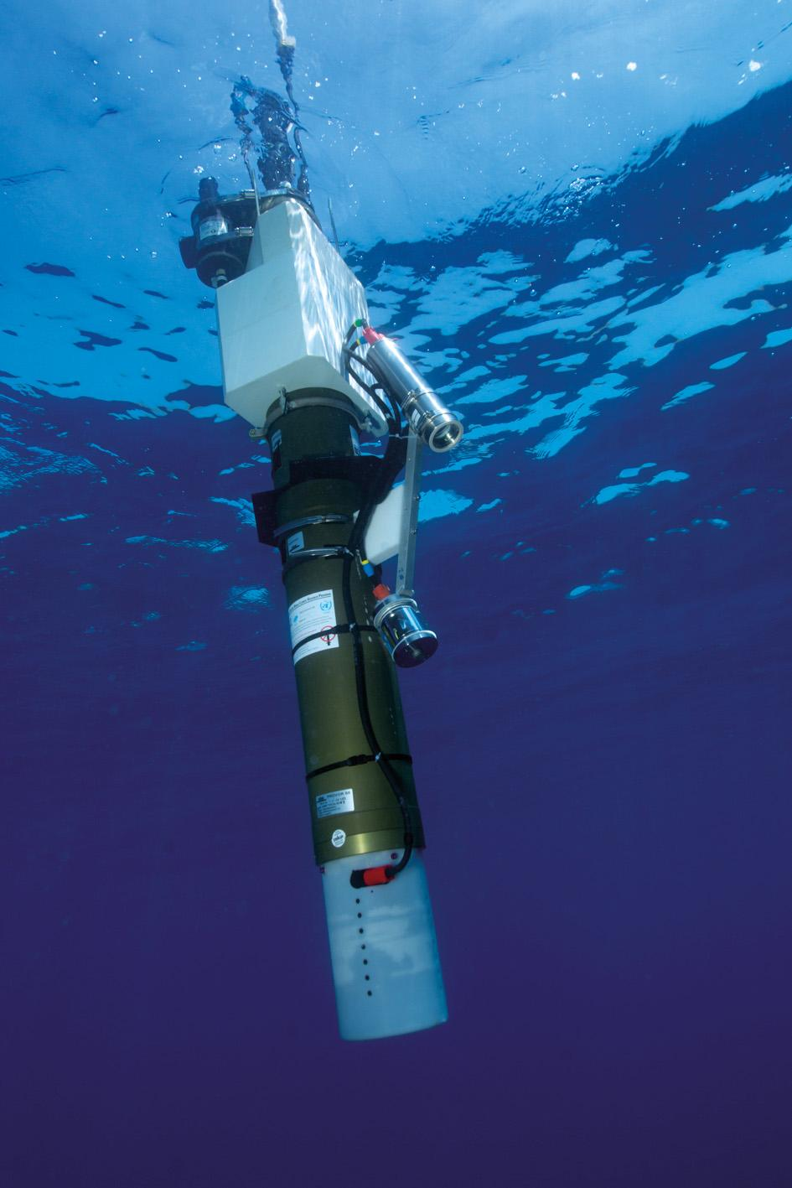
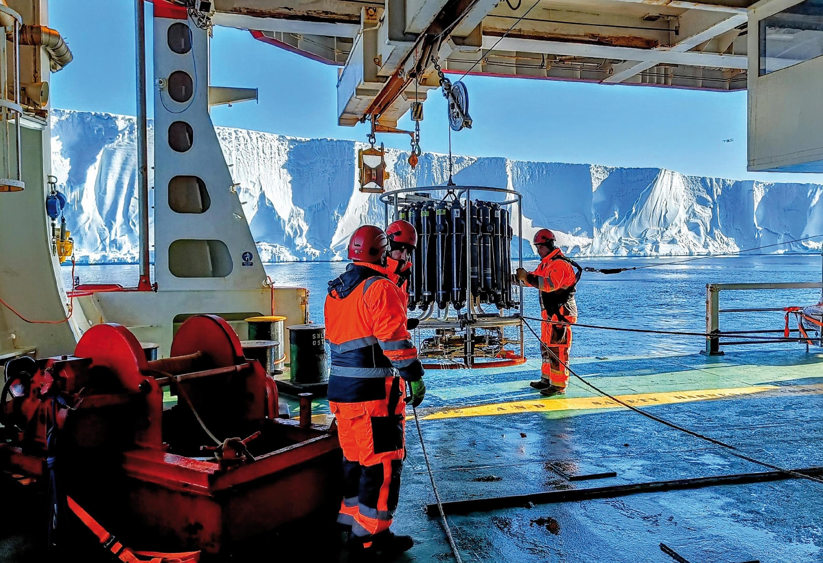
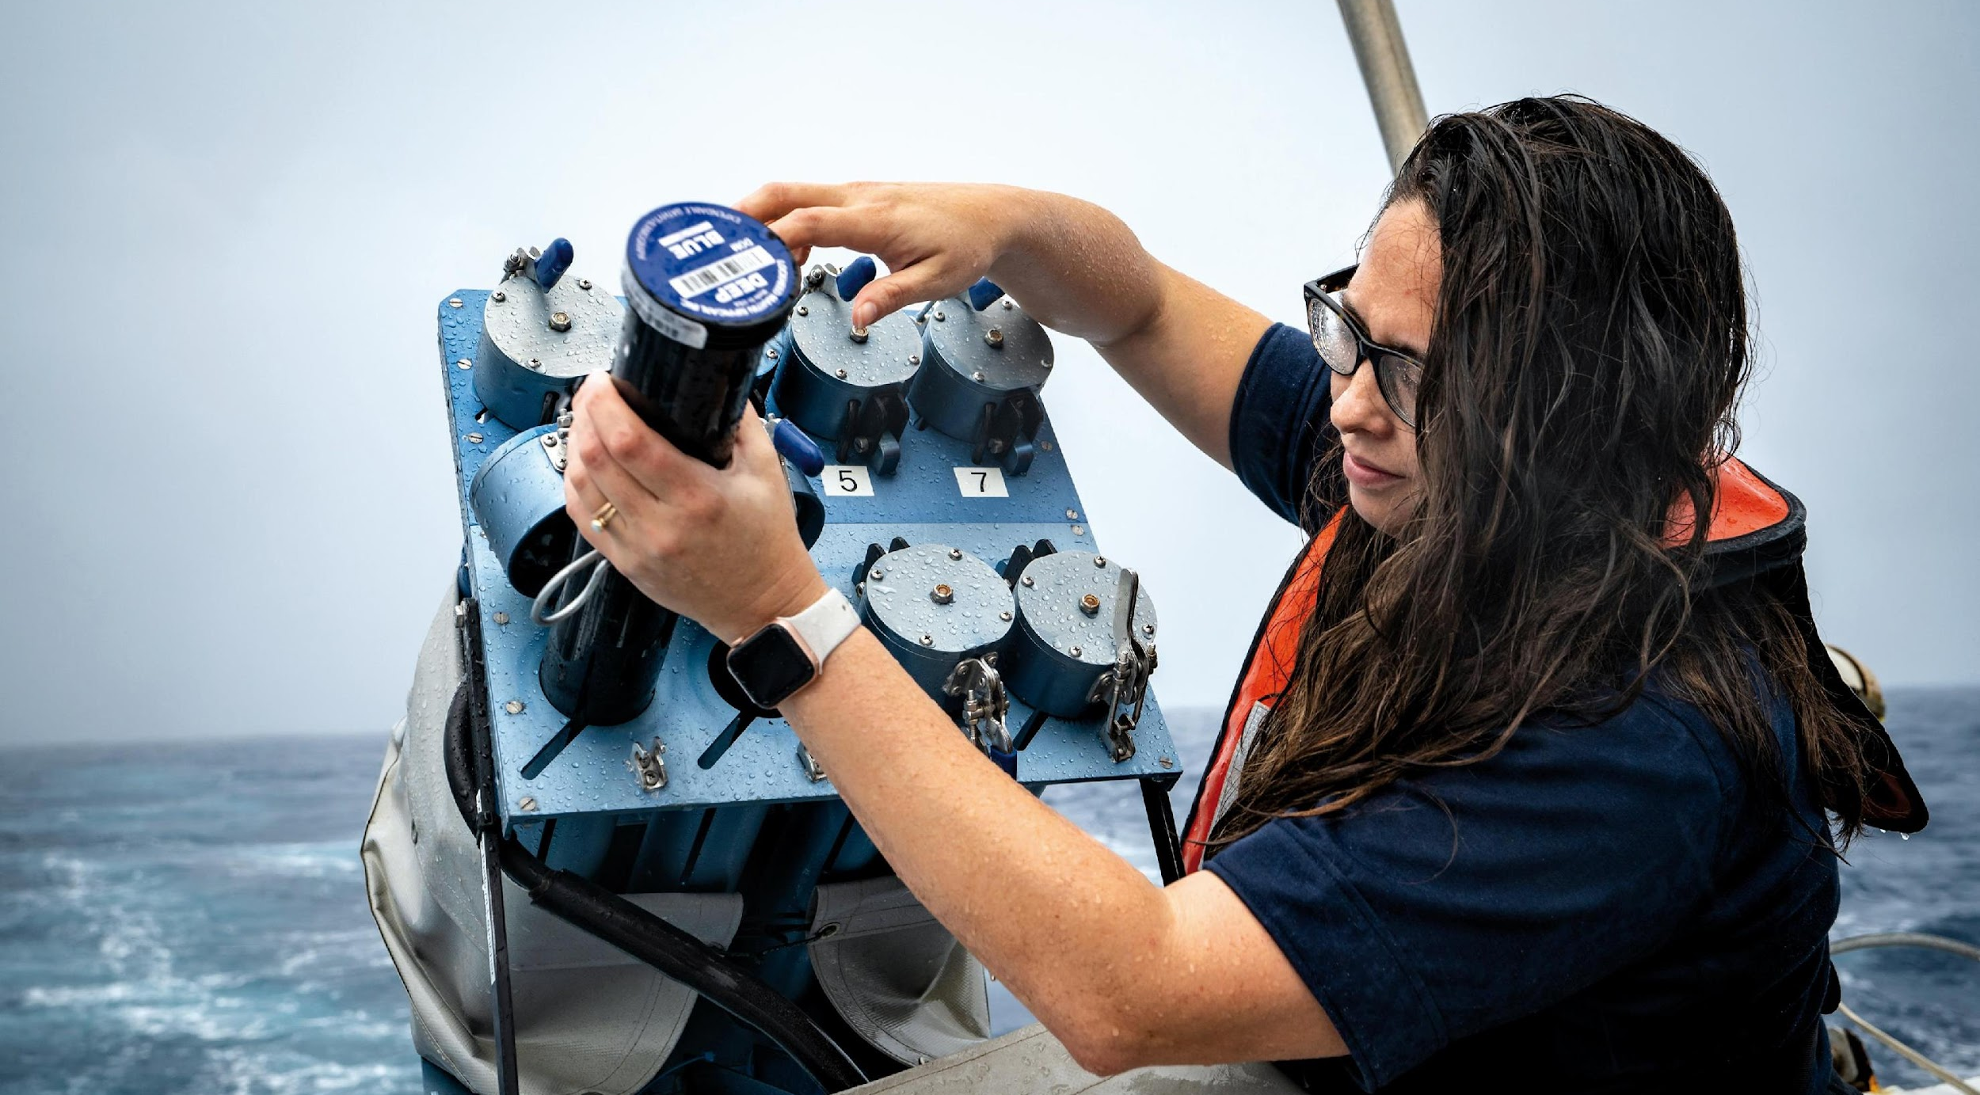
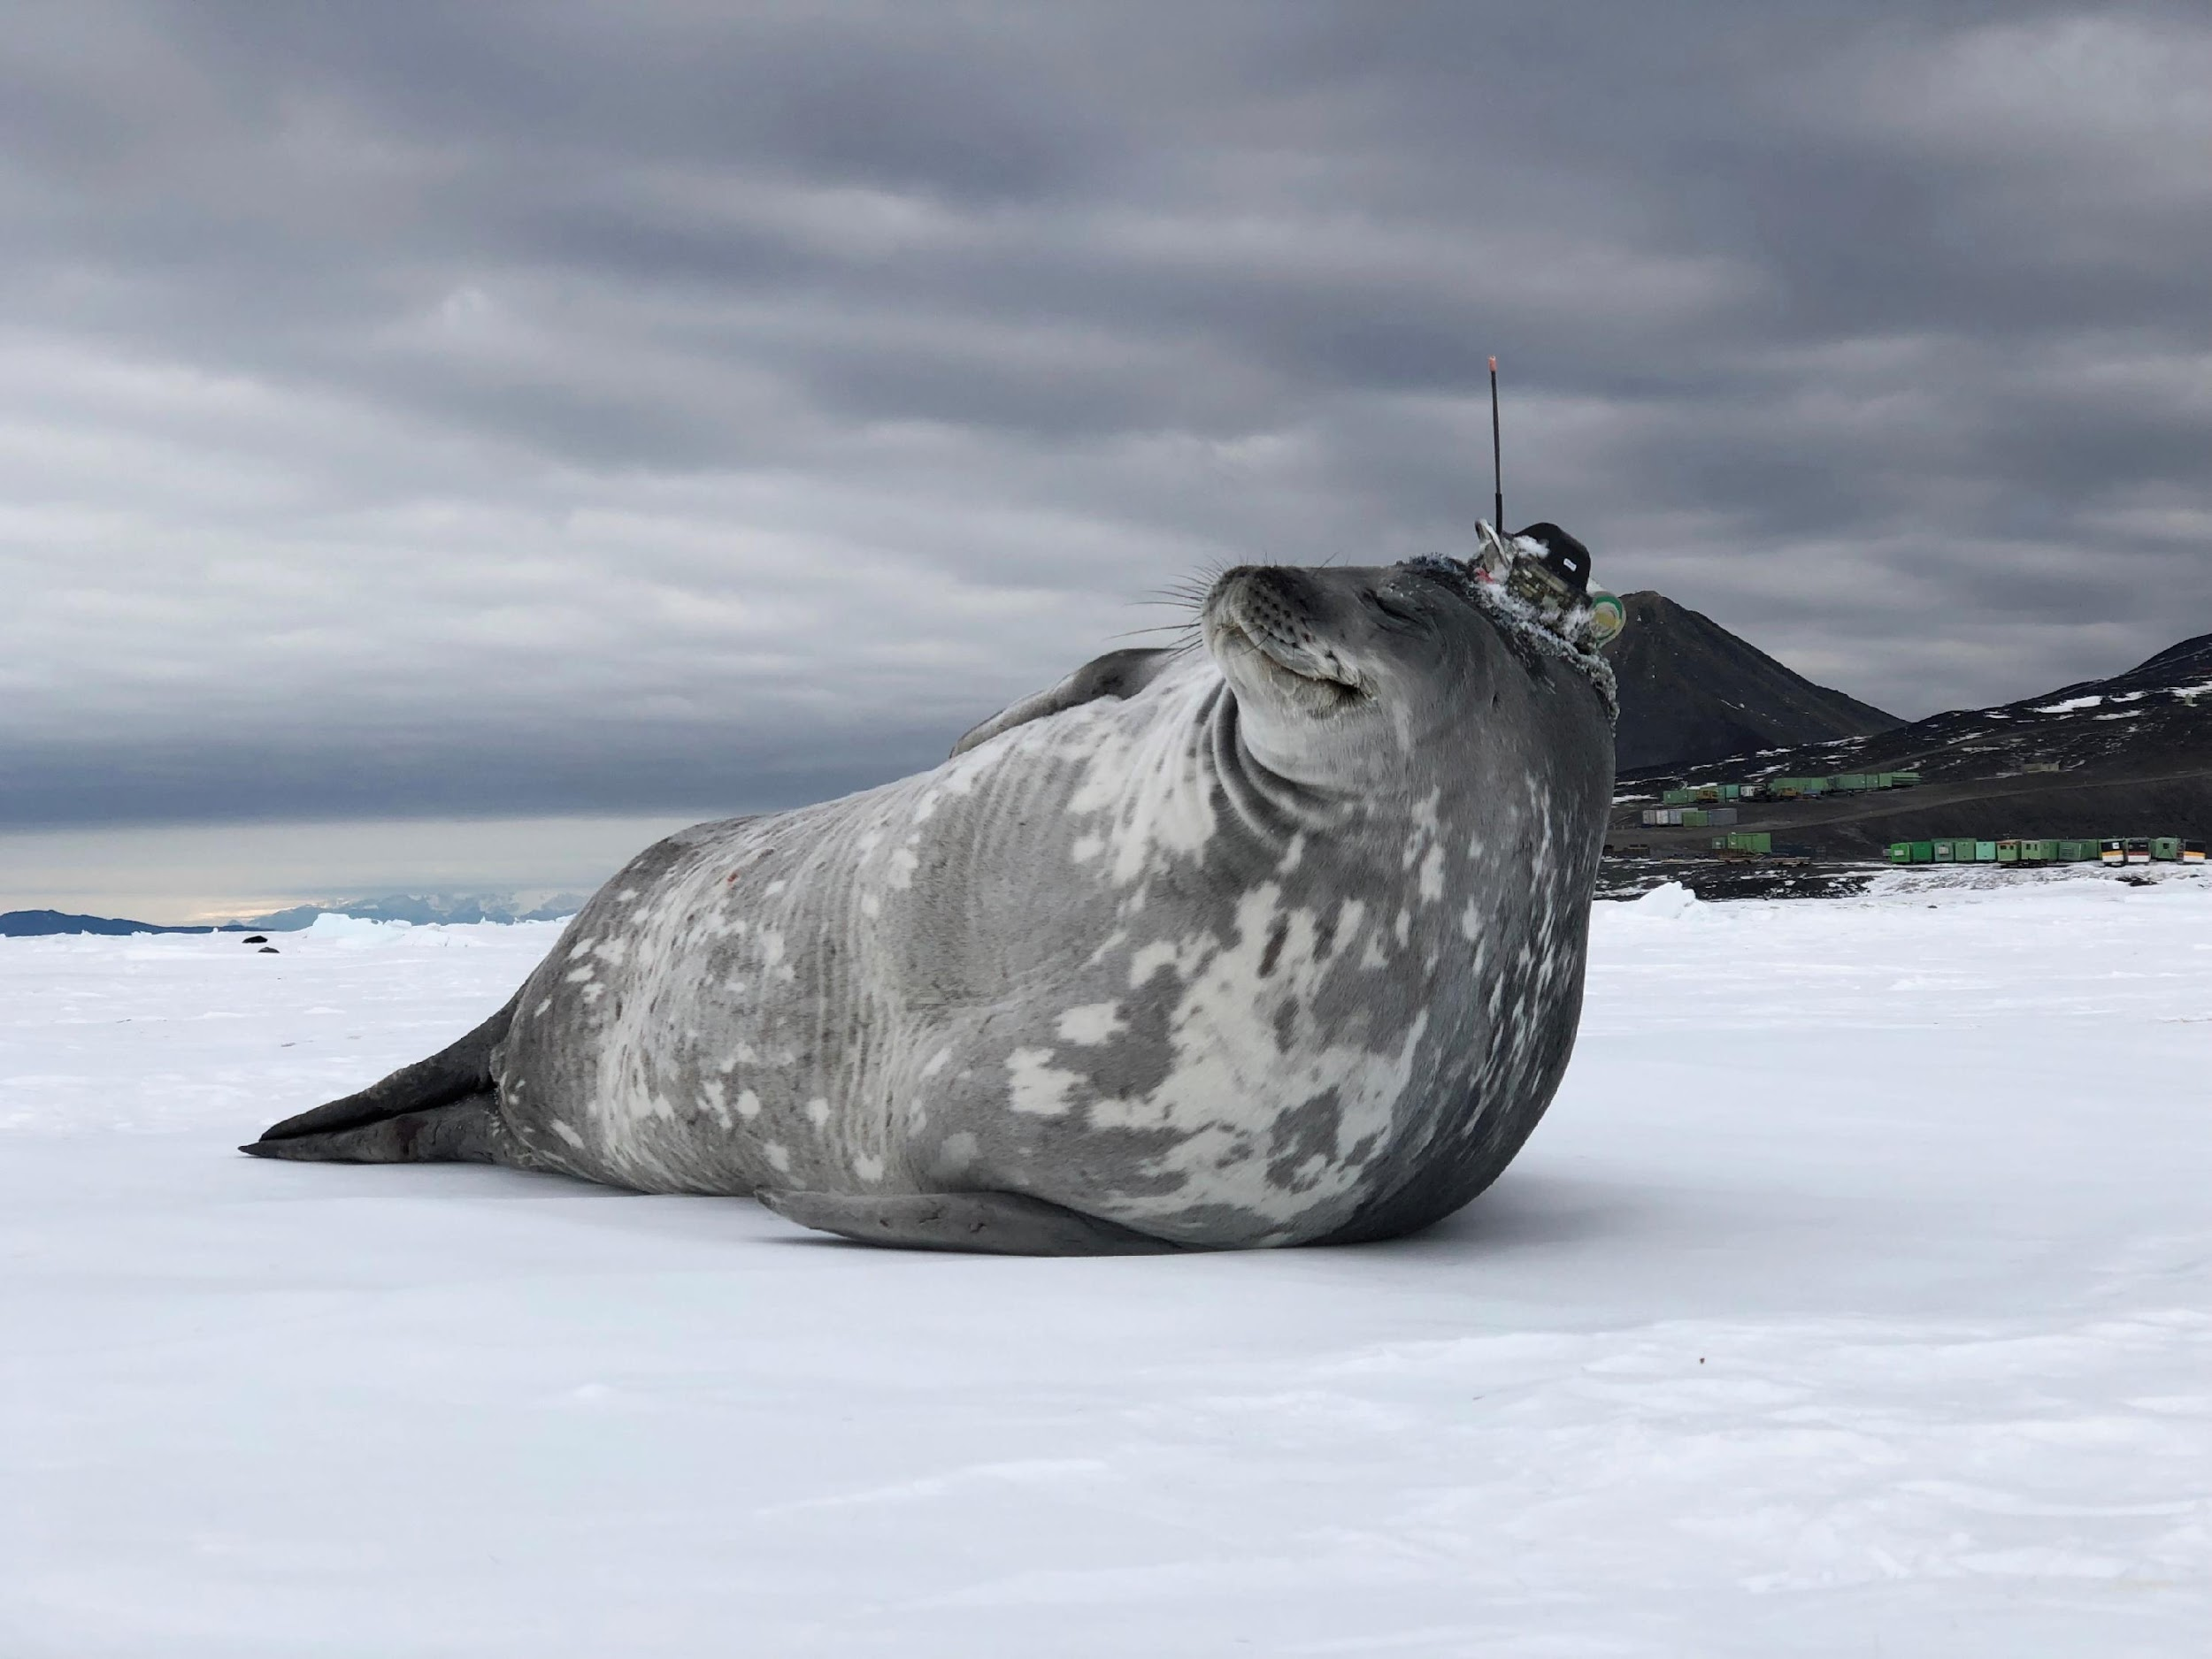
Thank you
goosocean.org

