Slide 1
Maturing the Ocean Enterprise to Deliver Essential Societal, Economic and Environmental Benefits
Dialogues with Industry – Roadmap
Emma Heslop, Global Ocean Observing System – IOC/UNESCO
Peer Fietzek, Kongsberg Discovery
Zdenka Willis, Marine Technology Society
Donna Kocak, L3Harris
Zack Baize, National Oceanic and Atmospheric Administration

Slide 2
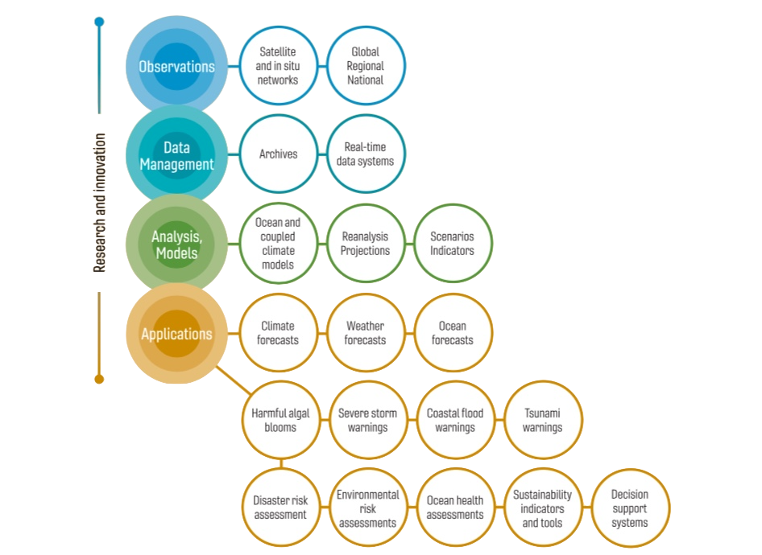
observations underpin solutions
Societal need for ocean information and services increasing exponentially
Drivers: (unavoidable) factors
Climate change - forecasts, adaptation, carbon storage...
Ocean management – ecosystem services, sustainable blue growth, biodiversity
Growth in the market across the value chain
Ocean observations are the foundation of downstream applications
GOOS 2030 Strategy
Vision: an expanded & integrated system

Slide 3
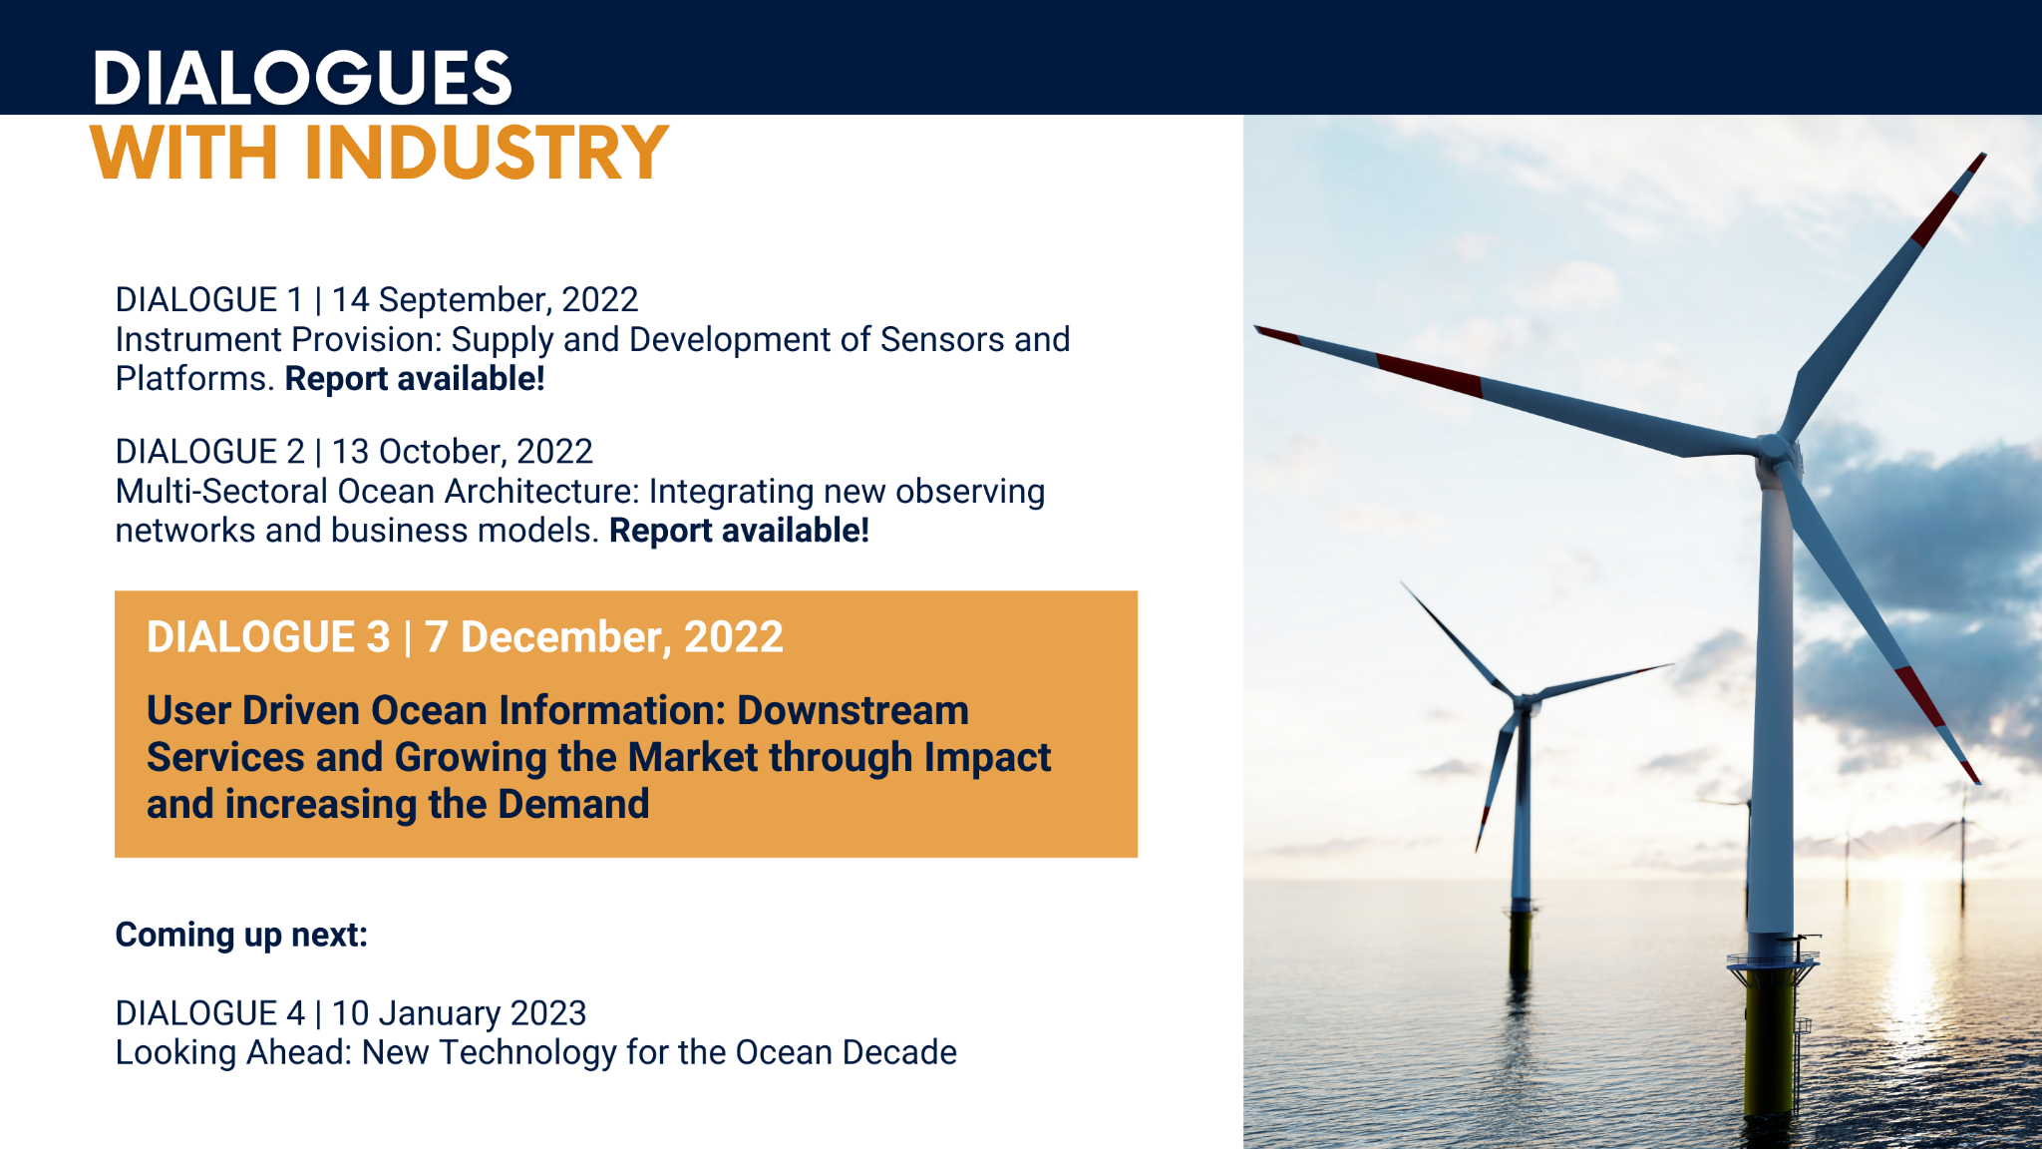
Why?
Identify opportunities
Lower barriers
Market immaturity inhibits the speed and efficiency of system development
New technology needed, but no established fast-track for technology
Current global effort will not be enough, need a step change across the value chain and wider participation than science
Dialogues with Industry set out to connect the public and private sector stakeholders in the Global Ocean Observing System – across the value chain
Aim: expand ocean observations, expand the market for the private sector, expand the Ocean Enterprise
Notes:
A quick re-cap of why we embarked on this effort
We wanted to really develop a systematic, and that's key, systematic mechanism for information sharing across the public, private, and academia, and highlight opportunities where we could act together for mutual benefit
We learned through this effort that terminology continues to be confusing.
But I wanted to make sure we understand the term Ocean Enterprise.
The Ocean Enterprise includes all entities in the public, private, nonprofit/NGO, research and academic sectors that provide infrastructure and capacity for ocean observation, measurement, and forecasting, or who deliver operational ocean information services
This is the premise of the effort to identify those opportunities, identify and then lower the barriers, and to be able to meet the new demands that are going to be required of the ocean observing system. How do we mature this enterprise? What are the market inhibitions? How do we speed up technology to market, and how do we do that in a coherent and cohesive way?

Slide 4
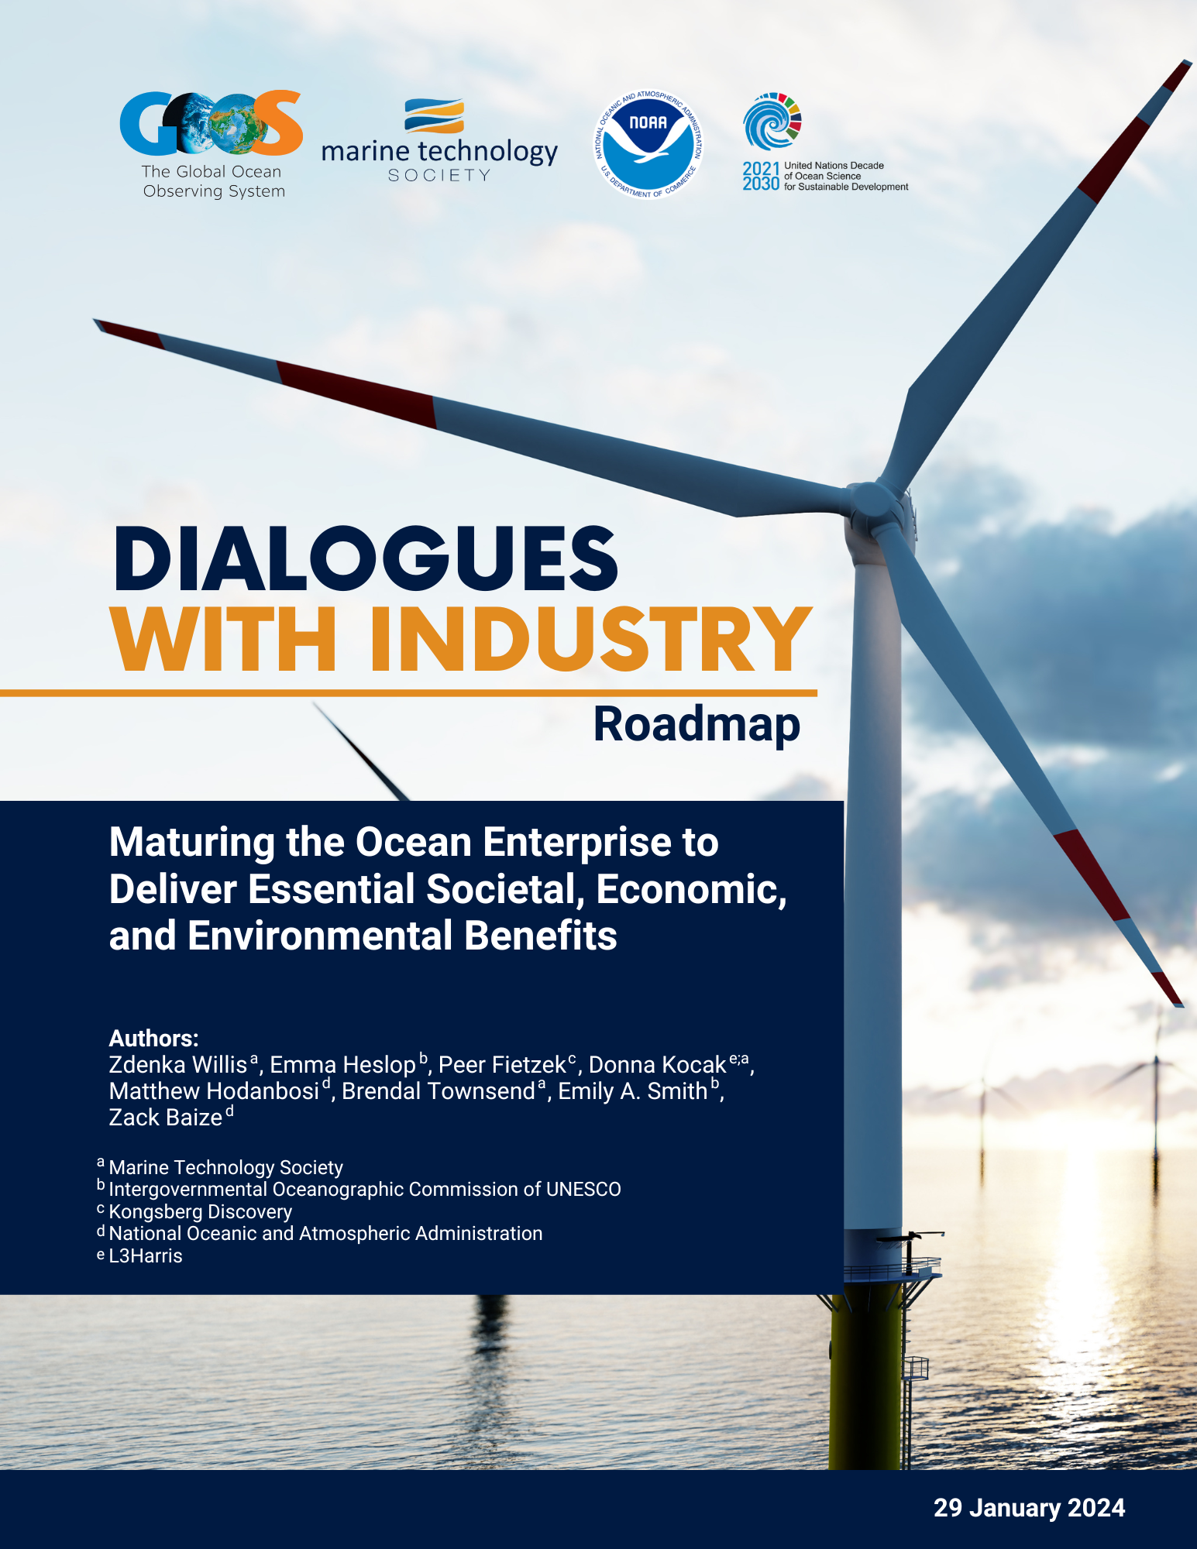
The Roadmap
Key takeaways synthesized into the Roadmap:
Ocean observing and services not seen as independent market
Articulating market size will help drive investment
Lack of sustained funding stymies growth
Lack of standards a barrier to accelerating the Ocean Enterprise
Aggregation of demand a barrier to the Ocean Enterprise
Ocean observing can de-risk Blue investment
Perception change needed from being peripheral to essential
Data as a service – a paradigm shift

Slide 5


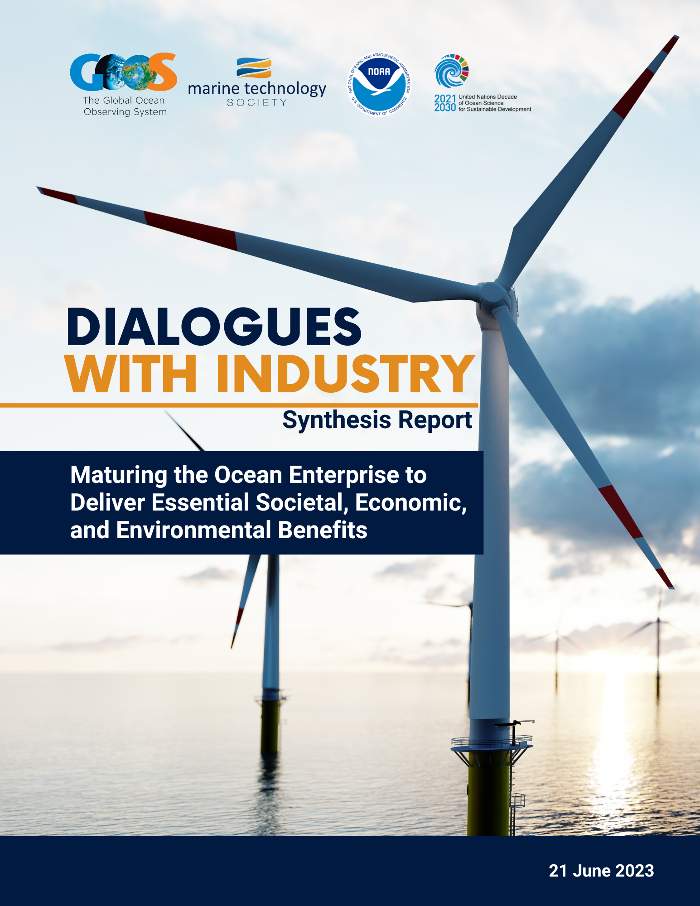





Roadmap Development
44 pathways evaluated:
Ease of implementation
Level of impact
Overall priority
26 priorities
Addressing
10 challenges
3 Priority Areas
Consultations with stakeholders in 2023

Slide 6



Roadmap – Goals
ESSENTIAL SERVICE
VISIBLE ENTERPRISE
DISTINCT MARKET
Ocean Enterprise recognized as essential to lives and livelihoods; ocean knowledge, products, and services are no longer peripheral
Contribution to the global GDP understood
The ocean observing, products and services sector is identified as a distinct market sector

Slide 7
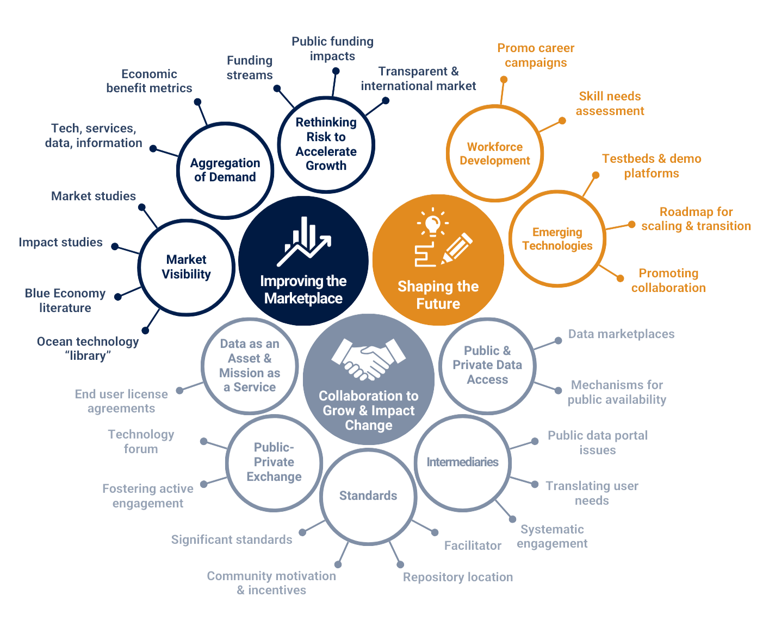
Roadmap - Structure
Notes:
Core – 3 Priority areas
10 - Challenges
Multiple potential Action pathways to tackle the challenges and make change for the priority pathways... with partners...

Slide 8
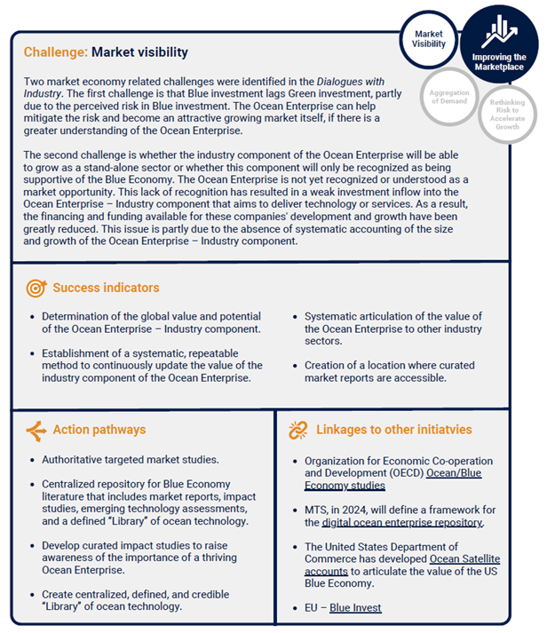
Roadmap Guide - Challenge Areas
Definition of the challenge
Indicators to evaluate success
Action pathways to tackle the challenge
Linkages to other initiatives - invitation to support change

Slide 9

What next - Implementation
01
Ocean Enterprise Initiative - MTS & GOOS will work together to develop actions with a global focus, 4 years funding through IOOS/NOAA, hosted by MTS
Grand Volume
02
New governance, structure, web page - Core Team, new Advisory Committee, support for GOOS, Dialogues will be come a part of the tools
03
Ocean Enterprise Initiative will undertaken some elements, partners already requesting to join, monitor implementation against the Roadmap

Slide 10
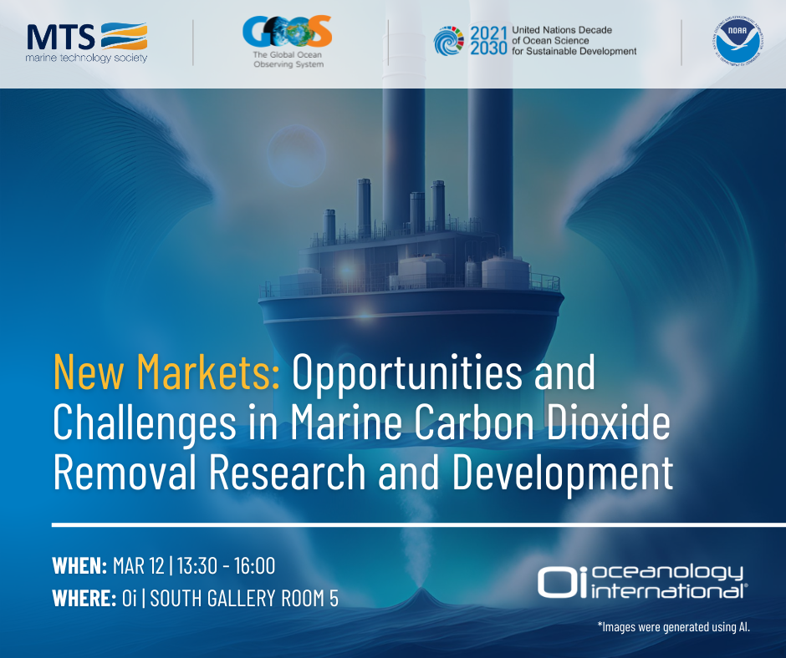
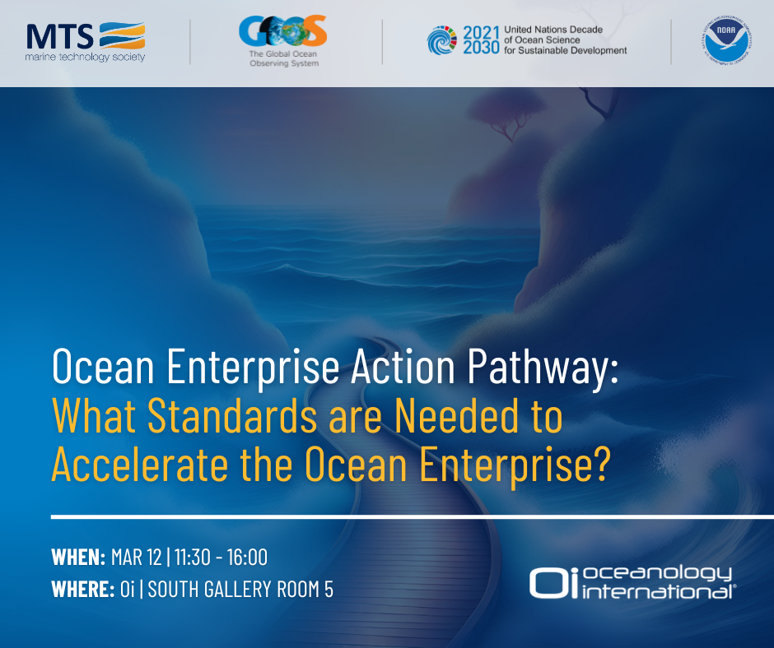

2024/2025 Ocean Enterprise Initiative
Key action areas to address the Roadmap:
Dialogues with Industry – expands the signature program of curated topical sessions around issues, next technology needed - agree across industry, science and government targets/approaches
Standards – ongoing work, select areas to address first, work with partners (IEEE)
Ocean Enterprise Hub – digital resource, interactive ocean library to include all market and summary analysis reports
Workforce development
Partners, communication, global meeting,

Slide 11


Dialogues - Tech Surges
Bio-Diversity Tech
Jun 2023
BioEco Panel
HAB Tech
Oct 2024
Cost Efficient Tech
Dec-Feb 2025
Decade Team
Carbon Obs Tech
March 2024
BGC Panel
Standards
Oi Session results – discuss/select focus
Define next steps, areas, partners
Digital Hub
Develop digital hub, market reports
Work Force
Virtual Job Fair, OCEANS Halifax
Partners, Comms, governance
Form Advisory Group
Define partners, Develop web site
Develop partners - context of the Roadmap
Track progress initial initiatives

Slide 12
Benefits
Visibility of ocean observing needs
New conversations, with new government sectors, about ocean observing as a part of economy/market
Industry as a partner and advocate
Get technology we need, faster, and at ‘agreed’ cost, work with industry and government to find solutions
Move ocean observing towards being seen as critical infrastructure
Support to develop standards – e.g. metadata encoded at sensors
More career opportunities
Support to GOOS from the Ocean Enterprise Initiative to support the engagement and guiding input from community
Some change needed – agreeing on needs/compromise, market size (to be worked out)
Notes:
A quick re-cap of why we embarked on this effort
We wanted to really develop a systematic, and that's key, systematic mechanism for information sharing across the public, private, and academia, and highlight opportunities where we could act together for mutual benefit
We learned through this effort that terminology continues to be confusing.
But I wanted to make sure we understand the term Ocean Enterprise.
The Ocean Enterprise includes all entities in the public, private, nonprofit/NGO, research and academic sectors that provide infrastructure and capacity for ocean observation, measurement, and forecasting, or who deliver operational ocean information services
This is the premise of the effort to identify those opportunities, identify and then lower the barriers, and to be able to meet the new demands that are going to be required of the ocean observing system. How do we mature this enterprise? What are the market inhibitions? How do we speed up technology to market, and how do we do that in a coherent and cohesive way?

Slide 13
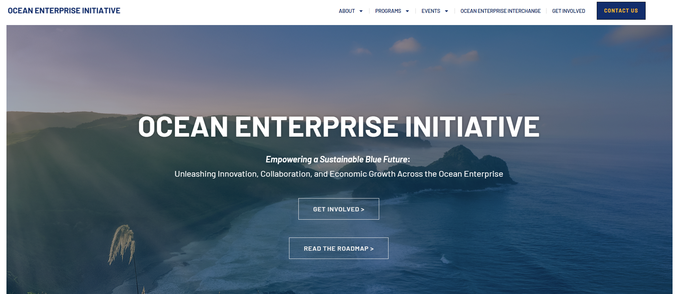

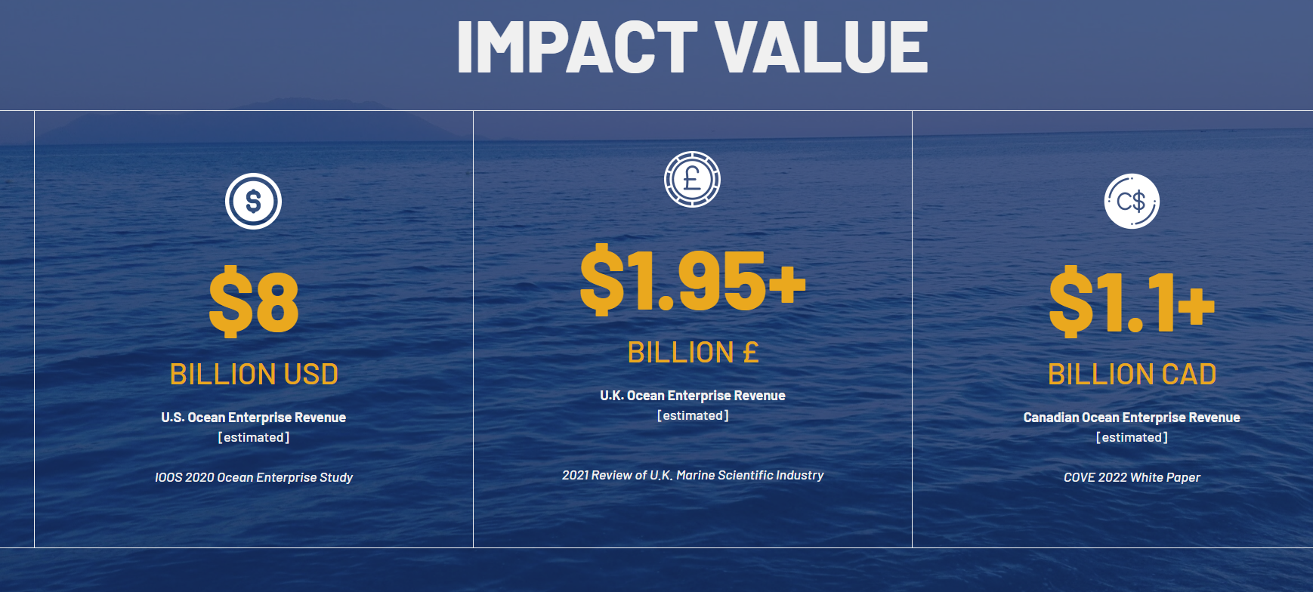
Shape the Ocean Enterprise Initiative
oceanenterprise .com
Seeking members to form the Advisory Group
Express interest in particular dialogues/action pathways
Connect to standards work
engage with next generation ‘dialogues'
Tell us about your Ocean Enterprise efforts so we can link
Notes:
Seeking members to expand the steering team
Express your interest on particular action pathways
Tell us about your Ocean Enterprise efforts so we can link up
Let's Mature the Ocean Enterprise together

Slide 14

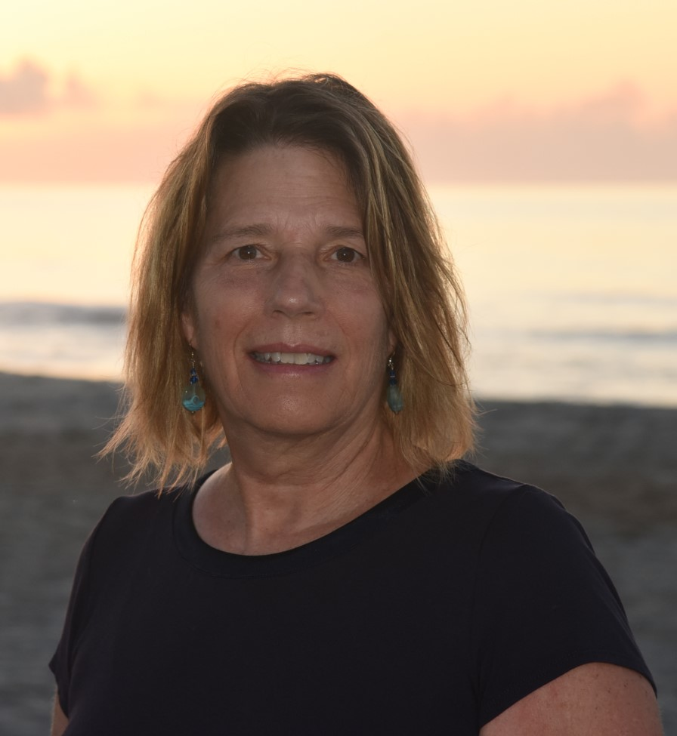


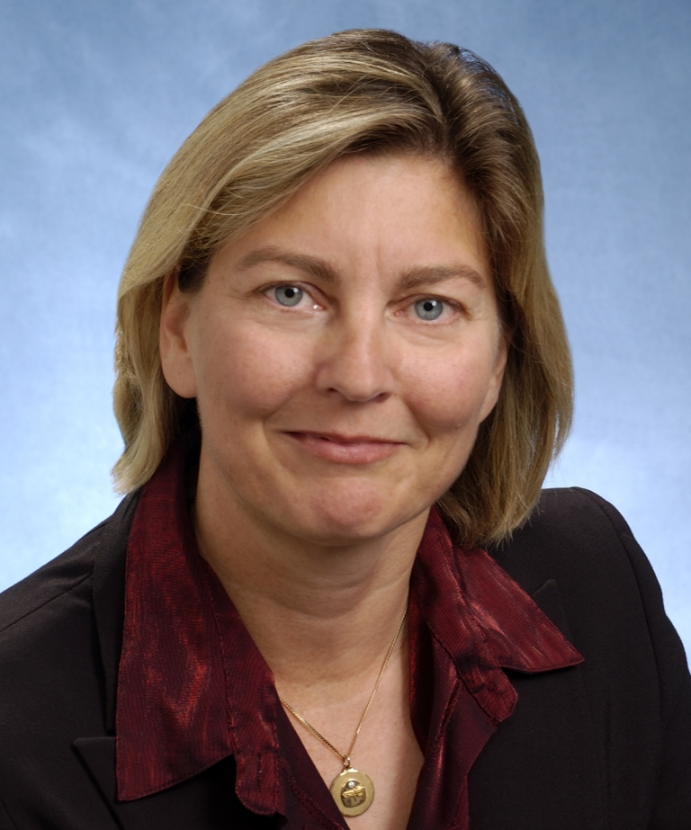

Core Team
Dr Emma Heslop
Program Specialist Global Ocean Observing System (GOOS)
IOC/UNESCO
Zdenka Willis
Past President
Marine Technology Society
Act. Dir Ocean Enterprise Initiative
Zach Baize
Program Manager
NOAA Blue Economy Program
Peer Fietzek
Snr. Business Development Mgr.
Ocean Science
Kongsberg Discovery
Donna Kocak
Fellow, Senior Scientist
Innovation Strategy Lead
L3Harris
  Caisey Hoffman Manager

