Slide 1
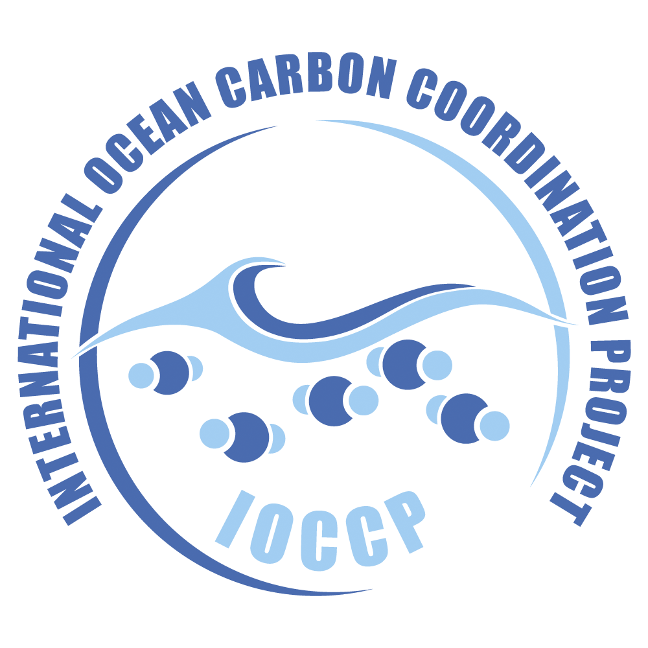
Emerging Network Session, OCG-15
Adrienne Sutton, GOOS Biogeochemistry Panel co-Chair,
NOAA, USA
Maciej Telszewski, GOOS BGC Panel, IO PAN, Poland
Véronique Garçon, GOOS BGC Panel co-Chair, IPGP, France
Richard Sanders, Expert on Surface Ocean Biogeochemistry
Observations of GOOS BGC Panel, NORCE, Norway

Slide 2
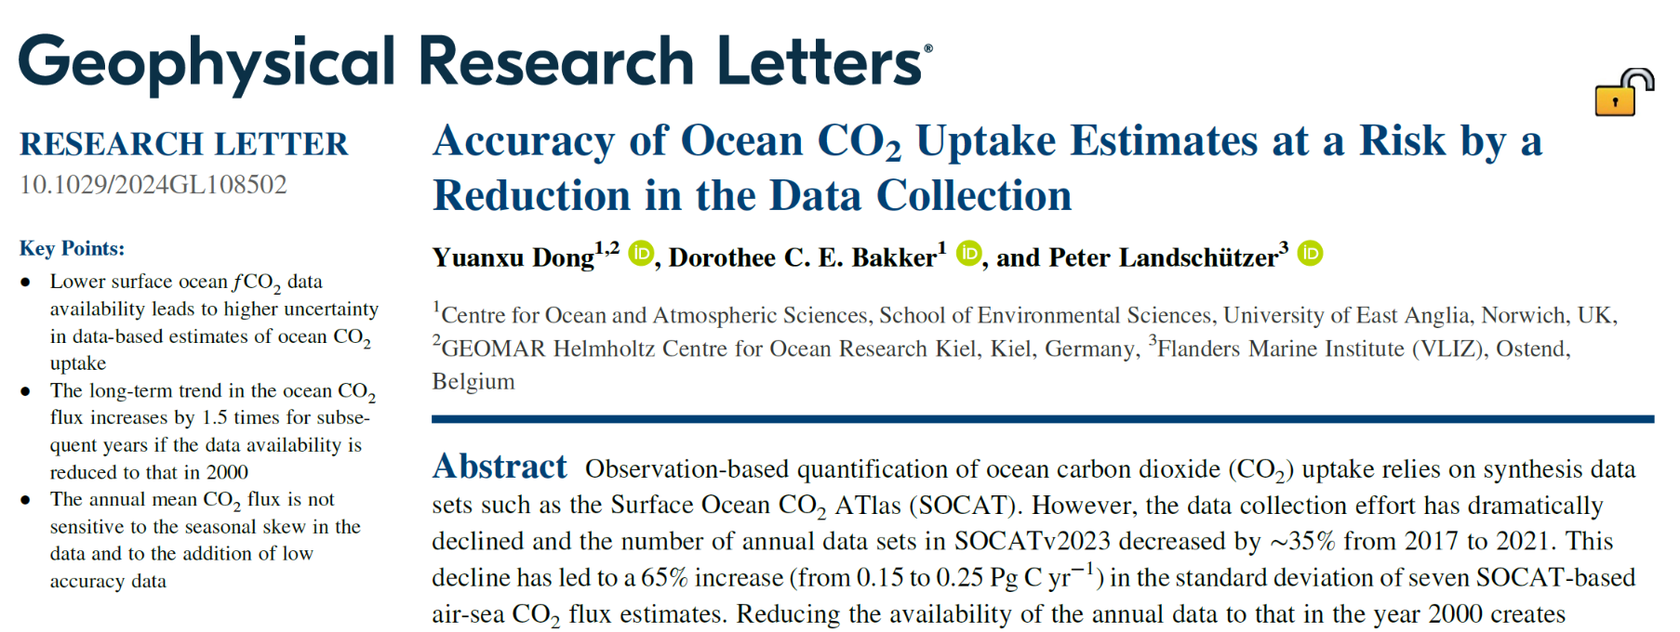
Motivation
2018
COVID
Recent decline in pCO₂ observations
# obs in SOCAT
published in April

Slide 3
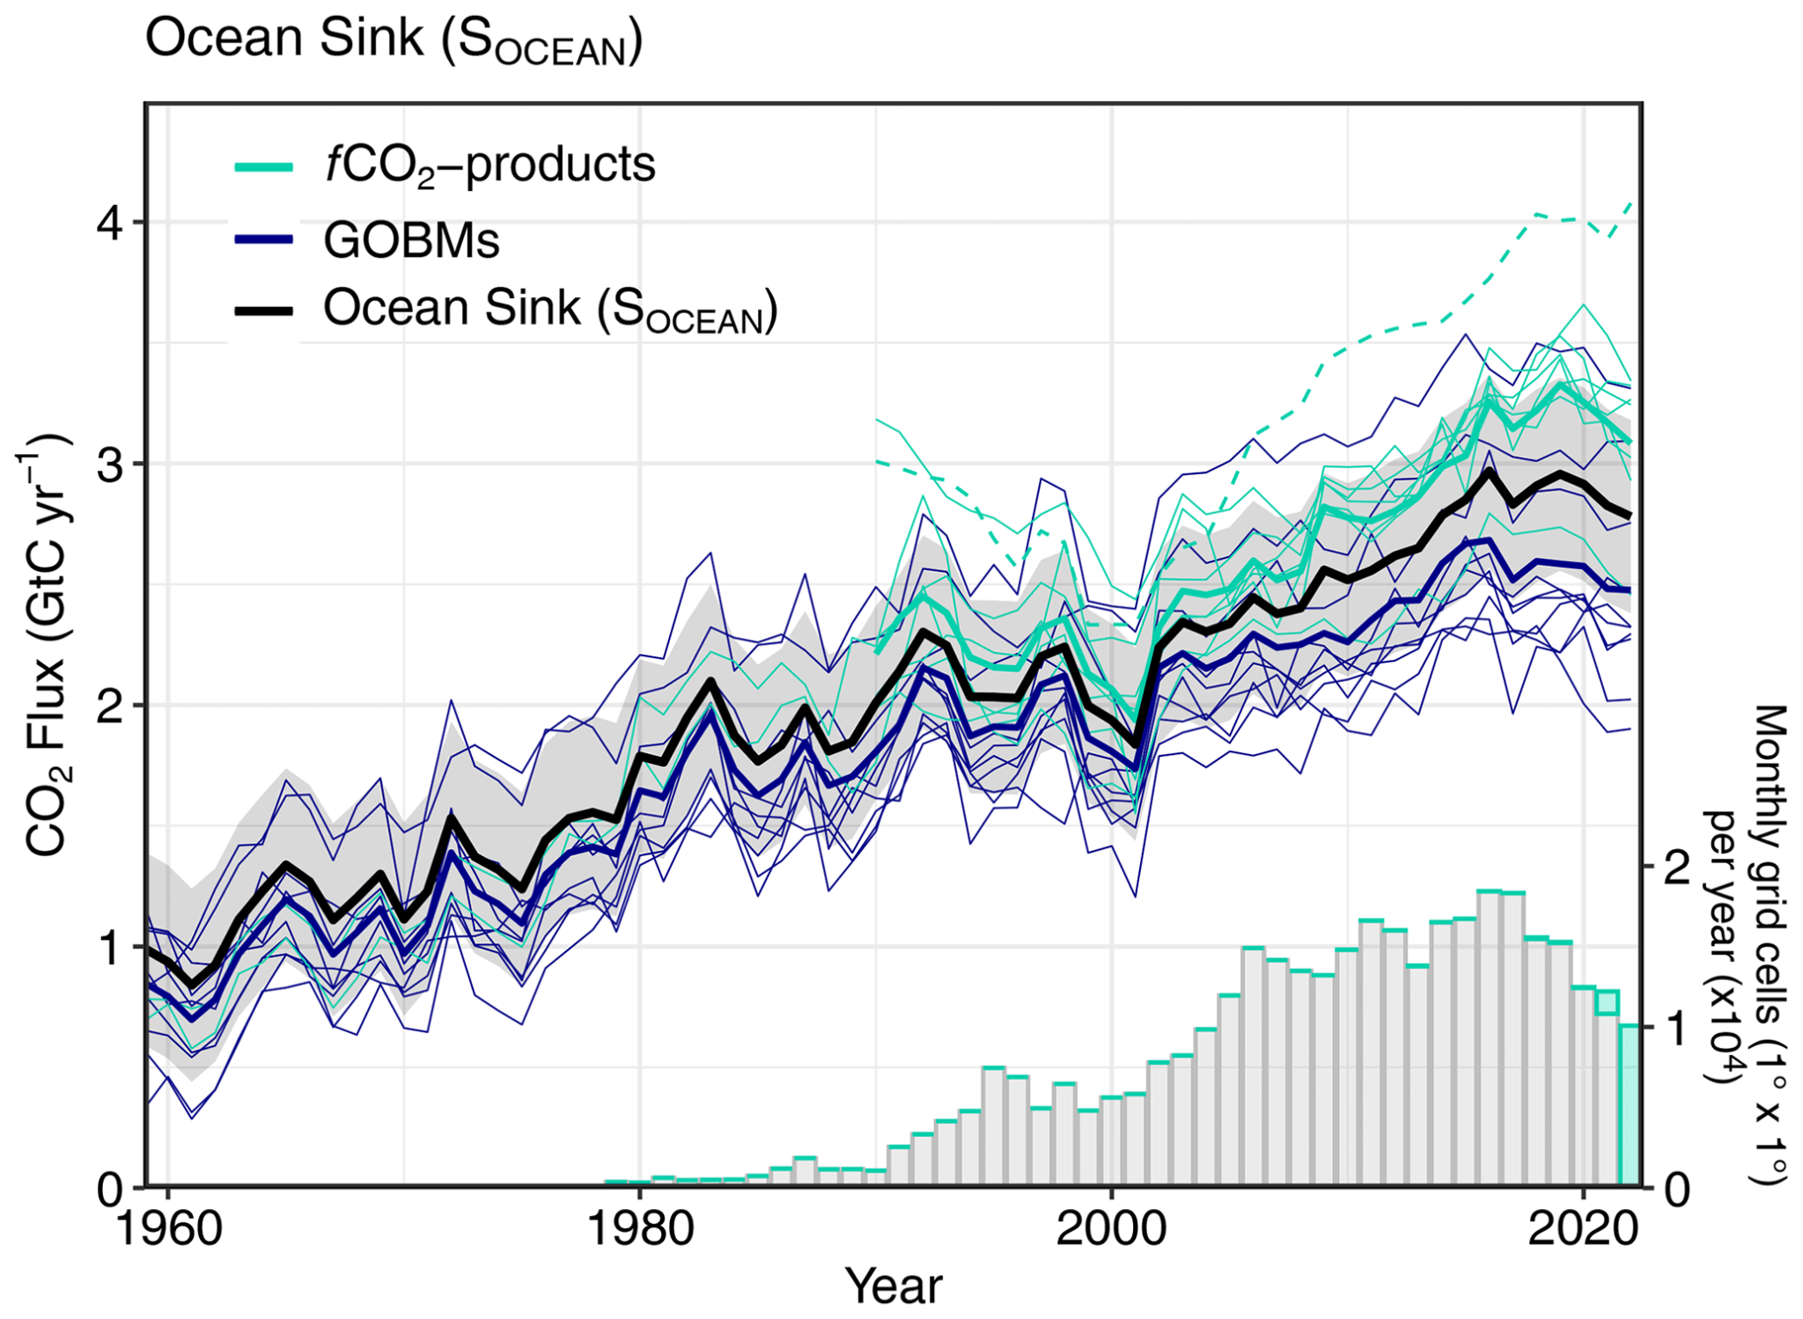
Motivation
2018
COVID
Recent decline in pCO₂ observations
Recent divergence of obs- and model- based ocean CO₂ sink estimates
# obs in SOCAT
GCOS and WMO Global Greenhouse Gas Watch implementation plans

Slide 4
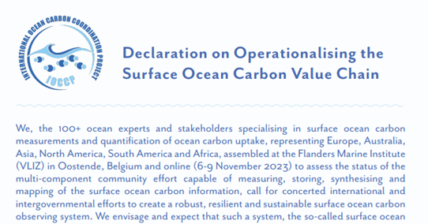
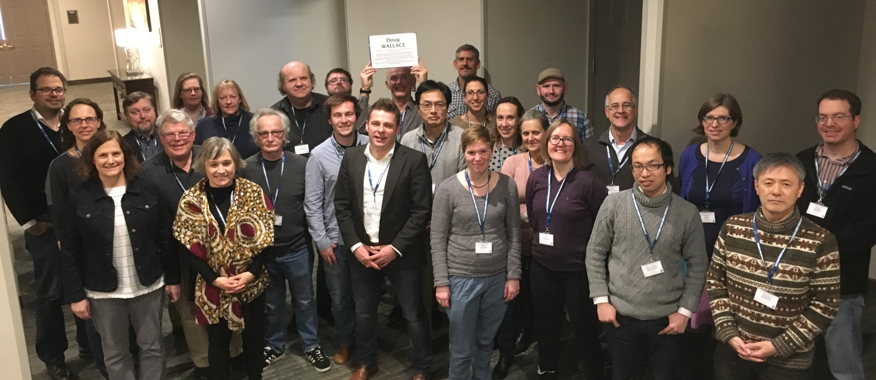
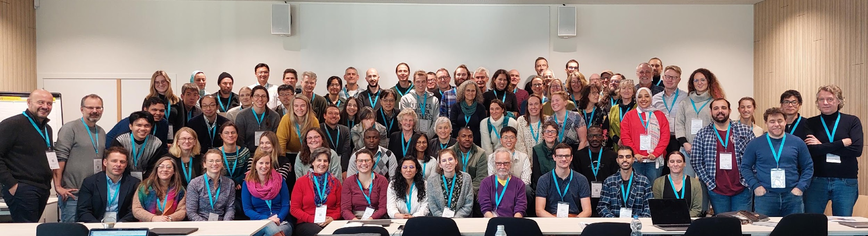
SOCONET history

Slide 5
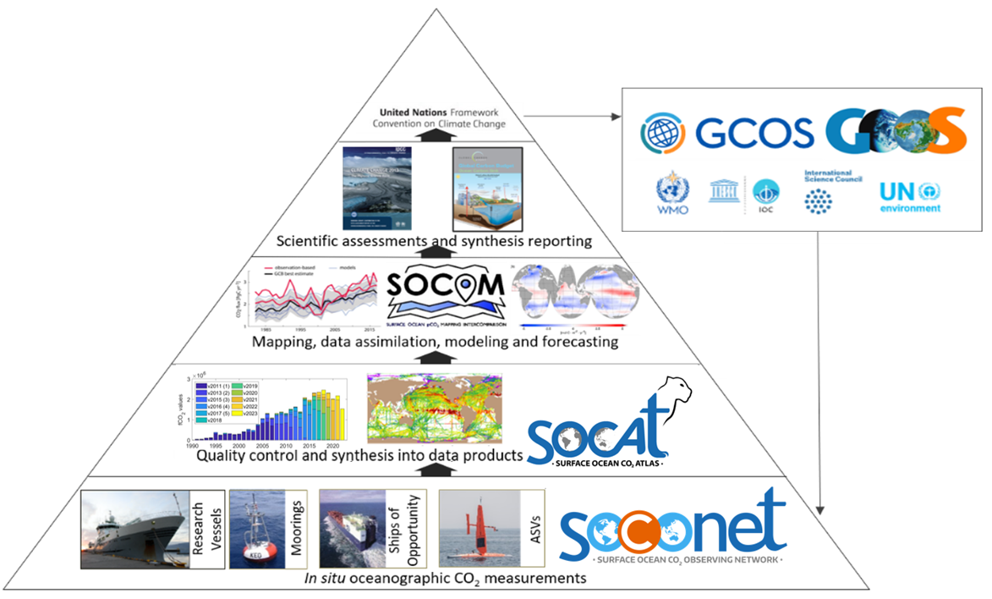
What is SOCONET?
SOCONET is a thematic, cross-platform EOV-based network (CO₂*), that will work with existing OCG networks
such as GO-SHIP, SOOP, and OceanSITES, and potential
future networks like USV
* direct measurements of surface ocean CO₂
Modified from Guidi et al. (2020)

Slide 6
What is SOCONET?
Data to information pipeline already
established
Community has been developing best practices through SOCAT
for the last 20 years, but
additional focus on SOPs
and capacity building
is needed
Modified from Guidi et al. (2020)

Slide 7
Attributes
OCG Network Attributes | SOCONET alignment
Global in scale | Global coverage with ships, moorings, uncrewed surface vehicles (USVs)
Observes one or more EOVs/ECVs | Inorganic Carbon
Observations are sustained | Back to 1990
Community of Practice | Build off Workshops on Surface Ocean pCO₂ Observations, incl creating a Steering Cmte
Maintains network missions/targets | To be included in SOCONET Implementation Plan
Delivers data that are free, open and available in timely manner | Continued submission through the established SOCAT data system and NODCs
Ensures metadata quality and delivery | Metadata are delivered to SOCAT and NODCs, and will be augmented, if needed, for OceanOPS metadata requirements
Develops Standards and Best Practices | Standards and best practices will be collated and updated in SOCONET Implementation Plan
Undertakes capacity development | Some currently, but more needed to elevate quality and provide assistance to under-resourced groups to entrain additional platforms into the network
Environmental stewardship | Sustained observations from SOCONET are a key for stewardship of marine resources and assessing impacts of ocean acidification, autonomous platforms offer lower carbon footprint

Slide 8
Initial Objectives (years 1-5)
Community of practice formalizing structures
Near-real-time platform tracking and annual metrics on data quality/quantity
Network provides resources towards OceanOPS platform tracking
Identify near-real-time data delivery needs (e.g., G3W)
Develop SOPs and continue intercomparison exercises
Mutual aid, exchange and assistance for technical issues in operations
Support for capacity building focused on elevating quality and entraining additional platforms into the network
Provide guidance to the community on new platforms, sensors, and protocols
e.g., N₂O and CH₄, derived pCO₂

Slide 9
Current Focus
Formal integration of SOCONET into the GOOS OCG
Formalize and convene SOCONET Steering Committee
Unofficial interim SC is currently writing grants and taking stocktake of SOCONET observing assets
Develop SOCONET Implementation Plan, including network mission, targets, and design
Serve metadata and perform platform tracking through OceanOPS - NOAA pilot

