Slide 1
Service Level Agreements with OceanOPS Establishing frameworks for collaborations
OCG-15 Session, 13-17 May, 2024
ONC, Victoria, British Columbia, Canada
OCG-15 Session, 13-17 May, 2024
ONC, Victoria, British Columbia, Canada

Slide 2
Session goals:
Define the purpose and scope of SLAs between OceanOPS and its stakeholders.
Present the classification of services offered by OceanOPS at different levels.
Discuss the potential impact of SLAs on resource allocation and budget planning.
Outline the implementation plan for establishing and reviewing SLAs with OCG networks.
Encourage active participation and feedback from OCG for successful SLAs development and execution.
Note:
Check the background doc, posters and add suggestions

Slide 3
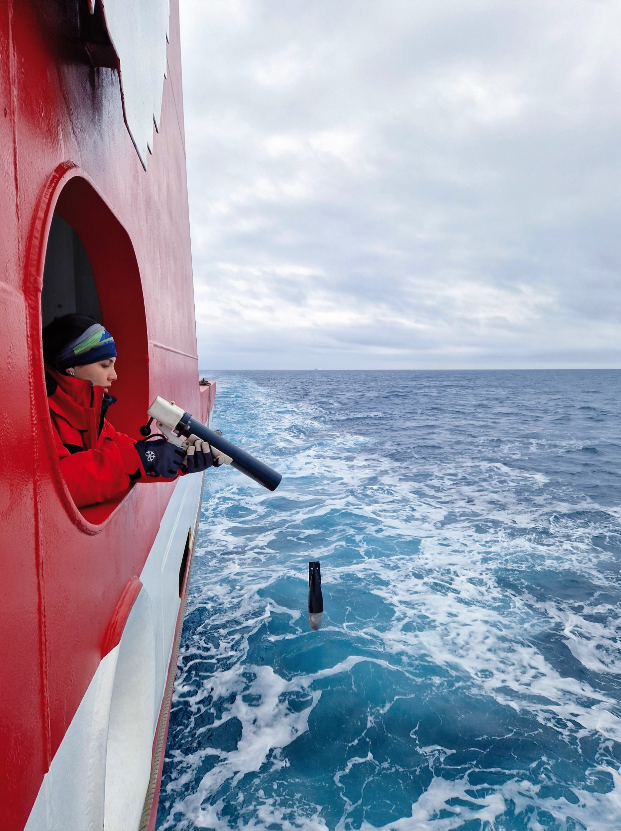
Background
“Develop agreements with OCG networks, emerging networks and other end-users for the system
to set boundaries and expectations for OceanOPS”
OceanOPS 5-year Strategic Plan
Why do we need SLAs ?
Recommendation from the 2018 JCOMMOPS Review
Alignment with OceanOPS 2021-2025 Strategic Plan
Emphasized in the 2024 OceanOPS restructuring
SLAs objectives & benefits:
Define core services and network specific activities.
Specify timelines and requirements for both parties.
Ensure transparency and collaboration across networks.
Essential for fundraising and attracting sponsorships.
Enhances delivery efficiency and resource allocation.
Beneficiaries:
Observing platforms operators, Networks, GOOS governing bodies, data users, Members States, EU, industry, civil society, and all new GOOS implementers.

Slide 4
Classification of Services for Networks
Service levels:
Level 1: Basic monitoring.
Level 2: Routine monitoring and technical support (dedicated ¼ FTE).
Level 3: Routine monitoring, technical, and operational support (dedicated ½ FTE).
Level 4: Advanced routine monitoring, technical, and operational support (dedicated ¾ FTE).
Level 5: Advanced operational monitoring and technical support (dedicated FTE).
Service categories - aligned with OceanOPS 5-year strategy:
Monitoring & Reporting.
Data & Metadata.
Technical support.
Operational support.
These categories encompass most existing services, including network-specific activities, even if not explicitly mentioned.

Slide 5
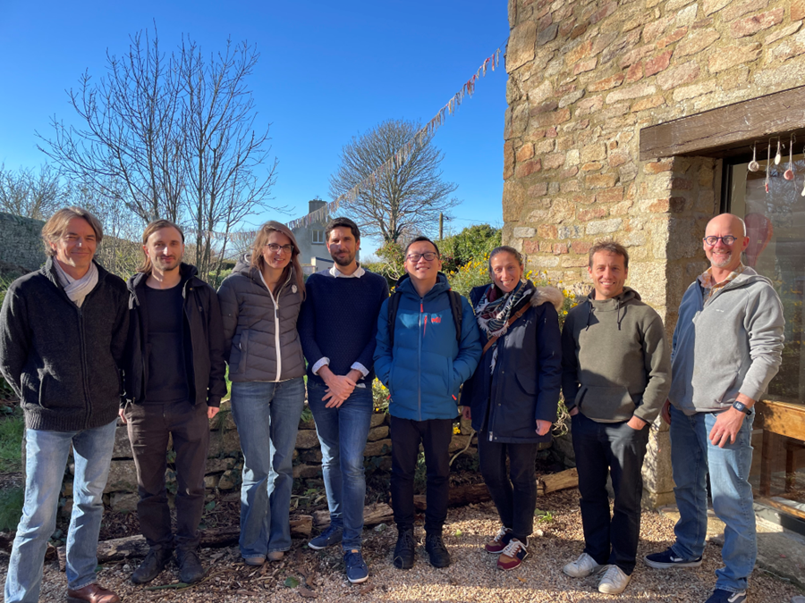
Level 1 – Services Overview
Monitoring & Reporting
Basic monitoring tools: maps, stats (yearly update).
Visibility on OceanOPS website and availability of common integrated tools.
Visibility in yearly Report Card and OceanOPS integrated reports.
Data & Metadata
Basic metadata management (minimum requirements: unique ID, program).
Yearly update from a single node (already aggregated).
API/GUI for unique ID allocations.
Metadata delivered via API, and to OSCAR if quality criterion met.
Technical Support
Support/guidance for networks integrating GOOS (OCG) and meeting its requirements.
Support for metadata workflow.
Guidance for data distribution.
Network promotion, support to new Members, international cooperation.

Slide 6
Level 2 – Services Overview
Includes Level 1 + additional services
Monitoring & Reporting
Routine (RT/monthly/yearly) monitoring tools: maps, stats, KPIs.
Visibility on OceanOPS website and availability of dedicated tools.
Visibility in yearly Report Card and OceanOPS integrated reports.
Status report in semi-annual technical bulletins.
Basic yearly report to Steering Team.
Data & Metadata
Metadata management (standard requirements: unique ID, controlled vocabulary, mandatory attributes - monthly update).
Metadata monitoring, quality control, regular update from multiple nodes (integration but no curation).
API/GUI for unique ID allocations.
Metadata delivered via API, and to OSCAR.
Monitoring of data made available on global nodes (Web and GTS).
Technical Support
Support/guidance for integrating GOOS (OCG) and meeting its requirements.
Support for metadata workflow.
Support for data flow (brokering).
Helpdesk/clearing house and technical coordination/project office support, with dedicated focal point (¼ FTE).
Participation in yearly sessions (travel, reporting), mailing lists.
Network promotion, support to new Members, international cooperation.

Slide 7
Level 3 – Services Overview
Includes Level 2 + additional services
Monitoring & Reporting
Routine (RT/monthly/yearly) monitoring tools: maps, stats, KPIs.
Visibility on OceanOPS website and availability of dedicated tools.
Visibility in yearly Report Card and OceanOPS integrated reports.
Status report in semi-annual technical bulletins.
Detailed yearly report to Steering/Data Teams.
Data & Metadata
Metadata management (standard requirements: unique ID, controlled vocabulary, mandatory attributes).
Metadata active monitoring, quality control, and regular update from multiple nodes (integration and curation).
API for unique ID allocations.
Metadata delivered via API, and to OSCAR.
Monitoring of data made available on global nodes (Web and GTS).
Technical Support
Support/guidance for integrating GOOS (OCG) and meeting its requirements.
Support for metadata workflow.
Support for data flow (brokering) and processing chains (formats, audits standardization).
Helpdesk/clearing house and technical coordination/project office support, with dedicated focal point (½ FTE).
Participation in yearly sessions, exec board (travel, reporting), mailing lists.
Network promotion, support to new Members, international cooperation, newsletter.
Operational Support
Coordination of operations (planning, opportunities).
Expertise on instrumentation, training workshops organization.
Notifications/Alerts: instruments beaching, icing, retrieval, data/metadata flow and quality, EEZ notifications.
Tracking and organization of ship opportunities, and partnerships (shipping).
Feedback loop from users to producers (data quality, WMO WDQMS).

Slide 8
Level 4 – Services Overview
Includes Level 3 + additional services
Monitoring & Reporting
Routine (monthly and yearly) advanced monitoring tools, including real-time tracking: maps, stats (on implementation, instrumentation, operations, data flow), advanced KPIs.
Visibility on OceanOPS website and availability of dedicated web-based advanced tools (performance, planning, gap analysis, etc).
Visibility in yearly Report Card and OceanOPS integrated reports.
Detailed performance report in semi-annual bulletin.
Yearly advanced status report to SC/DM groups (including list of national contributions), and TT as required.
Data & Metadata
Advanced metadata management (standard/mandatory requirements + network specifics) and continuous improvement (including discussion with industry).
Metadata active monitoring, curation, and quality control, regular updates from multiple nodes integration.
Metadata management tools: GUI, web-based tools for machine-based upload in multiple formats (CSV, JSON, netCDF).
API/GUI for unique ID allocations.
Metadata delivered via API, and to OSCAR.
Operational monitoring of data flow on multiple global nodes (GTS, GDACs, RT/DM) - availability, timeliness, quality, history.

Slide 9
Level 4 – Services Overview
Includes Level 3 + additional services
Technical Support
Active support for metadata workflow all along platforms lifecycle, including webinars/training sessions.
Active support for data flow (brokering) towards OCG data strategy and WIS 2.0.
Helpdesk/clearing house and project office/secretariat support, with dedicated focal point (¾ FTE) - active support to chairpersons and task teams.
Participation in yearly sessions (SC, DM, TT), exec boards: agendas, reports/minutes, mailing lists, and contact points management.
Contribution to bibliography monitoring (data uptake).
Network promotion, support to new Members, international cooperation (active development), regular visits to main partners.
Active communication, participation in brochure and newsletter production, partnerships, outreach.
Regular interactions with manufacturers (including dedicated travel).
Donor programmes, SOFF spec.
Operational Support
Coordination of operations (planning), regular roundtables on basin-based implementation, active deployments opportunities seeking from main hubs, support for logistics.
Expertise on instrumentation, training workshops organization.
Notifications/Alerts: instruments beaching/icing/retrieval, data/metadata flow and quality, EEZ notifications.
Tracking and organization of ship opportunities, including establishing dedicated charters and consortium on an ad hoc

Slide 10
Level 5 – Services Overview
Includes all Level 4 services + additional FTE delivered according to means.
Core Products included in SLAs requires meticulous planning, continuous monitoring, and collaborative efforts from OceanOPS team for optimal production and delivery:
Web-based monitoring dashboard(s)
Routine maps, statistics, performance indicators
WIGOS compliant metadata API
Yearly reports for Networks
Yearly financial report to OCG
Yearly work plan report to OCG
Yearly report for GOOS (on national contributions) - proposal from GOOS SC feedback)
Semestrial Technical Bulletin
Yearly Report Card
Quarterly basin-based coordination report

Slide 11
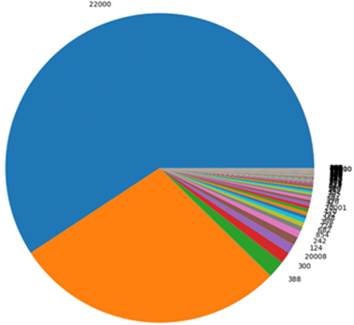
Services for IOC, WMO, GOOS, WIGOS, OCG ...
WMO/OSCAR full database distribution across all Earth monitoring system domains – +22,000 (blue) is coming from OceanOPS.
Monitoring & Reporting
Unique integrated view on GOOS.
Capability to report on Member/Region. contributions to GOOS/WIGOS.
Contribution to reports within IOC/WMO, UN framework.
Contribution to national reports.
Gap analysis in context of co-design, RRR (EOV).
Production of GOOS Report Card.
Web-based dashboard with comprehensive features.
Data & Metadata
Harmonization/integration/quality control function.
Unique ID allocation API, GUI, documentation.
Contribution to WIGOS/OSCAR (and potentially to ODIS).
Monitoring and increase of data availability (quantity, quality) for users.
Support for Member States data processing capacity development.
Technical Support
Expertise "in the fields" on networks & GOOS
Participation in GOOS-SC, OCG, and related meetings
Participation in many WMO TT, SC, and WG (GBON, WIGOS, OSCAR/nextGen)
Development of international cooperation and partnerships
Implementation of EC IOC XLI-4 requirements and LoS expertise
Support to IOC and WMO secretariats
"Secretariat support" to Networks/OCG/GOOS
Communication on GOOS, IOC, WMO
Direct access to GOOS implementers

Slide 12
Cost Estimation & Flexibility
OceanOPS essentially relies on networks to provide support for dedicated resources, including travels, and participation in infrastructure and overhead costs.
Dedicated PM amount Y, for a contribution of X USD:
Y = 12((X/1.1) - 10,000) / 160,000
Customization: Service levels may vary based on network differences in platform numbers, data nodes, and integration needs.
Adaptability: The list of services in SLAs can vary, and additional deliverables may be included.
Refinement: Each SLA will undergo refinement tailored to the specific network's requirements. Can include in-kind remote staff, projects boost...
SLAs | 1 |  | 2 | 3 | 4 | 5
FTE | 0 | 0.125 | 0.25 | 0.5 | 0.75 | 1 | 1.25 | 1.5
PM | 0 | 1.5 | 3 | 6 | 9 | 12 | 15 | 20
FTE (USD) | 0 | 15,625 | 31,250 | 62,500 | 93,750 | 125,000 | 156,250 | 187,500
TRAVEL (USD) | 0 | 2,500 | 5,000 | 10,000 | 15,000 | 20,000 | 25,000 | 30,000
INFRA (USD) | 0 | 1,875 | 3,750 | 7,500 | 11,250 | 15,000 | 18,750 | 22,500
SUBSCRIPTION (USD) | 10,000 | 10,000 | 10,000 | 10,000 | 10,000 | 10,000 | 10,000 | 10,000
OVERHEADS (USD) | 1,000 | 3,000 | 5,000 | 9,000 | 13,000 | 17,000 | 21,000 | 25,000
TOTAL (USD) | 11,000 | 33,000 | 55,000 | 99,000 | 143,000 | 187,000 | 231,000 | 275,000

Slide 13
Average contributions by Networks over 2022-2024
Networks | 2022-24 Average contribution including EU Projects | 2022-24 Average contribution | Contributors
DBCP | $91,211 | $91,211 | Australia, Canada, EUMETNET, India, US
Argo** | $179,999 | $178,145 | Australia, China, Euro-Argo, EuroArgo RISE Project, France, Germany, India, Italy, Japan, Monaco, UK, US …
SOT | $79,910 | $79,910 | Australia, Germany, EUMETNET, US
OceanSITES | $33,795 | $32,189 | Australia, EuroSea, France, US
GO-SHIP | $50,920 | $24,709 | Australia, EuroGOSHIP, EuroSea, US
OceanGliders | $46,734 | $25,425 | EuroSea, GROOM, US
SOCONET* | $30,000 | $30,000 | US, EU project submitted (TRICUSO)
Total Networks | $512,569 | $461,588
OceanOPS | $538,958 | $465,096 | AMRIT Project, EmodNET, EuroSea Project, France, Monaco, TRUSTED Project, US, WMO EU project submitted (AMRIT C2)
TOTAL | $1,051,527 | $926,684
*In 2024, a new contribution of 30 k$ towards SOCONET is expected ** in 2024 a new contribution of 30 k$ towards Argo (BGC) expected see Financial report (item 17)

Slide 14
Implementation Plan & Reporting
SLAs implementation timeline:
During the annual OCG session at year N, identify candidates, establish an SLA baseline for year N+1 based on contributions received at year N and/or N-1.
Once both parties are satisfied with the SLA, it can be signed for implementation at year N+1.
A critical mass might be needed to see substantial changes happening. Implementation might be delayed.
Planning/Executing/Monitoring/Reporting
OceanOPS will implement project management tools to effectively plan, monitor, and report on the development of its strategic plan, core services and products included in SLAs, and project development, ensuring transparency throughout the process.
Use the identified list of products as milestones for delivery (KPIs), complemented by a report on the staff time and feedback ("customer satisfaction") from each network.

Slide 15
Conclusion
Principles of SLAs:
Simple and adaptable, based on flexibility, transparency, service quality, equity, and integration.
Benefits:
Clearly defined responsibilities and expectations for both OceanOPS and its stakeholders.
Fostered communication, collaboration and transparency.
Enhanced service quality.
Efficient resource allocation.
Continuous improvement in service delivery, ensuring that the evolving needs of networks are effectively addressed.
Next steps & questions for OCG:
Gather feedback from OCG, Networks, IOC/WMO on the draft document, on services, priorities
OceanOPS and each Network to collaborate in the second semester of 2024 to refine SLAs and highlight network-specific requirements.
No SLA with OceanOPS means no support to Network – yes but ? (projects, ad hoc, in-kind, etc. Creativity!)

Slide 16
Risks
Some challenges/risks identified for OceanOPS are OCG and GOOS challenges
Growth without resources
Degrowth
Lack of equity
Lack of prioritization
Lack of solidarity
Where is the right equilibrium point ?
Secure core services (and cut where needed) and when done
Re-establish quickly but carefully some kind of incremental growth - where there is potential, appetite.

Slide 17
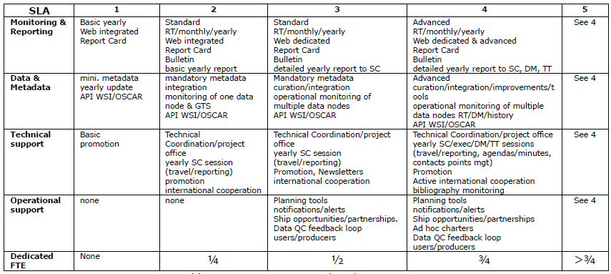
Review & Discussion
Principles of SLAs: Simple and adaptable, based on flexibility, transparency, service quality, equity, and integration
Candidates ? Argo, DBCP (4), SOT (3), OceanSITES, OceanGliders, GO-SHIP, SOCONET, any other ?

Slide 18
Thank you OceanOPS metadata are just information needed for international and technical coordination, i.e. for developing services and decision-making tools useful to operators and governance, for an efficient, transparent and integrated GOOS.

