Slide 1
OceanOPS Restructuring progress
OceanOPS management board
OCG-15, 15 May 2024
Observations
Coordination Group

Slide 2
Governance of OceanOPS
OceanOPS
management board
Observations
Coordination Group
Work Plan
Financial
Administrative
Human
resources

Slide 3
Rationale for restructuring
Proposed staff restructuring of OceanOPS to match income trends and better position it for the future.
Implications for the services that OceanOPS supports
Income trends: constant level of sustained funding, with shift from network contributions to integrated contributions.
Cost trends: core OceanOPS staff grew to stabilize IT support and build integrated capacity.
Cost of core staff exceeds amount of stable income. One-off contributions and projects have filled the gap. Other activities have been squeezed. IT manager vacancy temporarily reduced budget pressure, creating other problems.
OceanOPS management board sought enhanced contributions starting late 2023 – but in March OCG Roundtable recommended the reduction of network expert staff positions from 3 to 2.
Both networks and staff concerned consulted.

Slide 4
Positioning OceanOPS for the future
Strategic considerations within GOOS development trends
Position OceanOPS for a digital future - requires a strong IT workforce
Develop a hybrid model - with further remote in-kind support opportunities
Strengthen the integrated model - scale economies, delivery to global scale, more effective delivery to networks
Scale support to Networks - according to means, and adapt

Slide 5
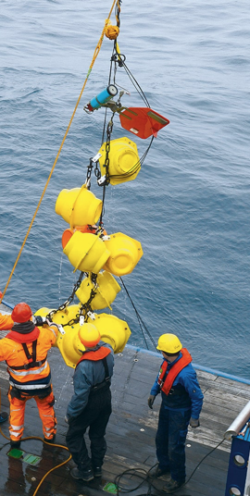
Restructured configuration of OceanOPS
OceanOPS Manager P4 Head of unit
M. Belbéoch
Administration & Communication
G4 E. Rusciano (IOC/UNESCO)
I.T. Manager
P2
to be recruited
Networks Coordinator
P2
comparative review process open to 3 present TCs
Metadata Expert G4
M. Krieger
Networks Coordinator
P2
comparative review process open to 3 present TCs
IT staff
Network experts

Slide 6
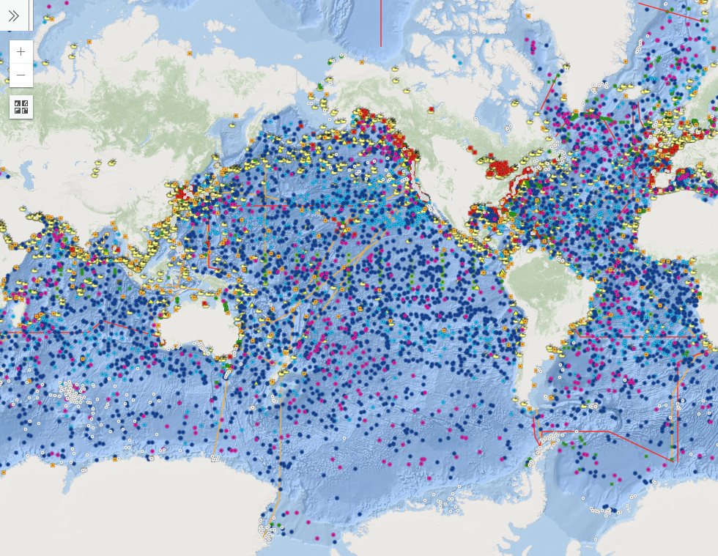
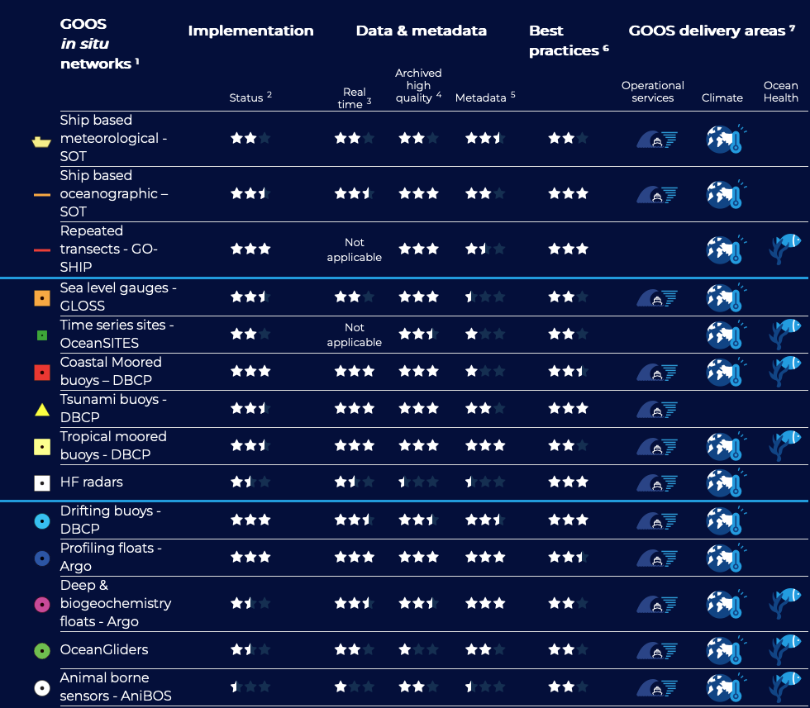
Feedback from the networks
The restructuring was accepted as being necessary by all OCG networks that provided feedback.
All of the networks emphasized the important role of OceanOPS; with a range of specific OceanOPS roles identified as important.
Useful in developing the SLAs that spell out specific future OceanOPS support and services. Development of common OceanOPS infrastructure and services in support of OCG networks requires increased consultation and discernment by the OCG and the Management Board.
Multiple networks highlighted the challenge of mobilizing needed support for OceanOPS, noting the importance of a clear value proposition for increased funding, and a coordinated approach towards potential sponsors

Slide 7
Staff restructuring process
May and June
Final recommendation to WMO Secretary-General by OceanOPS management board decided
WMO Human resources-led process: Job descriptions for posts in new structure will be established, affected staff members will be asked for their interest in position. Comparative review process with fixed criteria.
Should termination become necessary, affected staff will receive all entitlements (repatriation, termination indemnities, etc.) sourced from WMO common costs. These provide a substantial financial cushion to a terminated staff member, based on length of service.
Process to complete by end of June 2024.
Outlook
Restructuring doesn’t preclude re-opening or creation of new post(s) should the financial situation improve, and the management board agrees.

Slide 8
Thank you

