Slide 1
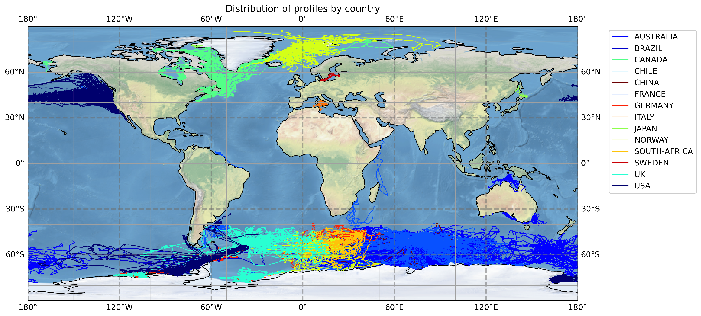
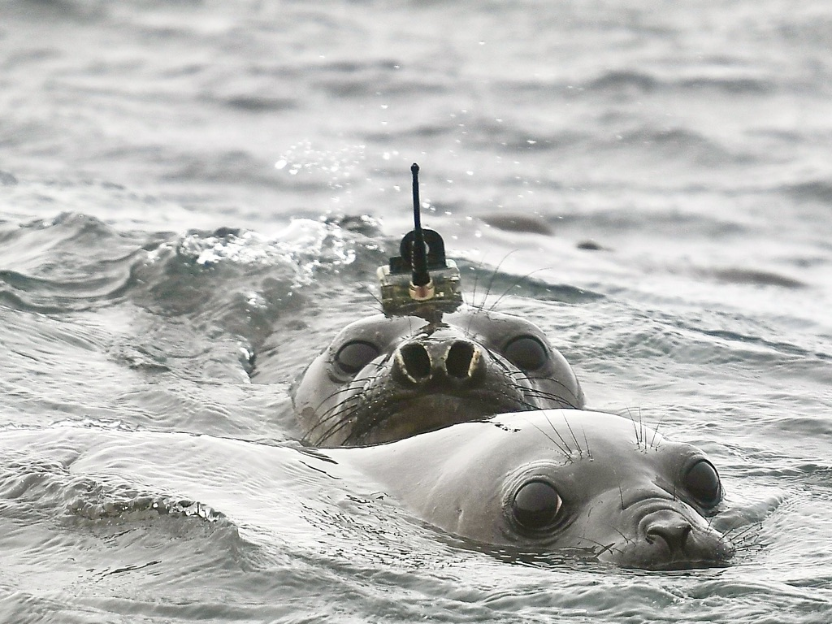
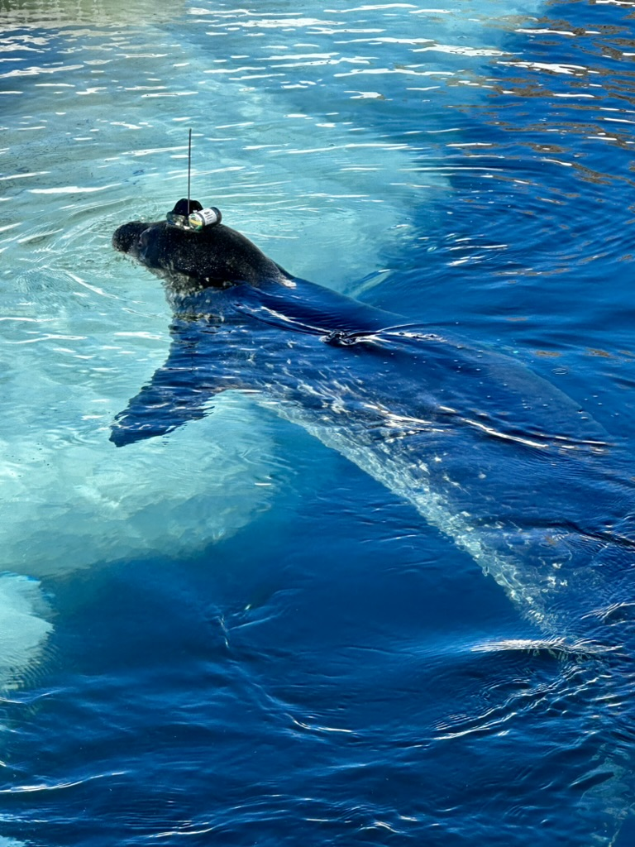
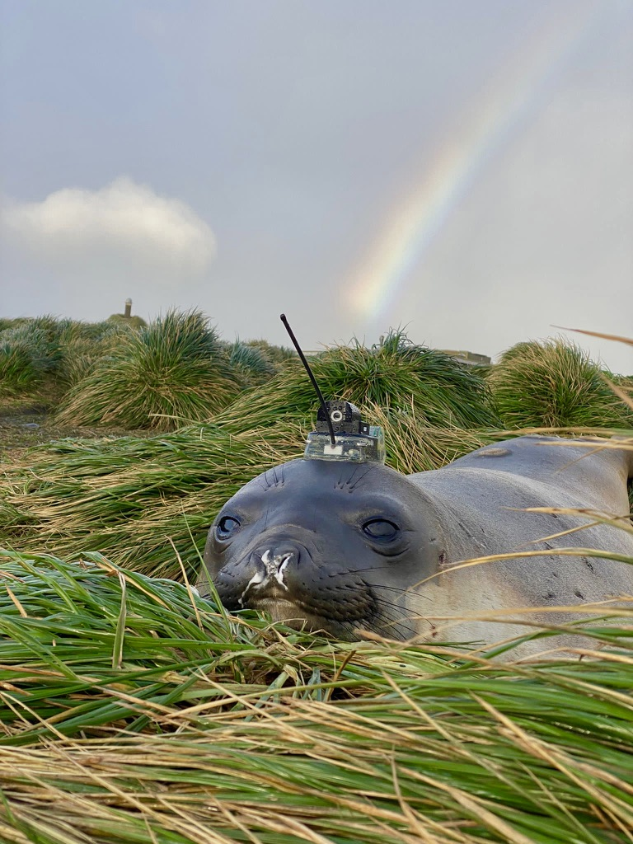
Observations Coordination Group (OCG)
Animal Borne Ocean Sensors – AniBOS
UN Decade – 101 Animal-Borne Ocean Sensors: A decadal vision through new eyes
Clive McMahon ¹ (clive.mcmahon@sims.org.au); Fabien Roquet² (Fabien.roquet@gu.se)
¹ IMOS Animal tagging, Sydney Institute of Marine Science | ² Gothenburg University
Highlights
AniiBOS is celebrating 20 years of continuous oceanographic (CTD) observations in the Southern Ocean.
In total over 800,000 vertical profiles of Temperature and Salinity (TS) have been collected, primarily by seals in the polar seas, since 2004
The MEOP-CTD database version 2024-03-08 is a major update on the previous version, with more than 150,000 new TS profiles made available freely. https://www.meop.net/news/
Funding has been secured to 2027 to deploy CTDs to seals in the Southern Ocean from IMO
IMOS has invested in an expanded (to 2027) animal borne ocean observing programme in the tropical seas to the north of Australia. This programme will deploy 20 CTDs on turtles in the Timor and Arafura seas
Future Plans and Opportunities
Integrating physics and biological observations to understand how in situ physical structure affects biological productivity and animal performance remains a fertile field of study that is a focus for the AniBOS community.
Establishing the links between water column physical properties and phytoplankton bloom dynamics (start, duration, and magnitude)
Evaluating to what extent phytoplankton blooms in different coastal polynyas exhibit fluorescence characteristics indicating iron stress or availability.
Exploring the use of oxygen sensors to constrain the physical influences on biological processes in polynyas.
Our multinational (Australia, France & Sweden) research project (Using animal-borne sensors to unravel East Antarctic coastal productivity - DP230101368) funded by the Australian Research Council provides the funding (AUD 807K) for the study to 12/2026.
Challenges and concerns
The AniBOS data committee (ADC) identified the 3 needs:
Hosting in-person Data Management meetings, ideally twice annually.
Periodic 1-2 day in-person meetings will allow the Committee to progress essential tasks far more efficiently than through our regular monthly Zoom meetings.
1 FTE position to support AniBOS data management development & operation.
ADC members spend considerable time taking on AniBOS tasks, but this lacks continuity - non-AniBOS responsibilities take priority. A dedicated AniBOS employee, to take on data management planning & operational tasks would ensure continuity to facilitate timely task completion
OCG Asks
Can OCG help identify funding opportunities to support data management & OceanOPS?
OceanOPS has raised funding concerns, how will this affect emerging networks that rely on off research funding (noting of course that AniBOS has built and maintained a continuous times series of ocean observing for 21 years)?
OceanOPS is a key partner to manage metadata, clear directives from OceanOPS on mutual obligations can facilitate solutions

