Slide 1
Session 11: Network Issues and opportunities
Emma Heslop and Ting Yu
Fifteenth Observations Coordination Group Meeting (OCG-15)
13-17 May 2024, Ocean Networks Canada, Victoria, British Columbia, Canada

Slide 2
Metadata - issues to discuss and get to the bottom of
OceanSITES
Motivate PIs to update metadata
Data & metadata access: Transform from a GDAC-centric to a truly “distributed data archive”
DBCP
Not all metadata synchronized to OSCAR
Identified data buoys not sharing real time data to GTS, but somewhere else such as those in Copernicus.
SOT
Most data from VOS which goes to GTS is not submitted afterwards to one of the two VOS GDACs

Slide 3
OceanOPS issues - restructuring/outage - are things returning to normal, are these core services, how do we prevent future outage.
DBCP
Webpages still under maintenance both integrated dashboards and static one.
VOSP&SOOPIP /SOT
Lengthy outage of OceanOPS portal during migration. Network operators unable to access new SOT-IDs or register new ships during this time.
TT-KPI/SOT
Current funding issues at OceanOps poses a risk to implementation of new SOT KPIs.
TT-Metadata /SOT
Pose a risk to long term support and management of metadata across the networks.
Argo
The ongoing outage at OceanOPS is a major issue for Argo and makes it difficult to meet our responsibilities under IOC resolutions with respect to measurements in EEZs.

Slide 4
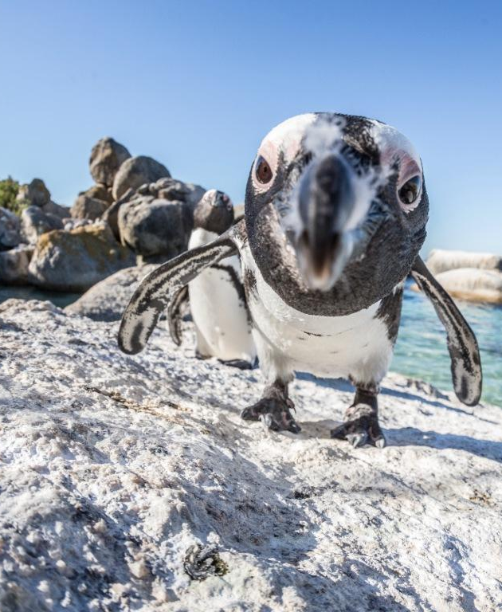
Regional connections - how can OCG help - what are good pathways
HF Radar
Funding the Regional coordination and Node in Europe is still a challenge.
The Ocean Radar Conference for Asia (ORCA) did not take place this year on its anticipated 4 year cycle.
Still difficult to engage Asian community in the Global HFR network
OceanSITES
Seamless integration with GOOS Regional Alliances (GRAs)

Slide 5
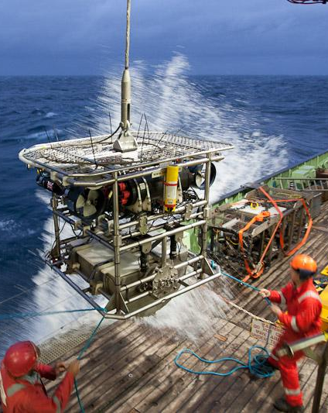
Data use - communication gaps
HF Radar
Unlock HFR data potential: boost the integration of HFR data in data downstream services, engage end-users, more science-based from HFR observations, enhance the applications development, promote the development and delivery of operational added-value products.
Unlock HFR data assimilation, crucial to improve the model performance; use HFR data to assess the SWOT satellite mission.

Slide 6
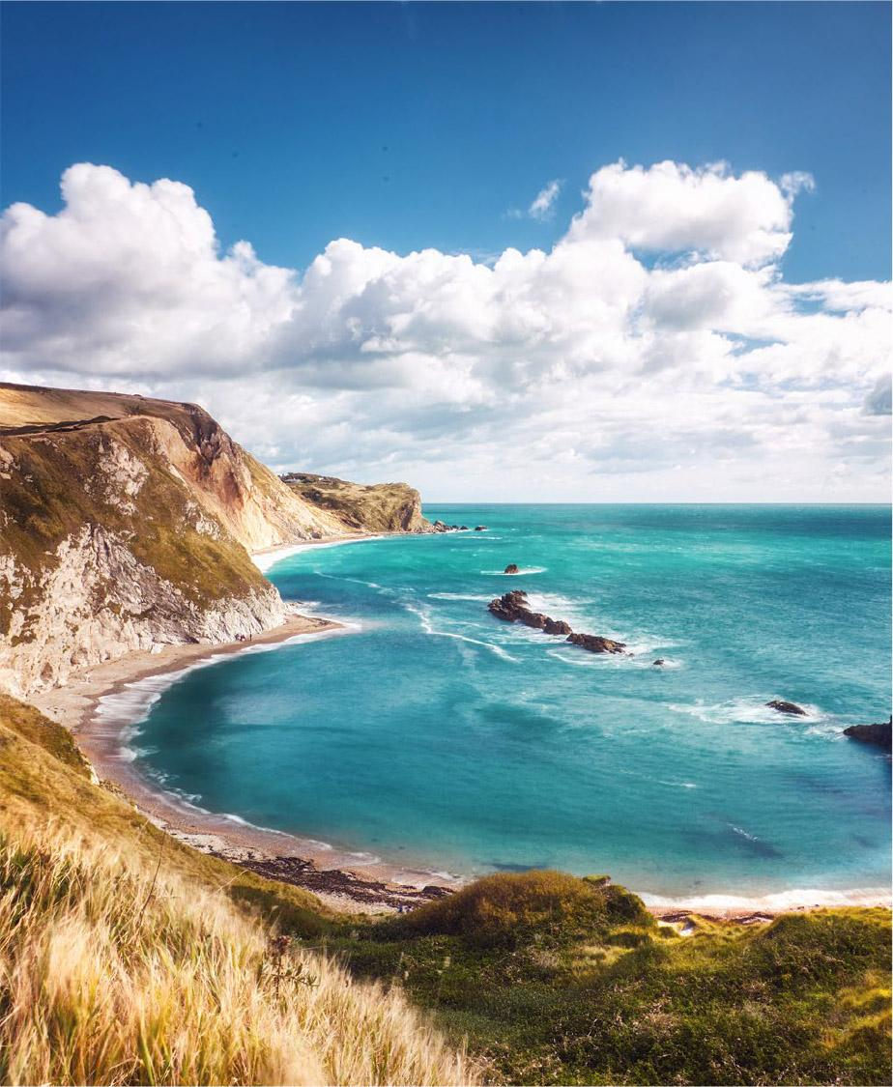
IOC/WMO
OceanGliders
Exploring Funding Mechanisms:
to secure funding through organizations (WMO or IOC) is crucial. Collaborative funding models, such as sharing mechanisms with Argo, could offer viable solutions
SOOPIP/SOT
Lack of participation and direct contact with IOC.

Slide 7
Weak points/network function threatened - need decide if we highlighting this - if we need to find/support
Argo
Seabird System has just announced that they will not be providing either Core or BGC NAVIS floats beyond their existing orders.
Argo is in a position to implement the OneArgo design at a global scale. Have a window of time to secure the required resources and establish a sustainable market for our suppliers.
HF Radar
Proposed funding for the Regional Associations within the U.S. IOOS office budget is $10 million. This is a reduction of more than 76% from the budgets enacted in fiscal years 2023 and 2024. If enacted, would cripple the nation’s HF radar observations.
The Mexican Radar Network stations in the Caribbean were vandalized, however we will rebuild them later this year.
VOSP/SOT
Development of Next Generation Turbowin software for the VOS network.
ASAPP/SOT
Budget cuts and declining performance, no progress
AniBOS
AniBOS Data Committee
Hosting in person meeting
1 FTE position to support AniBOS data management development & operation
GO-SHIP
Only a limited number of groups has the expertise to measure transient tracers (& other parameters. Requires sustained funding and coordination.
Some sections of high scientific value (Indian Ocean), have not been sampled for a long time.
Ongoing issues with supply of carbon and inorganic nutrient reference materials.
OceanGliders
Support for increased monitoring capacity
GLOSS
GLOSS has always relied on national contributions, which is a weakness..

Slide 8
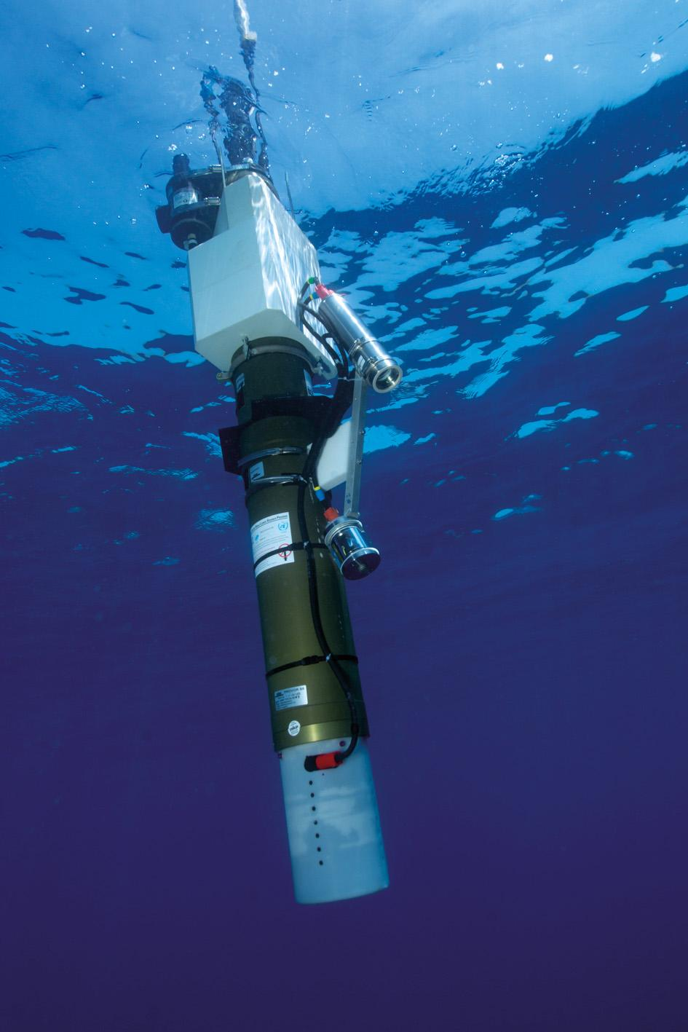
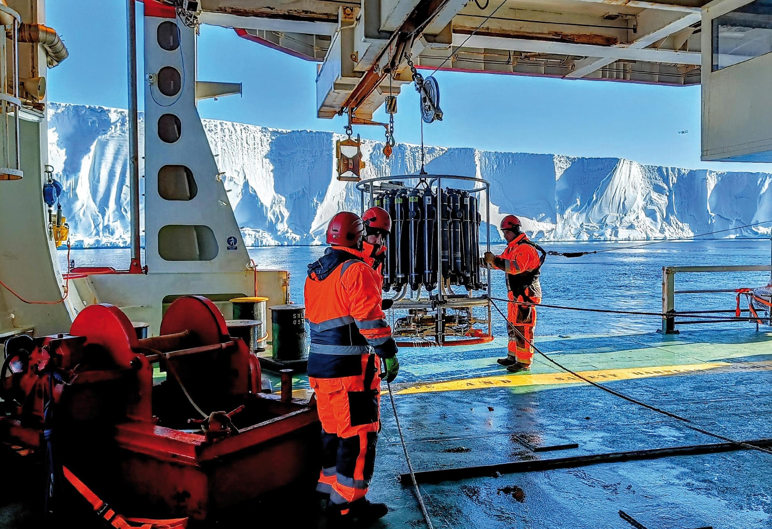
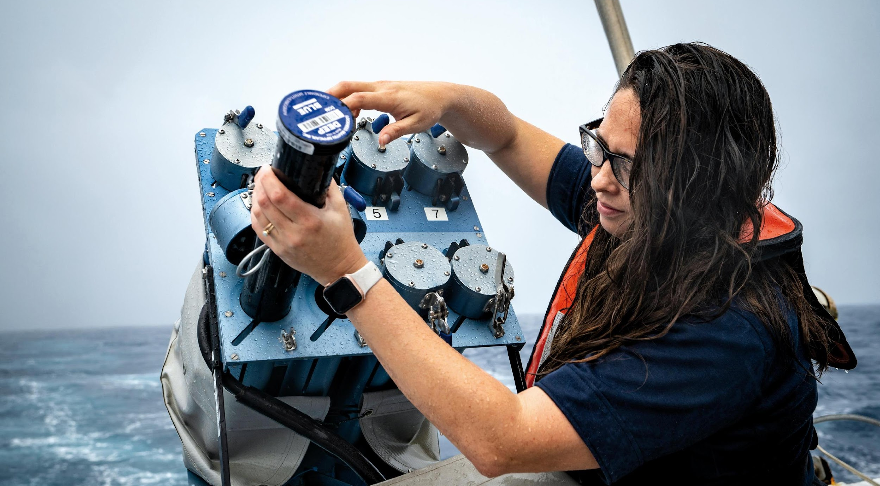
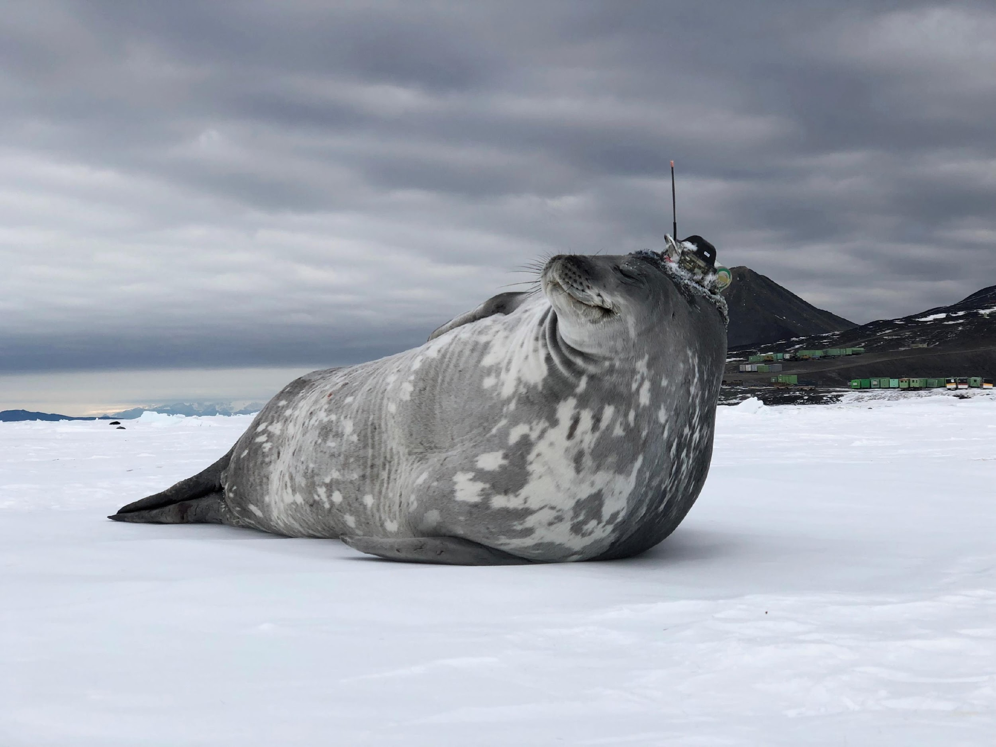
Thank you
goosocean.org

