Slide 1
BioEco Panel
Gabrielle Canonico, Karen Evans (co-chairs) and Ana Lara Lopez (IPO)
15th Observations Coordination Group (OCG-15)
Victoria, British Columbia 13-17 May 2024

Slide 2
Priorities and initiatives relevant for OCG
Data discovery, EOV data schemas and data management
Initiated discussions between OCG, OceanOPS, OBIS and ODIS
Stronger connections between the BioEco Panel and other GOOS panels, OCG, GRAs
Re-initiated a cross-panel meeting; in-person with panels, OCG, OceanOPS April 2024
Confirmed Ward Appeltans/OBIS as BioEco Panel representative to OCG
Broader engagement with diverse communities - OCG networks, deep ocean, biodiversity, POGO, etc.
Collaborating with EU projects MARCO-BOLO and BioEcoOcean:
Advancing a subset of EOVs, including data schemas and specification sheets
Building communities to improve EOV uptake and implementation
Connecting the BioEco Metadata Portal with ODIS; establishing helpdesk and community support (some support from EU projects; IODE and GOOS need to discuss funding)
Notes:
there is a bit of funding from Marco-Bolo and BioEcoOcean for this, but IODE and GOOS will need to find a way to co-fund this from core funds. For this biennium 2024-2025 all budgets are allocated.

Slide 3
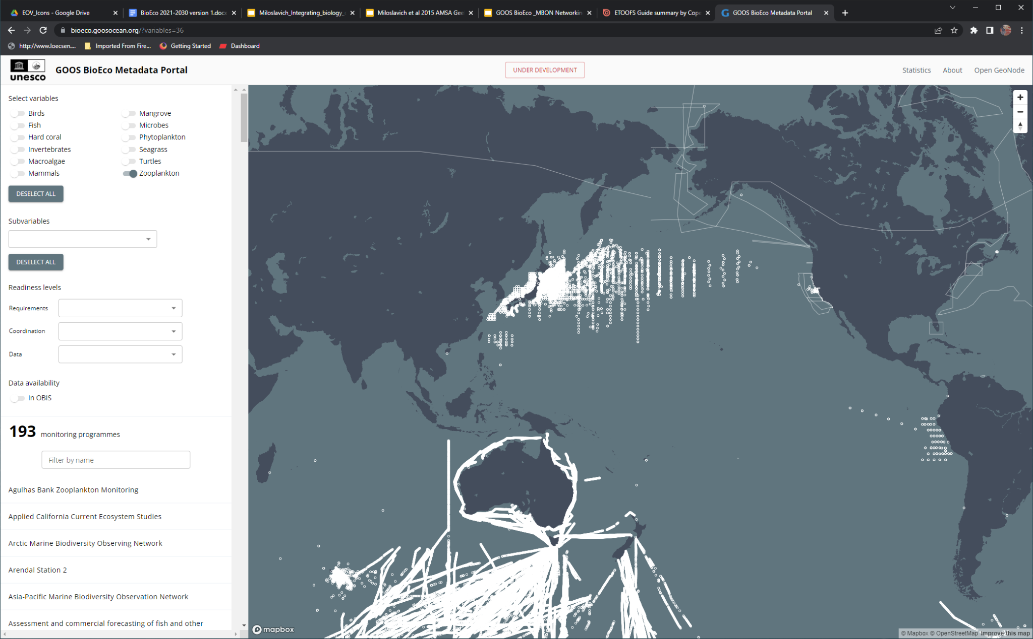
GOOS BioEco Portal: https://bioeco.goosocean.org/
Provides open access metadata and information on global ocean observing and monitoring programs collecting bioeco EOVs
Currently holds metadata of 600+ globally distributed active monitoring programs
GOOS anticipates that the portal will be fully operational by 2025, contingent on resources to be in place.
Resources needed for
Continuous technical and content maintenance, bug fixing, helpdesk and community support
Creation of an automated flow of metadata from ocean observing programmes to the portal (via ODIS)
Development of connector and harvest routine between ODIS / Ocean InfoHub and the GOOS BioEco Portal
EU BioEcoOcean: part-time person to provide helpdesk and community support
EU MarcoBolo: part-time person to connect BioEco portal to ODIS
Need extra resources for technical maintenance and IT development

Slide 4
BioEco-OCG Coordination Needs
Parallels
Many shared attributes for contributing networks (sustained obs of one or more EOV/ECV, community of practice, open data, standards/best practices, etc)
Differences
OCG and OceanOps lack biology focus and the resources to incorporate it
September 2023 BioEco-OBIS-OCG In-Person Discussion
Agreement among OCG, OceanOPS, OBIS and ODIS to:
Expand biological data discovery across OCG networks - pilot focus on Bio-GO-SHIP (plankton observations) and AniBOS (animal movement observations)
Facilitate reporting of BioEco observations by OceanOPS
BioEco also agreed to consider including the development of guidance of information exchange standards (metadata and data) in the revision and update to the BioEco EOV specification sheets.
March 2024 BioEco Panel Executive-OBIS-OceanOPS-ODIS online discussion
Agreement to continue technical discussion via github to identify steps to connect BioEco Portal and OceanOPS.
Plan (and resources) needed to advance data pilot and BioEco Portal/OceanOPS connection

Slide 5
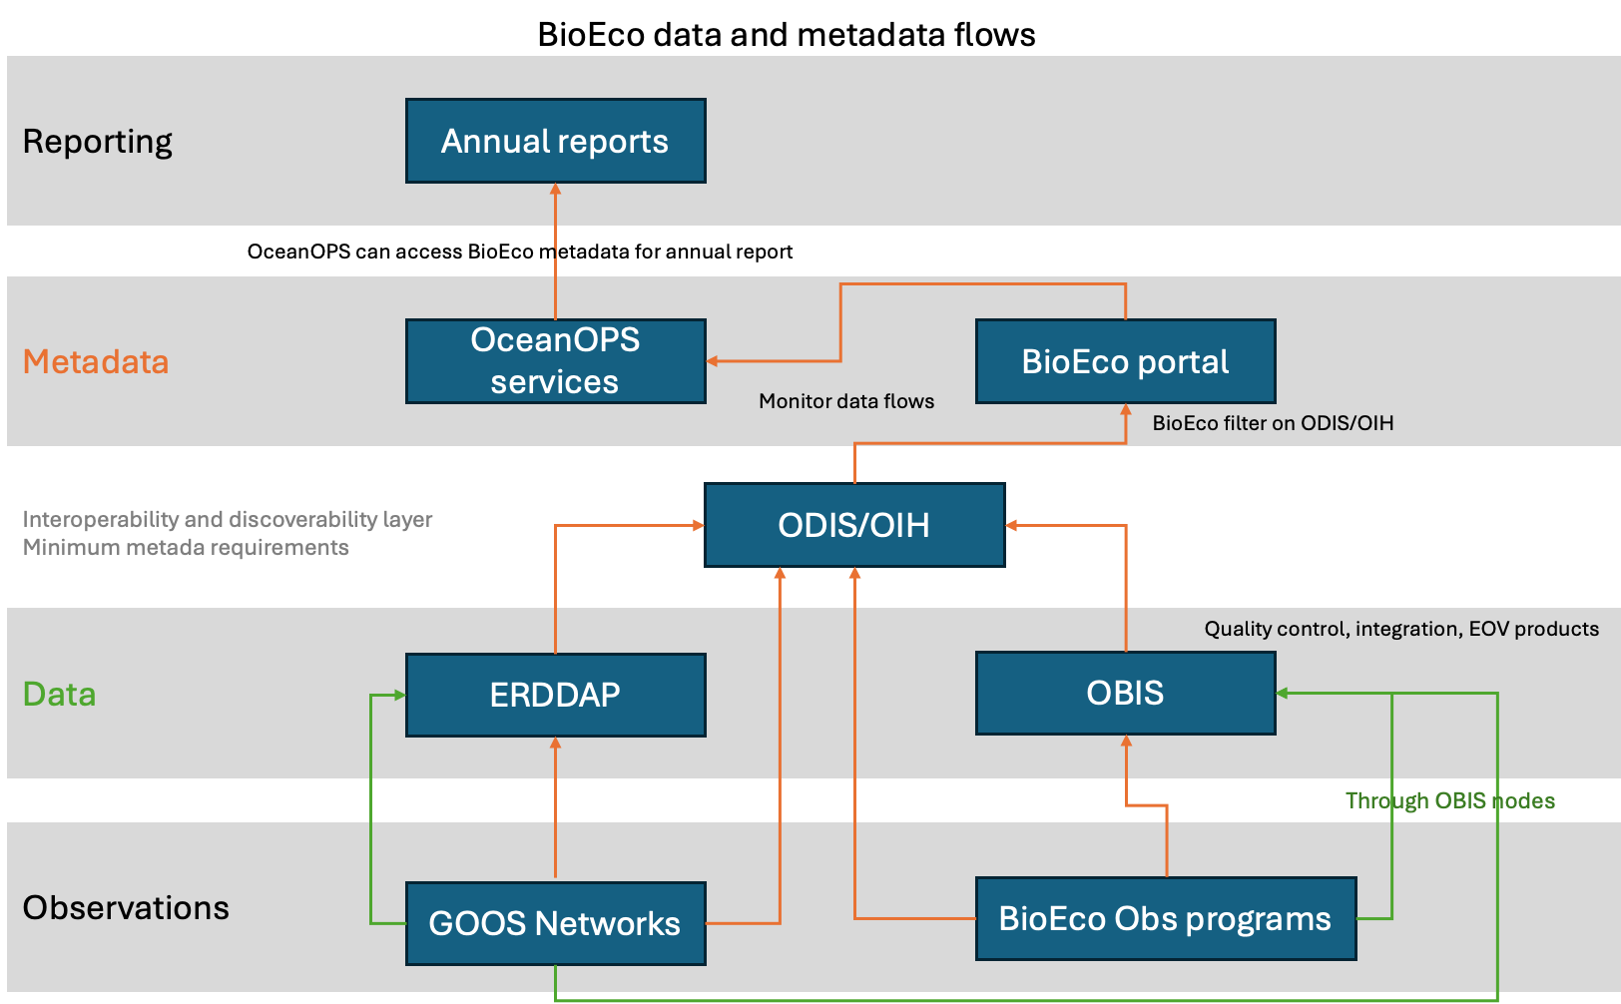
Connection of OBIS to ODIS planned
Currently in discussions of how to deliver information to OceanOPS for reporting
Initiating discussions on data discovery of biological observations from OCG networks
End goal: visibility/accessibility of biological observations across all GOOS components and external programmes
Notes:
Green is data; orange is metadata

Slide 6
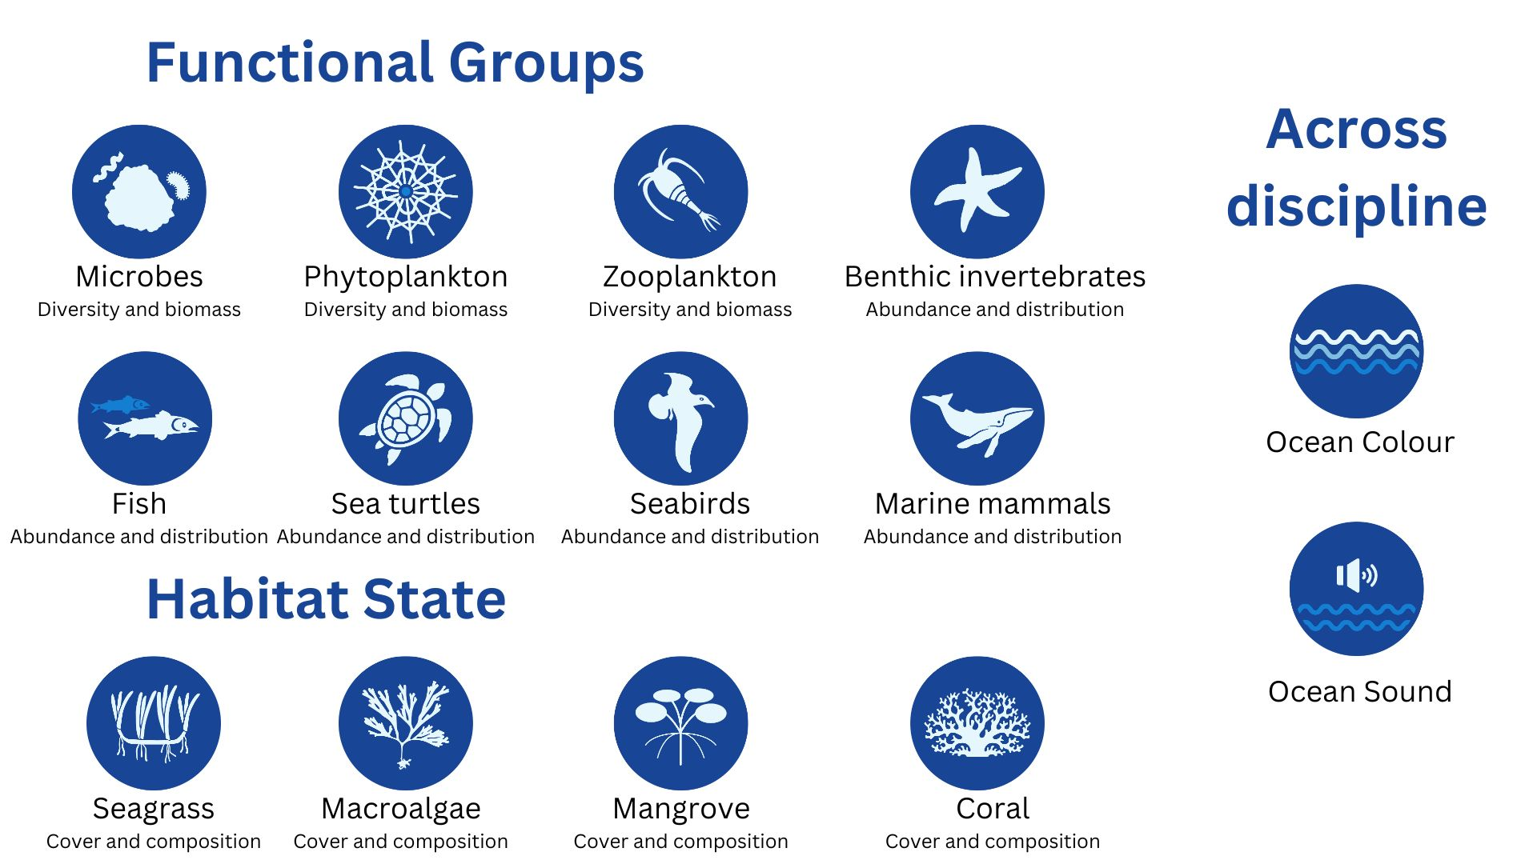
Observations
How can the OCG help address the key priorities for observations of the BioEco Panel?
OCG can encourage open discovery of biological observations collected by OCG networks to support open discovery of biological observations and BioEco EOVs
Pilot activities discussed to date:
Animal movement (tracks) from AniBOS
Bio-GO-SHIP (plankton biodiversity, omics, optical methods)
Other potential action areas:
OceanGlider network passive acoustics
Fixed Platforms with biological sensors/sampling
open discovery of biological observations collected by OCG networks that contribute to the EOVs

Slide 7
Needed Actions/Decisions
Action needed on three agreements from March 5 OBIS, OceanOPS, ODIS meeting:
Technical exchange between OceanOPS, ODIS and OBIS to start on github (hoping OceanOps can engage) https://github.com/iodepo/odis-arch/issues/402
Arrange technical/scientific workshops between OceanOPS, OBIS, GOOS BioEco Panel, OCG and ODIS to define the ODIS Architecture specifications for data exchange
Additional actions:
Agree on steps to advance pilot activities already identified (AniBOS, Bio-GO-SHIP) and who will support, with what resources
If github exchange is not feasible, organize a technical discussion between OCG/OceanOPS and OBIS to establish steps to connect OceanOPS to the BioEco Portal for use in future report cards
Discuss how OCG networks will familiarize themselves with the BioEco EOVs so they can help identify the observations and data streams that are viable moving forward
Notes:
A relationship between OCG and BioEco is yet to be practically (and strategically) developed
Identify clear common goals and a plan for activities moving forward (plus participants and resources needed)
Main connection points with OCG networks collecting biological observations that can contribute to BioEco EOVs, ensuring metadata are delivered through the BioEco Portal to OceanOPS
OCG can help address key priorities for BioEco by:
Working towards open discovery of biological observations collected by OCG networks that contribute to the EOVs
Developing and implementing data schemas for those observations in collaboration with OBIS
Ensuring those observations are visible in the BioEco Metadata Portal
Ensuring the metadata are reported by OceanOPS in the report card in a similar way as the other observations from OCG networks.

Slide 8
BACKGROUND

Slide 9
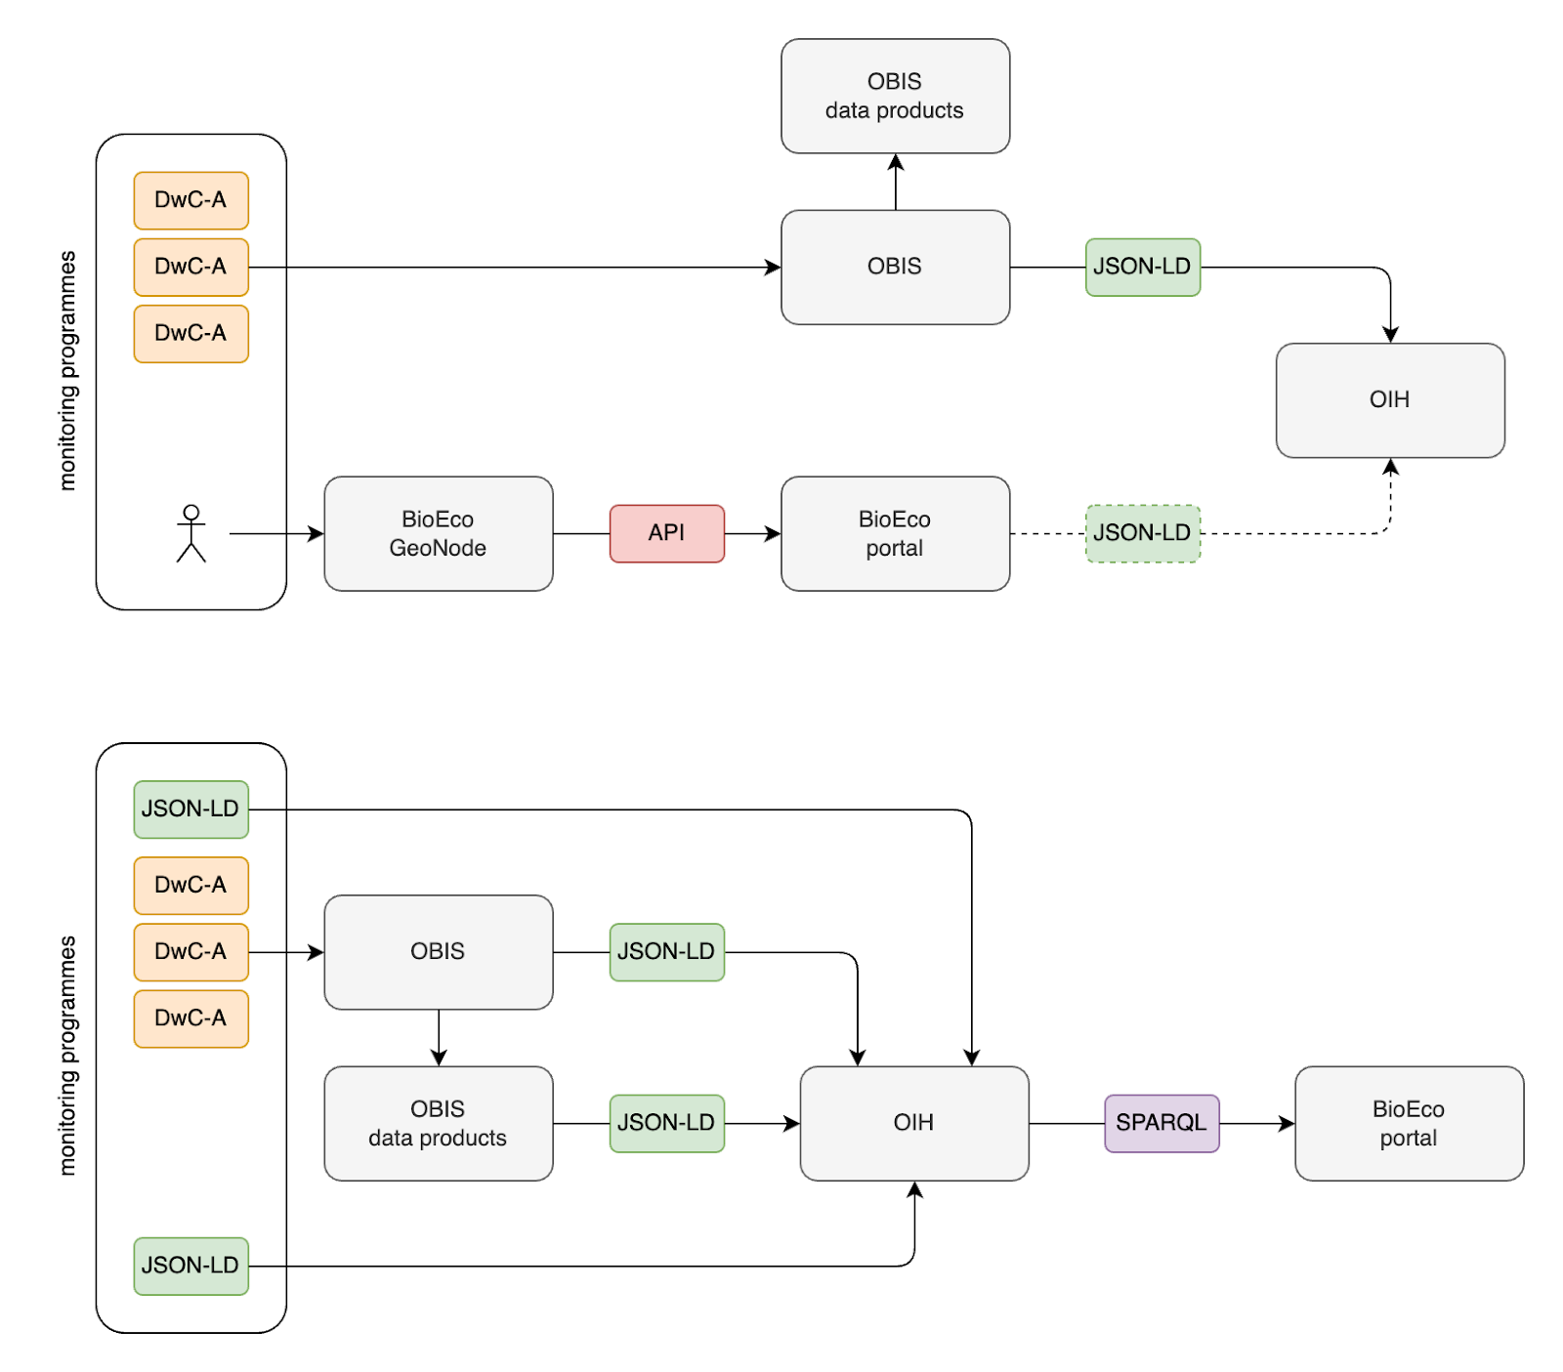
OBIS/BioEco Portal/connections across GOOS
Current – user entry
Planned – automated
Easy upload of metadata scripts – ensures consistency in metadata standards

Slide 10
Conclusion BioEco Portal
We need funds for technical maintenance of the portal. A technical work plan needs to be developed jointly between OBIS, ODIS and OceanOPS. Online meeting is planned for end of Feb/March 2024.
We need funds for a joint IODE/OBIS+ODIS-GOOS/OCG-OceanOPS strategic in-person meeting.

Slide 11
BioEco Panel: Main challenges and recommendations
BioEco Metadata Portal
Need to establish a sustainable connection between the BioEco observing programmes and ODIS, through the development of ODIS-Arch specifications for EOV observations.
Need additional technical support for maintaining connectivity of the Portal with OBIS and the observing networks, supporting the connection with OceanOPS for delivery of information for reporting purposes.
Delivery of BioEco observations
Need support for facilitating progression of delivering of biological observations from OCG networks (as a pilot AniBOS, Bio GO-SHIP) into OBIS.
Need enhanced connectivity between GRAs and OBIS for delivery of biological observations into OBIS
Ongoing support for the IPO
Delivery of EOVs into global processes
Requires that GOOS develop an engagement strategy with Global Environment Agreement custodians (e.g. CBD) under which direct partnerships for EOV reporting frameworks and agreements can be facilitated

Slide 12
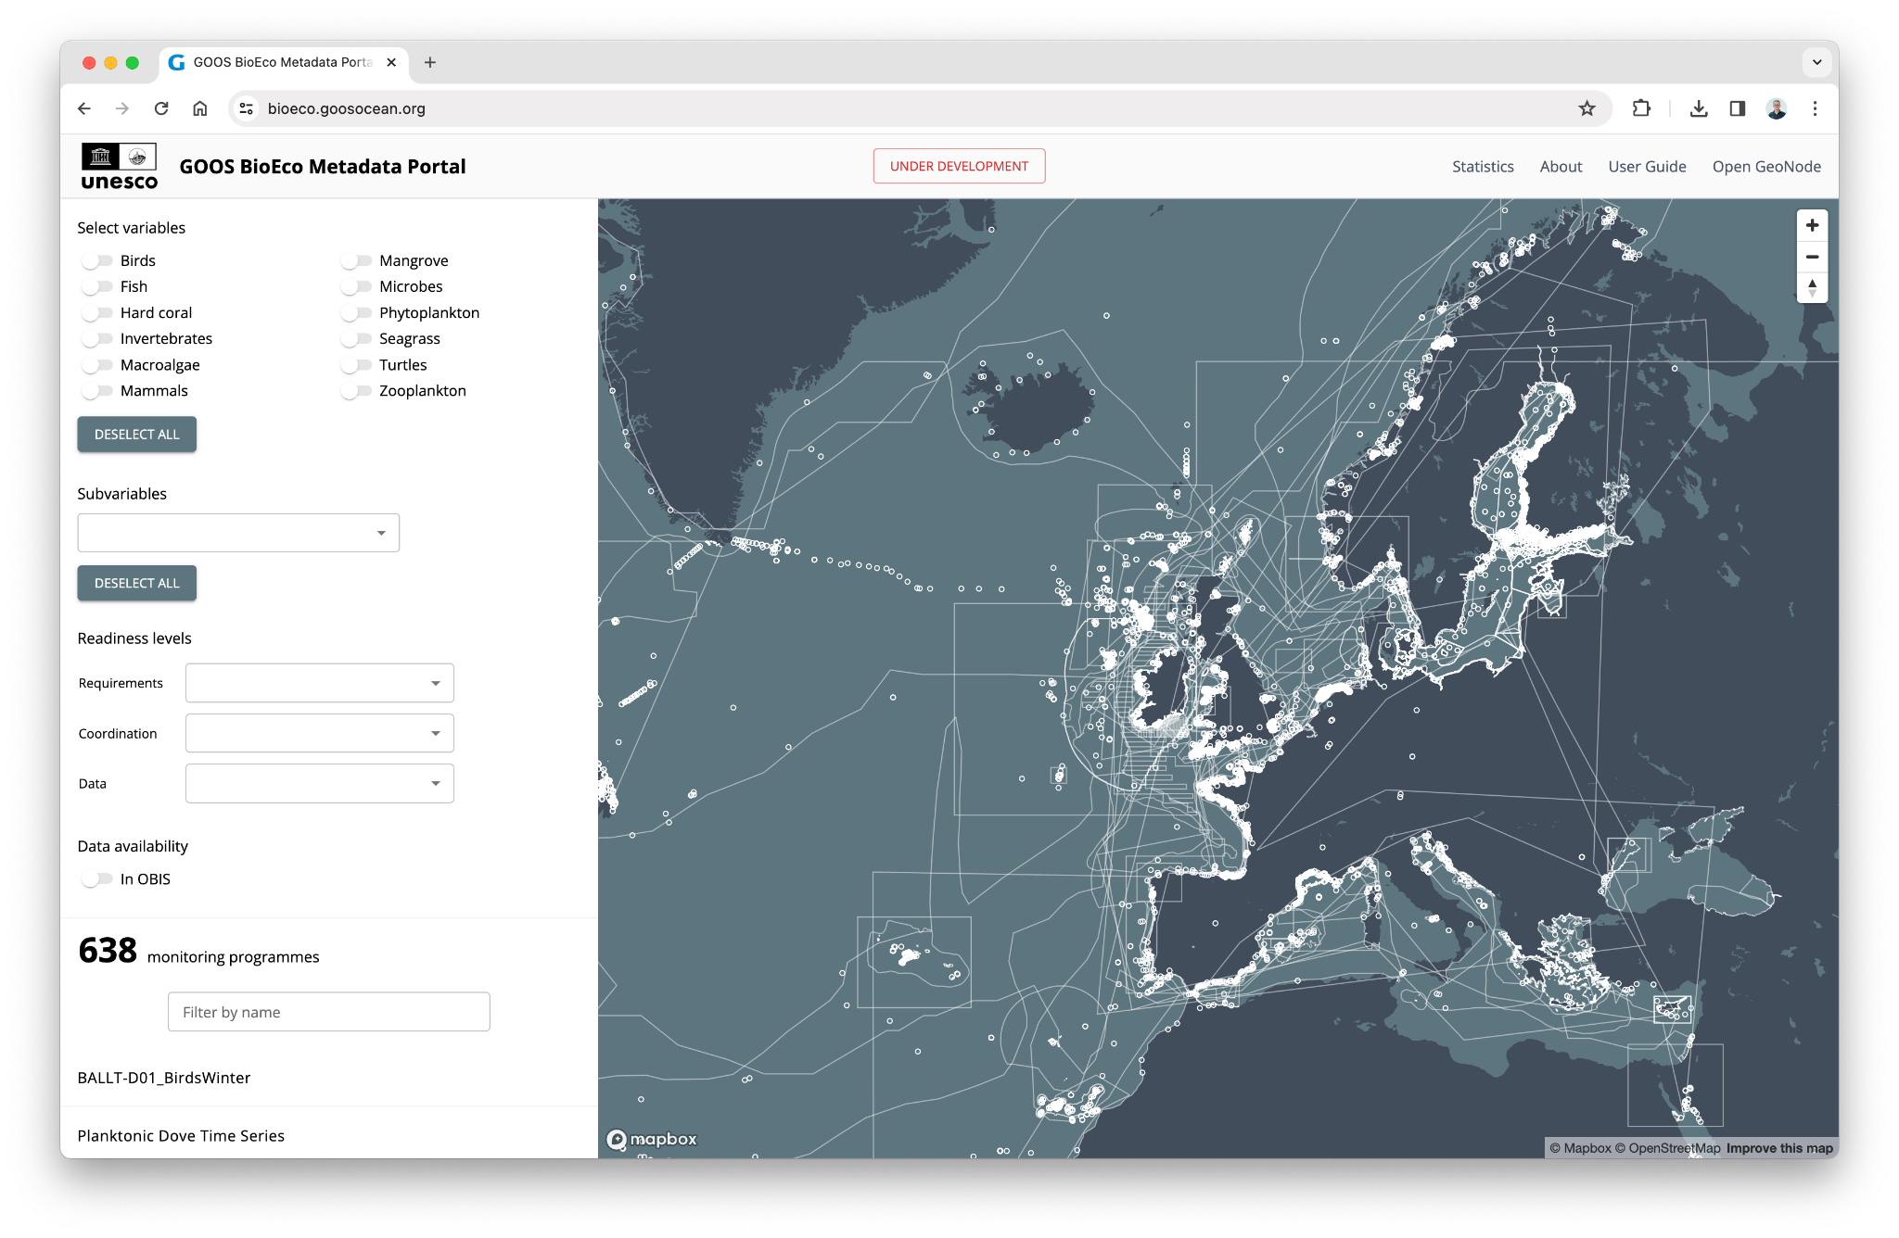
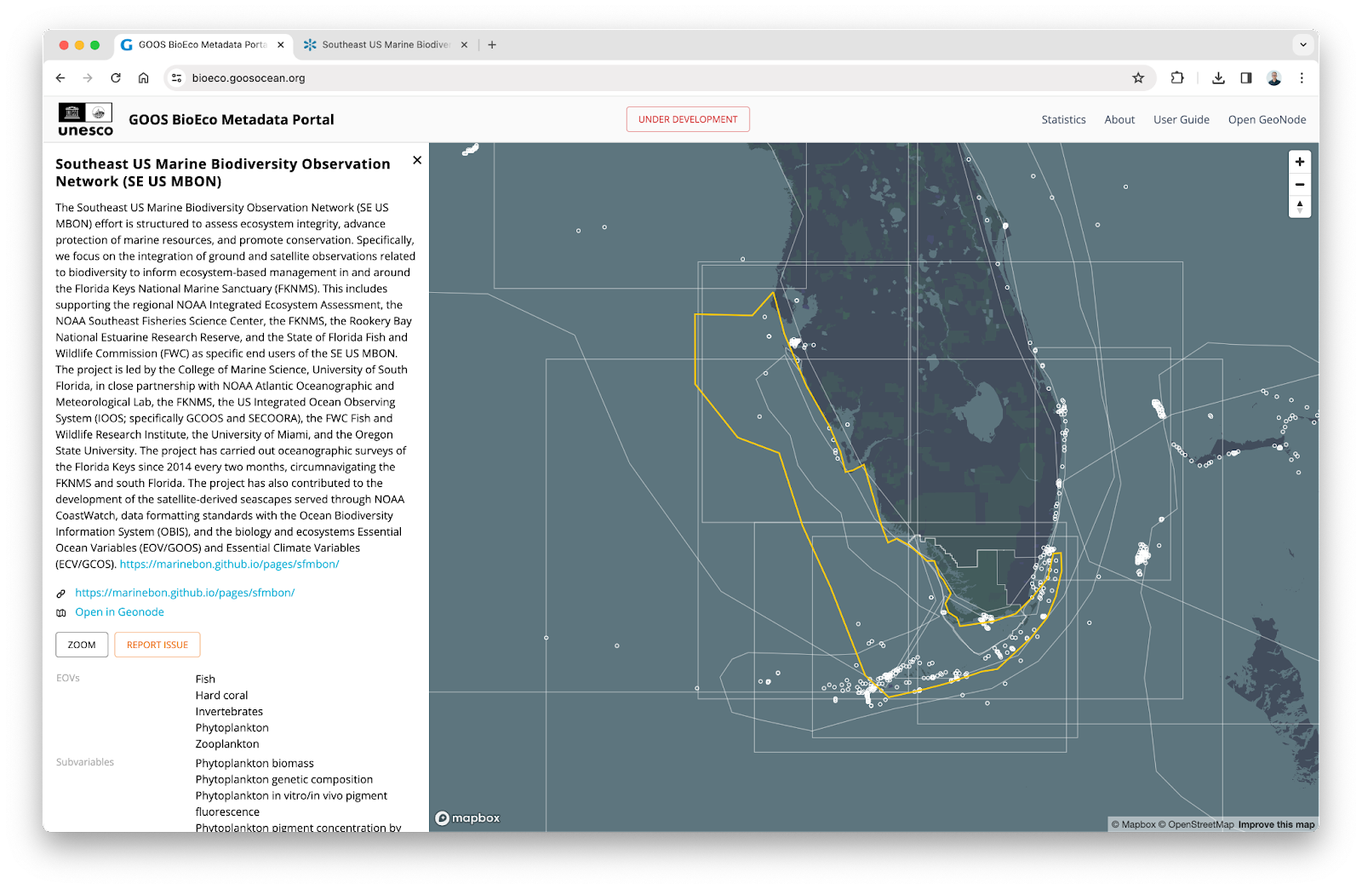
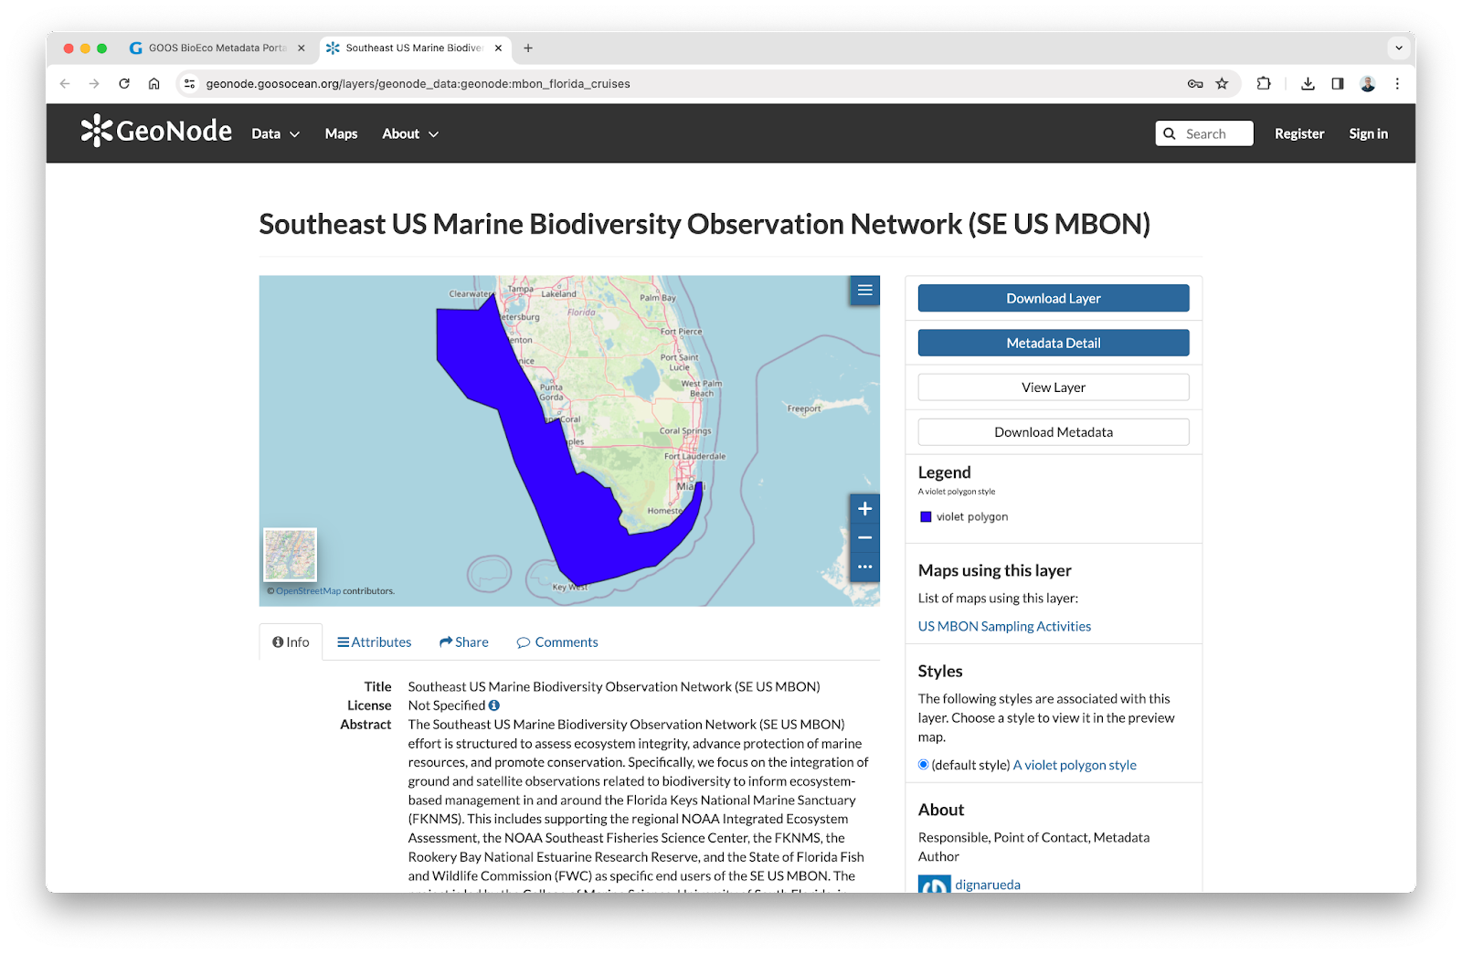
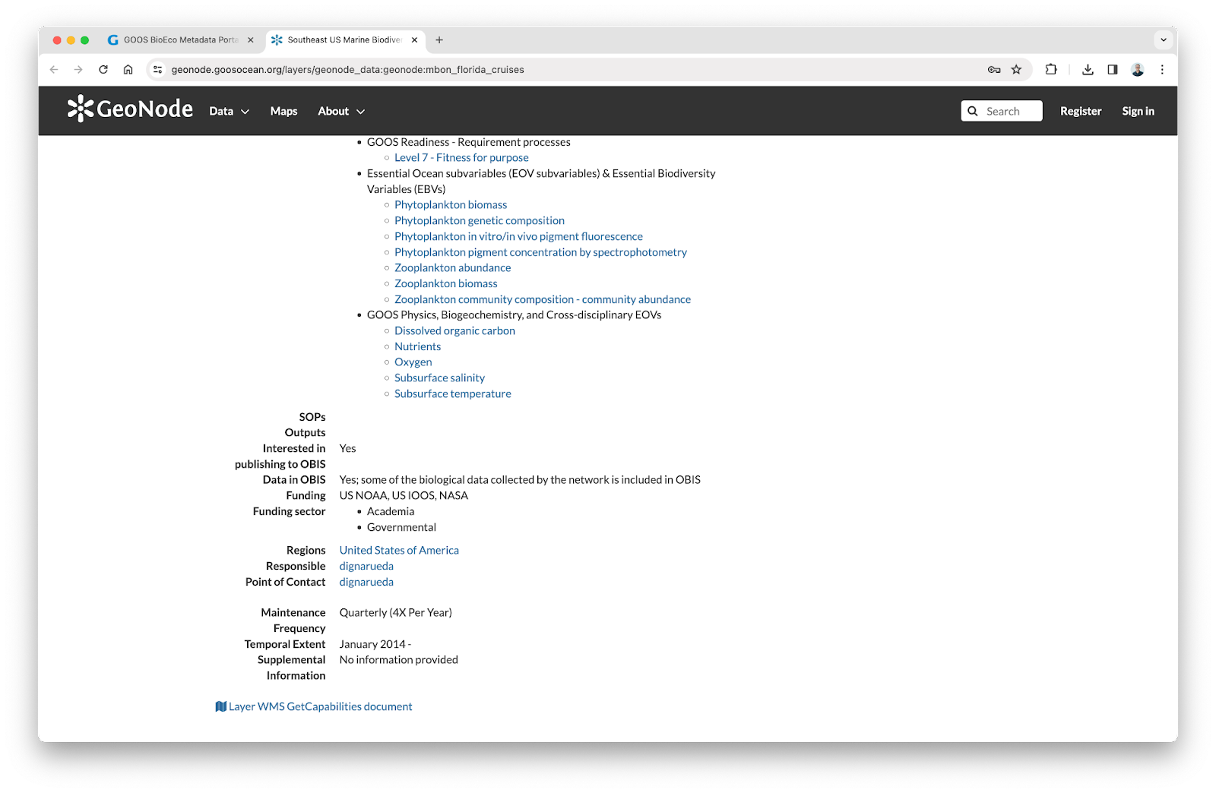
OBIS/BioEco Portal/connections across GOOS
Portal allows you to discover what programmes are collecting what EOVs, where (600+ programmes)

Slide 13
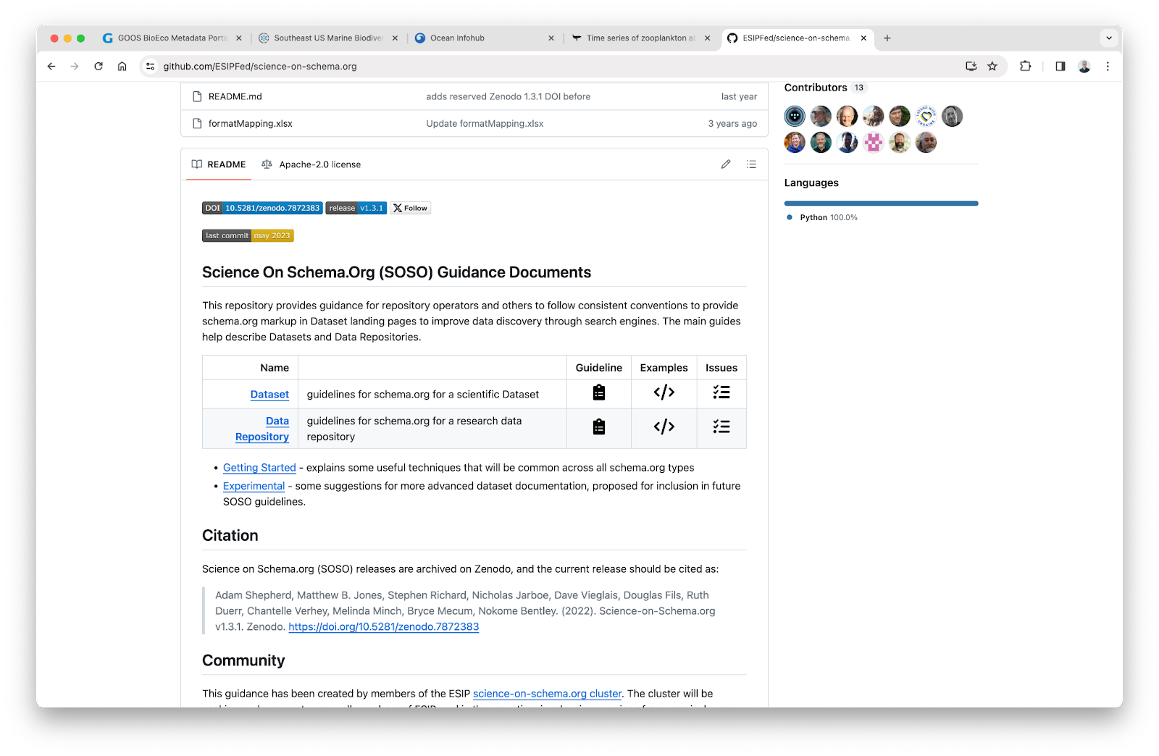
OBIS/BioEco Portal/connections across GOOS
Aiming for consistency in data schemas across EOVs, including metadata standards – can then be pushed out across programmes collecting EOVs

