Slide 1
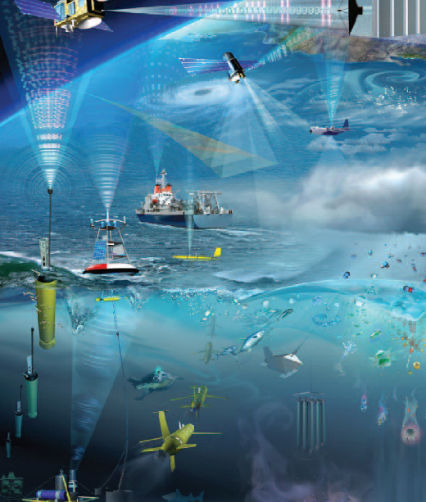




Ocean Observations Physics and Climate Panel (OOPC)
Weidong Yu, Sabrina Speich (co-chairs)
and Belén Martín Míguez (Secretariat)

Slide 2
Terms of Reference
Assess, review and prioritise requirements for sustained ocean observations of physical Essential Ocean Variables (EOVs), and ocean Essential Climate Variables (ECVs) in support of GOOS, GCOS and WCRP by:
Work with the GOOS Observations Coordination Group (OCG) and other relevant regional bodies to coordinate observing networks that contribute to ocean ECVs and physics EOVs
Work with the International Ocean Data Exchange (IODE), WMO Information System (WIS), GRAs and other partner organizations to review the status of and requirements for data and information management […]
Help develop a process for ongoing evaluation of the observing system in liaison with users of the data, based on the optimum suite of platforms for required variables, spatial and temporal scales and accuracy
Support global ocean observing activities by involved parties (national/regional activities including GRAs and global programs) through liaison and advocacy for agreed plans.
Report to the GOOS Steering Committee, GCOS Steering Committee and WCRP Joint Scientific Committee […].

Slide 3
Main Activities 2024-2028
Observing System Evaluation and Strategy for Ocean-Atmosphere Fluxes
Observing System Evaluation and Strategy for Boundary Systems
Global Ocean Indicators Framework
Observing System Evaluation and Strategy for Ocean Heat and Freshwater Storage and Transports
Pan-tropical Observing System (with CLIVAR)
* Global Ocean / Climate Essential Variables Stewardship (EOV/ECVs)
* GCOS Status Report/Implementation Plan

Slide 4
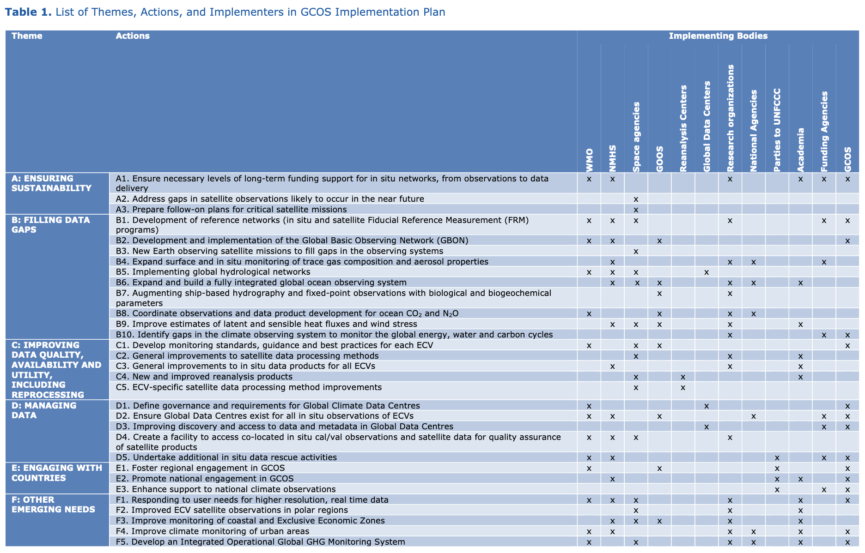
1. GCOS Implementation Plan

Slide 5
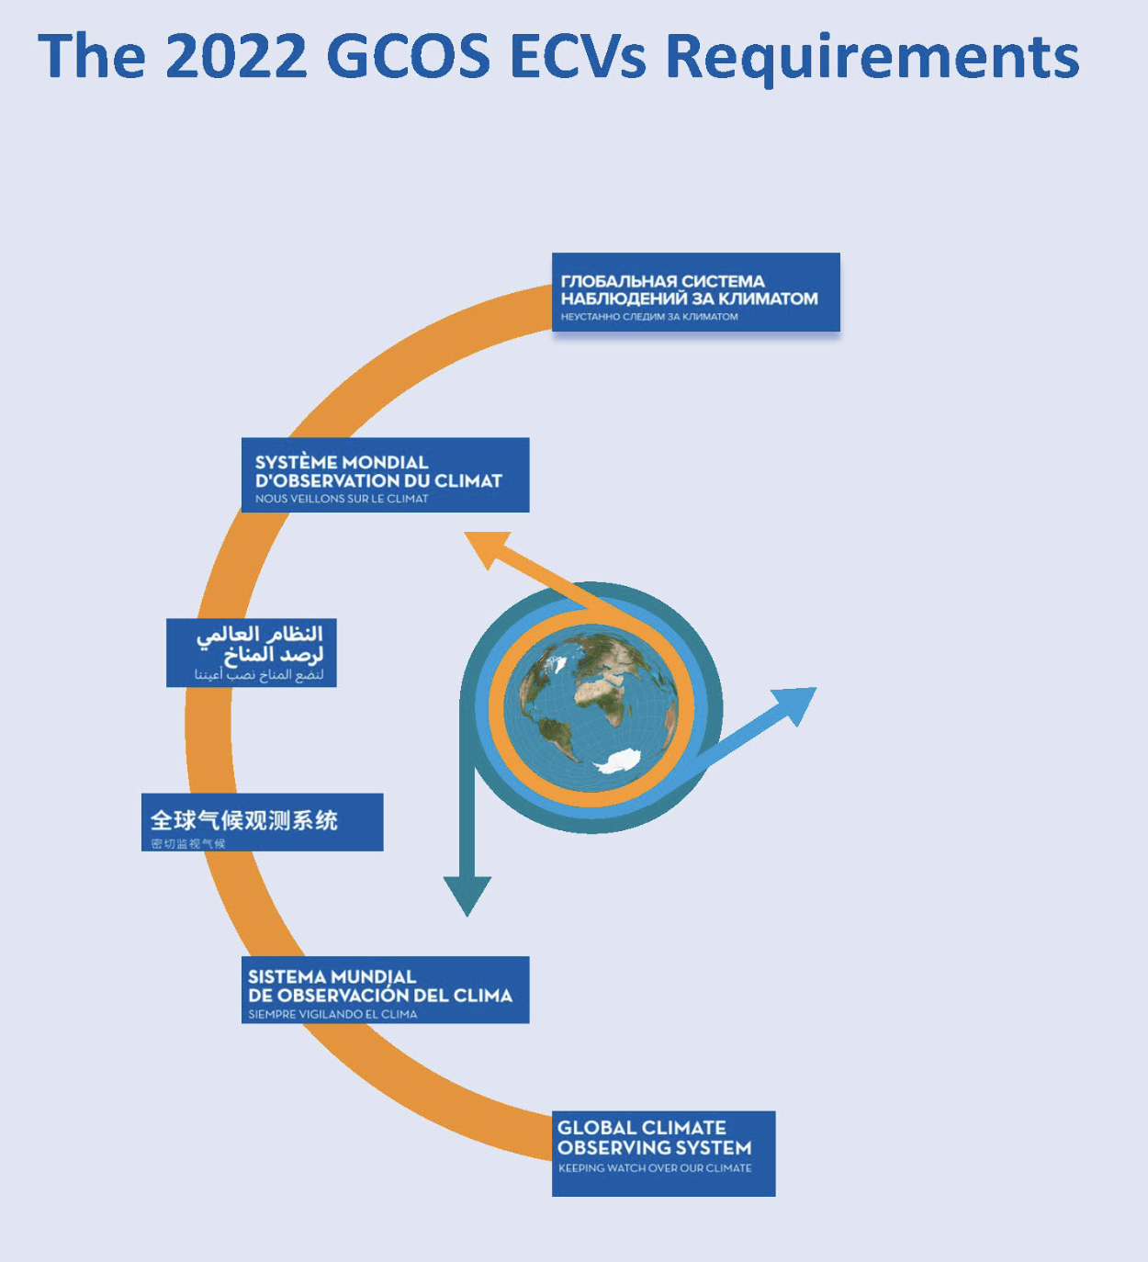
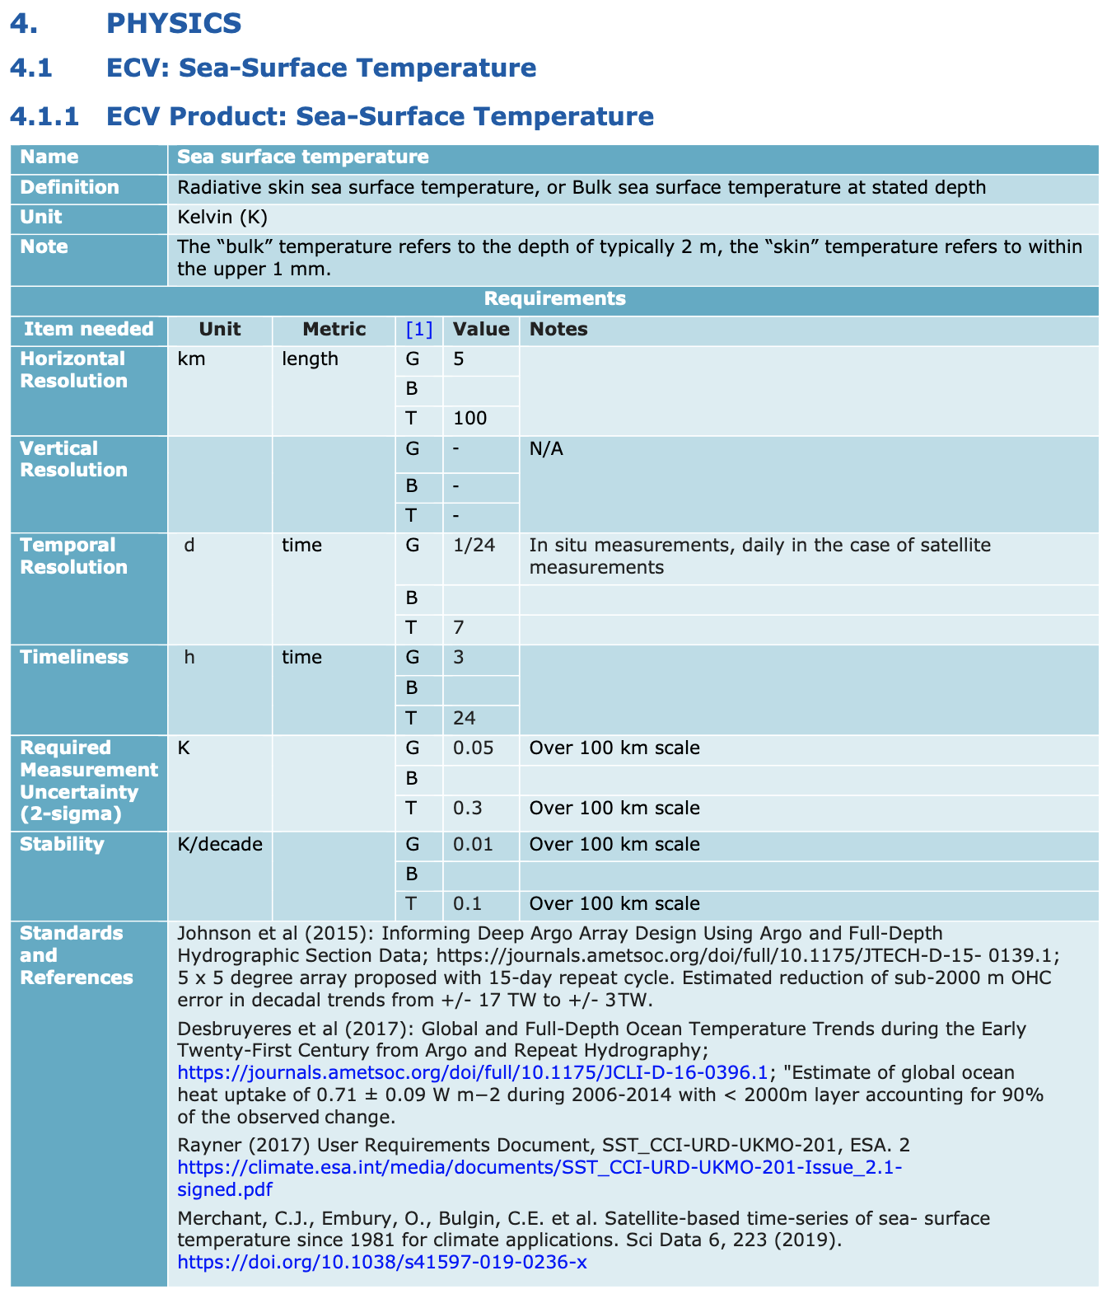
2. EVC Requirements

Slide 6
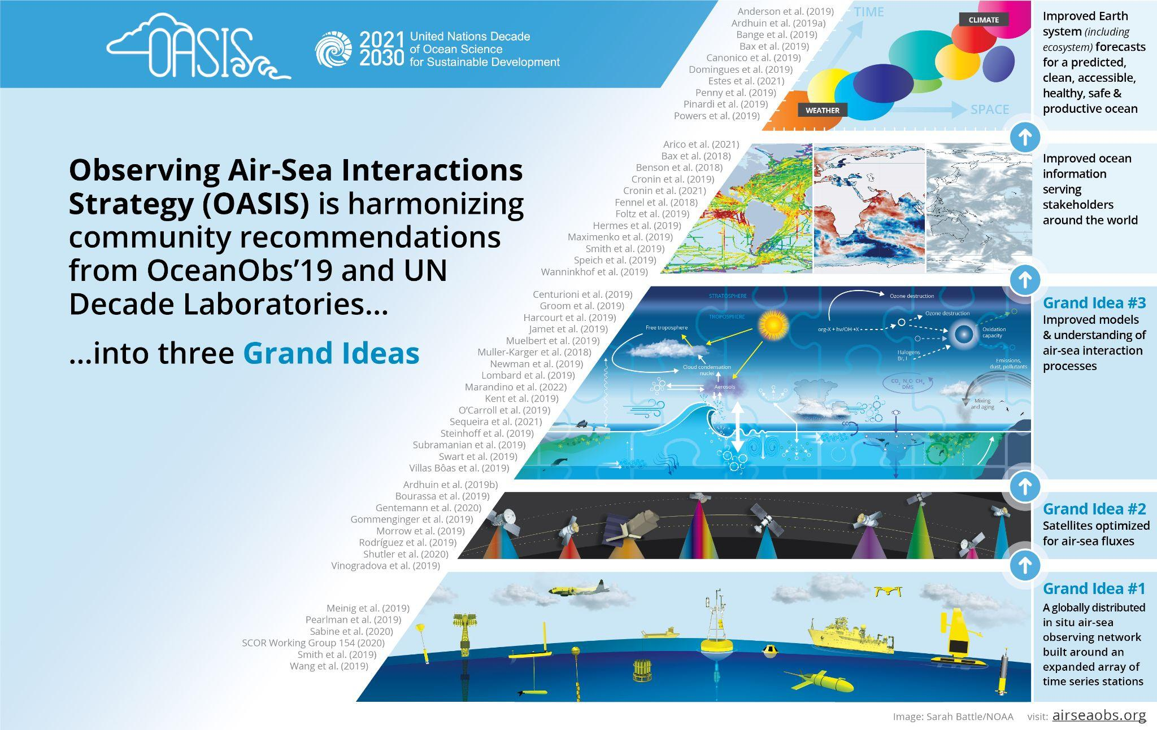
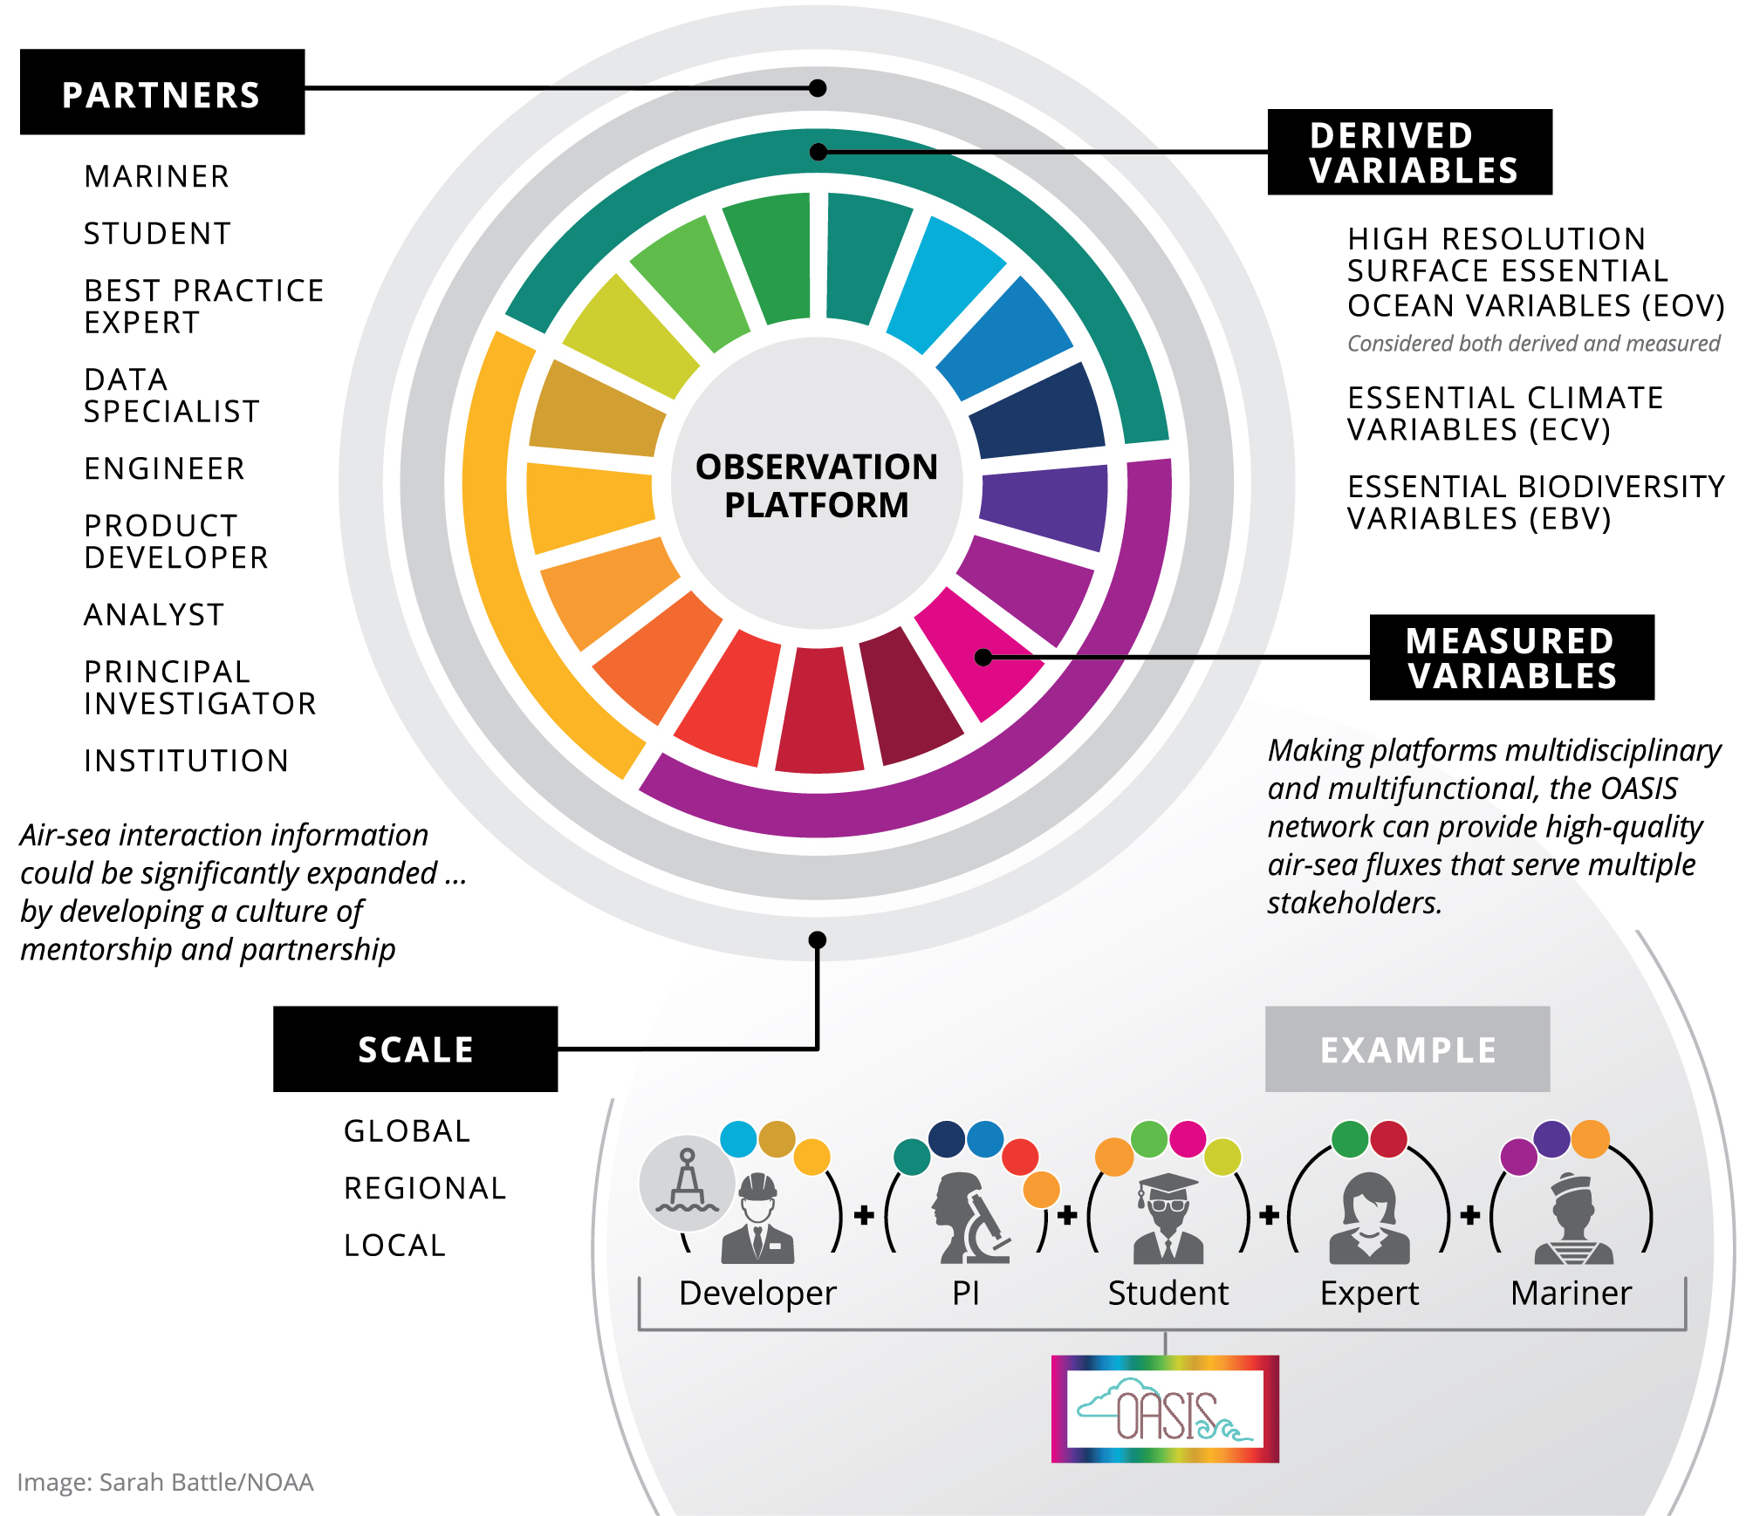
OASIS ACTIVITIES (select)
3. OOPC TT Requirements
      Riihimaki et al. (In Press) “Ocean Surface Radiation Measurement Best Practice” – Endorsed by OceanSITES. We request GOOS endorsement.
      OASIS and OOPC are helping to develop a longterm partnership between TPOS Equatorial Pacific Experiment (TEPEX) and Pacific Community and Pacific Island-GOOS. Request help with community building linking GOOS (TPOS), PI-GOOS GRA, SPC, OASIS and TEPEX.
      Uncrewed Surface Vehicle Network for GOOS (Action #35.3 project linked to OASIS) is working to meet the attributes of an emerging network. USV for GOOS representatives have participated in OCG annual meetings in 2022, 2023, and in May 2024. Request OCG and GOOS recognize the Uncrewed Surface Vehicle (USV) emerging network and provide guidance.
OASIS Grand Ideas
And
Theory of Change “Grandest Idea of All”

Slide 7
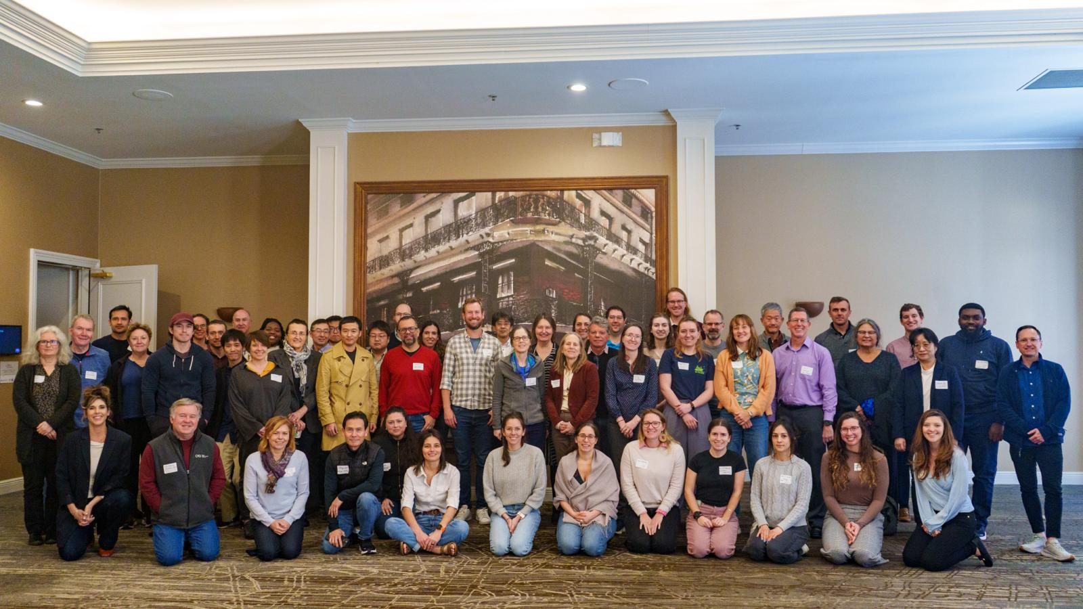
OASIS FUNDING PITCHES
OASIS Face to Face Workshop
February 17-18, 2024
New Orleans, LA USA
(1) Early Career Ocean Professionals (ECOP) Honorariums, travel, page charges.
(2) Creation of a website and data portal for the “Uncrewed Surface Vehicle (USV) network for GOOS”
(3) OASIS project office
(4) Support for community workshops
(5) Data buys for air-sea interaction observations (e.g. from Saildrone, Inc., Sofar, Inc) delivered to public “Open Data” repositories and modeling & data centers around the world, with support of mission management and scientific analyses
(6a) “Scientist in Residence” scientific extended visits (2 weeks or longer) to SIDS & the Global South and
(6b) Paid internships to foster international collaboration
(7) OASIS Graduate Research Fellowships with advisors & mentors from different institutions & countries
More than 54 In Person Participants with
ECOPs from Africa, Europe, Australia, Asia, South America, North America. Online participants as well.

Slide 8

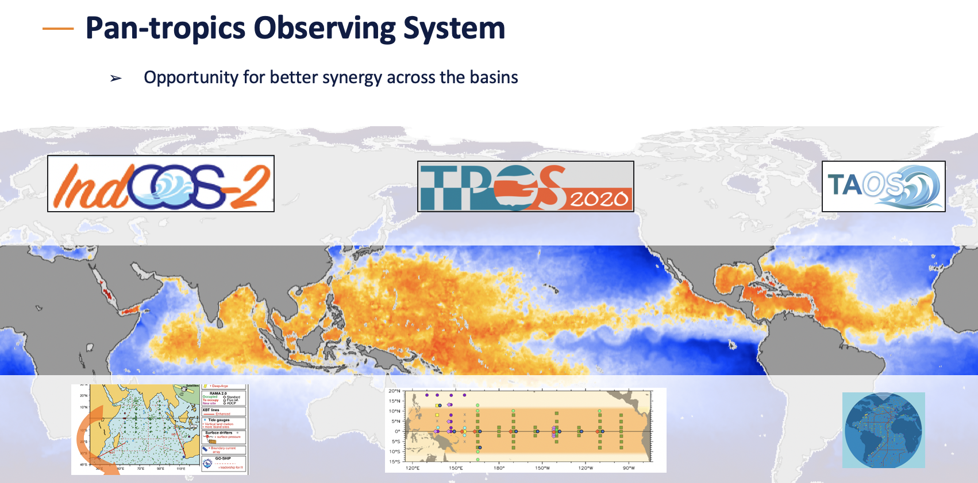

Slide 9
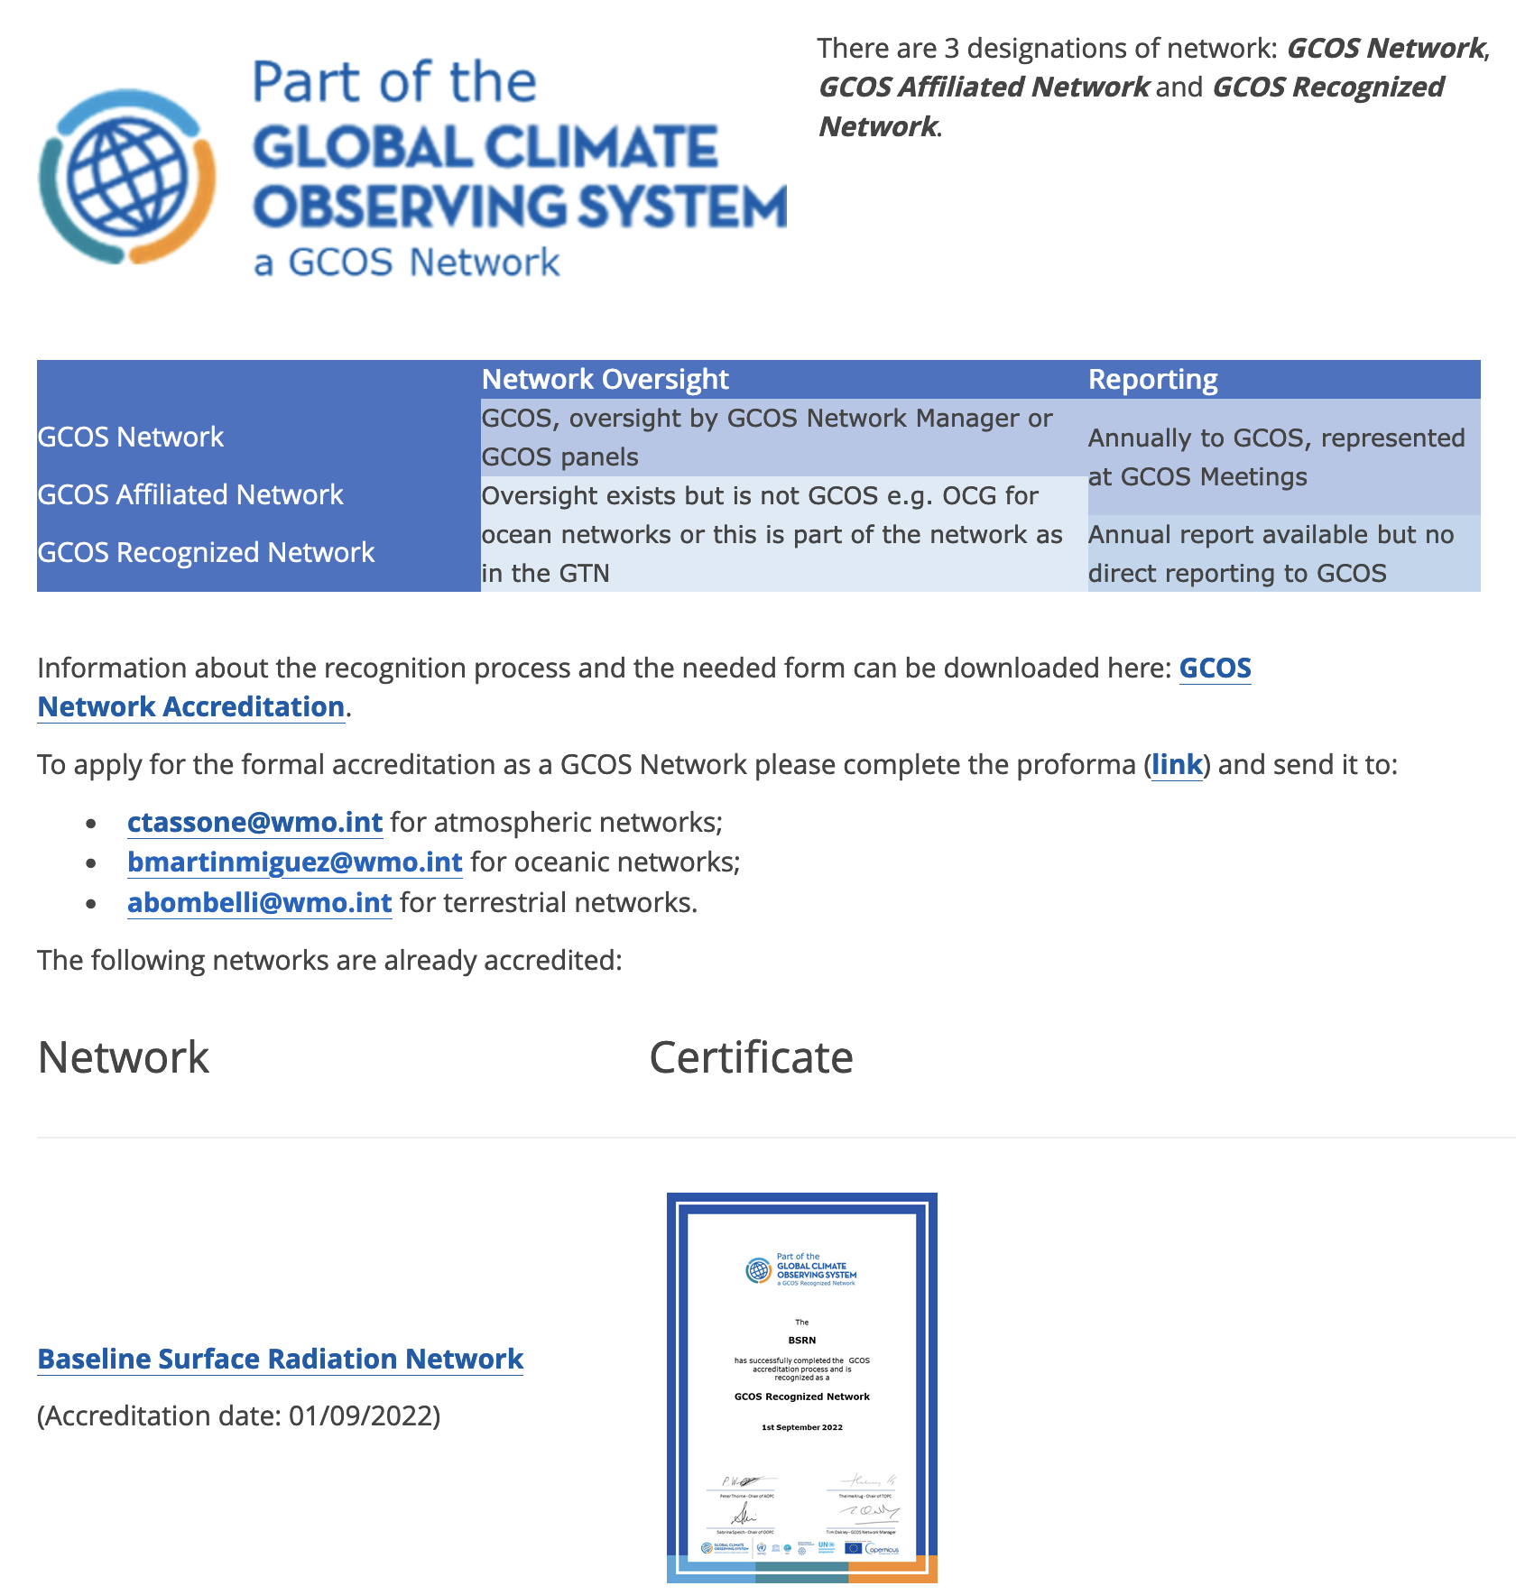
4. GCOS accreditation process for networks

Slide 10

THANK YOU
OOPC welcomes the OCG chair/members attending meeting to inspire the cooperation.

