Slide 1


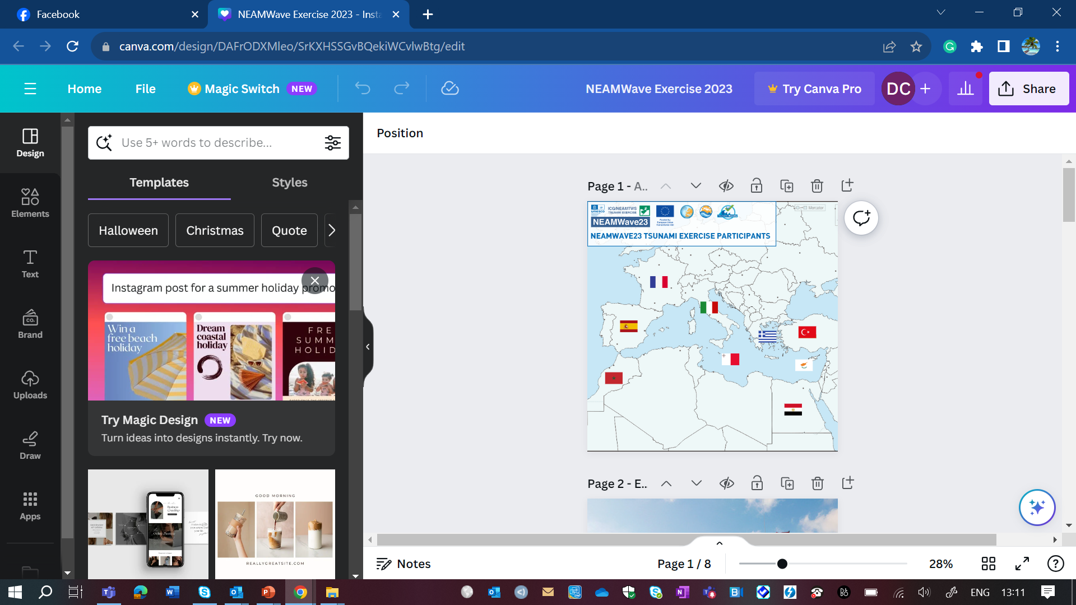
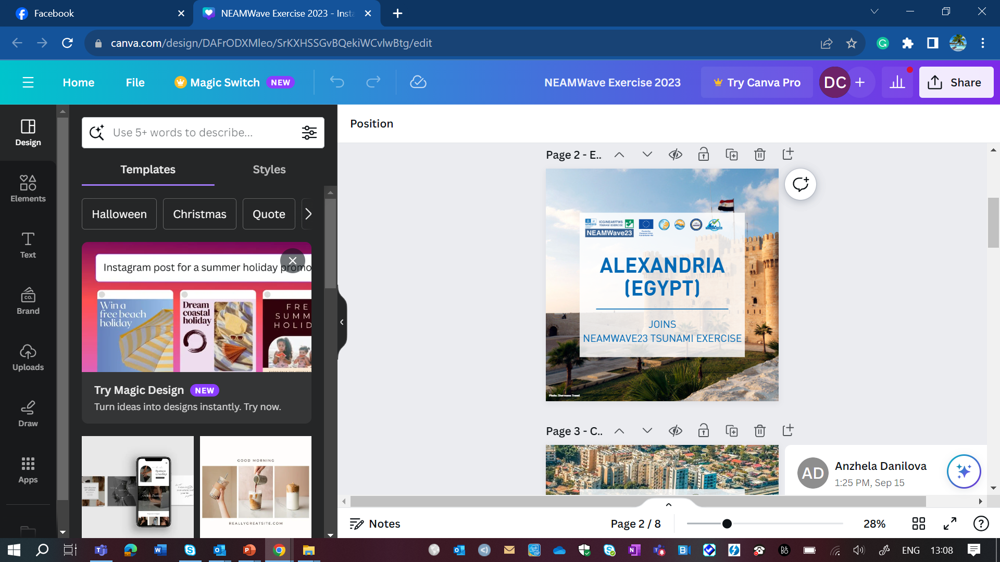
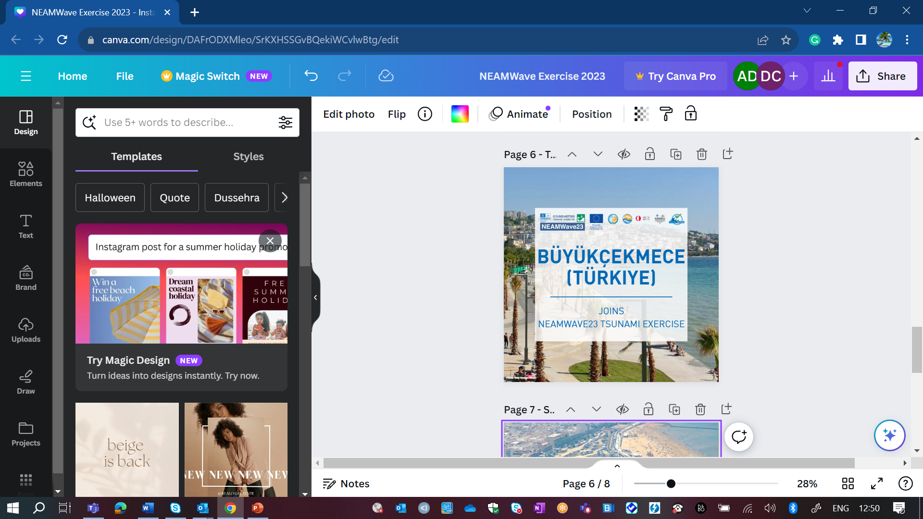
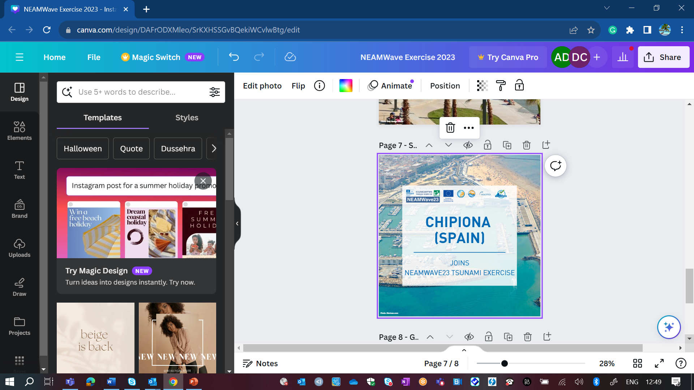
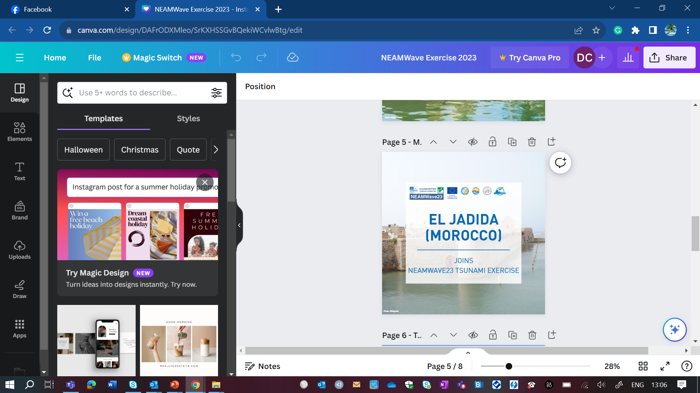
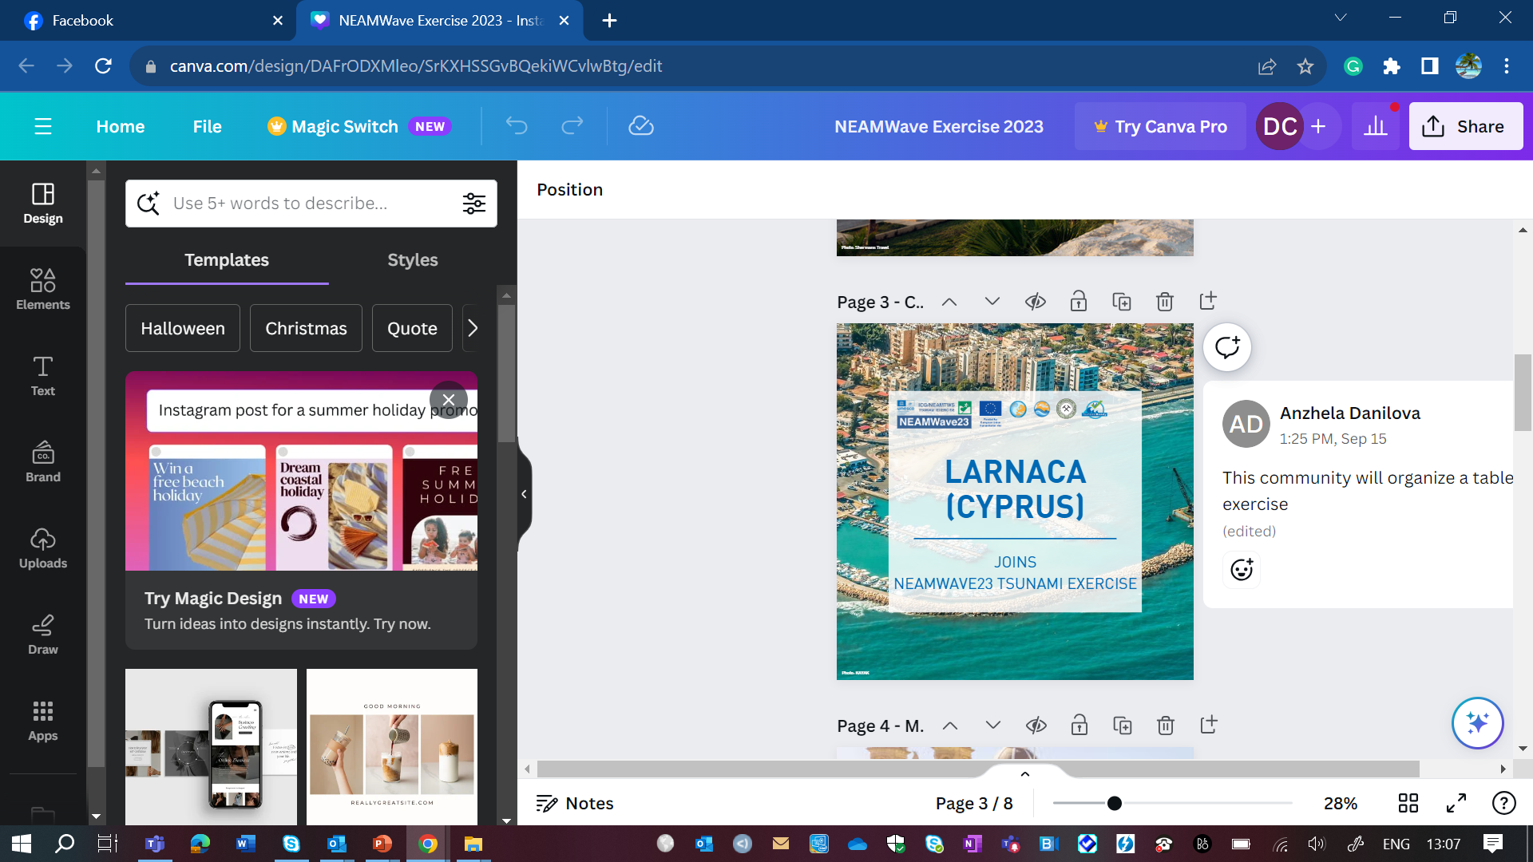
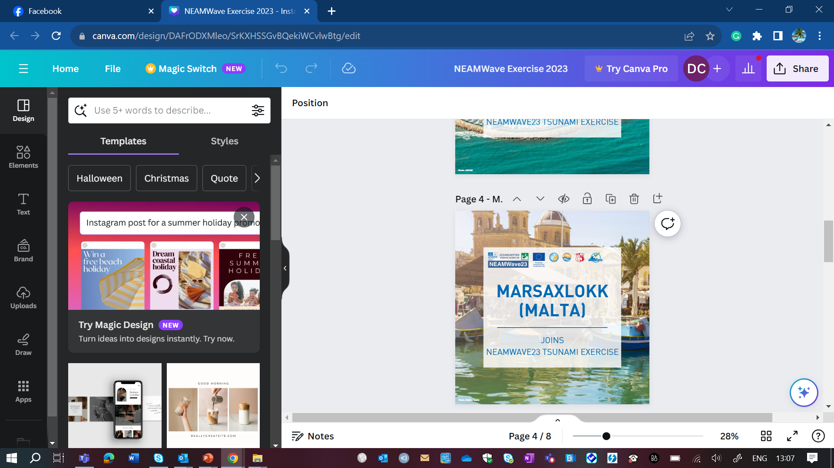
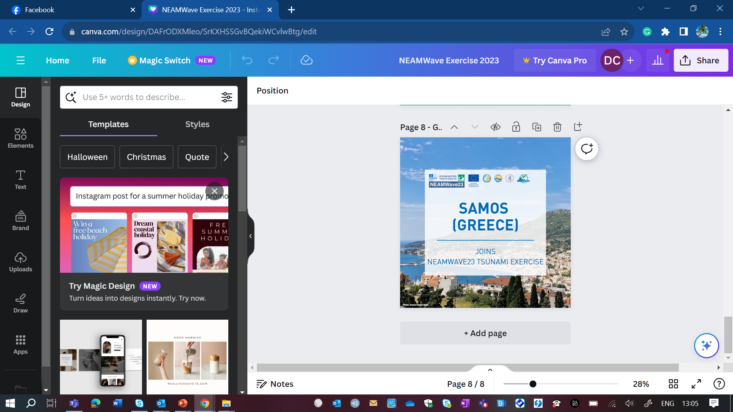











Funded by the European Union (EU) Directorate-General for European Civil Protection and Humanitarian Aid Operations (DG ECHO)
COASTWAVE PROJECT
Progress Summary
Presenter: Derya Itir VENNIN, PhD
Assoc. Project Officer UNESCO IOC/TSR
CoastWAVE Project Coordinator
d.dilmen-vennin@unesco.org
May 13, 2024, Paris

Slide 2
COMPONENT 2 (Tsunami Detection and Alerting Equipment )
Remaining Activities
Activity | Completed
Activity 1 Identify local partners to operate and maintain the systems | El Jadida-Governor of EL Jadida Alexandria- Governor of Alexandria Chipiona- Municipality of Chipiona Cyprus- Cyprus Civil Defence
Activity 2 Conduct site surveys to identify optimum locations for the tsunami detection and alerting systems | Partners identified the operating agencies responsible for handling and maintaining the systems . Performed site surveys Currently being completed by the companies and the local partners in Alexandria and El Jadida
Activity 3 Design, installation and commissioning of the tsunami detection and alerting systems | TOR established for the affordable tide gauges in collaboration with JRC TOR established based on FEMA guidelines for the sirens Advertised and followed the procurement procedures of UNESCO Designed, procured and installed 3 Affordable Tide Gauges (ATG) in Morocco, Cyprus and Egypt by Universitat de les Illes Balears and Spanish Institute of Oceanography. Needs determined by the companies and the local partners for the sirens: 2 electronic sirens-El Jadida 3 electronic sirens-Alexandria 2 electronic sirens-Chipiona 3 electronic sirens-Cyprus

Slide 3


REMAINING ACTIVITIES
May
June
July
20
24
20
24
20
24
External Evaluation of the project by the auditors
Final reporting
Publications on Risk perception and IDSL
Final project meeting in Alexandria, 27-30 May 2024
Installation of signages and alert systems in Cyprus, Morocco, Egypt and Spain
TR ceremonies of Morocco, Greece and Spain
External Evaluation of the project by the auditors
80%
85%
90%
95%
97%
99%
August
September
October
20
24
20
23
2024
External Evaluation of the project by the auditors
Summary brochures
External Evaluation of the project by the auditors
Final closure after the review of the external evaluation

Slide 4





Thank you for your attention.
coastwaveproject
CoastWave_IOC
DERYA VENNIN, PHD
d.dilmen-vennin@unesco.org

