Slide 1

2.1 Update on NEAMWave23
Evaluation Reports
Coordinated by Task Team on Tsunami Exercise
(co-chairs: Ceren Ozer Sozdinler - Marinos Charalampakis)
ICG/NEAMTWS Steering Committee and Information Session
13 May 2024

Slide 2

Opportunity for greater synergies within Tsunami Ready recognized communities.
IOC CL 2950: “For this exercise (NEAMWave23), a key objective is the involvement of Member States that participate in the CoastWAVE project, coordinated by UNESCO and those of other non-project countries (France, Italy). This exercise will test the efficiency and the abilities of the pilot UNESCO-IOC Tsunami Ready communities to respond in a complex and realistic situation, overcoming any challenges that may arise.”
Date & Time | Scenario | Region | TSPs
6 November 2023 08:00 UTC (6 hours)* | 1761 Atlantic Earthquake [8.5 Mw] | North-Eastern Atlantic [35°N, 12°E, 10 km] | IPMA - CENALT
7 November 2023 08:00 UTC (3½ hours)* | Hellenic Arc [8.1 Mw] | Eastern Mediterranean [34.52°N, 24.57°E, 10 km] | INGV – NOA – KOERI
* Duration of message dissemination by TSPs
ICG/NEAMTWS SC and Information Session ● 13 May 2024

Slide 3
Steps of NEAMWave23
Phase A
Phase B
Phase C
Dissemination of exercise messages to the NEAMWave23 subscribers via e-mail, fax, GTS and optionally SMS and CAP-TSU.
(TSP-TSR)
Orientation workshop
Drill exercise Table Table top exercise
Functional exercise
Full-scale exercise
(TWFP/NTWC – CPA)
Test of CECIS
Test of procedures for the request of international assistance
(CPA & ERCC)
ICG/NEAMTWS SC and Information Session ● 13 May 2024

Slide 4
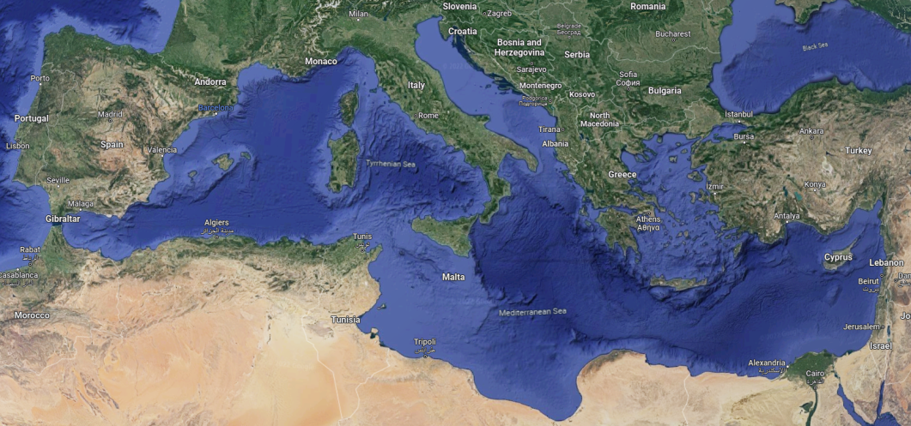
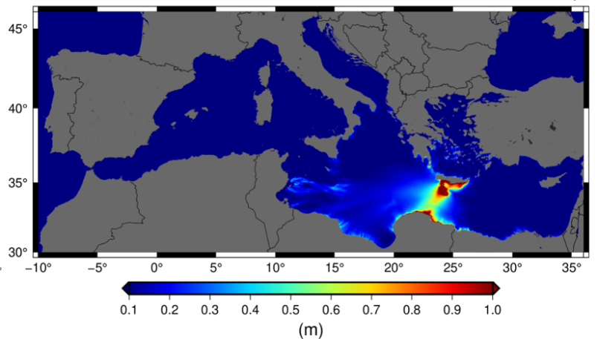
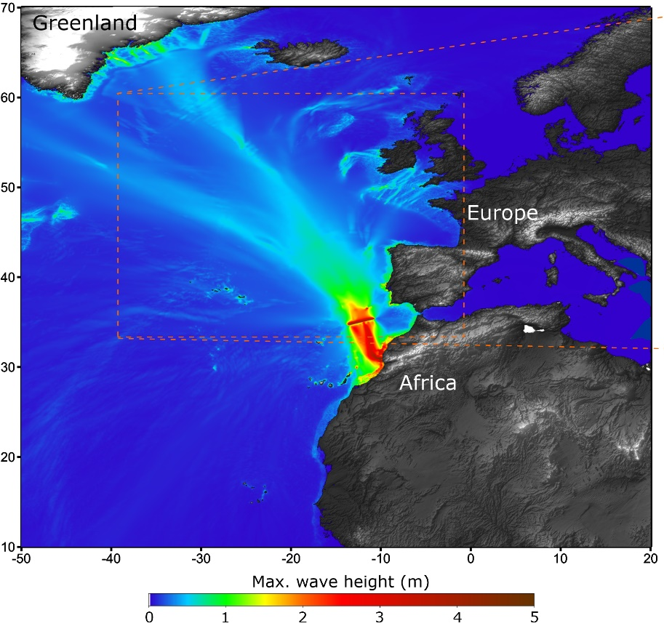
NEAMWave23 scenarios
North Eastern Atlantic
Joint scenario (Mw=8.5) by IPMA & CENALT
Eastern Mediterranean
Joint Scenario (Mw=8.1) by INGV, NOA & KOERI
ICG/NEAMTWS SC and Information Session ● 13 May 2024

Slide 5
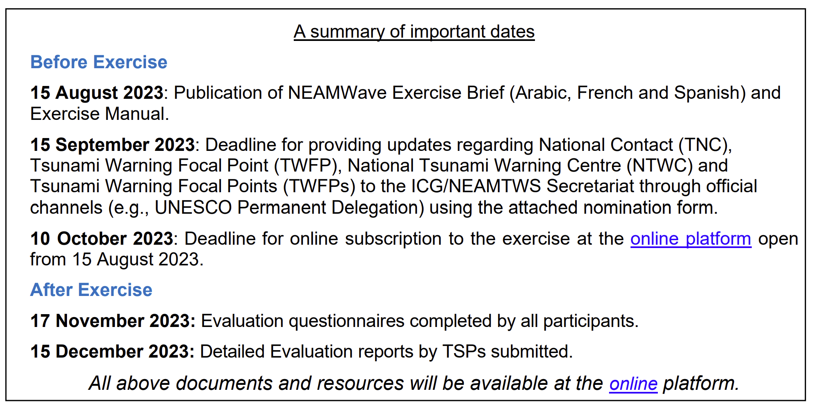
Announcements for NEAMWave23
IOC Circular Letter 2950 and 2950_form: on 10th of July, 2023
ICG/NEAMTWS SC and Information Session ● 13 May 2024

Slide 6
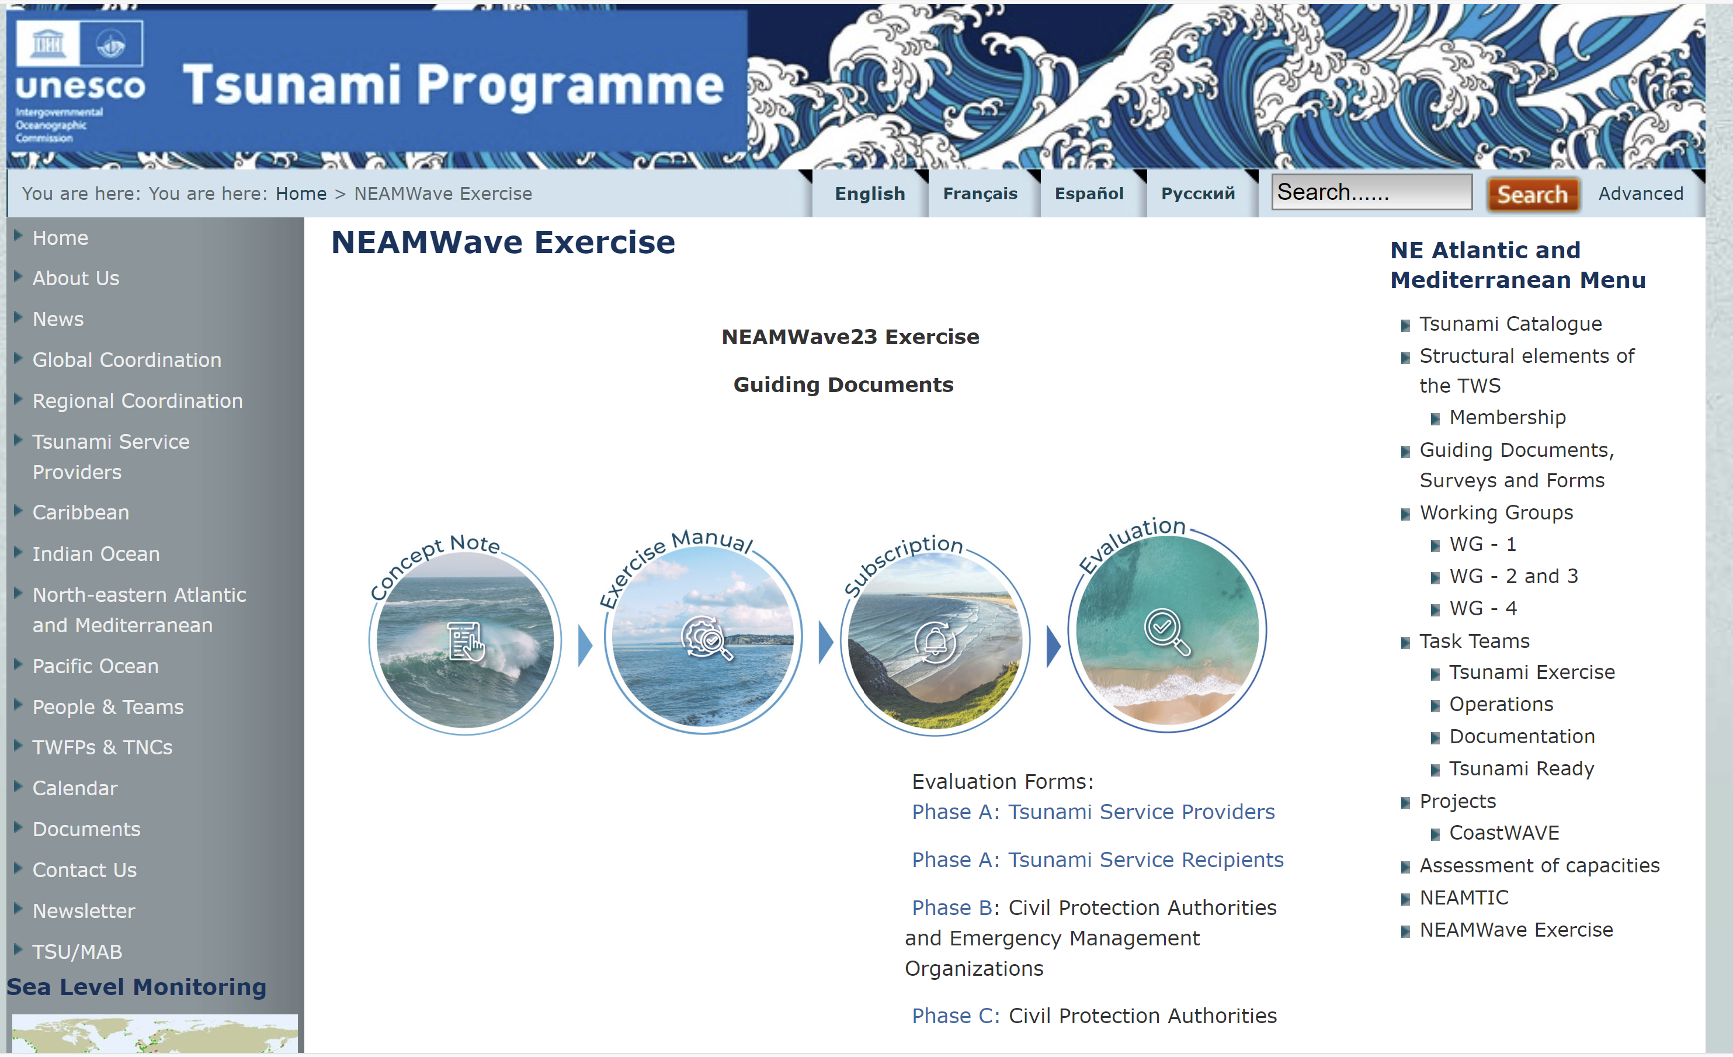
Preparations for NEAMWave23
ICG/NEAMTWS SC and Information Session ● 13 May 2024

Slide 7
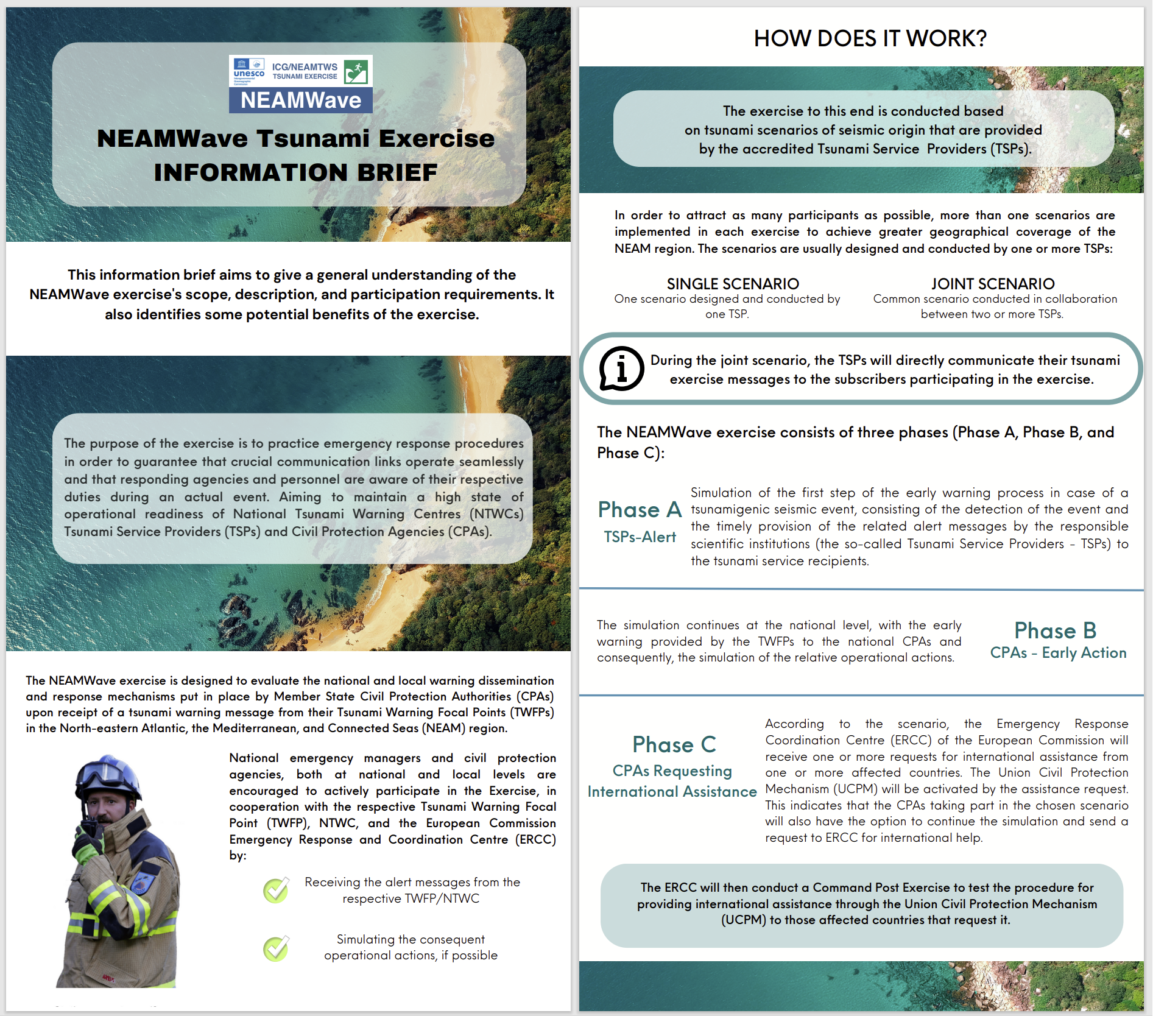
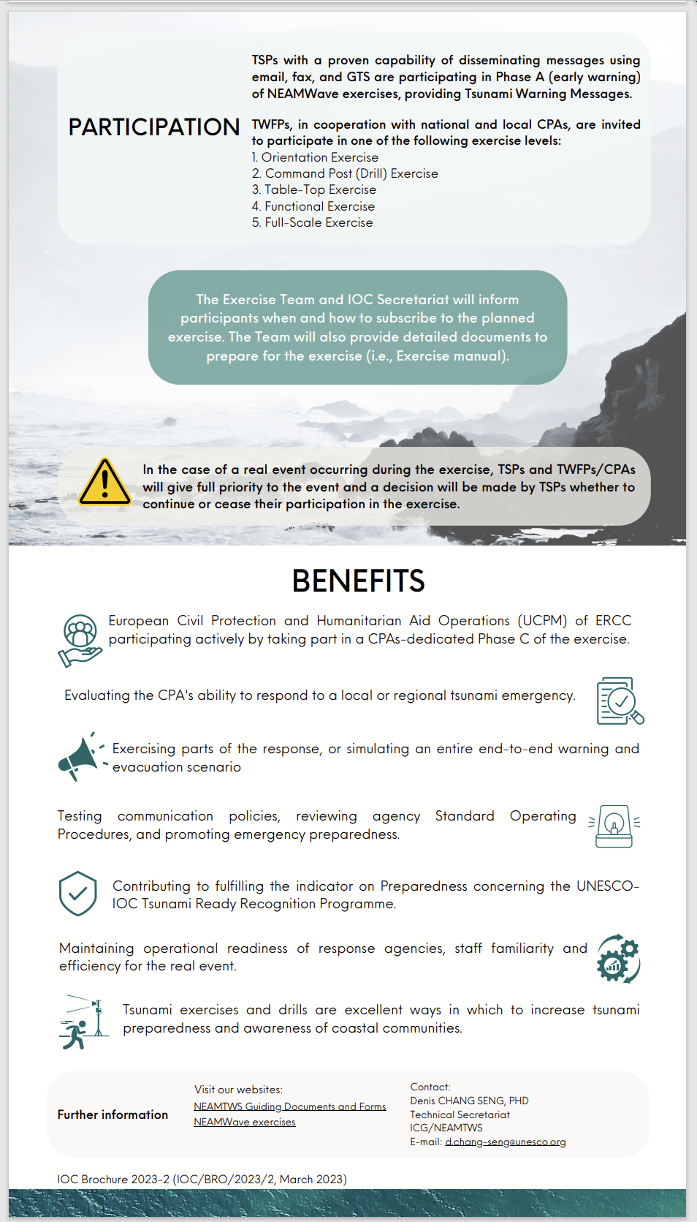
Preparations for NEAMWave23
Special thanks to Maria Camila León Duque!
ICG/NEAMTWS SC and Information Session ● 13 May 2024

Slide 8
Participation Statistics
IOC CL 2950: “Very importantly, Member States registered as recipients of a Tsunami Service Provider are urged to also subscribe to the exercise through the online form”.
ICG/NEAMTWS SC and Information Session ● 13 May 2024

Slide 9
Evaluation in numbers
44 Evaluation forms have been received.
Phase A (TSP): 5 Member States
France (CENALT), Greece (NOA), Italy (INGV), Portugal (IPMA) & Turkey (KOERI)
Phase A (TSR): 9 Member States and 1 International body
Cyprus, Finland, France, Greece, Italy, Portugal, Romania, Spain & Turkey and ERCC
Phase B: 14 Member States subscribed – 4 filled evaluation forms
Cyprus, Italy, Spain & Turkey
Phase C: 1 Member State
Finland
ICG/NEAMTWS SC and Information Session ● 13 May 2024

Slide 10
NEAMWave23 & Tsunami Ready
Istanbul
NE Atlantic Scenairo
(Mw=8.5) by IPMA & CENALT
Chipiona
Minturno
Samos
El Jadida
Larnaka
Malta
Eastern Mediterranean Scenario (Mw=8.1) by INGV, NOA & KOERI
Alexandria
ICG/NEAMTWS SC and Information Session ● 13 May 2024

Slide 11
NEAMWave23 & Tsunami Ready
The participation of CPAs is “indirectly” increasing with the synergy of CoastWAVE project.
Common sense is that it is an opportunity to start drafting the SOPs and to renew discussions with the local authorities.
Member States | Exercise Type
Cyprus | Table Top
Egypt | Drill
Greece | Table Top and Drill
Italy | School Drill
Malta | Full Scale
Morocco | Full Scale
Spain | Full Scale
Türkiye | Table Top
ICG/NEAMTWS SC and Information Session ● 13 May 2024

Slide 12
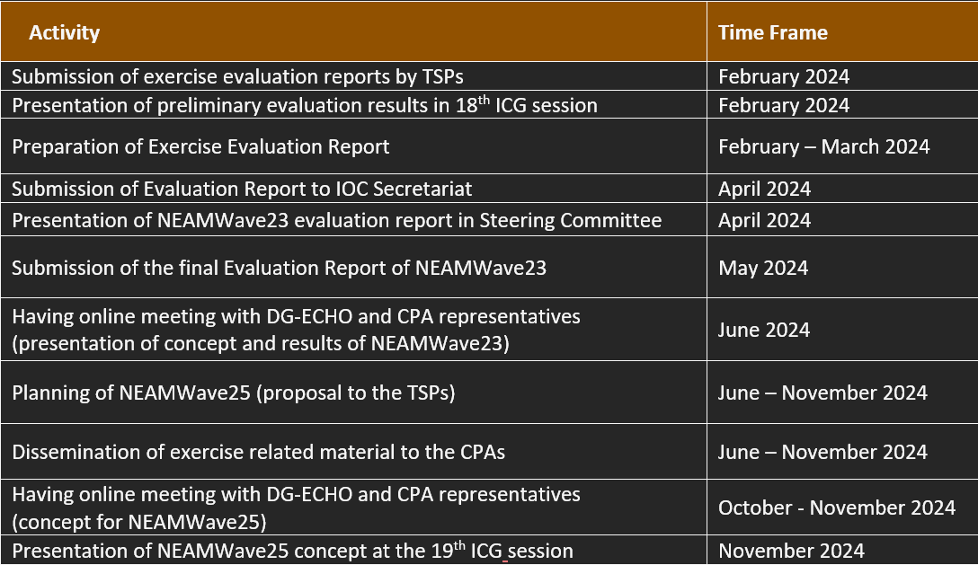
Next steps – PoA of TT-TE
ICG/NEAMTWS SC and Information Session ● 13 May 2024

Slide 13
Recommendations of the Task Team on Tsunami Exercises
To plan and conduct the next NEAMWave tsunami exercise in 2025 (NEAMWave25), but to decouple NEAMWave exercise from WTAD, since a lot of activities are organized at a national level, preventing MS from fully implementing NEAMWave exercise phases.
To revise the online tools (subscription and evaluation) to become more user friendly. Subscription mechanism should become more efficient to be able to better capture the number of participants;
MS to make use of the NEAMWave exercise as an opportunity for local tsunami exercises, especially at the communities that are implementing the TRRP;
To investigate the potential for further testing the use of Galileo EWS for message dissemination. Other dissemination methods like SMSs or automated phone calls should be explored, in order to evaluate the effectiveness and feasibility of non-internet-based methods, as alternative dissemination ways of sharing information;
ICG/NEAMTWS SC and Information Session ● 13 May 2024

Slide 14
Recommendations of the Task Team on Tsunami Exercises
To share the NEAMWave Exercise Manual with the exercise participants early to facilitate the necessary preparations and organizations;
To organize an adequate number of online meetings between the TT-TE Exercise Team and targeted participant groups, like TSPs, TWFPs, CPAs etc. prior to the exercise for explaining the details of exercise scenarios and discussing on the progress of NEAMWave activities;
To organize online meetings with ERCC and representatives of Civil Protection Authorities before implementing NEAMWave exercises in order to encourage them to participate in the exercises and discuss about a clearer classification of Phase B exercise types;
TNCs of Member States to encourage Civil Protection Authorities in their country to participate in future NEAMWave exercises;
TSPs to co-operate and prepare one or more joint exercise scenarios
ICG/NEAMTWS SC and Information Session ● 13 May 2024

Slide 15
TT-TE Next Actions
NEAMWave25 is planned to conduct within the fourth quarter of 2025.
Finalization of NEAMWave23 Evaluation report is delayed; it will be completed until next ICG.
Working on the preparations of the next NEAMWave exercise, in cooperation with the exercise team;
Updating the NEAMWave Exercise Manual and preparation of improved online forms for subscription and evaluation, in collaboration with the ICG/NEAMTWS Secretariat;
Supporting the ICG/NEAMTWS Secretariat in the organization of online meetings for exercise preparation;
Development of a digital tool/database for managing and updating contacts both for the exercise, but also for tsunami warning message dissemination
ICG/NEAMTWS SC and Information Session ● 13 May 2024

Slide 16
Thank you!

