Slide 1

15th Session of Observations Coordination Group (OCG) – Data Implementation Updates
OCG-15 Session, 13-17 May 2024
ONC, Victoria, British Columbia, Canada
Kevin O’Brien
UW/CICOES, NOAA/PMEL
GOOS OCG Vice-chair for Data and Information

Slide 2
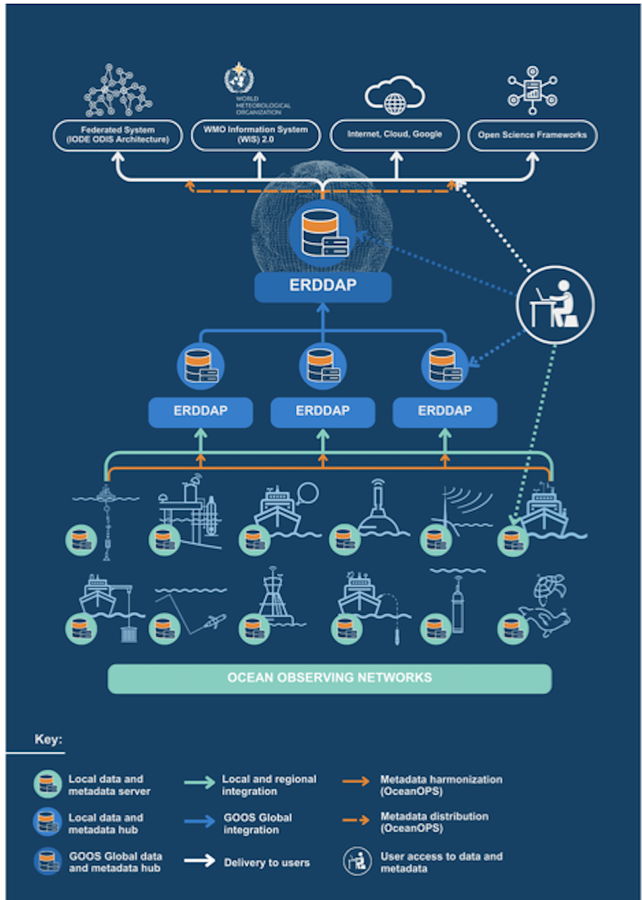
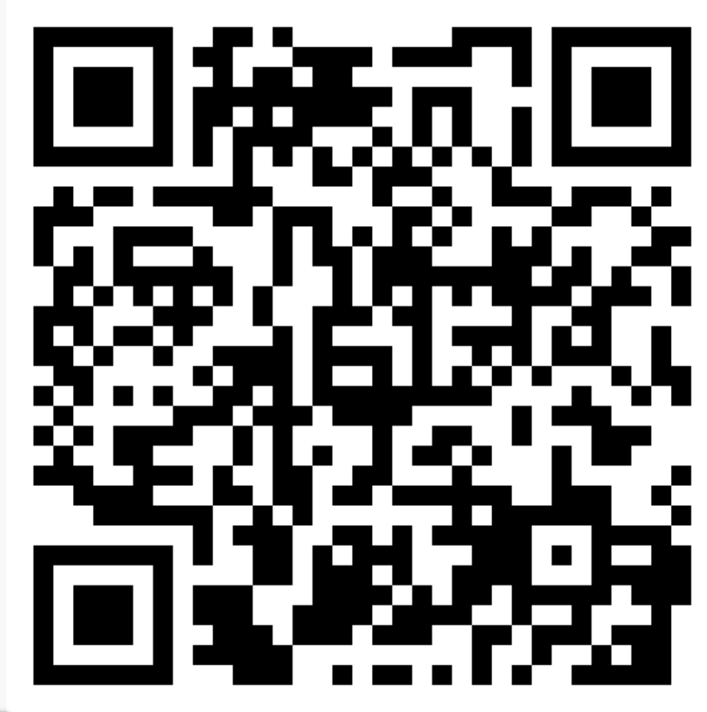
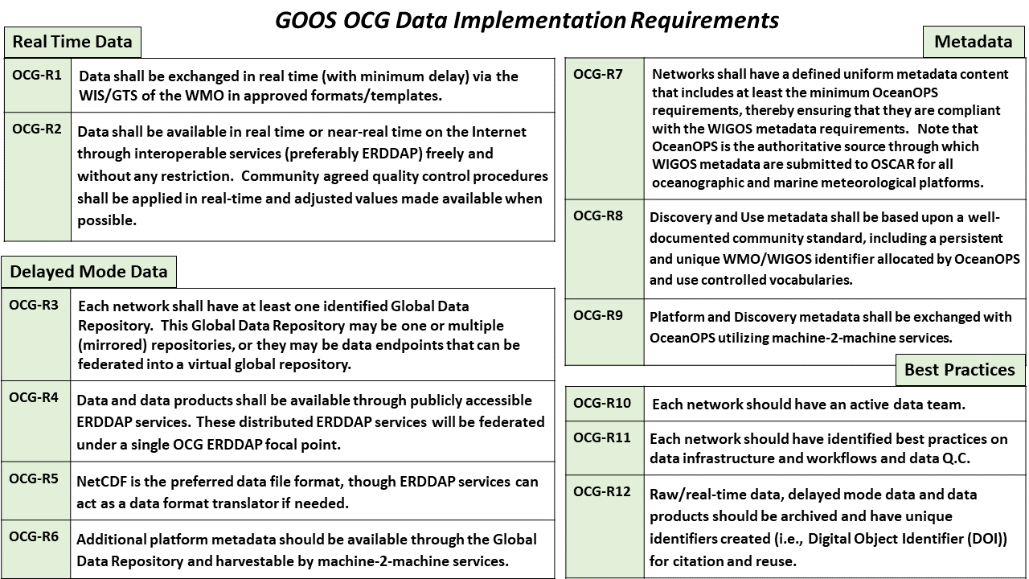
OCG Cross-Network Data Implementation Strategy Released
This Implementation Plan is an effort to define specific and actionable ways OCG network/programs can move towards FAIR compliance
Improve (meta)data discovery, exchange, accessibility and usability for all stakeholders
Improve access to distributed (meta)data endpoints through federated, uniform data services

Slide 3
Implementation across the networks
AniBOS
Working with data management task team (Ian Johnson, Fiona Carse co-chairs)
MEOP v2024 data in OCG Federated node
Developed metadata dataset for harvest (to be hosted by OTN eventually)
HF Radar
Meeting in January to discuss ERDDAP™️ implementation, metadata exchange with OceanOPS
Total velocities for all HF Radar stations hosted by EMODnet (will add these to Federated Node)
Both EMODnet and Rutgers host radials in ERDDAP™️
  use radials for metadata harvest by OceanOPS. Magali/Kevin need to assess metadata content in ERDDAP™️ services
OceanGlider
OG v1.0 finalized
Various ERDDAP ™️ services exist at IOOS, VOTO, EGO (?)
  hopefully use these to exchange metadata with OceanOPS
Glider meeting in June

Slide 4
Implementation across the networks
GO SHIP
CCHDO identified as GO-SHIP DAC at SC meeting in New Orleans
Data available in NetCDF and configured in ERDDAP™️ (federated in OCG node)
DBCP
GDP 1 and 6 hour velocities available in ERDDAP™️ from AOML DAC (federated into OCG Node)
Tropical moored buoys available from NOAA Coastwatch (federated in OCG node)
Working with Moored buoy to implement metadata dataset in ERDDAP™️
Mooring metadata in development ERDDAP™️ (Working with DBCP TM to validate, etc)
Discussions with GDP about metadata exchange with OceanOPS/WIGOS ongoing.
GLOSS
Interacted at January Steering Committee meeting
Productive discussions on data/metadata federated across GLOSS data repos using ERDDAP™️
  This will be the exchange mechanism with OceanOPS for metadata
University of Hawaii Sea Level data federated in OCG node

Slide 5
Implementation across the networks
SOT (VOS, SOOP, ASAP)
Not a lot from Data side (OceanOPS IDs and metadata work has been going on)
Working with Open-GTS to exchange non-traditional data on the GTS (Science RoCS, OceanSync)
OceanSITES
Working on integrating ERDDAP™️ : added flux products and existing long timeseries and some Deep T/S
Metadata exchange with OceanOPS is still an issue
Data products to provide to public is an ongoing discussion.
Argo

Slide 6
Implementation across the networks
FVON
Looking to provide summer mission data to GTS through Open-GTS
SMART Cables
Active as member of data team – looking for samples of (meta)data prior to 2025 deployment of first system
SOCONET
SOCAT is current data backbone of SOCONET effort. Data/Metadata available in ERDDAP™️. V2024 (June release) will be federated in OCG node.

Slide 7
Implementation across the networks
Paused the OCG data/metadata roundtables
Instead, working directly with the networks has been more productive at this stage
Moving forward, looking at having meetings/workshops focused on topics (metadata exchange, for example)
Implemented a successful ERDDAP™️ webinar series
  3 webinars last summer/fall
  3 scheduled for this summer

Slide 8
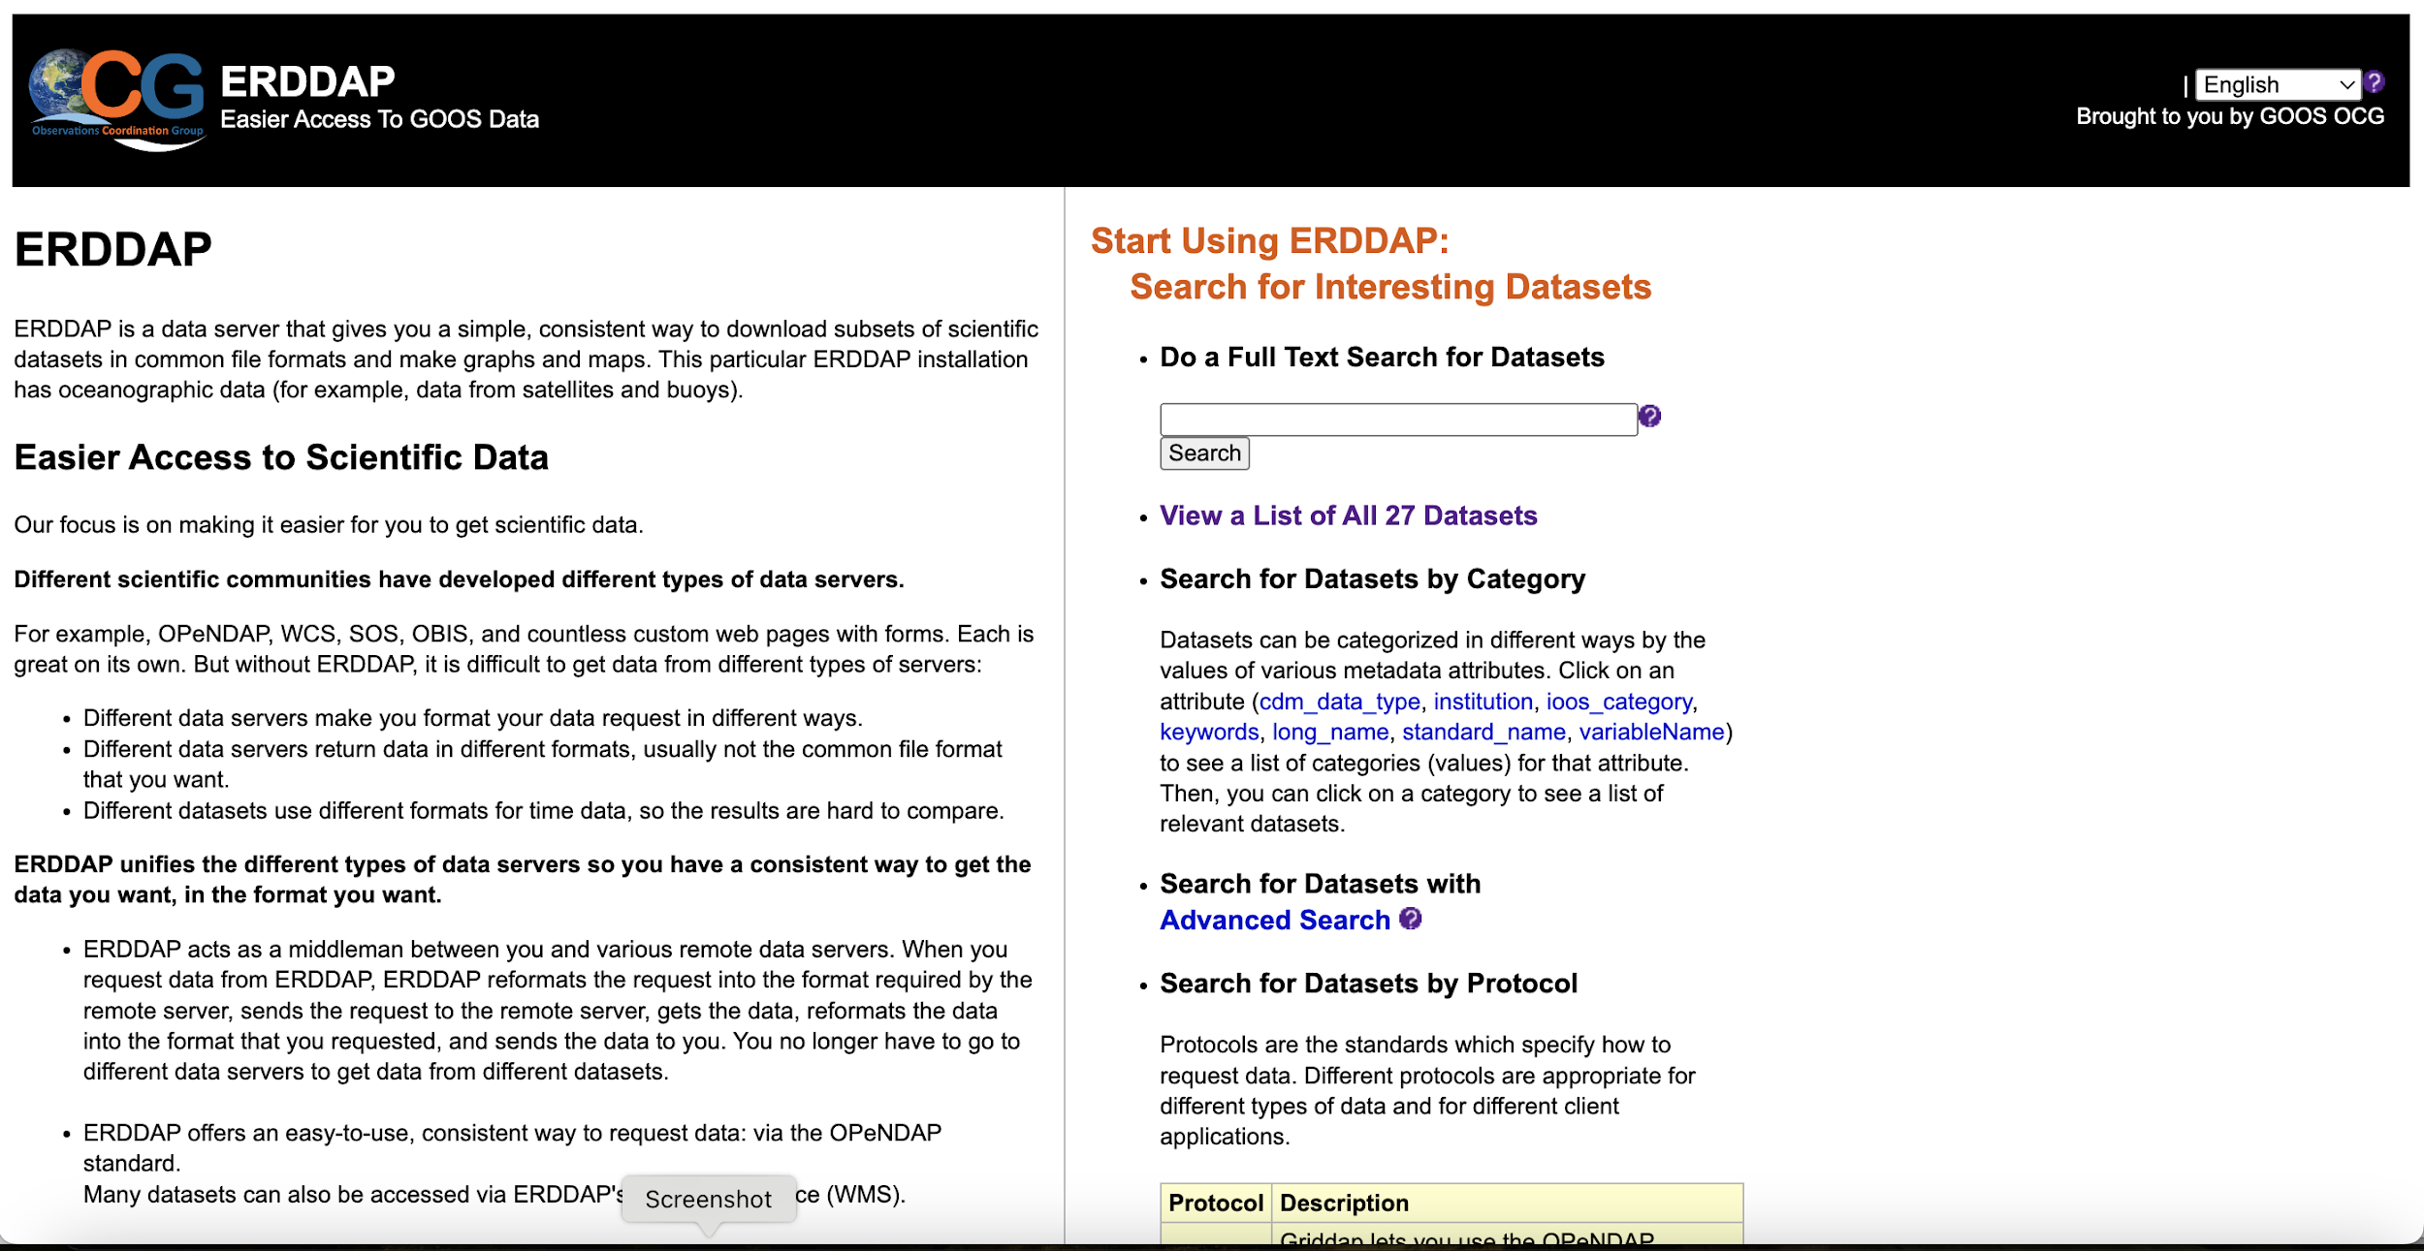
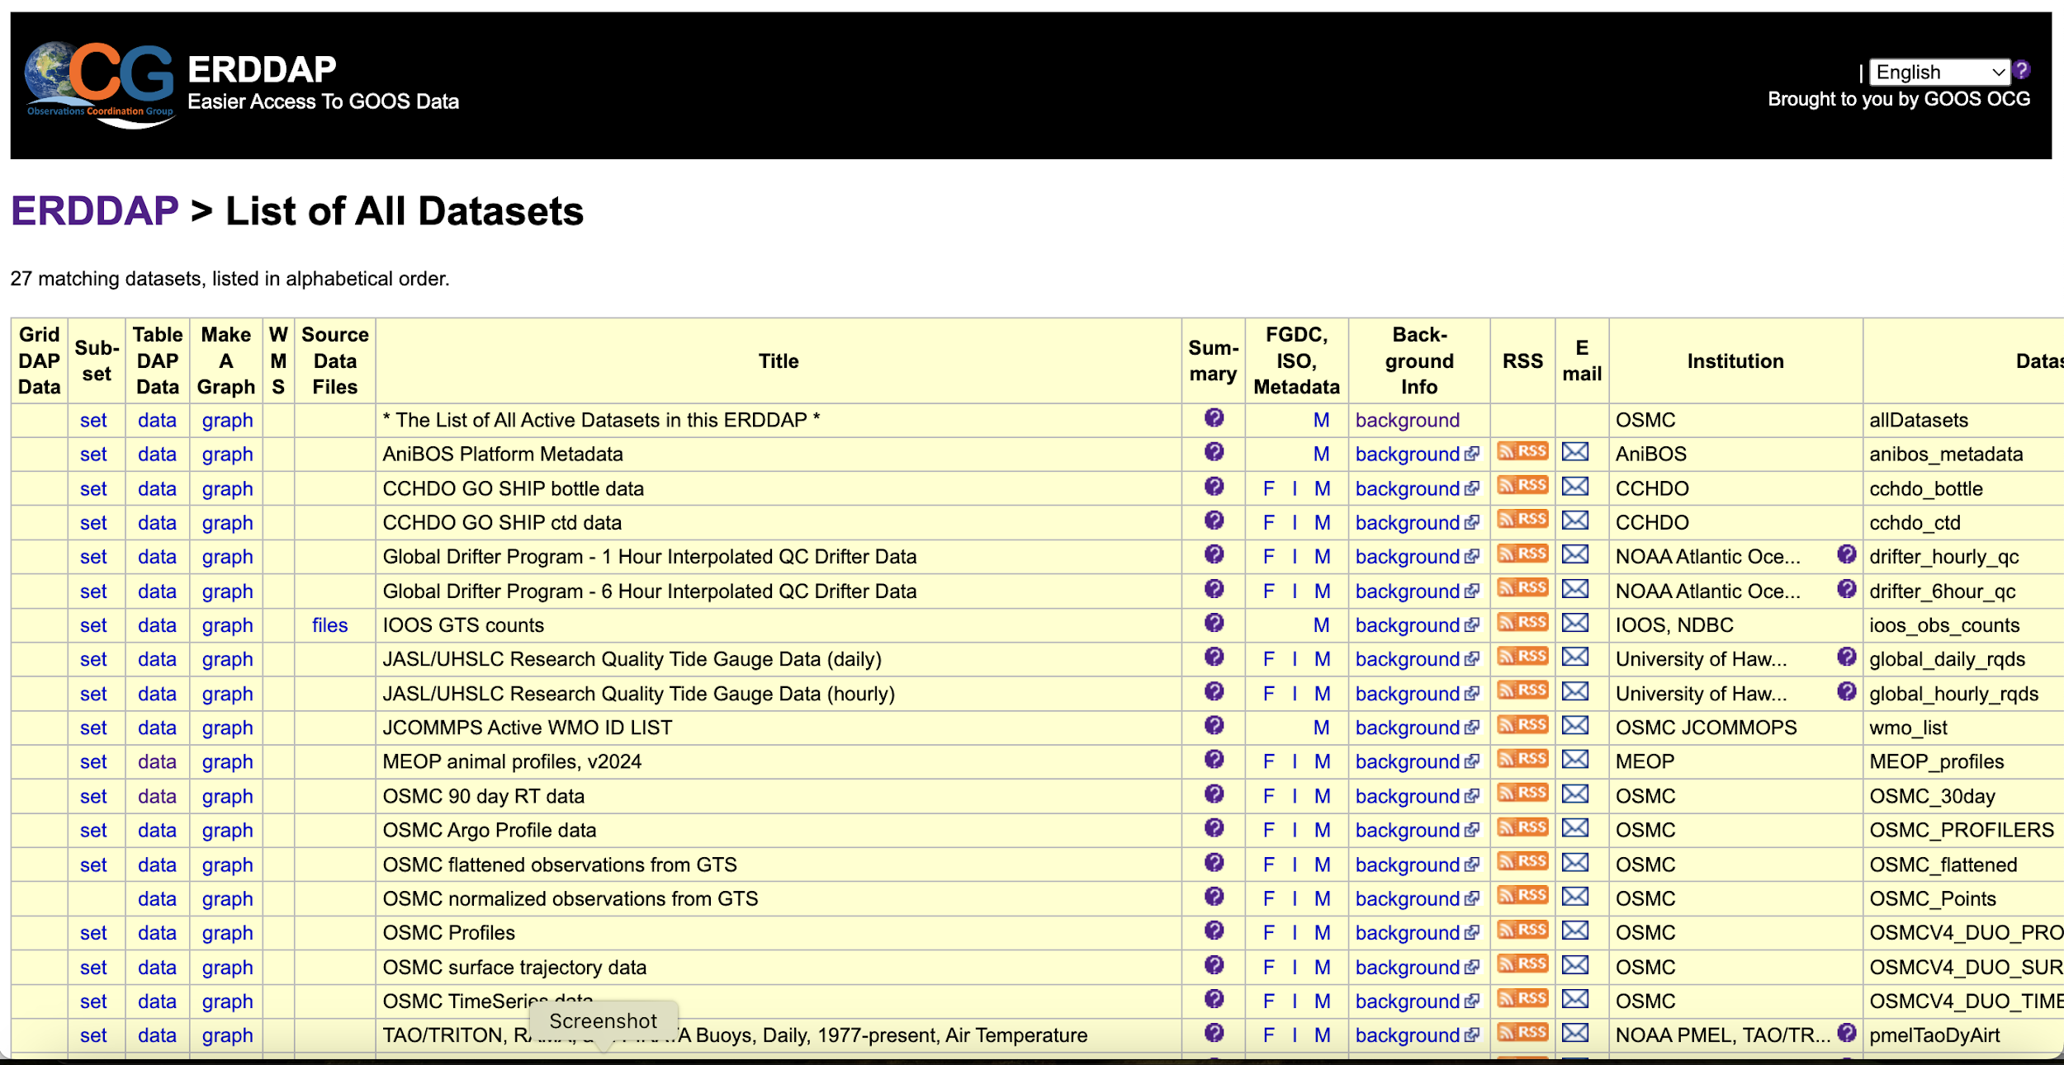
OCG Federated ERDDAP Node

Slide 9
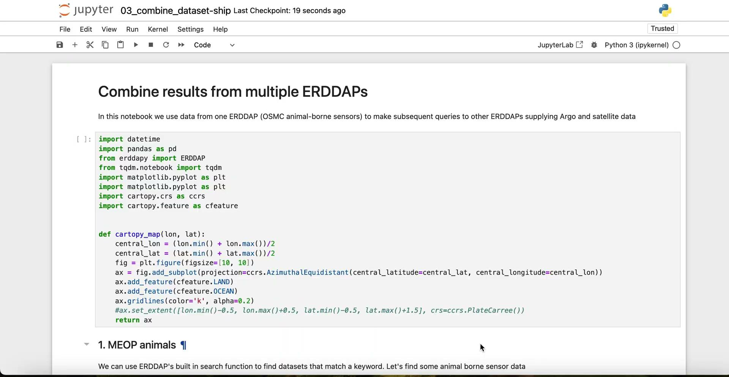
OCG Federated ERDDAP Node

Slide 10
What could a cross-GOOS infrastructure look like?
ODIS
GOOS/OCG ERDDAP
OBIS
OceanOPS
BioEco Portal
GOOS RAs

Slide 11
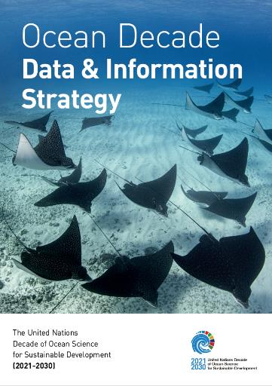

Links to the Community
UN Decade Data Strategy
IODE Ocean Data Information System (ODIS)

Slide 12
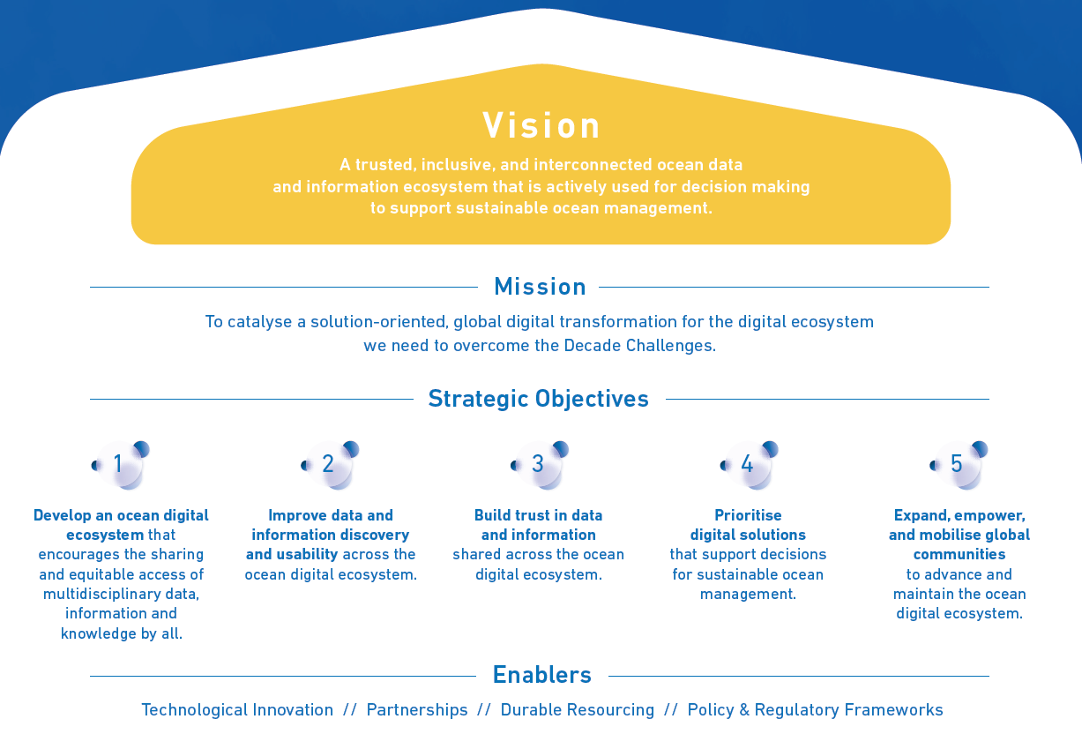
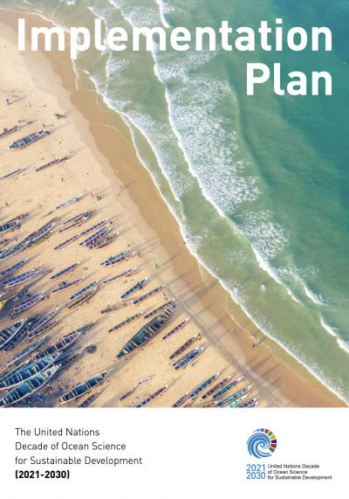




UN DECADE Data and Information Strategy, and the Data Implementation Plan
Notes:
Aligning to a multilateral mission
The implementation plan will guide you and your data teams to concretely and meaningfully align your system to others contributing to the Ocean Decade
We’re better together
If our digital capacities are implemented using similar norms, they can robustly and sustainably work together – this will help the Ocean Decade’s partnership thrive well past 2030

Slide 13
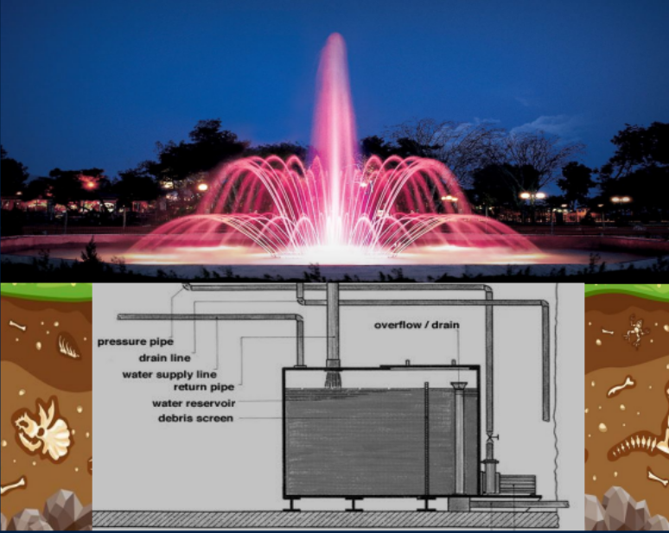
07
Strategy implementation plan – Why it matters to you
“Sparkly fountains need robust plumbing systems”
– Terry McConnell
G7 International Digital Twins of the Ocean Summit
Especially if you want to connect them
The IP talks about this bit,
where the real magic happens

Slide 14
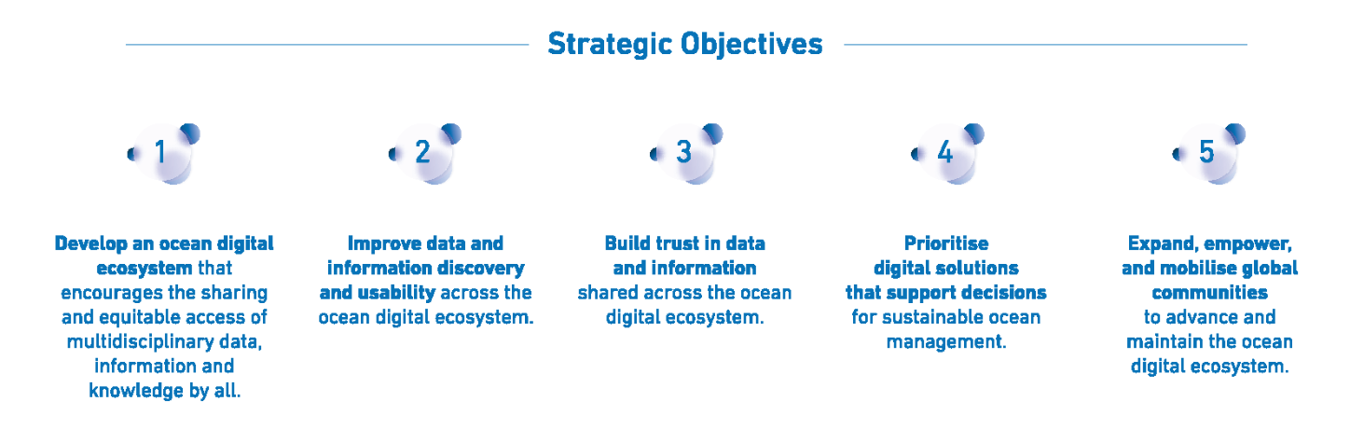
Integration with UN Decade Data Strategy
Ocean Decade Data
Strategy Implementation
GOOS Cross-Network Data Implementation Strategy
Action: Data publishers should deploy free and open (non-proprietary) data dissemination tools, capable of data mediation….services should provide data users easy access to enable discovery and use of data/metadata in preferred tools…..

Slide 15
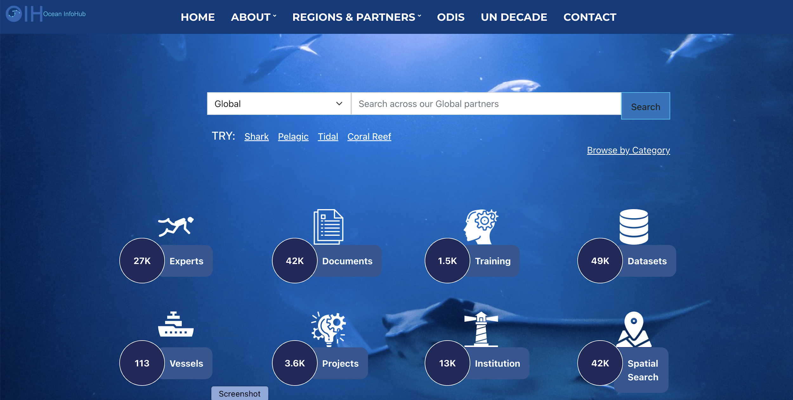
Integration with IODE Ocean Data and Information System (ODIS)*
*Federation of distributed metadata catalogs to further discovery and access of ocean data

Slide 16
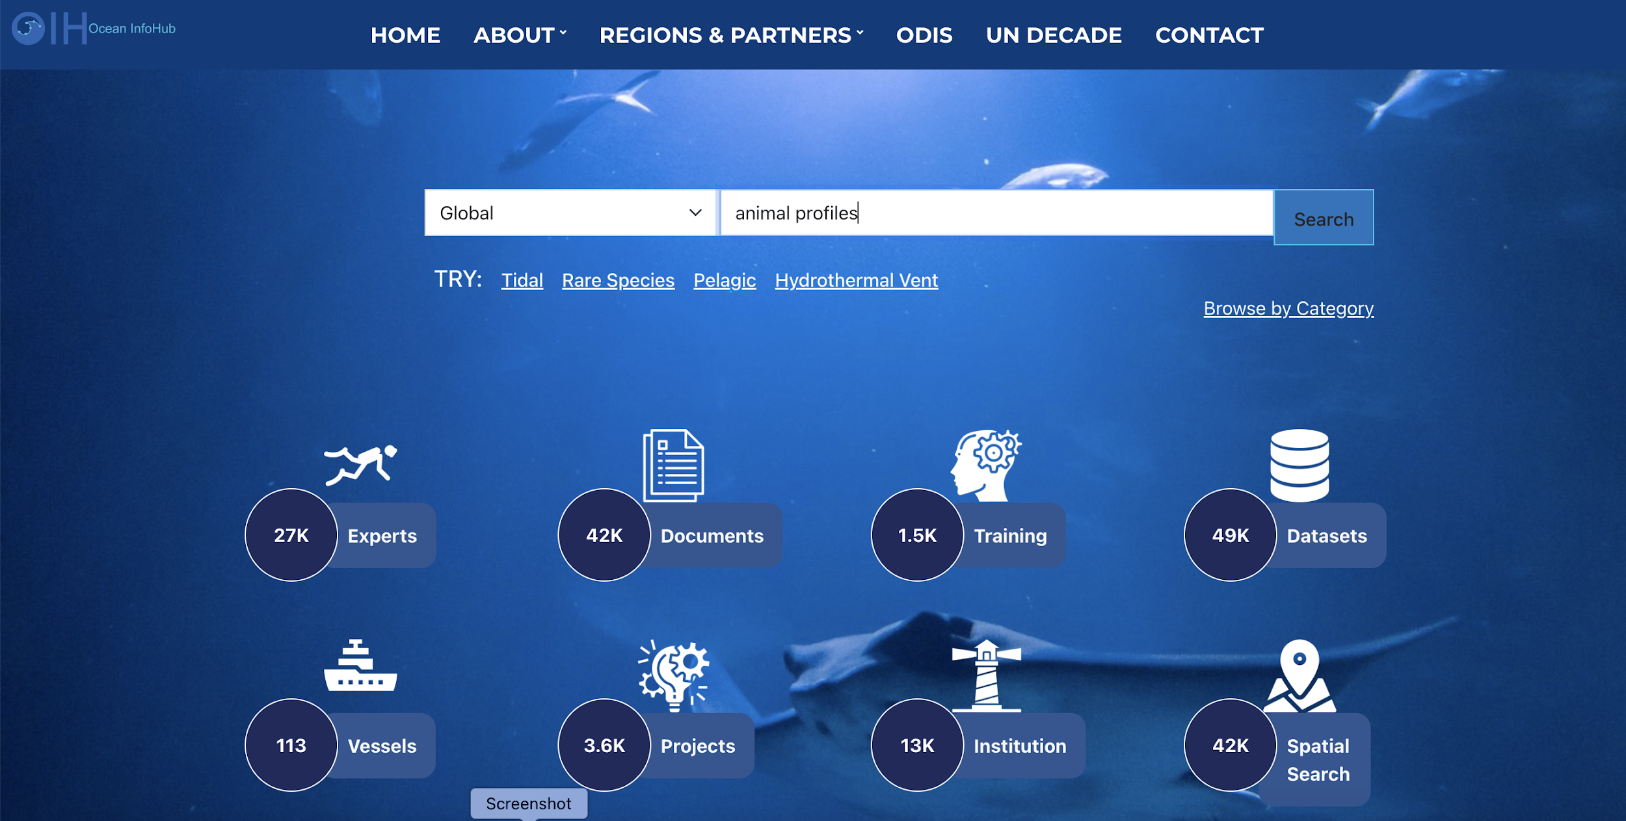
Integration with IODE Ocean Data and Information System
(ODIS)

Slide 17
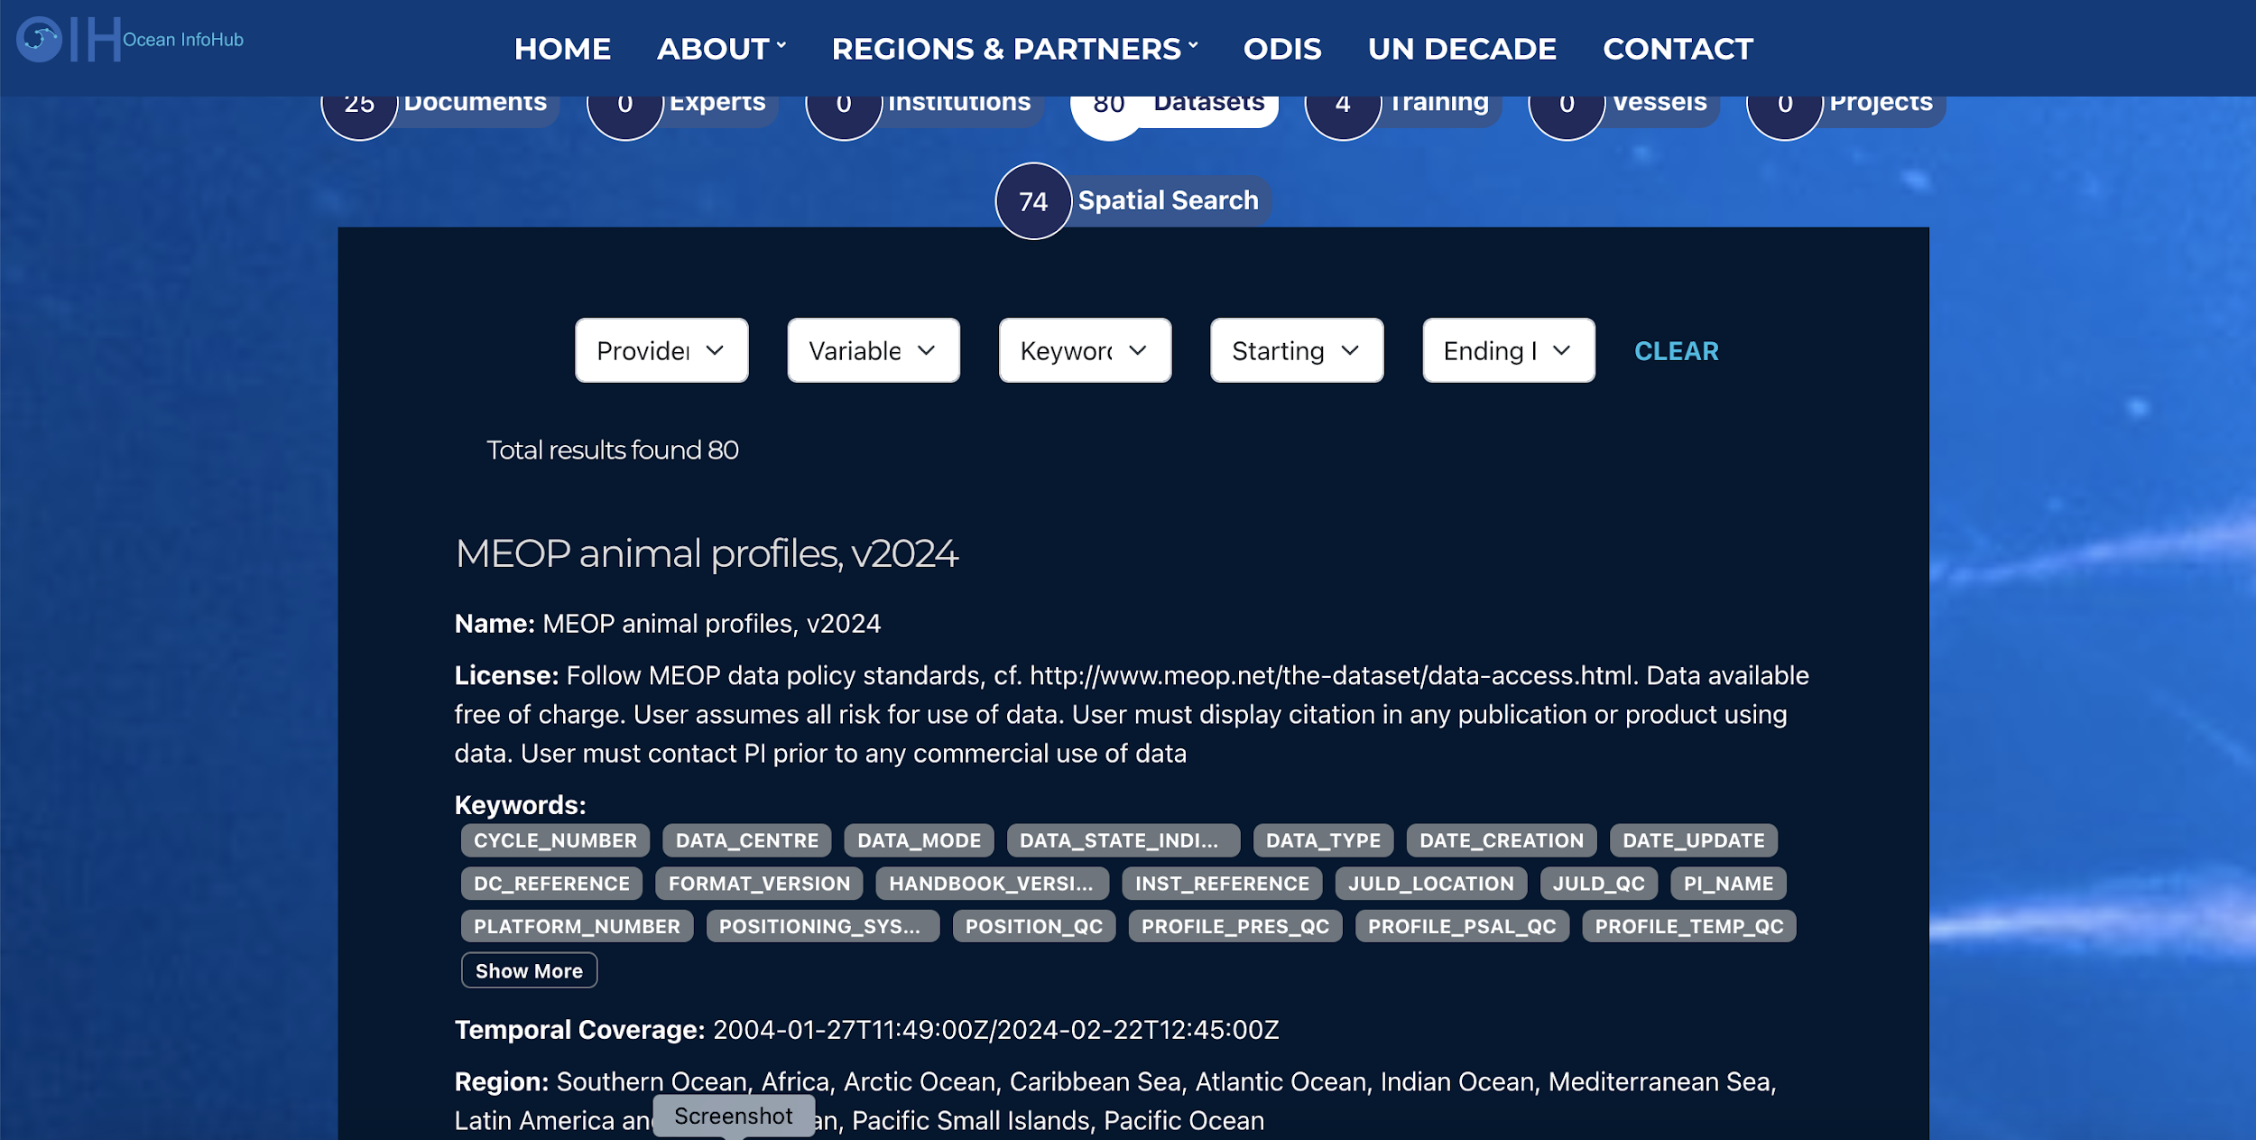
Integration with IODE Ocean Data and Information System
(ODIS)

Slide 18
Integration with IODE Ocean Data and Information System
(ODIS)
Sea surface temperature

Slide 19
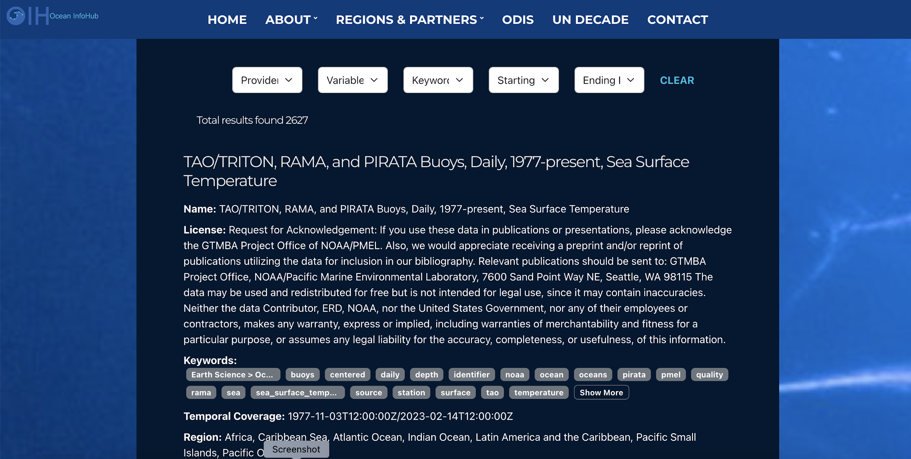
Integration with IODE Ocean Data and Information System
(ODIS)

Slide 20
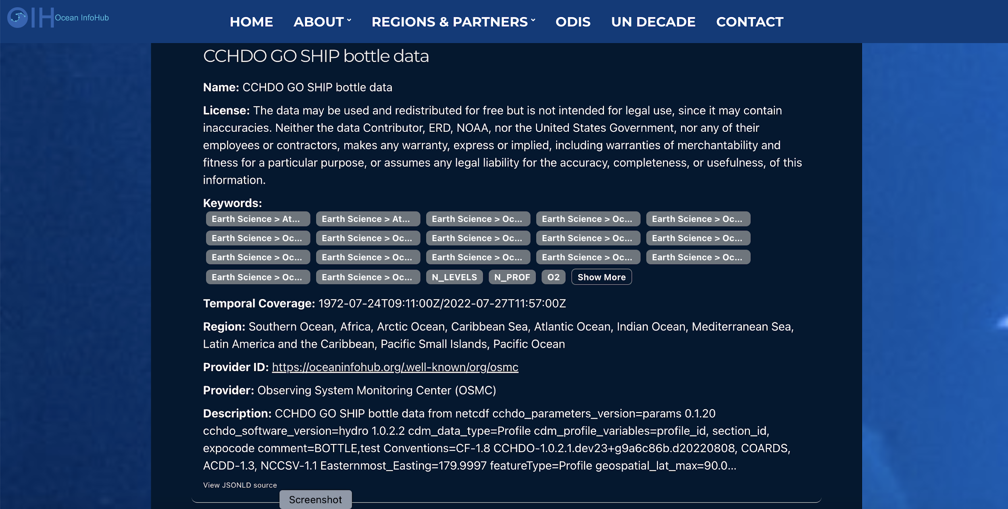
Integration with IODE Ocean Data and Information System
(ODIS)

Slide 21
Integration with IODE Ocean Data and Information System
(ODIS)

Slide 22
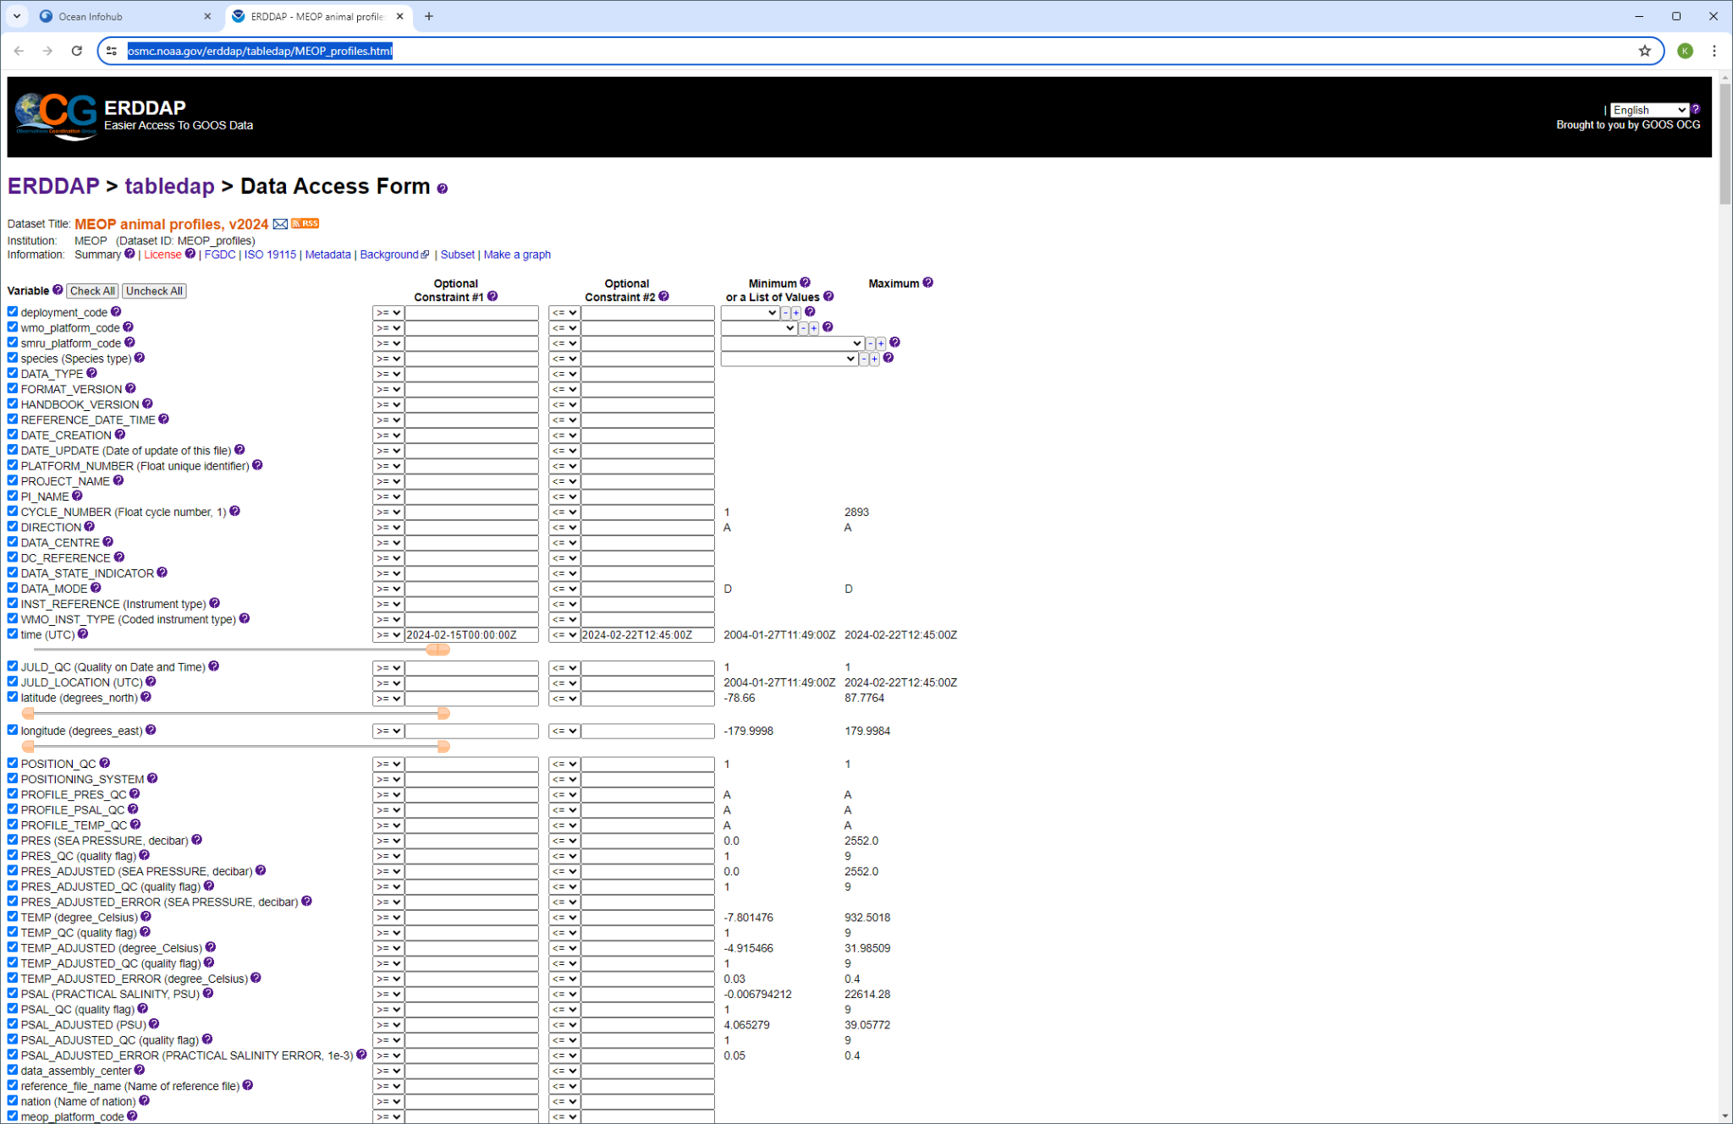
Integration with IODE Ocean Data and Information System
(ODIS)

Slide 23
Assessment of progress and gaps
Excellent progress in implementation of ERDDAP™️
Still lots of gaps with metadata exchange
In particular, implementation of machine-to-machine exchange of metadata with OceanOPS

Slide 24
Recommendations and Next Steps
Continue working with networks to implement ERDDAP™️
Integrate these services with OceanOPS metadata exchange
    Ensure that metadata content in ERDDAP™️ data services complies to OceanOPS requirements
    OceanOPS is still the official source of metadata for OCG networks to things like OSCAR and WIGOS – Do OceanOPS metadata requirements need to adjust?

Slide 25
Recommendations and Next Steps
Are there particular areas of focus that the Networks want to highlight?
What issues in implementing the OCG strategy can OCG data team help with?
What are barriers to implementing M2M metadata exchange with OceanOPS?
Do we need a dedicated workshop to overcome metadata issues? Are there other issues that need attention?

Slide 26
Recommendations and Next Steps
Discussions ongoing about what a Cross-GOOS infrastructure might look like
ODIS
GOOS/OCG ERDDAP
OBIS
OceanOPS
BioEco Portal
GOOS RAs

Slide 27
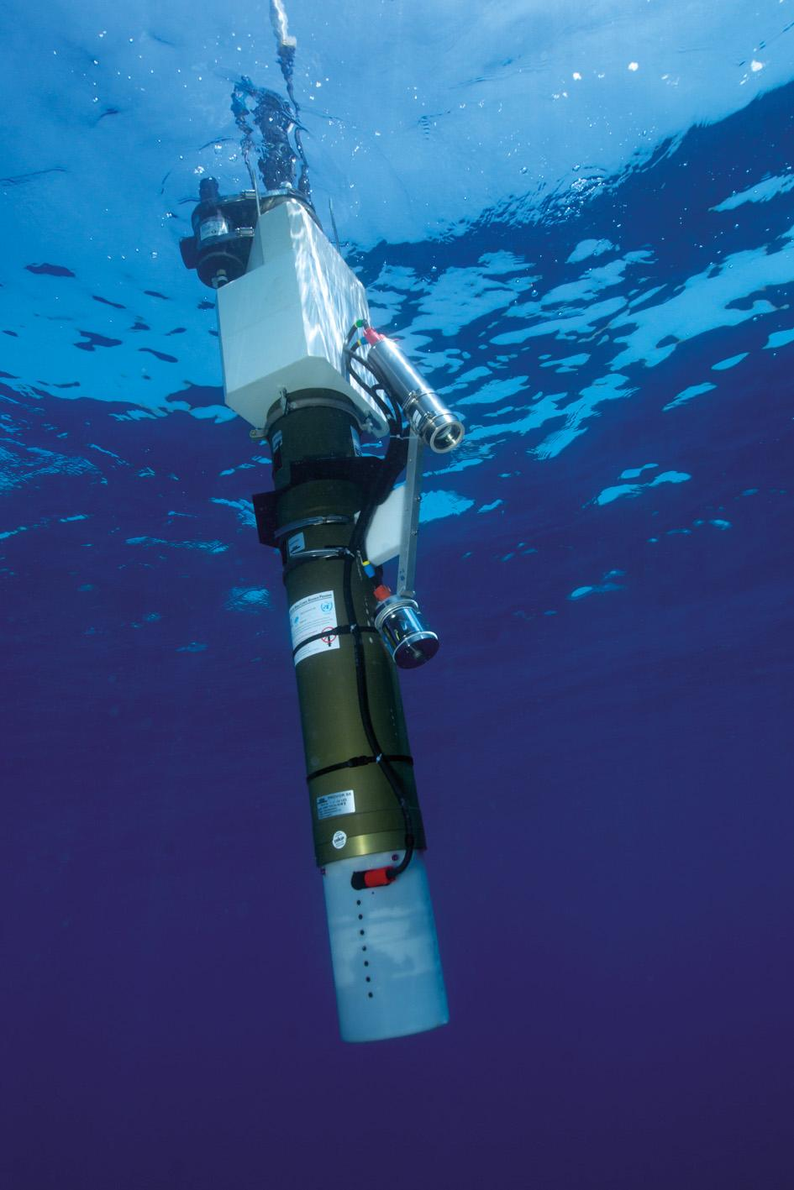
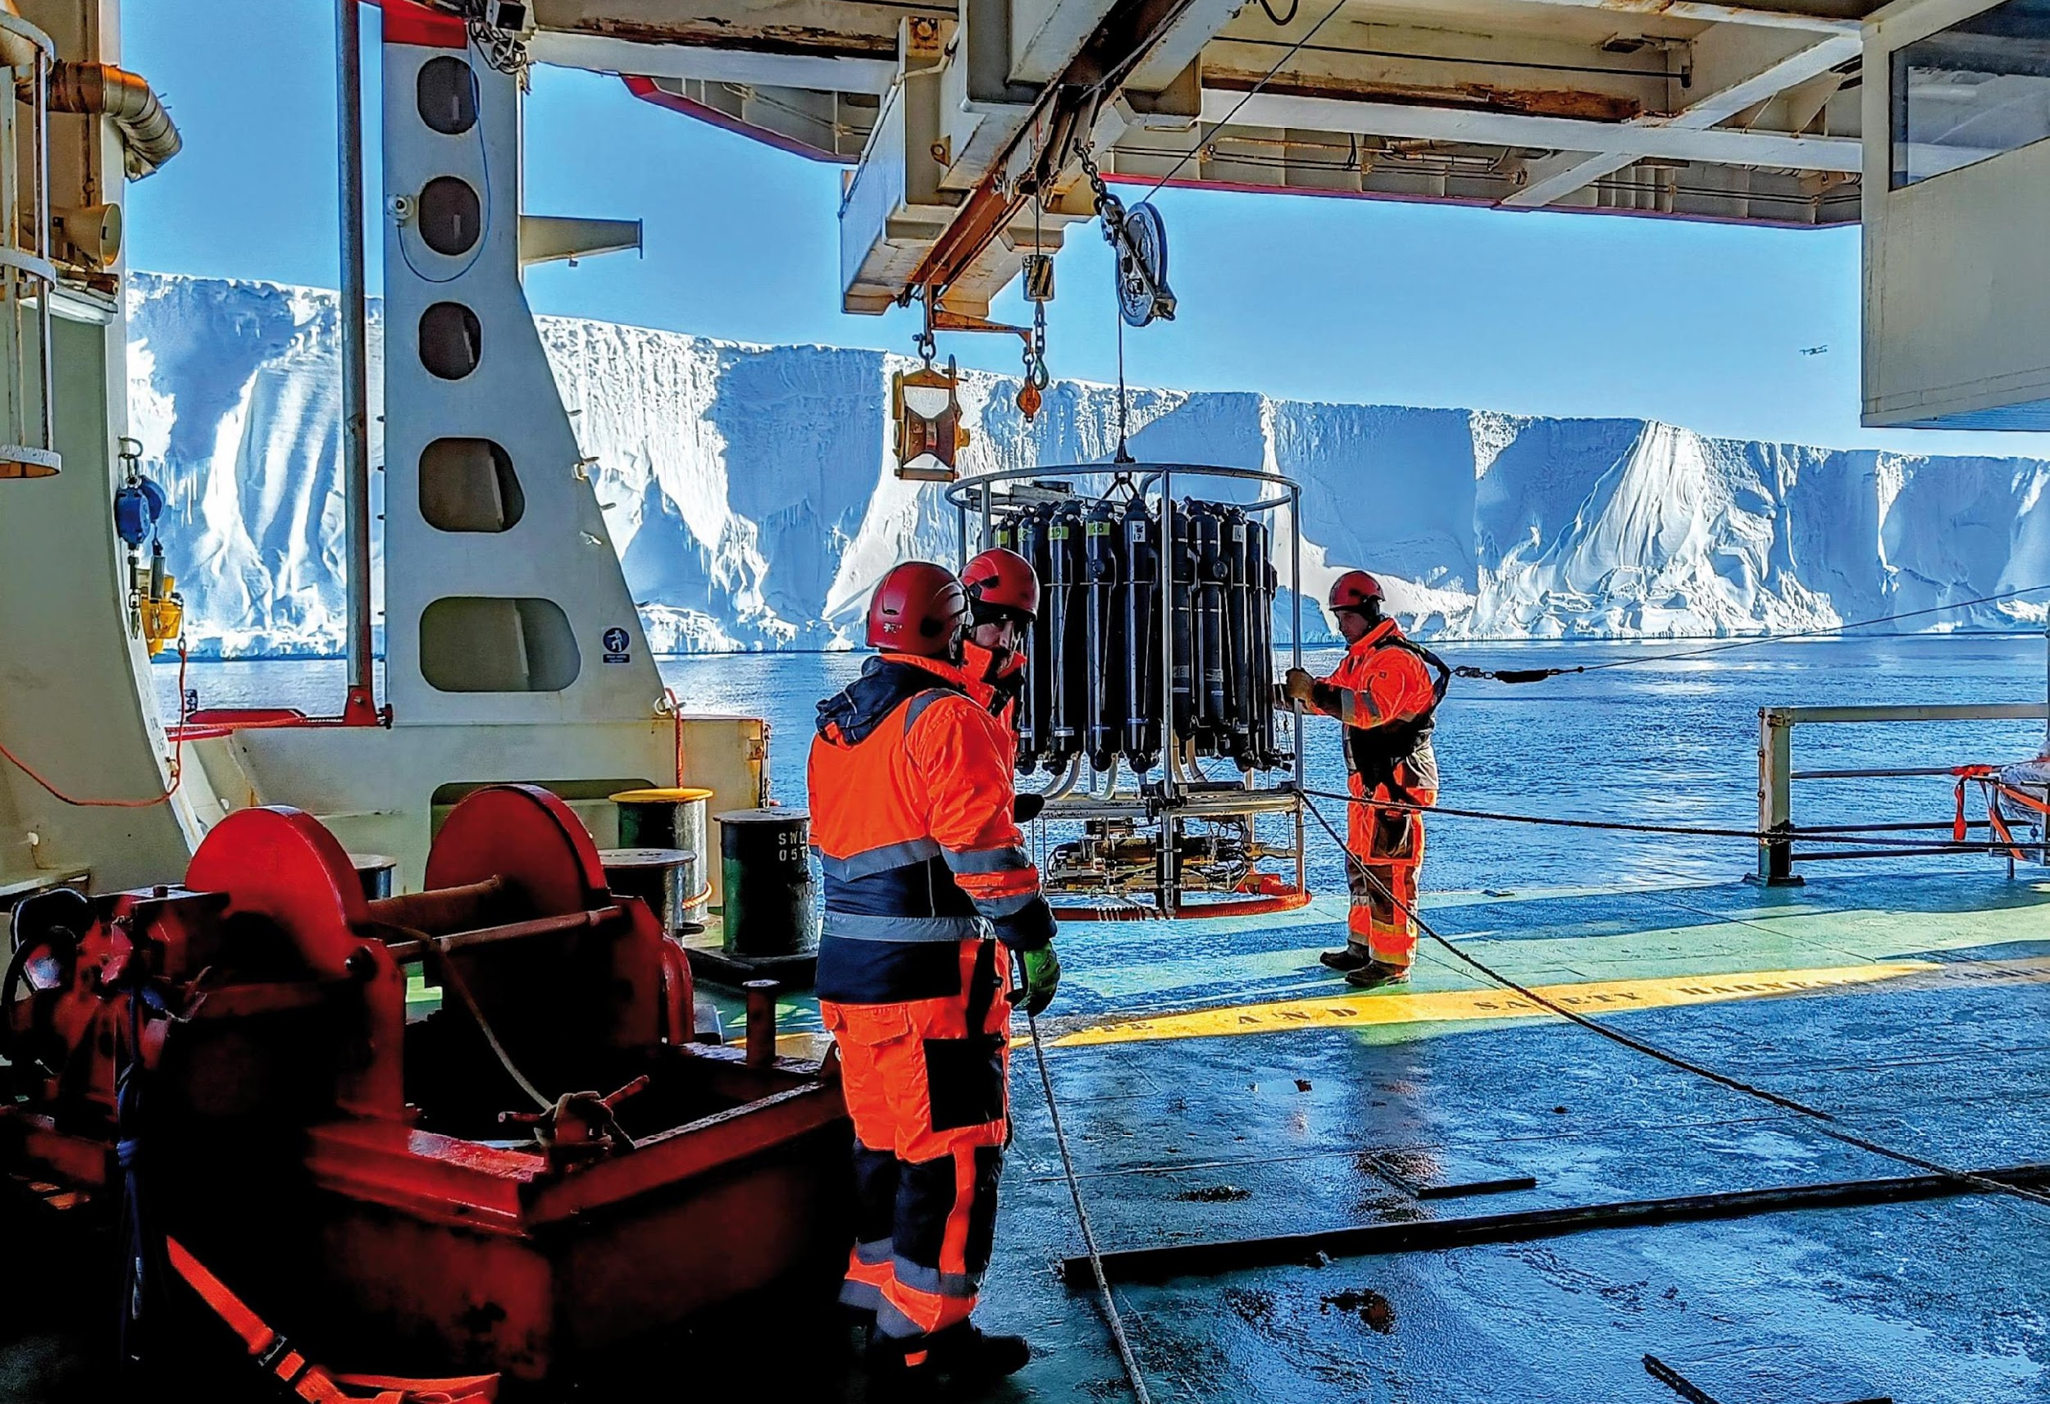
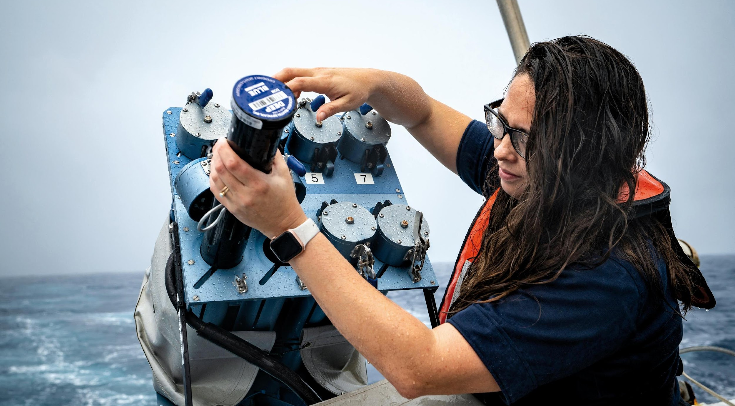
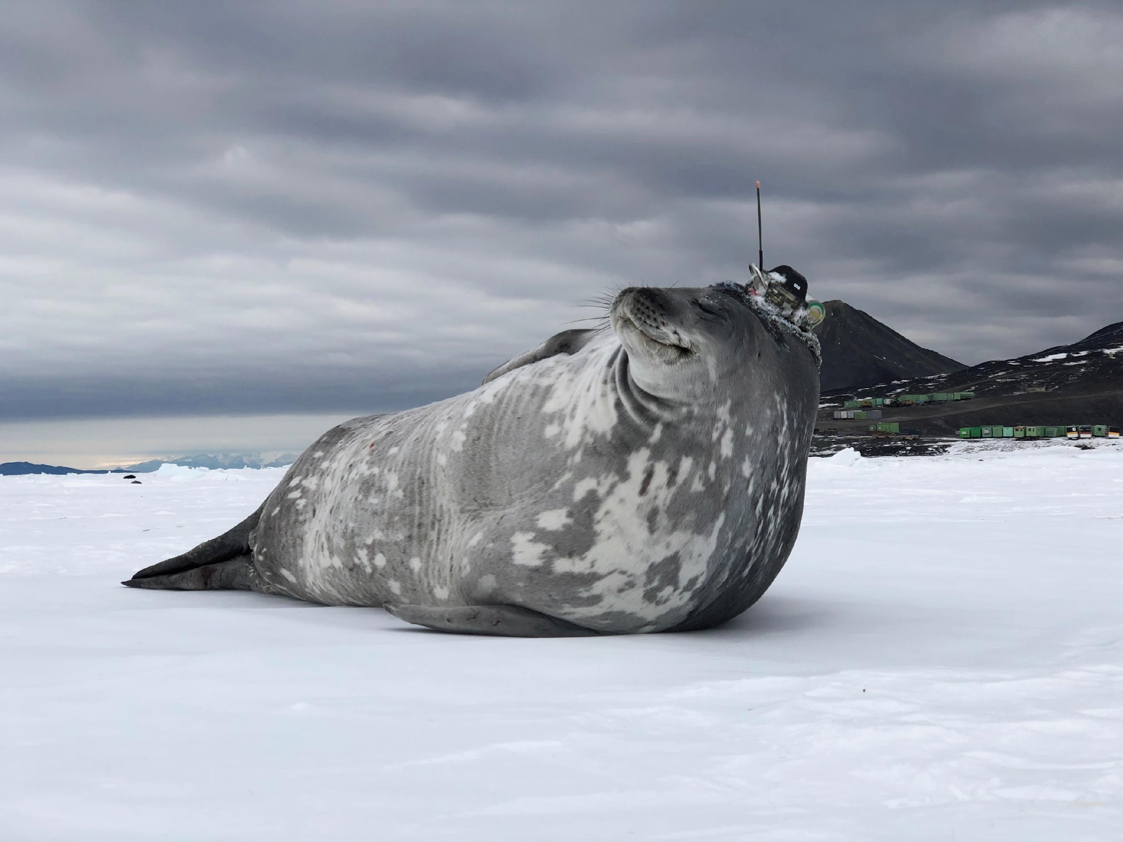
Thank you
goosocean.org

