Slide 1

Session 3: GOOS Update
Emma heslop, Programme Specialist GOOS, IOC/UNESCO
Joanna Post, Director GOOS Office, IOC/UNESCO
Fifteenth Observations Coordination Group Meeting (OCG-15)
13-17 May 2024, Ocean Networks Canada, Victoria, British Columbia, Canada

Slide 2
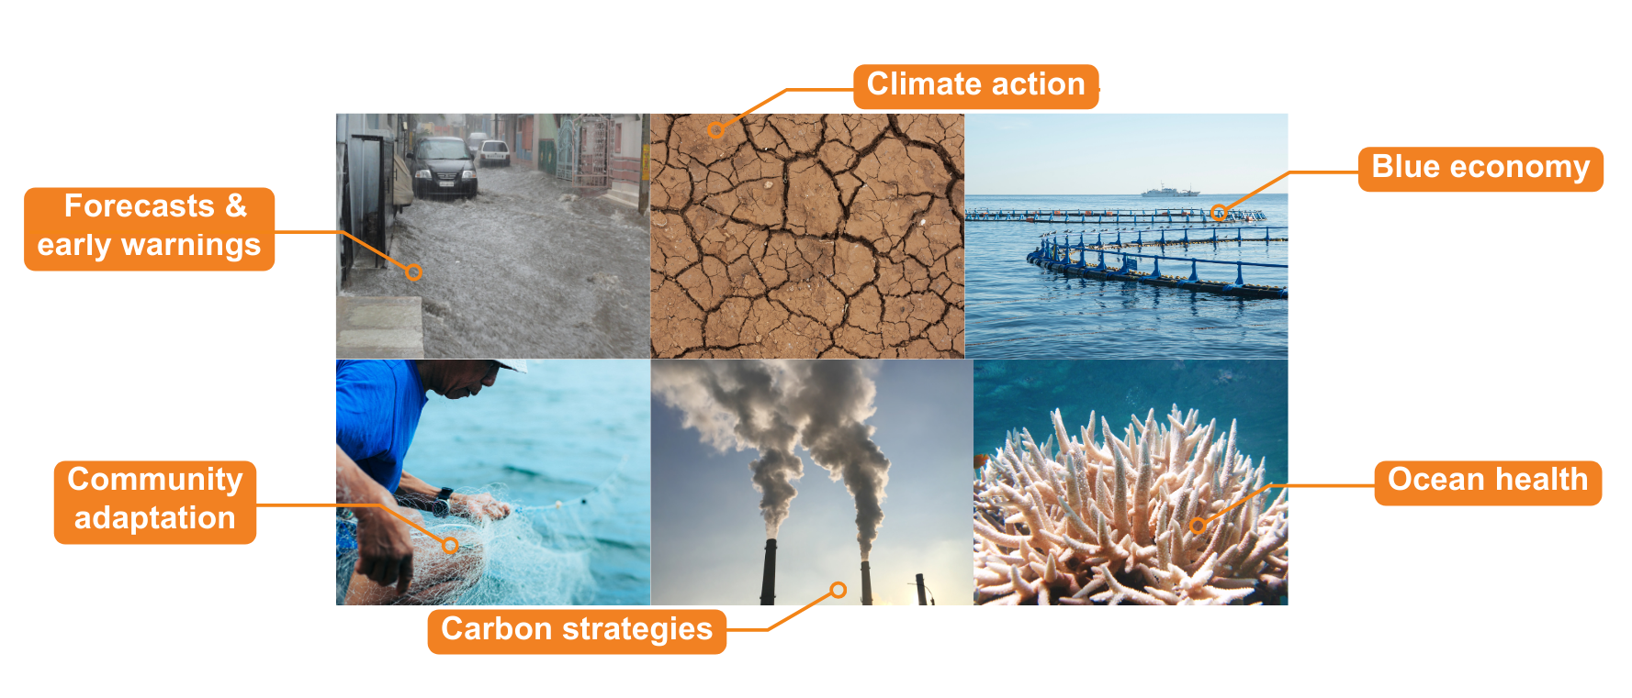
Ocean observations: fundamental to society
No one country can observe the ocean effectively on its own.
Notes:
We know that the ocean plays a huge role in the Earth’s climate, supports the livelihoods of 3 billion of the planets 7 billion population, provides food, pathways for transport, whole ecosystems, is source of biodiversity, a sink for anthropogenic carbon and heat. Ocean observations – data from the ocean – is vital our weather prediction, to hazard warnings, to predict and adapt to climate change globally, and our ability to effectively manage ocean ecosystems under the combined stress of climate change, overfishing pollution. However, the ocean is vast, processes complex, and no one country or project can cover or provide enough data to support global needs.

Slide 3
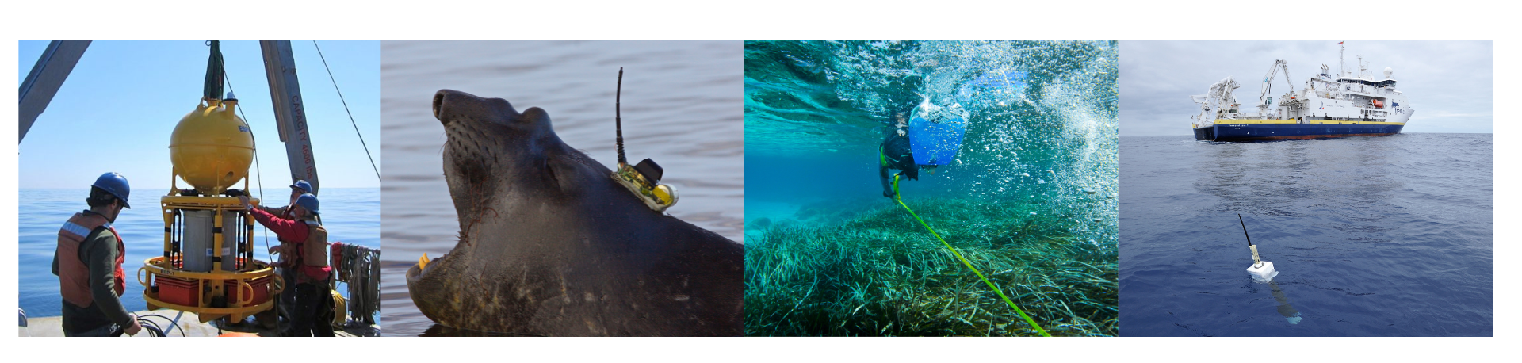
Opportunity for nations & communities
Enabling coastal communities to evolve and flourish
Supporting blue economic growth
Underpinning sustainable development
Notes:
Ocean observations underpin our adaptation to climate change and weather forecasts they are the key to the future of coastal communities being able to survive and thrive, and are the stable foundation for sustainable development and growing a diverse blue economy.

Slide 4

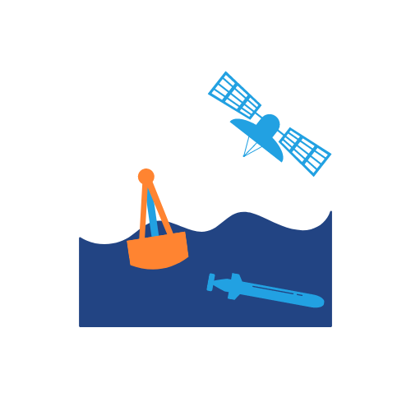






Leading the ocean observing community
  Global Ocean Observing System
  Ecosystem of providers
  Observation infrastructure
  Beneficiaries of ocean information
  GOOS management and system
  Ocean observing community & partners
  Research, Policy, Users, Investors
Notes:
Founded in 1991 the Global Ocean Observing System – GOOS – is led by the Intergovernmental Oceanographic Commission (IOC) of UNESCO, and co-sponsored by the World Meteorological Organization (WMO), the United Nations Environment Programme (UNEP) and the International Science Council (ISC). Our mission is to lead the ocean observing community and create the partnerships to grow an integrated, responsive and sustained observing system that serves users as effectively as possible.
The graphic aims to represent this role, on the one hand leading, supporting and connecting to a community of international, regional and national ocean observing programmes, governments, UN agencies, research organizations and individual scientists. And on the other side connecting to a range of users, investors and policy makers, to ensure that the role and need for ocean observing is visible and that the observations are fit for purpose and reach those that need them.
GOOS:
Creates links and frameworks to ensure that observations meet global policy needs
Works on strengthening delivery through best practices, data and metadata standards,
Advocates for OO, ensuring governments and UN know what underpins their weather, ocean health, risk management, blue economy, reporting and decisions
Makes the partnerships to ensure ocean data is turned into actionable information
GOOS supports global collaboration, connecting observers to form a system, and connecting the system to users, ensuring that data meets global needs and creating infrastructure and standards such that ocean data is fit for purpose, and is delivered to that that need it across operational weather and ocean forecasting, climate and ocean health.
GOOS and the ocean observing community made significant improvements in our ability to observe and understand the oceans over the last three decades, however we realised that our current efforts still fell well short of what will be required. With an exponentially growing societal need for ocean observations, driven by climate change, population growth, overuse of ocean resources and pollution. GOOS set in place an ambitious strategy to lift the ocean observing system to where it needs to be.

Slide 5
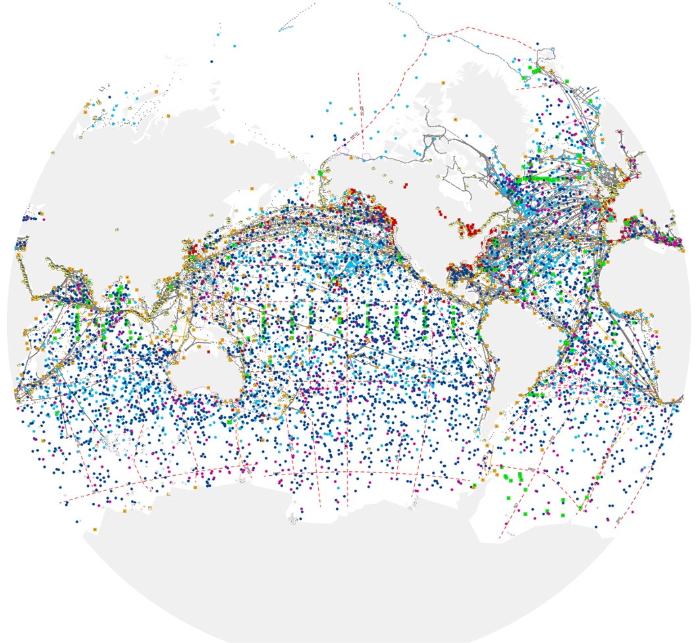
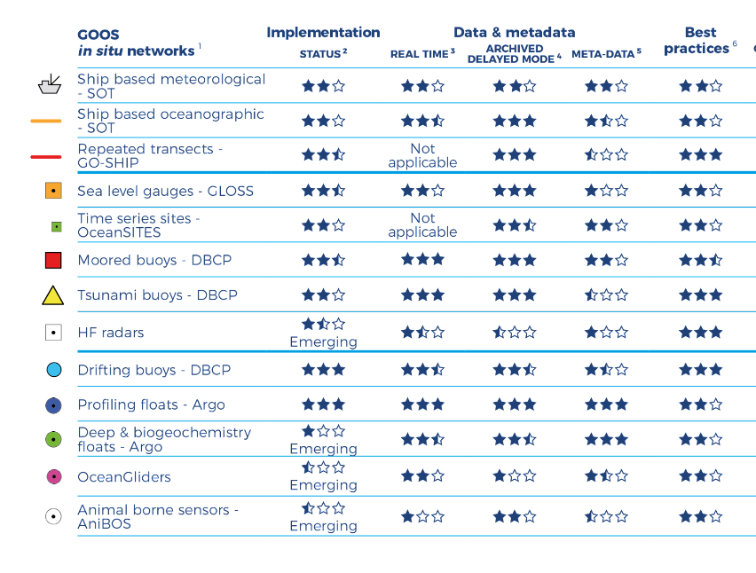

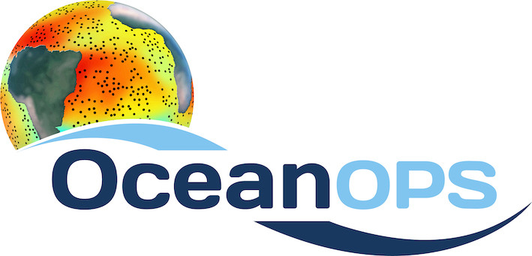
GOOS Today
      84 countries, 8,400+ observing platforms
      More than 120,000 observations per day - operational systems
      14 global networks and 12 BioEco EOV communities
“The weather forecasting systems will run off the rails if they don’t have the surface pressure information over the ocean to constrain them” - Lars Peter Riishojgaard, Director of the Earth System Branch WMO
www.ocean-ops.org/reportcard2023
Notes:
In the last 30 years, GOOS developed -
Mature networks drifting buoys, voluntary observing ships, tide gauges, Argo floats, and emerging networks; HF Radar, ocean gliders
Ocean Observing is big science

Slide 6
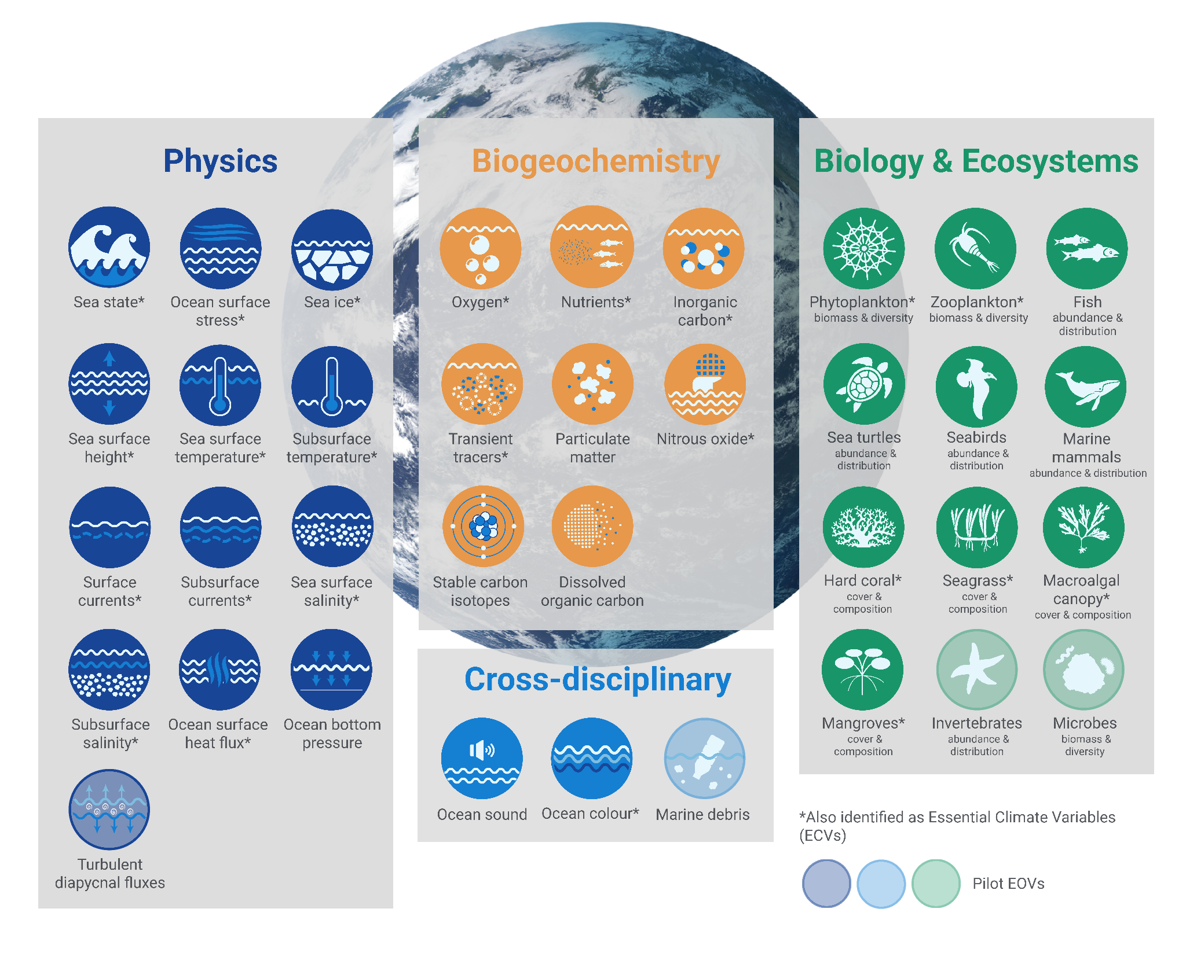
36 Essential Ocean Variables (EOVs)
Notes:
Convention on Biological Diversity - add the post-2024 framework

Slide 7
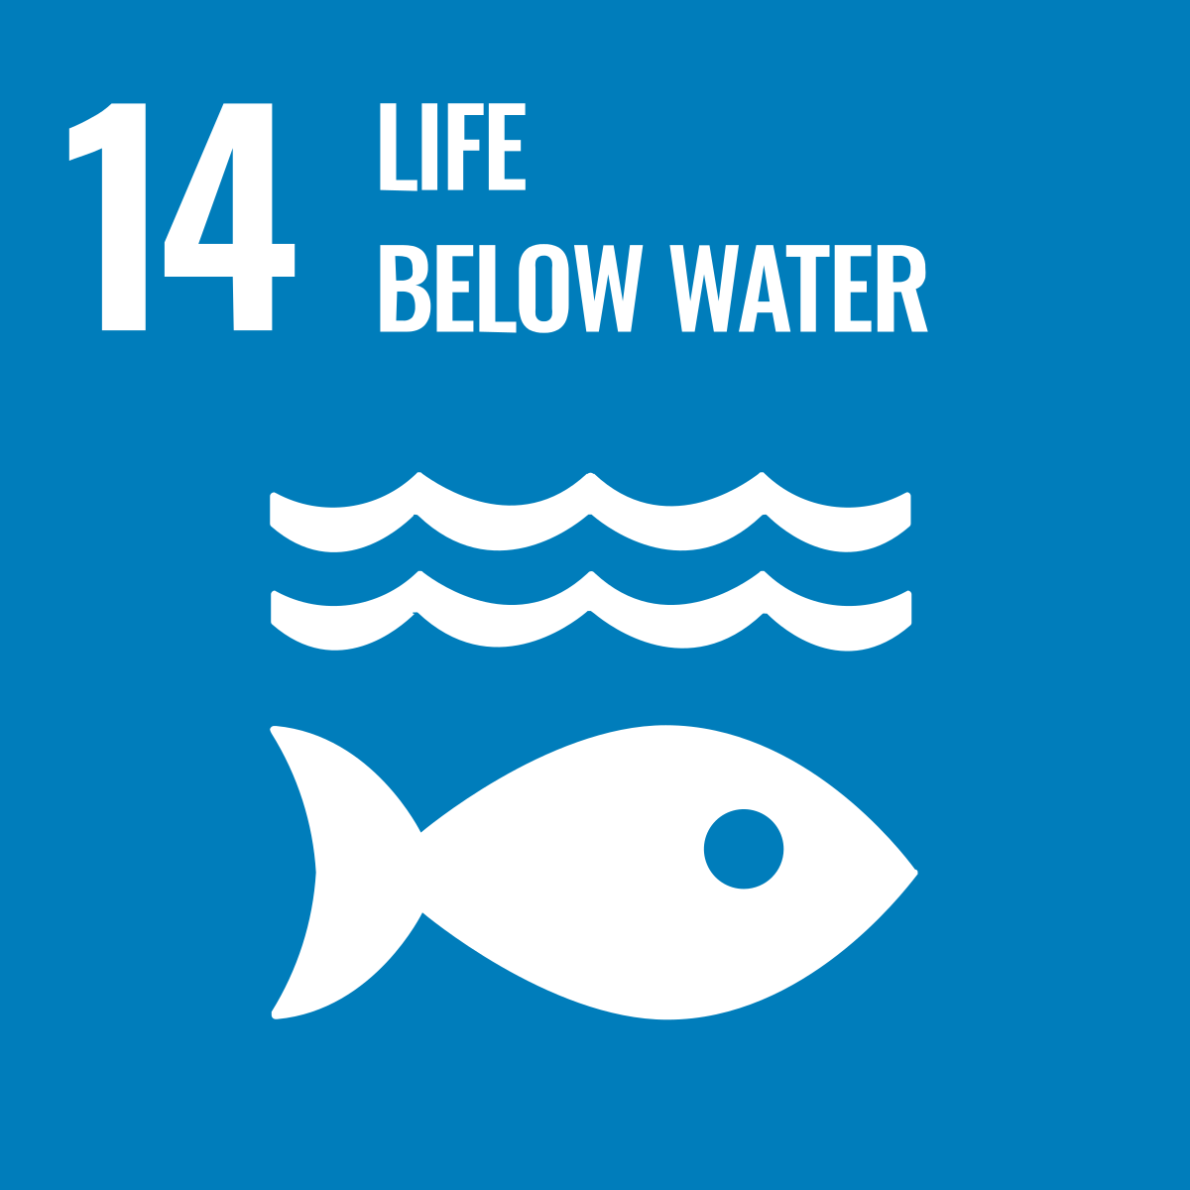

36 Essential Ocean Variables (EOVs)
Post-2020 Biodiversity Framework
International Legally Binding Instrument on Plastic Pollution 2024
+ Biodiversity Beyond National Jurisdiction
Notes:
Convention on Biological Diversity - add the post-2024 framework

Slide 8
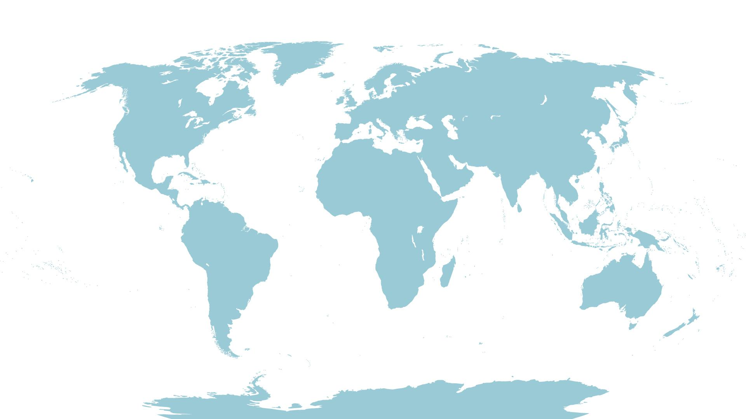
Regional & National Alliances
SAON (Arctic TT)
EuroGOOS
CIOOS
Black Sea GOOS
NEARGOOS
US IOOS
MONGOOS
IOCARIBE-GOOS
76 GOOS National Focal Points
SEAGOOS
GOOS-Africa
IOGOOS
PI-GOOS
OCEANTLAN
GRASP
IMOS
SAEON
SOOS
Notes:
GOOS is a global network.
1) 13 GOOS Regional Alliances – all very different in governance, scope and mandate – connected to 130 countries
Orange is in the network, Green is in dialogue
CIOOS: Canadian Integrated Ocean Observing System - to adopt today!
PI-GOOS: New hosting Office at SPC (Pacific Community, Fiji)
IOCARIBE-GOOS: Special session at the IOCARIBE meeting
GOOS Africa: Africa Roadmap Ocean Decade, new opportunities for support
2) Now have 73 GOOS NFPs – person employed to support them
National Focal Points – ToRs reviewed and adopted by SC in April. First meeting Oct 2023, now 73 GOOS NFPs.
Regional and national work: in the last 2 years supported development of regional and national coordination.
With growing recognition of the role of the ocean, have a clear, revival of interest, recognition of the need and value of regional coordination and a rejuvenation of coordination in some areas:
NEED:
CORE CO-ORDINATION

Slide 9
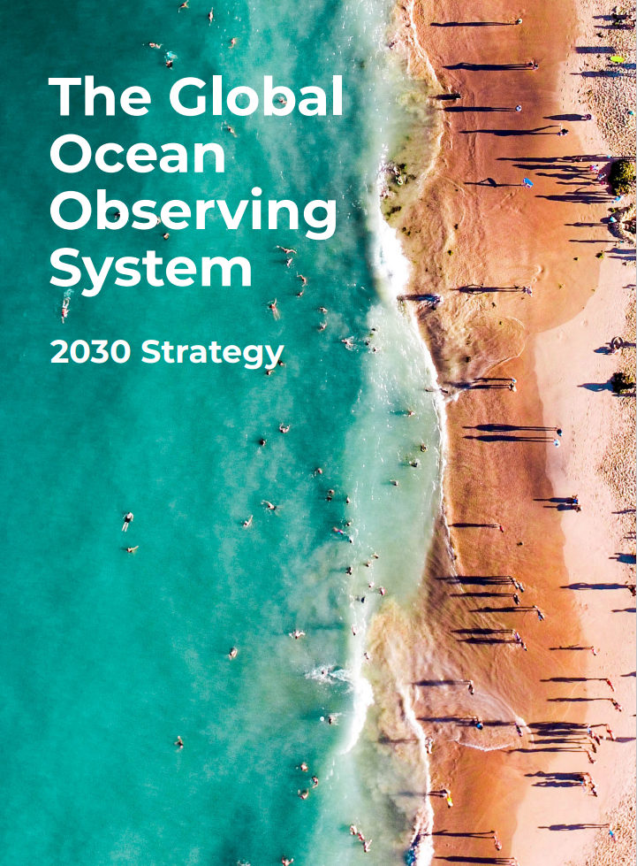
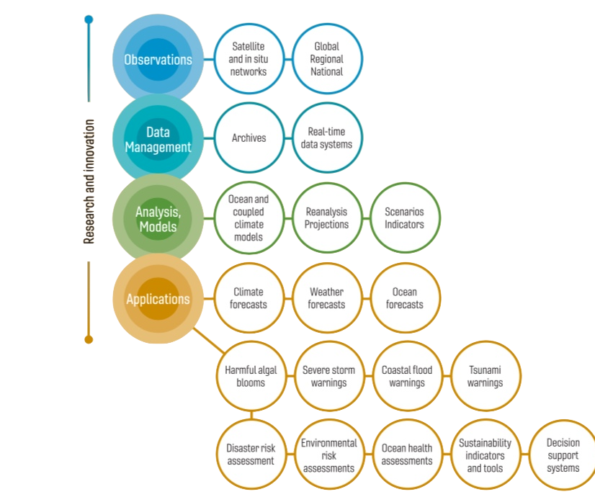
Sustained observations for a wide range of applications
Notes:
Underpinning the strategy is the ocean observing value chain, and the need for the ocean observing system – satellite and in situ - to support a wide range of applications and for partnership along the value chain to ensure that the observations are fit for purpose.

Slide 10
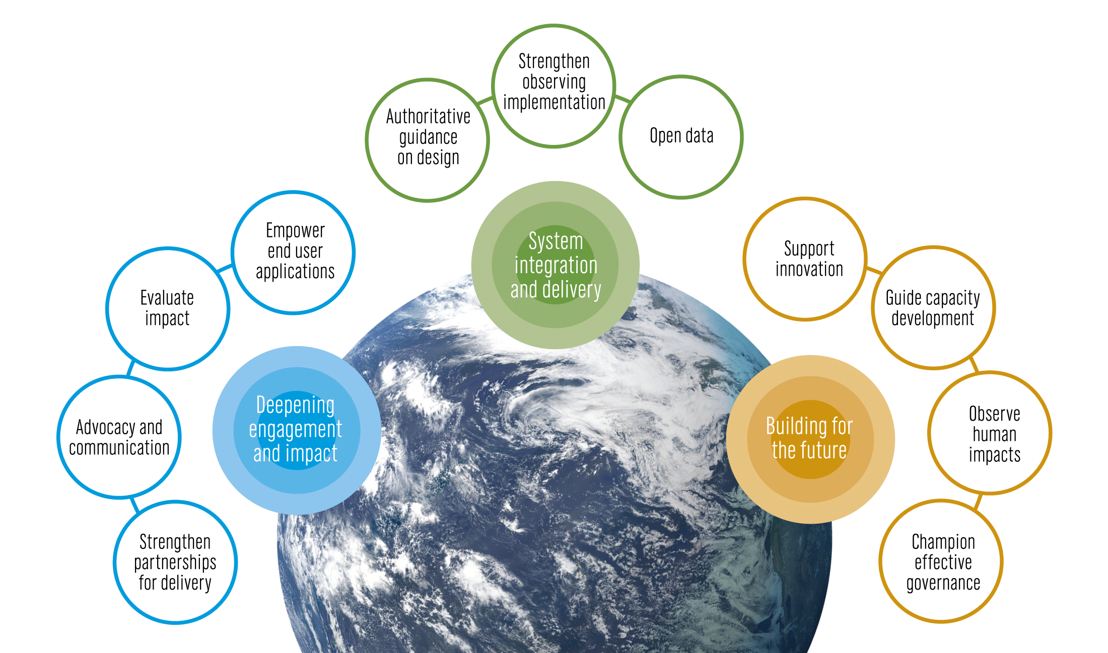
An integrated system supporting a wide range of applications
Notes:
In 2019 IOC Assembly adopted a Global Ocean Observing System 2030 Strategy which guides our our work
Here we spell out the need for a step-change in our observing capacity
GOOS and its ocean observing and forecasting communities have deep experience and knowledge, and through the work of its core components, Decade Programmes, and initiatives, GOOS is the hub where global expertise gathers to define priorities and action.
System integration and delivery are the ‘core’ of GOOS ‘business’ today
Deepening engagement and impact are key priorities, only achievable with strong support of our 4 sponsors and partnership with key stakeholders

Slide 11


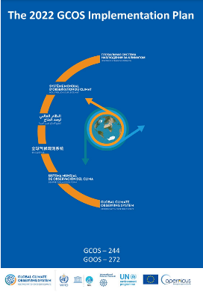
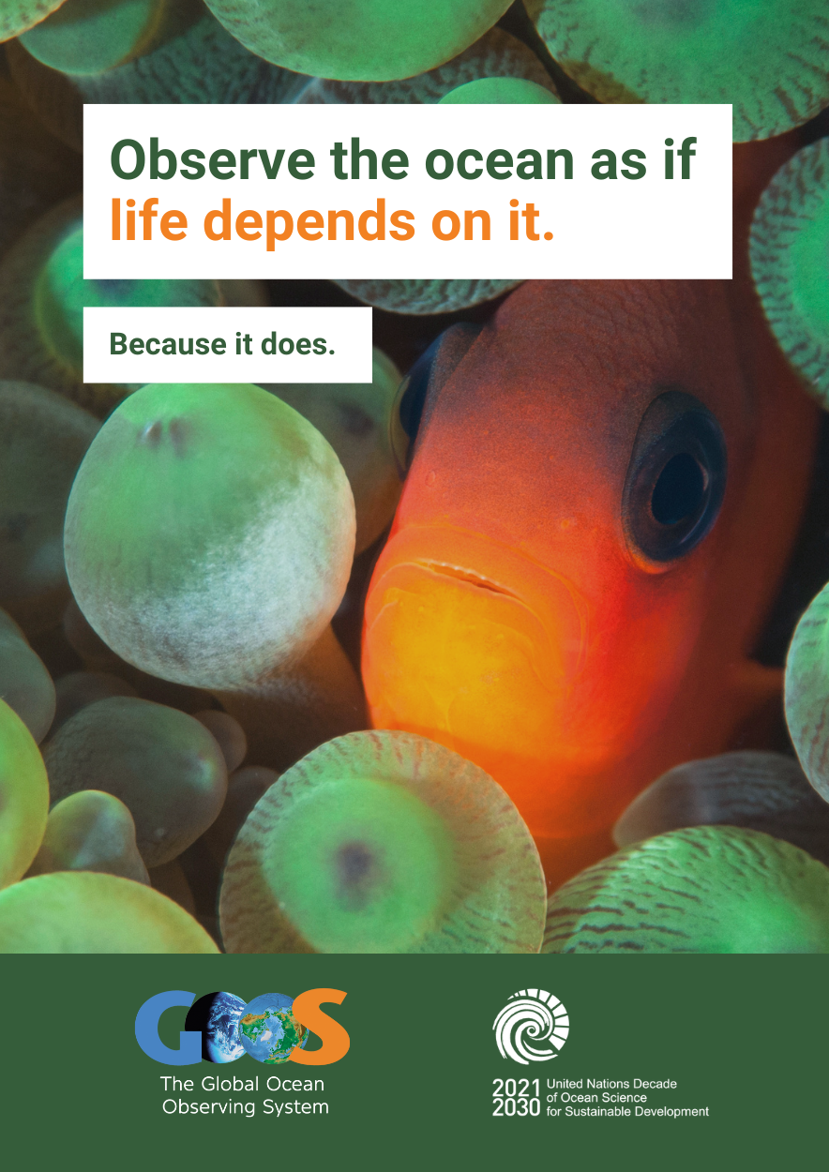
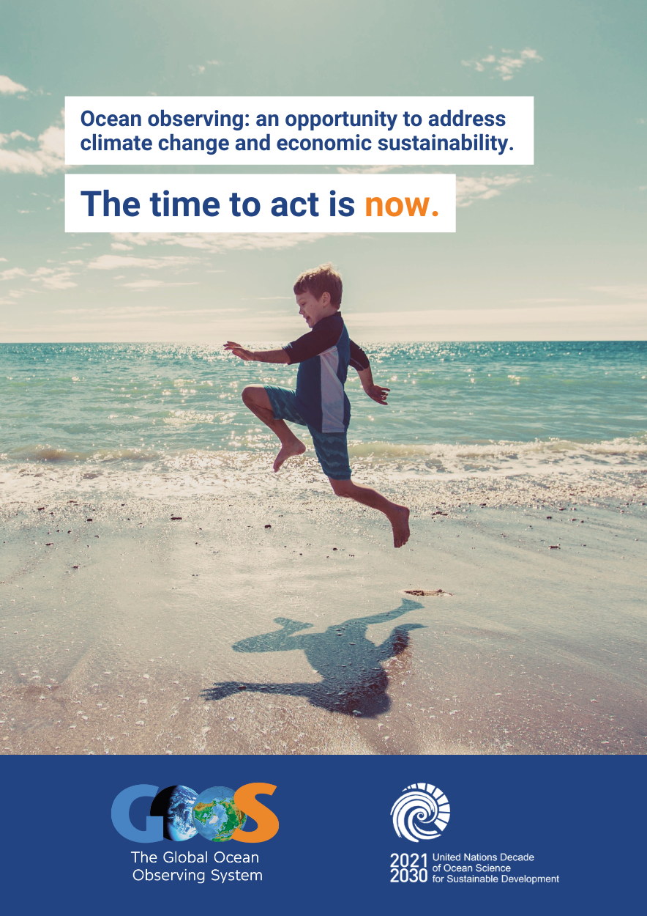
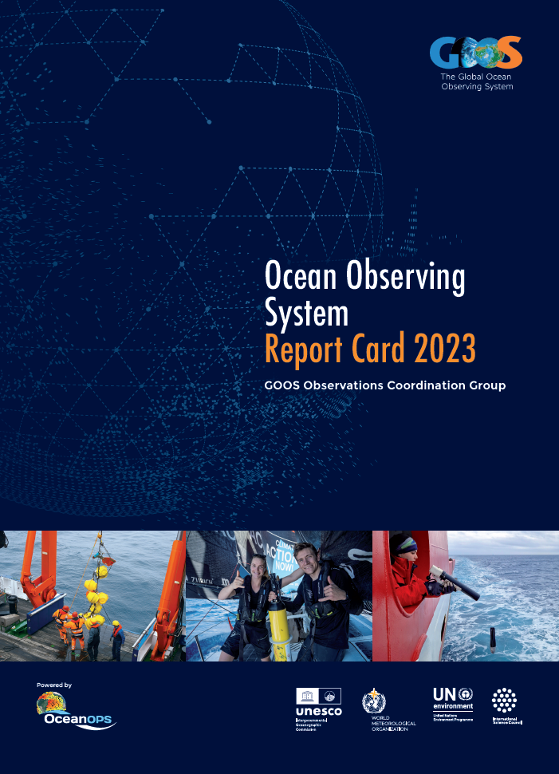
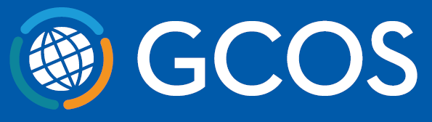




Advocacy within
United Nations
Implementing GOOS Communication Plan
Strengthened partnerships
2000+ mailing list subscribers
Articles and stories from the observing system
Flagship annual Report Card
Notes:
Implementing GOOS Communication Plan: Since August 2022, with a focus on both community and supporters/users, clear messaging and channels. Ocean Observing System Report Card is now fully cross GOOS.
Advocacy within UN: Increasing recognition of observing system and GOOS (e.g., Ocean Conference, COP27 and COP15).
Strengthened partnerships: WMO connection developed to the Rolling Review of Requirements, IODE and data, GCOS - ocean component of the GCOS Implementation Plan - work to strengthen with UNEP, GEO BON, MSP, and others.
Change: Building understanding need for ocean observing and GOOS - through consistent and clear messaging across communications and advocacy. We have adopted a professionally developed Communications Plan last August that channels and focuses our communications on both our observing community and on the supporters, users and funders (broader audience) on the observing system.

Slide 12
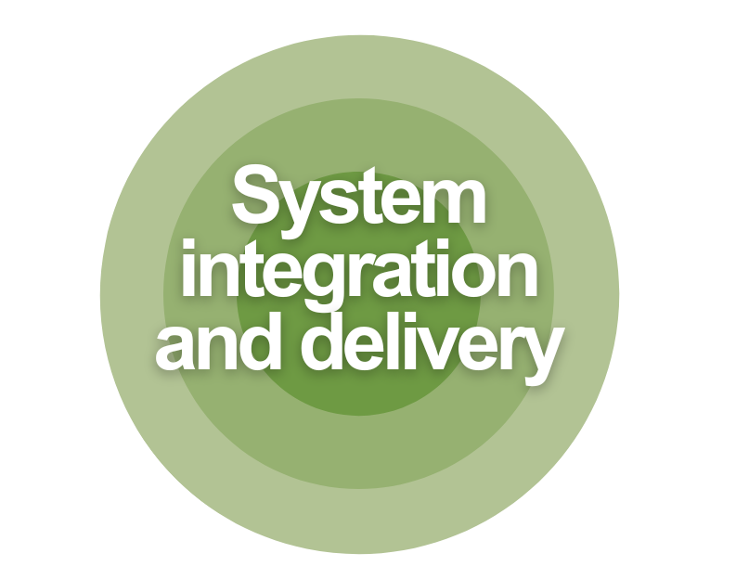

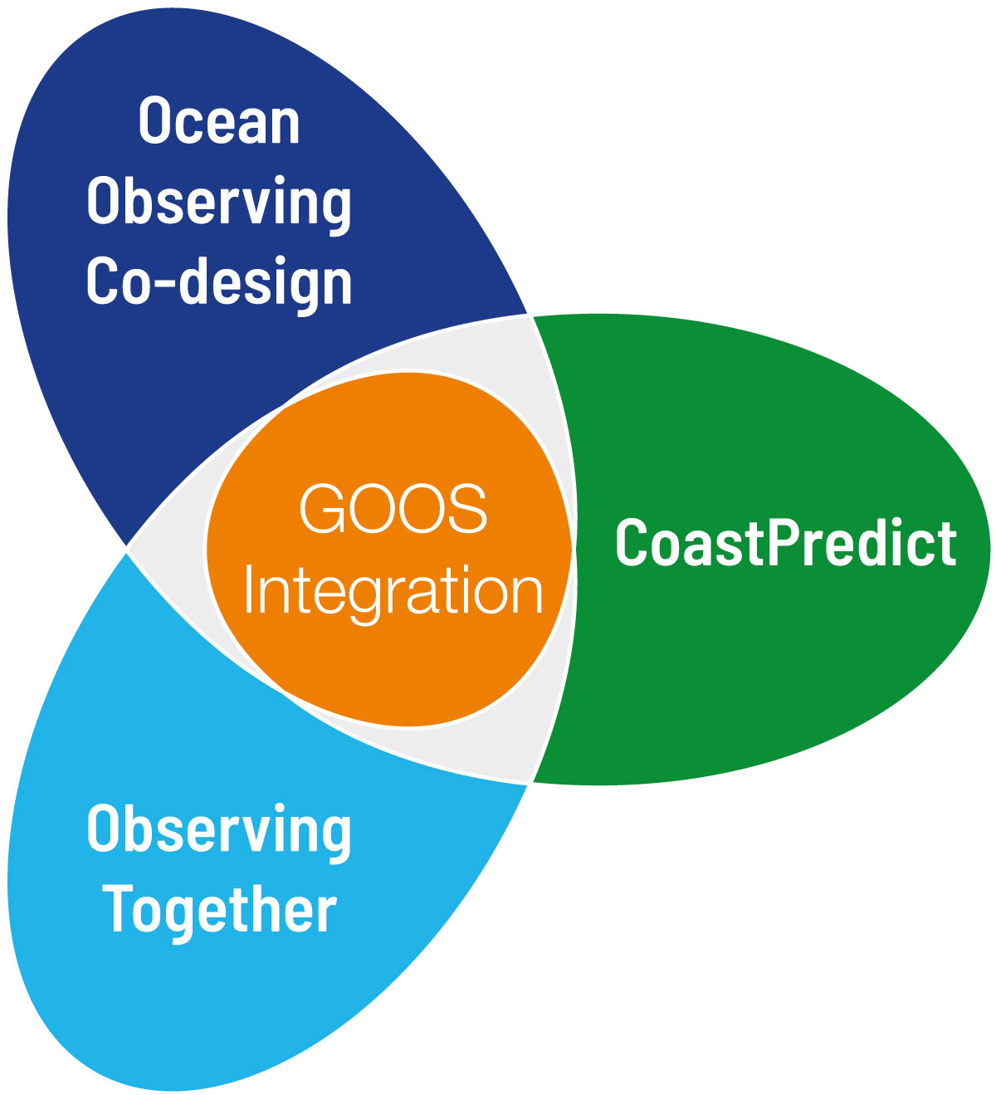
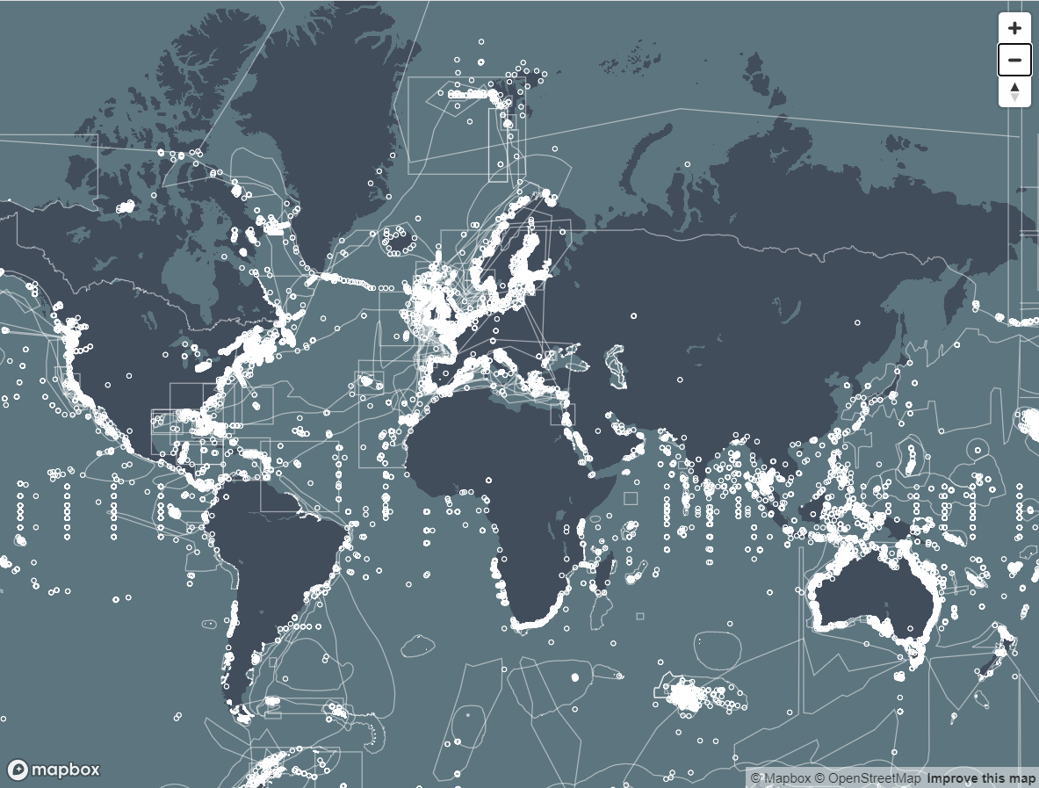
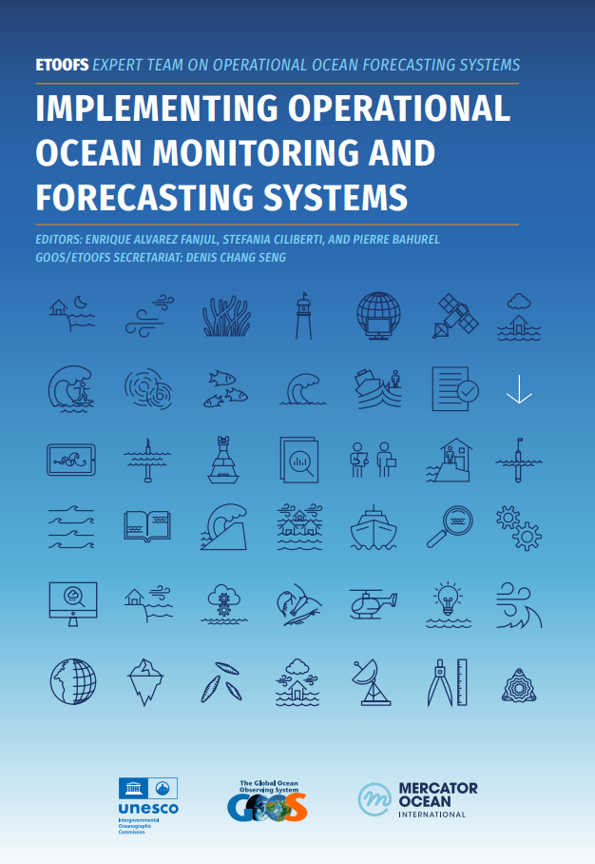






Structure & Standards
User focus – connecting down the value chain
Digital Ecosystem
Operational Ocean Forecasting
36 Essential Ocean Variables (EOVs)
10 GOOS endorsed best practices
2024 OCG Data Implementation Strategy
2023/4 new investment into BioEco Portal

Slide 13


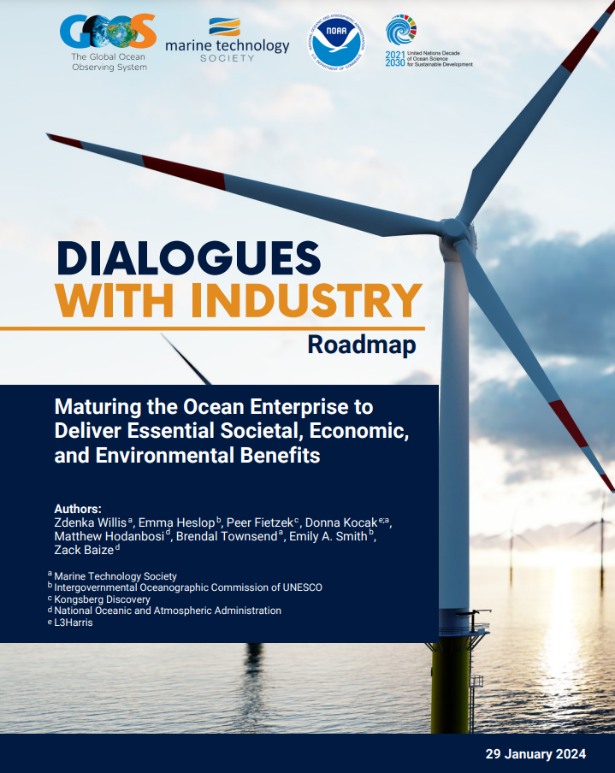

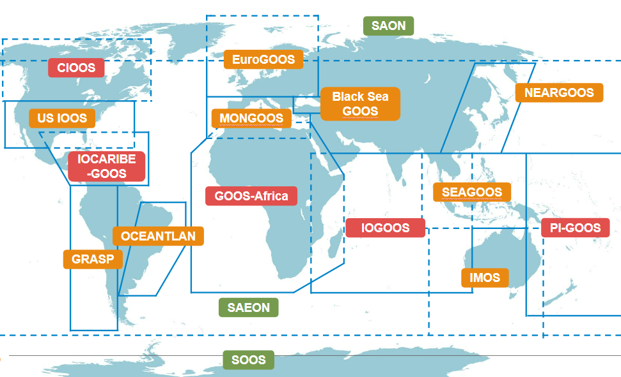


Collaboration with private sector
Tracking human impacts
National Focal Points & Regional activation
Dialogues with Industry Roadmap - just released!
3 Essential Ocean Variables
76 GOOS National Focal Points
4 GRA regions being reinvigorated Africa, Caribbean, Pacific Islands, Indian Ocean
Marine debris
Ocean colour
Ocean sound

Slide 14


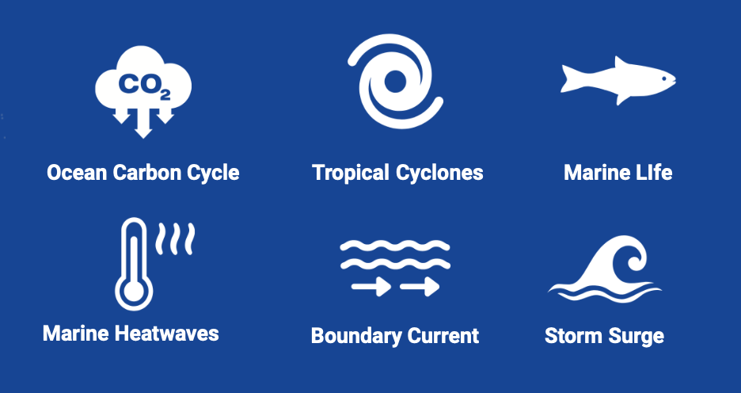
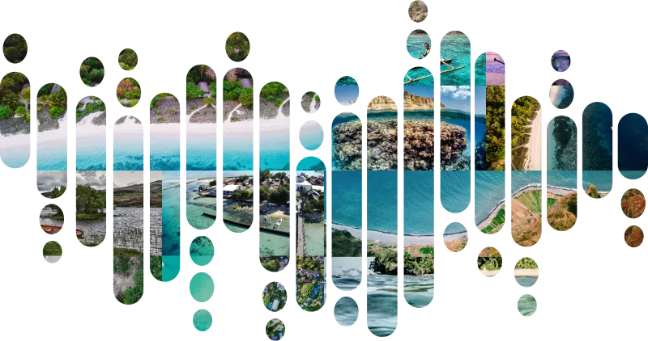

Ocean Observing
Co-Design
GOOS Decade Coordination Office: Ocean Observing
CoastPredict
11 Ocean Decade Programmes
91 Projects
30% Ocean Decade Actions
Co-Design observing-modeling-users
Establish clear investment priorities
Accessible ocean information
Effectively meet global challenges
6 Co-Design Exemplar Projects
GlobalCoast - implementation
125+ Pilot Sites
65+ countries
Multiple regions
Revolutionise global coastal observing and forecasting
Ocean Decade Challenge 7
Vision 2030 White Paper
https://oceanexpert.org/document/33599
Notes:
Finally, GOOS is very active in the Ocean Decade, using this to help transform GOOS, implement the 2030 Strategy and Ocean Decade - :
The Co-Design programme is tackling key areas in which we need more observations using co-design process with modelling and with users to ensure the observations are optimised, we can express their value, and reach their targets as services. There are 6 ‘first off the block’ Co-Design Exemplar Projects with several now maturing towards pilots including tropical cyclones, boundary currents, marine heatwaves and ocean carbon.
CoastPredict aims to revolutionize coastal observing, forecasting and service delivery, and GlobalCoast is the overarching implementation project, and has identified more than 120 pilot sites across the globe, covering 30 oceanographic regions and 65 countries.
Ocean observing is important to the Ocean Decade, it will underpin work towards a sustainable future and work of the other 9 challenges, expanding ocean observations is vital to the work of the Ocean Decade. GOOS supports the Ocean Decade Coordination Office for Ocean Observing (also supported directly by the Ocean Decade). This Decade Coordination Office for Ocean Observing connects and supports the ocean observing programmes - and this is quite a big job - there are 11 Programmes, 91 projects, which represents fully 31% of all Ocean Decade Actions. The DCO for Ocean Observing also connects to similar bodies for modelling and data to connect flow of data and information
GOOS will continue this transformative work with the Ocean Decade, but also looking to transforming GOOS and be an integral part of GOOS work in building for the future.

Slide 15






Co-design Pilot Areas
Notes:
Suggested pilot areas for Ocean Obs Co-design
Looking forward to working with regions

Slide 16
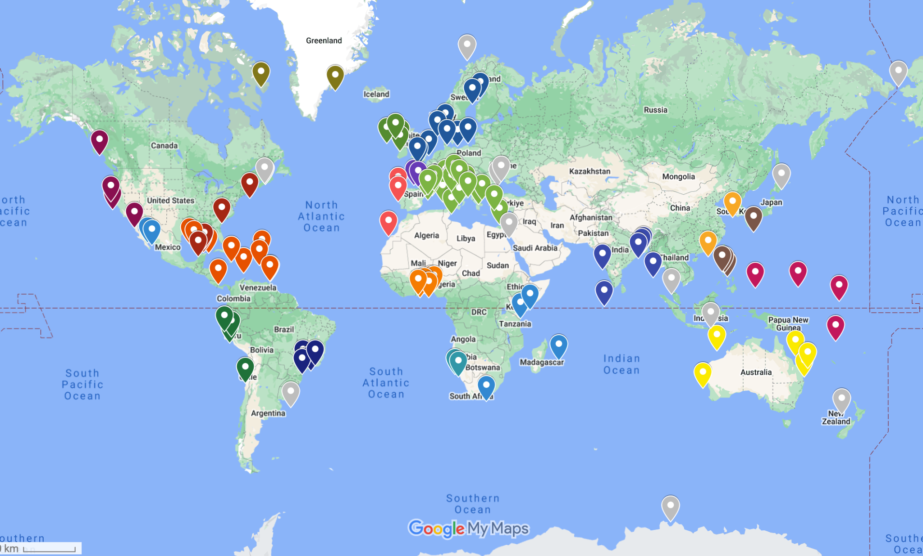

CoastPredict Pilot Site locations
30 Regions
> 125 Pilot Sites
225 institutions in
65 countries

Slide 17
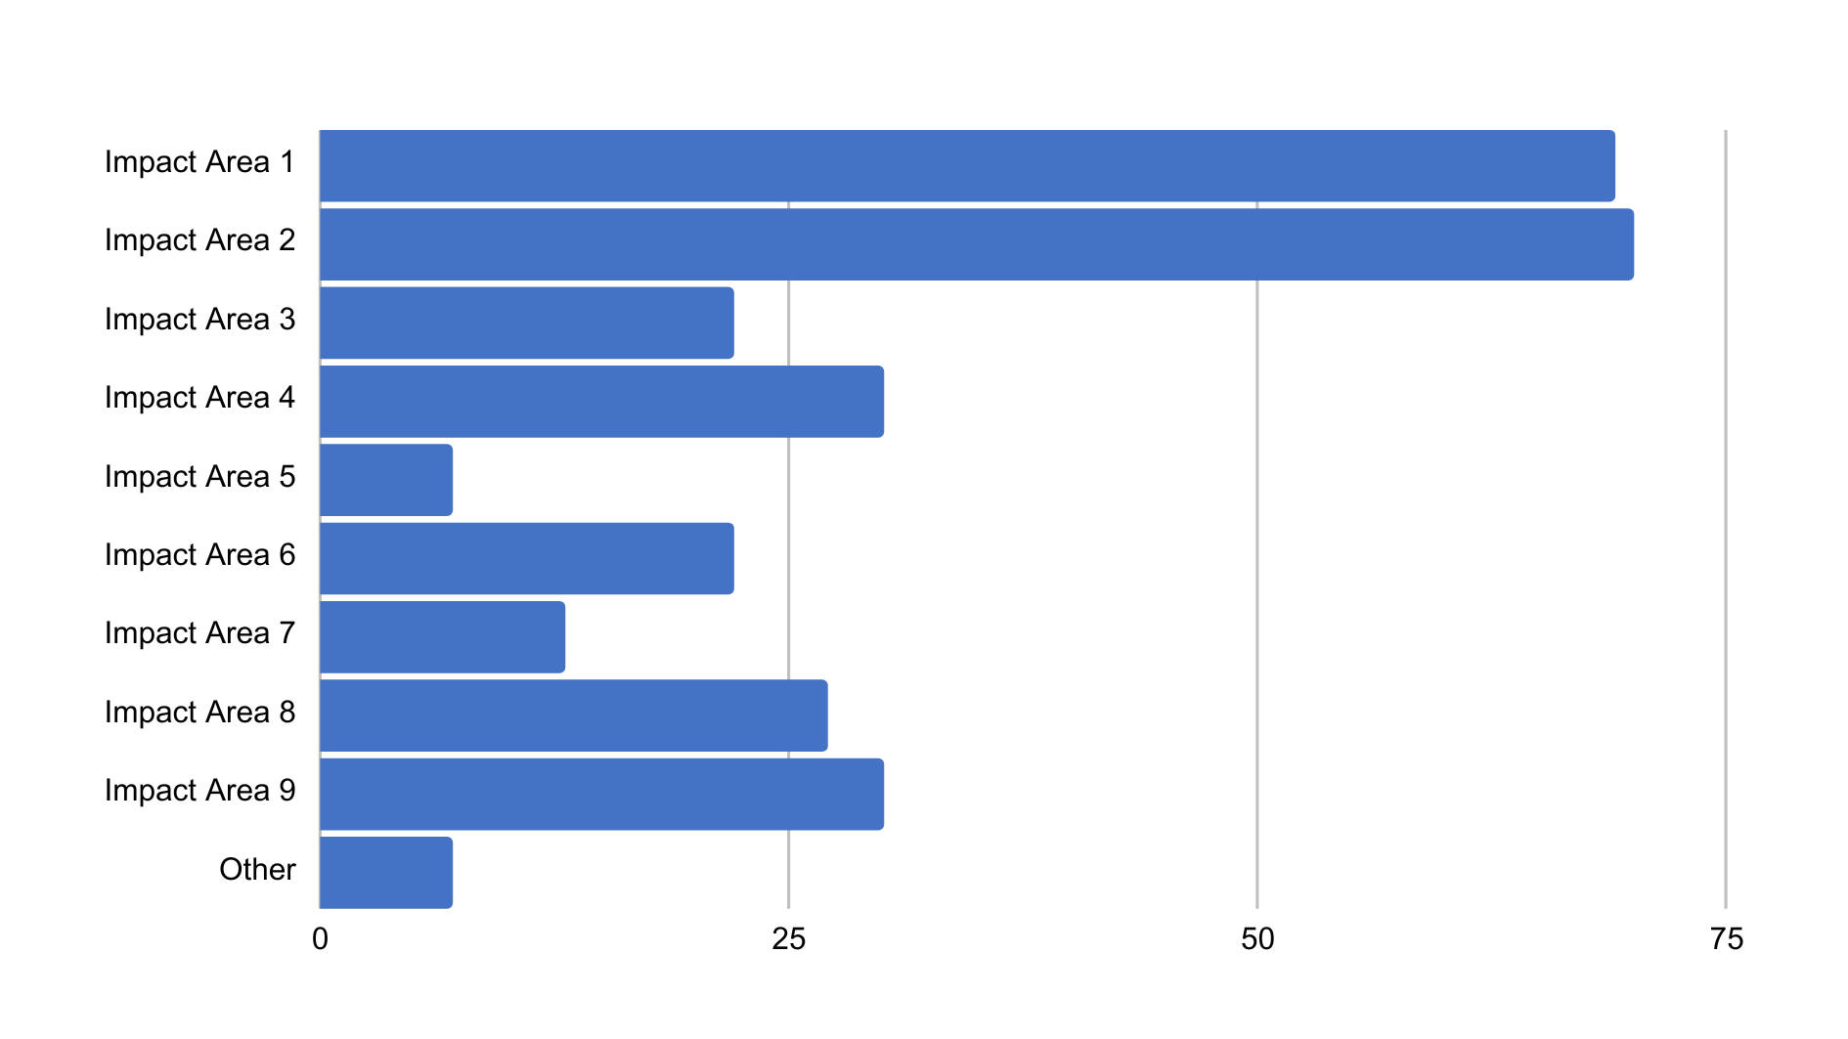


PRIORITY IMPACT AREAS
Q: Select up to three impact areas that will be addressed in your Pilot Site
IMPACT AREA 1
Capacity in disaster risk reduction - real-time forecasting of extreme events
IMPACT AREA 2
Support adaptation to/mitigation of impacts of climate change on coasts incl. indicators of sea level, temperature, biochemistry, biodiversity
IMPACT AREA 3
Prevention/mitigation of pollution impacts - hazard/risk mapping & forecasting at coastal scales
IMPACT AREA 4
Minimise climate & shorter-term impacts on morphodynamics
Improve urban oceanography science & planning
IMPACT AREA 5
Reduce impact of climate change through blue carbon monitoring, carbon dioxide uptake enhancement, NBS, ecosystem restoration
IMPACT AREA 6
Sustainable food production through coastal mariculture support system
Increase capacity on environmental awareness for all operations at sea - maritime safety, Search and Rescue
IMPACT AREA 7
Improvement in Integrated Coastal Zone Management & / or
Marine Spatial Planning
IMPACT AREA 8
IMPACT AREA 9

Slide 18
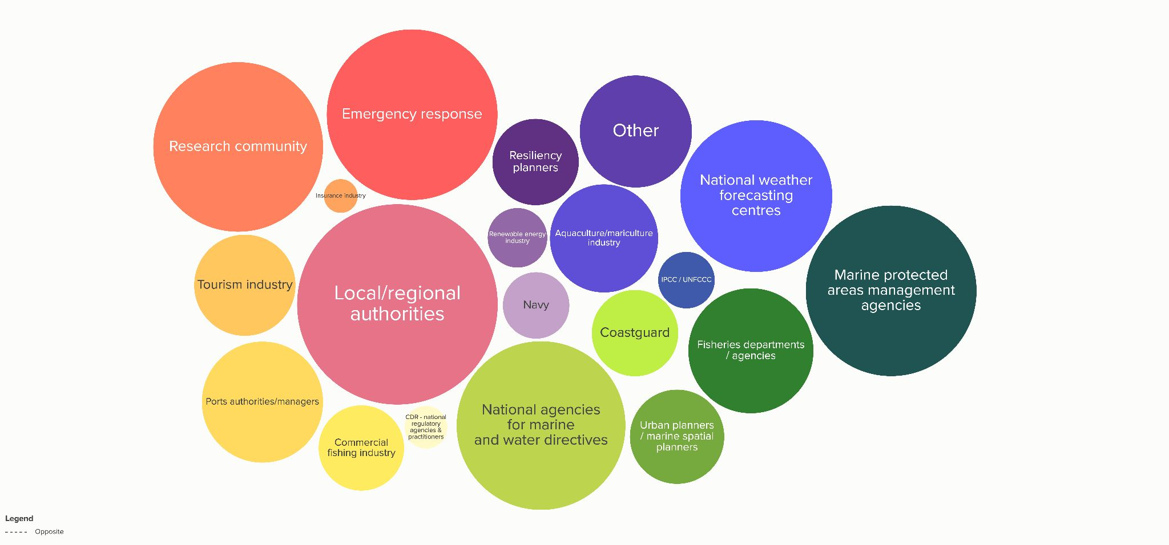
STAKEHOLDER GROUPS
Q: Who are key intermediate and end-users for the integrated observing & predicting system in your Pilot Site?
IMPACT AREA 1
IMPACT AREA 4
IMPACT AREA 5
IMPACT AREA 6
IMPACT AREA 7
IMPACT AREA 8
IMPACT AREA 9

Slide 19
Recent input
Notes:
Focus areas for the next period:
Communications and advocacy
Regional coordination
UN Ocean Decade - Co-Design
Evolving GOOS Governance - key 2023
AND
Strengthening GOOS core support is absolutely vital

Slide 20
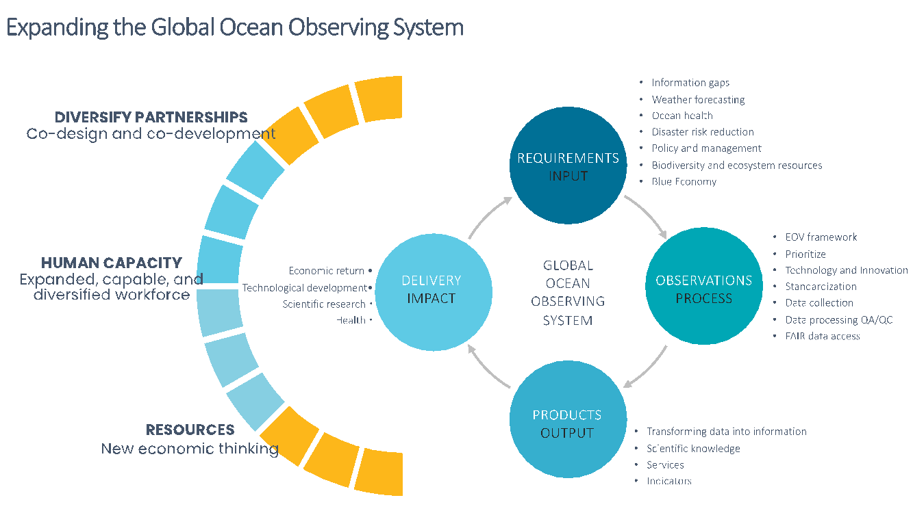
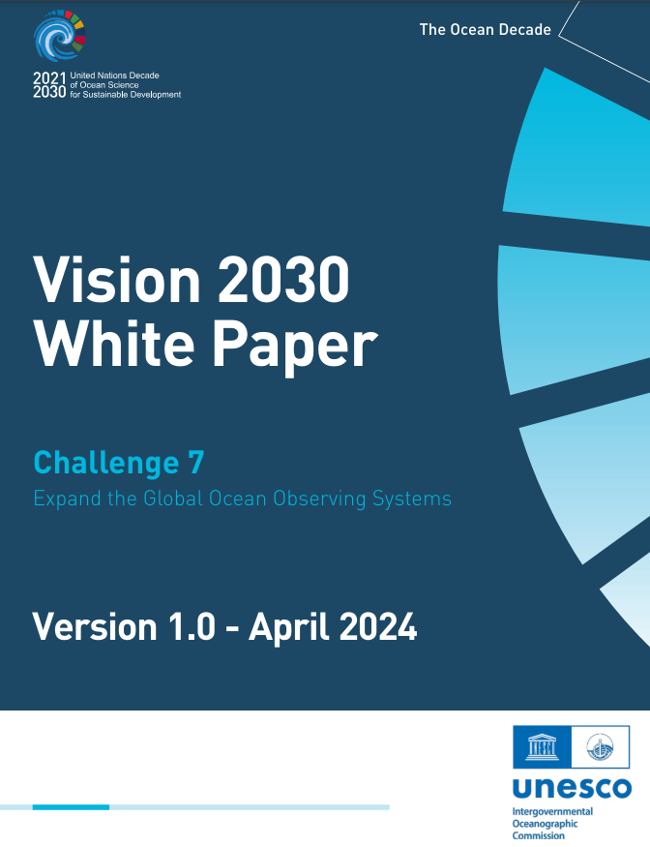
Vision 2030 White Paper
Recommendations include expanding global ocean observation capabilities, the translation of observations into information, fostering diversified partnerships, building a capable and diversified workforce, and emphasising a new economic thinking for resourcing ocean observing
https://oceanexpert.org/document/33599

Slide 21

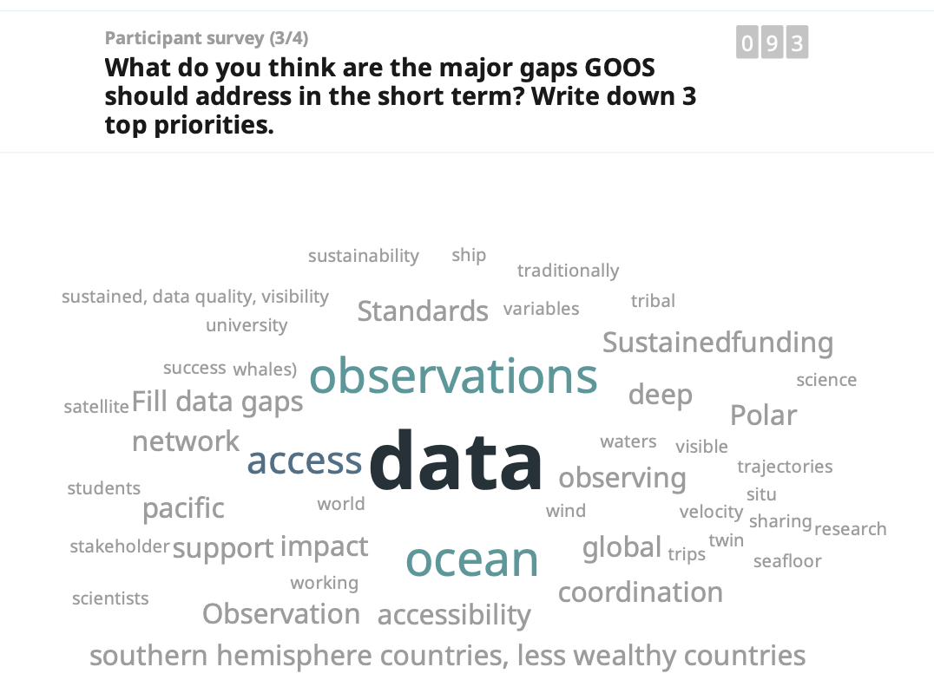
Townhall
Notes:
Not going to go through them all, many on track or work underway
Two perhaps of more concern

Slide 22
Townhall
GOOS has made great strides forward, areas highlighted for future work
      Not yet successful in making the case for sustained and operational ocean observing
      Seen as primarily science, make the connection to operational services clear – highlight that GOOS is operational
      Global scale to coastal scale, seamless and needs to be operational
      Data accessibility a problem, particularly global south, data management and accessibility weak
      GOOS not coupled enough with satellite community - make a core action.
      Gap between GOOS and fisheries management - FAO yet a partner
      First nations needs and knowledge integrated
      Gear up for optimisation, GOOS should have a system that tells us where the gaps are
Notes:
Not going to go through them all, many on track or work underway
Two perhaps of more concern

Slide 23
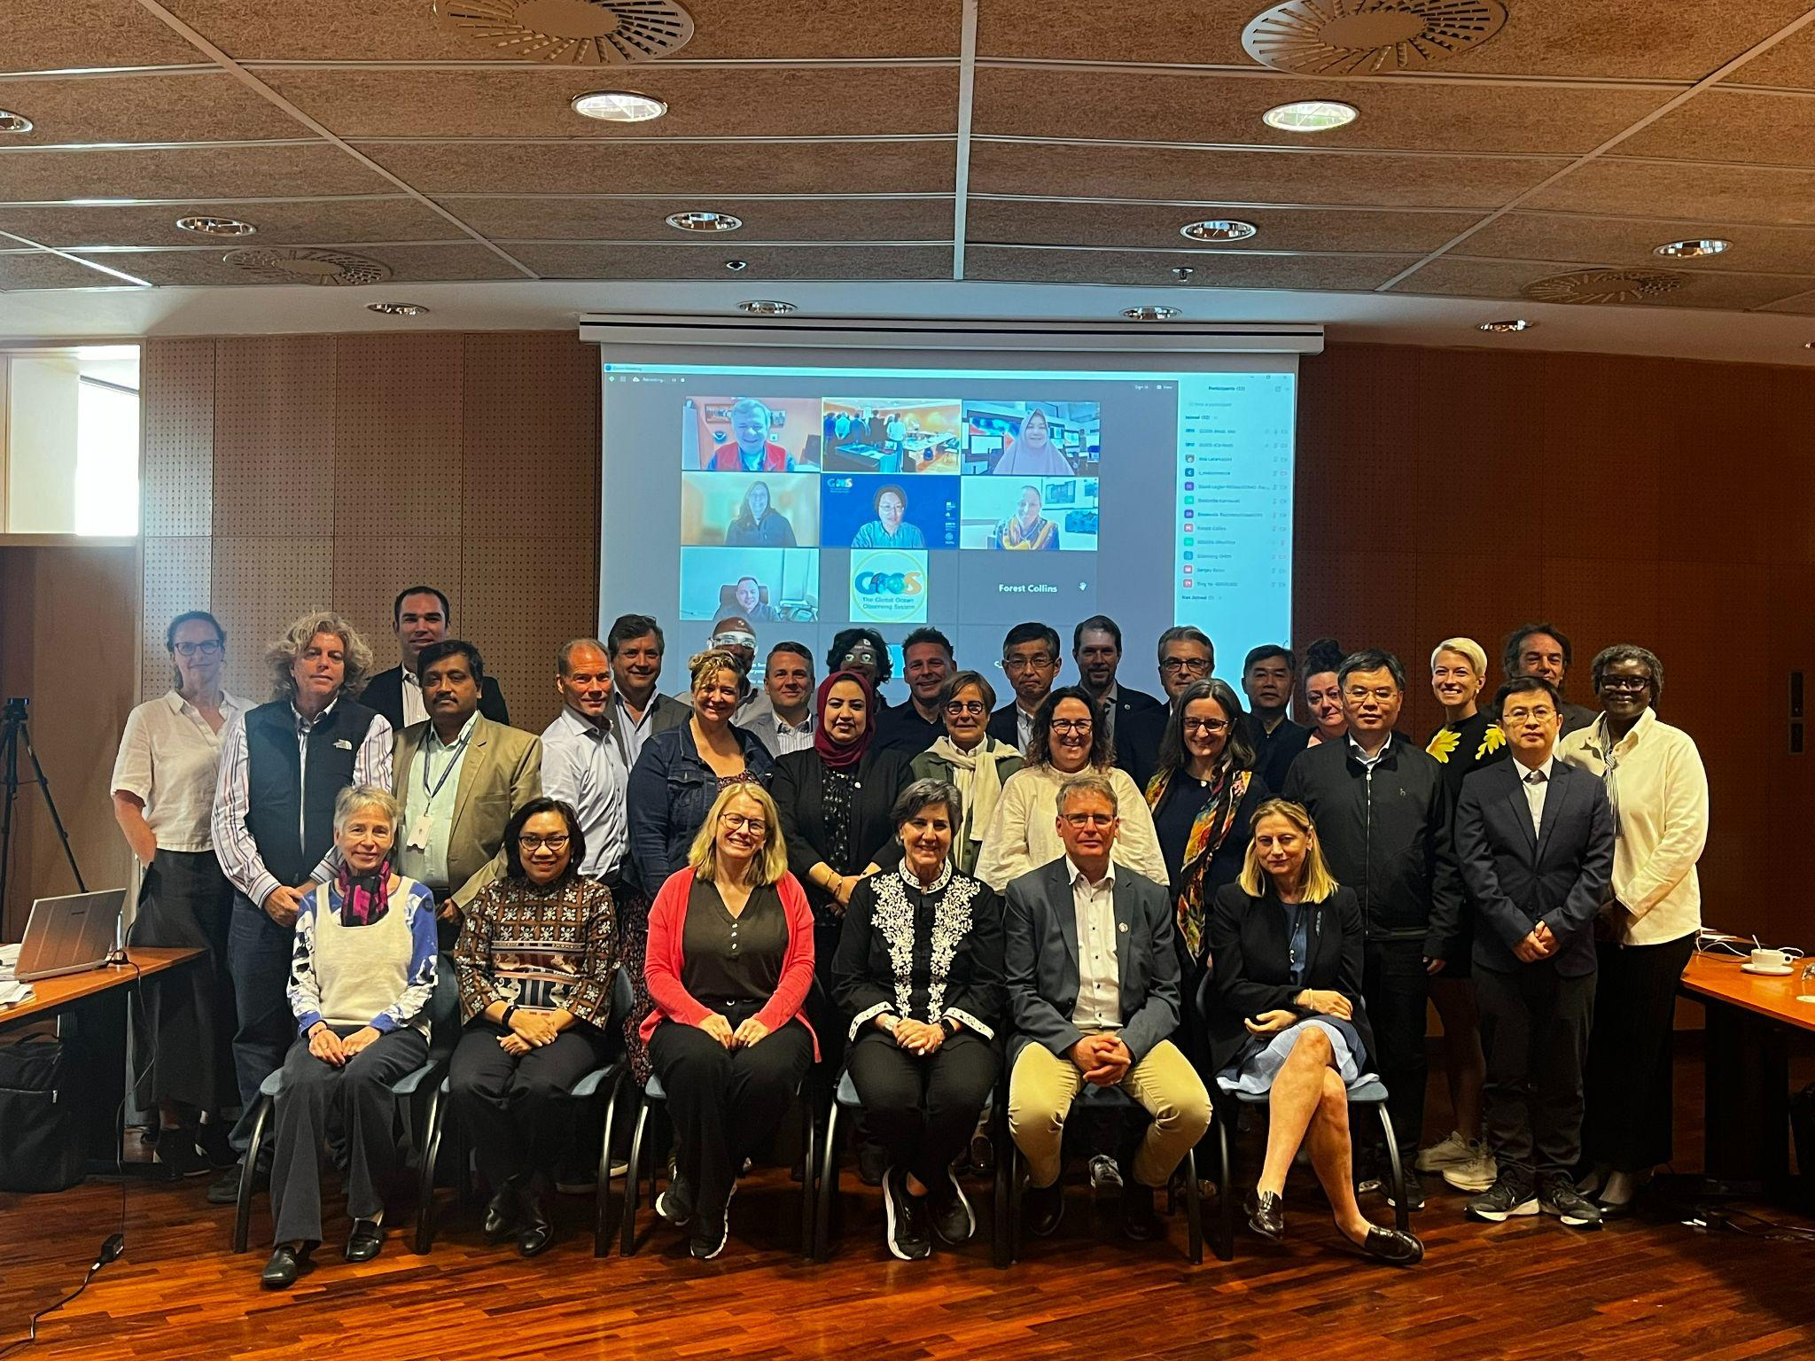
GOOS SC
April 2024
Barcelona
Notes:
Focus areas for the next period:
Communications and advocacy
Regional coordination
UN Ocean Decade - Co-Design
Evolving GOOS Governance - key 2023
AND
Strengthening GOOS core support is absolutely vital

Slide 24
Member States
Decision Makers | System Providers | Users | Funders
Decade Coordination Office| Decade Programmes + Projects
GOOS Projects | Partners
Research community | WCRP
Metadata, data & modelling
OceanOPS
Expert Team on Operational Ocean Forecast Systems (ETOOFS)
GOOS Regional Alliances (GRAs)
Co-Design |
Capacity Development
IODE |
Data | Data portals
Observations Coordination Group (OCG)
GOOS Networks
National Focal Points (NFPs)
Observing coordination
3 Expert Panels
Physics and Climate (OOPC) |Biogeochemistry (BGC) | Biology and Ecosystems (BioEco)
WMO: RRR | WIGOS
GCOS
  Requirements
  Connection with observing community
GOOS Management Team*
Coordination | Communication | Integration | Advocacy
GOOS Steering Committee
  Sponsors
IOC - UNESCO | WMO | UNEP | ISC
*HQ IOC/UNESCO, Paris
Notes:
Comments to consider:

Slide 25
SC Priority actions 2024/5
Develop cross-GOOS Digital Ecosystem – create strategy and implements, building on and connecting advances in OCG, BGC, BioEco
Marine Carbon Observing Strategy - linked to Co-Design Exemplar, WMO 3GW, Dialogues with Industry, cross panel (BGC Panel lead)
Biodiversity Observing Strategy - link to co-Design exemplar, cross-panel/ community effort for integrated for BBNJ, CBD, GBF (BioEco Panel lead)
Co-Design is key - strengthen work in Ocean Decade Co-Design, CoastPredict, private sector
Leverage Decade – new work DCO, DCCs, Vision paper
Consistent messaging - across GOOS structure, rebranding, tools
Strengthen GOOS governance - GOOS and its internal functions
Strengthen support OceanOPS - too fragile

Slide 26

State of the Ocean Report - StOR
      Every 2 years
      Framed under the Decade Challenges – status, gaps, future steps
      3 Articles GOOS:
        Ocean Observing
        Ocean Data
        Industry and civil society connections to ocean observing
        … biodiversity, ocean forecasting, etc.
      Could be powerful – not there yet
      Being able to make authoritative statements about gaps would have bigger impact for these opportunities (reviewers requested)
      Better tracking (OceanOPS+), better requirements response (session 15)

Slide 27

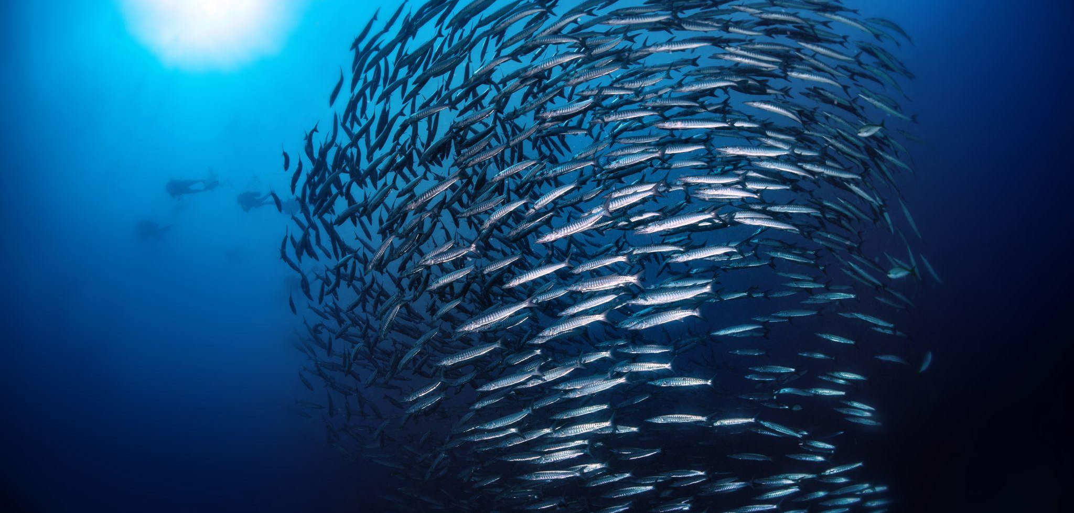
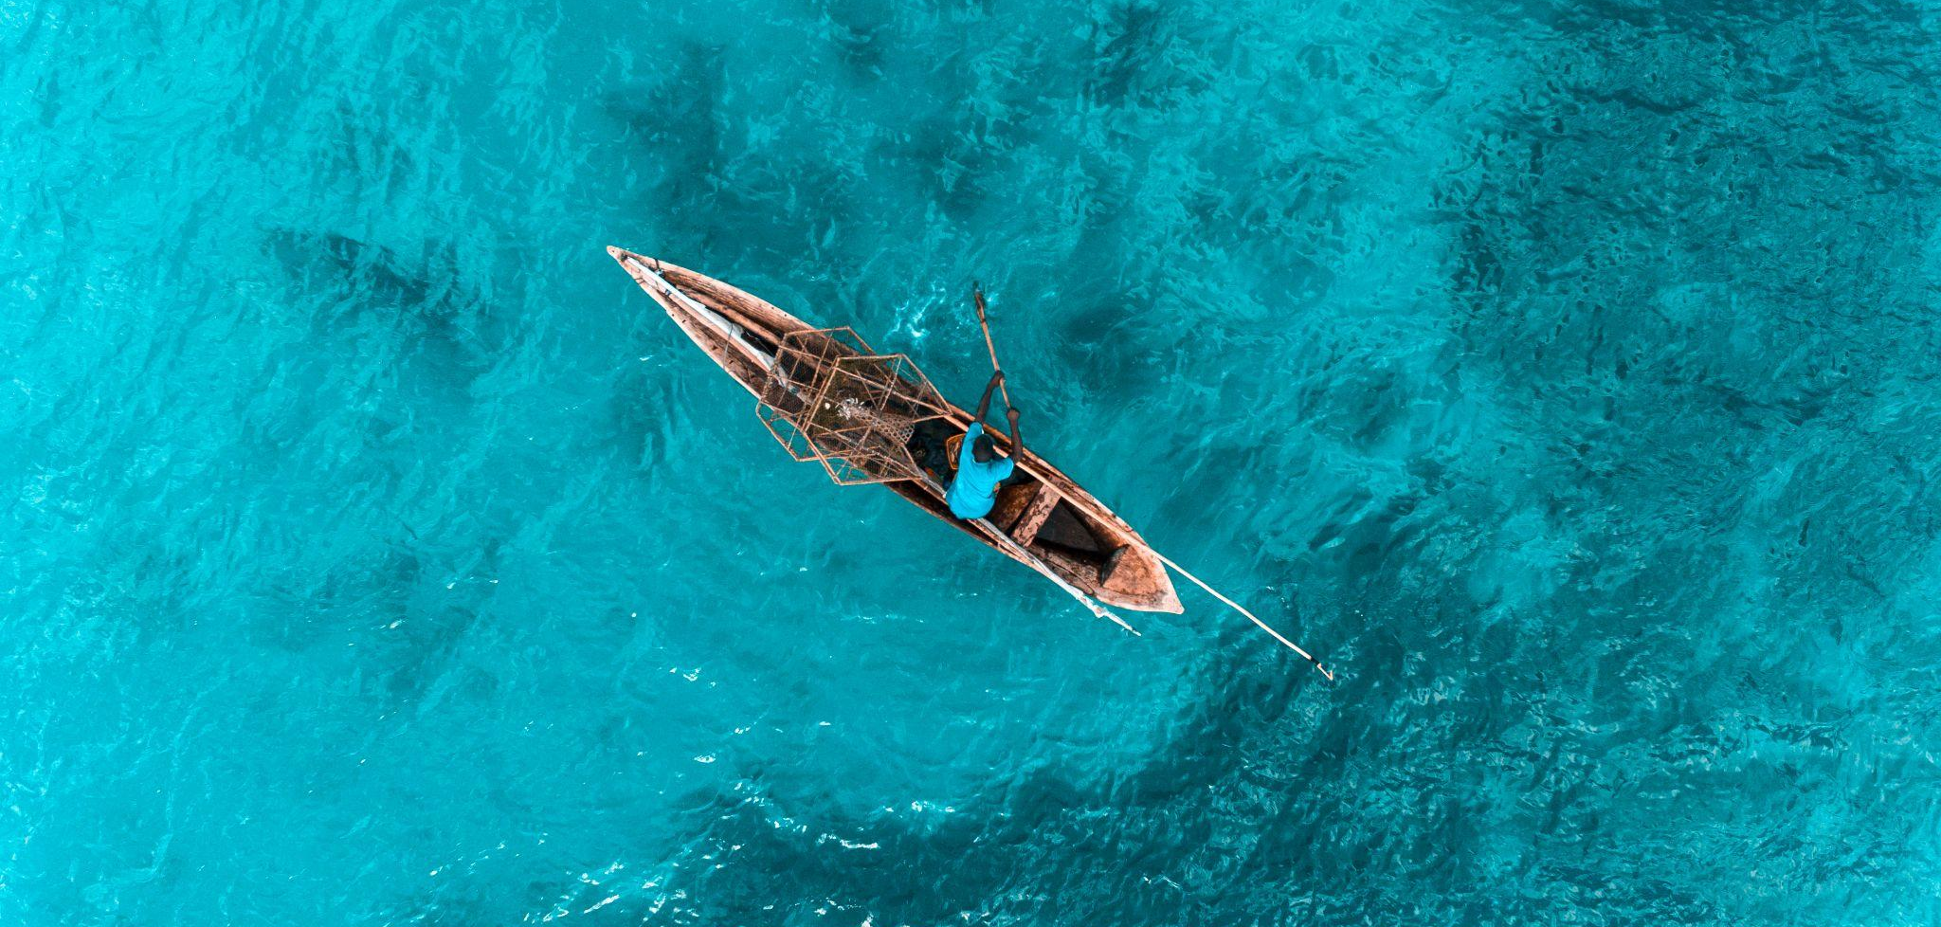
IOC/UNESCO
Increase in budget for GOOS for this biennium 2024-2025
Budget allocated to support regional GOOS - GOOS Africa, PI GOOS, IO GOOS, IOCARIBE-GOOS
New position created to support GRAs and NFPs
New Executive Secretary – Vidar Helgesen
Sustainable Ocean management Strategy
IOC EC-57
Report on progress governance process
Report on progress ad-hoc intersessional team OONJ
IOC/EC-57/3.1.Doc(1) Add. | Report of the IOC Executive Secretary on the work accomplished since the Thirty-second session of the Assembly (July 2023–May 2024) - Addendum

Slide 28
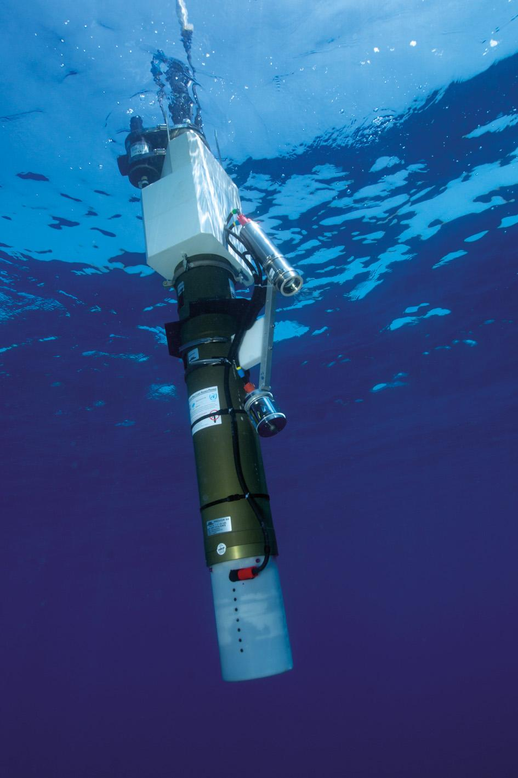
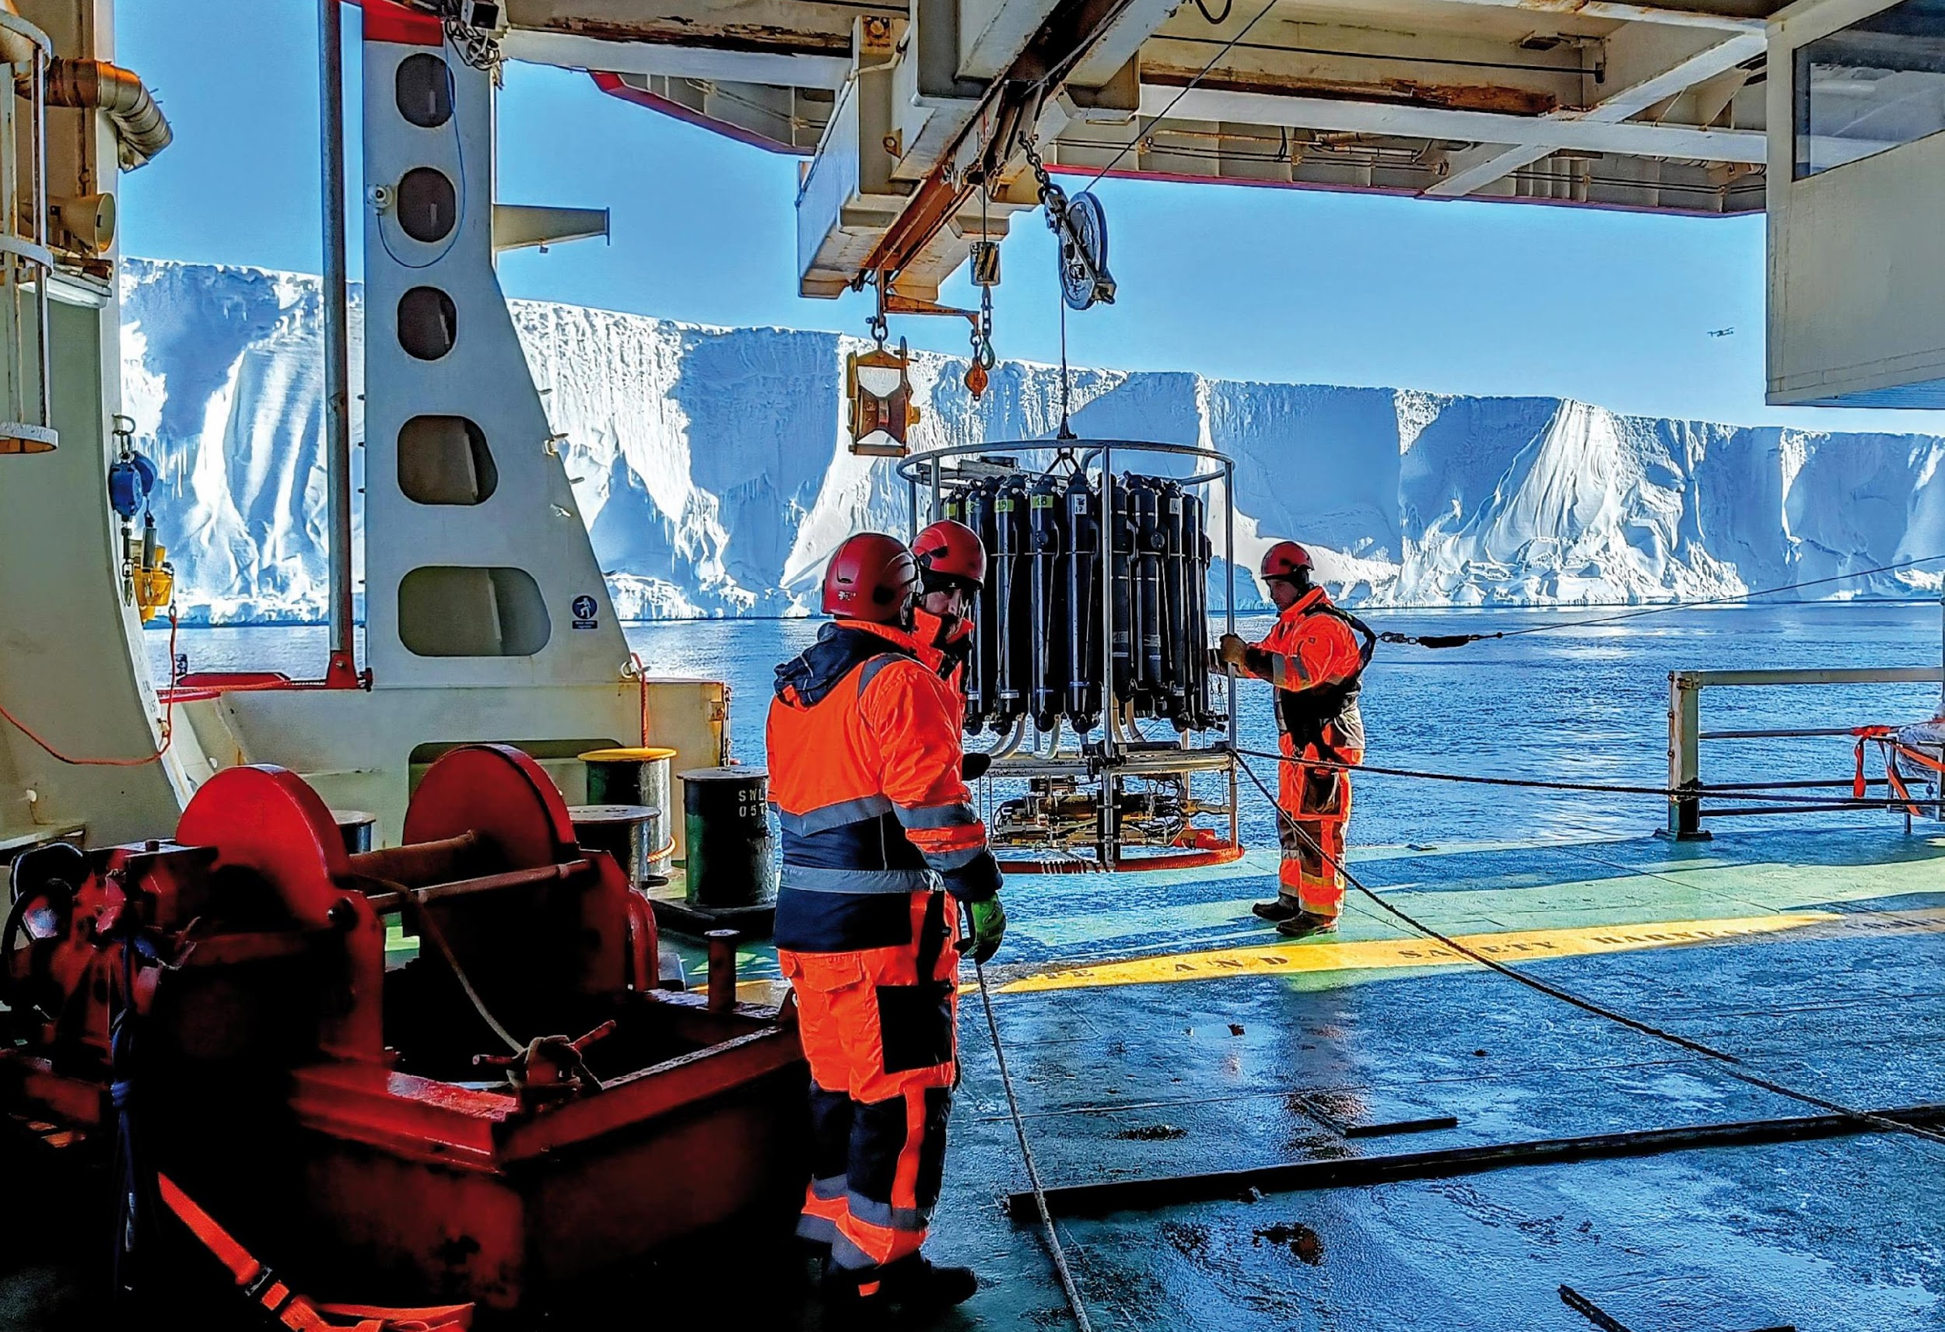
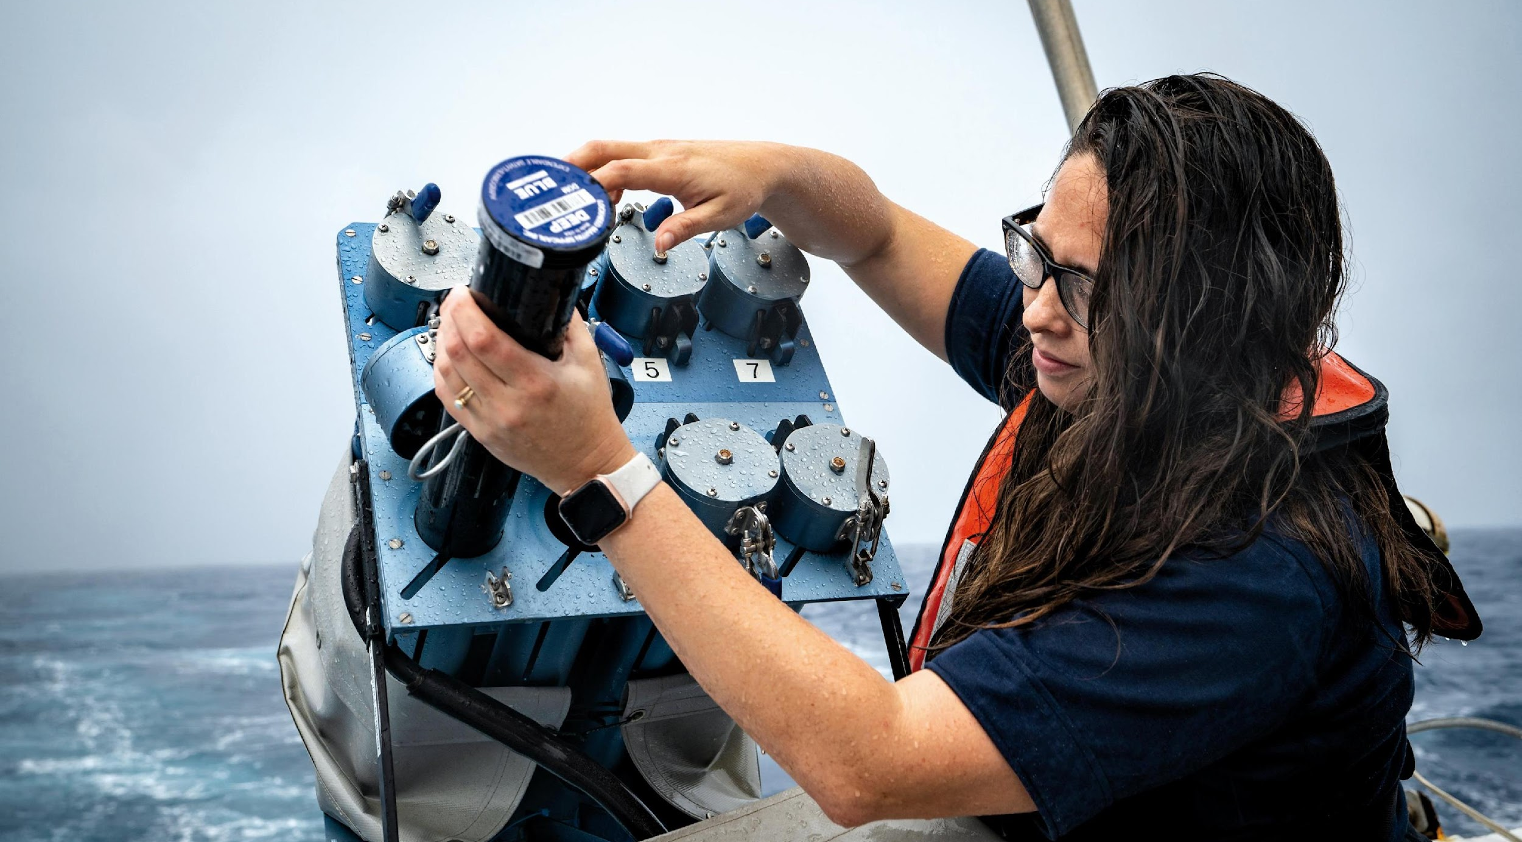
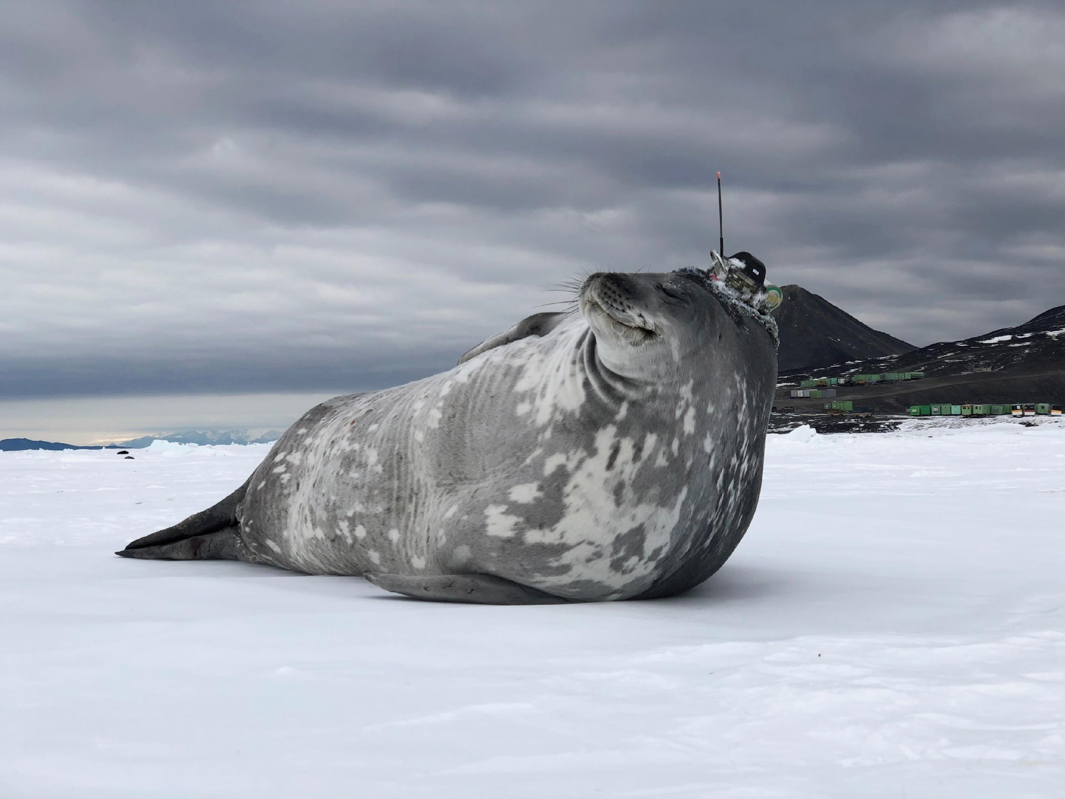
Thank you
goosocean.org

Slide 29
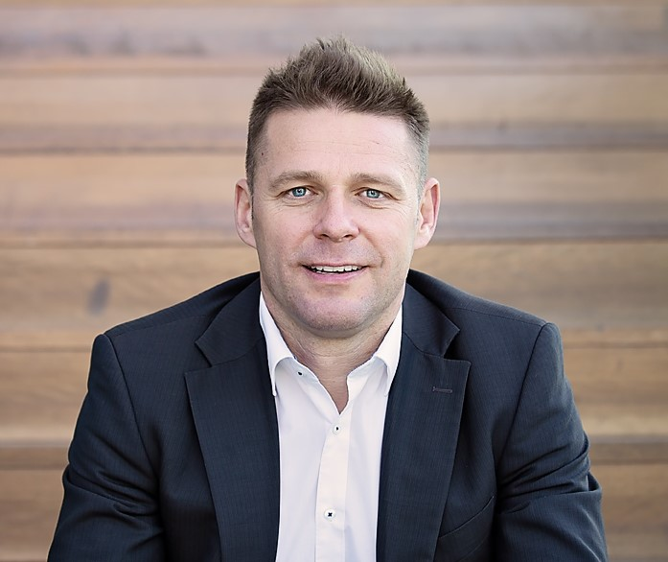

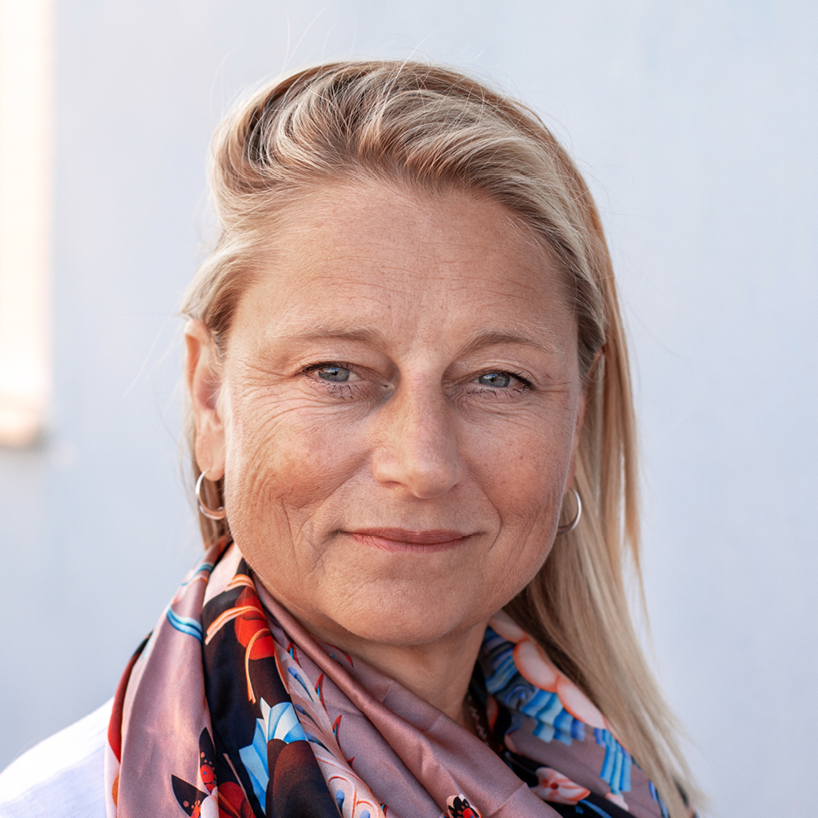

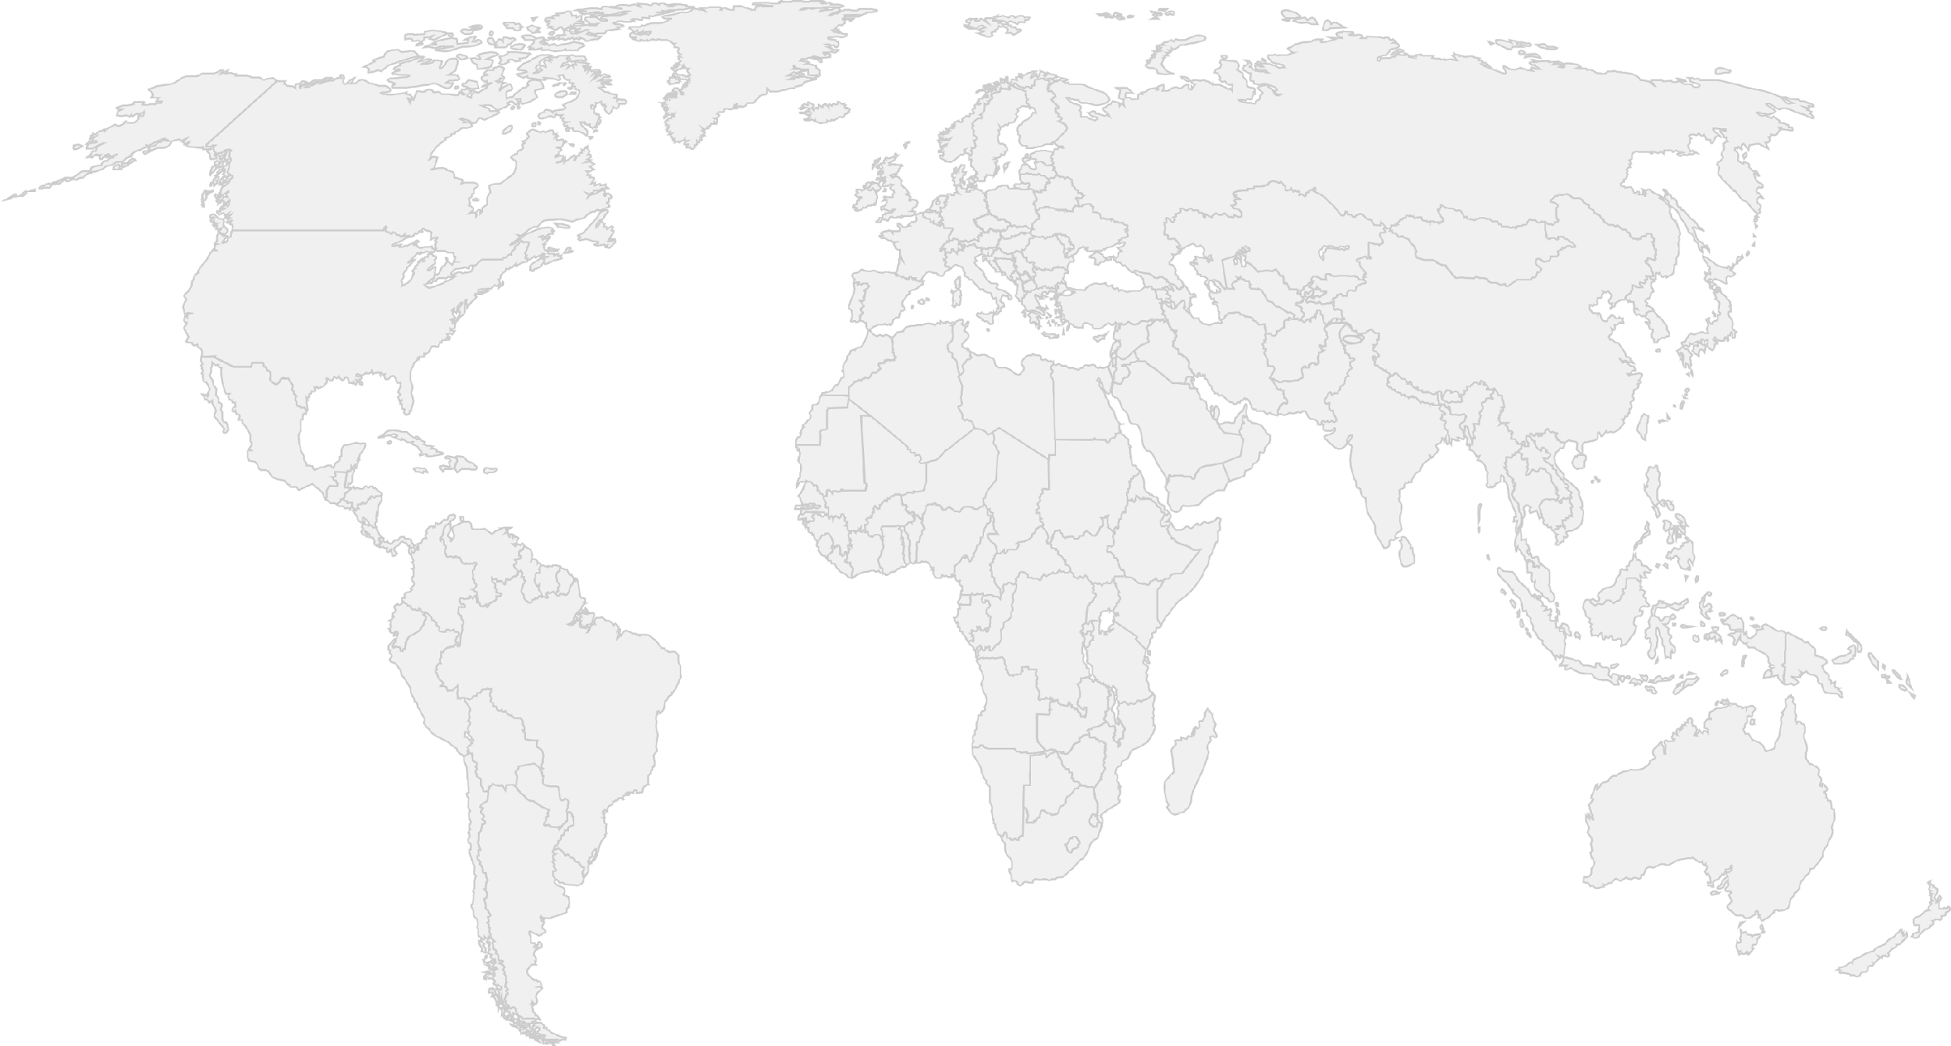
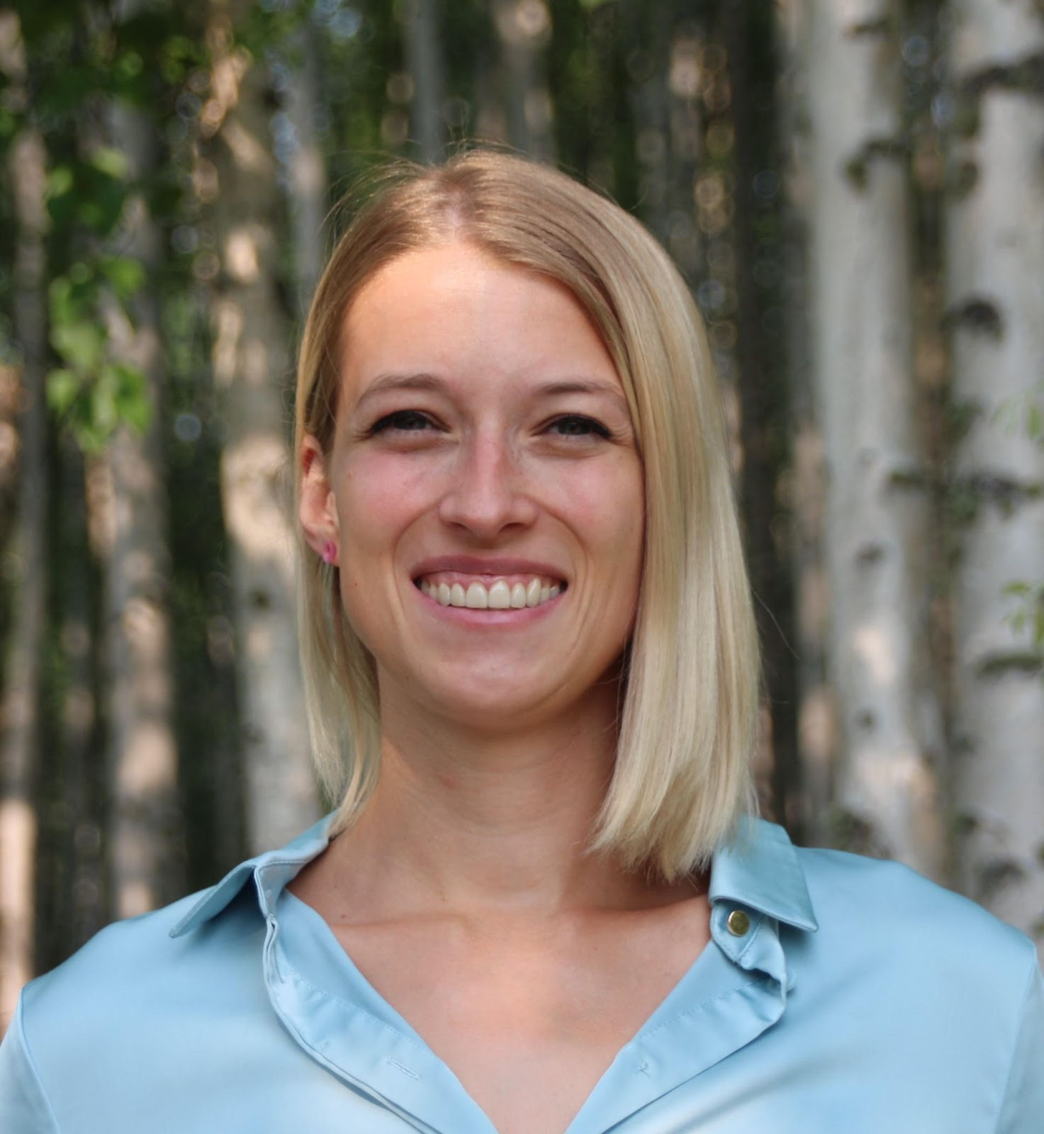

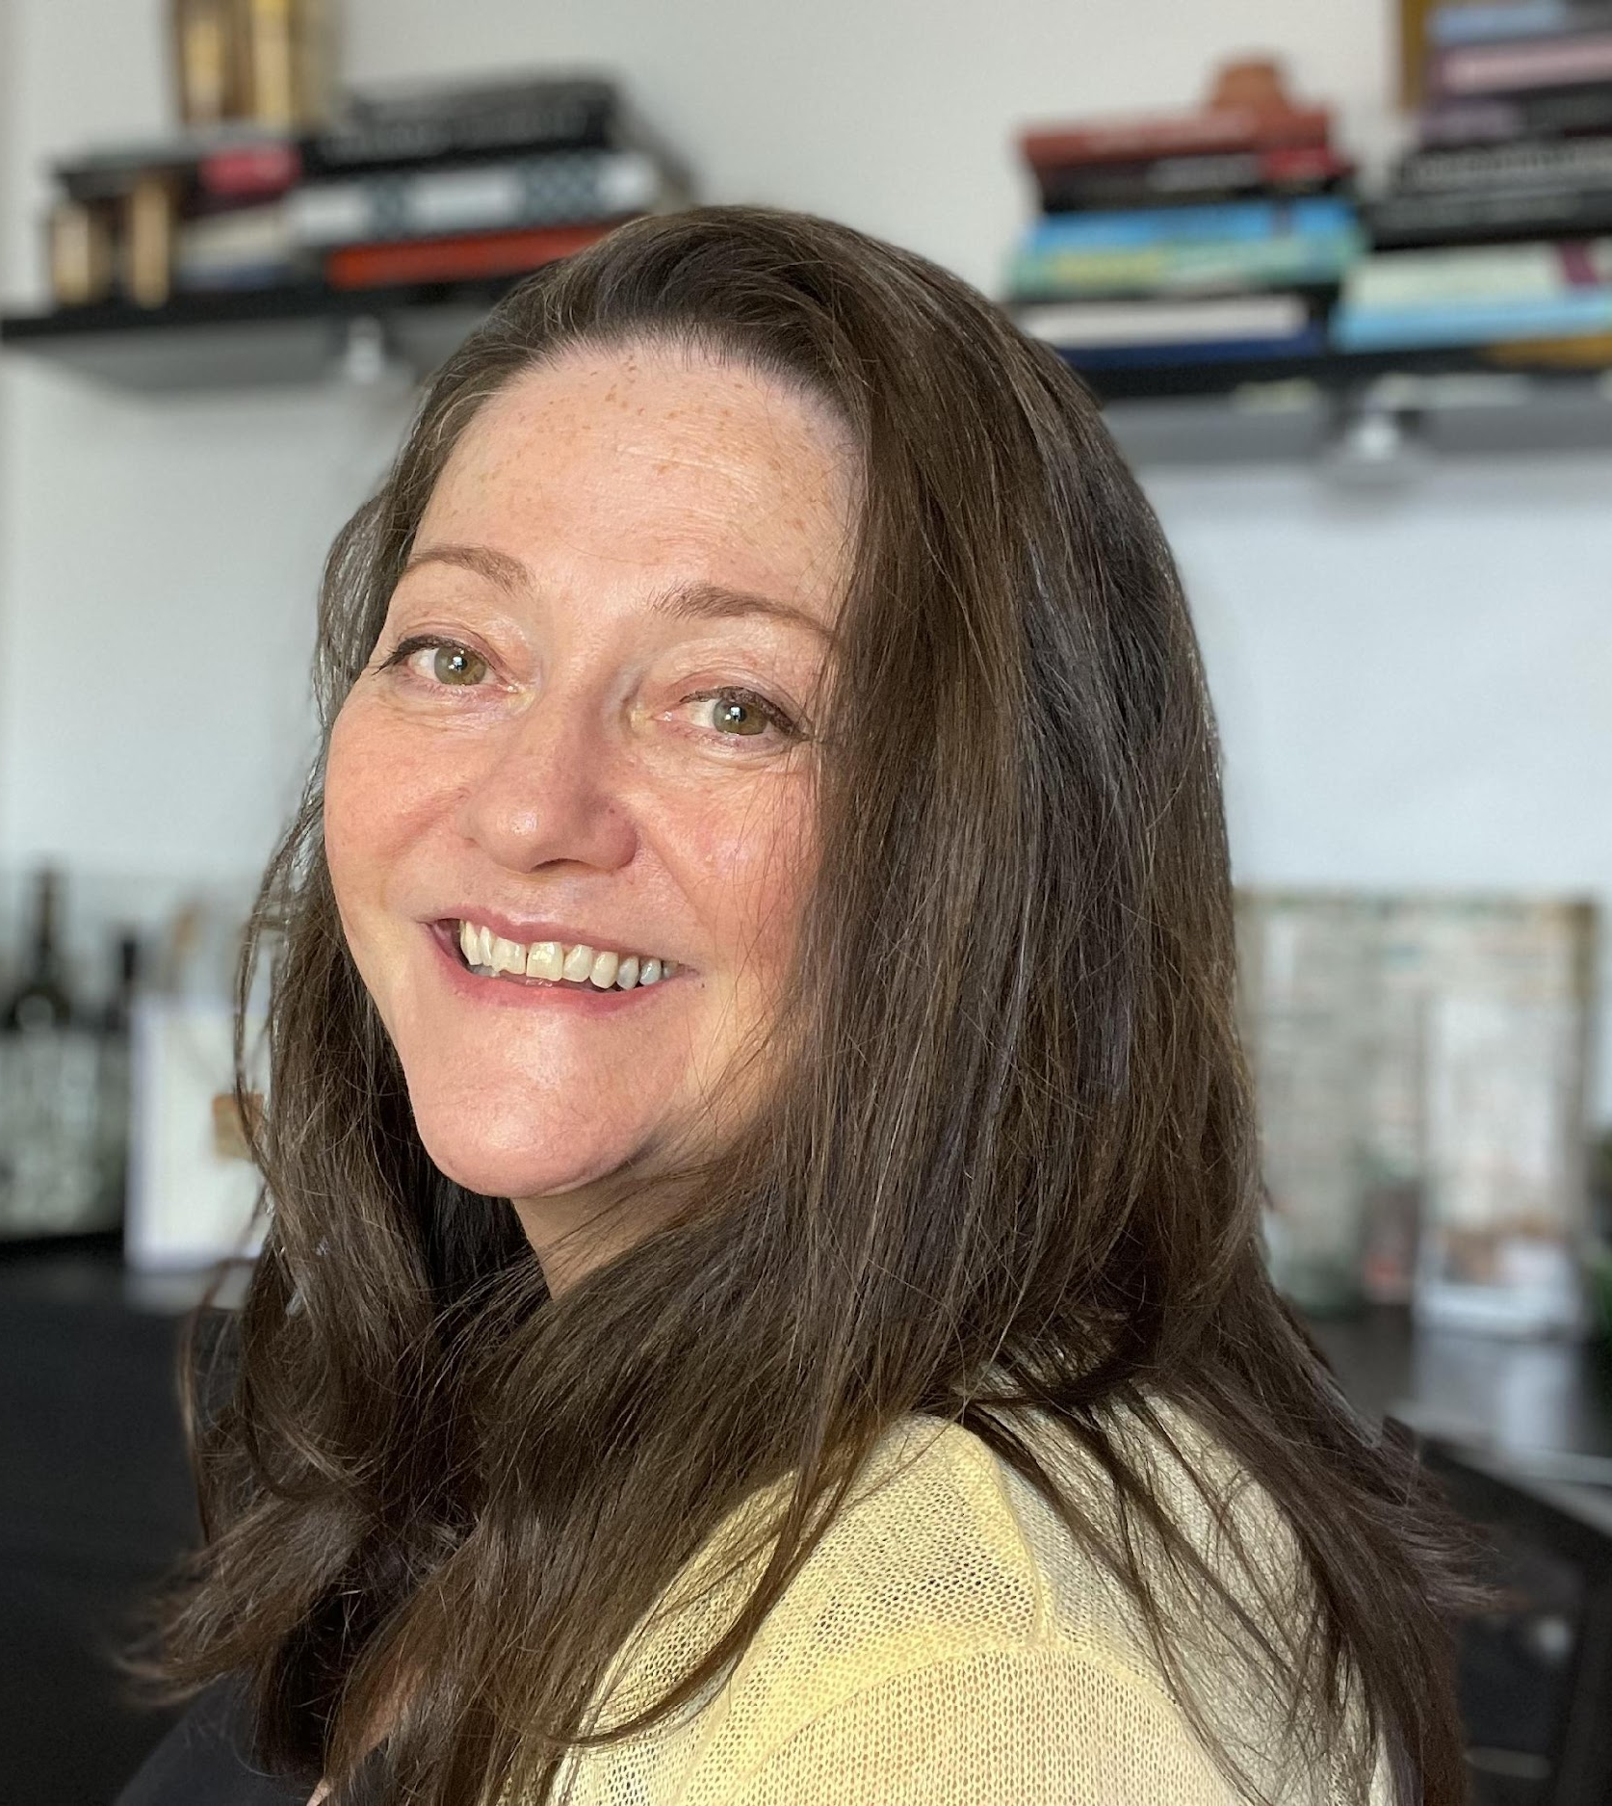

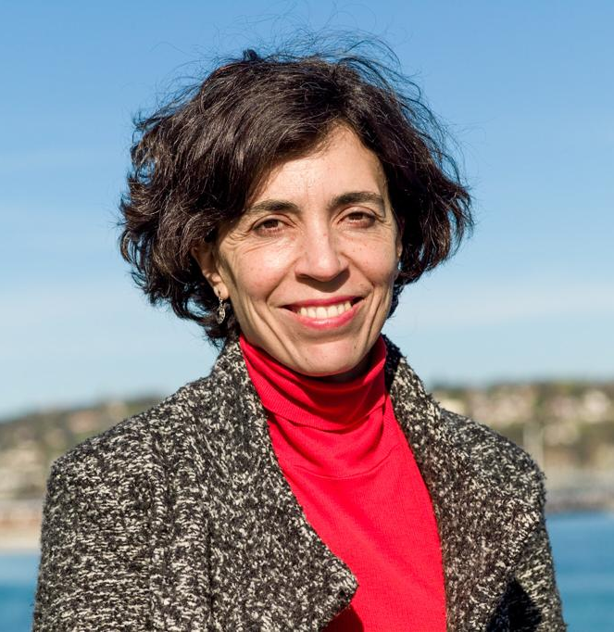
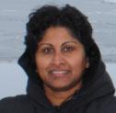
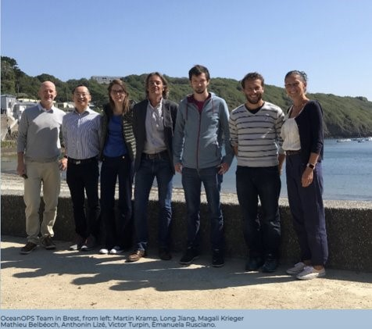
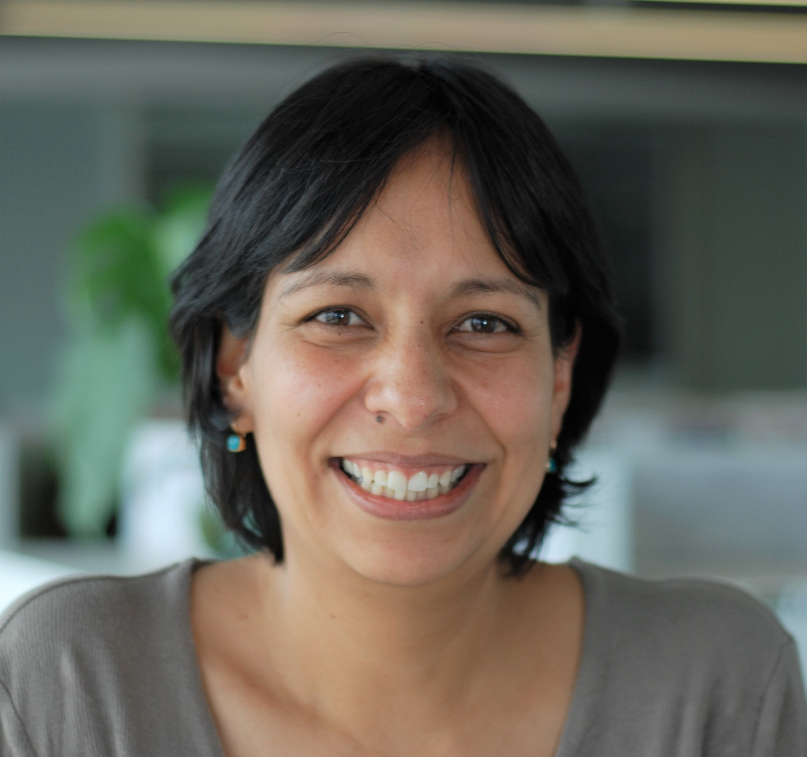
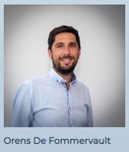
GOOS Coordination Office
Maciej Telszewski
BGC Panel
IOCCP, Sopot, Poland
Ann-Christine Zinkann,
OCG / Networks
NOAA, US
Joanna Post, Emma Heslop, Emily Smith
Yu Ting, Forest Collins
GOOS headquarter in Paris, France
Laura Stukonyte,
GOOS communication, Barcelona, Spain
Belen Martin Miguez, and Champika Gallage
OOPC Panel Networks/ Standards
WMO headquarter in Geneva, Switzerland
Ana Lara-Lopez
BioEco Panel
Hobart, Australia
OceanOPS team, Brest, France
From left: Martin Kramp, Long Jiang, Magali Krieger, Mathieu Belbeoch, Anthonin Lize, Victor Turpin, Emanuela Rusciano and
Orens de Fommervault, Monaco, France

Slide 30
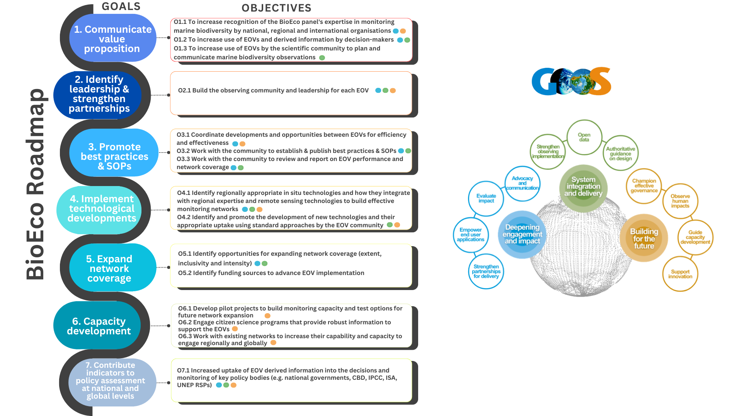
Notes:
Bioeco ocean plays a role in that, supporting development

Slide 31


Transformation in the Decade
Ocean Observing Co-Design will develop a more user-focused co-design process to evolve a truly integrated, responsive ocean observing system.
CoastPredict will revolutionise Global Coastal Ocean observing and forecasting, offering open and free access to coastal information and predictions.
Notes:
GOOS has exciting and transformative programme in the ocean decade, aiming to transform GOOS and deviler the ocean we need for the future we want.
Co-design and CoastPredict
w

Slide 32
Vision 2030 White Paper
Ambition: a clear roadmap to achieving a sustainable, co-designed, fit-for purpose, multidisciplinary, and geographically expanded global ocean observing system that delivers accessible data to all nations and users.
Access here:
https://oceanexpert.org/document/33599

Slide 33

GOOS 2030 Strategy
      2019: GOOS launched ambitious 2030 Strategy
Vision: A truly global ocean observing system that delivers the essential information needed for our sustainable development, safety, wellbeing and prosperity
      UN Ocean Decade launched in 2021: Challenge 7 ‘Expand the Global Ocean Observing System’
Notes:
In response to the urgent need to increase ocean observations GOOS launched the ambitious Global Ocean Observing System 2030 Strategy with the aim of providing the vehicle for designing, building and widening the use of the necessary observations and information systems.
– with its vision for a truly integrated and responsive global ocean observing system that delivers the information needed our sustainable development, safety, wellbeing and prosperity.
The 2030 Strategy called for a step change ocean observing, in our ability to manage and deliver a global system, and in the scope and extent, and in the range of actors and partners that are a part of that system - from government, private sector, intergovernmental and citizens.
OceanObs 19 - the same year as the strategy launch – saw many influential white papers that underpin the work to implement the Strategy
The UN Decade of Ocean Science for Sustainable Development (Ocean Decade) launched in 2021, with a similar urgency for the ocean - its vision being the ocean we need for the future we want, and with an expanded global ocean observing system as one of its foundational challenges.

Slide 34
Ocean Decade Challenge 7: Expand the Global Ocean Observing System
PRIORITY DATASETS
Measurement of priorities and EOVs
Forward-looking to evolve and be informed by other Decade challenges and emerging ocean needs
Improve funding for observations linked to tangible mitigation and adaptation actions
KNOWLEDGE GENERATION AND SHARING
Through dialogue between sectors accelerate the development of efficient resilient ocean observing infrastructure and user services to deliver information through tailored data products, and indicators
Draft Fig. WP#7, provided by P. Miloslavich.

Slide 35
Ocean Decade Challenge 7: Expand the Global Ocean Observing System
INFRASTRUCTURE AND PROCESS REQUIREMENTS:
Investment in enhanced data processing and modelling capabilities will be required.
Data interoperability to enable data fusion critical.
International efforts around data access and information sharing essential
TECH & INNOVATION SOLUTIONS
New technology that is more rapidly tested and implemented with agreed best practices and data flow (e.g. eDNA, Imaging FlowCytobot)
Draft Fig. WP#7, provided by P. Miloslavich.

