Slide 1
15th Session of Observations Coordination Group (OCG)
OCG-15 Session, 13-17 May, 2024
ONC, Victoria, British Columbia, Canada
Notes:
Ann

Slide 2
OCG-15 Etiquette
Keep your microphone muted unless you are speaking and try to use video.
For question or comment, please use the chat box or indicate by raising your hand in order to be called upon by the moderator.
Please be succinct in both your questions and answers.
The sessions will be recorded for the purpose of writing the report, and the recordings deleted afterwards.
Attendees who are joining as observers please edit their names and note OBS_ in front of their name.
Notes:
Ann

Slide 3
OCG-15 Format
Meeting time: Mo-Thur - 9 - 17:30 pm PST, Fri - 9 - 12 pm PST
Annotated Agenda at the bottom of the timetable outlines questions and intended outcomes for each session
Agenda topic, presenter and materials are linked in the Agenda and on the OCG-15 website
Notes and Key points will be recorded and reviewed daily
Workshops
Best Practices at Ocean Networks Canada - May 14
WIS 2.0 - May 13
Observing Implementation - May 15
Notes:
Ann

Slide 4
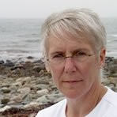
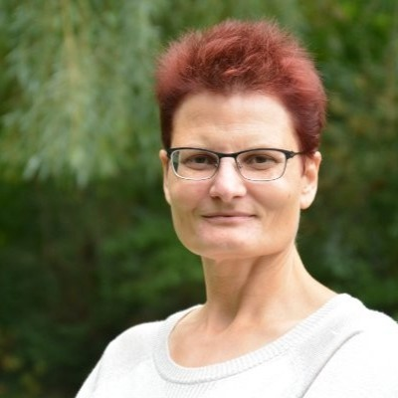
Dr. Kate Moran - President, Ocean Networks Canada at University of Victoria
Daniela Loock - Director, Corporate Services at Ocean Networks Canada
Notes:
Status of the Observing system: recovering from COVID gaps, particularly moorings
Remaining gaps: Indian Ocean (RAMA, Argo, Drifters) - US committed $2.5M resources to replace all of the RAMA moorings
New capabilities coming online: BGC-Argo, more gliders, etc.

Slide 5
Observations Coordination Group
David Legler (OCG Chair) and the OCG Executive Committee
OCG-15 Session, 13-17 May, 2024
ONC, Victoria, British Columbia, Canada
Notes:
Status of the Observing system: recovering from COVID gaps, particularly moorings
Remaining gaps: Indian Ocean (RAMA, Argo, Drifters) - US committed $2.5M resources to replace all of the RAMA moorings
New capabilities coming online: BGC-Argo, more gliders, etc.

Slide 6
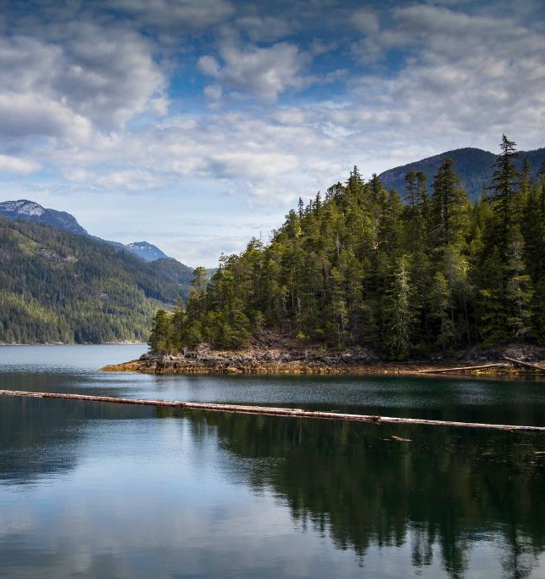
Welcome
To
Victoria!

Slide 7
Recap since OCG-15
Observations Coordination Group/GOOS continues its central role in developing an efficient, coordinated, and useful ocean observing system
Recognition of OCG as a central pillar of GOOS and significant strategic importance
Authoritative and public GOOS voice with the Report card strengthens, plus public ‘news’ items are often linked to “OCG” and networks
UN Decade opening up new connections and opportunities
Ocean-OPS.org goes dark, restructuring underway!
A year of challenges, ingenuity, determination
Notes:
Congratulations on making it through this year. Largely recovered, except ship-based activities where we WILL see a COVID gap in our records.
Despite the limitations from COVID, the community has responded and demonstrated dedication to ocean observing
OCG too
UN Decade (Wed)
Work and collaboration with UN Decade Programmes as they initiate
Time consuming endeavour. UN Decade activities are a pathway to change. Opportunity for more engagement (eventually resourcing???)
Things are becoming more clear, still need to be vigilant for duplication, efficiency, opportunity and developing and implementing the system.
How best for OCG to support networks with this?
EH Notes
What do we need this to do at the start of the meeting
Lay out some excitement about the agenda and aims
Show progress and good work across the year, responding to circumstances, focus on foci and actions from last year, acknowledge people's work, commitment, progress, ideas of exec (Vice Chairs) and networks - real successes we ahev had - we should be very clear on this - OCG, the networks gains recognition for efforts - in turn support our work to develop observing system
Other work to make OCG meaningful for OO - WMO IP etc
Challenges ahead
How our discussions this week will help guide OCG

Slide 8
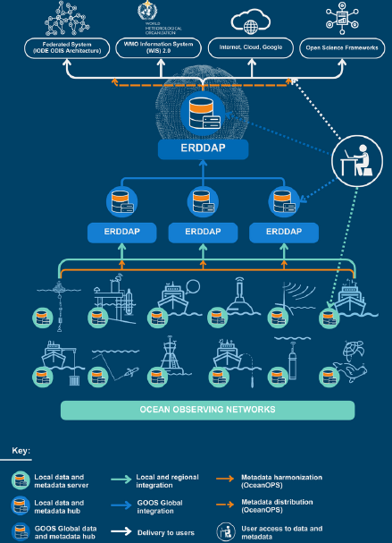
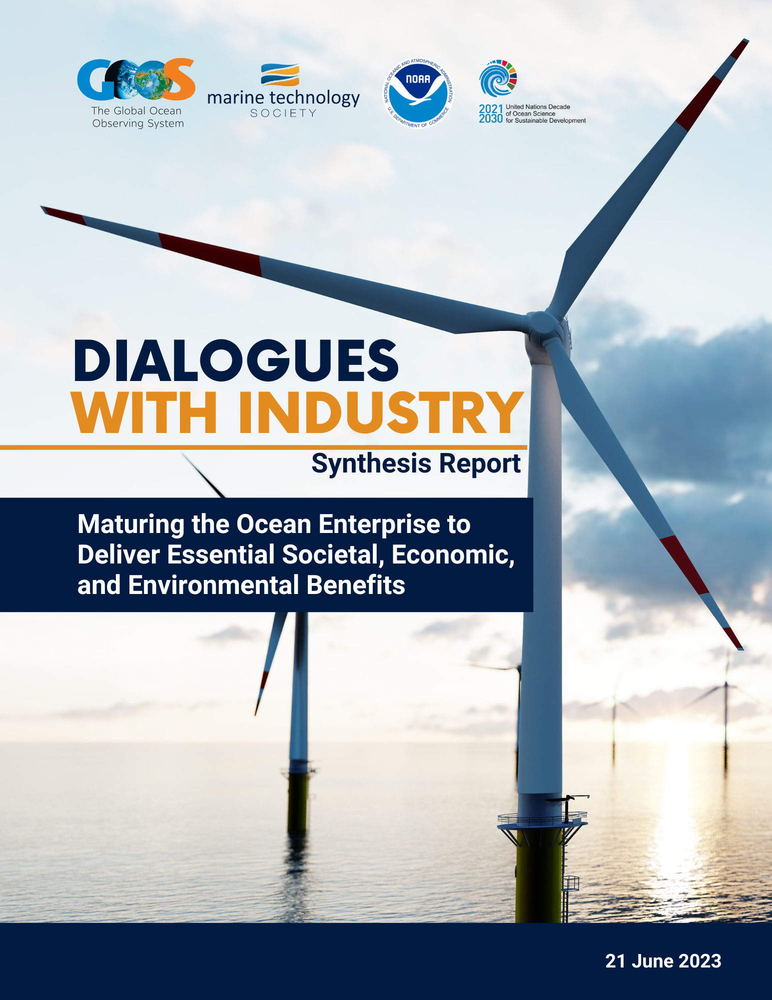
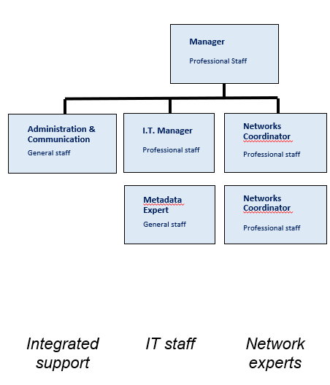
Achievements, important initiatives, evolving actions (May 2024)
Data/metadata integration discussion (5 March 2024)
OceanOPS/OCG, OBIS, BioEco Portal, and ODIS, discussed implementation, resource opportunities.
Data Implementation Strategy
OCG and Dialogues with Industry
OCG Cross Network Data Implementation Strategy (GOOS- 296)
ERDDAP seminar series
Data and metadata integration
Dialogues with Industry Roadmap: Maturing the Ocean Enterprise to Deliver Essential Societal, Economic, and Environmental Benefits (GOOS- 294)
Ocean Enterprise Initiative
Best Practices
Adoption of Argo BP.
9 “GOOS endorsed” BPs available via the Ocean Best Practices System repository
Capacity Building
Medi-1 workshop, Ocean Observations side event at the 18th WMO Regional Association I Conference, equipment donations, PMO training workshop.
Impact Study
The 8th WMO Workshop on the Impact of Various Observing Systems on NWP. Awaiting outcomes!
OceanOPS Restructuring
Network readiness level
Report Card 2023 (ocean-ops.org/reportcard)
OceanOPS restructuring document
Roundtable March 2024
Task Team on Metrics established, ToR.
Monthly meeting on the thematic discussion.
Draft metrics on data and metadata
New networks expansion
OCG-15 (13-17 May, Victoria, BC, Canada)
FVON, SmartCable, SOCONET → being new networks
Bring together the potential emerging networks and existing networks → potential overlaps and opportunities.
3 notable topics
CIOOS + indigenous + ocean carbon
Requirements + Co-design
WIS 2.0
Poster session, Cross panel discussion …
Notes:
Note: expected outcomes or decision etc.

Slide 9
Aims of OCG-15
OCG strives to enhance engagement with the Networks and focussing tasks on network needs and priorities
OceanOPS restructuring, and charting the course for the next year+
How we work with requirement setting and observing Implementation
New networks (metrics, and considering new networks)
Implementation for OCG Data Strategy, including WIS 2.0
Engagement with a new GRA - Canada
Setting priority actions for the next year!
Notes:
Congratulations on making it through this year. Largely recovered, except ship-based activities where we WILL see a COVID gap in our records.
Despite the limitations from COVID, the community has responded and demonstrated dedication to ocean observing
OCG too
UN Decade (Wed)
Work and collaboration with UN Decade Programmes as they initiate
Time consuming endeavour. UN Decade activities are a pathway to change. Opportunity for more engagement (eventually resourcing???)
Things are becoming more clear, still need to be vigilant for duplication, efficiency, opportunity and developing and implementing the system.
How best for OCG to support networks with this?
EH Notes
What do we need this to do at the start of the meeting
Lay out some excitement about the agenda and aims
Show progress and good work across the year, responding to circumstances, focus on foci and actions from last year, acknowledge people's work, commitment, progress, ideas of exec (Vice Chairs) and networks - real successes we ahev had - we should be very clear on this - OCG, the networks gains recognition for efforts - in turn support our work to develop observing system
Other work to make OCG meaningful for OO - WMO IP etc
Challenges ahead
How our discussions this week will help guide OCG

Slide 10
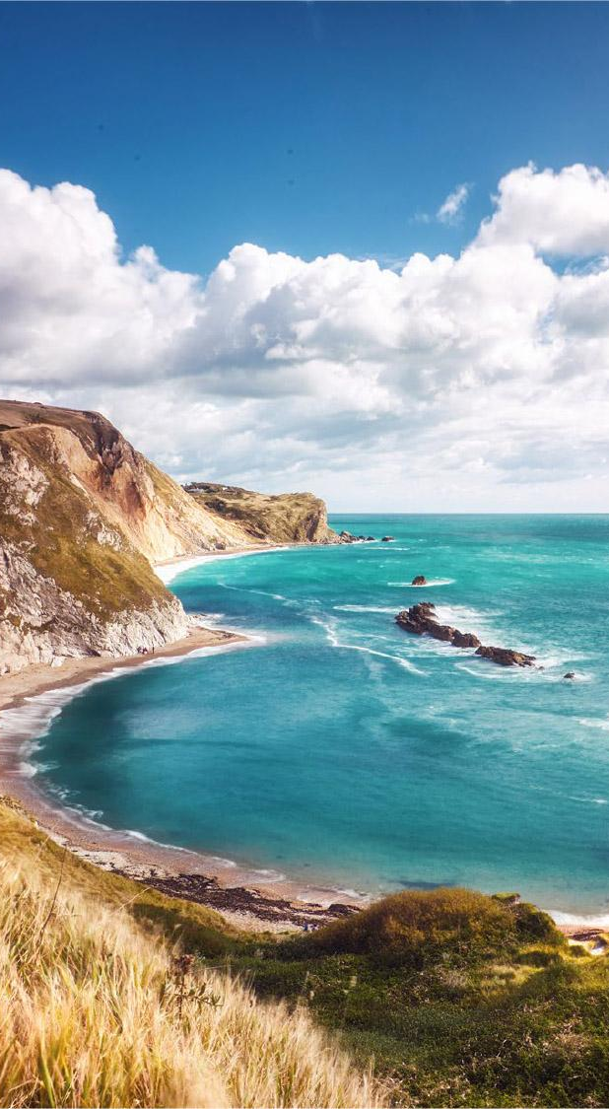
Major Challenges
Continued erosion of resourcing of many ocean observations (but some networks are growing, eg OceanGliders).
No guide or process to integrate and/or prioritize observing activities. How do we coordinate/prioritize? (with Panels and others)
Restoring OceanOPS and charting a future for OceanOPS services
Engaging and guiding private sector interests and resources (Challenge and Opportunity), eg GOOS/MTS Dialogues
Integration of emerging networks and clear guidelines for other networks wanting to be an OCG network
Finding a new OCG chair and other vice chair
Notes:
There needs to be more dialogue and coordination around a effectively implement the FOO

Slide 11
Opportunities
Implementation of OCG data strategy…what are our priorities?
Developing of metrics (measures) to track and clarify OCG network maturity and status
Consideration of ocean networks in WMO GBON
Observing technology development, assessment, and infusion across networks (System Evolution)
Improving engagement and feedback (e.g. UN Decade activities)

Slide 12
This Week and the Way Ahead
Celebrate successes!
Core business surrounding our foci remains critical
Enhance engagement with the Networks, and with the GOOS Panels, and network “users”
Significant opportunities for OCG and its networks!
Clear cross network dialogue on new opportunities, and our OCG foci priorities, also in identifying barriers to implementation
Help in communicating with/engaging with other groups in these communities

Slide 13
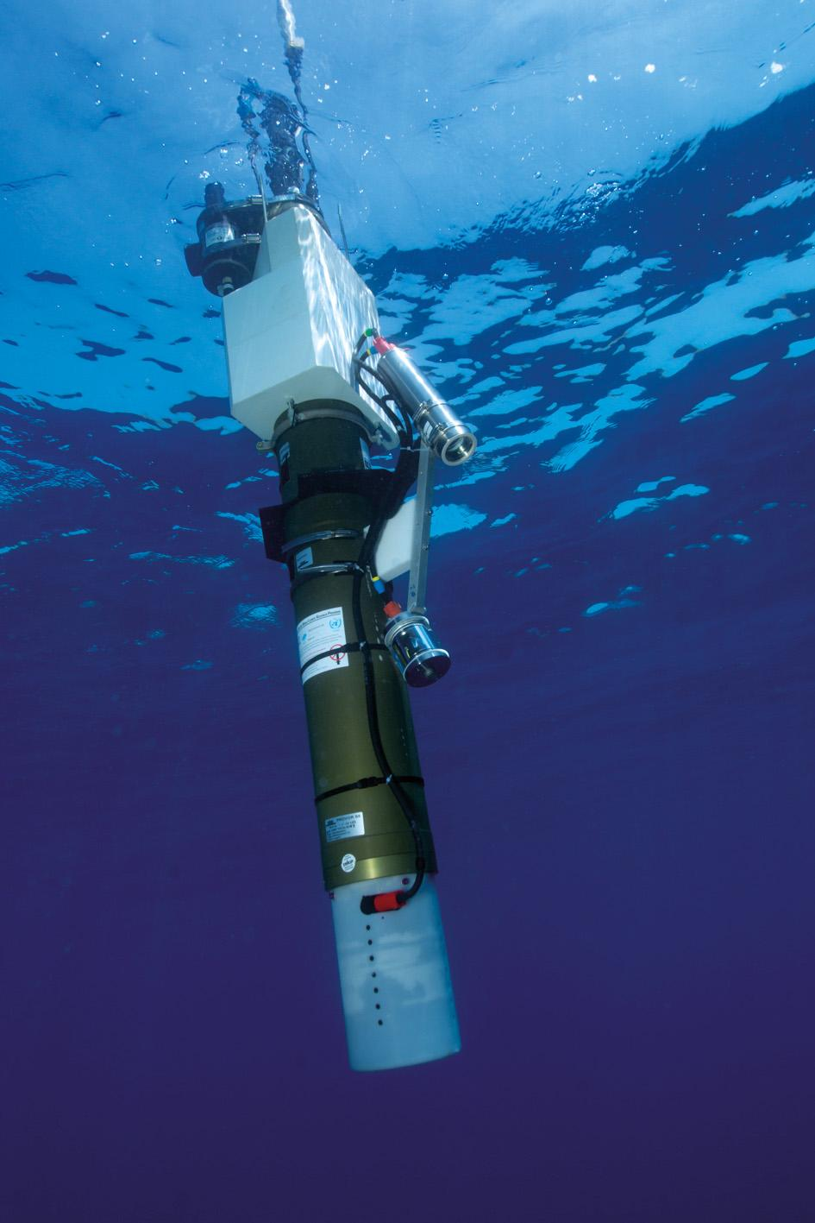
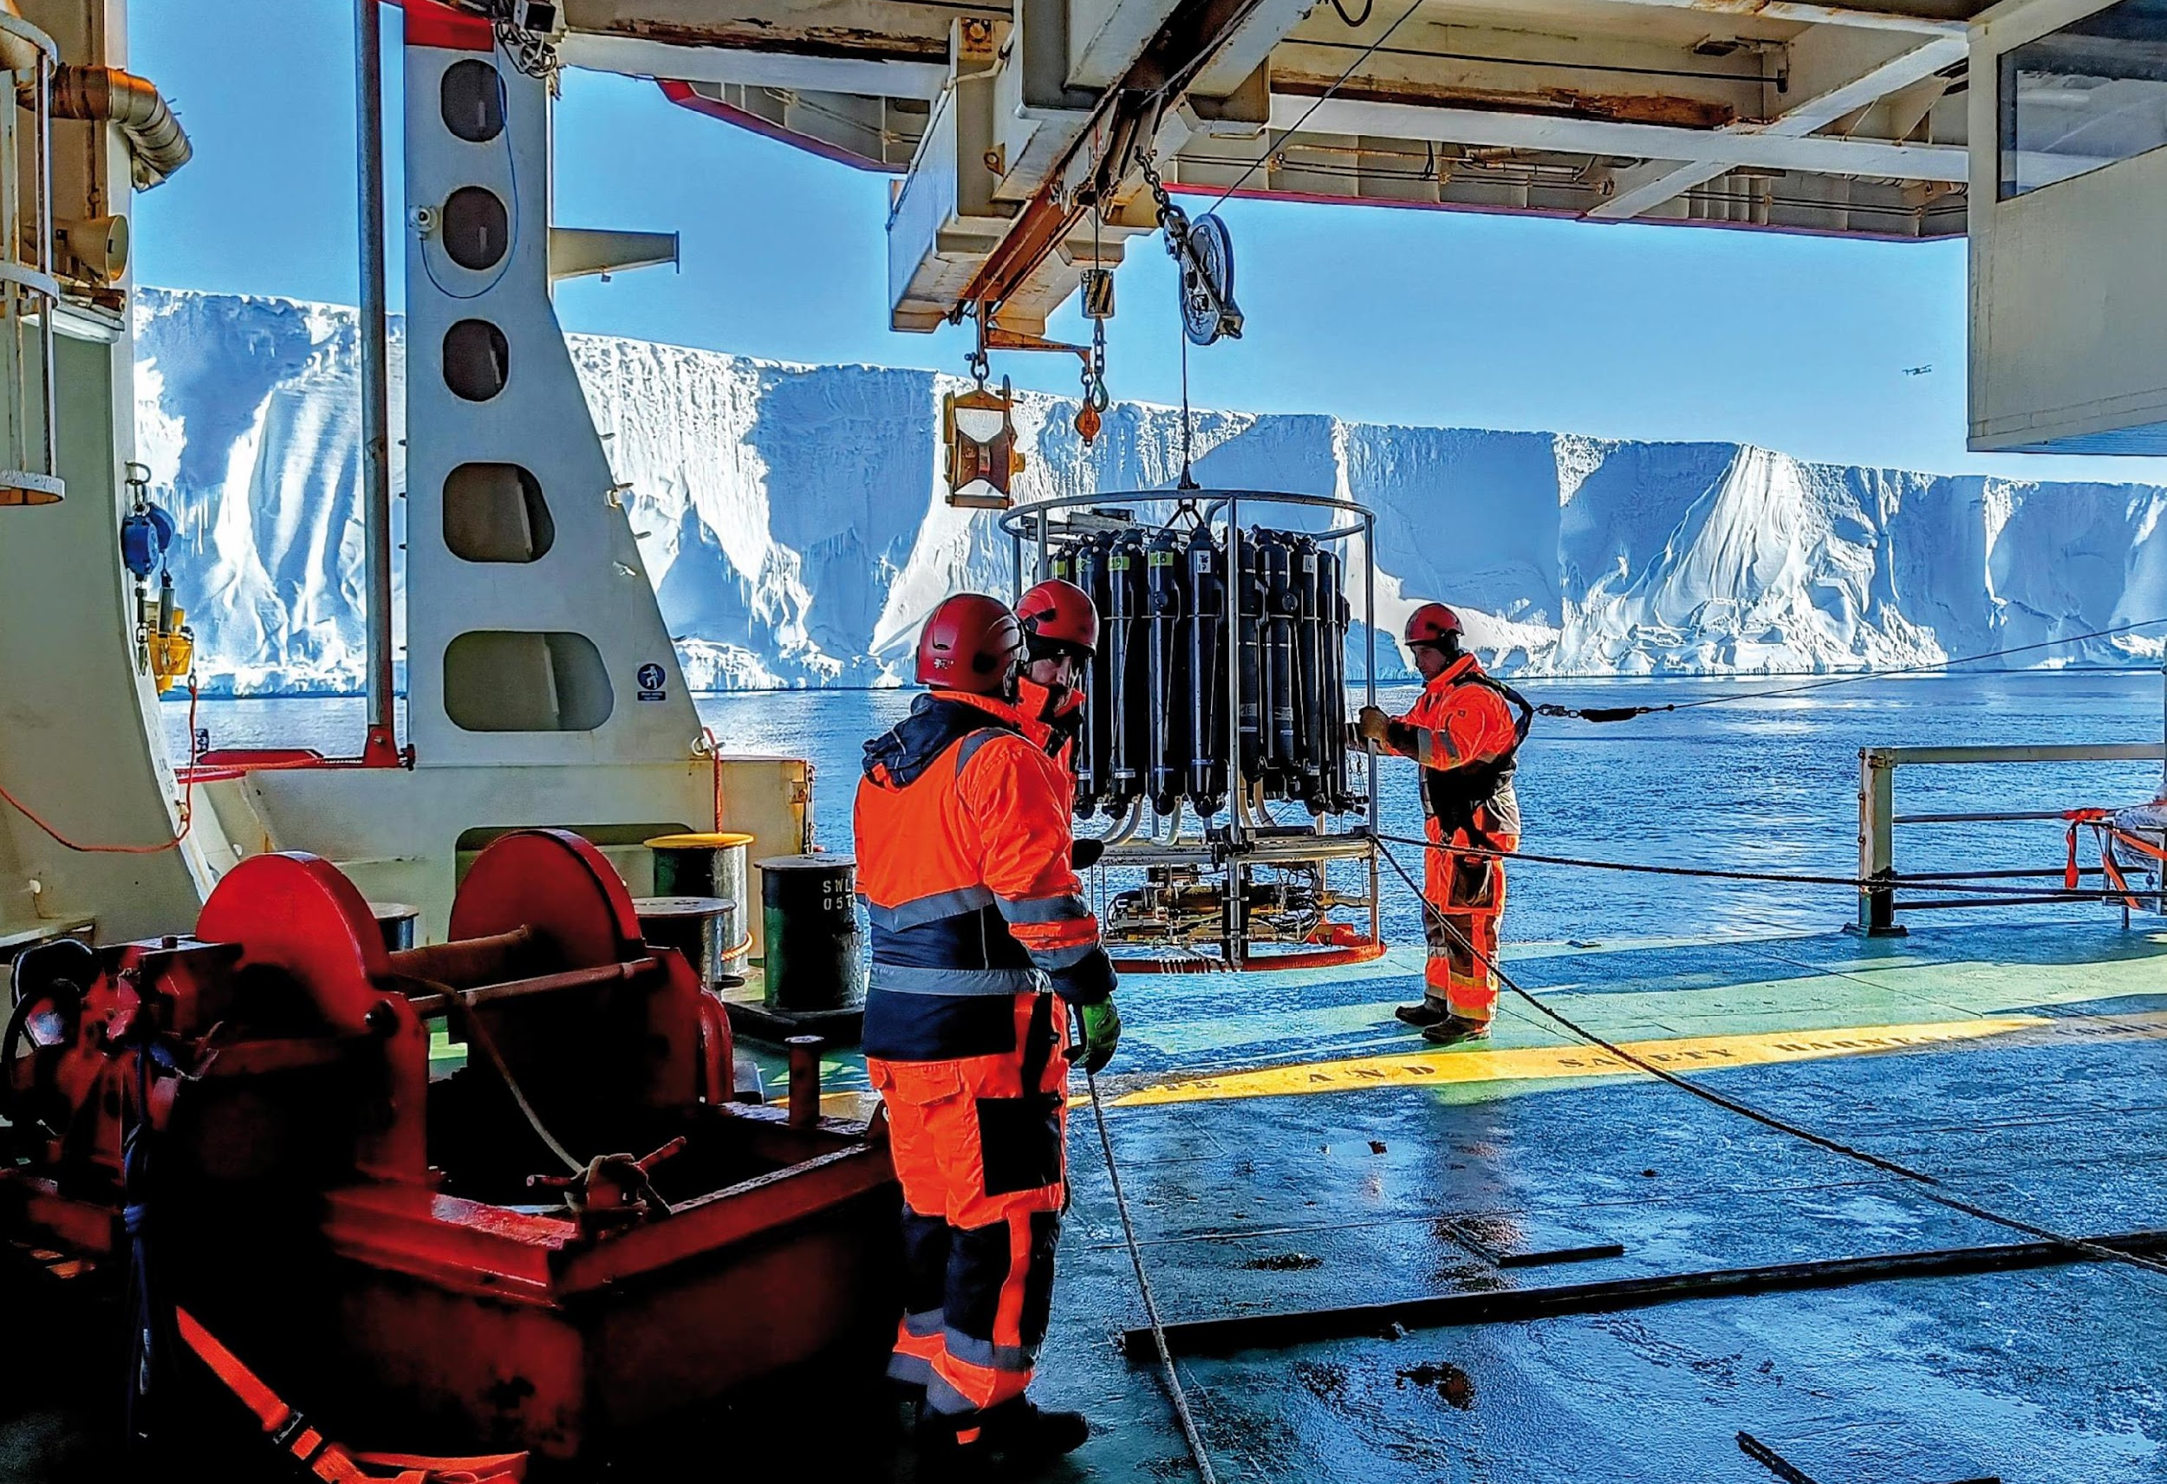
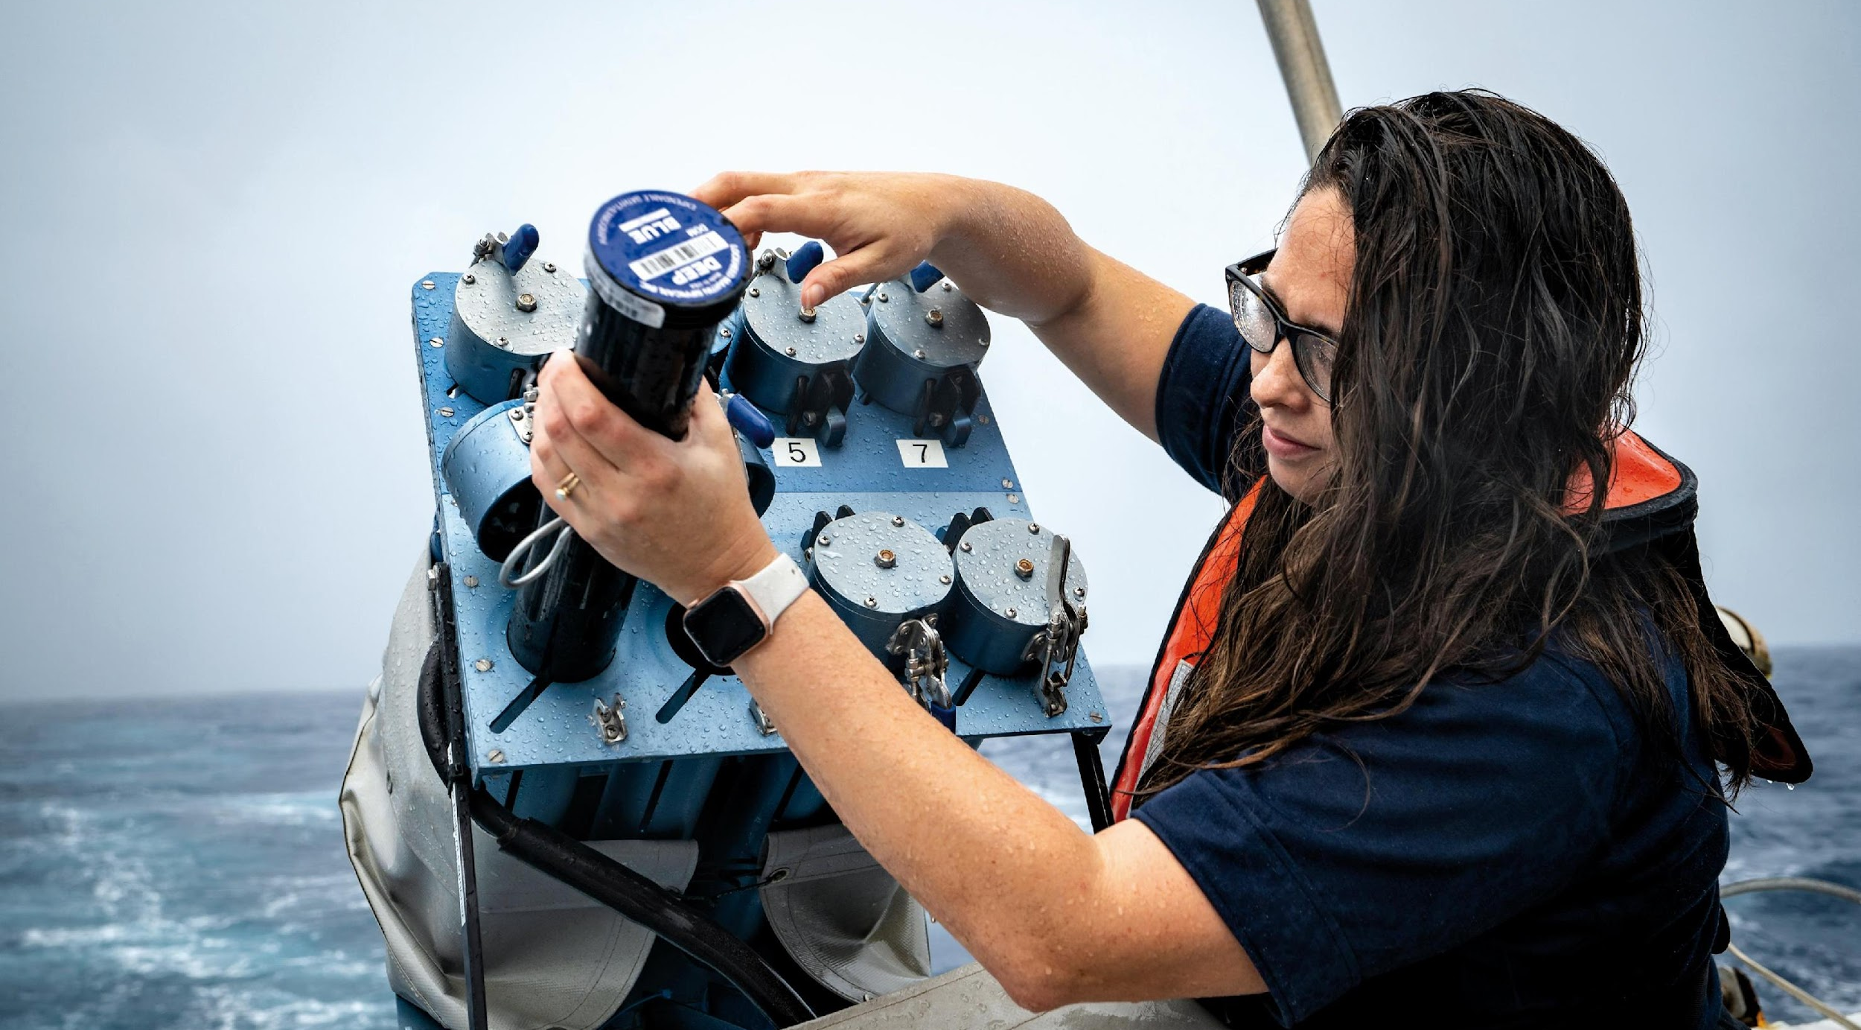
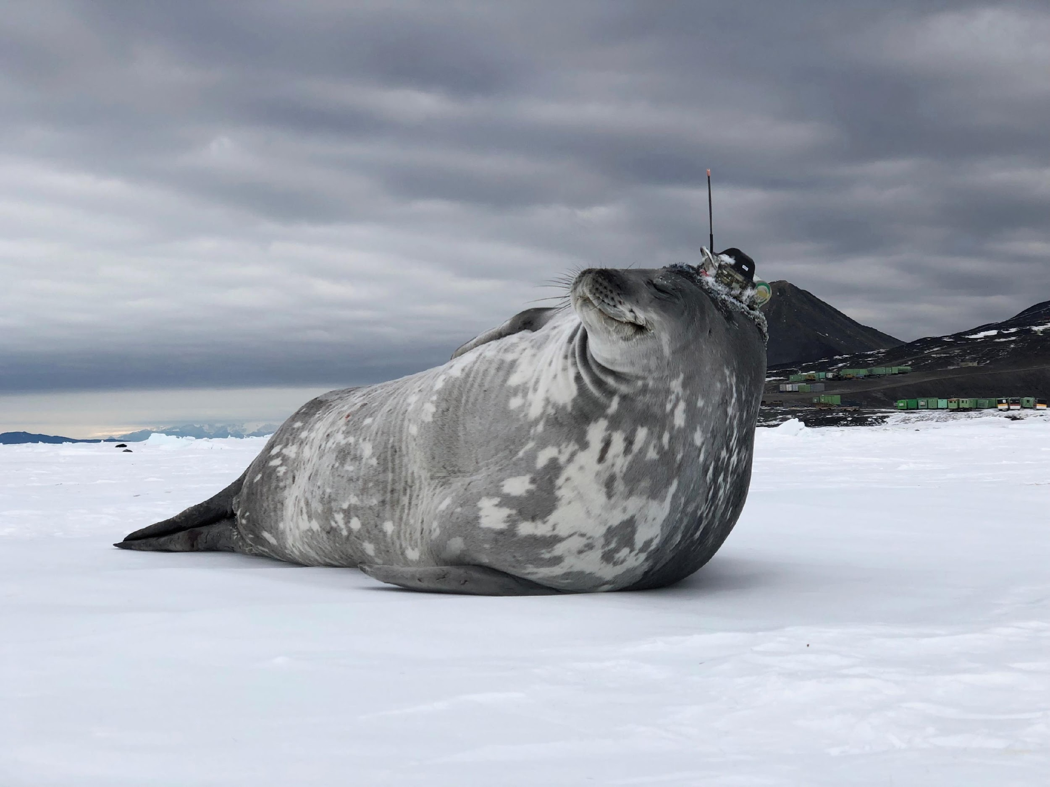
Thank you
goosocean.org

Slide 14
OCG-14 Actions Implementation
1 | GOOS updates ● Adopt best practices and for GOOS to track measurements in the EEZ ● Present on OCG work at NFP meeting Connect with smaller IOC nations and IOC sub-commissions to be active in the EEZ discussions | On track, 70% NFP Forum Oct. 2023 OONJ meetings on-going
2 | EuroSea: More granularity on the OCG attributes, EuroSea KPI’s for coordination metrics for consideration within OCG | Done. TT- Metrics established
3 | GLOSS: GLOSS tide gauges access points, best practices and specification sheets | Done. Discussion at GLOSS SC meeting (Jan 2024)
4 | GCOS: Network response to the GCOS IP recommendations, WMO RRR etc. | ?
5 | Networks Report ● Explore opportunities for a WIS2.0 pilot for HFR data ● Explore and define opportunities for more machine to machine metadata harvesting ● Refer to Data discussion: Roundtable on metadata and data issues and requirements ● Highlight the key data centers in the data mapping ● SOOP representative, or technical coordinator from OceanOPS at IRSO meetings ● KPI development - is that needed to be done by OCG ● Discussion on other third party data streams outside of OCG - is this fully or partially a responsibility and willingness within OCG? ● Explore the definitions and requirements for reference networks incl. WMO INFCOM-2/Doc. 6.1(7), 2022 ● Clarification on OCG attributes [general use, scoring or reporting related] ● Transition emerging networks to advance in maturity | On track?

Slide 15
OCG-14 Action Implementation -2
6 | OCG Network Readiness - from emerging to mature OCG network ● Establish a Task Team with OCG Exec and network volunteers to develop a set of metrics ● OCG to discuss the methodology to collate and articulate the impact of network work [including GRAs, CLIVAR etc.] | In progress
7 | Potential New Emerging Networks: Meeting in July 2023, to bring together the potential emerging networks to discuss potential overlaps with other networks and decision on whether they will be independent or sit under other networks | Done
8 | Industry Dialogues ● Roundtable discussion to work on demand articulation to industry in collaboration with networks and take forward with a discussion with industry ● Suggest to Dialogues with Industry to start conversations with sister industry sectors on demands/needs? ● Assess if OCG can facilitate and ask networks on a potential common practice and communicate the opportunity to industry on collaboration on field access. ● OCG and dialogues with industry to explore potential certification processes and/or standards. | Done ?
9 | Data Strategy ● Adopted the OCG Cross-Network Data Implementation Strategy. ● OSCAR Team, OCG Data team, and OceanOPS to discuss solution on how to update/change submitted metadata in the OSCAR system. ● OCG to develop the draft ToR and goals/deliverables of the proposed OCG data Task Team for OCG review and distribute to the networks in the next months. ● OCG to discuss and define an OCG minimum metadata standard to use by the platform operators and data users when developing the network metadata format. | In progress GOOS- 296 ERDDAP seminar series

Slide 16
OCG-14 Action Implementation -3
10 | Impact Studies ● GOOS to create a communications piece with Synobs to raise visibility of the Synobs OSE/OSSE data set and encourage participation at the WMO Impacts workshop (May 2024). ● OCG, OOPC, and GRAs (and other interested parties) to have more regular communication with OceanPredict. ● Suggest GRAs to invite Yosuke to the GRA meeting to broaden the reach of the work. | In progress
11 | Best Practice ● Provide pictures of Best Practices in action to the BP team. ● Develop a GOOS story around the top best practices and people involved. | In progress Argo BP endorsed
12 | OceanOPS ● Promote and outreach activities to various audiences on OceanOPS activities and work including through GOOS. ● OCG recommends OceanOPS to explore machine to machine harvesting of metadata with specific networks [e.g., HFR] into OceanOPS. ● OCG encourages new emerging networks to contribute financially to OceanOPS. ● OCG to ask the networks why the metadata is not appearing in OceanOPS [resources, harvesting not easy]. ● OCG approves OceanOPS work plan and financial plan. ● Prepare and review the next OceanOPS Strategy ● WMO and OCG to explore potential funding strategies for EOV tracking/assessment/tools.

Slide 17
OCG-14 Action Implementation -4
13 | Capacity Development ● OCG CD Group to reach out to networks and explore potential overlaps and synergies. Consider utilizing other CD platforms [Ocean teacher academy, WMO etc.] ● Encourage Low tech groups to focus priority actions developed in the workshop and determine the implementation of them. | In progress DBCP workshop in Aug. 2024
14 | GOOS Communication ● OCG to update the OCG Slide deck and request for annual updates from Networks to go out in February of every year [to be included] ● Adopt the wording on the GOOS website to better reflect the contribution of other agencies (e.g., WMO) ● OCG to encourage the networks to work with Laura on Network stories ● Develop recommendations to update Network specification sheets and reach out to Networks . ● CD webinar on application on specification sheets. ● CD webinar on Ocean Acoustics | In progress √ √ √ √
15 | UN Decade Programmes ● Identify and develop pilot projects to connect the programmes. ● OCG to share contact information for all the UN Decade programs leads. ● Meetings with Exec, OceanOPS, SOT - how to prioritize and approach vessel sectors and companies for deployment and observations. | In progress √ √

Slide 18
Highlights and Accomplishments (to be updated)
OCG led engagement with WMO in their RRR process. GOOS, ETOOFS, OOPC, and potentially BGC Panel will now have stronger role in RRR and WMO Statements of Guidance
GOOS request to be considered in WMO GBON (approved by GOOS SC)
3 Emerging networks transitioning to mature status; engaged several new potential networks
OCG Data implementation strategy under review with OCG networks
Progress on metadata standards across networks [OceanOPS]
Notes:
3 Emerging networks transitioning to mature status [AniBOS, OceanGliders, HF Radar]
Potential new networks interacting with OCG [Smart Cables, Ship based ocean time series, USV OASIS, Marine Debris]

Slide 19
Continued! (to be updated)
6 Best practices endorsed, 3+ in process
Report Card - moving cross GOOS [OCG/OceanOPS leading]
Published the OONJ Workshop Report (GOOS Report No. 246)
Continued capacity development Webinar Series & in-person workshop in June
OceanOPS strategic plan on track
3 OCG Roundtables
Notes:
3 Emerging networks transitioning to mature status [AniBOS, OceanGliders, HF Radar]
Potential new networks interacting with OCG [Smart Cables, Ship based ocean time series, USV OASIS, Marine Debris]

Slide 20
Potential actions (to be updated)
Adoption of the OCG data strategy development, network reporting (eg via report card), & Best Practices
Networks, panels, and UND actions to work with modelers to catalyze studies for WMO Impacts Workshop in 2024. Do we need a complementary workshop to fill in gaps?
We need a process across GOOS to assess readiness and prioritize observing actions (e.g., new networks, invest in advancing TRLs).
Establish a Task Team to refine metrics of readiness and maturity of networks
Notes:
MOU between GOOS and MBON and OBIS need to be renewed, Panel would like to propose the MOU that GOOS Exec can implement
The BioEco Panel co-chairs are currently discussing potential attendance at the GRA Forum (date still being decided but likley to be early 2024) to discuss emerging BioEco networks and to further facilitate uptake of BioEco EOVs into the GRAs.
https://obis.org/2016/12/15/goosgeobonobis/

