Slide 1
Session 6 Capacity Development
Ting YU, and DBCP TT-CB
OCG-15 Session (13-17 May 2024, ONC, Victoria, British Columbia, Canada)

Slide 2
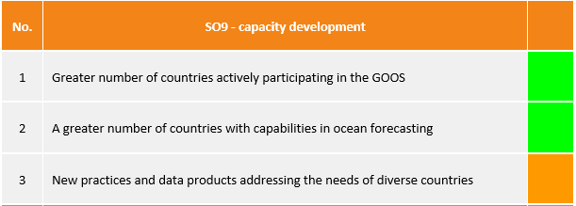
Cross-GOOS Progress
 | Type of event | Aimed at | Attendees | Description | Partners
OCG | Showcase / tour | School kids | 4000 | OCG-14 May 2023 in South Africa had a large outreach event organised that showcased the impact of ocean observations on society - 3 day event had participation from organisations across South Africa.
OCG | Webinar (series) | ocean professionals | 60 - 200 per webinar | WMO Information System 2.0 (WIS 2.0), Argo Data IOC/UNESCO information data related resources and the Ocean InfoHub Project, ASAP, Upper air profiles at sea and ERDDAP
DBCP - OCG | Workshop and instrumentation | SIDS, Africa, LME young professionals | 30 in person, 50 online Tunisia, May 120 for online session November | Mediterranean Training Workshop on Ocean Observations and Data Applications May 2023, Tunisia. Plus November 2022 online session with special secession on carbon and biogeochemistry observations. Funding provided to those who had not previously engaged in DBCP/GOOS, laying the groundwork for future initiatives. Solomon Islands were supported with 2 wave buoys (Scripps). Pacific Community has plans to further strengthen capacity through deployment of buoys. | Tunisian National Institute of Meteorology (INM), Ministry of Transport, IOC, WMO, LDL/SIO
SOT - OCG | Training workshop | Port meteorological officers (PMOs) | 37 from 24 countries | 7th Port Meteorological Officer (PMO) Training workshop, in Fiji, Oct 2023. Objective to get more countries in the Pacific involved in PMO as this is a gap. Region is working on strengthening its observing capacity including VOS. | Pacific Community (SPC), WMO
BGC | Summer School - training workshop | early career scientists | 28 from different parts of the world | 3rd "Instrumenting our ocean for better observation: a training course on a suite of biogeochemical sensors" was held in June 2023, in Sweden. Lectures and hands-on workshops, to teach best practices for biogeochemical sensors, data and critical thinking for optimum sampling strategy in the context of local, regional and global and climate, operational services, and ocean health: oxygen particulate organic carbon, pH, pCO2, nitrate. | Kristineberg Marine Research Station in Sweden, IOCCP, Integrated Carbon Observation System Ocean Thematic Centre (ICOS OTC), NOAA, Ocean Frontier Institute, and Carbon to Sea.
BGC | Summer School | early career scientists | 33 young researchers from 17 countries | GOOD-OARS-CLAP-COPAS Summer School in Chile, November 2023, 15 world experts, presentations on ocean acidification and deoxygenation as well as practical sessions on modelling, laboratory experiments, shipboard measurements and analysis, communication training and an introduction to ethics in science. | IOC, SCOR, PICES, EGU, IAEA -OA-ICC, OARS, GOOD, IRD, OCB, CEAZA, FCM, ESMOI, COPAS COASTAL, Uni. Catolica del Norte, COROA, IOCCP (SCOR)
BioEco | Various workshops | ocean professionals |  | BioEco have contributed to and facilitated sessions, workshops and symposia at various conferences to expand our outreach into the community in building awareness, understanding and capacity in EOV implementation. Involving continued engagement directly with MBON through participation of MBON. | MBON
BioEco | Leadership | ECOPS | several | Development of EOV co-lead roles provides an opportunity for direct engagement and capacity development of Early Career Researchers in implementing EOVs and engaging with international communities.
SO9 - capacity development
GOOS develop partnership with IODE/OTGA - courses+
Enable community of practice capacity development in GOOS
Investigate mechanisms to support CD activities within regions through GRAs e.g. instrument donation, sharing of training materials, etc.
Source: GOOS SC-13 Reporting- Strategic Objectives

Slide 3
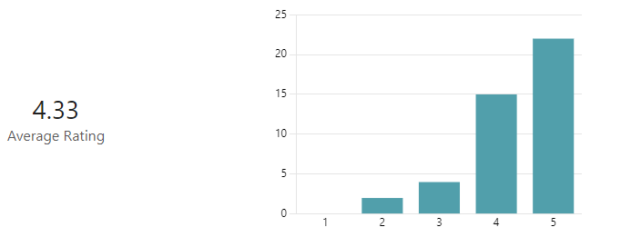
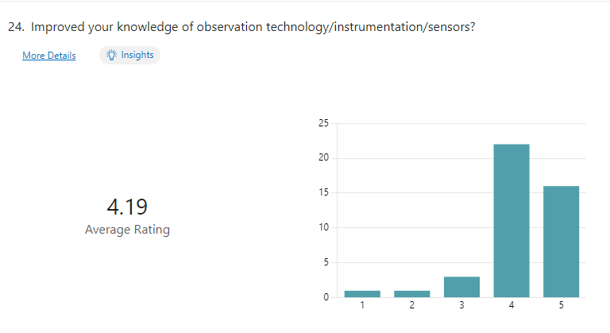
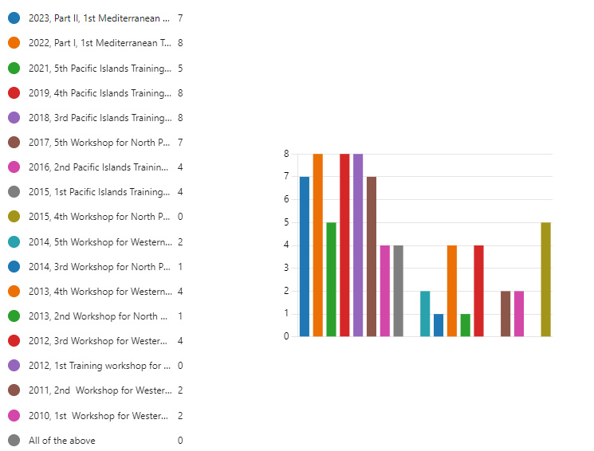
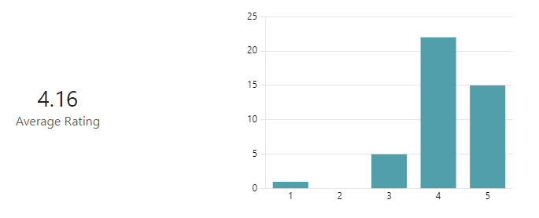
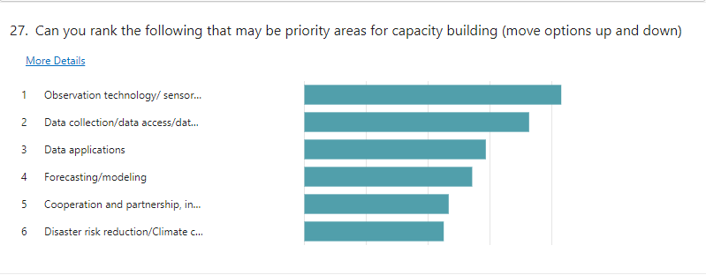
DBCP Capacity Building
The topics and presentations improved capacity/knowledge/technical skills in your interested subjects.
Improved your knowledge of observation technology/instrumentation/sensors?
Questionnaire for DBCP Capacity Building Feedback and Needs
44 responses, 43 valid [TRAINEES only]
24 Members/Member States
Improved your professional knowledge/technical skills, incl. quality control, etc?
Can you rank the following that may be priority areas for capacity building?
DBCP Training Workshop on Ocean Observations for Weather Forecast and Climate Prediction (6-8 Aug 2024)
Modules and Topics of Workshop
Session 1: Needs and Requirements of Ocean Data
Session 2: Data Management and Access
Session 3: Data Application in Forecasting
Session 4: Data Application in Climate Prediction
Session 5: Regional Requirements and Cooperation
2012-2015 two workshops every year,
No CB activity in 2020, and virtual 2021&2022
No response from 2012 Chennai, and 2015 Busan
Please feel free to contact JIANG Qiu ( jlzxjq@163.com ), Chair of DBCP TT-CB, and JIANG Long (LJiang@wmo.int), for any questions.
Notes:
Total number of participants 500+, from +++ member states/members
Who responded (Cameroon, China, Micronesia, Haiti, India, Indonesia, Iran, Kenya, Kiribati, Malaysia, Mauritius, Nigeria, Pakistan, Marshall Islands, Samoa, Solomon Islands, Sri Lanka, Tanzania, Thailand, Tonga, Tunisia, Vanuatu, Venezuela, Vietnam)

Slide 4
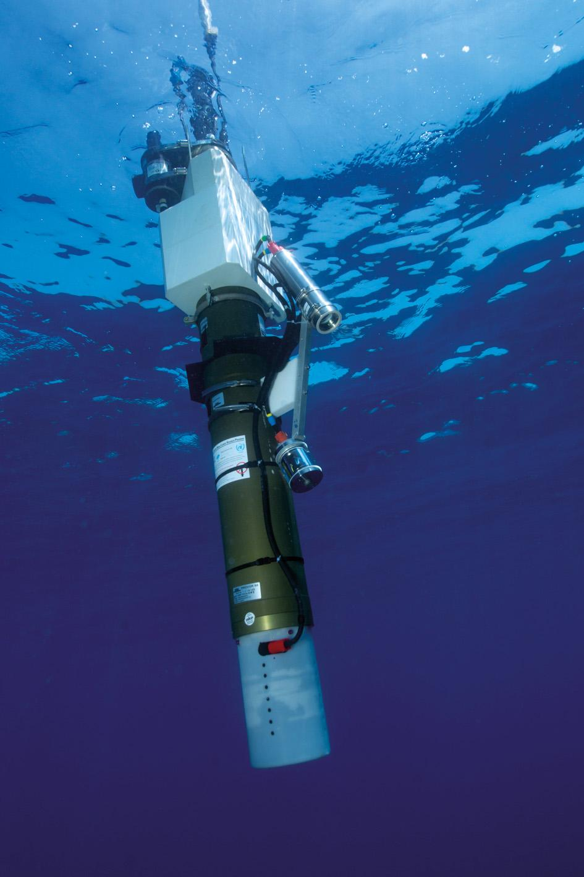
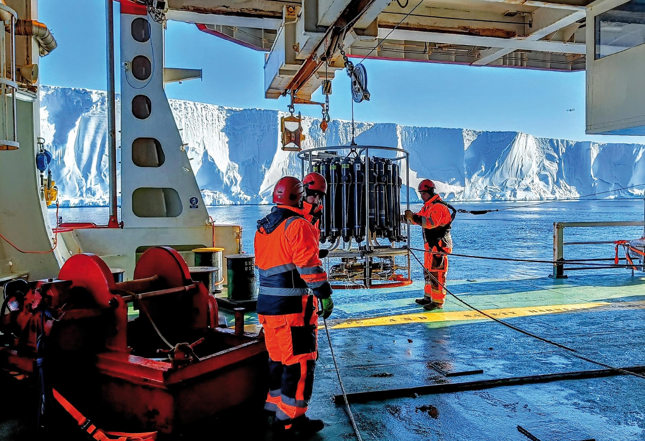
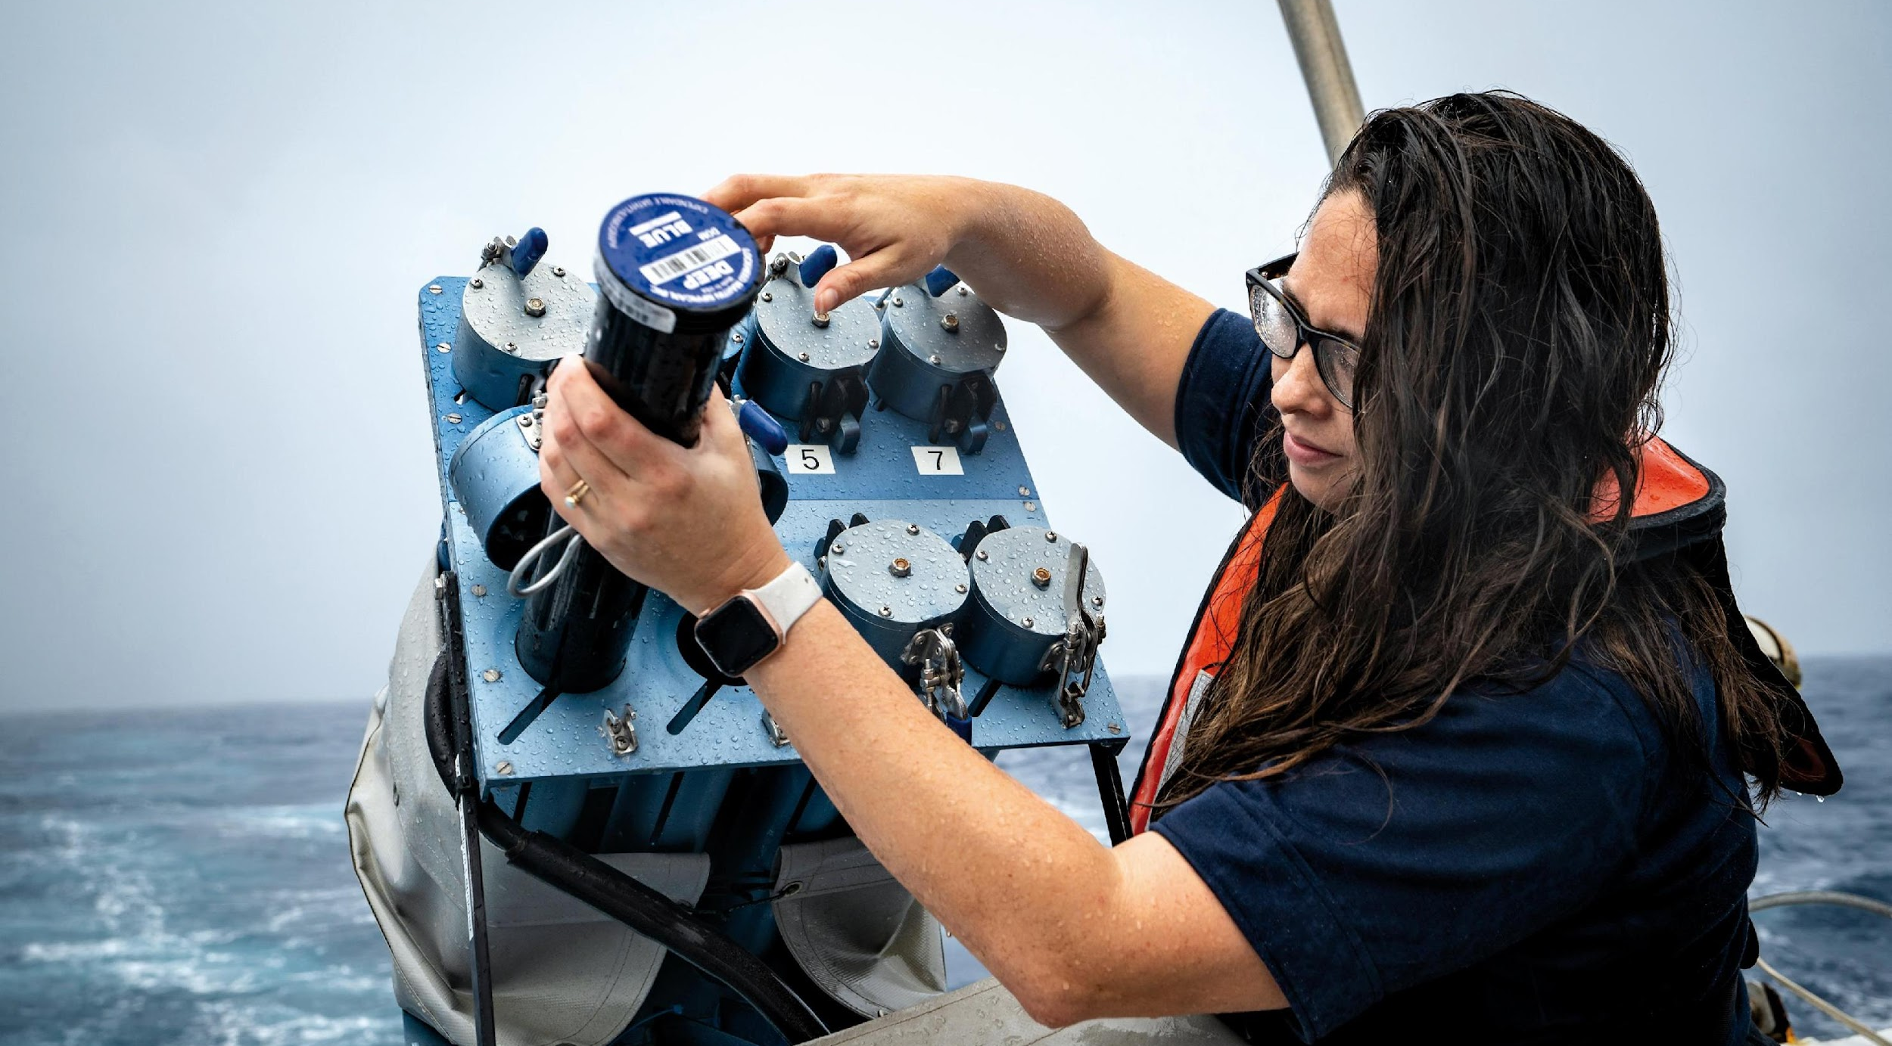
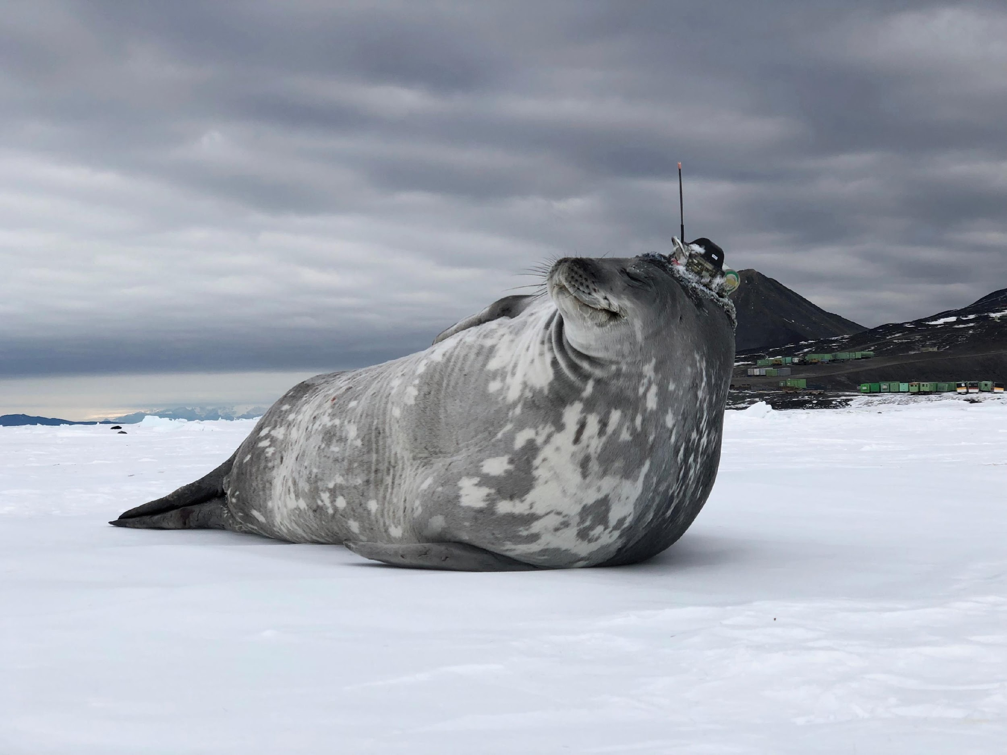
Thank you
goosocean.org

