Slide 1
OceanOPS Budget Report
E. Rusciano, M. Belbéoch
OCG-15 Session, 13-17 May, 2024
ONC, Victoria, British Columbia, Canada

Slide 2
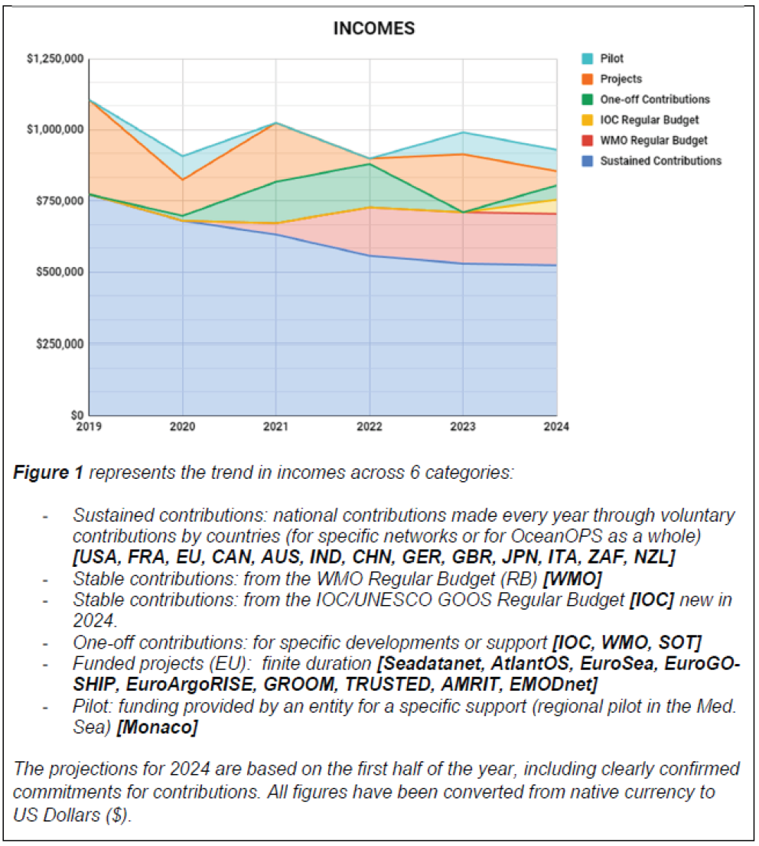
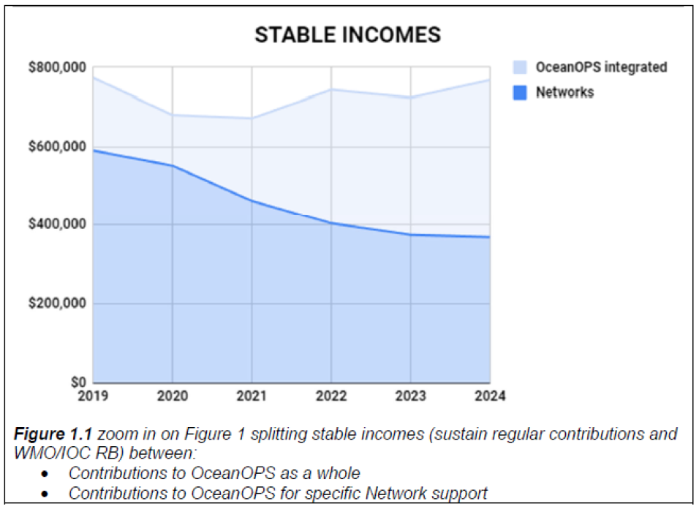
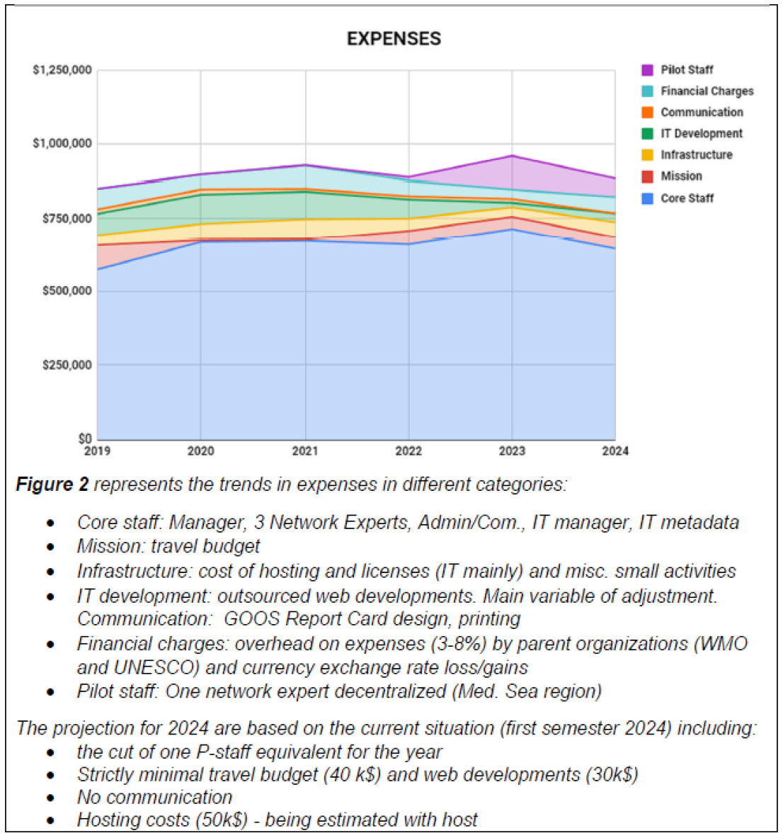
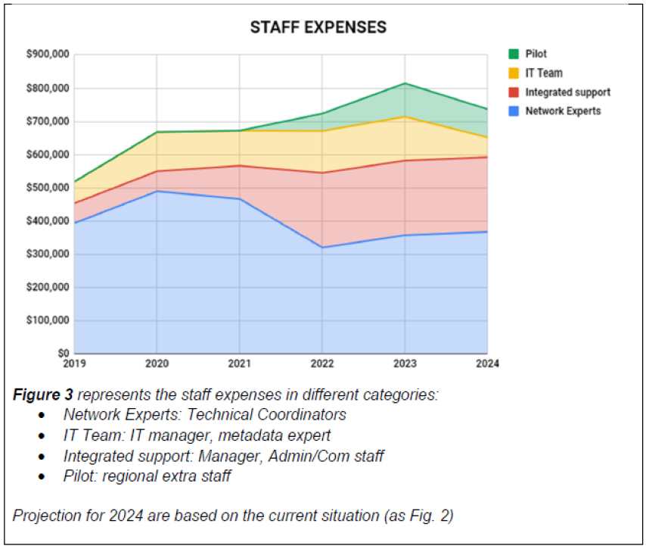
Overview
Decline in Networks contribution, compensated by WMO RB (Manager).
Increase in staff cost expenses with two necessary restructuring steps on Network Experts (pilot in 2022, formalized in 2024)
strengthening IT with IT Manager, Metadata Expert
Critical step towards sustainability: Core expenses are finally aligned with stable resources.
However, we have suffered a major outage and a huge pressure on staff, which is not yet overcome.
And services delivery to all is impacted ...

Slide 3
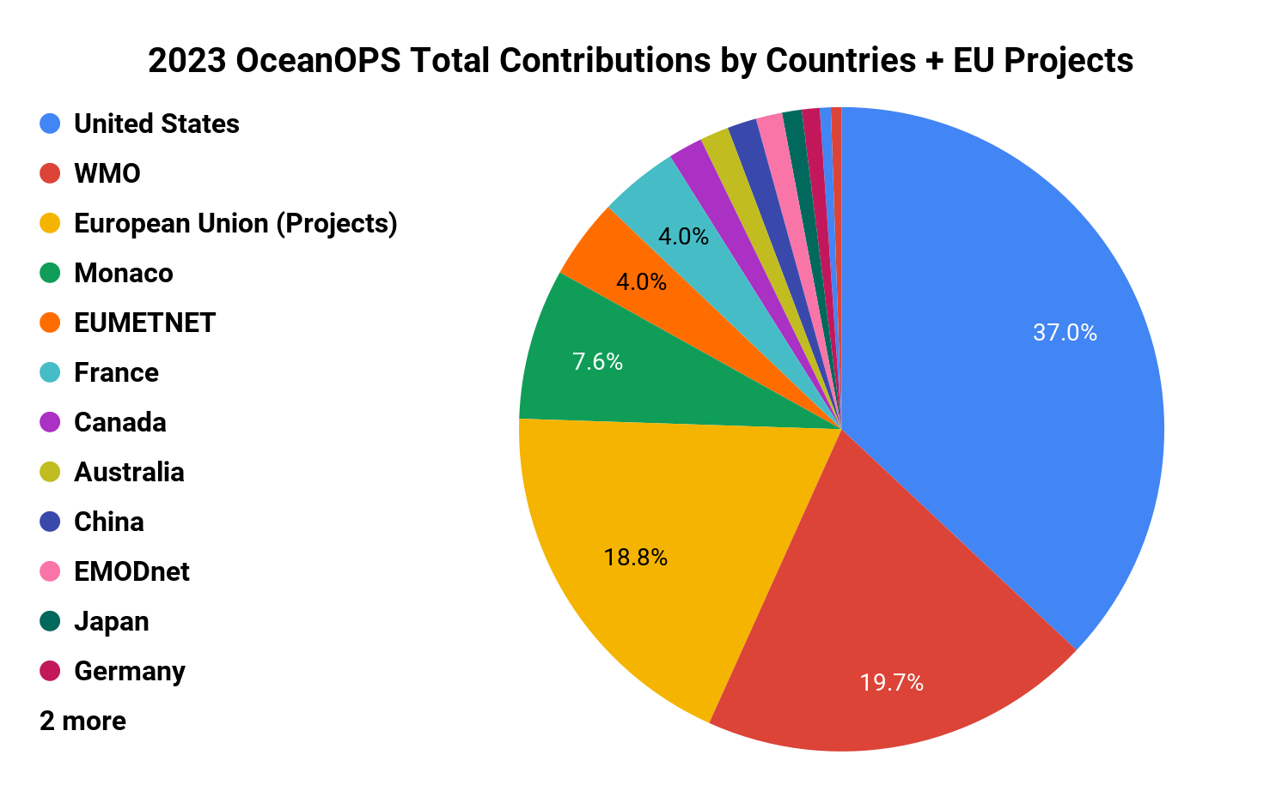
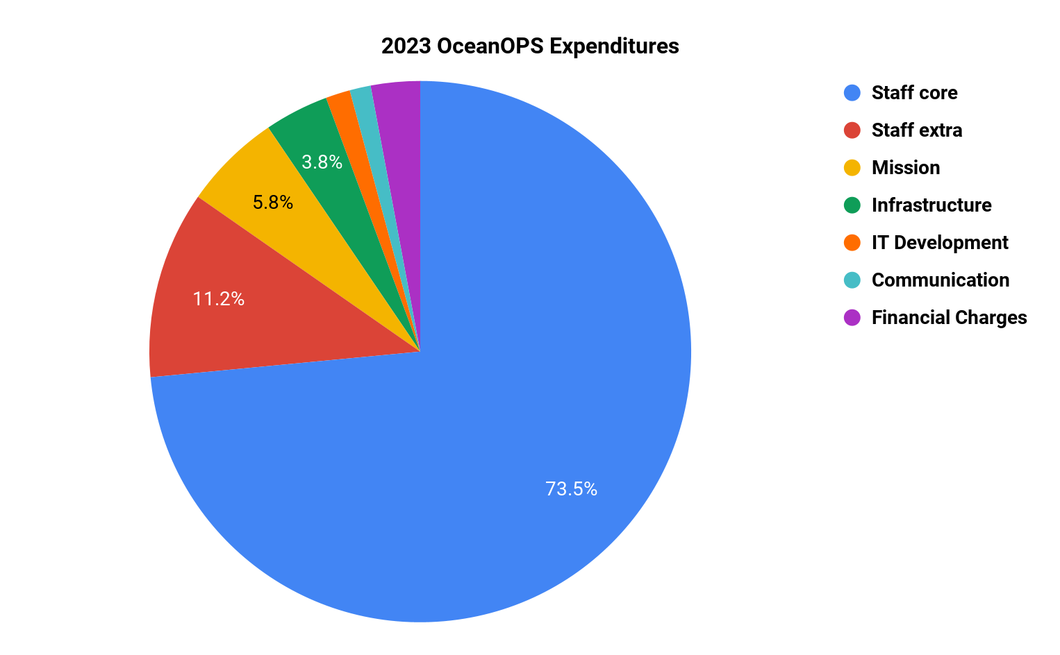
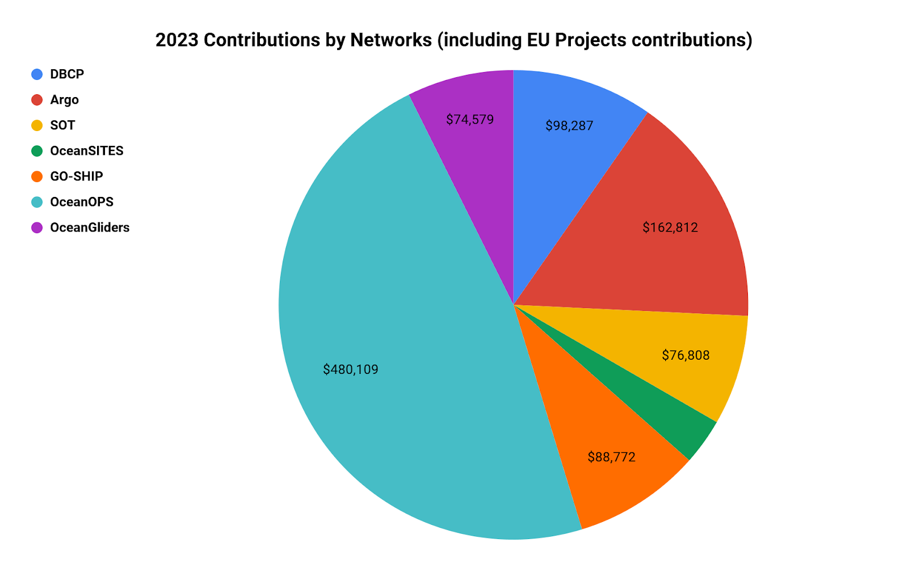
2023 Financial Overview
Incomes: 1 M$
Stable incomes: 800 K$
Total expenditures: 1 M$
2023 Highlights:
WMO continued investment in OceanOPS: 200 K$
Regular national contributions decreased from 699K$ in 2022 to 600k$ in 2023. Some delayed contributions (35 K$) were received in 2024
NOAA contribution remained stable at 372K$
Significant support from EU Projects (190 K$)
Remarks & Recommendations: We encourage diversification of funding sources for networks such as OceanSITES, OceanGliders, GO-SHIP, DBCP and SOT, which have relied on support from only 3-4 countries for many years.

Slide 4
2024 Interim Budget
Expected incomes: 1,160 M$
Expected stable incomes: 950 K$
Expected expenses: 960 K$
Highlights:
Budget increase thanks to:
New contributions from: NOAA to support SOCONET, IOC/UNESCO support via GOOS budget, new EU Project AMRIT, new suncontract with EMODnet for the next biennium
Delayed 2023 national contributions received in 2024
Slight decrease in expenses due to: overall staff net cost reduction, Report Card postponed to 2025
Important decisions for 2024 anticipated budget, include:
Decrease the three Technical Coordinators to two
Hire the IT Manager as soon as possible (probably effective in October 2024)
Decrease pilot staff from 1 to ½ FTE to align incomes/expenses
Hire Web Consultant for 8 months (through GOOS funds)
Keep a stable travel budget
Skip Report Card production
Host agreement with CLS is terminated - a new one is being developed with Ifremer.
OceanOPS will end the year with a positive balance and the needed carry forward to obligate salary expenses.

Slide 5
2025 Anticipated Budget
Expected incomes: 1,107 M$
Expected stable incomes: 950 K$
Expected expenses: 1,147 M$
Highlights:
OceanOPS anticipates resolving structural challenges through restructuring and anticipated funds from the AMRIT project.
A new IT Manager position will be in place.
Web development capacities will be reinforced with a full-time position for at least 3 years thanks to AMRIT.
GOOS commitment will enable the production and future enhancement of the GOOS Report Card.
Communication/Administration position must be “transferred” to WMO.
Travel budget will be kept stable at the same level as 2024.
Need to identify new funds to sustain a full-time position for the BGC-Argo/Med. pilot.

Slide 6
Remaining Challenges
Although 2022 proved successful for OceanOPS, enabling full operations and the stabilization and upgrade of key staff, the end of 2023 revealed the precarious nature of its funding mechanism.
2024 marked a crucial step in addressing structural weaknesses and establishing a stable foundation for future operations.
In 2025, OceanOPS is poised for recovery, with achievements such as the migration and upgrade of the I.S. to Ifremer, establishment of a unified budget at WMO, and the agreement of SLAs with networks and OCG.
Several challenges remain:
Transfer of the remaining staff from IOC/UNESCO to WMO and the need for position upgrades present ongoing concerns.
Negotiations with the host country could impact finances.
Some networks will experience decreased support through new SLAs
Web developer should be stabilized and not funded through projects.
Regional pilot position's instability requires attention.

Slide 7
OceanOPS expresses its deepest thanks to all countries and organizations including Australia, Canada, China, EMODnet, EUMETNET, Europe, France, Germany, India, Italy, Japan, Monaco, UK, US, WMO, and IOC/UNESCO, for their support and contributions. OceanOPS supports 12 GOOS-OCG networks, including Argo, Global Drifting Array, Global Tropical Moored Buoy Array, National Moored Buoy Array, Tsunami, OceanSITES, OceanGlider, GO-SHIP, SOCONET, Voluntary Observing Ship, Automated Shipboard Aerological Programme (ASAP), and Ship Of Opportunity Program (SOOP XBTs). Thank you!

