Slide 1
15th Session of Observations Coordination Group (OCG)
OCG-15 Session, 13-17 May 2024
ONC, Victoria, British Columbia, Canada

Slide 2
Progress/Achievements
Please add a relevant photo on the right side

Slide 3
Actions
Strengthen partnerships to improve delivery of forecasts, services, and scientific assessments

Slide 4
Outcomes
Goal1 Outcomes
Outcomes layed out by HQ

Slide 5
Assessment of progress and gaps
Assessment
Gaps

Slide 6
Recommendations and Next Steps
(collectively)
Are we missing elements that will take us to the outcomes?
- Are we missing partners or actions?
- Need to identifying societal needs in regional and national level?

Slide 7
Resource required - new
(Collectively)
Identify resource needs and priorities
- What can be done with existing resources
- What additional resources needed - where
Potential sources for funding?

Slide 8
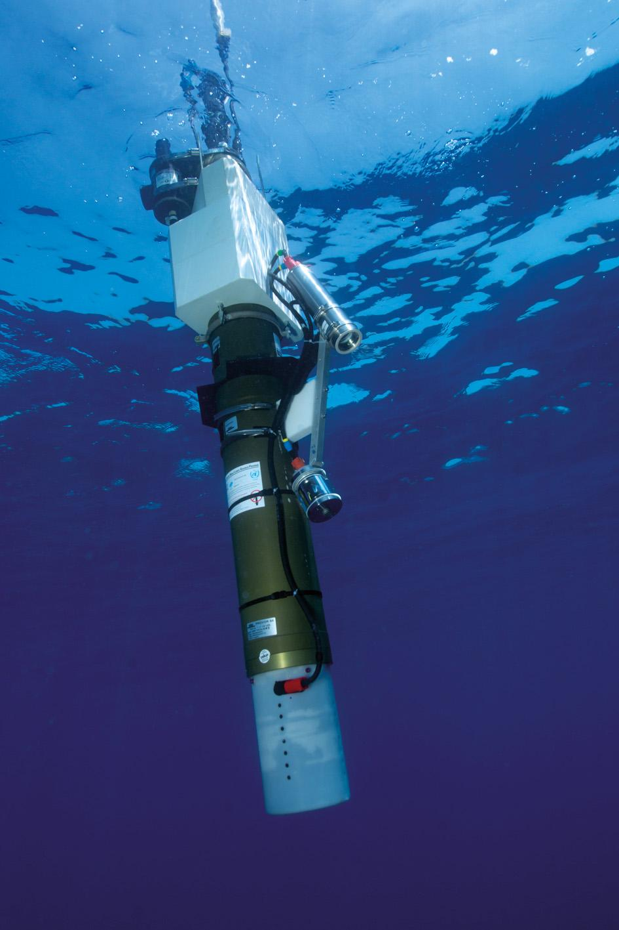
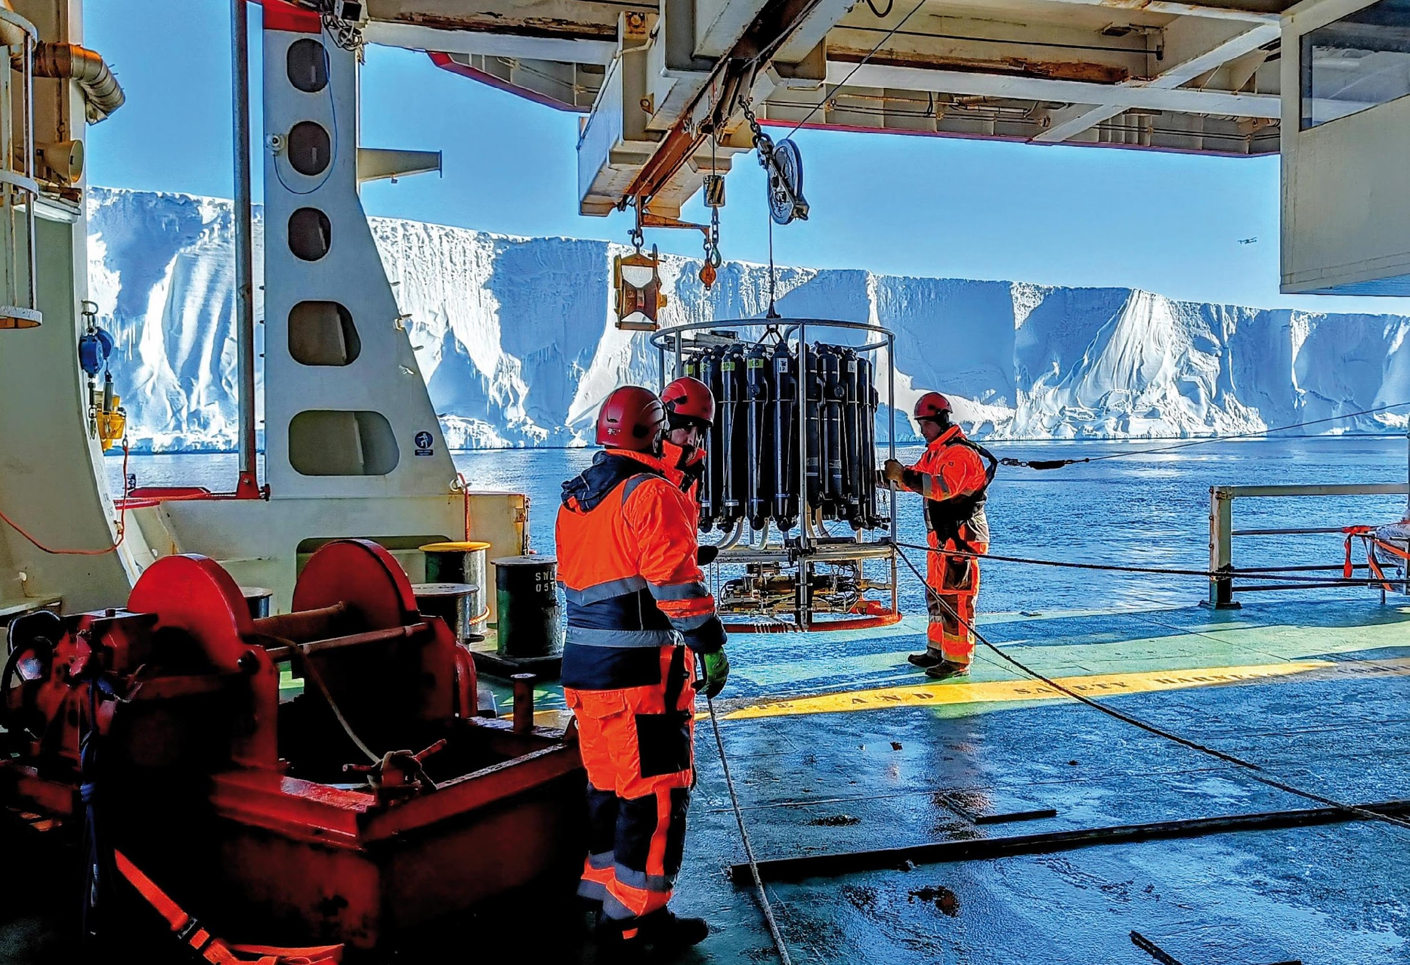
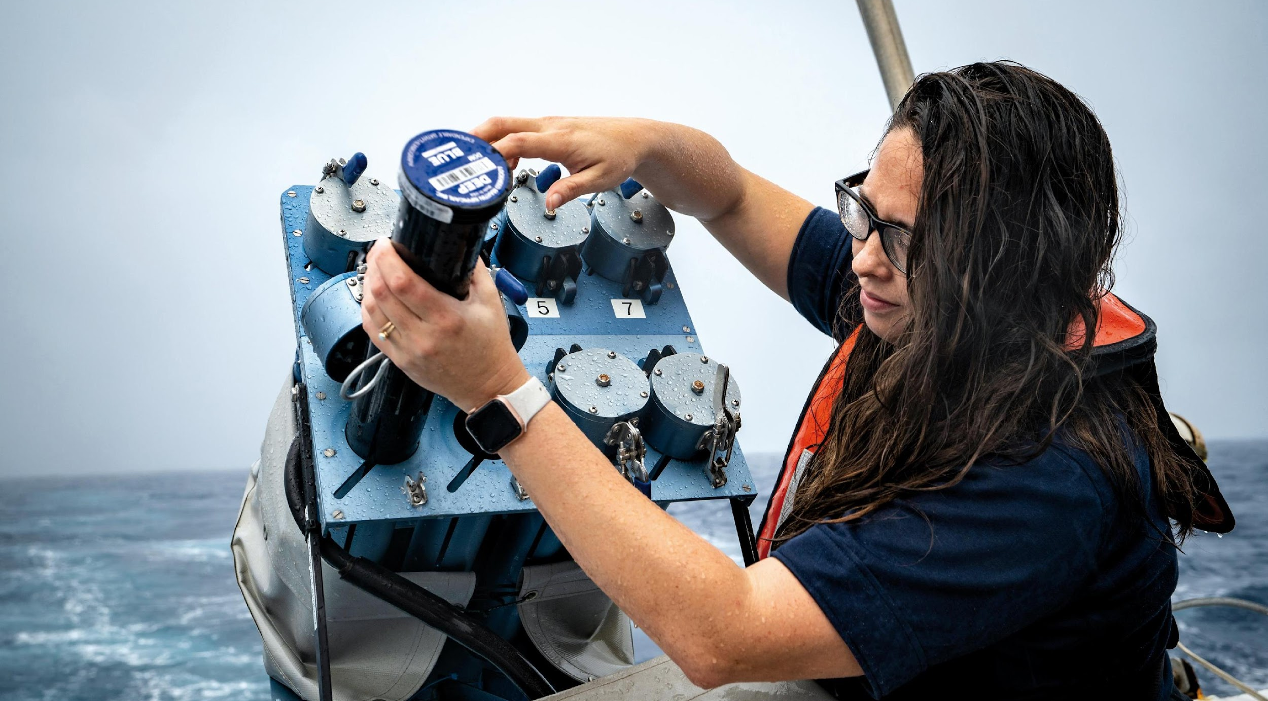
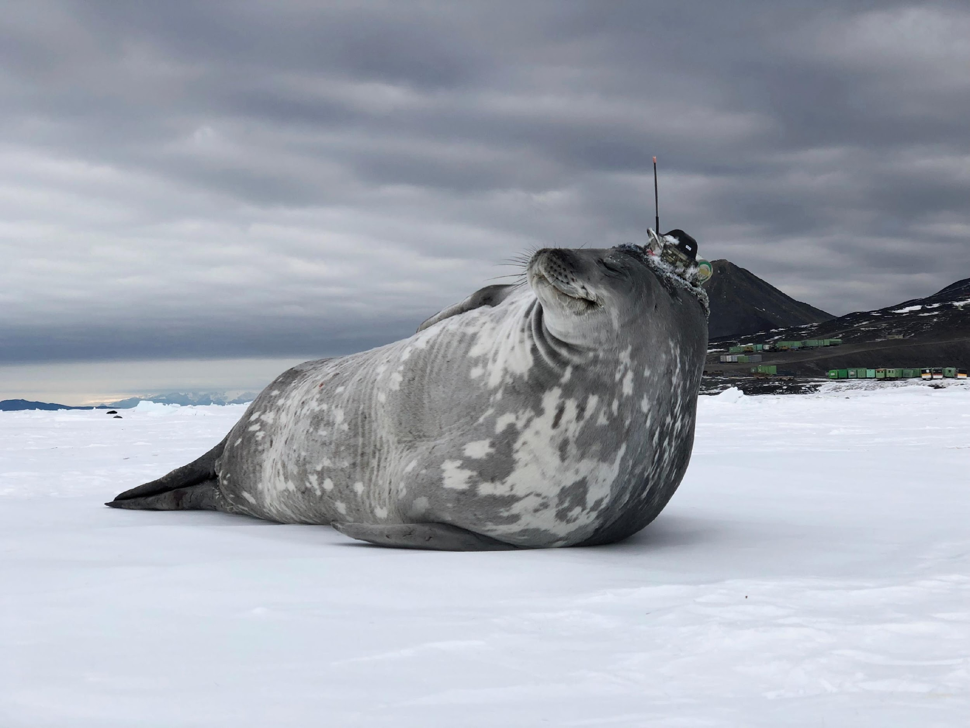
Thank you
goosocean.org

