Slide 1


Information Meeting
25 April 2024
IOC UNESCO EU DG ECHO CoastWAVE 2.0
Denis Chang Seng, PhD
Programme Specialist
ICG/NEAMTWS Technical Secretary
CoastWAVE Project Responsible Officer
Tsunami Resilience Section
UNESCO IOC

Slide 2
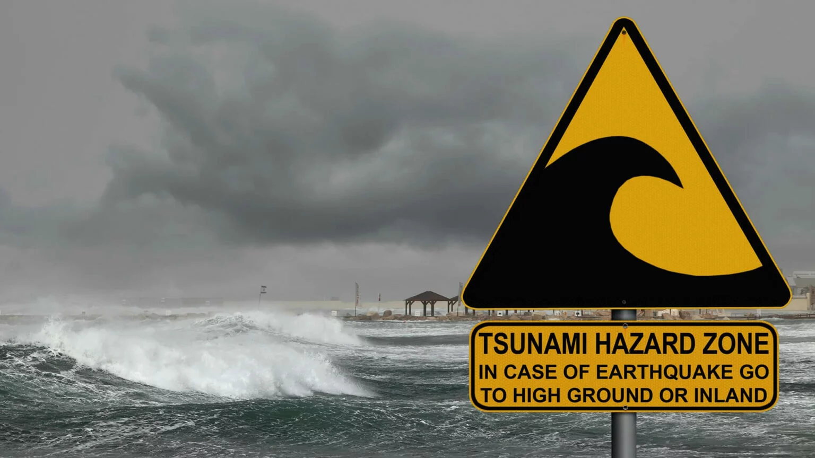
CoastWAVE 2.0
1
CoastWAVE 2.0
2
Preparations

Slide 3


New IOC DG-ECHO Funded CoastWAVE Project
CoastWAVE 2.0
Scaling-Up and Strengthening the Resilience of Coastal Communities in the North-Eastern Atlantic and Mediterranean Regions to the Impact of Tsunamis and other Sea level-related coastal hazards.
Amount: 1.2 M Euros -Phase –II
Start: 1 July 2024
Duration : 2 years
Direct Beneficiary Countries: Max 8
Maintaining CoastWAVE countries: Egypt, Greece, Morocco, Spain, Türkiye ( Malta and Cyprus indicated future interest)
Proposed new countries: France, Italy & Portugal

Slide 4

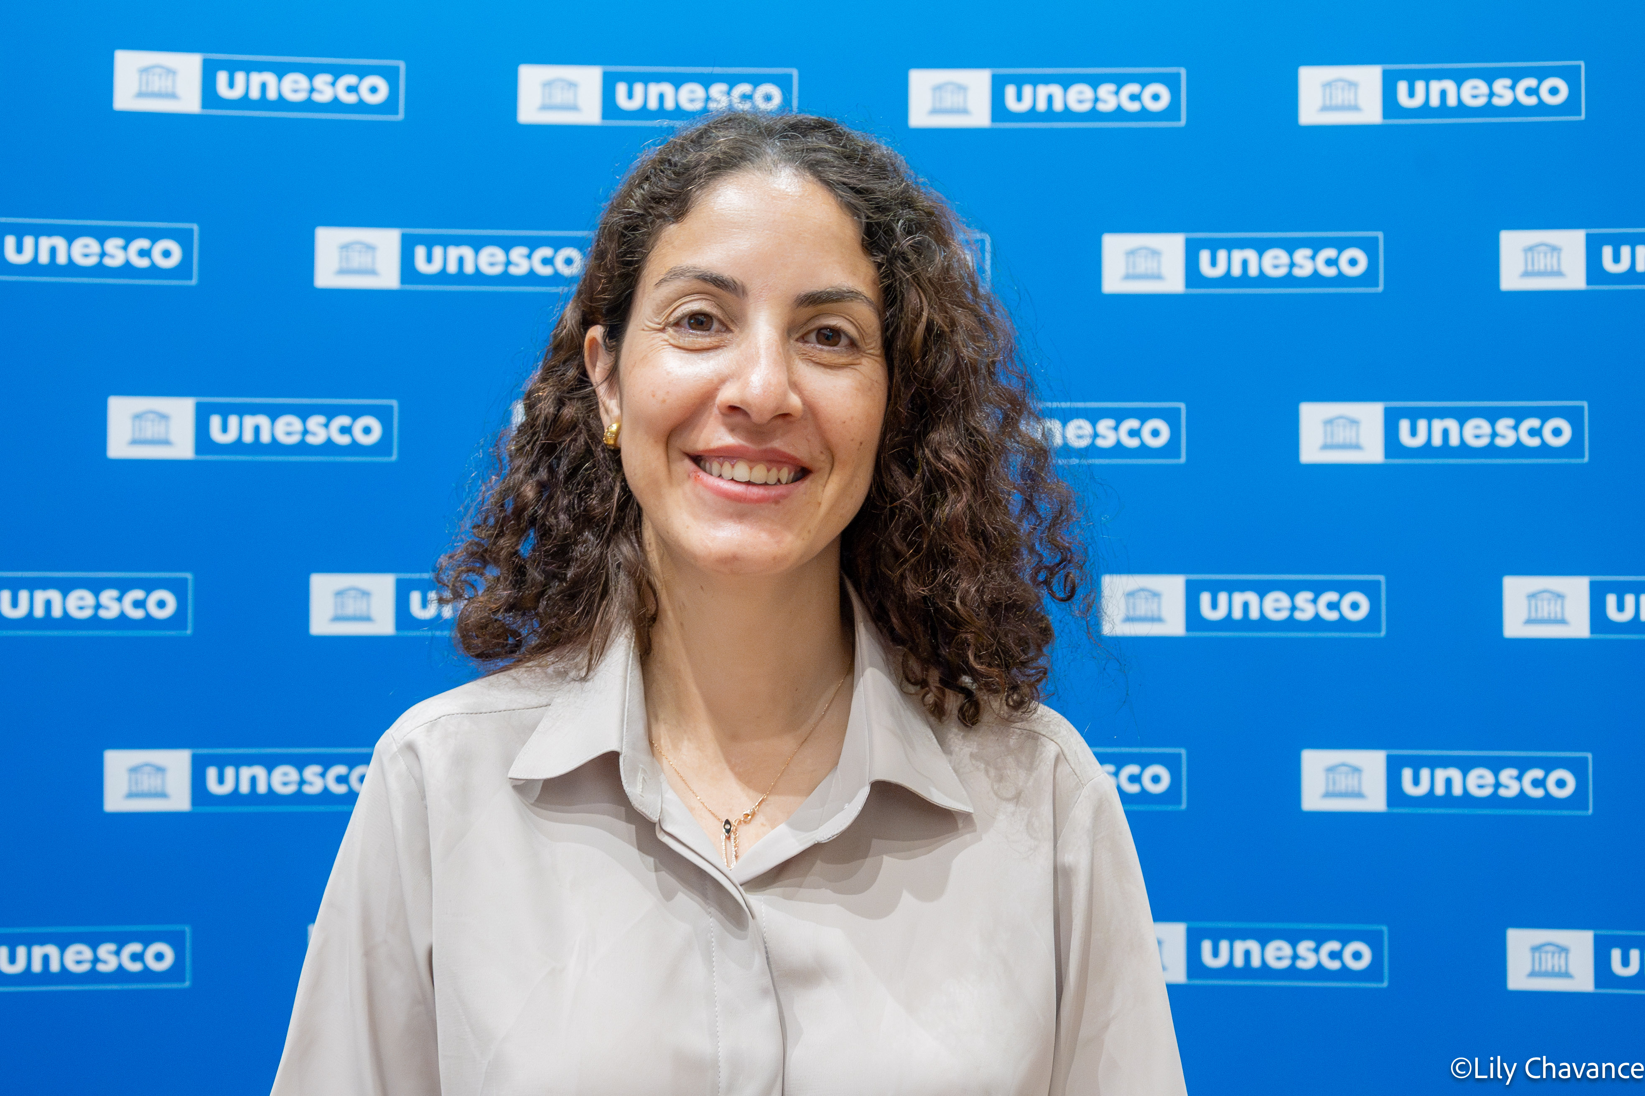

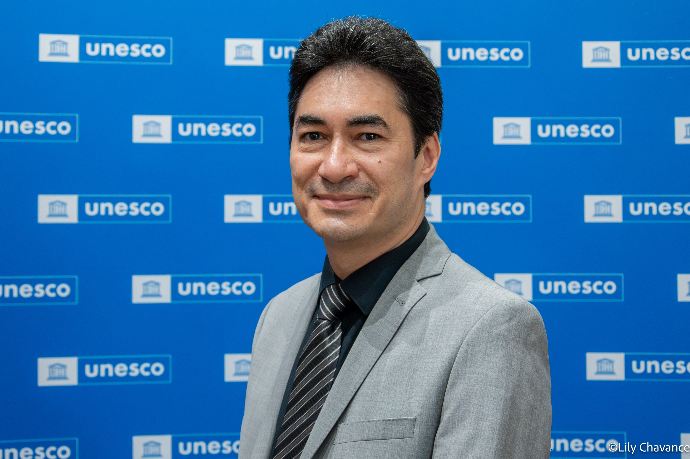
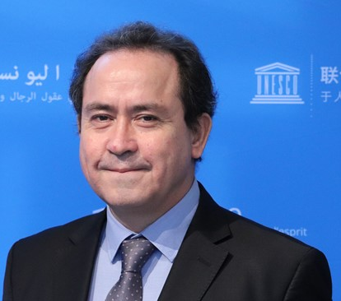
CoastWAVE 2.0 Team
Derya Vennin Associate Project Officer (CoastWAVE Project Coordinator) Tsunami Resilience Section | Anzhela Danilova Project Assistant CoastWAVE Tsunami Resilience Section | Denis Chang Seng Programme Specialist and Technical Secretary ICG/NEAMTWS, CoastWAVE Project Officer | Bernardo Aliaga Head Tsunami Resilience Section

Slide 5

CoastWAVE 2.0 Project Components
Component 1: Build and strengthen tsunami hazard assessments and evacuation mapping, risk knowledge, risk communication, and decision-making capacities.
1
Component 2: Scale-up and expand Tsunami Ready in selected NEAM countries.
2
Component 3: Enhance and densify detection, monitoring, and alerting systems.
3
Component 4: Enhance Dialogues on HILP (Tsunami) events within a multi-hazard context to improve strategies and effective decision-making capabilities.
4

Slide 6
CoastWAVE 2.0 Project Outcomes
Outcome 1:
Standard and improved tsunami hazard assessments and evacuation mapping based on probabilistic and or non-probabilistic approaches for better planning, decision making at national to local level.
1
Outcome 2: Enhanced understanding and communication of tsunami and other sea­ level-related risk in selected communities in NEAM countries.
2
Outcome 3:
More coastal communities and countries in the NEAM region joining the UNESCO-IOC Tsunami Ready Programme to be better prepared to respond to sea-level­ related hazards.
3
Outcome 4: Increased/improved access to near real-time seismic and/or sea level detection and alert technology to provide early warning of rapid onset sea level-related hazards.
4
Outcome 5: Improved understanding and knowledge of how to address HILP (Tsunami), highlighting strategies and procedures to better factor and integrate tsunamis in MHEWS approaches, and enhance real time decision making and long-term planning
5
COMP 1

Slide 7
COMPONENT 1
BUILDING AND STRENGTHENING TSUNAMI HAZARD ASSESSMENT,
RISK KNOWLEDGE,
RISK COMMUNICATION AND
DECISION-MAKING CAPABILITIES € 118,214.00

Slide 8
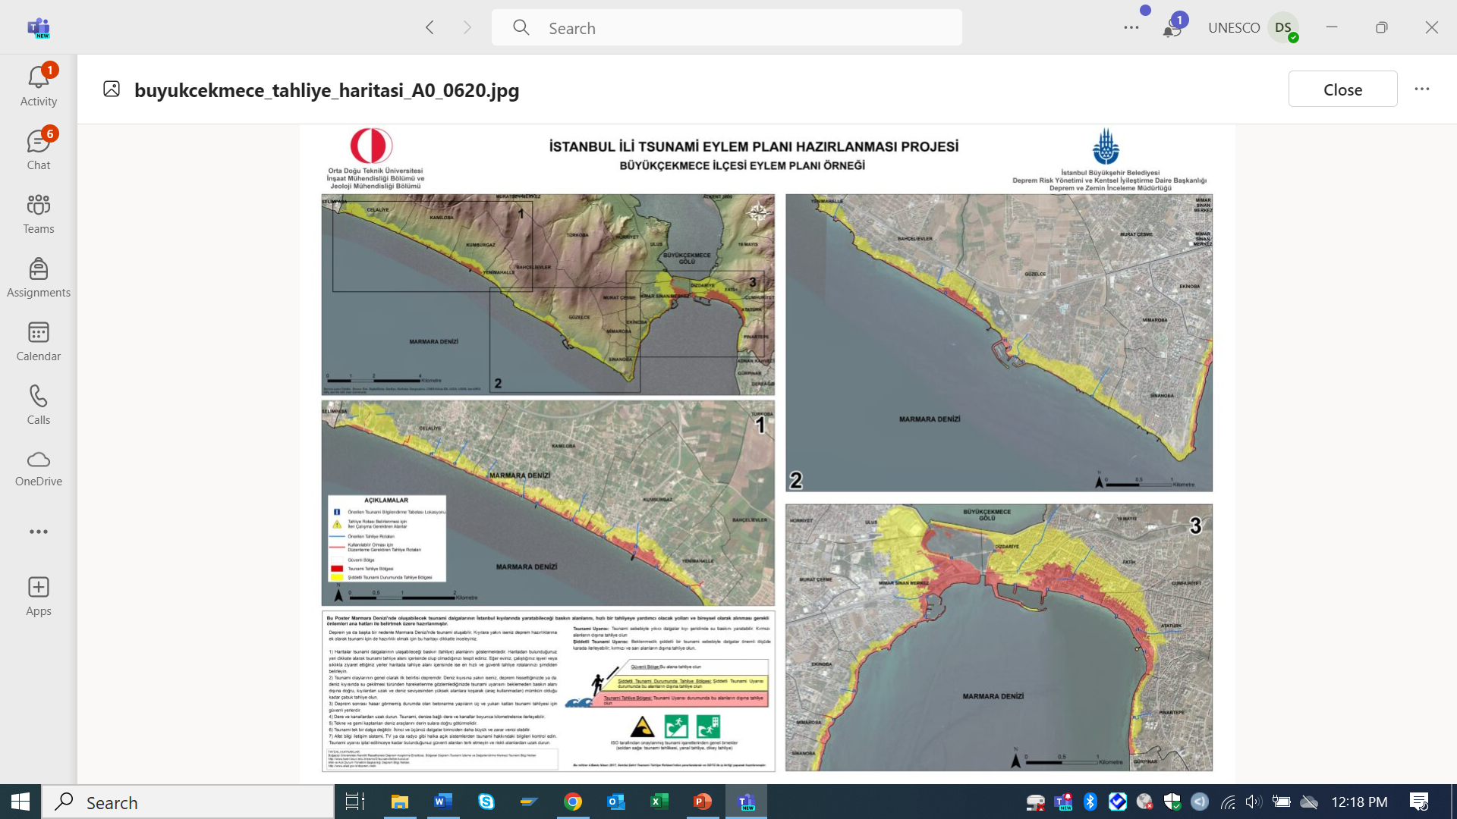
OUTCOME 1: STANDARD AND IMPROVED TSUNAMI HAZARD ASSESSMENTS AND EVACUATION MAPPING FOR BETTER PLANNING AND DECISIONS AT LOCAL LEVEL.
Output 1.1 (Currently 1.2)
Enhanced Capacity Building and Training in PTHA and non-PTHA [Funded by TSR Core budget] and evacuation mapping
Output 1.2 (Currently 1.1)
Tsunami Ready Indicator on Assessment 1: Tsunami Hazard zones are mapped and designated.
  High-resolution maps illustrating tsunami hazard zones, including areas prone to inundation and potential impact scenarios based on PTHA or non-PTHA (Project country to decide approach)

Slide 9
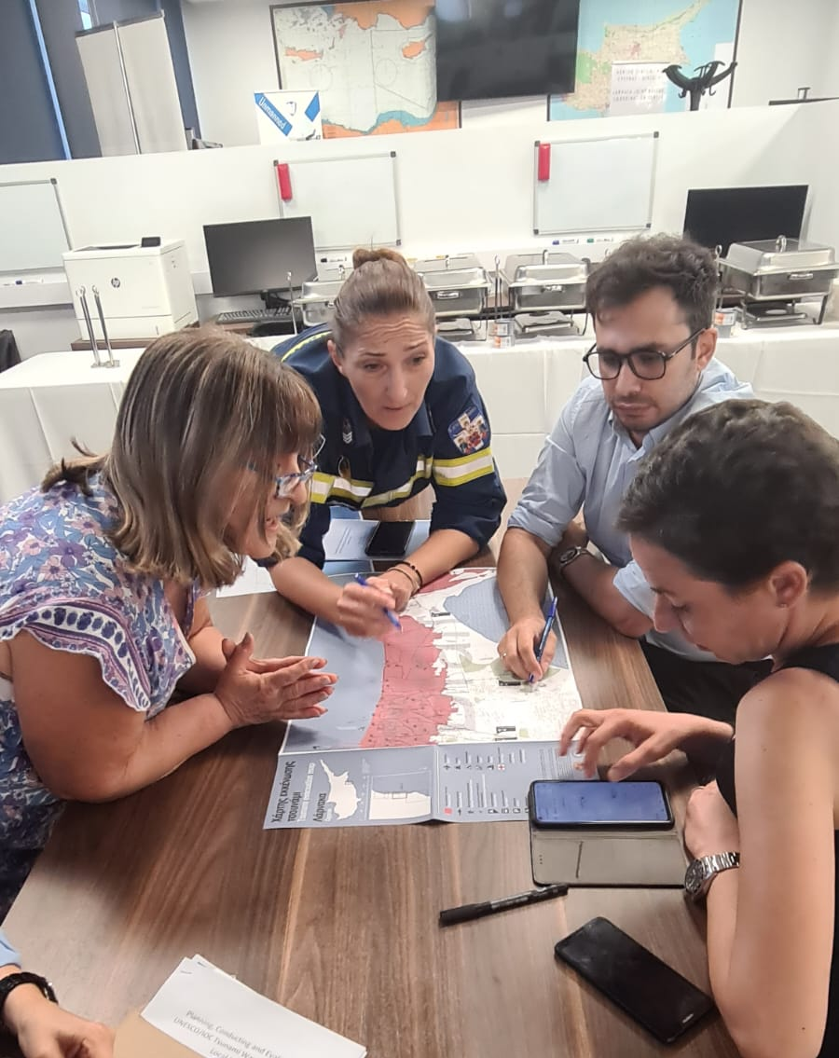
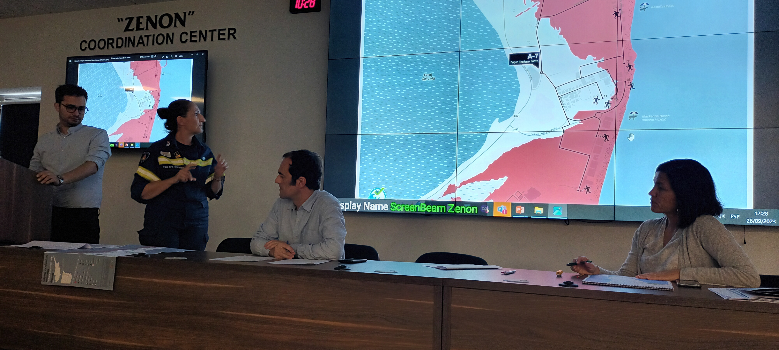
Output 1.3
Tsunami Ready Indicator on Preparedness 1: Tsunami Evacuation maps (Approved at later stage)
Proposed Activities
Organize 1 regional workshop and national-local workshop(s)
  Regional non-PTHA (1 Day) and PTHA (2 Days), and evacuation mapping (2 Days) [5 Days total]
  National to local in each project country on Non-PTHA or PTHA and evacuation mapping (2-3 days) based on Member State choice /preference.
Prepare maps in interactive and accessible formats.
Disseminate results to relevant stakeholders.
Prepare a report to be submitted to the ICG Steering Committee and ICG session by the end of the project.

Slide 10
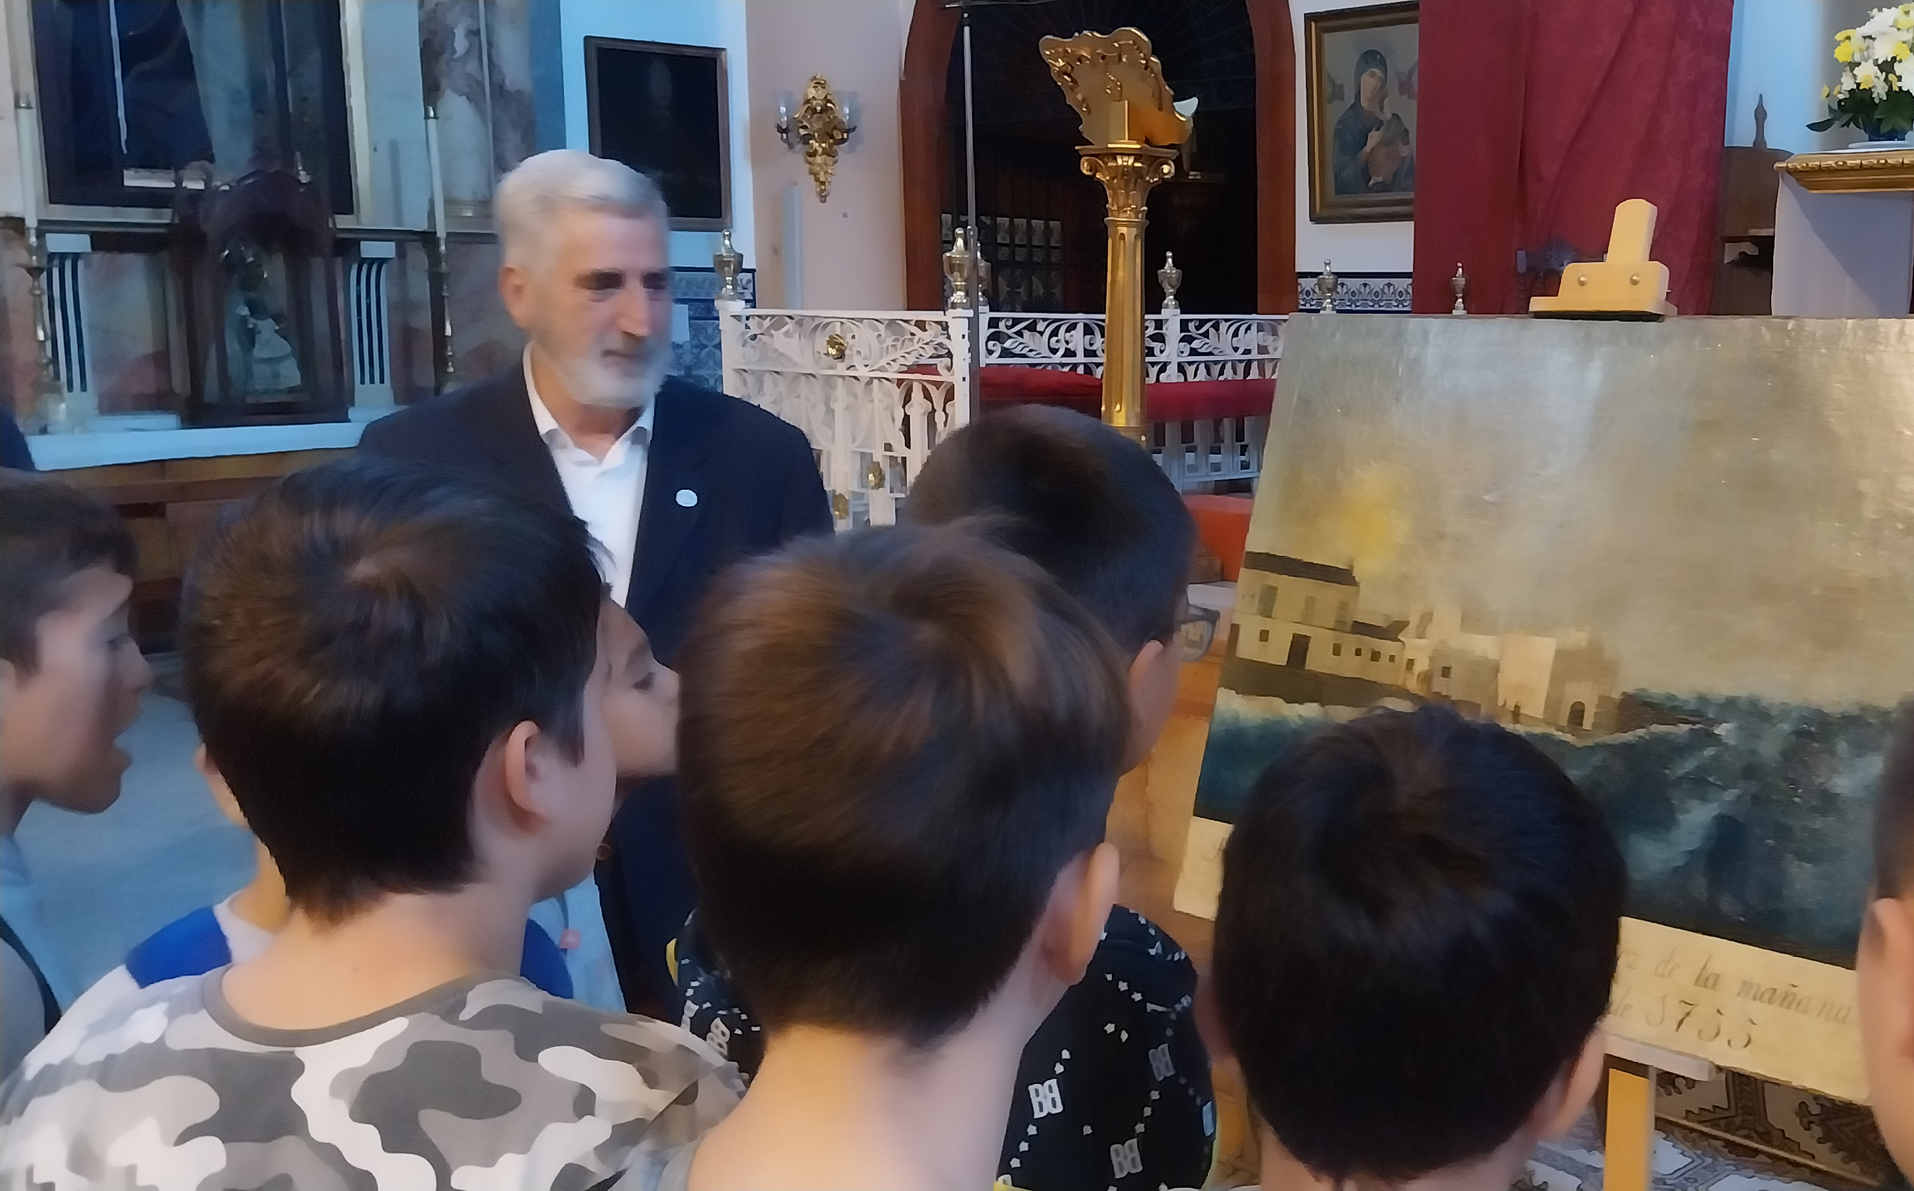
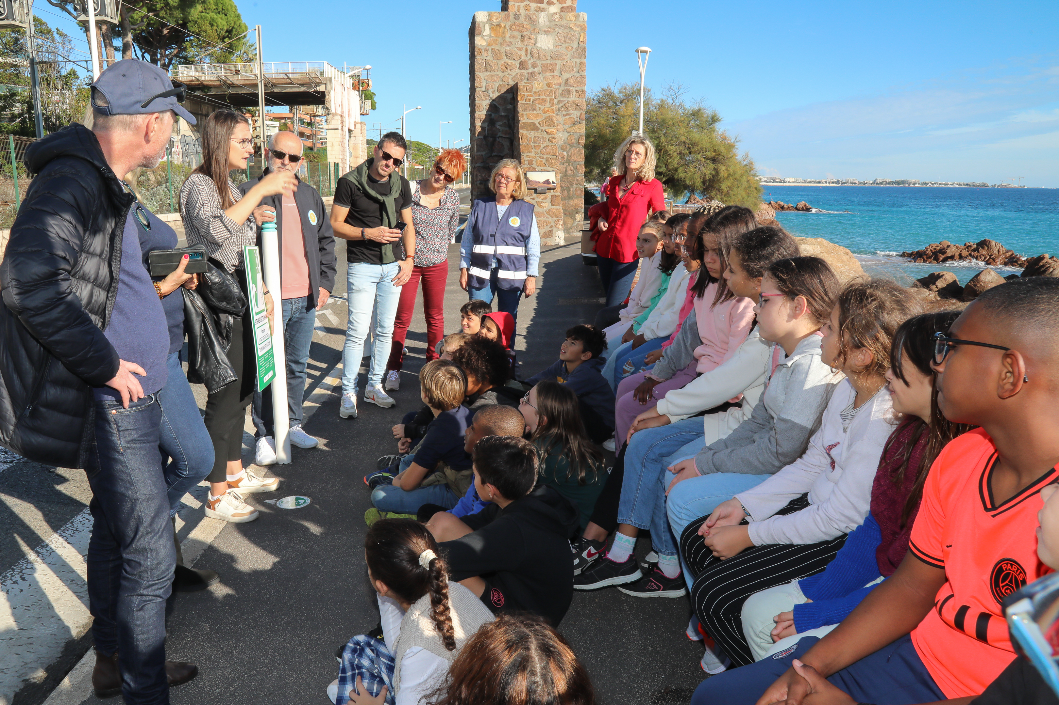
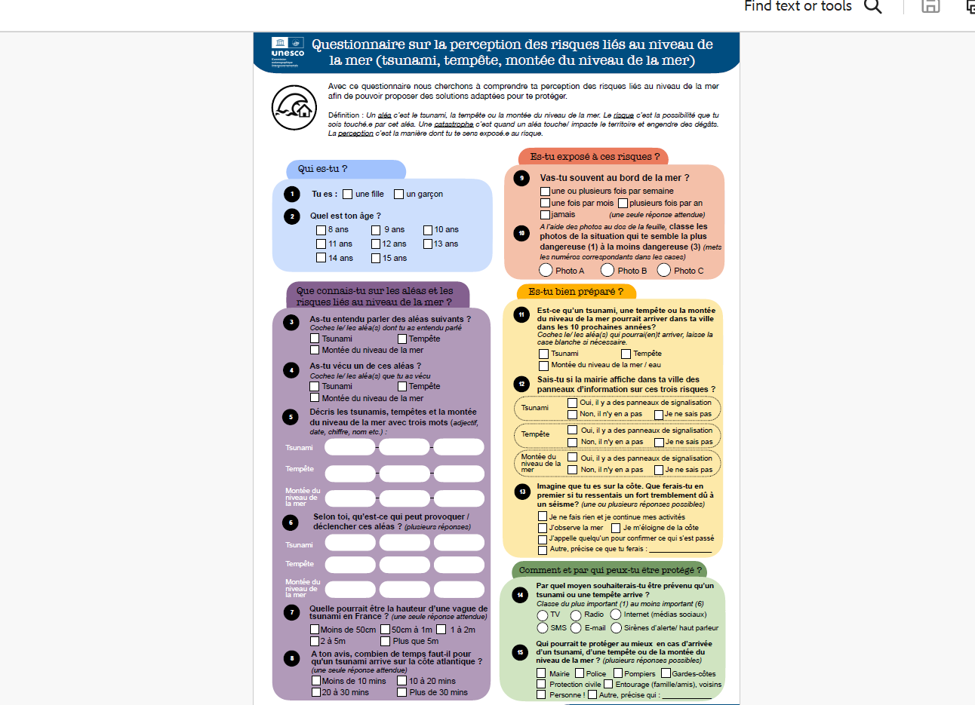
OUTCOME 2: ENHANCED UNDERSTANDING AND COMMUNICATION OF TSUNAMI AND OTHER SEA-LEVEL RELATED RISK IN SELECTED COMMUNITIES OF THE NEAM REGION
Output 2.1
Tsunami and other sea level-related risk perception for enhanced risk communication strategies and products to support effective decision making at national and local level.
Output 2.2
Tsunami and sea-level risk information packaged and shared to different target groups, including schools and Civil Protection Agencies in NEAM countries.
Proposed Activities
Identify the target groups in each project community in consultation with local partner agencies.
Disseminate the survey in the target groups within the selected project communities. .
Write the study report, translate into Arabic, Spanish and French and circulate to partner agencies, target communities and ICG/NEAMTWS WG 4
Integrate and package findings and share tsunami and sea level hazard risk communication and dissemination strategies, tools and products with stakeholders.

Slide 11

Questions?
Next Comp 2

Slide 12
COMPONENT 2
SCALING -UP
UNESCO-IOC TSUNAMI READY
€ 279,444.00

Slide 13
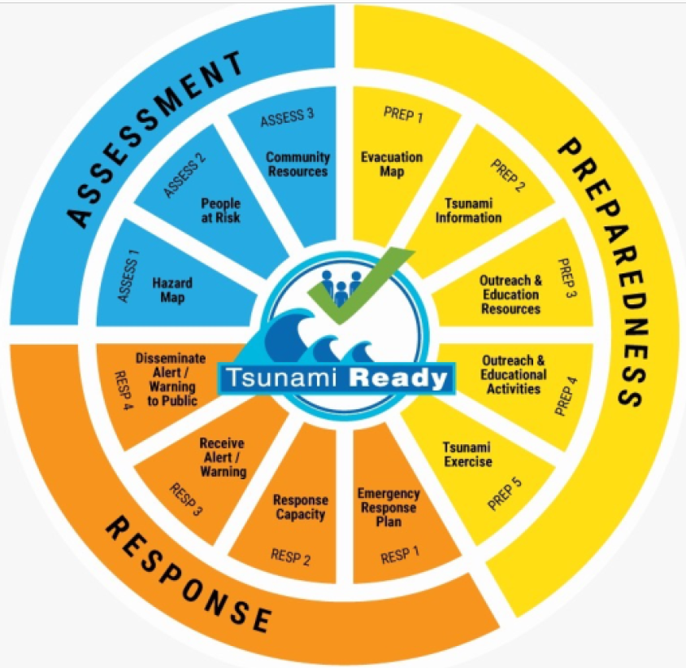
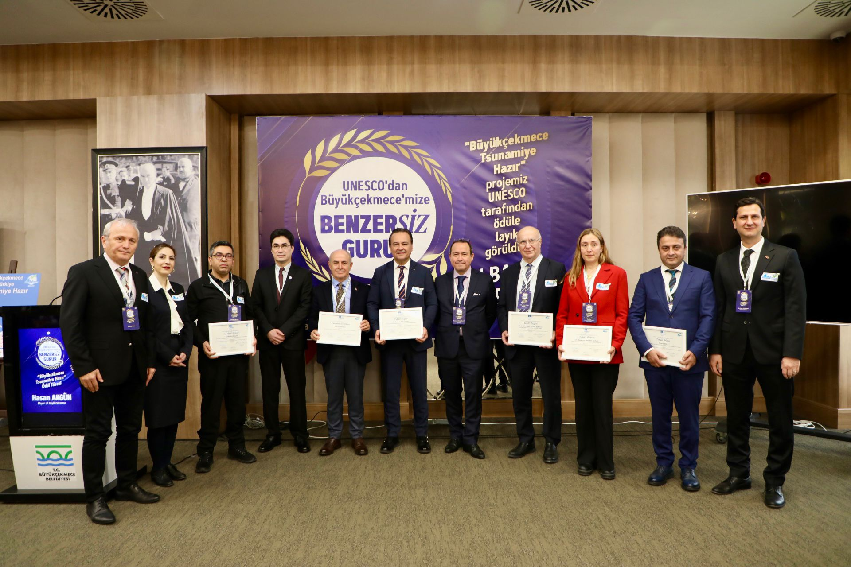
OUTCOME 3
More coastal communities in NEAM countries joining Tsunami Ready Programme to better prepare to respond to sea level related hazards.
Output 3.1
Needs, resources, capacities, stakeholders, partners, and requirements, support for the Tsunami Ready programme assessed.
Output 3.2
NEAMTWS Member States implement Tsunami Ready programmes based on UNESCO Manual and Guide 74, including the Governance structure, National Tsunami Ready Board
Output 3.3
Selected communities recognized as Tsunami Ready by the National Tsunami Ready Boards (or national equivalent) and IOC/UNESCO.
Proposed activities in line with the TR Indicators (M & G 74 ) [ Except Asses 1 and Prep 1]
Organize Tsunami Ready workshops for the selected communities.
Organize national to local level Tsunami Awareness and Standard Operating Procedures (SOP) workshops in selected countries.
Conduct a tsunami community exercise following the guidelines of ICG/NEAMTWS NEAMWave Exercise .
Organise Tsunami Ready recognition event ceremony

Slide 14
COMPONENT 3
ENHANCE AND DENSIFY,
DETECTION,MONITORING,
AND ALERTING SYSTEMS
€ 209.228.40

Slide 15
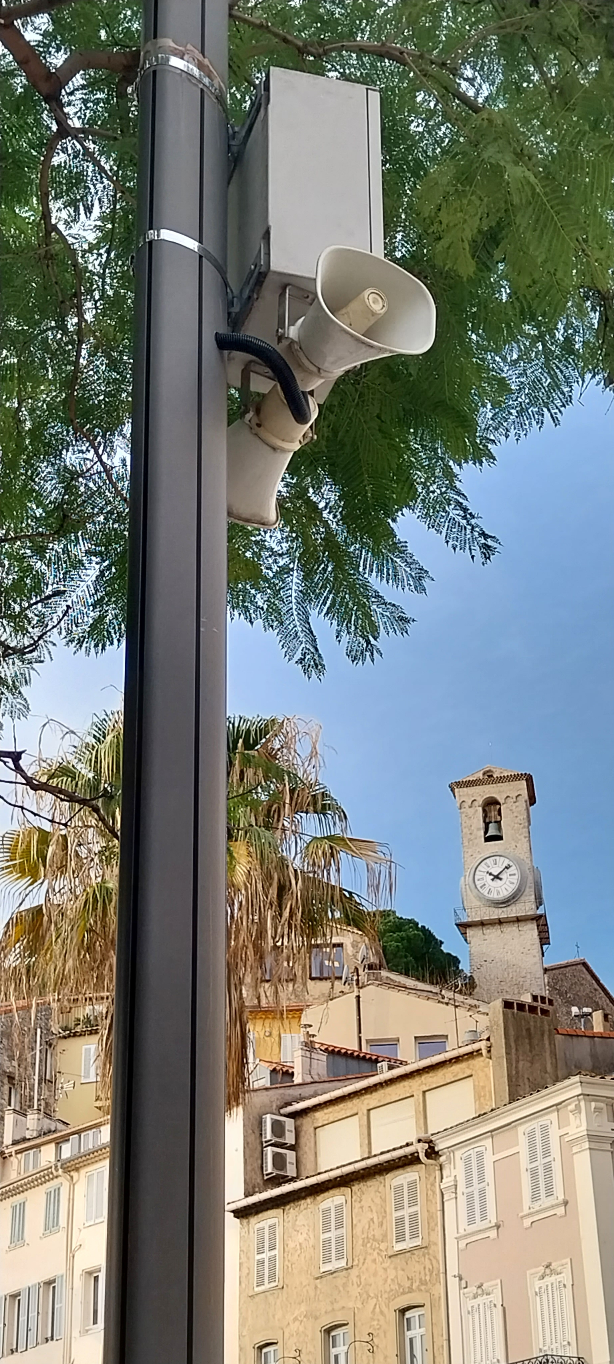

Training
Integration
Planning
Installation/ maintenance
OUTCOME 4
Increased access to near real time seismic detection and alert technology to provide early warning of rapid onset sea level-related hazards in selected new coastal communities.
Output 4.1
Tsunami detection (including seismic) and alerting systems (e.g. sirens) installed or upgraded at selected sites.
Output 4.2
Operators trained in the installation, operation and maintenance of tsunami detection (including seismic) and alerting systems (e.g. sirens).
Output 4.3
New Affordable Sea level devices for Tsunami detection and alerting systems installed at selected sites.
Output 4.4
Operators trained in the installation, operation and maintenance of affordable sea level devices.
Output 4.5
The effectiveness, compatibility, performance and benefits of the new affordable sea-level devices in NEAMTWS countries evaluated and submitted to the ICG/NEAMTWS.
Output 4.6
Maintenance programme and budget for the new affordable sea level devices prepared for follow up activities.
Output 4.7
Affordable sea-level devices network fully integrated into the IOC/UNESCO Sea Level Station Monitoring Facility

Slide 16
Proposed activities
Identify local partners to operate and maintain the alerting systems and affordable sea-level devices.
Conduct site surveys to identify optimum locations for the tsunami detection and alerting systems, including affordable sea-level devices.
Supply, install and commission tsunami detection and alerting systems and affordable sea-level devices.
Conduct training course for local operators on the operation and maintenance of the tsunami detection and alerting system, and sea-level devices.
Integrate tsunami detection and alerting systems and affordable sea-level devices into a national sea level hazard warning system in selected communities.

Slide 17
Questions?
Next Comp 4

Slide 18
COMPONENT 4
ENHANCING DIALOGUES WITH EMERGENCY RESPONDERS,DECISION MAKERS ON HILP (TSUNAMI) EVENTS WITHIN
A MHEWS CONTEXT
€ 13,650 Euros + Budget Realignment (10 k) and Core Programme Budget ( 7k ) [€ 30,000 ]

Slide 19

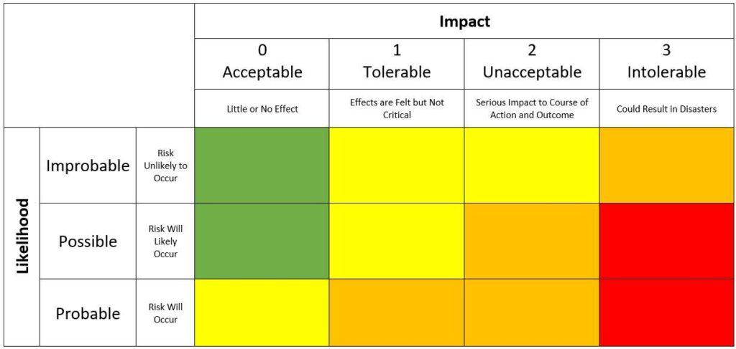
OUTCOME 5
STAKEHOLDERS UNDERSTAND AND HAVE THE KNOWLEDGE AND CAPACITY TO INTEGRATE RARE, BUT HIGH IMPACT TSUNAMI EVENTS IN MULTI-HAZARD APPROACHES, DECISION-MAKING AND PLANNING
O Output 5.1
  Enhanced dialogues and training with first and second level responders, including Civil Protection Agencies, government, non-governmental organizations and the professional and private sectors, media, citizens schools and others on HILP (Tsunami) and tsunami alerting systems within a MHEWS context./framework.
o Output 5.2
  Developed best practices with the identification of specific challenges of knowledge transfer regarding HILP (Tsunami) events.
Proposed Activities
Develop a literature analysis on HILP (Tsunami) in the context of MH/ MHEWS approaches
Organize a series of dialogues (2) and awareness workshops with various stakeholders on high impact low probability tsunami events in a multi-hazard context.
Develop and distribute outreach and public educational materials highlighting different scientific knowledge, tools, as well as management and planning strategies in dealing with threats of various probabilities of occurrence, including tsunamis.
Prepare a guideline/report on best practices and specific challenges of knowledge transfer regarding HILP events.

Slide 20

Other Project Budget
Project Management ( Including cost for 2 full time staff): € 468,294.00
Monitoring & Evaluation: € 32,664.91
Project Support Cost (7%) € 78,504.67

Slide 21
Provisional Work Plan
 | Year 1 |  |  |  |  |  |  |  |  |  |  |  | Year 2
 | Q1 |  |  | Q2 |  |  | Q3 |  |  | Q4 |  |  | Q1 |  |  |  |  |  | Q2 |  |  | Q3 |  |  |  | Q4
INCEPTION PHASE Project setup, recruitment of project coordinator and assistant, inception workshop and report
COMPONENT 1 – Building and Strengthening Tsunami Hazard Assessment, Risk Knowledge, Risk Communication and Decision-Making Capabilities
Outcome 1. Enhanced understanding and communication of tsunami and other sea-level related risk in selected communities in the selected NEAM countries.
Outcome 2. Standard and improved tsunami hazard assessments based on PTHA for better planning and improved understanding, effective communication and better decision-making from regional, national to local level of tsunami.
COMPONENT 2 – Scaling-Up and Expanding Tsunami Ready in NEAM Countries
Outcome 3. More coastal communities in NEAM countries joining Tsunami Ready Programme to better prepare to respond to sea level-related hazards.
COMPONENT 3 – Enhancing and Improving Detection , Monitoring and Alerting System in a Multi-Hazard Context
Outcome 4. Increased access to near real time seismic detection and alert technology to provide early warning of rapid onset sea level-related hazards in selected new coastal communities.
COMPONENT 4 – Enhancing Dialogues with Emergency Responders, Decision Makers on Low Probability High Impact Tsunami Events within a MH context to Improve Strategies and Decision-Making Capabilities
Outcome 5. Stakeholders understand and have the knowledge and capacity to integrate rare, but high impact tsunami events in multi-hazard approaches, decision-making and planning.
Project Reporting and Closure

Slide 22
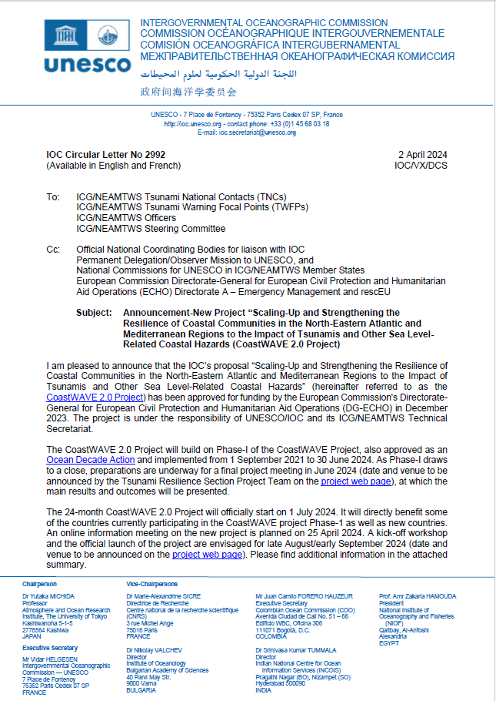
On Going Preparations to kick Start CoastWAVE 2.0 Project
2 April: Announcement to ICG/NEAMTWS Members States (IOC CL 2992)
First Week of May: Letters to MS. Confirm interest , project focal point(s)
25 April: CoastWAVE 2.0 Information Meeting
30 April : Deadline to confirm interest
Mid May: Project meetings. Discuss best way forward/modalities of implementation
End of May: Submit CoastWAVE 2.0- as a new Ocean Decade Action
1 July: Project officially starts
Mid July: Implementation Partnership Agreement (IPA) signed
Summer Holiday
By end of August : Launch of CoastWAVE 2.0 with project partners
October: Regional workshop on hazard assessment and evacuation mapping [5 Days]

Slide 23
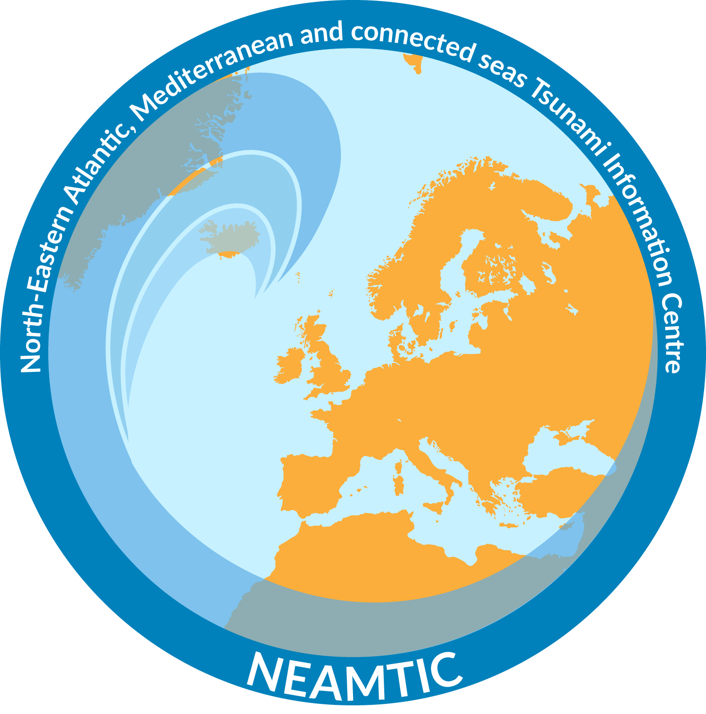
Q /A
AND
DISCUSSION
Your feedback is very important/appreciated/welcome
Thank you.
d.dilmen-vennin@unesco.org | a.danilova@unesco.org and d.chang-seng@unesco.org

