Slide 1
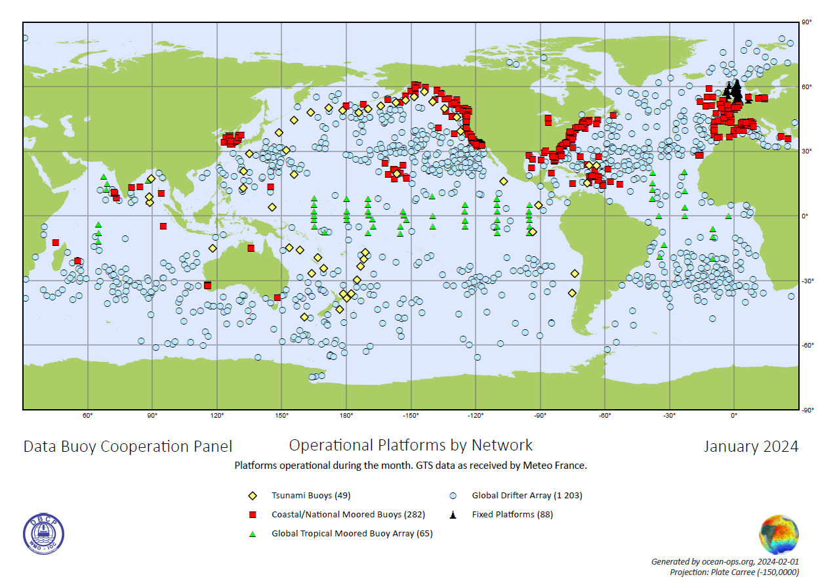
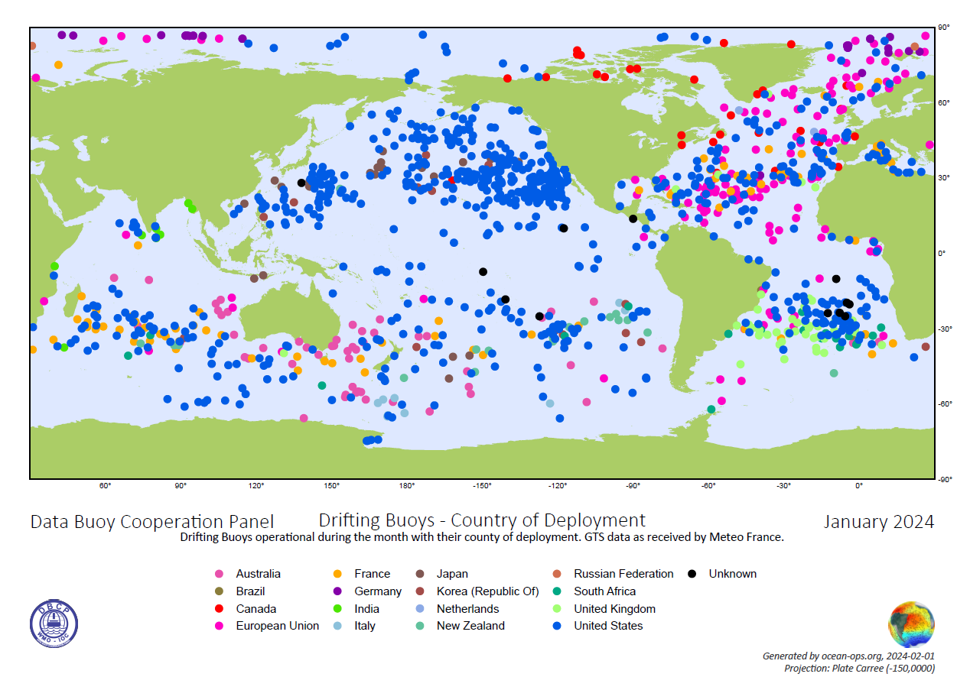
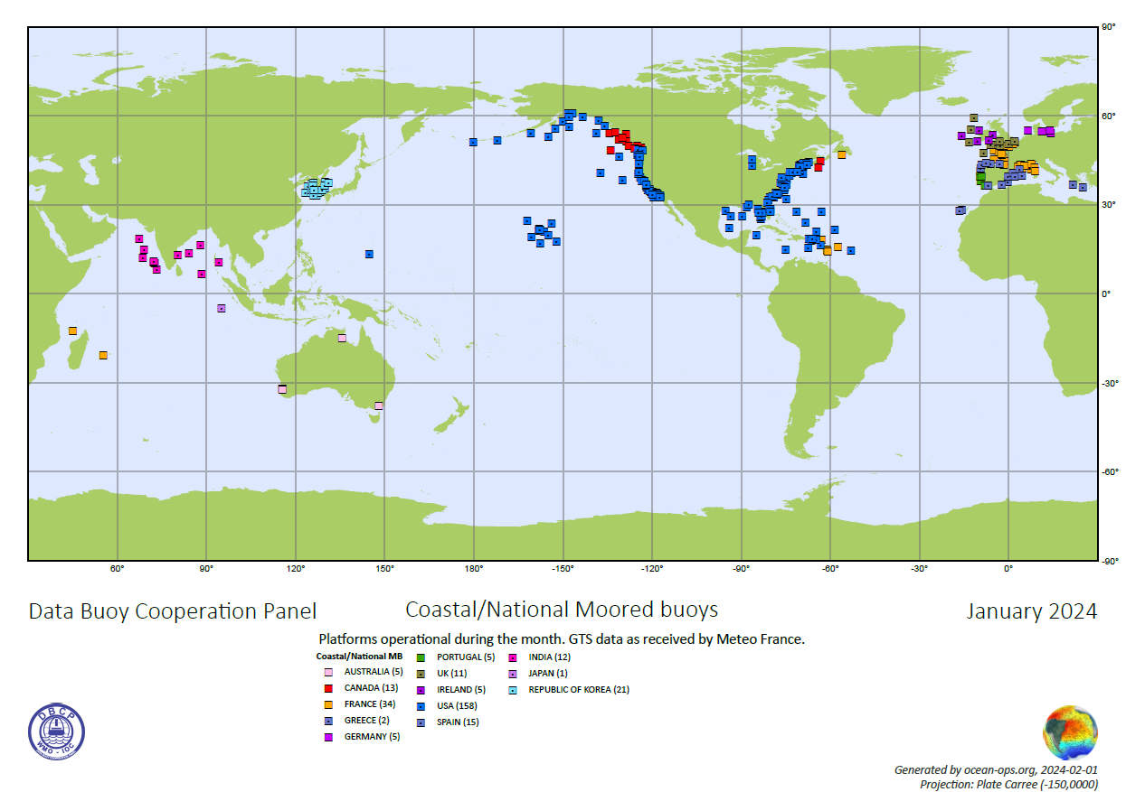
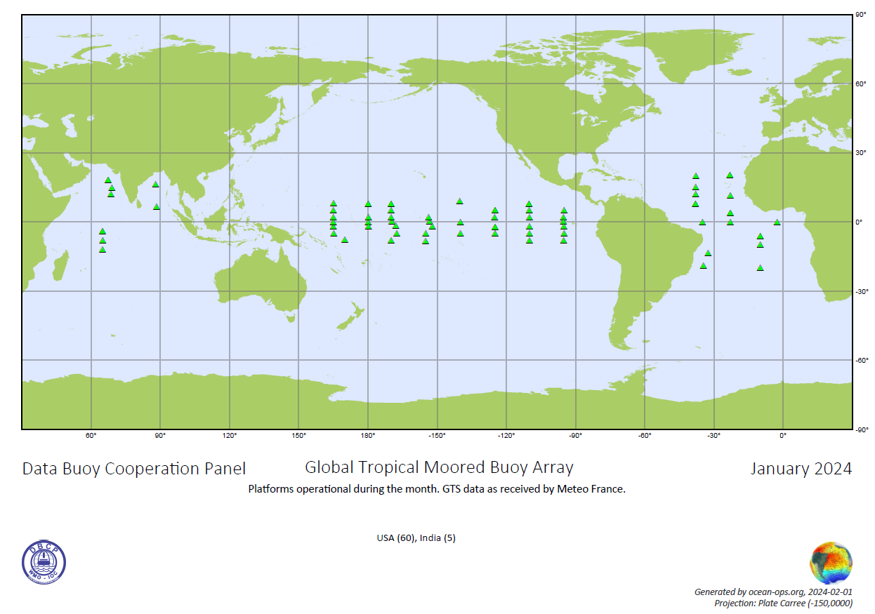
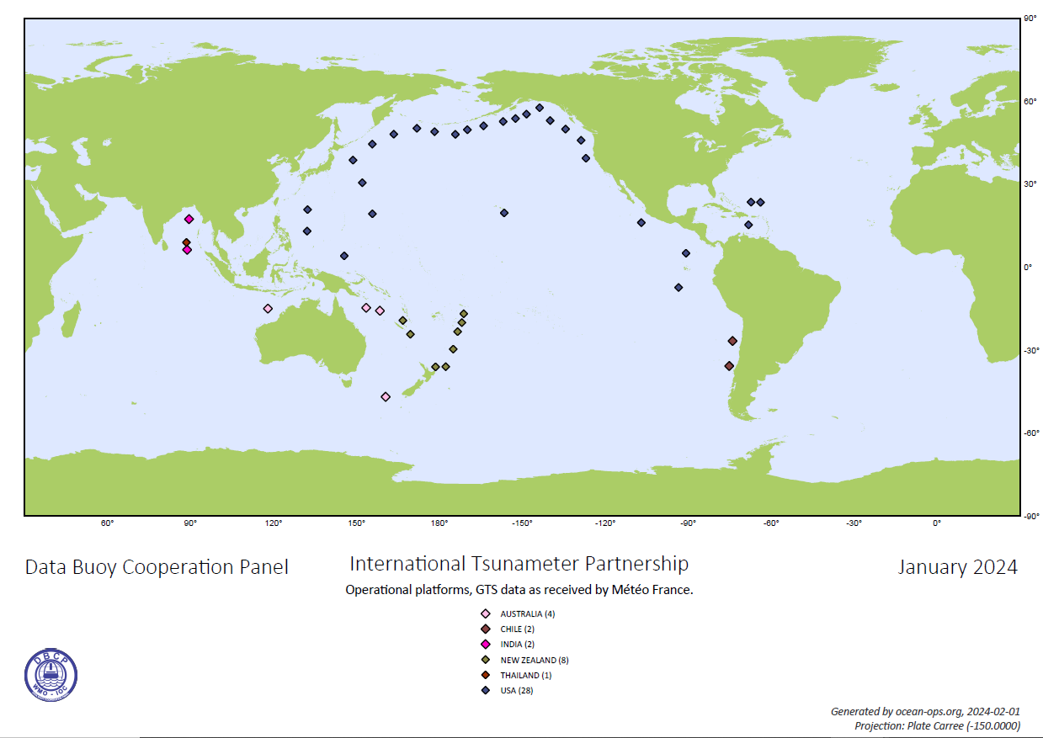
Observations Coordination Group (OCG)
Data Buoy Cooperation Panel
40 Years MetOcean Observations
Nelly Riama (nelly.florida@bmkg.go.idemail); Lance Braasch (lbraasch@ucsd.edu); Long Jiang (ljiang@ocean-ops.org)
Data Buoy Cooperation Panel has evolved over forty years, from initially coordinate drifting buoys to include moored buoys (coastal/national, tropical, and tsunami buoys) for varying purposes
Essential Ocean Variables shared through GTS/WIS 2.0, incl. SST and SLP from buoys are core data to WMO Global Basic Observing Network (GBON)
Global Drifters Array contributed from 17 members maintains above design target 1250 operational units, >95% transmitted data within one hour, averaged <30mins. More wave data from drifters visible on the GTS/WIS2.0
Coastal/national moored buoys array sustains more than 300 targeted operational units, 80% data in BUFR format compliant(TM 315008), 67% with wave measurements shared to GTS.
Tropical moored buoys array stagnated with 69% reporting data to the GTS in Jan 2024; Operators limited to USA, India, and partners for deployments (Brazil, France, ROK, etc.); PIRATA redeployments by PMEL since Feb 2024
Tsunameters array gradually expanded to 67% operational units shared to GTS in Jan 2024 from 6 members
Issues:
Persistent sparse areas near equators, Indian and Southern Oceans
Cost inflation in cycle of operations
OSCAR metadata; attribution and sensor information requiring corrections and expansion; TT-DM pilot initiated
Opportunities:
Capacity building and training activities, both in-person and online
TPOS upgrade to have barometers in all moorings
Increase of wave drifters
GBON expansion & SOFF mechanism
GDAC/Moored buoys (Coriolis/France) to facilitate metadata integration as well as more moored buoys from Copernicus
References:

