Slide 1
The Global Ocean Observing System
goosocean.org
2024 Ocean Decade Conference
GOOS Regional Alliance Forum (GRF-XI)
8-9 April 2024, Barcelona , Spain
Round Table Discussion
RT1: Strengthening Connections-Evolving the GRAs to strengthen each other.
RT2: Strengthening Capacity between GRAs, GOOS Panels, Projects, and Networks
Denis Chang Seng, PhD
Programme Specialist
IOC/UNESCO
Notes:
I'm here to talk to you about what makes a collection of activity into a cohesive and high-performing system - how we can work at global and regional levels to leverage our individual national contributions and make them stronger together

Slide 2
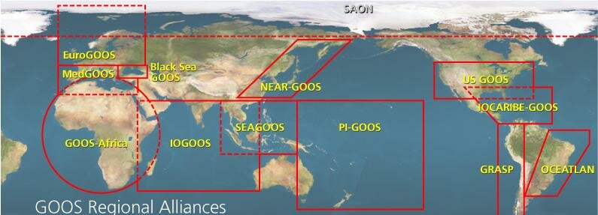
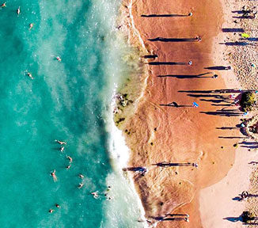
BACkGROUND
Notes
GOOS inspires that by 2030, we will have a global ocean observing system truly responsive to the needs of end users, able to mitigate mounting pressures on the ocean and enable resilient and sustainable blue economies.
GOOS will provide the critical ocean information required for policymakers and the public and private sectors to adapt to and mitigate climate change
GOOS Regional Alliances (GRAs) is a mechanism that integrate national needs into regional systems and deliver the benefits of GOOS’s strategy, structure, and programmes at a regional, national and finally global level.
GRAs function in particular way to emphasize on data sharing or regional capacity development, while others are building out extensive observation systems with dedicated marine service goals.
Africa and Small Island Developing States (SIDS) remain a special case for sustainable development.

Slide 3
Round Table Discussion #2 13:45-15:30 (105 mins)
Strengthening Capacity between GRAs, GOOS Panels, Projects, and Networks
Aim: Explore opportunities to actively engage with other aspects of GOOS

Slide 4
Discussion Questions
What are the observing needs in regions that align with Projects, Panels, and Networks
What additional information would you need to better engage with these groups?
Other Questions?
What priority actions could be made with partners over the next 2 years to enhance GRA observing?
Rapporteur

Slide 5
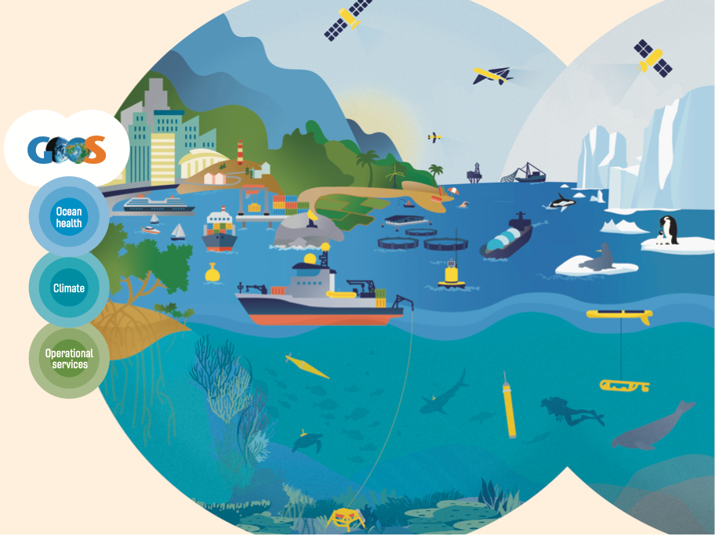
www.goosocean.org/join

