Slide 1


The Global Ocean Observing System
goosocean.org
2024 Ocean Decade Conference
GOOS Regional Alliance Forum (GRF-XI)
8-9 April 2024, Barcelona , Spain
Round Table Discussion
RT1: Strengthening Connections-Evolving the GRAs to strengthen each other.
RT2: Strengthening Capacity between GRAs, GOOS Panels, Projects, and Networks
Denis Chang Seng, PhD
Programme Specialist
IOC/UNESCO
Notes:
I'm here to talk to you about what makes a collection of activity into a cohesive and high-performing system - how we can work at global and regional levels to leverage our individual national contributions and make them stronger together

Slide 2
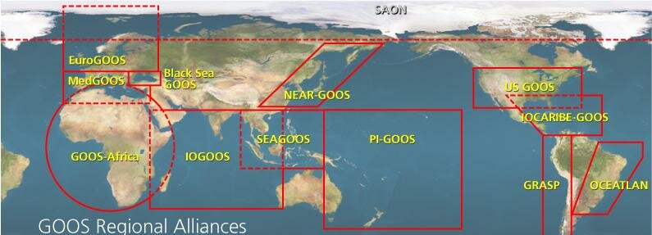
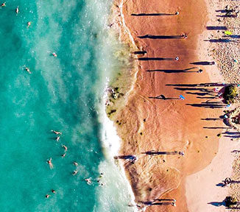
BACkGROUND
Notes
GOOS inspires that by 2030, we will have a global ocean observing system truly responsive to the needs of end users
Adapt to and mitigate climate change
Enable resilient and sustainable blue economies
EWS/DRR etc.
GOOS Regional Alliances (GRAs) is a mechanism and structure that integrate national needs into regional systems and deliver the benefits of GOOS
GRAs function in particular way to emphasize on data sharing, regional capacity development, while others are building out extensive observation systems with dedicated marine service goals.

Slide 3
Round Table Discussion #1
Strengthening Connections-Evolving the GRAs to strengthen each other.
Aim:
GRAs collaborate integrally TO STRENTHEN CAPACITY.
Key overarching questions:
How can GRAS coordinate to help evolve capacity and sharing of knowledge.

Slide 4
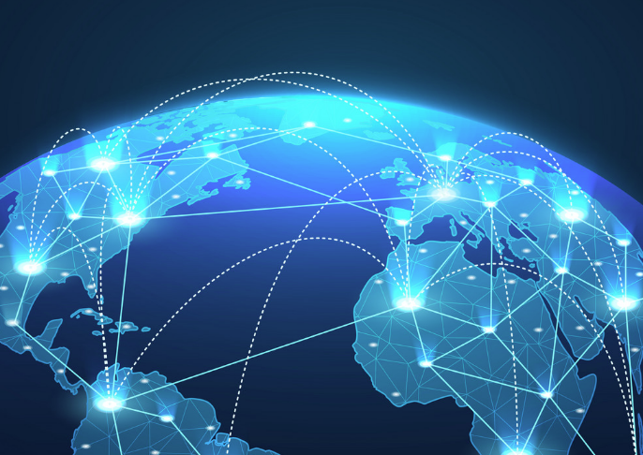
Discussion Questions
What can GOOS Management Team or other well-funded GRAs help/support/share knowledge?
What regions can be better connected? E.g. . IMOS to help support PIGOOS
What is a way to facilitate intra-coordination for the regions?
What are the observations needed in your region to support the blue economy?
Funding–to support jobs within countries vs. buying equipment
How to message to governments the importance of hiring ocean positions?
Use cases for sustained observing
What can GOOS say/share with Member States for support in regions with needs?
Rapporteur

Slide 5
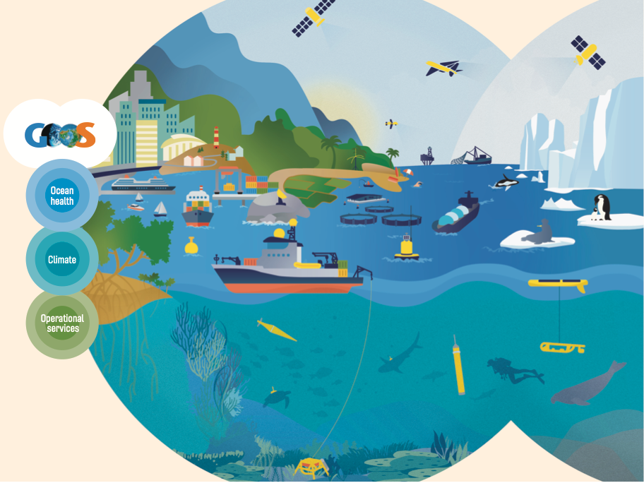
www.goosocean.org/join

