Slide 1
PTWS Steering Committee Meeting, online, 26 March 2024
PTWS
UNESCO/IOC
Tsunami Ready
Update – 24 March 2024
PTWS WG 3 Chair, Co-Chair
Ashleigh Fromont, NEMA
Laura Kong, ITIC

Slide 2
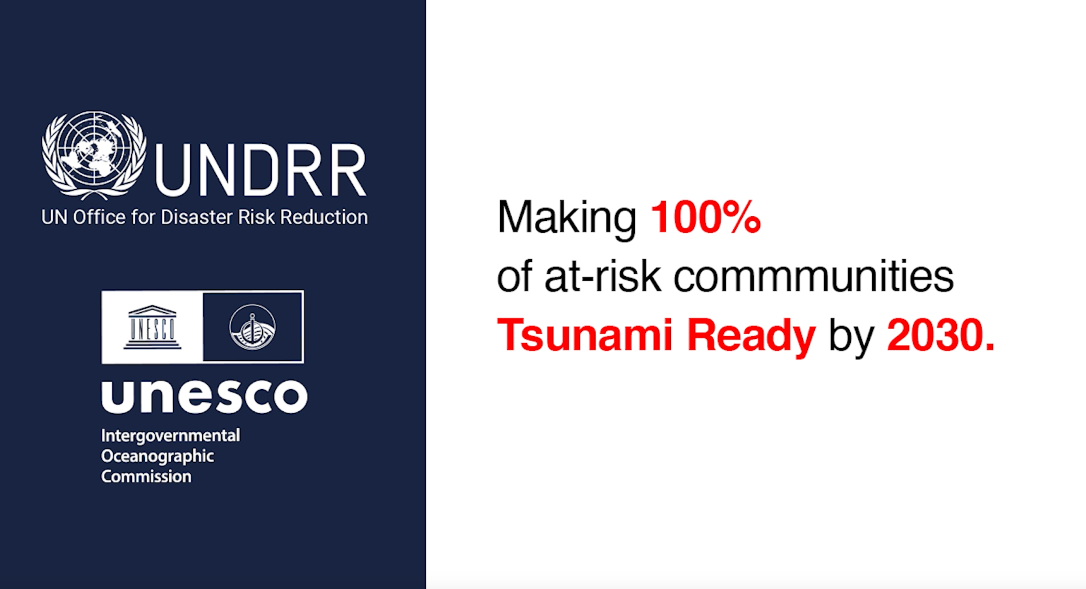


Slide 3

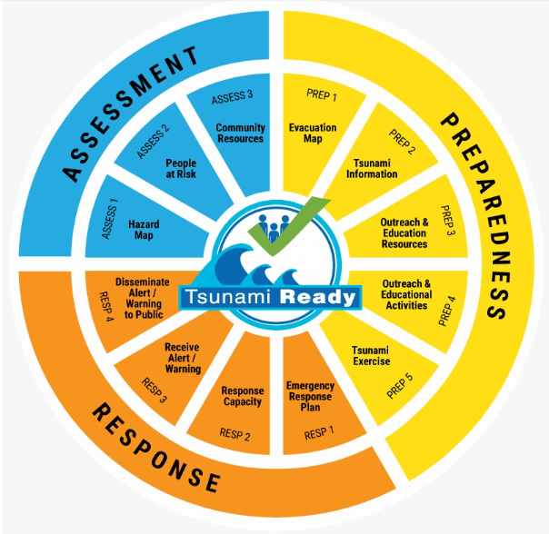
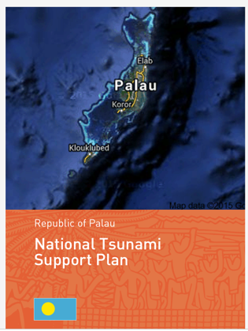




100% AT-RISK COMMUNITIES TSUNAMI READY
UN OCEAN DECADE TSUNAMI PROGRAMME:
STRATEGY: Be Aware, Be Prepared
FRAMEWORK:
  Harmonized global guidelines UNESCO IOC Tsunami Ready
  Performance-based Community Recognition
ACTION:
  National programs empower Communities
GLOBAL MEASURE
Standard Guidelines for the Tsunami Ready Recognition Program, UNESCO IOC TS 74

Slide 4
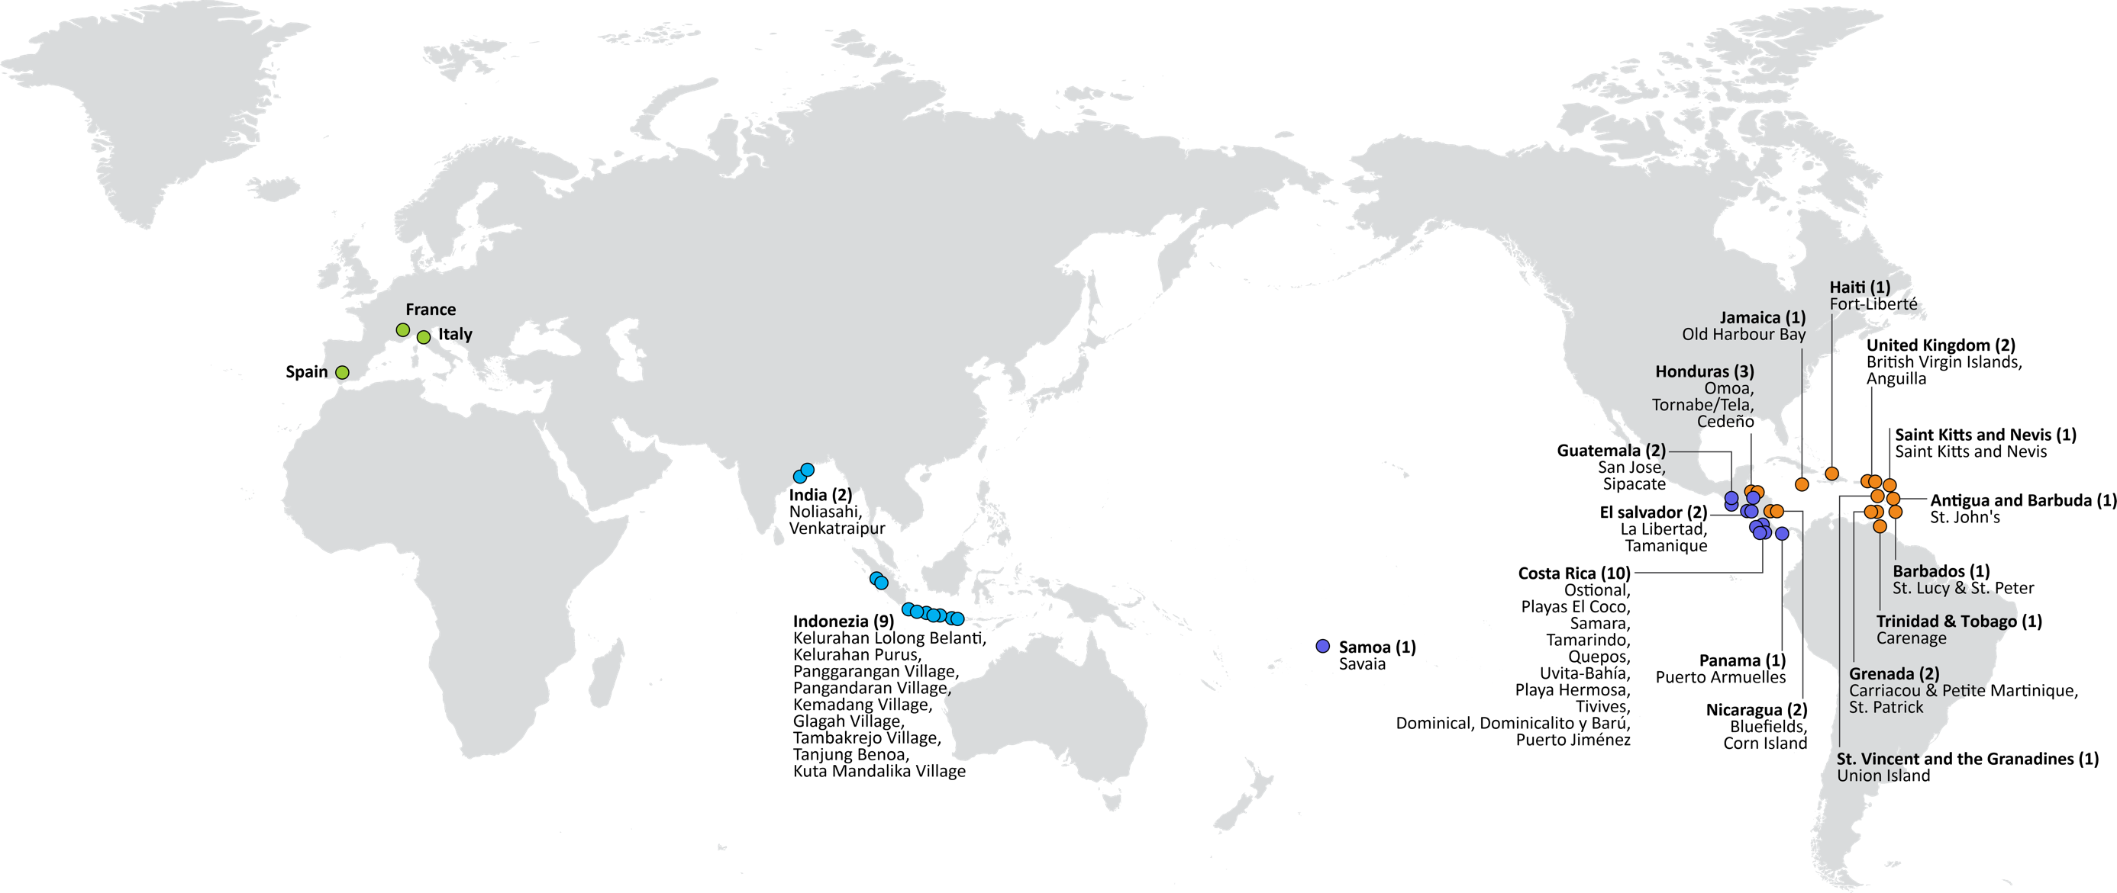




UNESCO/IOC TSUNAMI READY RECOGNITION PROGRAMME (TRRP)
50
TSUNAMI READY
COMMUNITIES
NEAMTWS
in progress
11 – IOTWMS
19 – PTWS
18 – CARIBE-EWS
2 – NEAMTWS
Türkiye
Greece
Israel
MAJOR ACTIVITIES IN 2021-2024
Planned Next TR PTWS: Ecuador Galapagos (Apr); FSM (4, Apr-Jun); RMI (1), Palau (1), Honduras
Development of a global
Tsunami Ready Interactive Map Viewer
Hosting by ITIC of the
Tsunami Ready web site
Development of a new
Tsunami Ready Board Game
Publication of the IOC Manuals and Guides 74
«Standard Guidelines for Tsunami Ready Recognition Programme»
Palau, FSM, RMI
2022-2024
Fiji
HN – renew
KI, WS, SB, VU
2024-2026
Frolov, 2023; ITIC, March 2024

Slide 5
Tsunami Ready - East Pacific - ITIC support
Ecuador – Santa Cruz, San Cristobal and Isabela – New Recognitions
  Led by INOCAR with Ministry of Risk Reduction and Local Authorities
  Finalizing Documentation for Submission of application
  First UNESCO/IOC TR recognized communities in South America
  Target Date for Recognition: April 11, 2024 at the Ocean Decade Conference
Honduras – Cedeño – Renewal (Original recognition was Feb. 2016)
  Funded by USAID/BHA through the ITIC Caribbean Office (along with Omoa and Tela on the Caribbean coast and Belize, Antigua and Barbuda and Anguilla)
  Initial meeting held in November 2023
  Site visit and trainings scheduled for June 14-23

Slide 6
Tsunami Ready - East Pacific – Capacity Building
Tsunami Evacuation Workshop
  San José, Costa Rica – April 22-24, 2024
  Organized by Florida International University’s Extreme Events Institute (FIU_EEI) and the Bureau of Humanitarian Affairs of the United States Development Agency (USAID/BHA). Collaboration of the National Tsunami Monitoring System of Costa Rica (SINAMOT), the International Tsunami Information Center Caribbean Office (ITIC-CAR a UNESCO/IOC-NOAA Partnership) and the coordination and financing support of the Tsunami Resilience Section IOC/TSR of UNESCO.
  Purpose: Exchange advances associated with tsunami evacuation in areas such as technology, modeling, communication, warning systems, community organization, associations/partnerships, training (different levels).
  Attendees: 2 Representatives (NTWC and DRR) from 11 countries with Pacific coasts: Mexico, Guatemala, El Salvador, Honduras, Nicaragua, Costa Rica, Panama, Colombia, Ecuador, Peru and Chile.
  Agenda
    Day 1: Presentation by countries on state of tsunami preparedness
    Day 2: Field work to observe tsunami warning and response systems along Pacific coast
    Day 3: UNESCO/IOC TEWS, US TsunamiReady® Program, Working Groups
Tsunami Ready Workshop
  Managua, Nicaragua – May 10, 2024 (day after the ICG CARIBE EWS meeting), 8:00 AM – 1:00 PM
  Organized by ITIC CAR with collaboration of CTIC and UNESCO/IOC/TSR and financial support of USAID/BHA
  Purpose – familiarization with the UNESCO/IOC Tsunami Ready Recognition Programme and verification process. Exchange of best practices and challenges
  Attendees – 1 representative of countries with current USAID supported TR projects (Honduras, Belize, Antigua and Barbuda and Anguilla), PTWS Secretary, CTIC Programme Officer, US CARIBE EWS/PTWS Tsunami National Contact, and other interested stakeholders

Slide 7
PTWS TR Details – 14 countries Planning or Done/Renewing
STATUS | PTWS
Expression of Interest | 0 | EOI
TR process planned | 3 | P
Initial TR process ongoing | 8 | O
TR recognition valid | 12 | V
TR renewal due | 0 | R
TR renewal in progress | 0 | RIP
TR renewal delayed | 7 | RD
Total PTWS | 30
Total SIDS | 7
Note:
Most countries have many more communities to be recognized to reach 100% Tsunami Ready
But, it takes time, so it is important to start now!
PTWS Technical Secretary (26 March 2024)

Slide 8
TOWS – February 2024
Appreciation of progress made by PTWS on ways to recognise ‘tsunami readiness’ outside of the programme (TT TR established)
Request PTWS TR TT to share back on the development of guidance
TT-Disaster Preparedness and Management – Actions
  TR Toolkit to be developed to assist in implementation / submission
  Tsunami Ready signage – take into account distant tsunami wording (will not feel shaking), and local tsunami (will likely feel strong or long shaking)
  OTGA Tsunami Awareness and Tsunami Ready to be completed Summer 2024

Slide 9
Development of TR ‘Equivalency’ Guidance
TT TR will be progressing this in the intersessional period (9 members)
It will be key that this guidance can be used by a diverse range of communities – so the TT will need the support of the ICG and especially the Regional WGs to develop this
TOWS TT-DMP noted it will be important to ensure that the formal Tsunami Ready Recognition Programme isn’t devalued.
  There was extended discussion regarding what best to call it – ‘equivalency’, ‘parity’ etc.
  It will need to be clear that this is not a method for achieving formal TR recognition, but enabling measurement global progress towards the UNOD goals

