Slide 1
re
Proposal for
2024 Tsunami Preparedness Capacity Assessment
September 2023
ESCAP Multi-Donor Trust Fund for Tsunami, Disaster and Climate Preparedness

Slide 2
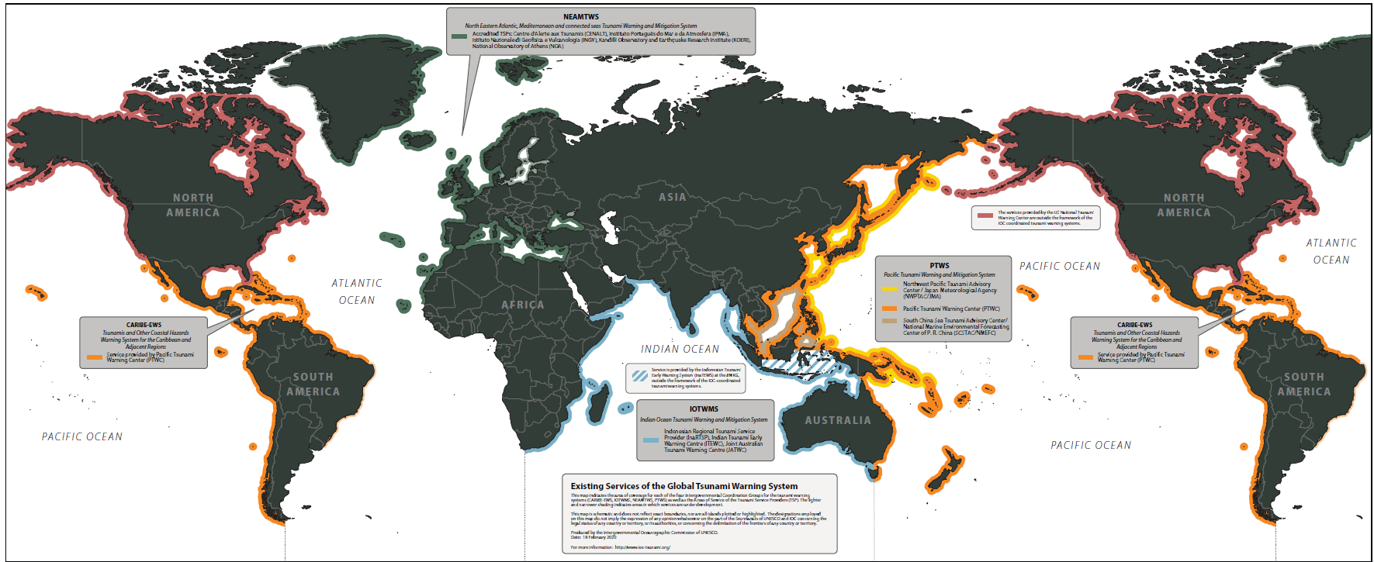
UNESCO-IOC Global Tsunami Warning System

Slide 3
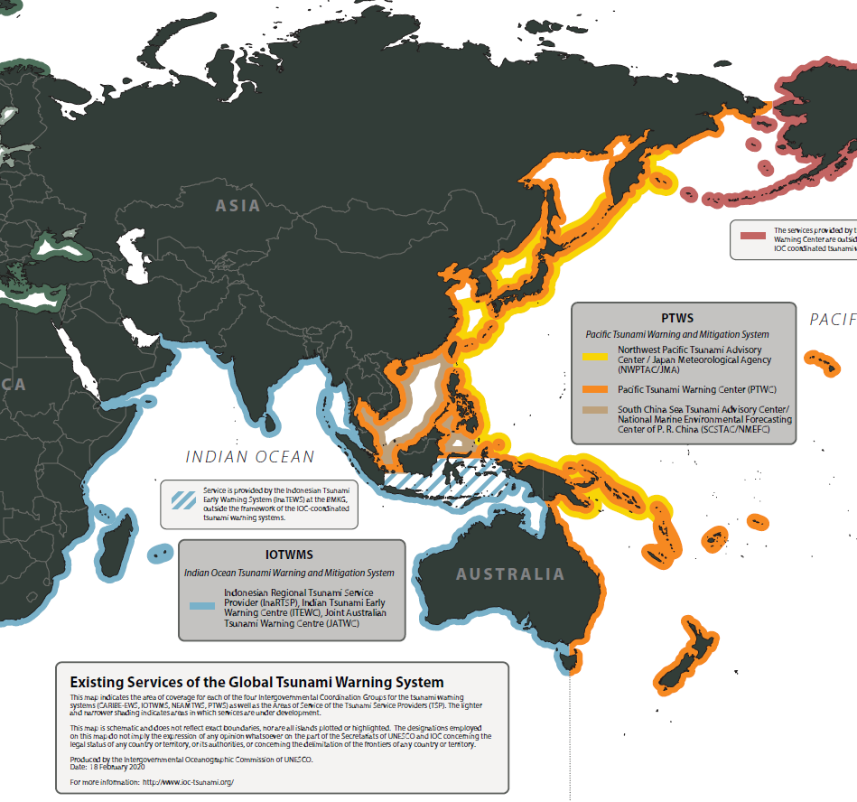
IOTWMS = 27 members
14 ESCAP members
6 ASEAN
5 SAARC
2 PIF
8 EW4All countries
PTWS = 46 members
33 ESCAP members
9 ASEAN
17 PIF
8 EW4All countries
ASEAN = 10 out of 11 members are in PTWS/IOTWMS
Indonesia, Malaysia, Singapore, Thailand and Timor-Leste are members of both mechanisms
Brunei, Cambodia, Philippines, Vietnam are members of PTWS only
Myanmar is a member of IOTWMS only

Slide 4
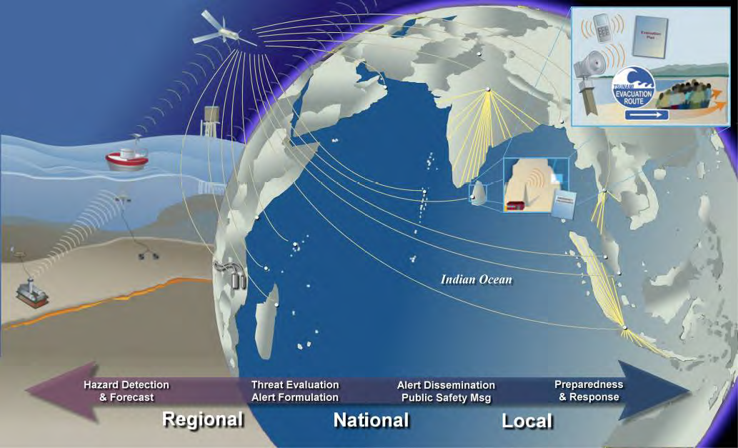
A seamless global to local weather information warning chain is important for early warning efficacy.
Regional and subregional efforts on tsunami preparedness support critical links in this chain
Impact Estimate
Early Action
Weather information
Weather Translation
Early Warning Dissemination
Anticipatory actions and Mitigation strategies
Weather analysis and forecast data
Extraction of relevant information
Accessible communications of expected impacts
Placing into situational context
Weather-impacted user
Weather Information provider

Slide 5
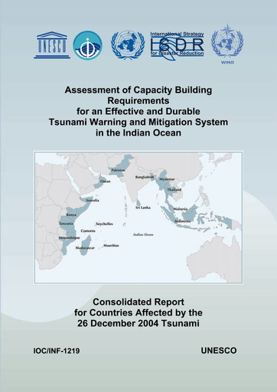
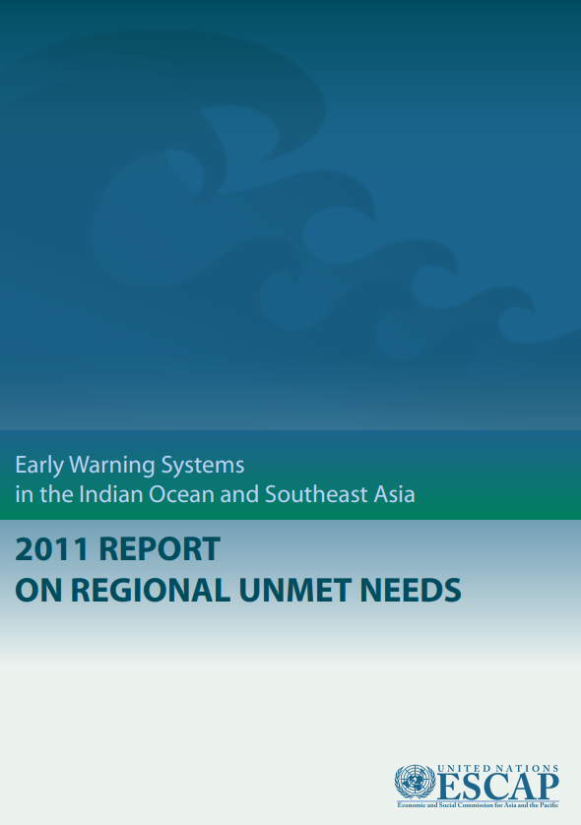
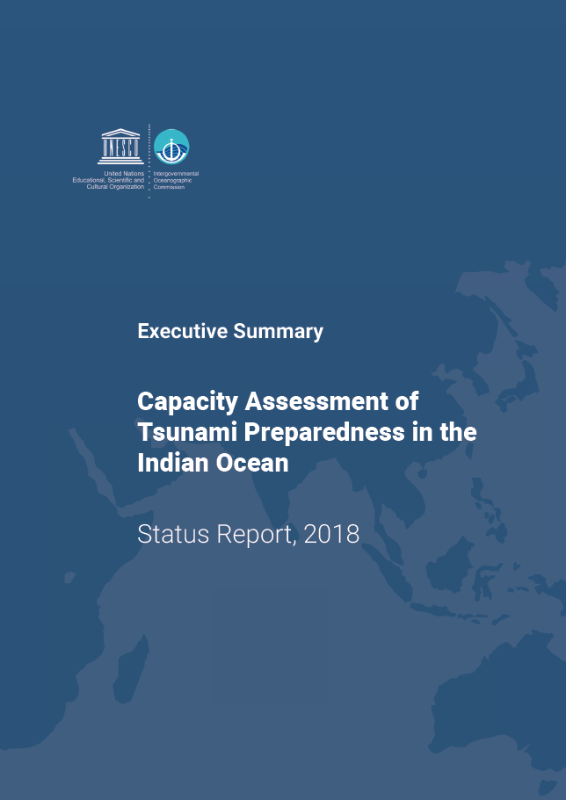
Previous Comprehensive Assessments
PTWS
National capacity assessments for 14 Pacific countries and Consolidated regional report in 2009/2010 funded by Australia
ESCAP
Unmet needs survey for the region conducted in 2008 and 2011
IOTWMS
Full capacity assessments in 2005 and 2018 and commitment to update
Capacity assessment framework and tools already developed

Slide 6
Capacity assessment of tsunami preparedness
CAPITALIZING ON
ASEAN will to strengthen tsunami preparedness
existing technical capacity assessment methodologies and UNESCO-IOC IOTWMS commitment to conduct a assessment for 2024
UNDP/UNDRR/UNESCO/National
20th commemoration events and campaigns
OBJECTIVES
To evaluate the existing technical capacity of the UNESCO-IOC Indian Ocean Tsunami Warning and Mitigation System (IOTWMS) and Pacific Tsunami Warning System (PTWS) and highlight the progress made since 2004 IOT and subsequent assessments.
To identify specific gaps and capacity development requirements at regional and national levels for strengthening the technical and policy aspects of the tsunami warning and mitigation systems in the region
To reinvigorate political commitment and provide recommendations for investments in tsunami preparedness, aiming to address the identified gaps in Asia and the Pacific through regional and subregional cooperation.

Slide 7
Capacity assessment of tsunami preparedness
2024 OUTPUTS - IOTWMS
1.A_ Technical Capacity Assessment for IOTWMS (IOC)
1.B_ IOTWMS assessment summary and comparative analysis (IOC)
3.A_ Tsunami preparedness recommendations for ASEAN policymakers (UNESCAP)
3.B_ Tsunami preparedness recommendations for SAARC policymakers (UNESCAP)
2025 OUTPUTS - PTWS
2.A_ Technical Capacity Assessment for PTWS (IOC)
2.B_ PTWS assessment summary and comparative analysis (IOC)
3.C_ Tsunami preparedness recommendations for PIF policymakers (UNESCAP)

Slide 8
Major Milestones
Data Collection and Analysis
Nov 2024 IOC Global Tsunami Symposium & UNESCO-IOC 14th Session ICG-IOTWMS
Dec 2022 ICG/IOTWMS-XIII (Assessment included in 2024 workplan)
July 2023 CDRR8 (Member State consultations)
Aug 2023 ADB (Endorse concept note and budget)
Apr 2024 80th Commission
Oct 2024 APMCDRR
Nov 2024 WTAD and 25th Advisory Council
Dec 2024 ASEAN 20th Commemoration Event (ASEAN political statement)
Sept 2023 ICG/PTWS-XXX (Adoption of assessment exercise in workplan)
July 2024 Joint ICG validation workshop
Planning and Inception
Validation
Mar 2024 11APFSD
Finalization
Nov 2023 WTAD (Assessment Launch and 24th Advisory Council)
Nov 2023 to May 2024 (IOTWMS ongoing data collection and synthesis)
Apr 2024 to May 2025 (PTWS ongoing data collection)
Nov 2024 43ACDM & 11AMMDM
May 2024 to Oct 2024 drafting of summaries for policymakers (2025 for PIF summary)

Slide 9
 | 2023 |  | 2024 |  |  |  | 2025
Outputs | Q3 | Q4 | Q1 | Q2 | Q3 | Q4 | Q1 | Q2 | Q3
Overall | Develop proposal | - Endorse Proposal (Trust Fund Advisory Council, ASEAN, and UNESCO-IOC ICG PTWS) - Launch Tsunami Capacity Assessment exercise at WTAD 2023 - Recruitment - Workshop online review and endorse Phase 2 by ICG/PTWS | - University of Huddersfield training for University of South Pacific | - High-level sessions (80th Commission, 11APFSD) | - IOTWMS validation and learning workshop - Opportunities for high-level sessions (APMCDRR) | - Prepare Presentation Packages & Media releases - Printing - Launch, publication around 20th commemorations events (1.A, 1.B, 3.A, 3.B) | - PTWS validation and learning workshop | - High-level sessions (81st Commission, 12APFSD) | - Prepare Presentation Packages & Media releases - Printing - Launch, publication at event tbc (2.A, 2.B, 3.C)
IOTWMS Technical (1.A, 1.B) |  | - Data collection begins | - Data collection continues - Data analysis and synthesis | - Data collection continues - Data analysis and synthesis | - Finalise UNESCO-IOC IOTWMS technical reports - Circulate ICG-IOTWMS review | - Adoption by UNESCO-IOC ICG/IOTWMS-XIV (1.A and 1.B)
PTWS Technical (2.A, 2.B) |  | - Include exercise in ICG-PTWS workplan |  | - Data collection begins | - Data collection continues - Data analysis and synthesis | - Data collection continues - Data analysis and synthesis | - Finalise PTWS Technical reports - Circulate to ICG/PTWS for review - High-level sessions (PacWave24) | - Adoption by UNESCO-IOC ICG/PTWS (2.A and 2.B)
Subregional Policy Papers (3.A 3.B 3.C) |  |  |  | - Drafting of Phase 1 ASEAN and SAARC reports | - Circulate ASEAN report for review - Finalisation of Phase 1 IOTWMS ASEAN and SAARC reports (3.A, 3.B) | - Incorporate findings into new programming |  | - Drafting of Phase 2 PIF report | - Circulate PIF report for review - Finalisation of Phase 2 PTWS and PIF reports (3.C)
Notes:
Develop proposal
- Endorse Proposal (Trust Fund Advisory Council, ASEAN, and UNESCO-IOC ICG PTWS)
- Launch Tsunami Capacity Assessment exercise at WTAD 2023
- Recruitment
- Workshop online review and endorse Phase 2 by ICG/PTWS
- University of Huddersfield training for University of South Pacific
- High-level sessions (80th Commission, 11APFSD)
- IOTWMS validation and learning workshop
- Opportunities for high-level sessions (APMCDRR)
- Prepare Presentation Packages & Media releases - Printing - Launch, publication around 20th commemorations events (1.A, 1.B, 3.A, 3.B)
- PTWS validation and learning workshop
- High-level sessions (81st Commission, 12APFSD)
- Prepare Presentation Packages & Media releases - Printing - Launch, publication at event tbc (2.A, 2.B, 3.C)
- Data collection begins
- Data collection continues - Data analysis and synthesis
- Data collection continues - Data analysis and synthesis
- Finalise UNESCO-IOC IOTWMS technical reports - Circulate ICG-IOTWMS review
- Adoption by UNESCO-IOC ICG/IOTWMS-XIV (1.A and 1.B)
- Include exercise in ICG-PTWS workplan
- Data collection begins
- Data collection continues - Data analysis and synthesis
- Data collection continues - Data analysis and synthesis
- Finalise PTWS Technical reports
- Circulate to ICG/PTWS for review
- High-level sessions (PacWave24)
- Adoption by UNESCO-IOC ICG/PTWS (2.A and 2.B)
- Drafting of Phase 1 ASEAN and SAARC reports
- Circulate ASEAN report for review
- Finalisation of Phase 1 IOTWMS ASEAN and SAARC reports (3.A, 3.B)
- Incorporate findings into new programming
- Drafting of Phase 2 PIF report
- Circulate PIF report for review
- Finalisation of Phase 2 PTWS and PIF reports (3.C)

Slide 10
Assessment Indicative Budget
NEEDS
Staffing
1 Project Support (UNESCAP) - 24 months
2 Reporting officers (IOC) - 8-10 months
Contractors - Editor, Designer, Printer for publications
Workshops
1 regional IOTWMS validation workshop - 3day
1 regional PTWS validation workshop – 3day
Travel
Technical expert travel to support national surveys in high-risk low-capacity countries
University data analysis exchange
Participant travel to Workshops
Budget Line | Cost
Staffing | 140,895
Contractual Services | 19,500.00
General Operating and other costs | 2,000.00
Travel and Workshops | 141,400.00
Transfer to IP | 15,600.00
Total Programmable costs | 319,395.00
PSC (3%) | 9,581.85
Total | 328,976.85

Slide 11
re
THANK YOU
For more information on the Trust Fund please see the website: https://www.unescap.org/disaster-preparedness-fund
or contact Temily.baker@un.org

