Slide 1

PTWS Steering Committee Meeting, online, 26 March 2024
(based on TOWS Joint TT-TWO / DMP, Feb 2024, Agenda 6)
PTWS National Tsunami
Warning Centre (NTWC)
Competency Framework - Minimum Levels for Operations Staff
2024-25 ITIC Training Pilot
USAID funding
Laura Kong
Director, ITIC

Slide 2

Global Interest and status : TOWS WG-XVI (Feb 2023)
Establishing a Global Framework
Appreciated intersessional progress
  Work of the Intergovernmental Coordination Group for the Pacific Tsunami Warning and Mitigation System (ICG/PTWS) to develop a National Tsunami Warning Centre (NTWC) Competency Framework (2019), and the ITIC’s leadership to pilot training courses based on the Framework;
Instruct the regional ICGs (PTWS)
  ITIC to pilot the Draft PTWS National Tsunami Warning Centre (NTWC) Competency Framework (2019) for endorsement by ICG/PTWS with the goal to develop a global framework for all ICGs to use.

Slide 3
Global Interest and status : TOWS WG-XV (Feb 2022)
Recommendation 13 for training competencies:
Notes with appreciation the work of the PTWS to develop a NTWC Competency Framework (2019), and the ITIC’s leadership to pilot training courses based on the Framework,
Noting the interest of other ICGs, requests the PTWS to share its document with other regions, and invite comments and feedback,
Also noting the challenges in developing and implementing a global competency framework.
Requests the TT TWO and TT DMP to continue to consider development of guidelines for a global NTWC competency framework based on the available set of documents and Pacific input, noting that implementation can be at a regional level

Slide 4


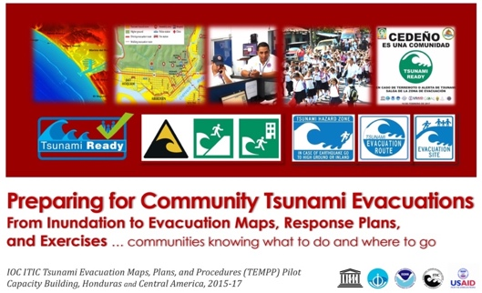

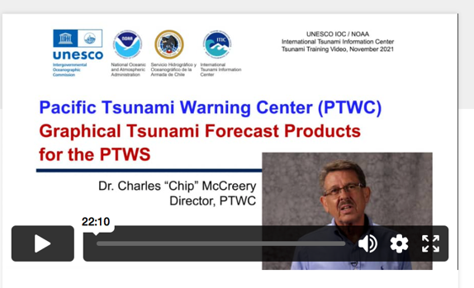
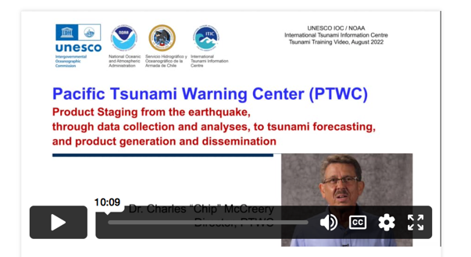

Existing
PTWS Country Schema – Australia, Chile, India, NZ, USA, other
ITIC Standard Training based on IOC Manual and Guides
    TWC / TER SOP (MG 76); Evac Planning (TEMPP, MG 82)
    145+ trainings since 2005
ITIC Ocean Teacher Global Academy (OTGA) – online/hybrid TEWS, SOPs, Decision Support Tools/Software, TEMPP
PTWC Products training videos

Slide 5
ITIC Plan - NTWC Competency Training Pilot
Requirements - Content and Training Modality
  Knowledge – do self-paced, hybrid
  Operational SOP – do self-paced, hybrid, in-person
  Real-life Experience – do by attachment to Advanced Centre, e.g., PTWC or others (Australia, Chile, Japan, New Zealand, ?? …)
  National Qualification / Certification – by country. IOC / ITIC does not provide certification for tsunami training and cannot certify staff
ITIC confirmed USAID funding for pilot for PTWS in 2024+ Pilot with PICT at PTWC.
Concept after US NWS Weather Pacific Training Desk (small cohort group staying 3 weeks -1 month, incl attachment, measured competency at end). Next Steps:
  Approved PTWS NTWC Min Competency / Framework & Training Req (PTWS-XXX, following SC)
  Develop Implementation Concept (include partnerships, modality, assessment) – build on best practices, and Develop Training Course with Subject Matter Experts (incl International)
  Pilot 1 small cohort Q1 of 2025. Report back to ICG/PTWS-XXX

