Slide 1


Ocean Decade Tsunami Programme
Research, Development & Implementation Plan
ICG/PTWS Steering Committee Meeting
26-27 March 2024, Online
Agenda 8 – UN Ocean Decade Tsunami Programme
Yutaka Hayashi
Ocean Decade Tsunami Programme Scientific Committee (ODTP-SC)
1

Slide 2
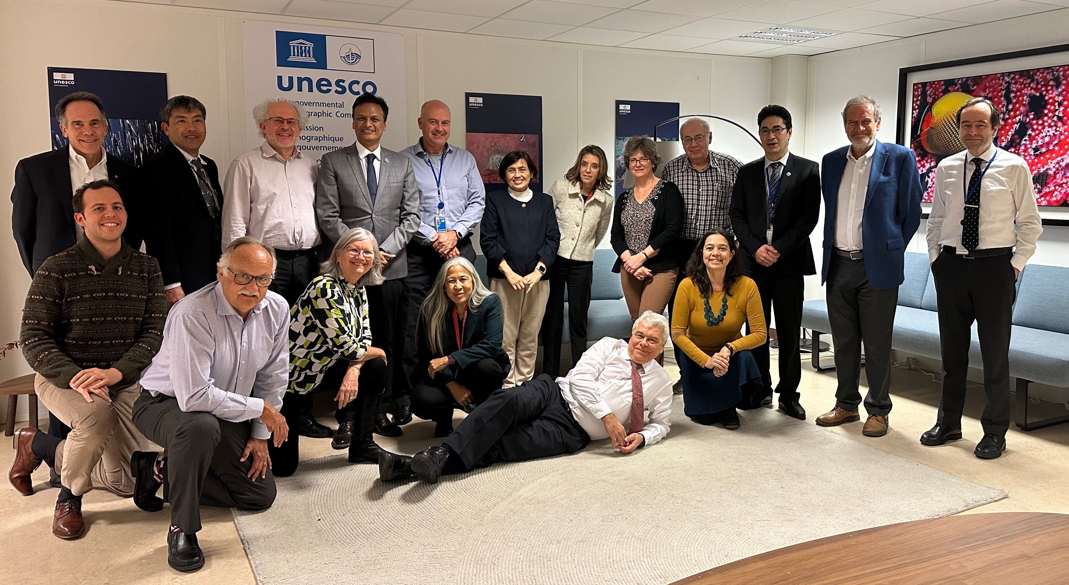
4th Meeting of SC-ODTP
25-26 January 2024, Paris
0. Updates and Follow up activities related to the ODTP-RDIP
1. UN Ocean Decade initiatives and their relationship with ODTP
2. Current work programmes of TOWS-WG TT-TWO and TT-DMP
3. ODTP and Challenge 6 coordination with TOWS-WG Work Programmes
4. ICGs initiatives with respect to ODTP
5. ODTP involvement in coming symposiums
6. Review of Actions – 6th call referring to ODTP
7. SC-ODTP Work Programme
The following slides were edited based on the report to the TOWS-WG by the chair, Srinivasa K. Tummala.
2

Slide 3
Progress in the development of the UN Decade of Oceans Tsunami Plan
Goal=Draft a 10-Year Research, Development and Implementation Plan for the Ocean Decade Tsunami Programme
Consultants to draft chapters
Consultations with TSU community (TTs/ICGS)
Consult/contributions Member States (CL)
17 Feb 2022
24-25 Feb 2022
7-8 Apr 2022
13-17 Jun 2022
18-20 Jan 2023
2–3 Mar 2023
21–30 Jun 2023
SC 1st meeting
(online)
TOWS-WG
XV
Safe Oceans
Lab
IOC -EC 55
3rd SC meeting (in person)
TOWS-WG XVI
IOC
Assembly
IOC Governing body
Laboratories are innovative formats that function as self-sustaining events. They act as a creative platform to link diverse stakeholders and topics to trigger collaborative efforts regarding the UN Ocean Decade.
2nd SC meeting
(in person)
Final version of the 10-Year Research, Development and Implementation Plan for the Ocean Decade Tsunami Programme for the
Endorsement
10-Year Research, Development and Implementation Plan for the Ocean Decade Tsunami Programme
Endorsed by the IOC Assembly
The purpose of this meeting is to first and foremost meet (virtually) and present each other, but also to broadly discuss the terms of reference and agree on a timeline for delivering the 10-year plan
TOWS-WG is a standard setting and advisory body to the IOC on tsunami and other coastal hazards. This session will discuss among other matters, SMART Cable, Tsunami Ready & UN Decade
2nd draft of the 10-Year Research, Development and Implementation Plan for the Ocean Decade Tsunami Programme
1st Draft of the 10-Year Research, Development and Implementation Plan for the Ocean Decade Tsunami Programme
Draft TORs consultancies
  4th Call for Decade Actions 31 Jan 2023 – Coastal Resilience
1st Draft to TNCs/TWFPs Dec2022
  2nd draft to TOWS-WG/ICGs/TTs Jan2023
3

Slide 4
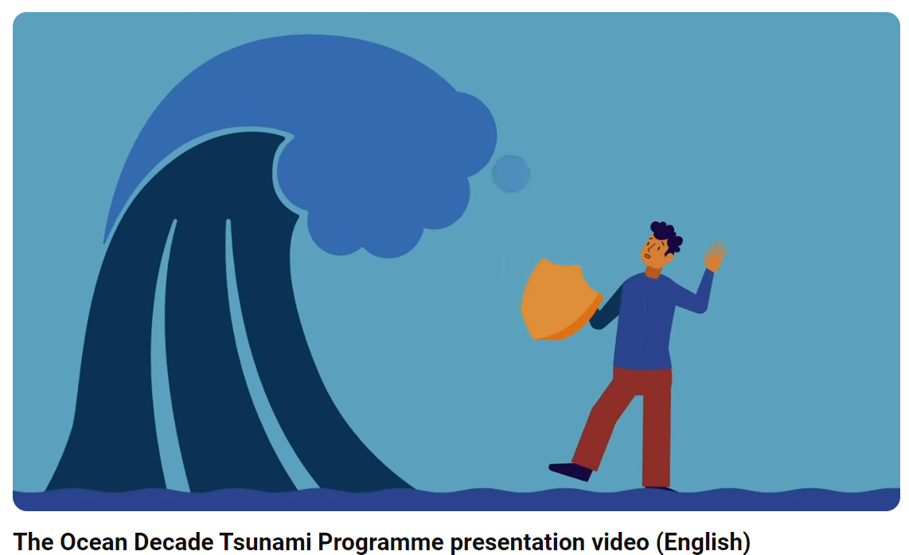
“Research, Development and Implementation Plan for the Ocean Decade Tsunami Programme” has endorsed in June 2023
The SC developed the draft 10-Year Research, Development and Implementation Plan for the Ocean Decade Tsunami Programme which was presented and endorsed at the IOC Assembly in June 2023
Executive Summary (in 6 languages)
IOC/BRO/2023/4
Presentation Video (in 6 languages)
YouTube
available through
UNESCO Digital Library
IOC/2023/TS/180
4

Slide 5
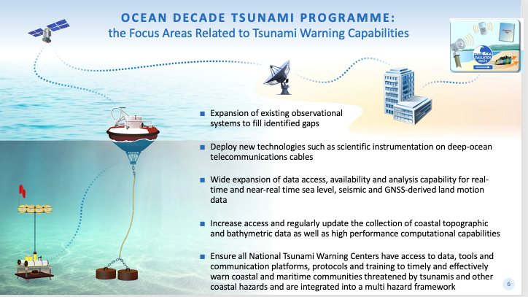
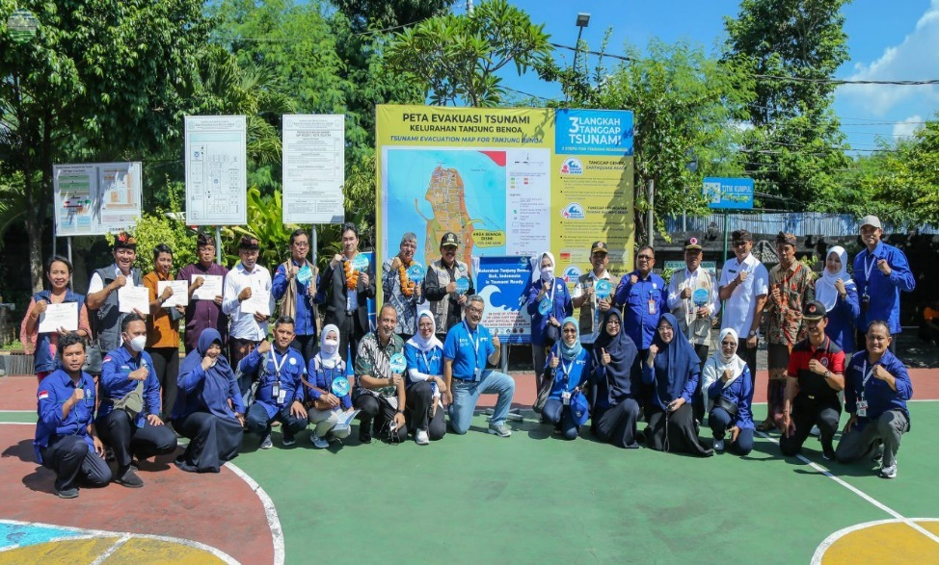
Objectives of ODTP-RDIP
To develop the warning systems’ capability to issue actionable and timely tsunami warnings for tsunamis from all identified sources to 100% of coasts at risk
100% of communities at risk be prepared and resilient to tsunamis by 2030 through programmes like the IOC-UNESCO Tsunami Ready Recognition Programme (TRRP)
5

Slide 6
Key Elements of ODTP-RDIP
1. Tsunami Risk Knowledge :: Identify and prioritise at-risk communities
2. Tsunami Detection, Analysis and Forecasting : Expand existing, and deploy new observing technologies and warning systems
4. Preparedness and Response Capabilities : To build tsunami-resilient communities
3. Warning, Dissemination and Communication : Access to data, tools, communication platforms, protocols and training to effectively warn coastal and maritime communities
5. Capacity Development : SIDS and LDCs, Multi-hazard Framework, Underpinning elements
6. Governance and Pathways to Implementation
6

Slide 7
UN Ocean Decade Tsunami Programme Scientific Committee
Terms of References (ToRs) (Rev IOC EC-55)
1. Develop a Draft 10-Year Research, Development and Implementation Plan for the Ocean Decade Tsunami Programme based on the concept paper “Protecting Communities from the World's Most Dangerous Waves: A Framework for Action under the UN Decade of Ocean Science for Sustainable Development”;
2. Identify and address gaps in global tsunami hazard assessment as follows:
      a. comprehensive assessment to include all potential tsunamis, anywhere in the world, regardless of their source,
      b. strategies to validate historical tsunami sources, through the application of paleotsunami techniques and historical seismology;
3. Identify gaps in tsunami detection, measurement, forecasting, with a special emphasis on tsunamis generated close to populated coastlines;
4. Propose to enhance sensing and analysis strategies to enable the rapid characterization of tsunami sources through the combined use of land-based seismic and geodetic sensors, GNSS terminals, coastal sea level gauges, deep-ocean tsunameters, SMART repeaters on deep-ocean fiber-optic cables and satellite-based observations;
5. Propose a roadmap for collaboration with the ITU/WMO/IOC SMART Joint Task Force cable initiative to fully explore the feasibility of widespread deployment of scientific instrumentation on deep-ocean fiber-optic cables to improve capability to rapidly detect and characterize tsunami sources as well as propagating tsunami wave fields;
7

Slide 8
UN Ocean Decade Tsunami Programme Scientific Committee
Terms of References (ToRs) (Rev IOC EC-55) (cont.)
6. Consider and propose strategies, programmes and content to enhance societal resilience for tsunami and other ocean hazards;
  Build the framework needed to ensure the training and development of the next generation of technical-scientific expertise,
  Identify strategies that allow to characterize structural and social vulnerability in tsunami hazard zones
  Propose strategies for promoting implementation of community preparedness initiatives such as IOC Tsunami Ready to ensure 100 % at risk communities are prepared & resilient to tsunamis by 2030
7. Overview the consolidation of inputs received to IOC Circular Letter 2825 on Inventory of actions being considered under the United Nations Decade of Ocean Science for Sustainable Development (2021–2030) in the field of Tsunamis and Other Sea-Level Related Hazards warning and mitigation;
8. Submit a Draft 10-Year Research, Development and Implementation Plan for endorsement by the TOWS-WG at its 16th meeting.
8

Slide 9
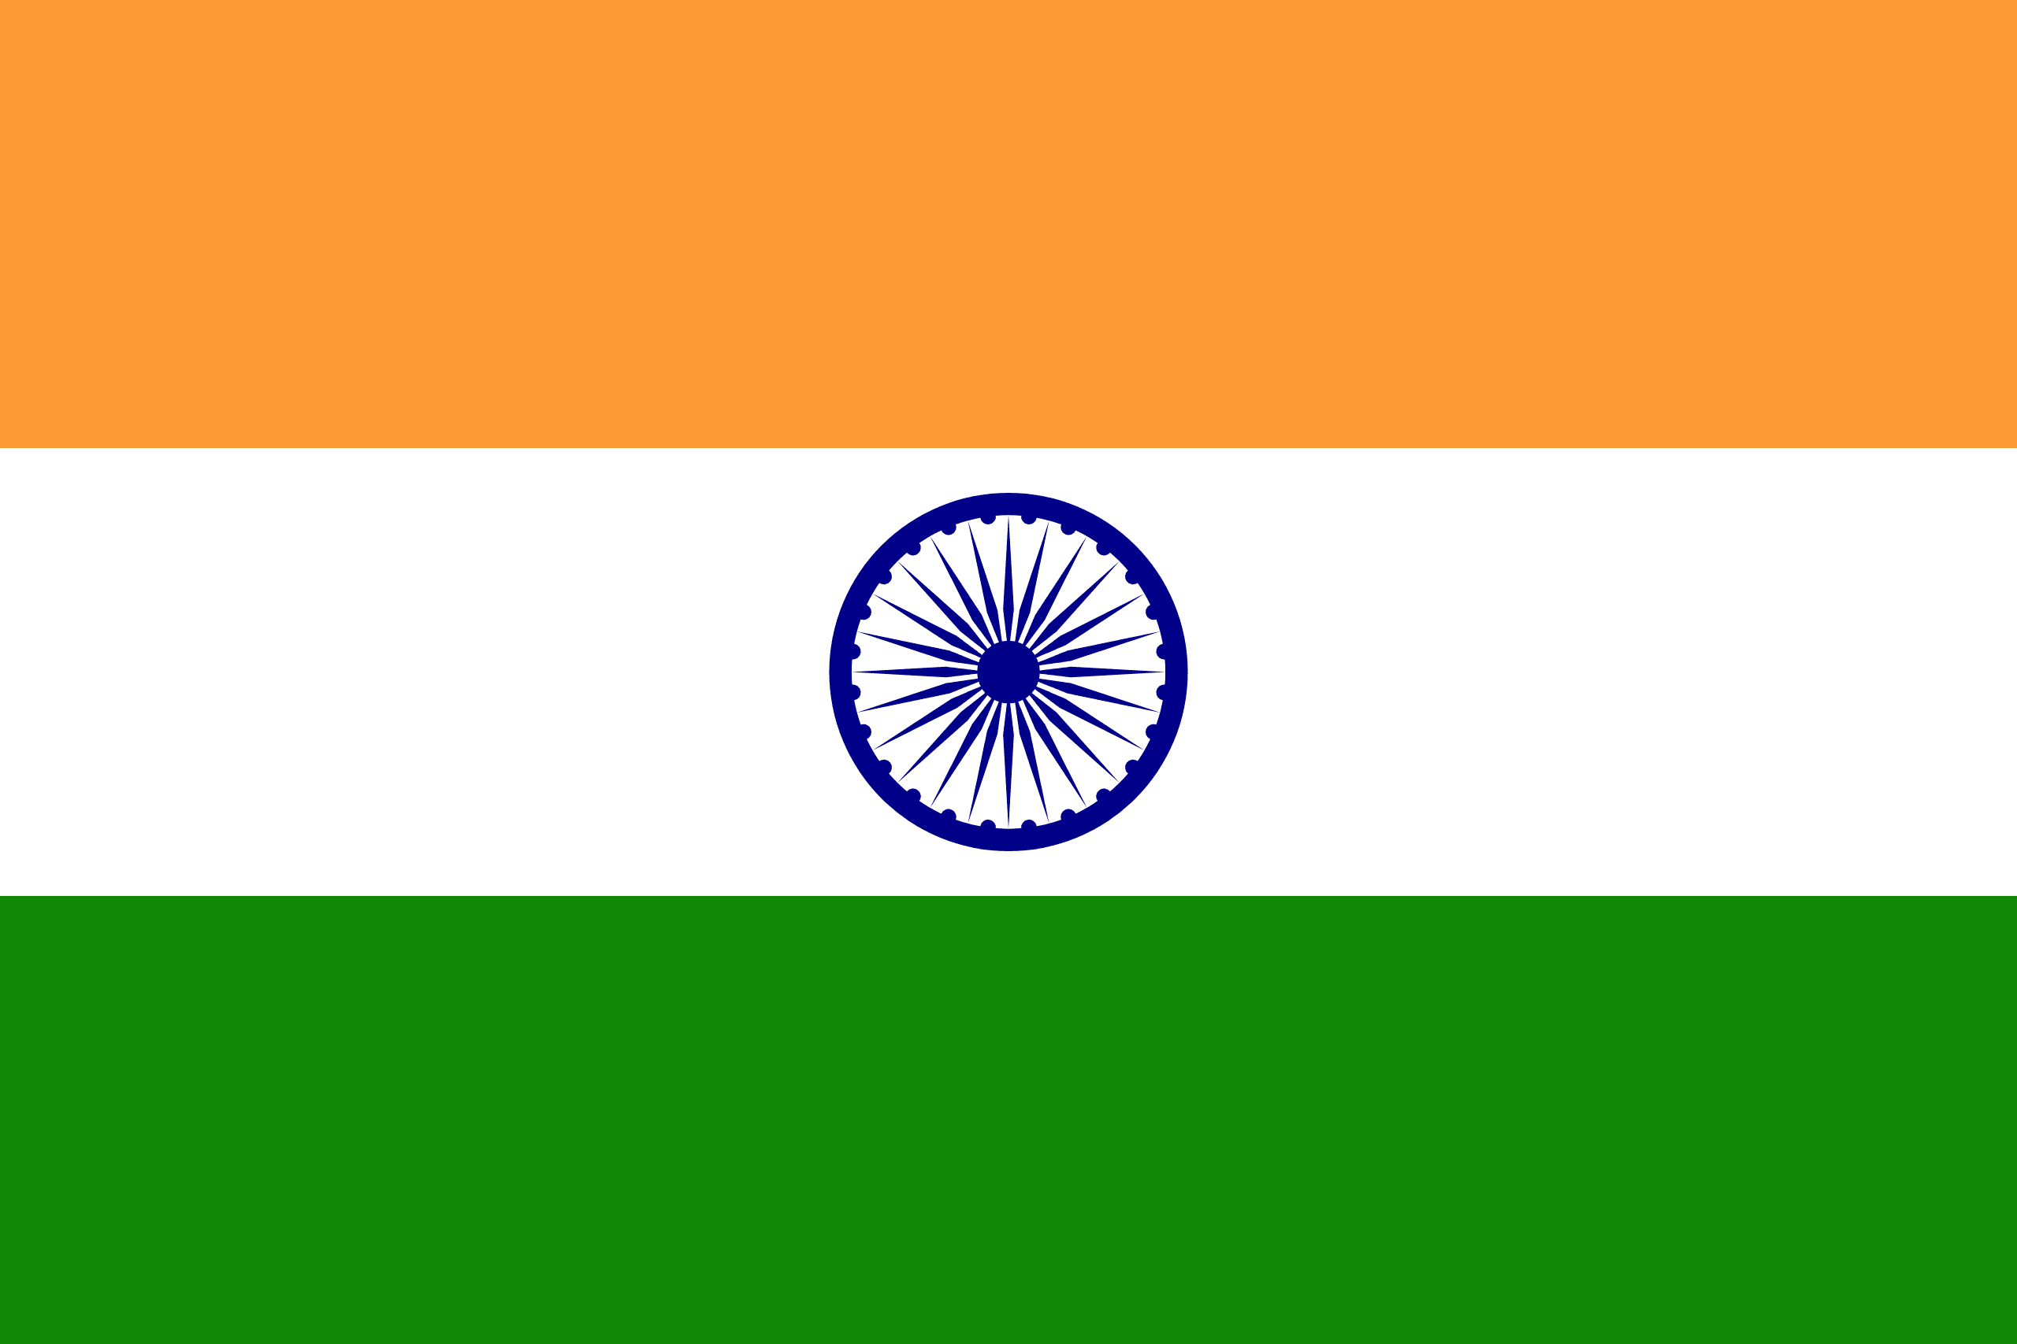

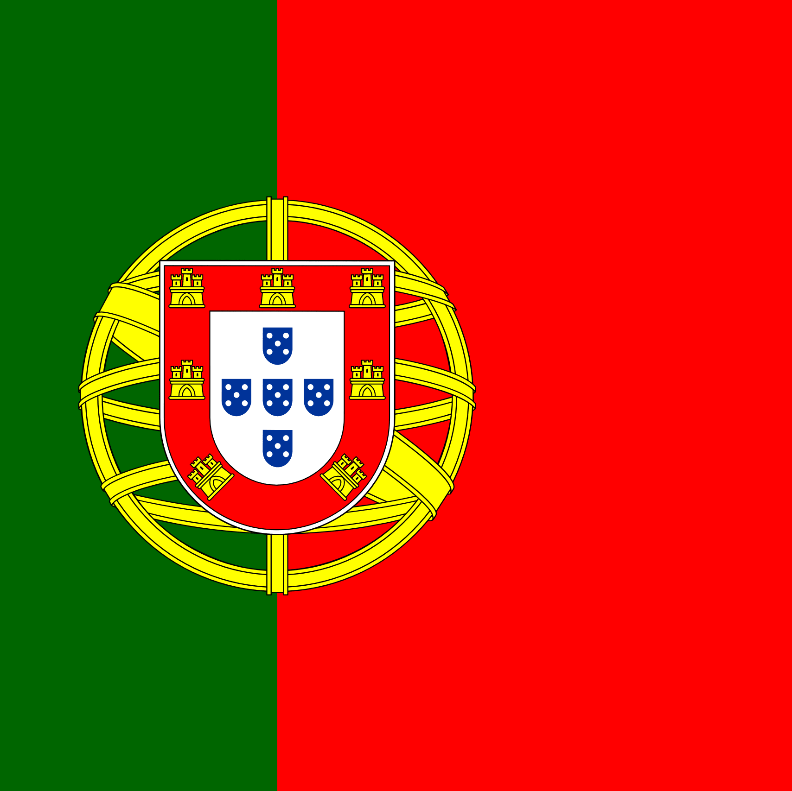

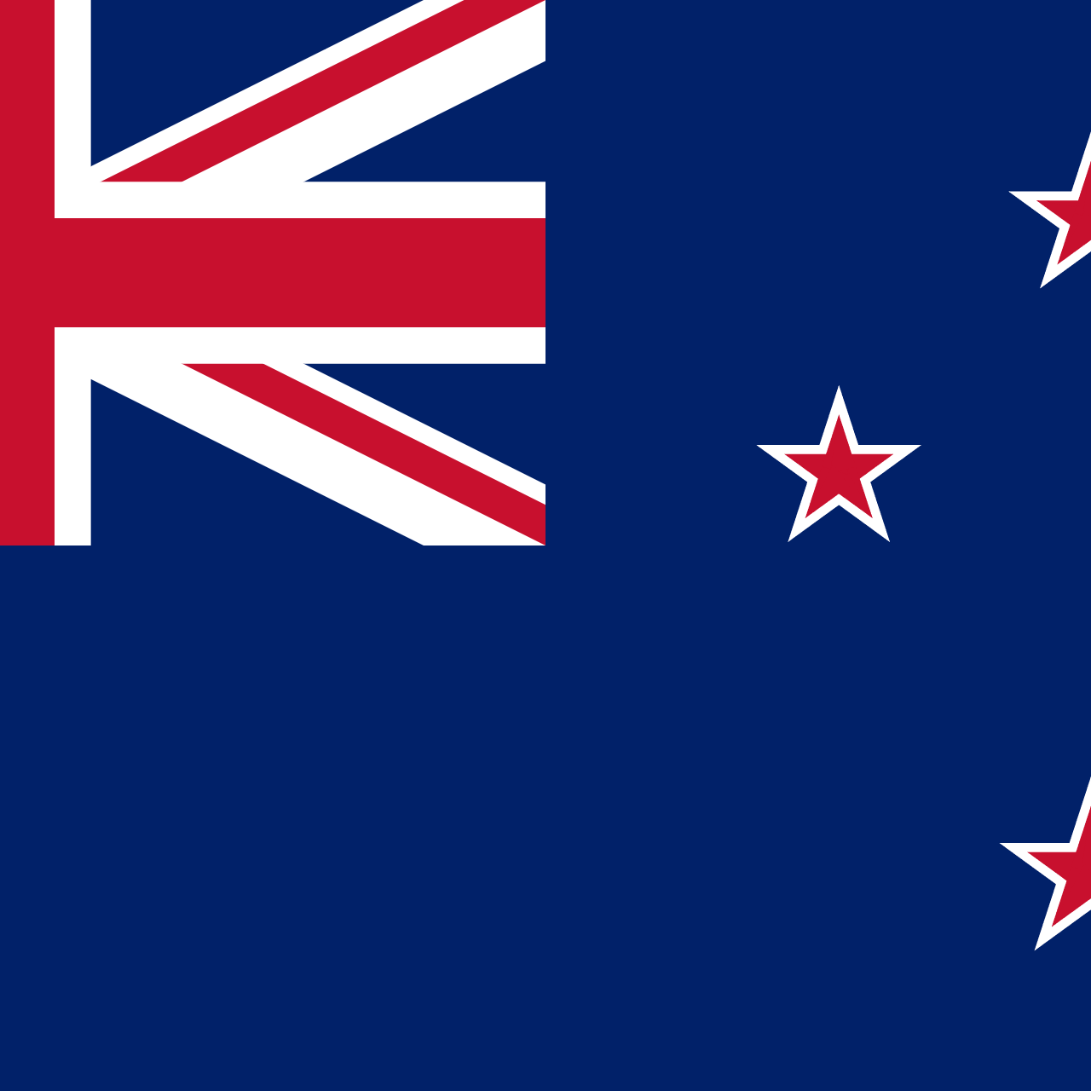
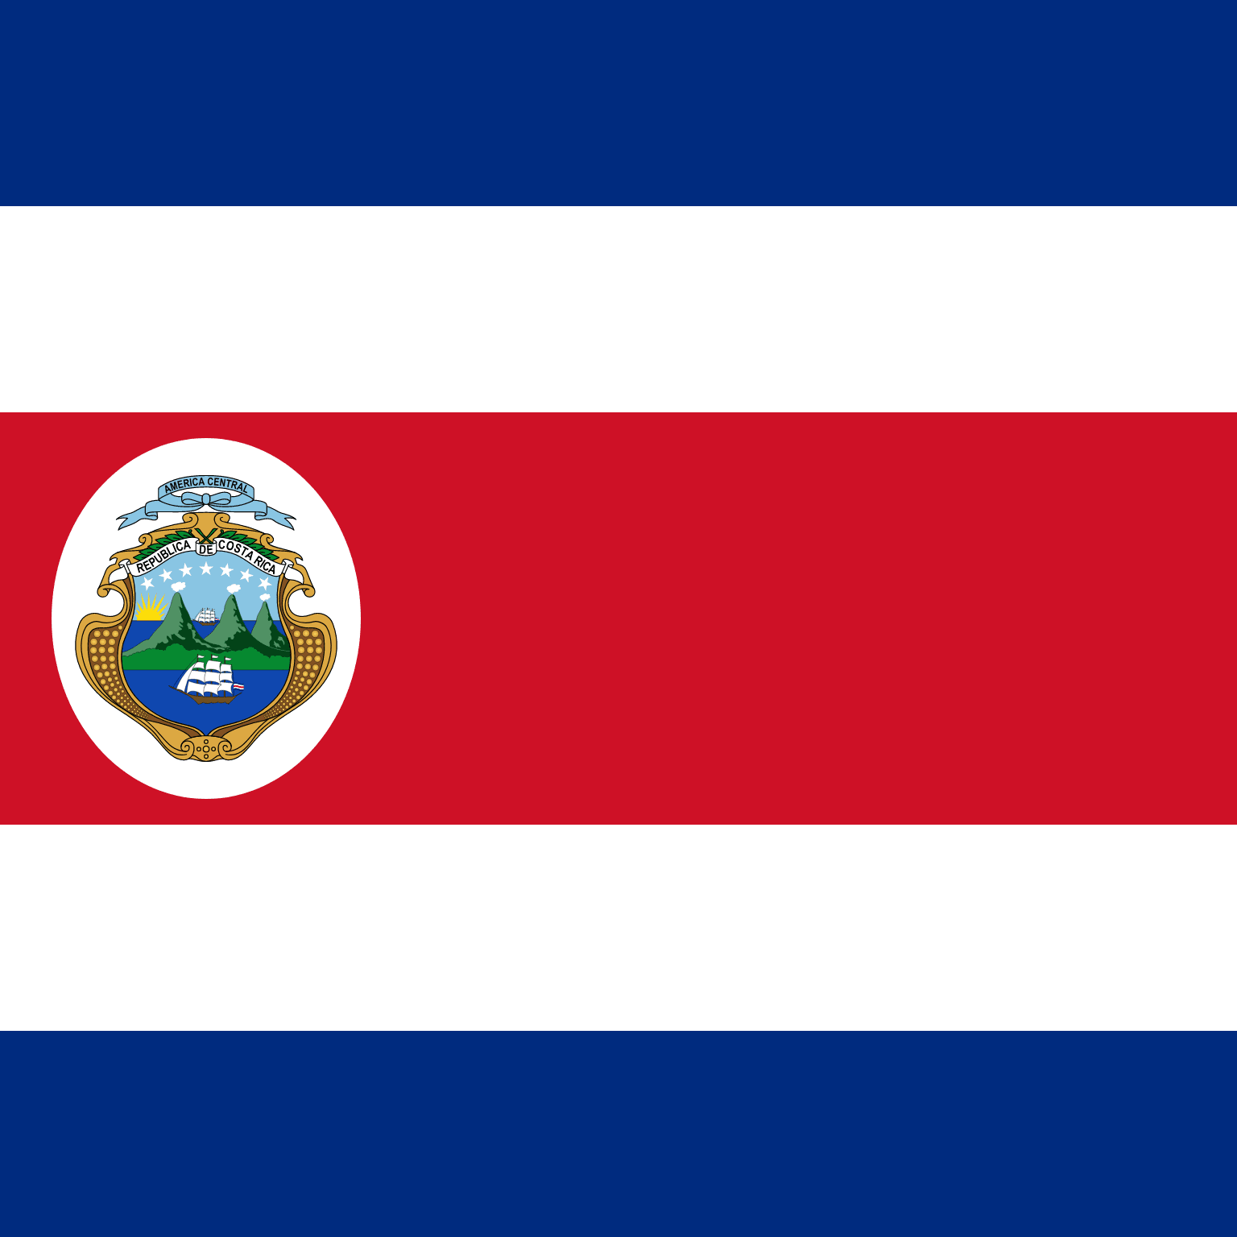


UN Ocean Decade Tsunami Programme Scientific Committee
2024-2025
Annex to Dec. A-31/3.4.1
Terms of reference of the Scientific Committee for the Ocean Decade Tsunami Programme
The Scientific Committee has an advisory role for the duration of the Ocean Decade Tsunami Programme (referred to as the programme).
Annex to Dec. A-31/3.4.1 (cont.)
Membership:
• Four (4) members nominated by the each of the TOWS-WG Task Teams;
• Three (3) members nominated by the TOWS-WG on the basis of their scientific expertise;
• All members will serve for a period of two years and would be eligible for renewal once.
• In selecting Expert Members, due consideration will be given to geographic, generational and gender balance.
Srinivasa Kumar Tummala
Chairperson
Christa von Hillebrandt
Maria Ana Baptista
Harkunti Pertiwi Rahayu
David Coetzee
Silvia Chacon
Srinivasa Kumar Tummala
Helene Hebert
Yutaka Hayashi
Michael Angove
Sergio Barrientos
Alexander Rabinovich
9

Slide 10
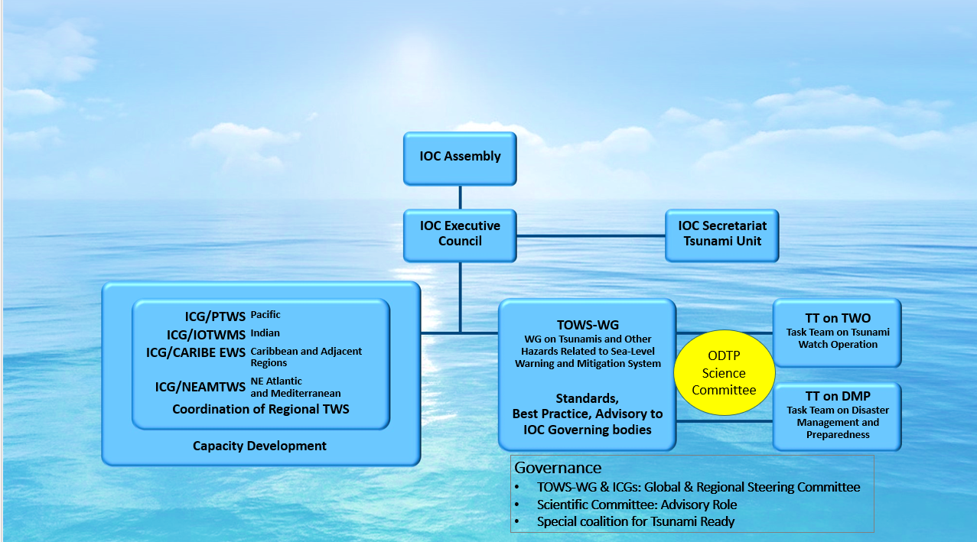
Governance of ODTP-RDIP excerpt from “Research, Development and Implementation Plan for the Ocean Decade Tsunami Programme” (UNESCO/IOC, 2023)
To explore opportunities and establish connections with Decade programmes, projects, contributions, DCCs and CoPs, Calls for Action
To align with international frameworks, call for action and multi-lateral environmental agreements – SFDRR, SDGs (3, 8, 11, 14), Paris Agreement on climate change, early warnings for all, UN Global Early Warning Initiative (2023-2027) etc.
To provide new cooperation opportunities by laying out the building blocks, through an international Science Committee and International Tsunami Ready Coalition while renewing and strengthen existing cooperation with partners
To encourage and promote inclusiveness and gender diversity, and that youth and early career professionals engage and involve in tsunami early warning systems and actions
To develop and operationalize a transparent performance monitoring system based on international norms, standards and agreements
ICG-TICS
  The IOC-UNESCO tsunami programme will oversee the overall implementation of the ODTP through contributions and engagement of Member States, in coordination with the ICGs, and with the collaboration of academic institutions, researchers, industry, philanthropic organisations and other stakeholders
10

Slide 11
UN Ocean Decade Initiatives and relationship with ODTP
Capacity Development Facility
To build on unique strengths and expertise of IOC to support CD needs of institutions involved in OD with focus on SIDs, LDCs and ECOPS – Eg Co-Design, Actions
Need to Leverage CDF – TSR to keep track of the next call for action on CD facilities / resources and needs
Share capacity building efforts within the IOCs Tsunami Program (including IOTWMS UNESCAP Regional Tsunami Capacity Assessment Project, PTWS)
Thematic / Regional Decade Collaborative Centres / Coordination Offices
Links with DCC-PICT, DCC-OP, DCC-CR, DCC-IOR
Initiate communication with DCCs/DCOs to connect ODTP with their actions / activities
Elements of interest for TTTWO include Digital Twins, AI, Deep Learning, MeteoTsunamis, Multi-hazard Ocean Observations, 2nd Tsunami Symposium
11

Slide 12
Current work programmes of
TOWS-WG TT-TWO and TT-DMP
ODTP-SC noted the work progress of TOWS-TT-TWO and TOWS-TT-DMP, especially in connection to volcano-origin and meteo-tsunamis.
ODTP-SC further noted the prior initiative by TOWS-WG on the tsunami hazard assessment, and the need to explore the need for TOWS-WG to revisit global tsunami hazard/risk assessment, which is currently undertaken at the ICG level.
12

Slide 13
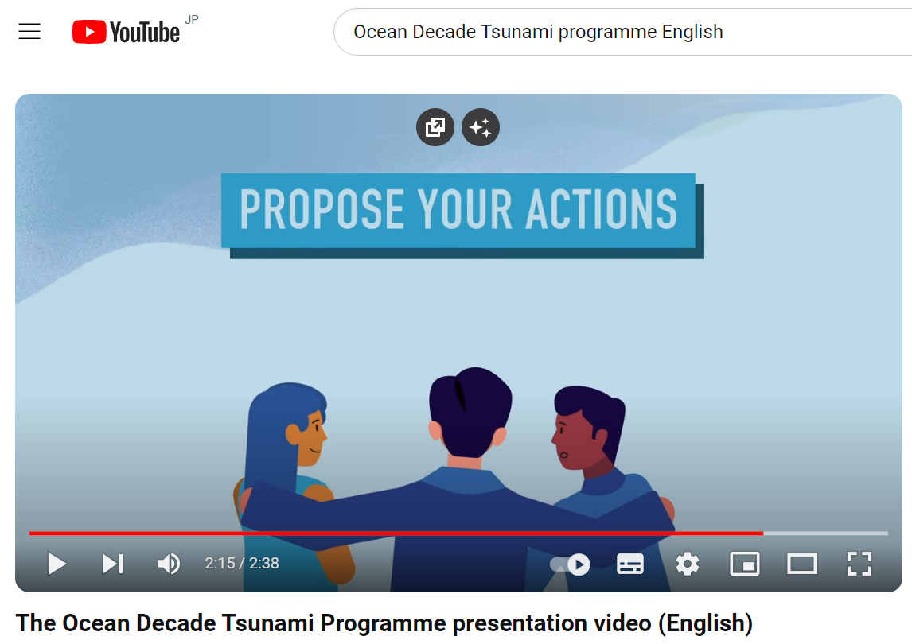
Endorsed Decade Actions related to ODTP and Challenge 6 and coordination with TOWS-WG Work Programmes
Need to identify gaps and work closely with the IOC/DCU for future calls to encourage national projects relevant to IOC’s tsunami programme to be submitted & endorsed – eg. SMART Cable, New Zealand DART Project, and UNESCAP IOTWMS Capacity Assessment project are not listed
Several reasons could contribute to this including awareness of UN Decade at the national level or the initiatives not being perceived as “transformative” enough in the context of the Decade by the implementers
13

Slide 14
Endorsed Decade Actions related to ODTP and Challenge 6 and coordination with TOWS-WG Work Programmes (cont.)
Proper communication through multiple means including by the DCU, TSR, ICGs, National Decade Committees
Further granularity required in the calls for action & DCU summaries to facilitate proper mapping to relevant programmes and monitoring
14

Slide 15
ICG initiatives/coordination with respect to ODTP
  Need to have a mechanism to relate the progress at each ICG with respect to ODTP goals as described in the ODTP-RDIP (IOC Technical Series #180)
  Explore alignment with the Global Tsunami Performance Monitoring Framework
  Need for standardized reporting at the Member State/ICG level for further compilation at global level by TSR
  ODTP-SC decided to recommend TOWS-WG to request ICGs (through Member States) to report with respect to ODTP Appendices through an online interface to be provided by the IOC/TSR.
  All efforts in this regard should be synchronized with the IOC/DCU, which has its own assessment tools.
  ODTP-SC appreciated the presentations on Optimal Sensor Locations in the Pacific and progress in the implementation of cabled systems in the ICG/NEAMTWS, also useful for planning purposes at the Member States level.
  ODTP-SC also noted ongoing efforts by the IOC/TSR towards determination of the total number of communities subject to TRRP.
15

Slide 16
ODTP involvement in other relevant Activities
  2nd UNESCO IOC Global Tsunami Symposium, 11 – 14 November 2024, Banda Aceh
    Reorganization of sessions in alignment with ODTP RDIP, the conceptual flow of the program, speakers, and public sessions
  2nd UN Ocean Decade Conference, 10 – 12 April 2024, Barcelona
    Side event “Coastal Futures” and satellite Event “Coastal Cities and Communities Joining Tsunami Ready”
    Talks by Lorna Iniss & Silvia Chacon Barrantes
  EW4All
    Hazards covered under the EW4All ? Guiding documents on geo-hazards?
    IOC/TSR to work with WMO and share OD white papers and capacity assessment
16

Slide 17
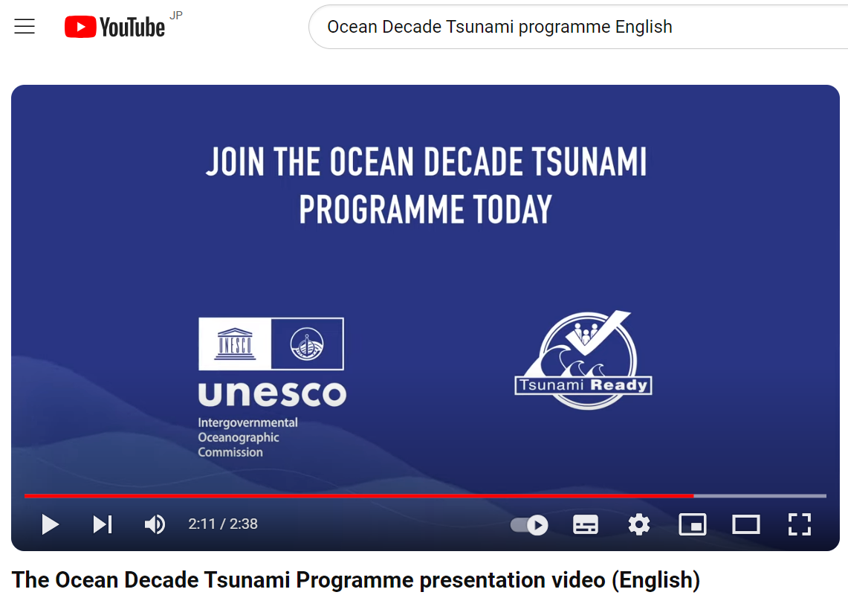
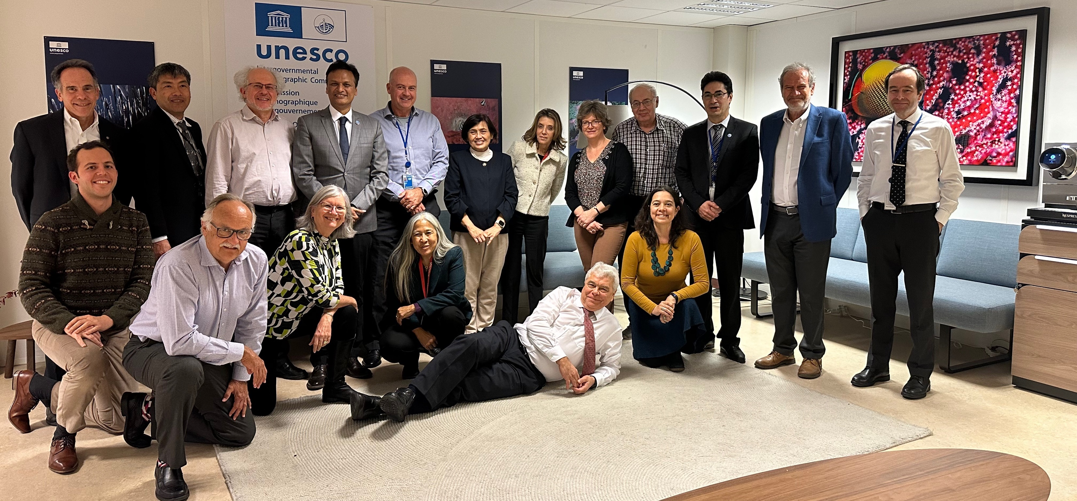
THANK YOU
17

