Slide 1
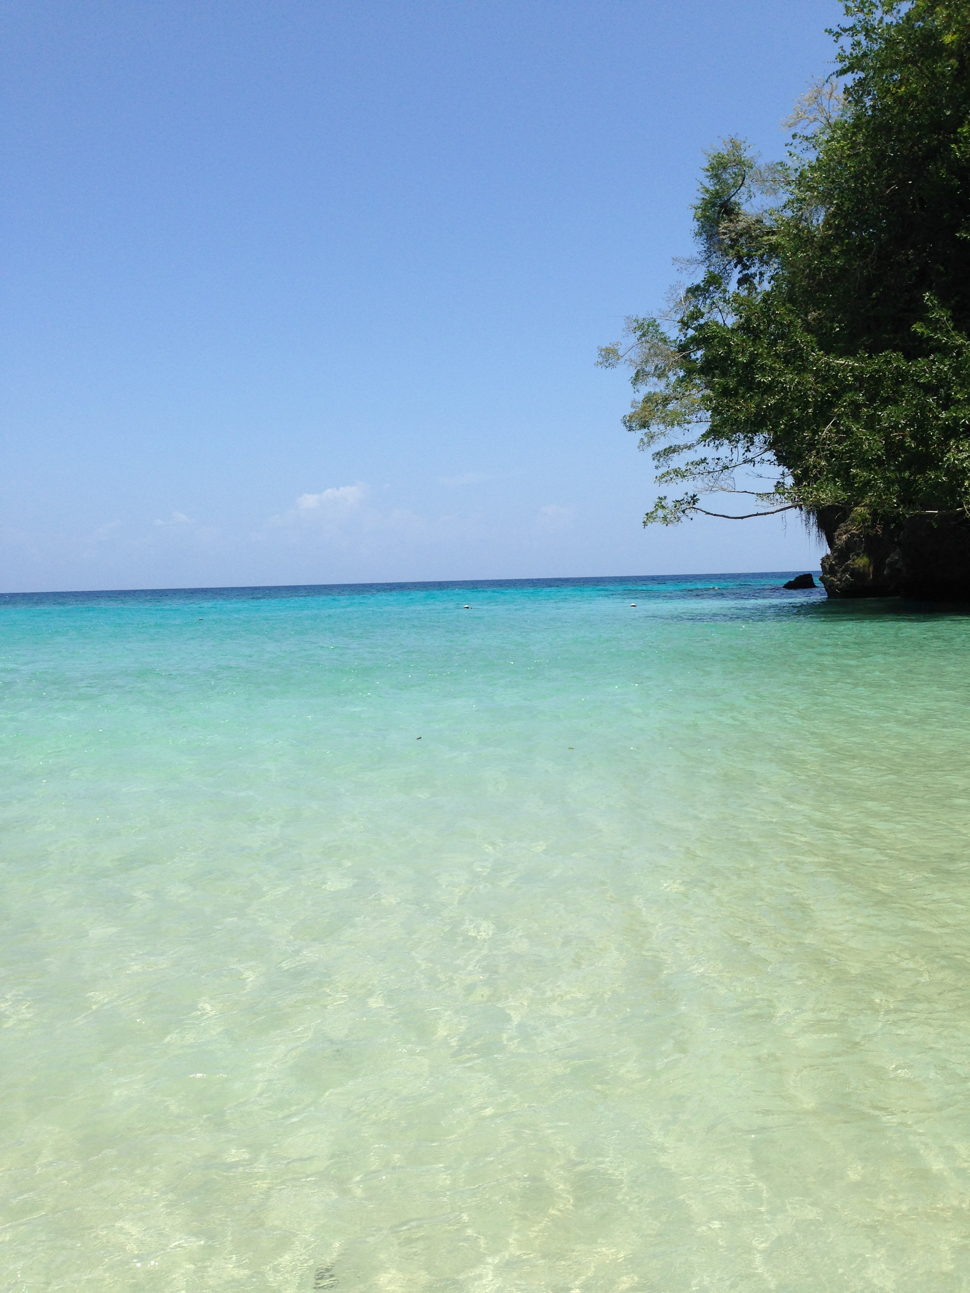
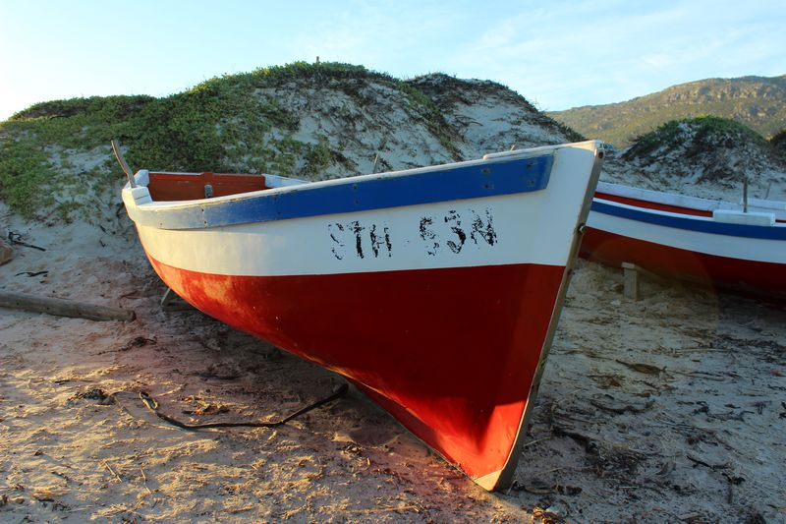
A Biodiversity Data Hub for the High Seas
GE-CD-V Meeting
27 to 29 February, Paris
Lucy Scott
L.Scott@unesco.org

Slide 2
Rationale and background
On 19 June 2023, the Conference adopted, by consensus, the Agreement under the United Nations Convention on the Law of the Sea on the conservation and sustainable use of marine biological diversity of areas beyond national jurisdiction (A/CONF.232/2023/4) (https://www.un.org/bbnj/).
This new UN Treaty will require a data and information system, or clearing-house mechanism to manage and access data and information related to the various elements of the agreement including:
Capacity building and transfer of marine technology (CBTMT)
Area-based management tools including marine protected areas
Environmental impact assessments
Marine genetic resources.

Slide 3
Rationale and background
To produce the basis for delivering meaningful and integrated information at global scale, the BBNJ CBTMT system would need to address access to existing bodies of data, as well as facilitate coordinated entry of new in-situ and other data relevant to the treaty.

Slide 4
Rationale and background
Over the past decades, IOC/UNESCO has successfully designed, operated, and connected a network of data and information systems to assist the global community to discover, understand, and manage life in the sea.
IOC Ocean data infrastructure interoperates with existing data bodies to provide free and open access to marine biodiversity data through the Ocean Biodiversity Information System (OBIS), the largest clearinghouse of its kind, also facilitating the connection with other spatial ocean data hubs through the Ocean Data and Information System (ODIS). These systems, data portals, and associated networks of specialized centres deliver several marine biodiversity data products and services, applied to address a wide range of uses and multiple stakeholders.

Slide 5
Overall purpose (objectives) and relevance
The IOC is a recognized competent UN body for CD/TMT and with the current developments under its Ocean Data and Information System (ODIS), IOC is also well positioned to support the BBNJ secretariat by further development and expansion of its data system, and to provide technical support for the CHM managed by the BBNJ secretariat.
The IOC-UNESCO Criteria and Guidelines on the Transfer of Marine Technology can provide the guidance and substantive scope of technology needs assessments including its capacity development needs assessment based on its experience from its successful initiatives.
This pilot project intends to demonstrate the utility of the Ocean Data and Information System infrastructure, to support the needs of a Biodiversity Data Hub for the High Seas.

Slide 6
Implementation strategy
The Biodiversity Data Hub for the High Seas will build on technology developed under the Ocean InfoHub project and will develop a demonstrator for several elements of the BBNJ Clearing-House Mechanism.
This project will not develop the BBNJ-CHM, but will use ODIS technology in a pilot project to demonstrate how it can serve a future BBNJ CHM:

Slide 7
Implementation strategy: Part 1
Development of a pilot biodiversity hub (this section is under revision given the amended budget)
ODIS/OIH currently possesses the capability to function as an information hub for discovering and accessing a diverse range of information, including documents, reports, and training opportunities related to various aspects of BBNJ
Create a biodiversity Hub / interface for the High Seas
Modify the interface to register / monitor / manage information required by users and the BBNJ Secretariat.
Guidelines and training materials for member states to use the BBNJ Hub

Slide 8
Implementation strategy: Part 2
Desktop study on CHM requirements and solutions related to Marine Genetic Resources (this section is under revision given a White Paper just released on MGR)
Managing data and information related to Marine Genetic Resources (MGR) is complex and requires the involvement of various existing organizations.
A consultant will conduct an in-depth study to explore the essential elements for the MGR component of the BBNJ CHM, identify the major stakeholders and recommend technical solutions.
The results of this comprehensive study will provide a plan including resource requirements to develop an MGR hub as part of ODIS/OIH.

