Slide 1
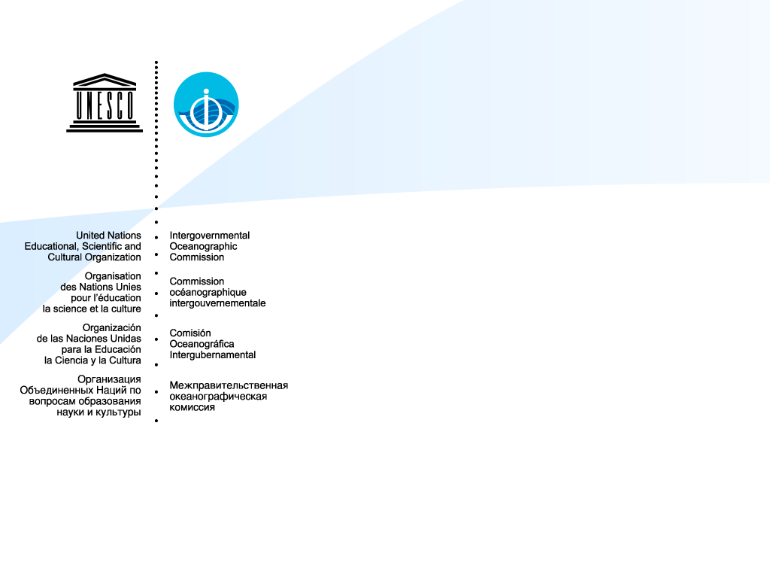
IOC Sub Commission for Africa and the Adjacent Island States
GE-CD-V Meeting 27-29 February 2024
John Ngatia
IOC Sub Commission for Africa & the Adjacent Island States
Notes:
This presentation provides an overview of the programmes of UNESCO/IOC’s Sub Commission for Africa and the Adjacent Island States.

Slide 2
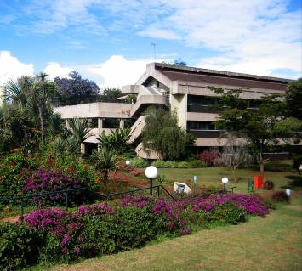
IOC’s Sub Commission for Africa and the Adjacent Island States
Promote regional and international cooperation for the understanding and management of the African oceans and coastal ecosystems, in order to ensure sustainable development and safety of the coastal populations, taking into account the priorities of Member States from Africa
Ocean Observations and Monitoring
Ocean Sciences and Assessments
Ocean Data and Information Management
Capacity development in Marine Science and Technology
Public Awareness and Science Policy interface
Location of IOCAFRICA Secretariat
UNESCO Regional Office for Eastern Africa
UN Offices in Nairobi, Kenya
Notes:
The first Recommendation was on the Pan African Conference on Ocean Science for Sustainable Development. The Sub Commission stressed that the conference must be different from previous conferences and should be used to take ocean sciences in Africa to another level, by bringing new actors to the table, such as the regional economic communities, regional development banks and the private sector.
The Second Recommendation establishes the IOCAFRICA Strategic Planning Group to guide the planning for the conference and develop ideas for the regional implementation of the UN Decade for Ocean Science for Sustainable Development (2021–2030) as well as the IOCAFRICA Strategic Plan for 2022–2029;
The third Recommendation focused on the revival and reactivation of GOOS-AFRICA so that it can support the Sub Commission in responding to the ocean observations requirement of member states from the region, including contribution to the Second International Indian Ocean Expedition, and the UN Decade for Ocean Science for Sustainable Development.

Slide 3

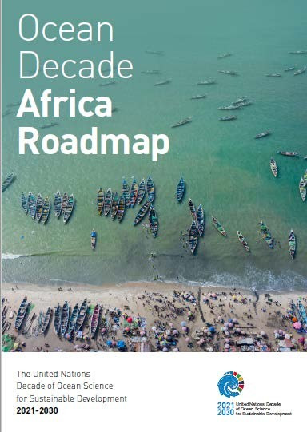
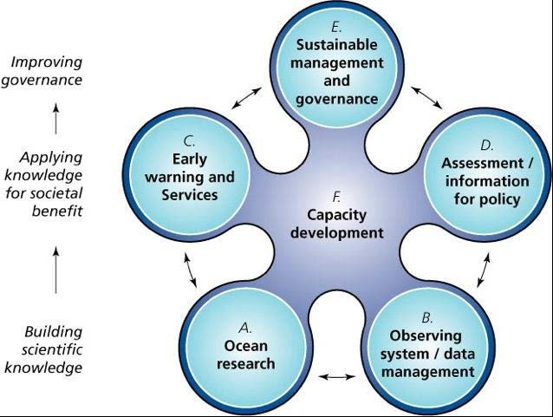

FOCUS AREAS OF IOCAFRICA
Ocean Observations and Data and Information Management | Ocean Science and its Application to Management | Capacity Development for Marine Science and Technology and Ocean Literacy | Ocean Decade
Oceanographic Expeditions & Coastal Observation platforms Climate variability and climate change (weather forecast & extreme events) Marine Spatial Planning, Coastal/ Marine Atlases, Marine Biodiversity | Modeling and forecasts of ocean state Assessment of marine and coastal ecosystems in Africa Vulnerability & adaptation of marine/coastal ecosystems to climate change Harmful Algal Bloom: Detection and Early Warning Ocean Acidification: Observation and Research Marine Pollution: Survey and assessment | Basic training in the ocean sciences (UNESCO Chairs in Universities, Research Institutions, development of portal for training opportunities,) Continuous Professional Development (Focused workshops, Regional Training Centres, Fellowships, Ocean Literacy (Artwork/Essay competitions, exhibitions, conferences, Partnerships and collaboration (WIOMSA, UNEP, National Institutions) | Coordinate the implementation of the Ocean Decade Africa Road Map

Slide 4
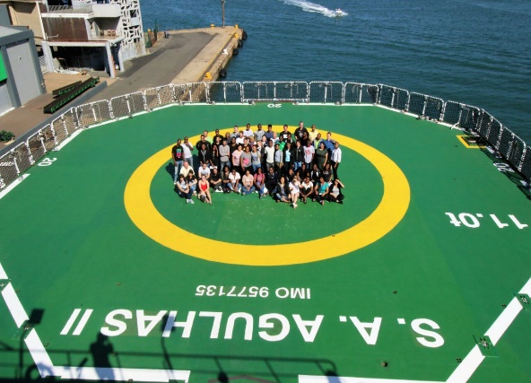
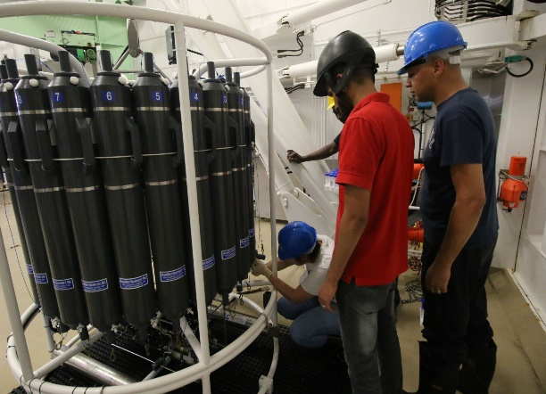
Capacity Development
OTGA Regional Training Centres in Kenya, Mozambique, Senegal.
Research Data Management
Marine Biodiversity Data Management
Application of Remote Sensing and GIS to Marine and Coastal Management
Hydrodynamic and Environmental Modeling
Marine GIS
Operational data management
Marine Spatial Planning
Ship board training on SA Agulhas II and RV Mtafiti
Environmental Data Analysis with the EAF-Nansen programme
UNESCO Chairs in Marine Science: Mozambique, Senegal, Morocco, Algeria, Sudan, and Tanzania

Slide 5
Capacity Development for Marine Science and Technology and Ocean Literacy: Activities in last Biennum
1. Assessing of capacities available for marine science and technology in the region (including human resources and facilities/equipment).
Two Surveys were piloted in 2022 and 2023 to assess existing capacities in data sharing infrastructure, human resources, and existing gaps. The surveys targeted 26 National Oceanographic Data Centres (NODC) and 40 marine-affiliated institutions. The findings of the surveys were communicated during the IOCAFRICA VII session and informed the Sub Commission’s strategic plan on where and what to focus its capacity building initiatives on.
A comprehensive survey of the status of the ocean observation platforms in Africa and the Adjacent Island states was undertaken and a webinar organised to review the report on 23 March 2022. The report is already being used to inform the potential areas that require strengthening in the region’s ocean observation network.
2. Development of a portal on training facilities and opportunities in the region, and facilitation of the strengthening of the linkages and collaboration between ocean programmes in universities and research institutions
Training portal developed (accessible at https://africa.marinetraining.org) and linked to the Ocean Teacher Global Academy as well as OceanExpert through the Ocean Data Information System (ODIS) Network. 310 Training programmes (short courses,summer courses and Degrees) uploaded and shared via the platform.
Notes:
A total,108 experts from 22 member states benefited from the capacity building initiatives of the Sub Commission as outlined under the themes below. The capacity development initiatives entailed undertaking three surveys / inventories for both infrastructural and human resources within member states, as well as supporting five training sessions on various ocean-related themes. In addition, an online data platform was developed to facilitate the strengthening of the linkages and collaboration between ocean programmes in universities and research institutions.

Slide 6
Capacity Development for Marine Science and Technology and Ocean Literacy: Activities in last Biennium
3. Organize and support training courses and workshops, using regional training centres (Ocean Teacher Global Academy RTCs, UNESCO Chairs and Centres of Excellence) on priority topics identified by IOCAFRICA.
Earth Observation data and techniques for fisheries management (online); 24 January - 4 February 2022, Ghana (17 participants from 14 countries:
Regional Training Centre Mozambique (CePTMar-UEM & INAHINA), Técnicas de recolha de dados oceanográficos e acesso a dados online gratuitos (curso de formação online), 9 May - 31 October 2022, Mozambique. The course had 6 out of the 28 participants from 3 African countries:
EAF-Nansen Programme of FAO & IOC/OTGA: Vessel-based ocean monitoring with applications to R/V Dr Fridtjof Nansen surveys, 30 May - 17 June 2022. There were 13 participants from 8 African countries:
Remote sensing applied to oceanography at the Université Félix Houphouët-Boigny, in Côte d'Ivoire (21-25 November 2022) attended by 15 participants from Benin, Cameroun, Côte d’Ivoire, Ghana, Namibia, Nigeria, Senegal, and Togo.

Slide 7
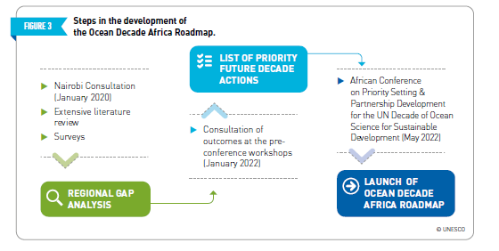
CAPACITY DEVELOPMENT NEEDS : KEY REPORTS
Key Issues
▶ Challenges in data sharing due to lack of common platforms, and incompatible metadata and data formats
▶ Insufficient standardized policies in relation to access and sharing of data
▶ Limited trust between organizations to share data
▶ Limited technical capacities and resources
▶ Need to empower local/regional scientists with skills and tools to enable them to analyse and interpret the large number of data sets available in the region
▶ Insufficient appropriate tools for the dissemination of climate information
▶ Inadequate effective communication between science and policy; need for improved ocean literacy and better communication
▶ Limited funding available to promote outreach programmes to educate the public on issues of sustainability and conservation
IOCAFRICA VII
REPORT

