Slide 1
IOCARIBE Regional Capacity Development
Ms. Lorna Inniss,
Regional Coordinator
February 27, 2024

Slide 2
OUTLINE
Governance & Coordination
Agreed CD Tasks from WGs
Funding for capacity development

Slide 3
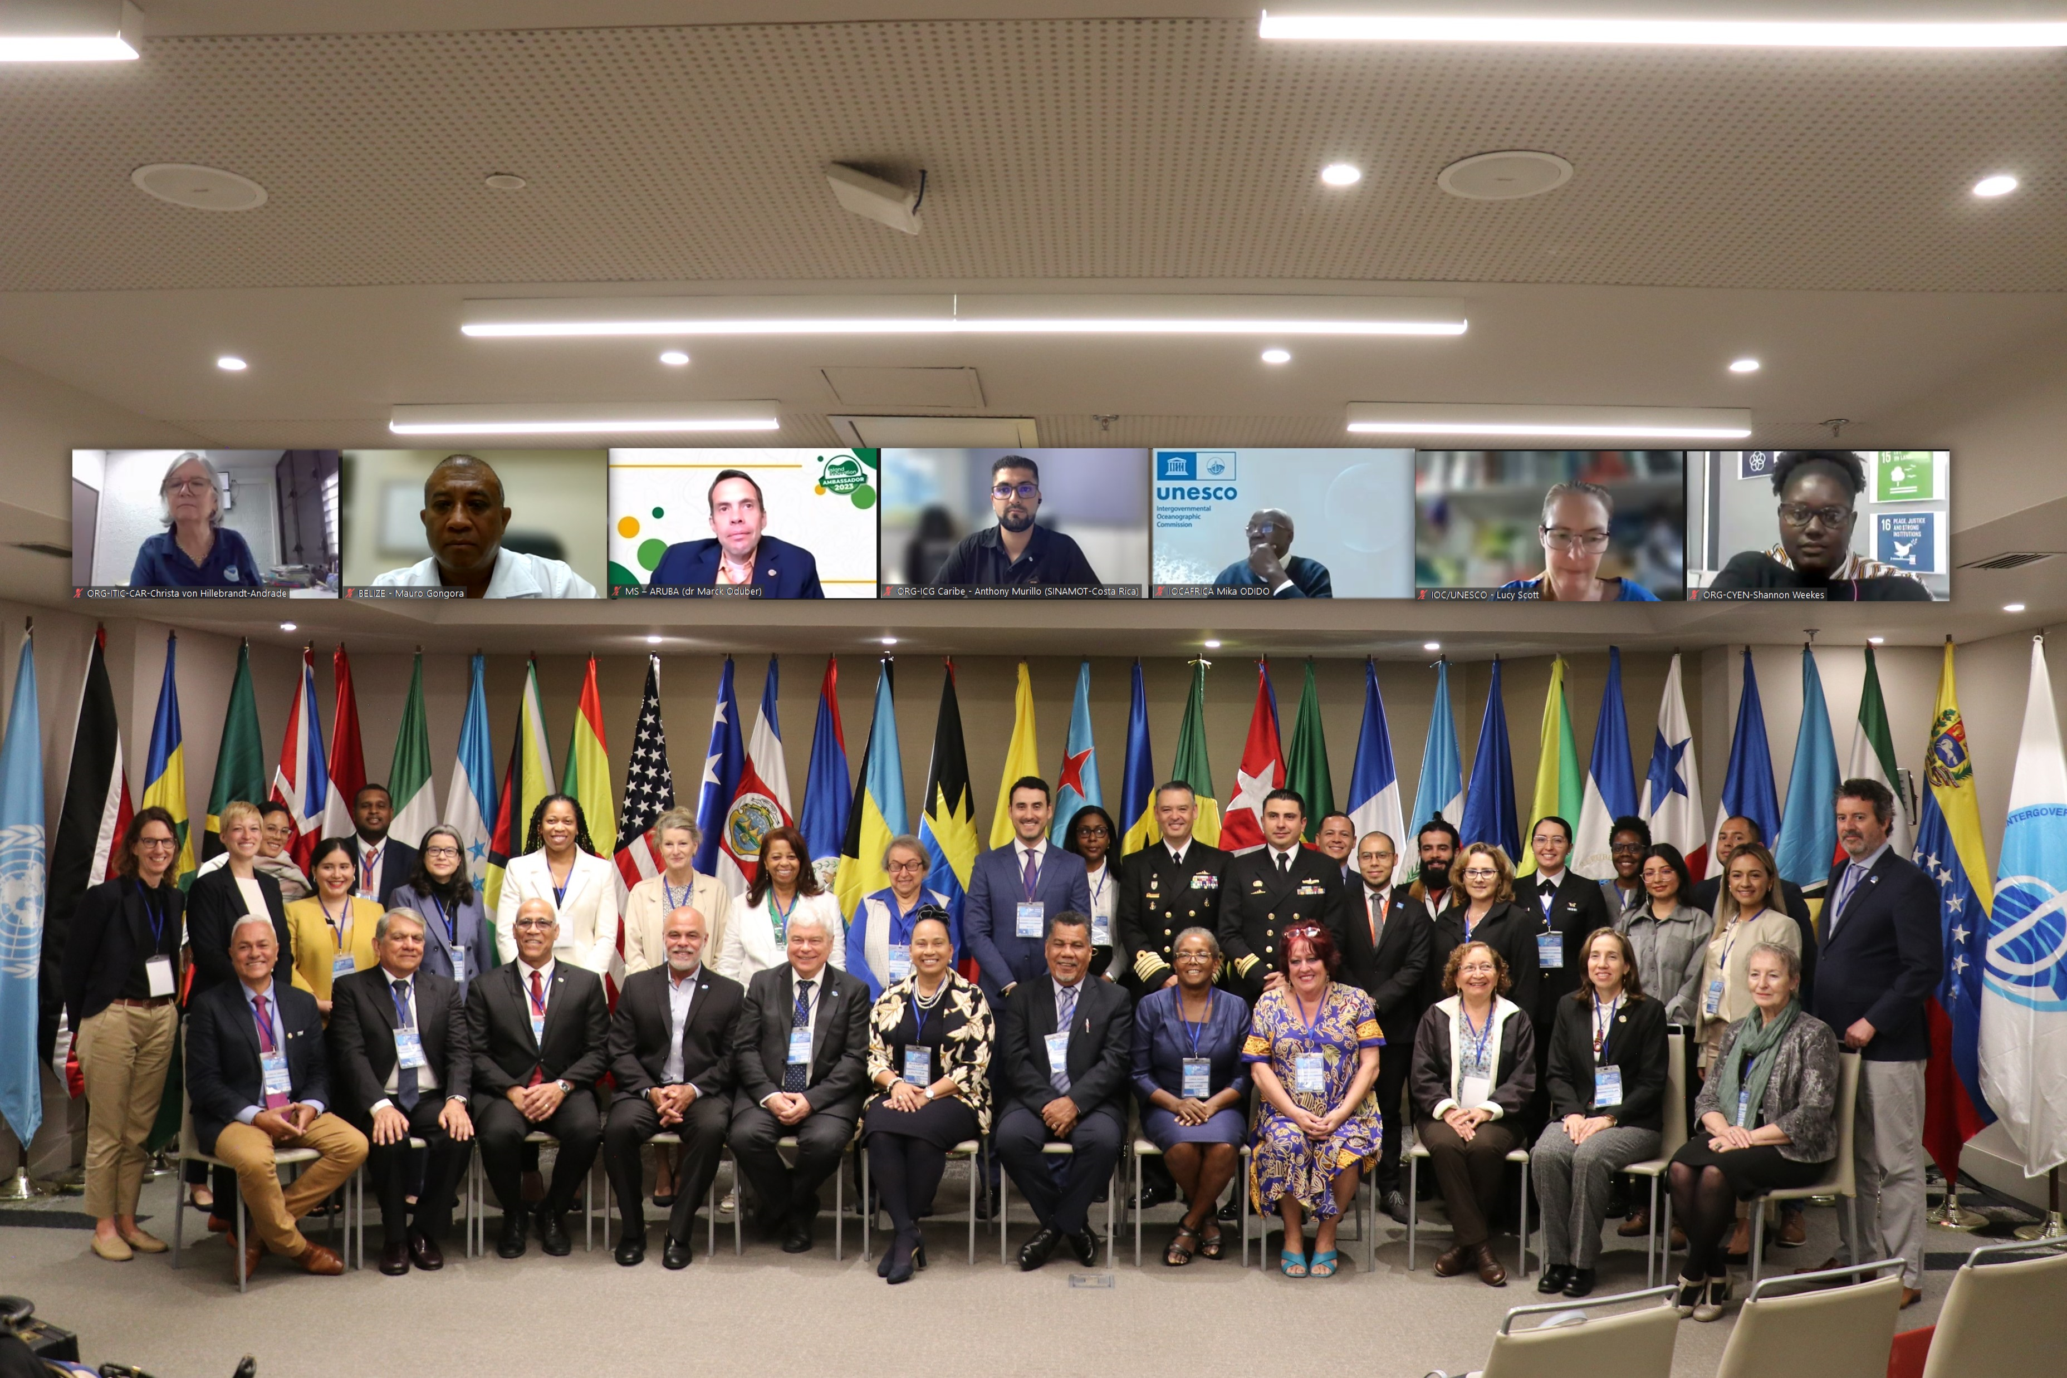
IOCARIBE DECISIONS OF MEMBER STATES
1
2
3
4
Rec1 - Prioritization
Rec2 - Governance
Rec3 - Stakeholder engagement
Rec4 - Youth engagement
Rec5 - Communication
Rec6 - Collaboration
Rec7 - Awareness
Rec8 - Data, information, knowledge and tools
Rec9 - UN Ocean Decade
Rec10 - IOCARIBE-GOOS
5
6
7
8
9
10

Slide 4
Regional Governance & Coordination
Capacity Development Group
IOCARIBE GOOS Executive Working Group and Steering Group
Ocean Literacy Task Team
MSP SIDS Partnership Team
Data and Information Working Group
Improve OBIS regionally
Promote Ocean InfoHUB
Ocean Decade
Establishment of TAC DCO
P3 Recruitment and Interns
Task Force (Regional Roadmap)

Slide 5
Proposed IOCARIBE CD Group
Chair: Expected from OTGA Regional Node
Representatives:
Working group Coordinators/Chairs
(OD, Sargassum, HAB-ANCA, GOOS, Data & Information, OL Task Team)
Focal points
HL university reps (Spanish and English)
Private sector representatives (tourism, fisheries, oil & gas)
ECOP
Community

Slide 6
SARGASSUM
TASK TEAM | ACTIVITIES
Task Team 1. | Sargassum Information Hub
Task Team 2. | Community lead decision support tools
Task Team 3. | An Integrated Observing System
Task Team 4. | Remote Sensing advancement
Task Team 5. | Modelling advancement
Task Team 6. | Sargassum Forum 2024/2025

Slide 7
OCEAN LITERACY
ACTIVITIES | PROJECTS
Promote Regional Ocean literacy research activities among partner universities and institutions. Encourage new research related to OL (Deep Sea) | Ocean literacy: Indigenous and Local Communities Ocean Literacy in the Caribbean
Official Launch of the Caribbean SIDS Ocean Literacy Program at UN SIDS4 Summit (May 2024) LAC Ocean Literacy Dialogue | Ocean Literacy in the Caribbean
Establish Task Team on Ocean Literacy Regional tourism and fisheries sector ocean literacy training | Ocean Literacy in the Caribbean ADAPT project OTGA Training Course
Plan for Caribbean SIDS and Central American Countries Two pilot countries – GRENADA and HONDURAS | Ocean Literacy in the Caribbean

Slide 8
IOCARIBE GOOS
Field training and access to technology
Training in use of data networks
Training for Ocean Observations for decision making
Support of approvals for data collection in EEZs
Engagement sessions for policy-makers

Slide 9
HARMFUL ALGAL BLOOMS
ACTIVITIES | PROJECTS
Reactivate the current FAN introductory virtual reality course that is in the Play store | Increased visibility among the different social stakeholders in the Caribbean region.
Inclusion of the toxins module in the virtual reality course | Train HAB researchers for the region, taking advantage of the existing knowledge in the Caribbean and the international cooperation.
Reorganization of the task group: ANCA-HAEDAT | Collect and analyze information that allows making decisions related to HABs in the Caribbean region.
Conducting the Course: La Ciguatera a potential risk for the tourism industry | Increased visibility among the different social stakeholders in the Caribbean region.
Continue with the HAB outreach and training program | Increased visibility among the different social stakeholders in the Caribbean region.
Layout and publication in digital format of the Ciguatera book, already existing in Spanish and English | Increased visibility among the different social stakeholders in the Caribbean region.
In-person workshop on HAB early warning systems | Progress in initiatives on HAB early warning systems. Reorganize the group

Slide 10
MARINE SPATIAL PLANNING
MSP Regional Forum
MSP Challenge Training (Board Game - Spanish)
Follow up to
PROCARIBE+ (IOCARIBE as implementing partner)
Enhanced national capacity and enabling conditions
Key actions by all sectors of society
- MSP Work Plan
- Capacity Development Work Plan,

Slide 11
OCEAN DATA AND INFORMATION
Establish a regional Working Group on Data and Information Management in the IOCARIBE Region
A co-designed list of specific indicators needed by stakeholders that respond their needs.
Invemar will conduct 8 courses for IOCARIBE region in 2024 (Next slide)
ADAPT - Adapting Ocean Best Practices to the local context (Caribbean Pilot Project)
IODE Assembly in February 2025 in Santa Marta, Colombia – regional satellite event
CBD COP 16 in Colombia (October 2024) – satellite event

Slide 12
OTGA Courses 2024 Invemar
Marine GIS
Data Management for conservation, restoration and management of blue carbon ecosystems, emphasis on mangroves
Development of capacities for the management of oceanographic data and information under international standards in LAC research institutions
Data and Information for the management of Marine Protected Areas
Relevant data to report indicator 14.3.1 Ocean acidification
RedCAM Workshop Course
GODAR Course?
ADAPT course in Spanish/English in Ocean Observations

