Slide 1
IOC Ocean Science Section
(Functions A and C)
Capacity Development Activities

Slide 2
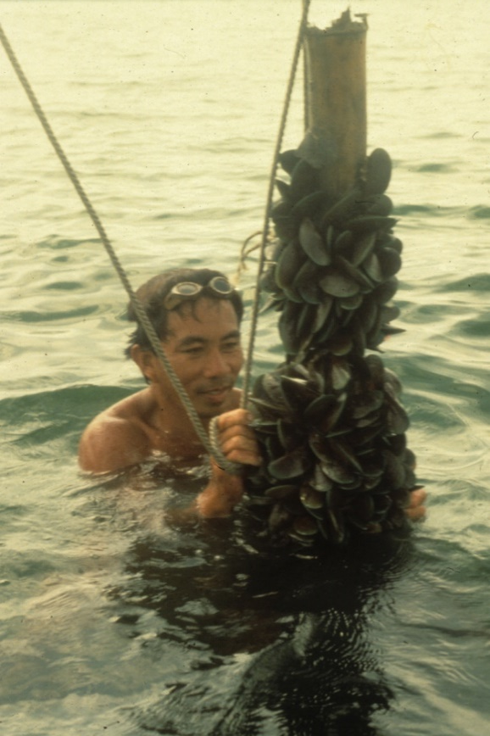
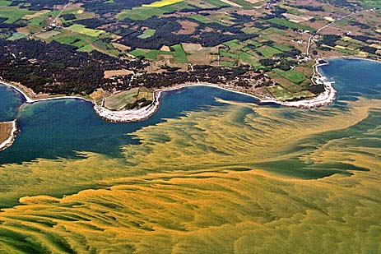
Harmful Algae:
Organized annually, e-learning in OT + practical identification
Include an exam qualifying for the ‘IOC Certificate of Proficiency in Identification of Harmful Marine Microalgae’
Stable demand from MS institutions for training on harmful algae
Implementation of combined OT on-line and face-to-face courses works well
Activity is 100% demand driven and primarily user funded
+30 years partnership with University of Copenhagen, Denmark
Series of in-country training courses in collaboration with FAO, IAEA and IOC regional CD activities in WESTAPC and IOCARIBE.
In-country training on demand and MS funded
Strong position of the IOC in HAB CD

Slide 3
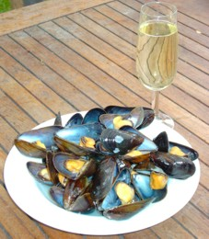
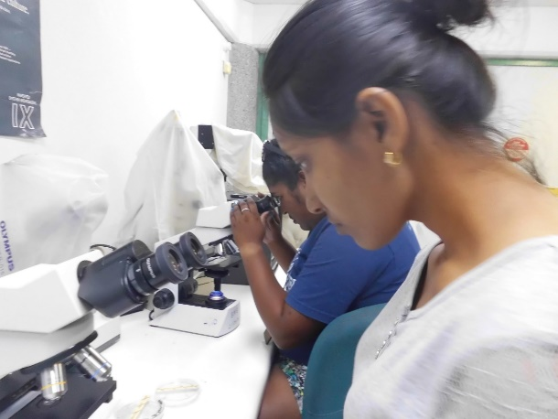
The International Phytoplankton Intercomparison (IPI)
IPI is a proficiency testing scheme for Phytoplankton analysts. IPI working towards accreditation as a Proficiency testing provider under ISO 17043 and ISO13528.
Runs every year from May to December with 70-80 participating laboratories.
IPI is being offered by the IOC Science and Communication Centre in collaboration with The Canary Islands Harmful Algal Bloom Observatory at the University of Las Palmas de Gran Canaria, Spain and the Marine Institute, Ireland.

Slide 4
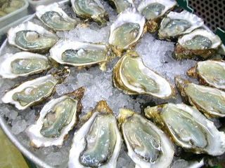
Ocean acidification
A topic of continuous capacity development demand is the field of ocean acidification.
Successful implementation of an OTGA online course in February 2022 focusing on the Pacific Islands with more than 130 participants (60 % female attendees).
It is envisaged to repeat this exercise in Africa and one more region over the next two years. The course on ocean acidification attracts strong interest from scientists and MS and has successfully positioned IOC as a provider of CD in the field.
The IOC Secretariat is developing new course content and translating part of the course material into French and Spanish.
Continuously conducting online trainings and webinars to advance the capacity of Member States to report towards SDG 14.3.1
Development of CD strategy for OARS/GOA-ON
GOA-ON mentoring programme, IOC presented on AB

Slide 5
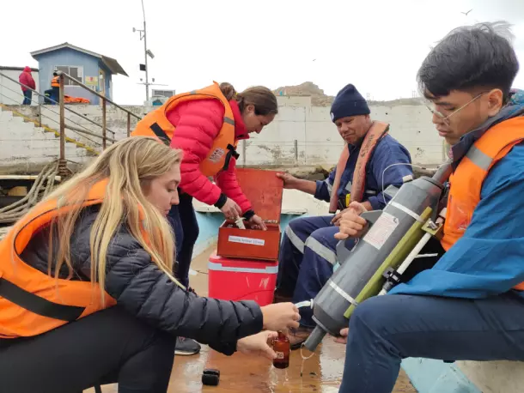
Deoxygenation
Deoxygenation was the focus of one IOC summer school in September 2019
A new edition is organized in November 2023 now as part of the Decade Programmes GOOD/OARS with 33 young researchers from 17 countries to meet more than 15 world experts in their respective fields
Next edition planned in 2025/2026 is South East Asia.
The IOC working group organizes monthly webinars featuring each time a junior and a senior scientists. (on average more than 100 participants coming from more than 60 countries) .
Development of mentoring programme considered.

Slide 6
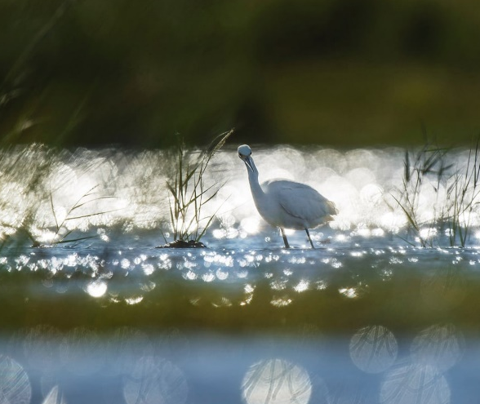
Blue Carbon
Together with CI development of an online (OTGA) course).
In the framework of the GO-BC Decade programme, training are and will be conducted.
GO-BC - development of scientific training material, including online course.
Regular knowledge exchange session on BC science and implementation (IPBC).

