Slide 1


GOOS- Capacity Development
Emily Smith, Ting Yu, Emma Heslop, and Joanna Post
GE-CD-V Meeting, February 27-29, 2024
UNESCO HQ, Paris, France
Notes:
Ann

Slide 2
Connections with Challenge 9
Develop the skills required by various actors to study, sustainably utilize, and manage the ocean.​
Promote equal representation of all groups in the science, communication, management, and policy areas of the ocean.​
Ensure fair and equitable distribution of infrastructure and technology required to study, sustainably exploit, and manage the ocean.​
Remove barriers/restrictions on the sharing and movement of ocean data and knowledge among different users of the ocean​
Ensure equitable distribution of funding and encourage all countries to invest in ocean science.​
Encourage constructive, multi-directional partnerships to find common objectives that fulfil the needs of all parties involved.​

Slide 3
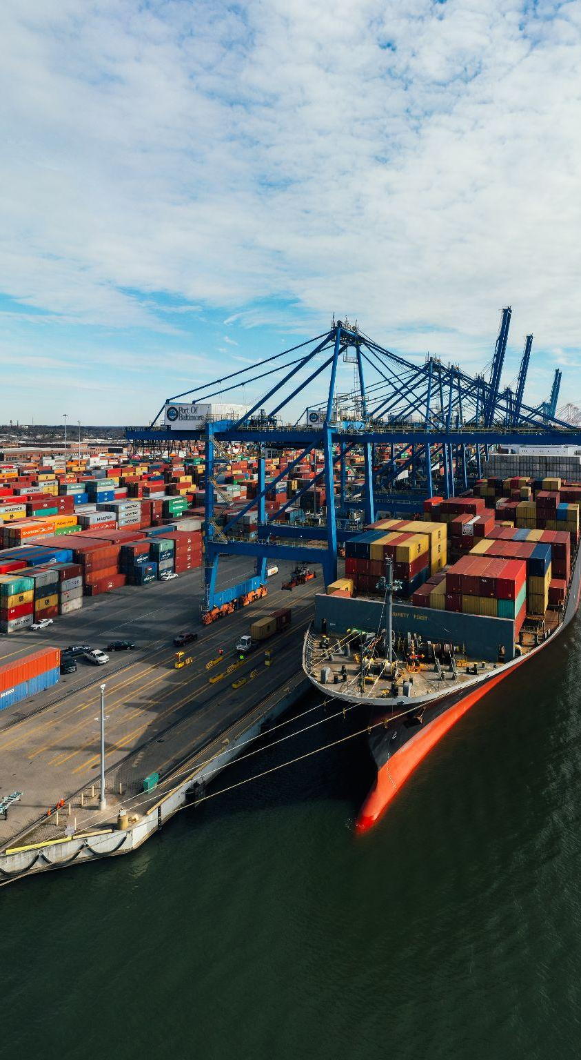
Developing the skills…
Webinar Series:
  WMO Information System 2.0 (WIS 2.0)
  Argo Data - how to access and use this freely available dataset
  IOC/UNESCO information and data related resources and the Ocean InfoHub Project
  ASAP - Upper air profiles at sea
https://www.youtube.com/@goosocean
Notes:
Ann

Slide 4
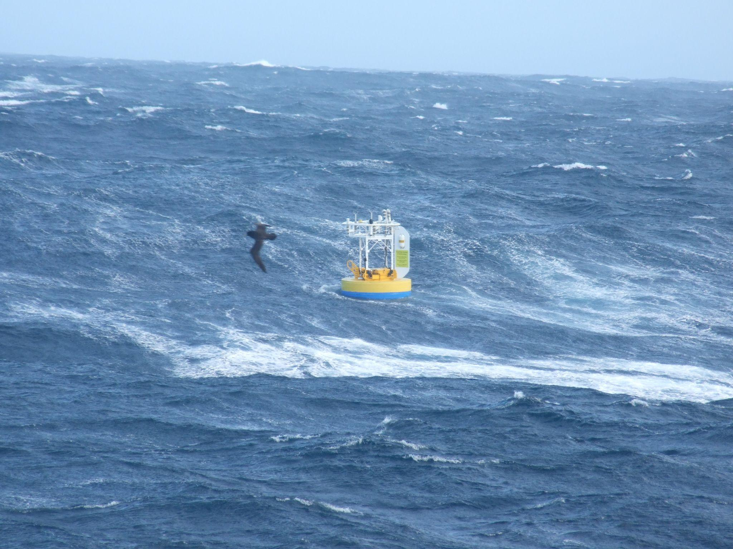
Meetings and Workshops
Ocean Observations side event at the 18th WMO Regional Association I Conference-multi-directional partnerships to find common objectives
Fair and equitable distribution of infrastructure and technology required to study
  2 drifters donated by DBCP (to Solomon Islands )
  3 VOS observation instruments donated by SOT (to Argentina, Chile, and Russia)
Notes:
Ann

Slide 5
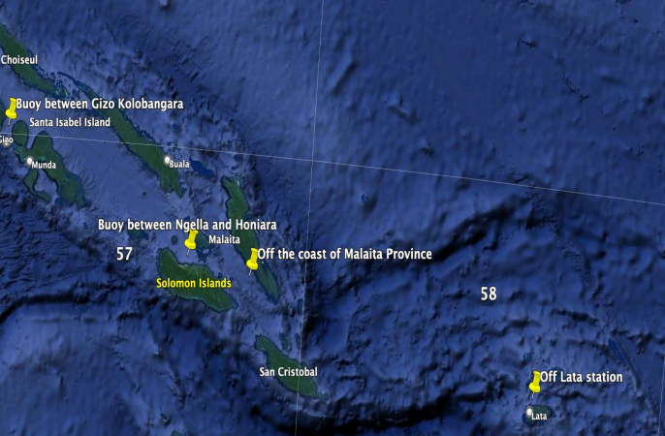
Equal representation of all groups in the science, and Encourage all countries to invest in ocean science
2 decades of dedicated in-region capacity building activities from 2003
5 Western Indian Ocean, 5 Pacific Islands, 5 NPOMS, 1 Mediterranean, 500+ trainees, great appreciation from Members/Member States

Slide 6


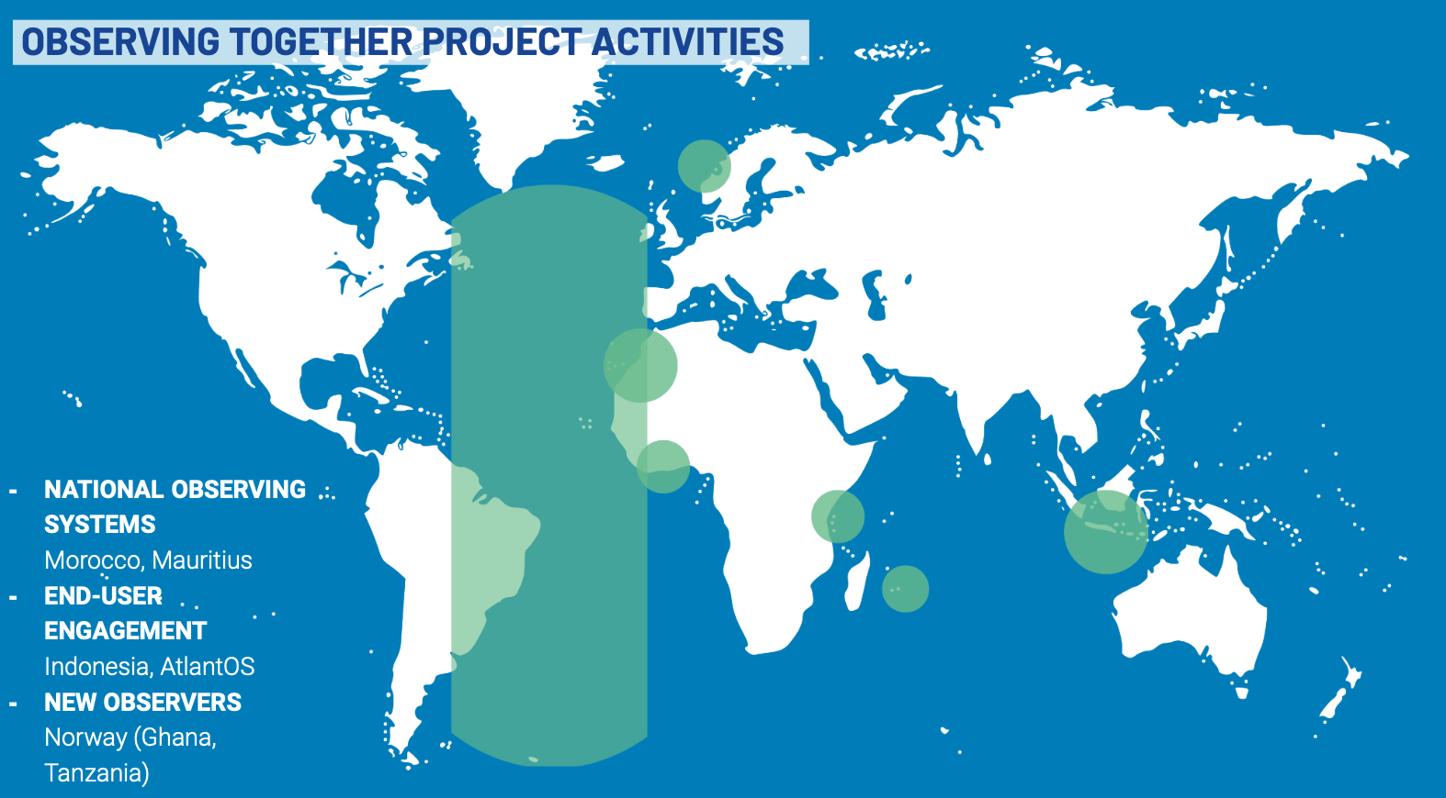
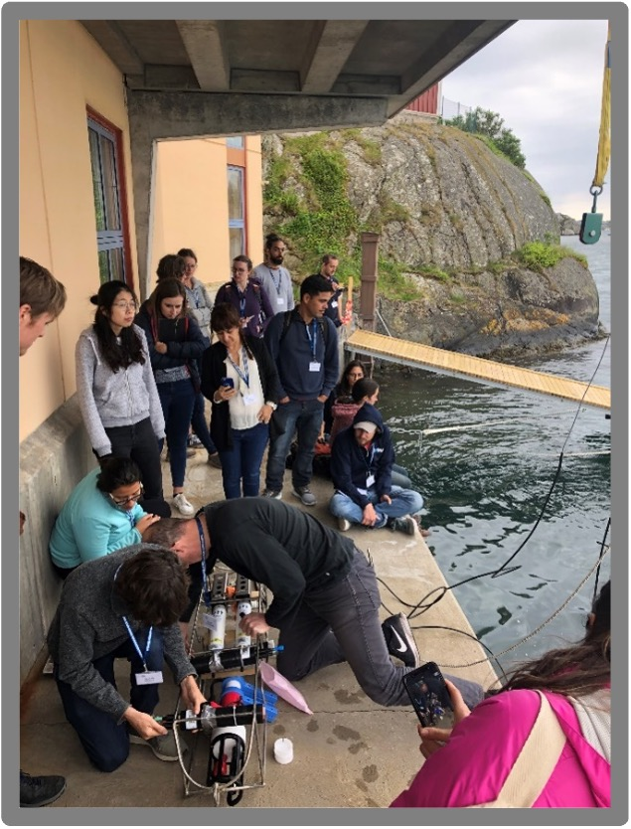
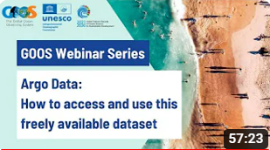
Capacity
Ocean Decade: Observing Together
272 participants 65 countries ETOOFS Workshop (OTGA)
40 students 20 countries BGC summer school
>50 GOOS webinars
Notes:
Scattered efforts, beneficial but not sufficiently coordinated or targeted and do not address the fundamental question lack of operations in global south,m developing countries, Africa, SIDS - when blue investment is needed to support data delivery for sustainable development and adaptation

Slide 7
Connections to Global Regional Alliances
Focus going forward–SIDS and Africa
**Data sharing and increased observations for better forecasting
**Technical guidelines for each region, specifically,
IOCARIBE (Caribbean)
PI-GOOS (Pacific Islands)
IO-OOS (Indian Ocean)
GOOS Africa
Remove barriers/restrictions on the sharing and movement of ocean data
New data policy from the Observations Coordination Group

Slide 8
Next steps
Additional resources available for regions - specifically GOOS Africa, PIGOOS, IOCARIBE, IOINDIO; to bring people together to support regional capacity
NORAD funding to support GOOS Africa CD
Increased coordination with our CD and GOOS colleagues, inc ETOOFS and Ocean Ops, to support development of guidance for NFP and for CD in under-resourced member states

Slide 9
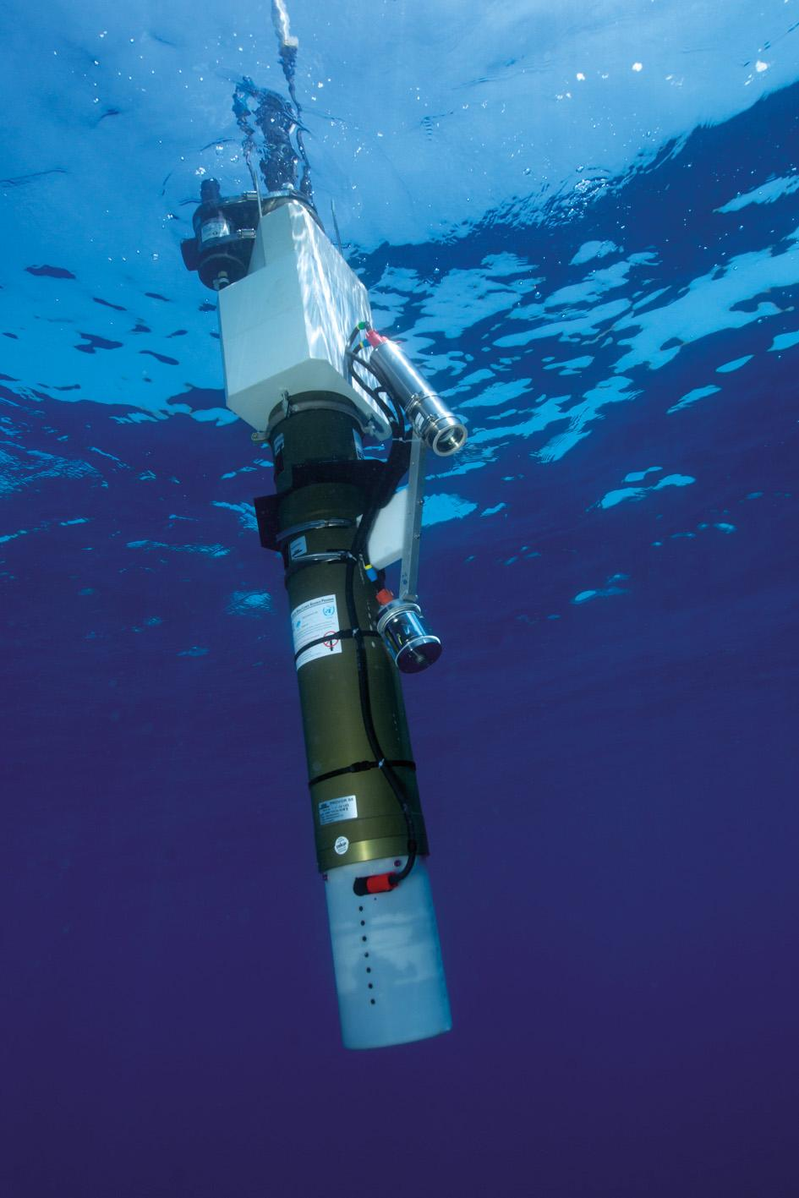
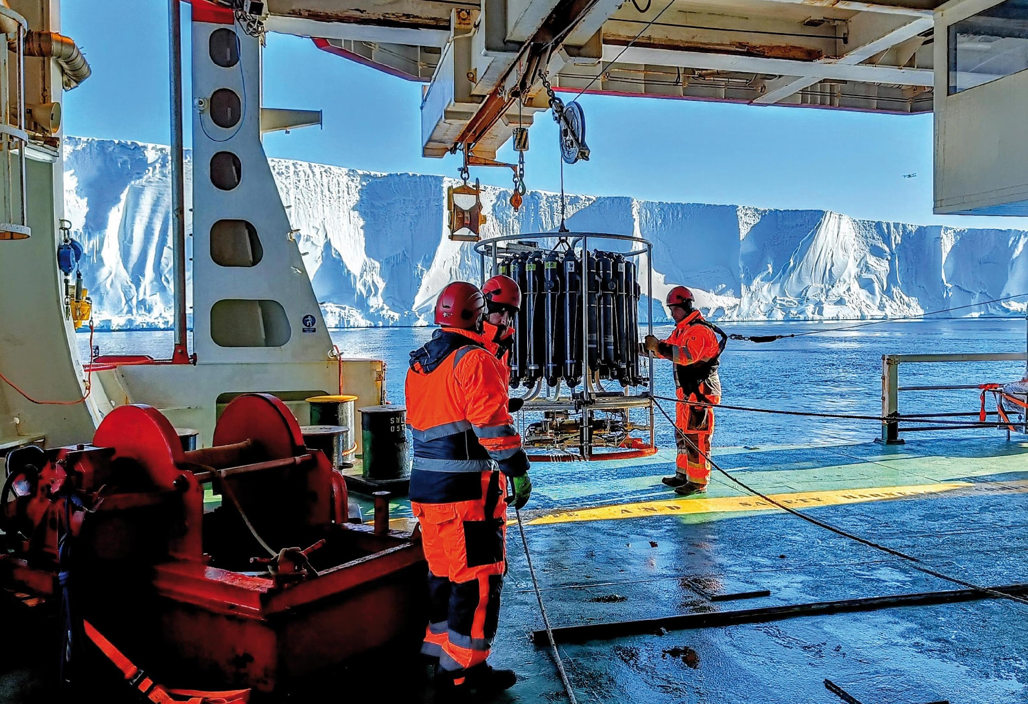
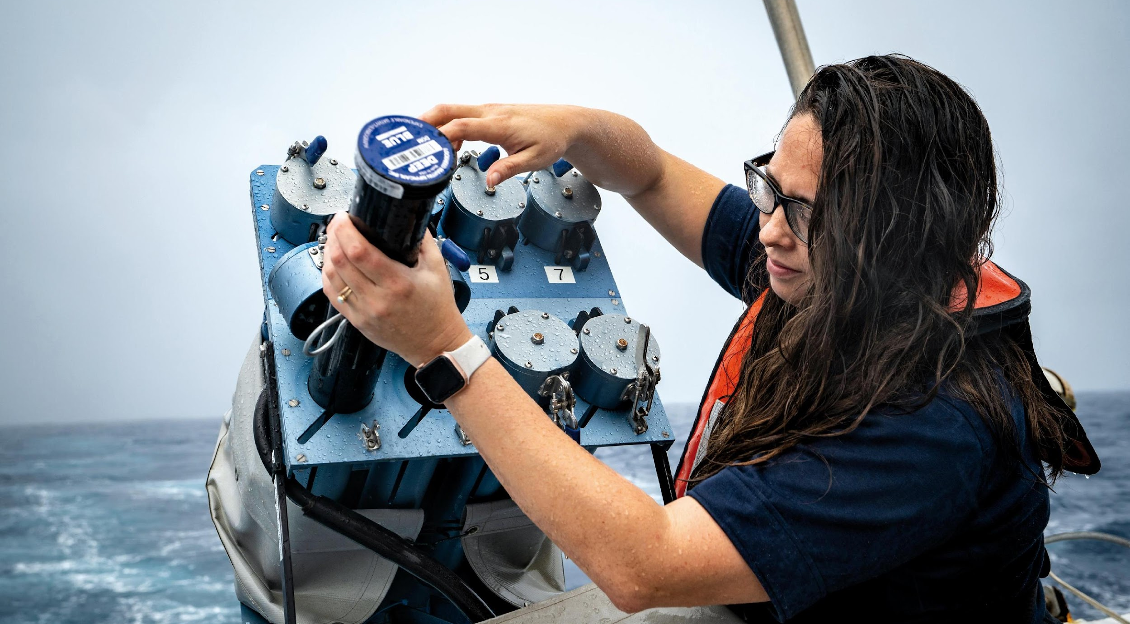
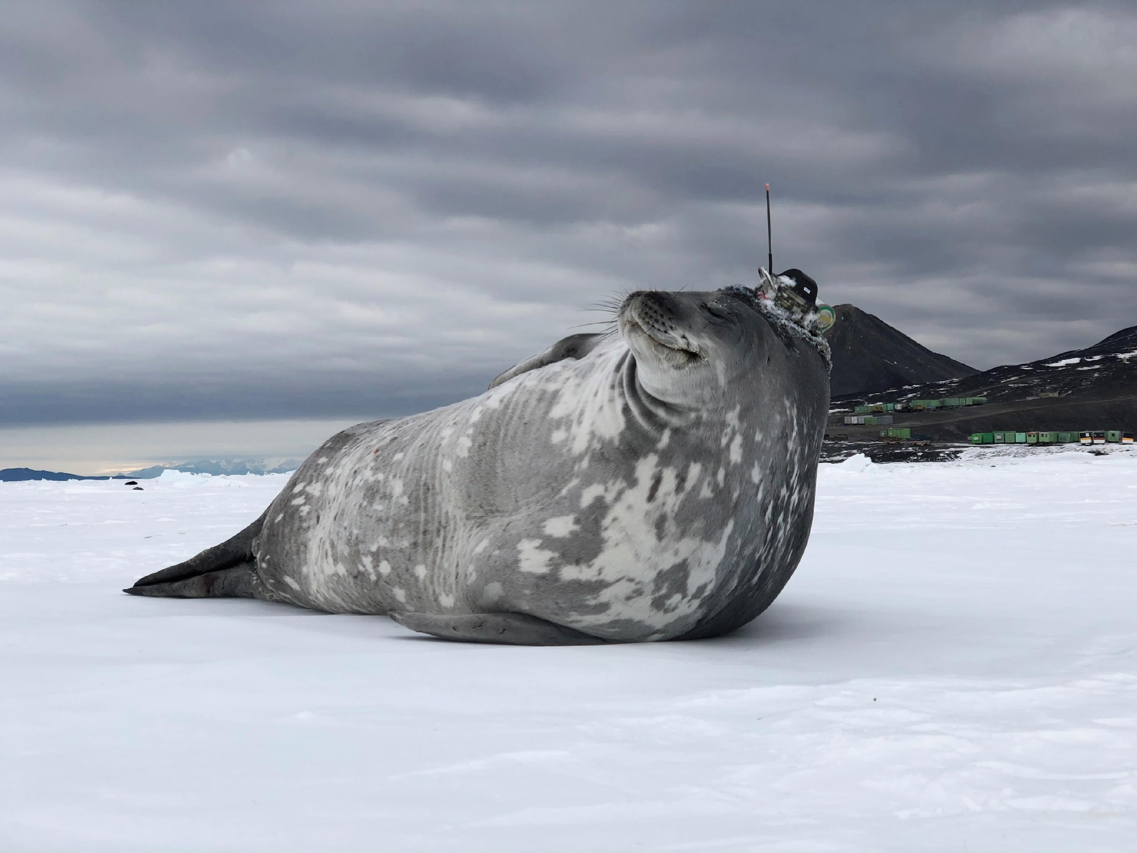
Thank you
goosocean.org

