Slide 1





IOC Group of Experts on Capacity Development
Fifth Session
Paris, France 27-29 February 2024
4.1. GLOBAL PROGRAMMES
4.1.1. IODE: OceanTeacher Global Academy
Ana Carolina Mazzuco
IODE Training Coordinator – OTGA Project Coordinator
Greg Reed
OTGA Project Coordinator
UNESCO/IOC Project Office for IODE

Slide 2
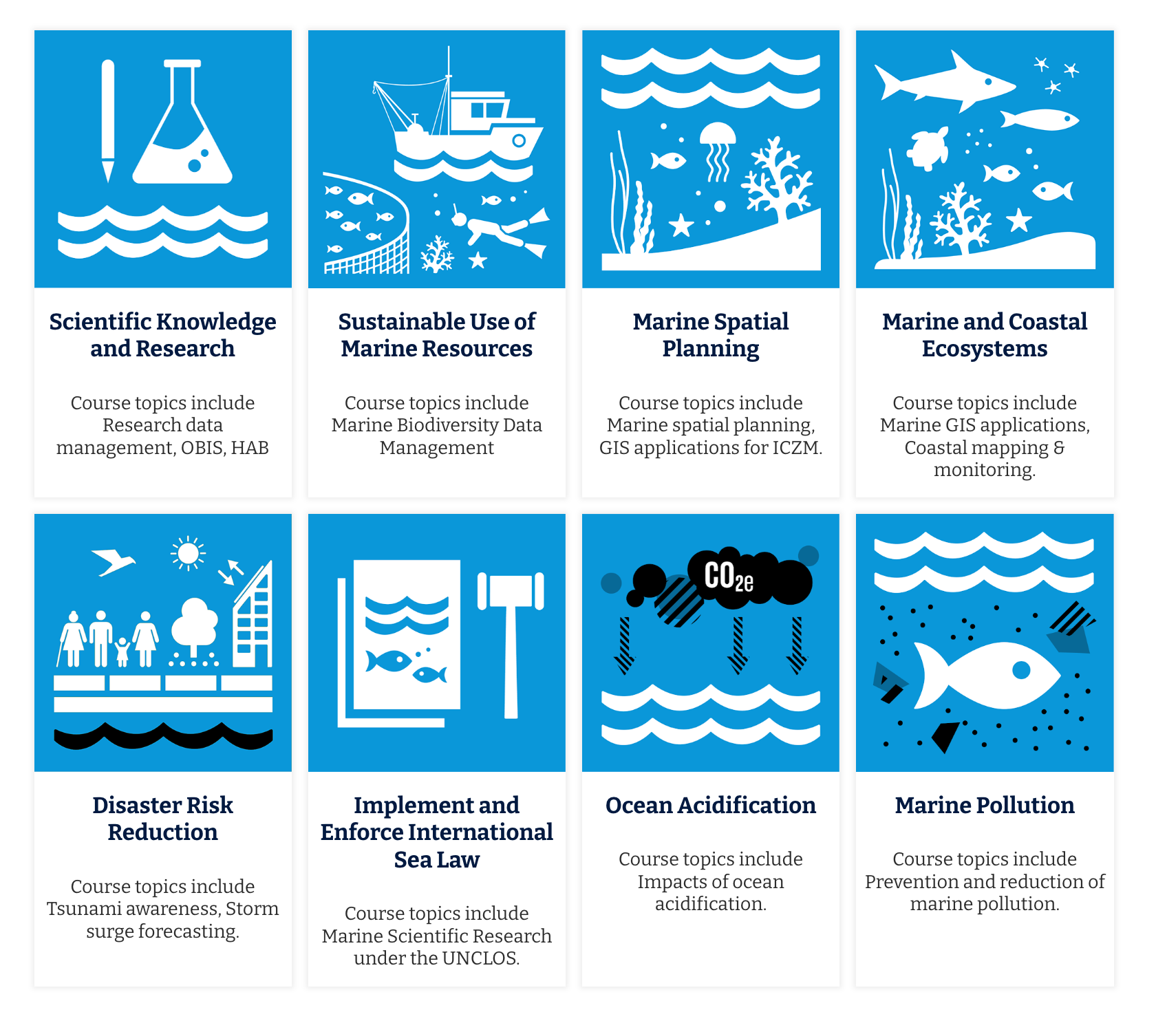
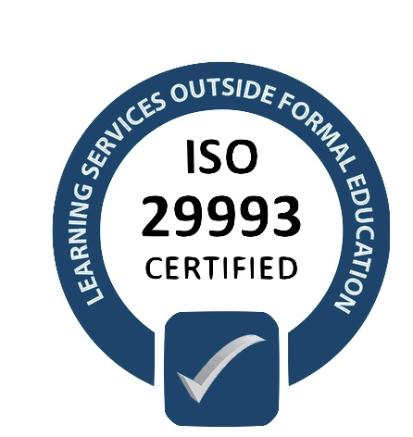
IOC Group of Experts on Capacity Development
Fifth Session
Paris, France 27-29 February 2024
Overview and Performance
4.1. GLOBAL PROGRAMMES
4.1.1. IODE: OceanTeacher Global Academy
Build equitable capacity related to ocean research, observations, and services in all IOC Member States by delivering training courses on a range of topics addressing the priority areas of the UN Decade of Ocean Science for Sustainable Development and the 2030 Agenda and its SDGs as well as supporting the implementation of the IOC Capacity Development Strategy.
Online, blended, face-to-face
4 languages
Common e-Learning platform
Standardized and coordinated management
New learning resources
49 courses
17 RTC/STCs
11.300 users
380 sets of educational resources
Partners, facilitators, and experts
32 courses
29 courses
8 courses
2020
2021
2022
2023
2023
more than 2,300 learners enrolled
48 courses
4 languages
90% of online courses
13 self-paced courses
common e-learning platform

Slide 3
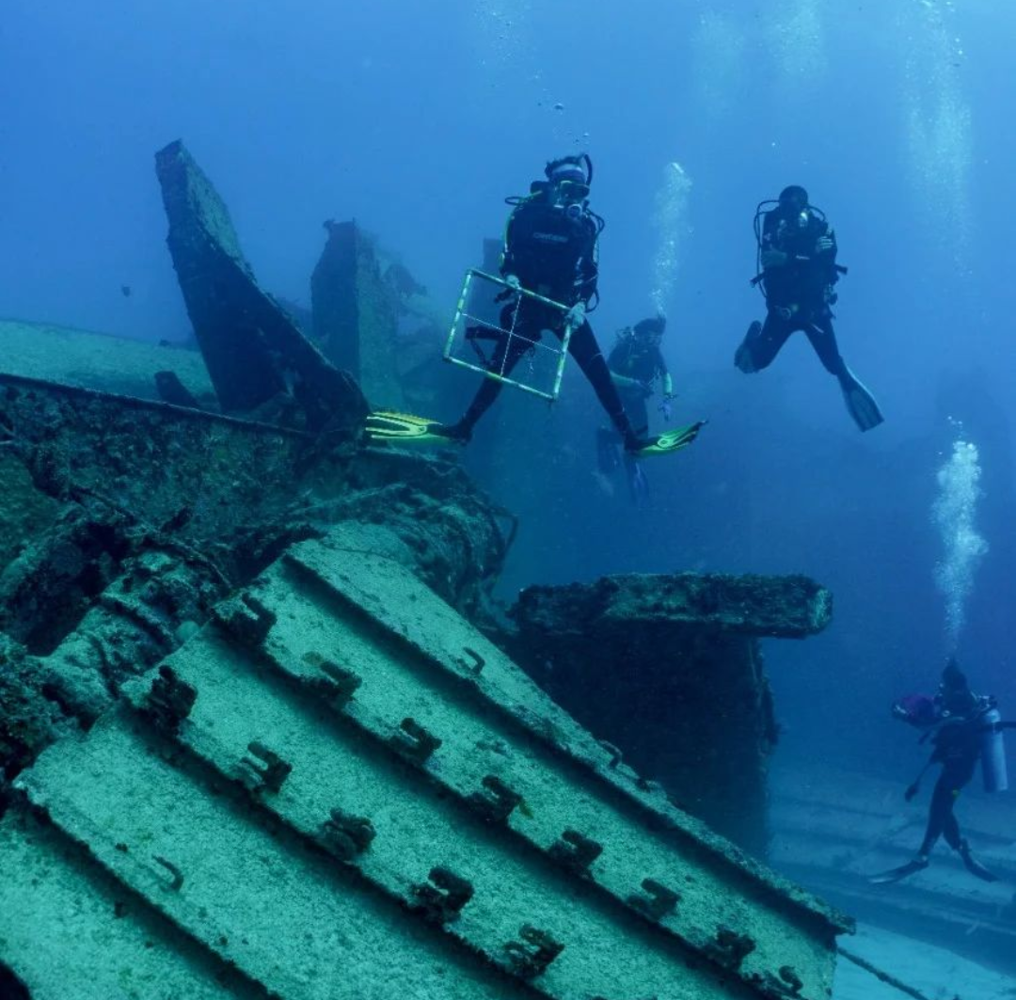
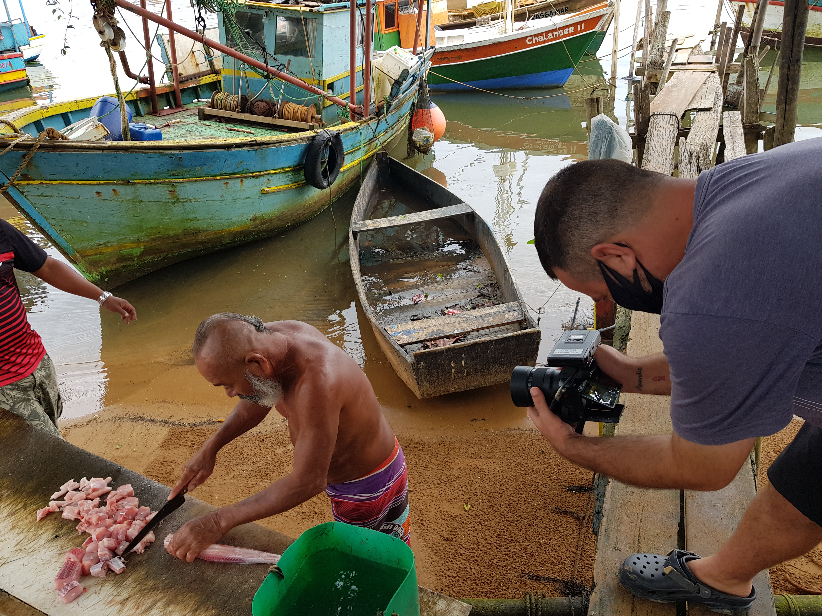
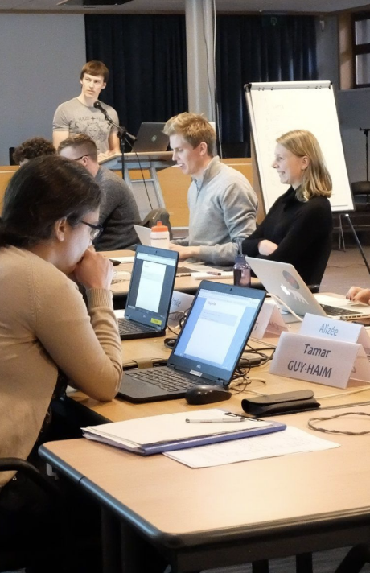
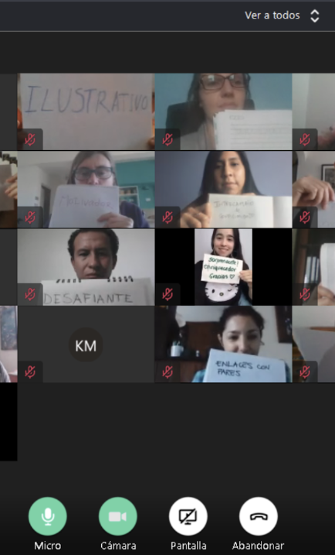
IOC Group of Experts on Capacity Development
Fifth Session
Paris, France 27-29 February 2024
Planning and priority
4.1. GLOBAL PROGRAMMES
4.1.1. IODE: OceanTeacher Global Academy
2024 and beyond
OTGA-SG meeting (11 to 13 June)
Challenges
Sustain high-quality operations
Address needs from the regions
Increase participation in SIDS
Link with with field-observations
Include traditional knowledge
Up-to-date with change in education
+ 65 course proposals
Request for face-to-face
Increase in staff demand
Mobilization of extra-budgetary funding

