Slide 1
IOC Group of Experts on Capacity Development
5th Session
Agenda 3.3 Revision of the GE-CD TORs
Alan Evans
27-29 February 2024
Paris

Slide 2
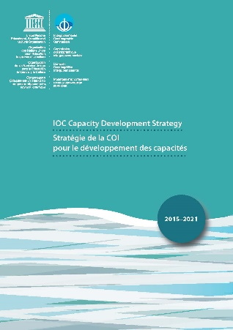
IOC Group of Experts on Capacity Development (GE-CD)
2015 IOC-28: adoption CD strategy 2015-2021
2017 IOC-29: establishment GE-CD
2021 IOC-31: instructions to prepare new strategy
2023 IOC-32: submission new strategy to Assembly (2023-2030)
2024 EC-57 reconstitution GE-CD with new ToRs
to assist the global and regional programmes with the implementation of capacity development (CD) needs assessments, the development of related work plans, mobilization of resources, and provide advice on relevant methods and tools to deliver CD.
+ develop new strategy and outreach plan
+ CD surveys
+ coordinate with GOSR and UN Ocean Decade
Draft decision to be submitted at EC-57

Slide 3
Proposed Revisions on GE-CD Terms of Reference
Terms of Reference
Group of Experts on Capacity Development
Mindful of the role of the GE-CD in informing and, where relevant, assisting the Secretariat in implementing IOC CD initiatives,
assist global and regional programmes with the implementation of capacity development needs assessments in a consistent manner;
assist global and regional programmes with the development of programmatic and regionally relevant capacity development work plans based on the IOC CD strategy and related needs assessments, building on ongoing activities and making use of existing training and education facilities;
develop an implementation plan for the current IOC CD Strategy 2023-2030 for submission to the 33rd Assembly of the UNESCO IOC in June 2025;
provide advice to global and regional programmes on the implementation of the IOC Capacity Development Strategy 2023-2030 and on relevant methods and tools to improve the quality and impact of CD efforts;
advise on the design and implementation of the biennial CD survey in close collaboration with the regional secretariats, possibly including CD implementation impact monitoring/metrics, also taking into account other methods such as regional reviews, science conferences etc.;
ensure coordination of the work of the Group of Experts and its Task Teams with GOSR and CD aspects of the United Nations Decade of Ocean Science for Sustainable Development, including the Capacity Development Facility and Working Group 9 of the Vision 2030;
guide the further development and promotion of the Ocean CD-Hub by highlighting linkages of CD activities and collaboration opportunities between users and providers and among other global, regional and national organizations;
provide advice to Member States on the promotion of visibility and reach of the IOC Capacity Development Strategy 2023-2030 to assist with the planning and implementation of their capacity development efforts.

