Slide 1

IOC Group of Experts on Capacity Development
5th Session
Agenda 3.1 IOC CD Strategy 2023-2030
Alan Evans
27-29 February 2024
Paris

Slide 2
IOC Capacity Development Strategy 2023-2030
Capacity Development is a primary Purpose of the IOC, as included in its Statutes¹
IOC CD is a stand alone core function of the IOC Medium-Term Strategy, 2022–2029, delivering its own initiatives e.g. Needs assessment surveys, Ocean CD-Hub, Ocean Teacher Global Academy, Ocean InfoHub (with IODE)
IOC CD cross-cuts all other IOC functions:
All functions should adopt and deliver IOC CD Strategy as a key output
All Regional Offices should adopt and deliver IOC CD Strategy as a key output
Collaborative efforts² and complementary activities by other UN organisations will be critical in ensuring cohesive and all-inclusive capacity development
¹ Article 2 – Purpose - 1. The purpose of the Commission is to promote international cooperation and to coordinate programmes in research, services and capacity-building [..]
² Article 2 – Purpose - 2. The Commission will collaborate with international organizations concerned with the work of the Commission, and especially with those organizations of the United Nations [..]

Slide 3
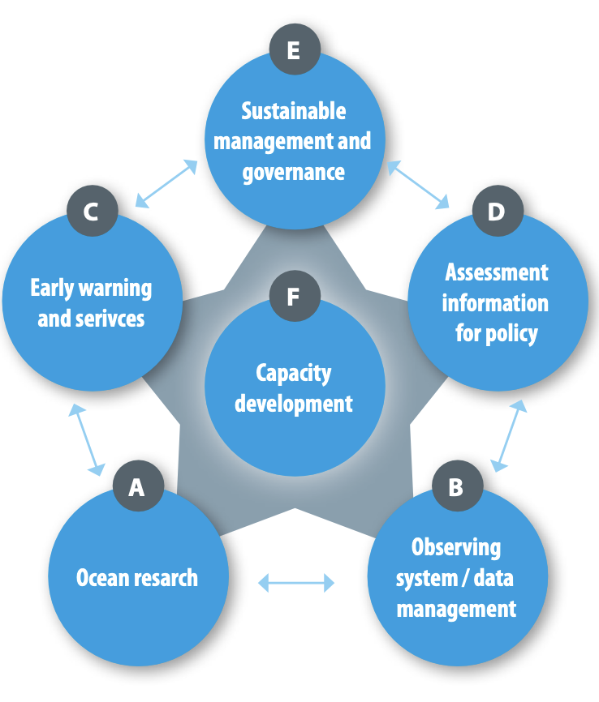
IOC Capacity Development Strategy 2023-2030
IOCs CD must recognise activities undertaken by its Member States and other marine stakeholders, bringing visibility to opportunities and promoting CD activities. To which end partnership and collaboration are essential pillars of IOC’s Capacity Development Strategy, working with other United Nations specialised agencies
Executive Summary:
Reflects the increased recognition that the ocean plays in political, commercial, science and society
Reflects the importance of capacity development in IOCs contributions to the delivery of the Decade of Ocean Science
The IOC’s critical role in fostering international cooperation
Use the strategy as the motivation to develop an implementation plan, such that IOC CD activities are clearly articulated and that the benefits are more readily identified
Vision and Mission:
Through international cooperation, IOC will assist its Member States to collectively achieve the IOC’S high-level objectives (HLOs), and in doing so support the delivery of the societal outcomes of the United Nations Decade of Ocean Science for Sustainable Development (2021-2030), with particular attention to ensuring that all Member States have the capacity to meet them

Slide 4
IOC Capacity Development Strategy 2023-2030
Output | Activity
1. Human resources developed at individual and institutional levels | 1.1 Academic and higher education
 | 1.2 Continuous professional development
 | 1.3 Sharing of knowledge and expertise including through community building
 | 1.4 Integration of ocean science in basic education
 | 1.5 Improving gender, generational and geographic diversity
2. Access to technology, physical infrastructure, data and information established or improved | 2.1 Facilitating access to technology and infrastructure
 | 2.2 Facilitating equitable access to and sharing of ocean data and information
3. Global, regional and sub-regional mechanisms strengthened | 3.1 Further strengthening and supporting secretariats of regional commissions
 | 3.2 Enhancing effective communication between regional sub-commission secretariats and global programmes as well as other communities of practice (incl. other organisations)
 | 3.3 Identifying specific national and regional capacity development needs through regular needs assessment
 | 3.4 Encouraging regional and sub-regional organisations to be leaders in, and amplifiers of capacity development
4. Development of ocean research policies in support of sustainable development objectives promoted | 4.1 Fostering the development of ocean research policies
5. Visibility, awareness and understanding on the roles and values of the ocean and ocean research in relation to human wellbeing and sustainable development increased | 5.1 Fostering the development of ocean related public information and communication services
 | 5.2 Fostering the development of ocean literacy
6. Sustained resource mobilization reinforced | 6.1 Enhancing sustained support (in-kind and financial) to the IOC for its international coordination role
 | 6.2 Promoting sustained bilateral and multilateral support among Member States
Strategic Framework:
An enhanced and expanded portfolio of Activities, based on the existing six Outputs of the IOC CD Strategy
Integrated additional activities and actions (total of 16 activities; 31 actions)

Slide 5
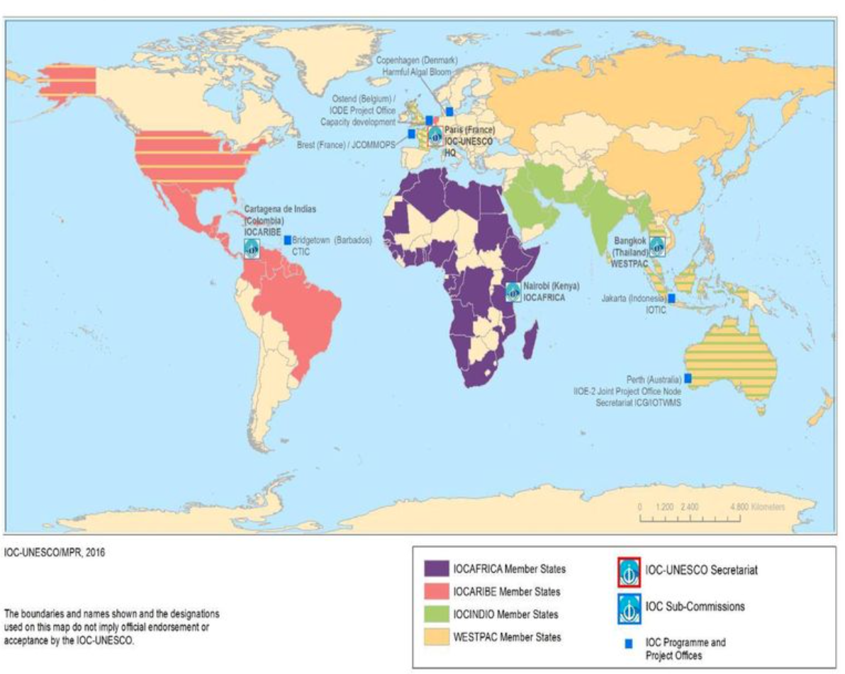
Capacity Development through the IOC Regional Subsidiary Bodies
IOC CD: cross-cuts all other IOC functions:
  all functions should adopt and deliver IOC CD Strategy as a key output
  all RSBs should adopt and deliver IOC CD Strategy as a key output
Regions are all different and have varying CD needs and societal priorities
Informed by regional needs assessments
RSBs are key in the successful delivery and implementation of a cohesive and inclusive capacity development in the regions
2024-2025: develop regional workplans and implementation plans in cooperation with RSBs that responds to the IOC capacity development strategy (e.g. IOCARIBE, soon with IOCAFRICA and IOCINDIO)

