Slide 1

IOC Group of Experts on Capacity Development
5th Session
Agenda 2.2 IOC CD-Hub
Johanna Diwa-Acallar
27 February 2024
Paris

Slide 2
OVERVIEW
Initially proposed at the first meeting of the Working Group on the IOC CD strategy revision on 25 January 2022:
”The Working Group decided to develop a compendium of CD activities by other global and regional programmes, UN specialized agencies, intergovernmental organizations (non-governmental organizations (and national aid programmes, etc. to be maintained as an online portal, and requested the Secretariat to seek external funding to hire a consultant to carry out the work.”
Identified a clear need for an online platform where users (Early Career Professionals, Scientists, Educators, Policy Makers, stakeholder groups, etc.) can easily search for a broad range of CD activities and opportunities around the world
This is a unique opportunity for the IOC CD to further invest in and market this tool as the main one-stop shop for other organizations to advertise their CD opportunities and for Member States to use as a search tool.
Quality of publicly available information on CD activities is highly variable amongst organizations, e.g., inconsistent, difficult to find and sometimes outdated

Slide 3
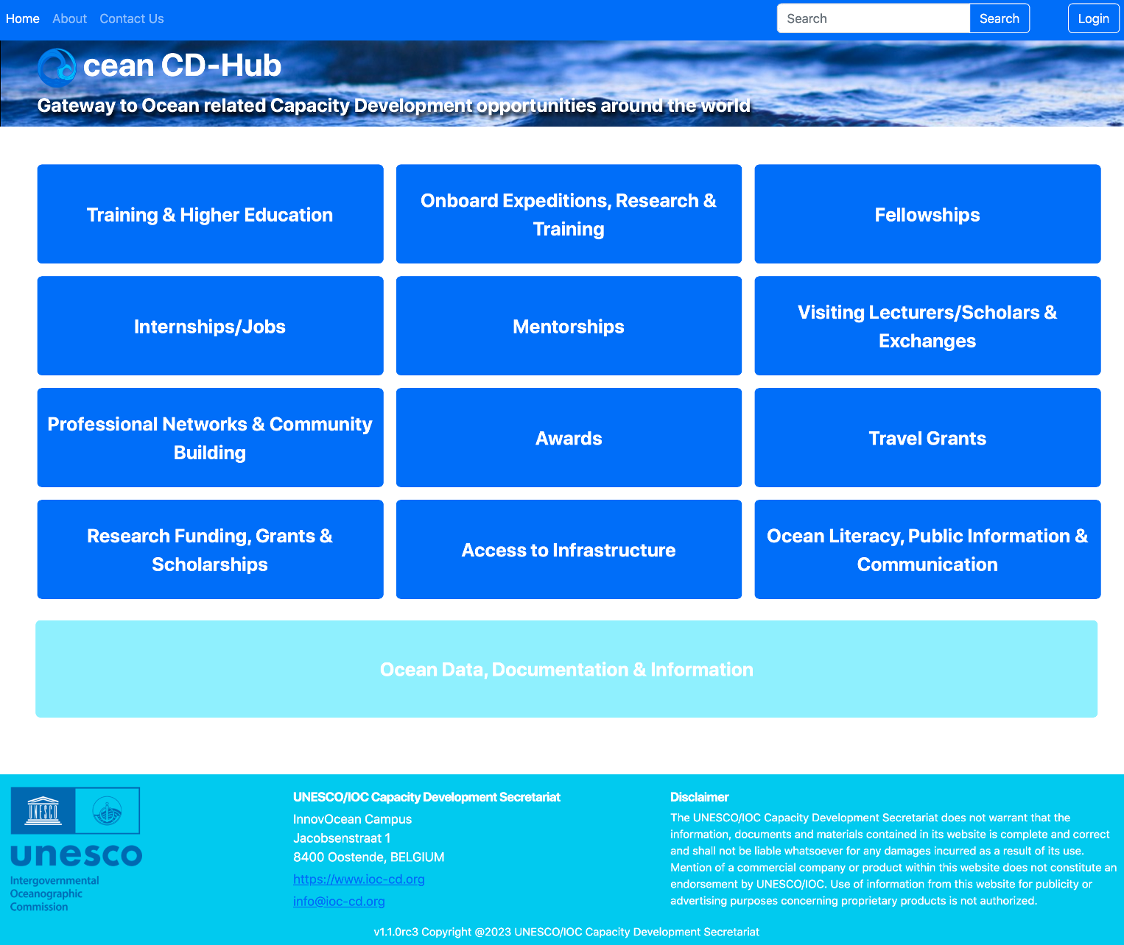
URL: OceanCD.Org
Launched in early 2023
The Ocean CD-Hub is a response to a request from IOC Member States to create an online search engine which helps individuals and organizations (e.g., early career professionals, managers, technicians, government officials, schoolteachers, etc.) search for capacity development opportunities (e.g., awards, fellowships, grants, Internships/Jobs, teaching materials, trainings, etc.) offered around the world

Slide 4
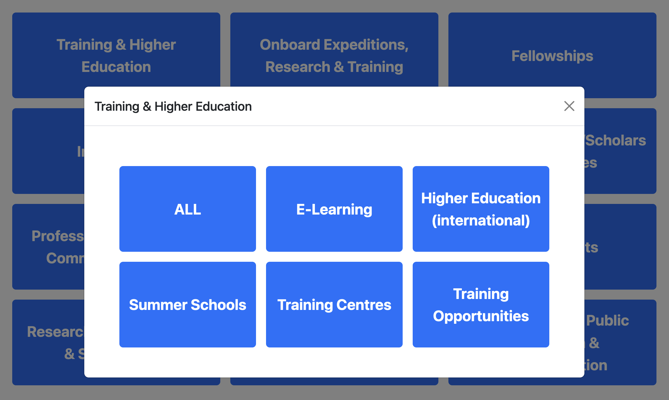
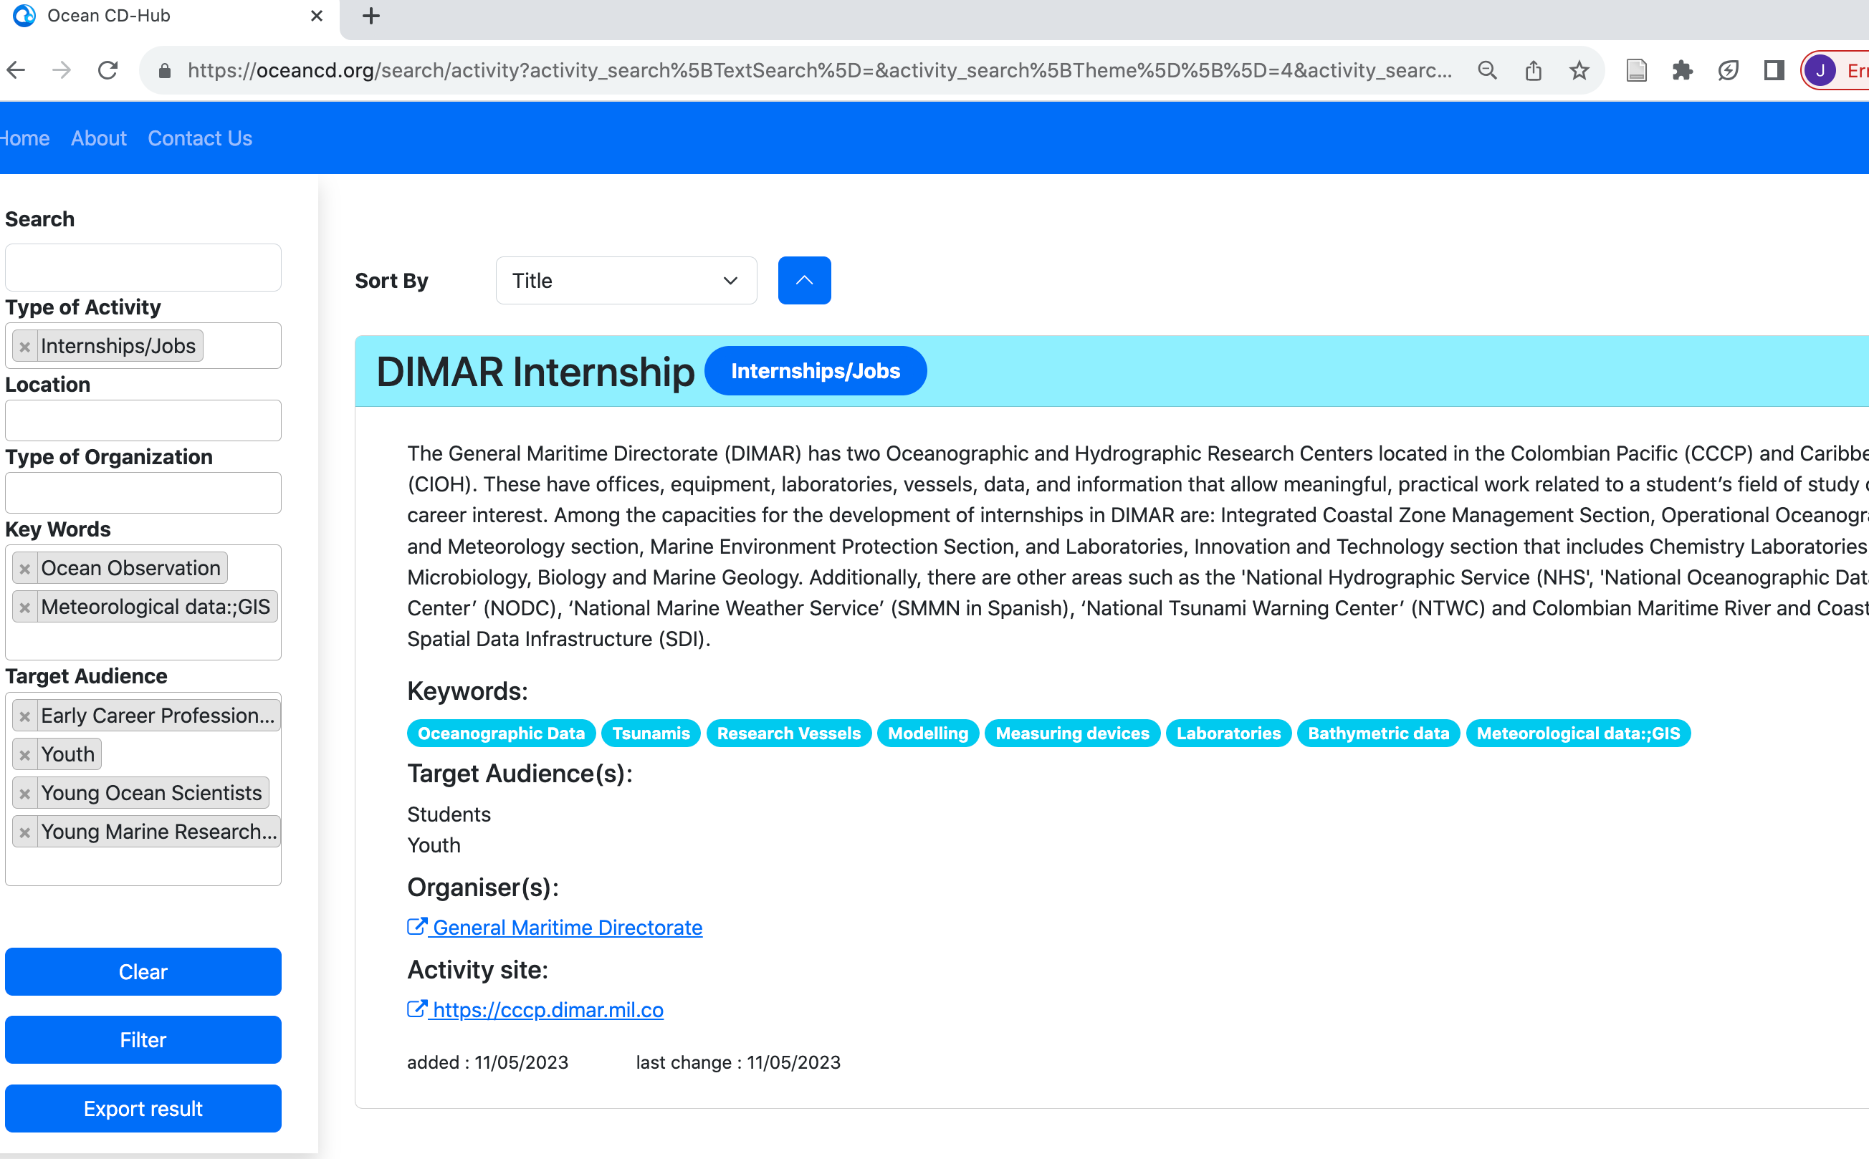
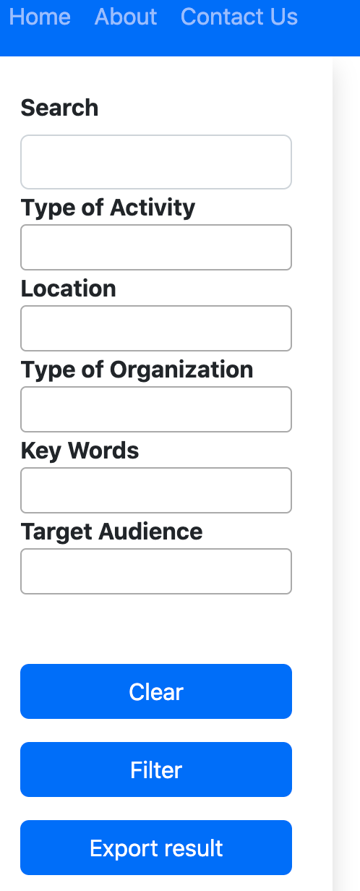
13 head buttons for categories of
CD activities (in line with the IOC CD Strategy)
2nd-level sub-categories for training and higher education related activities
Search function on the home page and second landing page where users can enter general search e.g., meteorological data
Full metadata displayed, with high-level information when title is selected
Linked to website of the activities including contact details to request further information and application details
Refine research into filters:
Entries can be tagged into type of activity
keywords
target audience:
Specific groups/beneficiaries
E.g. ECOPs? Youth?

Slide 5
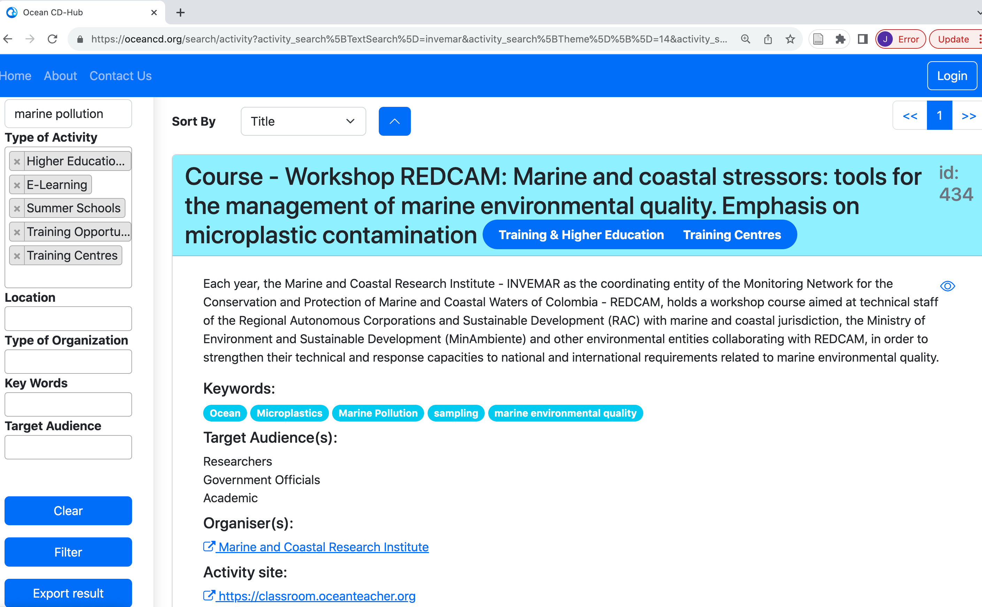
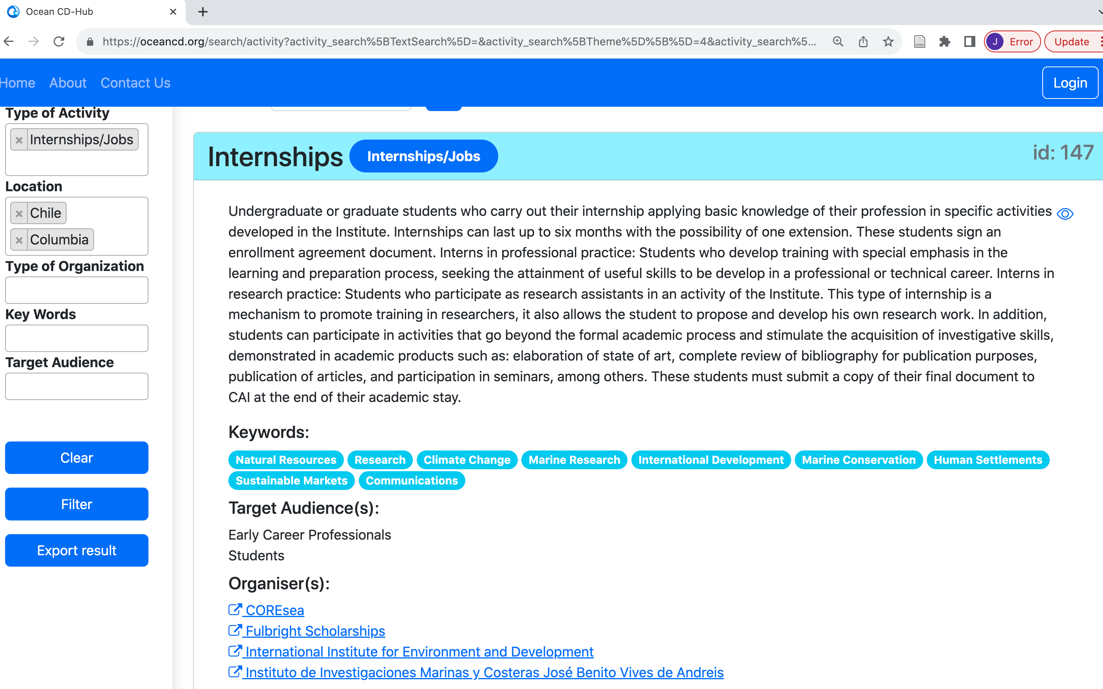
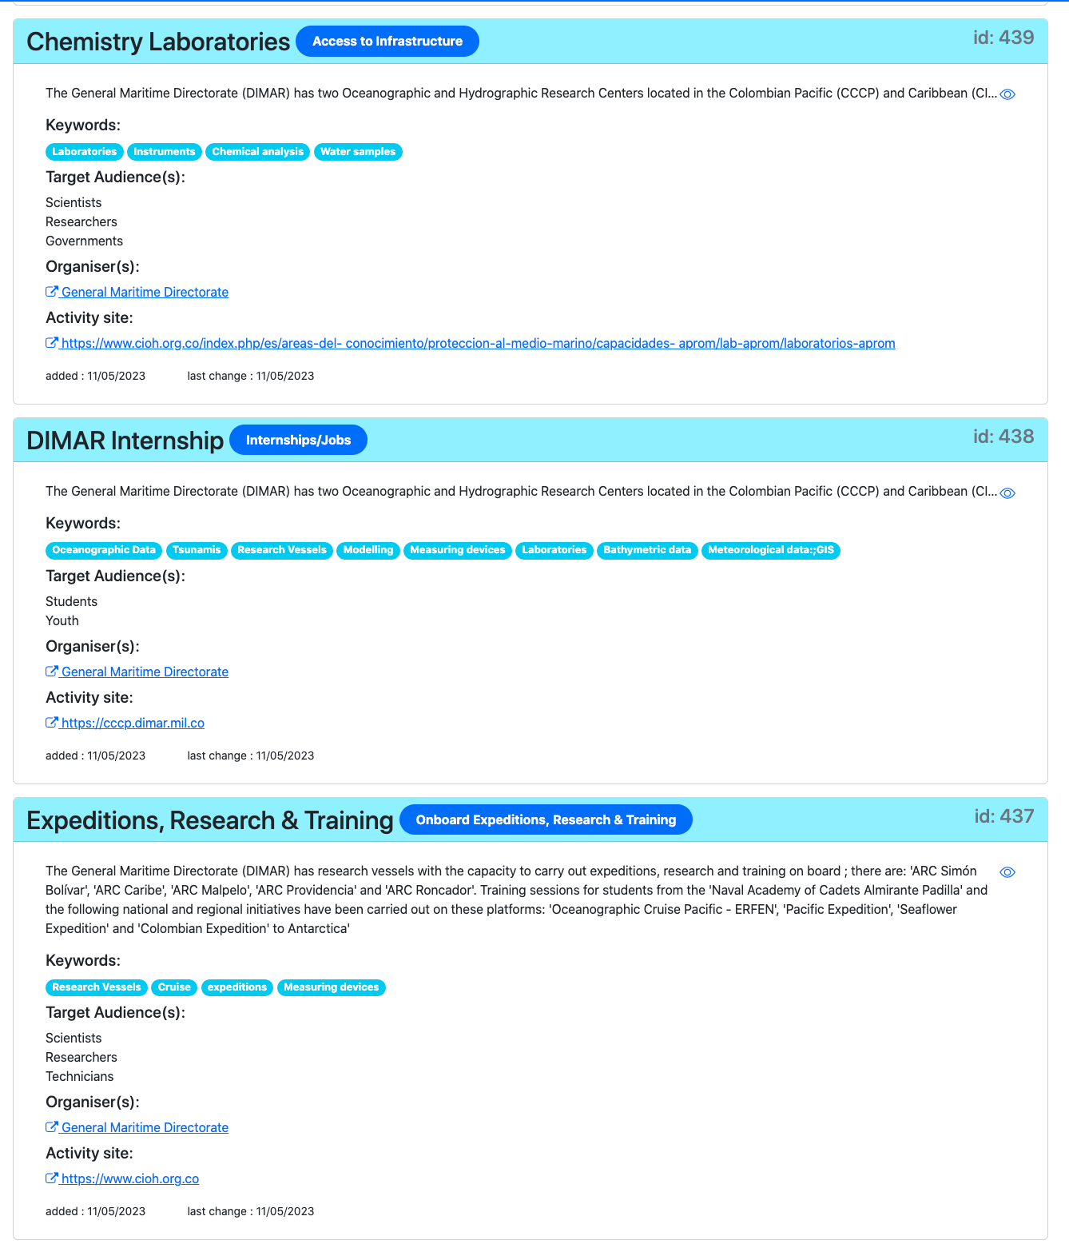
BENEFITS
Serves as a central repository to easily search for available CD opportunities
Identifies synergies and potential partnerships with other organizations
Avoids duplication of effort and mutualize resources
Helps Member States report on progress and achievements towards: SDGs, UN Ocean Decade, BBNJ, etc.
The Ocean CD-Hub as a living entity where new entries can be added as opportunities are shared and discovered…
IOCARIBE Webinar Series
What CD opportunities are there in the region?
What expertise are available in the countries?
What potential collaboration or partnerships are possible?

Slide 6
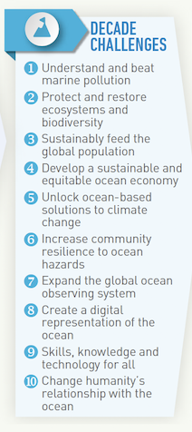
NEXT STEPS
Expand the Ocean Capacity Development Hub list of CD opportunities offered globally and regionally
Matchmaking exercises with existing expertise and resources vis-a-vis identified regional priorities for capacity development
Collaborate and contribute to capacity development ambitions of the Decade through the CD Facility
  Add metadata for CD components of the Decade actions
Further development of mechanisms to capture new entries
  Interactive functions
  Inclusion of more keywords
https://oceancd.org
CD FACILITY

Slide 7
Thank you.

