Slide 1
Tsunami OTGA
Tsunami Awareness
Tsunami Ready
TTDMP-TOWS Meeting
19-23 February 2024
IRIDES, Tohoku - Sendai
Ardito M Kodijat
Indian Ocean Tsunami Information Centre
Laura Kong
International Tsunami Information Centre

Slide 2

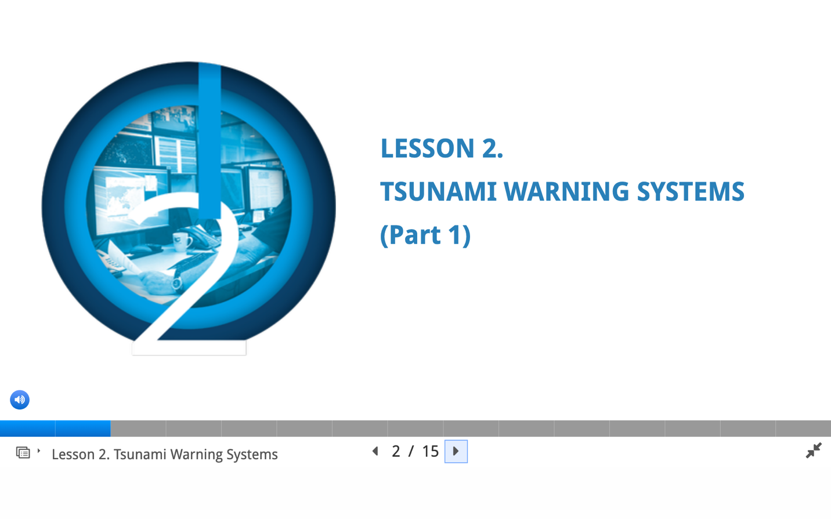
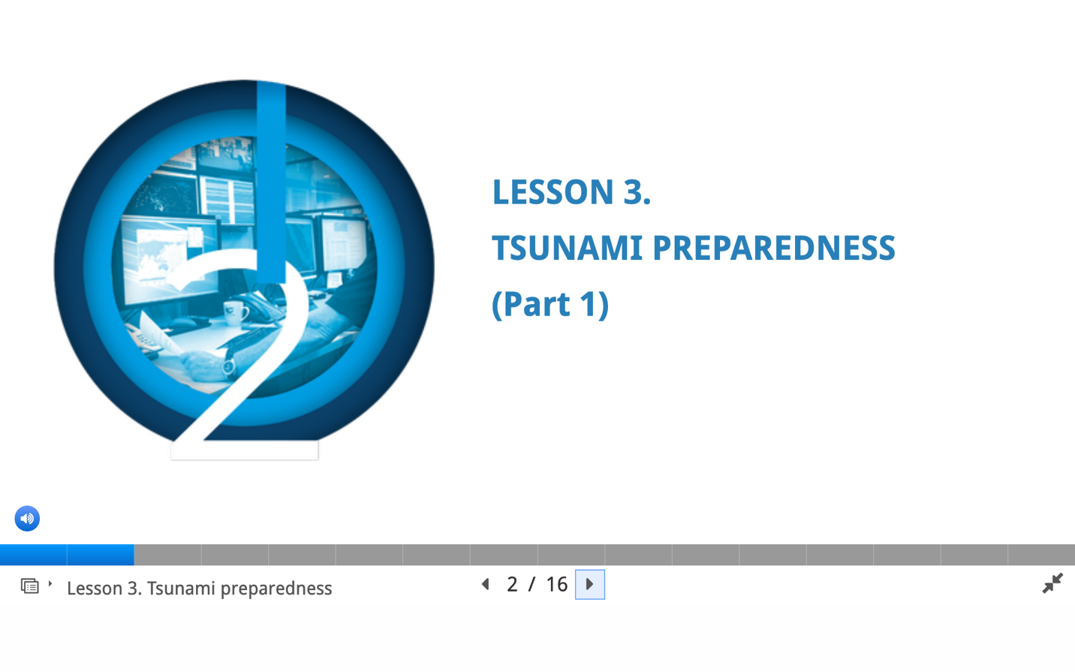
Tsunami Awareness Training Course
OTGA Tsunami Awareness certificate required to enrol in Tsunami Ready
ITIC and IOC TSR Joint work on OTGA Tsunami Awareness Materials
Pre-Quiz
Lesson 1: Tsunami Basics (Parts 1 and 2)
Lesson 2: Tsunami Warning Systems (Parts 1 and 2)
Lesson 3: Tsunami Ready Preparedness (Parts 1 and 2)
Post-Test
Tsunami
Awareness
21 and 24 Slides
Narrated Transcript
17 and 19 Slides
Narrated Transcript
16 and 25 Slides
Narrated Transcript

Slide 3
Tsunami Awareness Training Course
ITIC and IOC TSR Joint work on OTGA Tsunami Awareness Materials
Final steps:
Course Development (in OTGA Moodle).
  Finish updates of images/maps for data/events, definitions through 2023
  Review and update scripts for each slide
  Re-record voice narration of script, as needed
Course Delivery
  Test Course (registration, take course (pre-quiz, modules with activities, post-test, grading, certificate receipt)
  Make Course Live

Slide 4
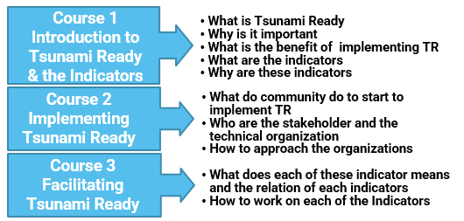



Tsunami Ready OTGA Training Materials
ITIC and IOTIC Joint work on OTGA Tsunami Ready Training Materials
Course 1
Introduction to UNESCO-IOC Tsunami Ready Recognition Programe
Lessons 1: Tsunami Ready Background
Lessons 2: Tsunami Ready Implementation Process
Lessons 3: Tsunami Ready Indicators
Course 2
Facilitating Tsunami Ready
Lessons 1: Approach to Tsunami Ready Community Capacity Building
Lessons 2: Assessment Indicators
Lessons 3: Preparedness Indicators
Lessons 4: Response Indicators
23 Slides
Transcript of each slide
19 Slides
Transcript of each slide
22 Slides
Transcript of each slide

Slide 5
Tsunami Ready OTGA Training Materials
ITIC and IOTIC Joint working on OTGA Tsunami Ready Training Materials
Next steps
Change images/diagrams with high quality version or new images
Develop task and assignments
Review the scripts
Review the quizzes
Video or voice recording of the script
Convert to Moodle

Slide 6
Thank you

