Slide 1
Tsunami Recognition Sign
TOWS WG-XVI (2023) - approved (xii) encourage the standard text in the UNESCO/IOC Tsunami Ready signage for vertical evacuation such as “Go to the designated building for vertical evacuation”

Slide 2
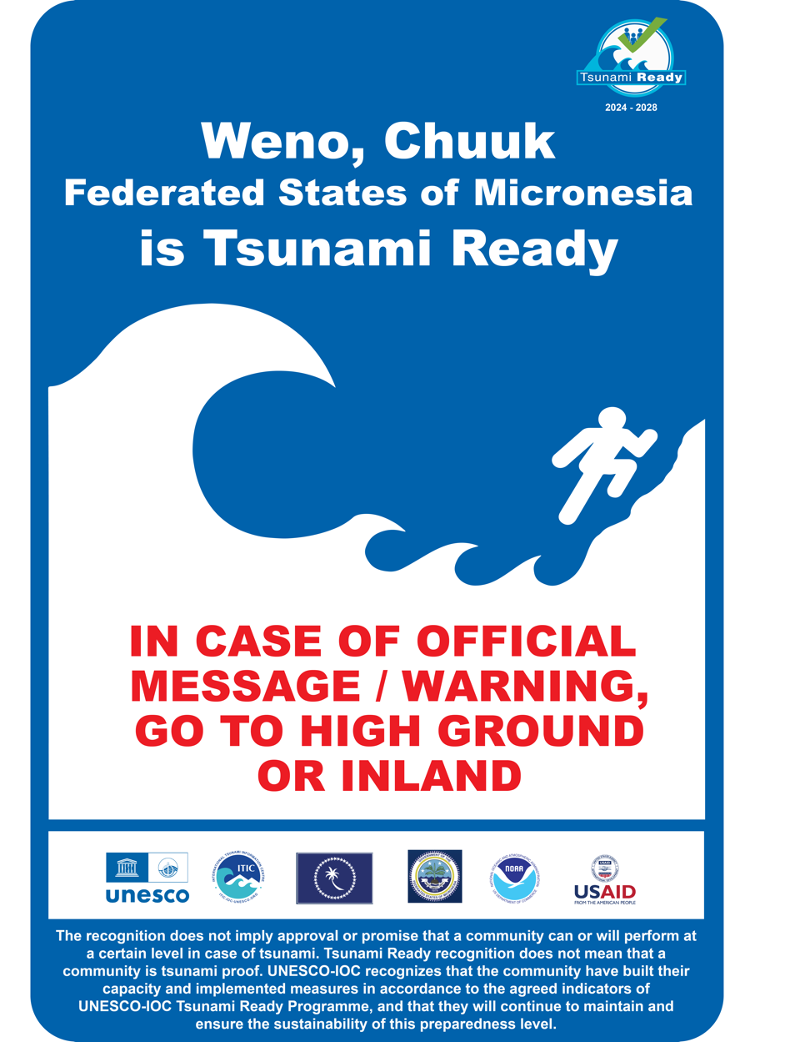
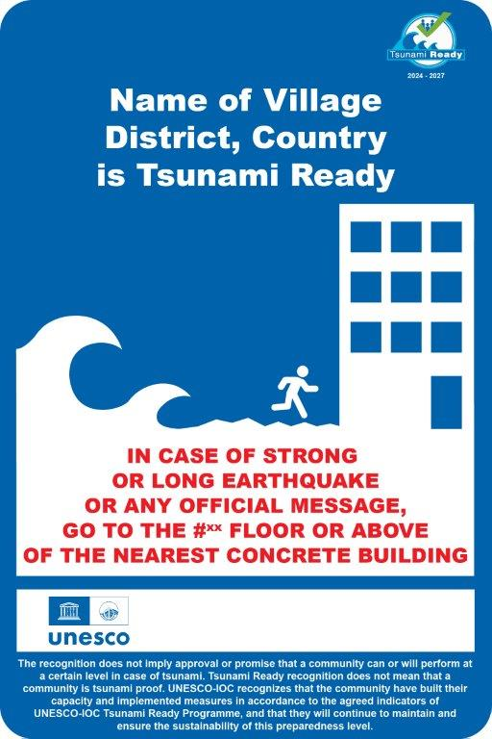
Customize to local context (near, far-field source, vert evacuation)

Slide 3
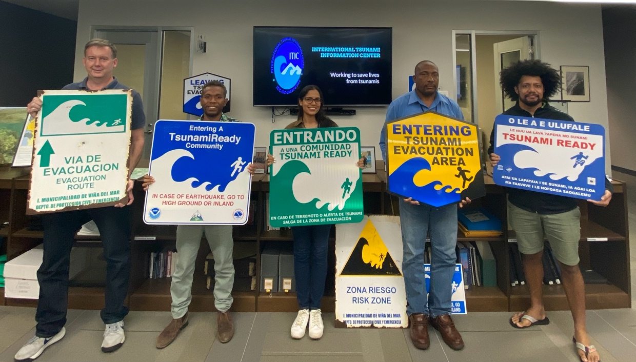
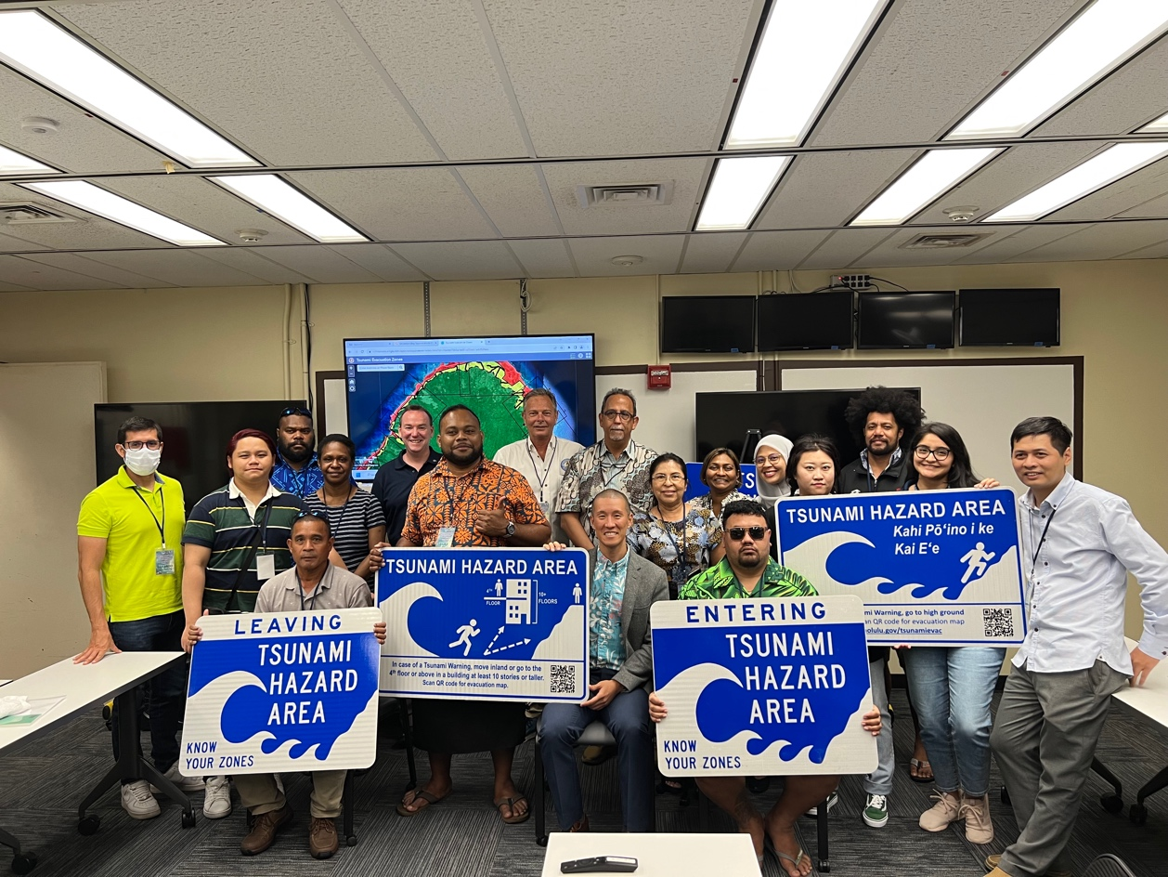
Customize to local context (near, far-field source, vert evacuation)

