Slide 1
WMO Report
for
TOWS-WG XVII
Sendai, Japan
Sarah Grimes (Marine Services),
Hassan Haddouch (WIS) &
Nadao Kohno (SC-MMO)
22-23 February 2024
(WMO hybrid connection)

Slide 2
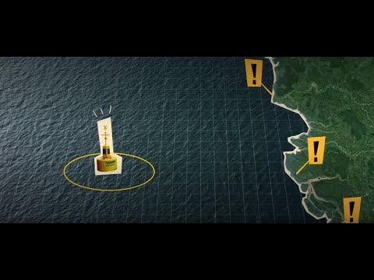

Met Services & Tsunami EWS
Multiple roles:
>35% Meteorological Services globally are Tsunami Service Providers – operational 24/7
Even more Meteorological services back up the National Service Provider, and/or support with infrastructure
In some regions, majority of NMHS are involved in tsunami early warning process eg. 80% NMHS in the Pacific Islands
How do National Meteorological and Hydrological Services and WMO support Tsunami Early Warnings?

Slide 3
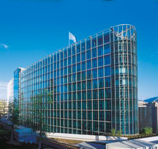
WMO & Tsunami EWS
WMO support NMHS, to strengthen their efforts in tsunami early warning, and maximise
efficiencies
2 Key areas where WMO supports the tsunami EWS process:
  Infrastructure, especially via the WMO Information System (WIS), and observations
  Early Warning Services, especially to strengthen the last mile of communication
Recap of relevant WMO structures:
SERCOM (SC-MMO* & SC-DRR), INFCOM*, Research Board* (*IOC rep)
WMO-IOC Joint Collaborative Board:
  Co-Chairs: India PR (WMO), Srinivasa Kumar (IOC )
  Services Members: TOWS WG Chair (IOC), Chair SC-MMO (WMO)
  WMO-IOC Strategy (2021 –2025)approved by WMO & IOC, 2021

Slide 4


WMO Information System (WIS) WIS 2.0
NCs / DCPCs are going to implement a WIS2 Node to exchange data in WIS2
The WIS2 Node shares data from an HTTPS service and sends notifications to MQTT subscribers
No need to provide access to all the users in the world, only to some WIS2 Global Services
WIS2 node is the component to provide data and associated metadata
WIS2 node replaces the GTS Message Switching System
Global
Services
Downloads data
Receives notifications of new data
Subscribes to
WIS2 node

Slide 5







Global Services
Downloads core data
Subscribes to topics
Discovers data/services
Downloads recommended data
Global Cache
Global Broker
Global Discovery Catalogue
Global Monitoring
WIS2 node
A storage providing a copy of the WMO Core data from the NCs/DCPCs to be accessed by the users.
  Data will be open to everyone.
  Some Global Caches are required globally for resilience.
Providing notifications of all the data available in the Global Caches or in originating centers.
  Users will subscribe to a Global Broker to get notifications of new data to be downloaded from Global Caches or WIS2 node
Monitoring of data exchanged in WIS2.
  Sensor Centers will make available statistics from data in real time
  Global Monitoring Center will collect statistics from Sensor Centers and provide web accessible maps and results.
It is a discovery catalogue of data and services.
  Provides an API to list the available data and services
  Harvests metadata from the WIS2 Nodes.

Slide 6
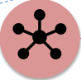





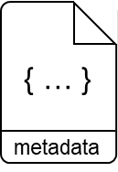
WIS2 in a box: What is it?
WIS2 in a box is a reference implementation of a WIS2 Node
  MQTT
  HTTP
Software (not hardware)
Publishing facility/capability compliant to WIS 2.0 Architecture
  Provides basic data transformation
  Can integrate with existing data management systems
Global Broker
subscribe
notification
of new data
notification
of new data
Data
Consumer
subscribe
download
Message Broker
Core Data
WIS2 Node
Recommended
6

Slide 7

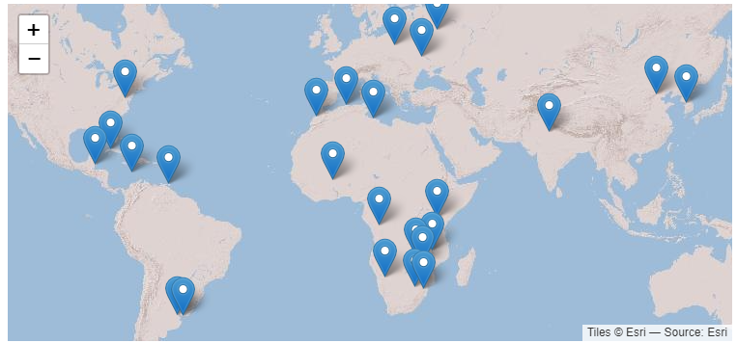
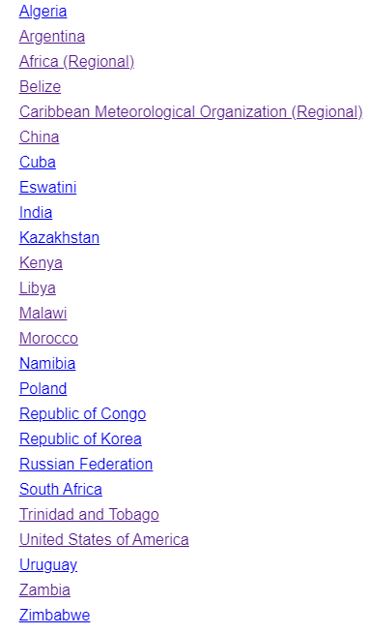
WIS2 in a box
gitHub repositories and docs
Code: https://github/wmo-im/wis2box
Documentation: https://docs.wis2box.wis.wmo.int
Demo: https://demo.wis2box.wis.wmo.int
Discussion Forum : github.com/wmo-im/wis2box/discussions
Apache license version 2.0
Permissions
Commercial use
Distribution
Modification
Patent use
Private use
Conditions
License and copyright notice
State any changes
Limitations
Liability
Trademark use
Warranty

Slide 8
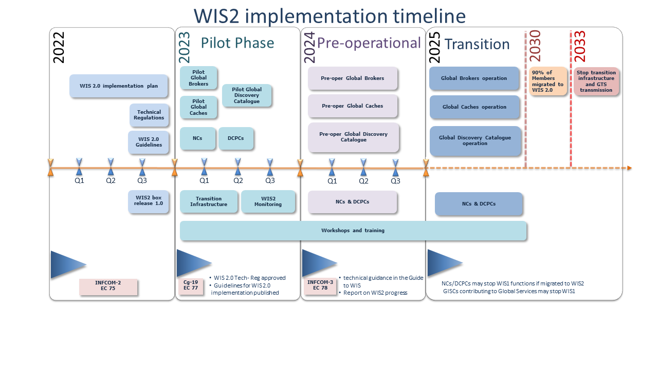

Slide 9
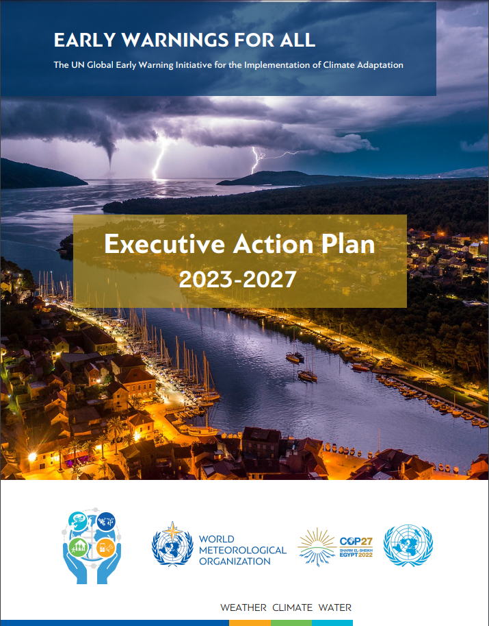
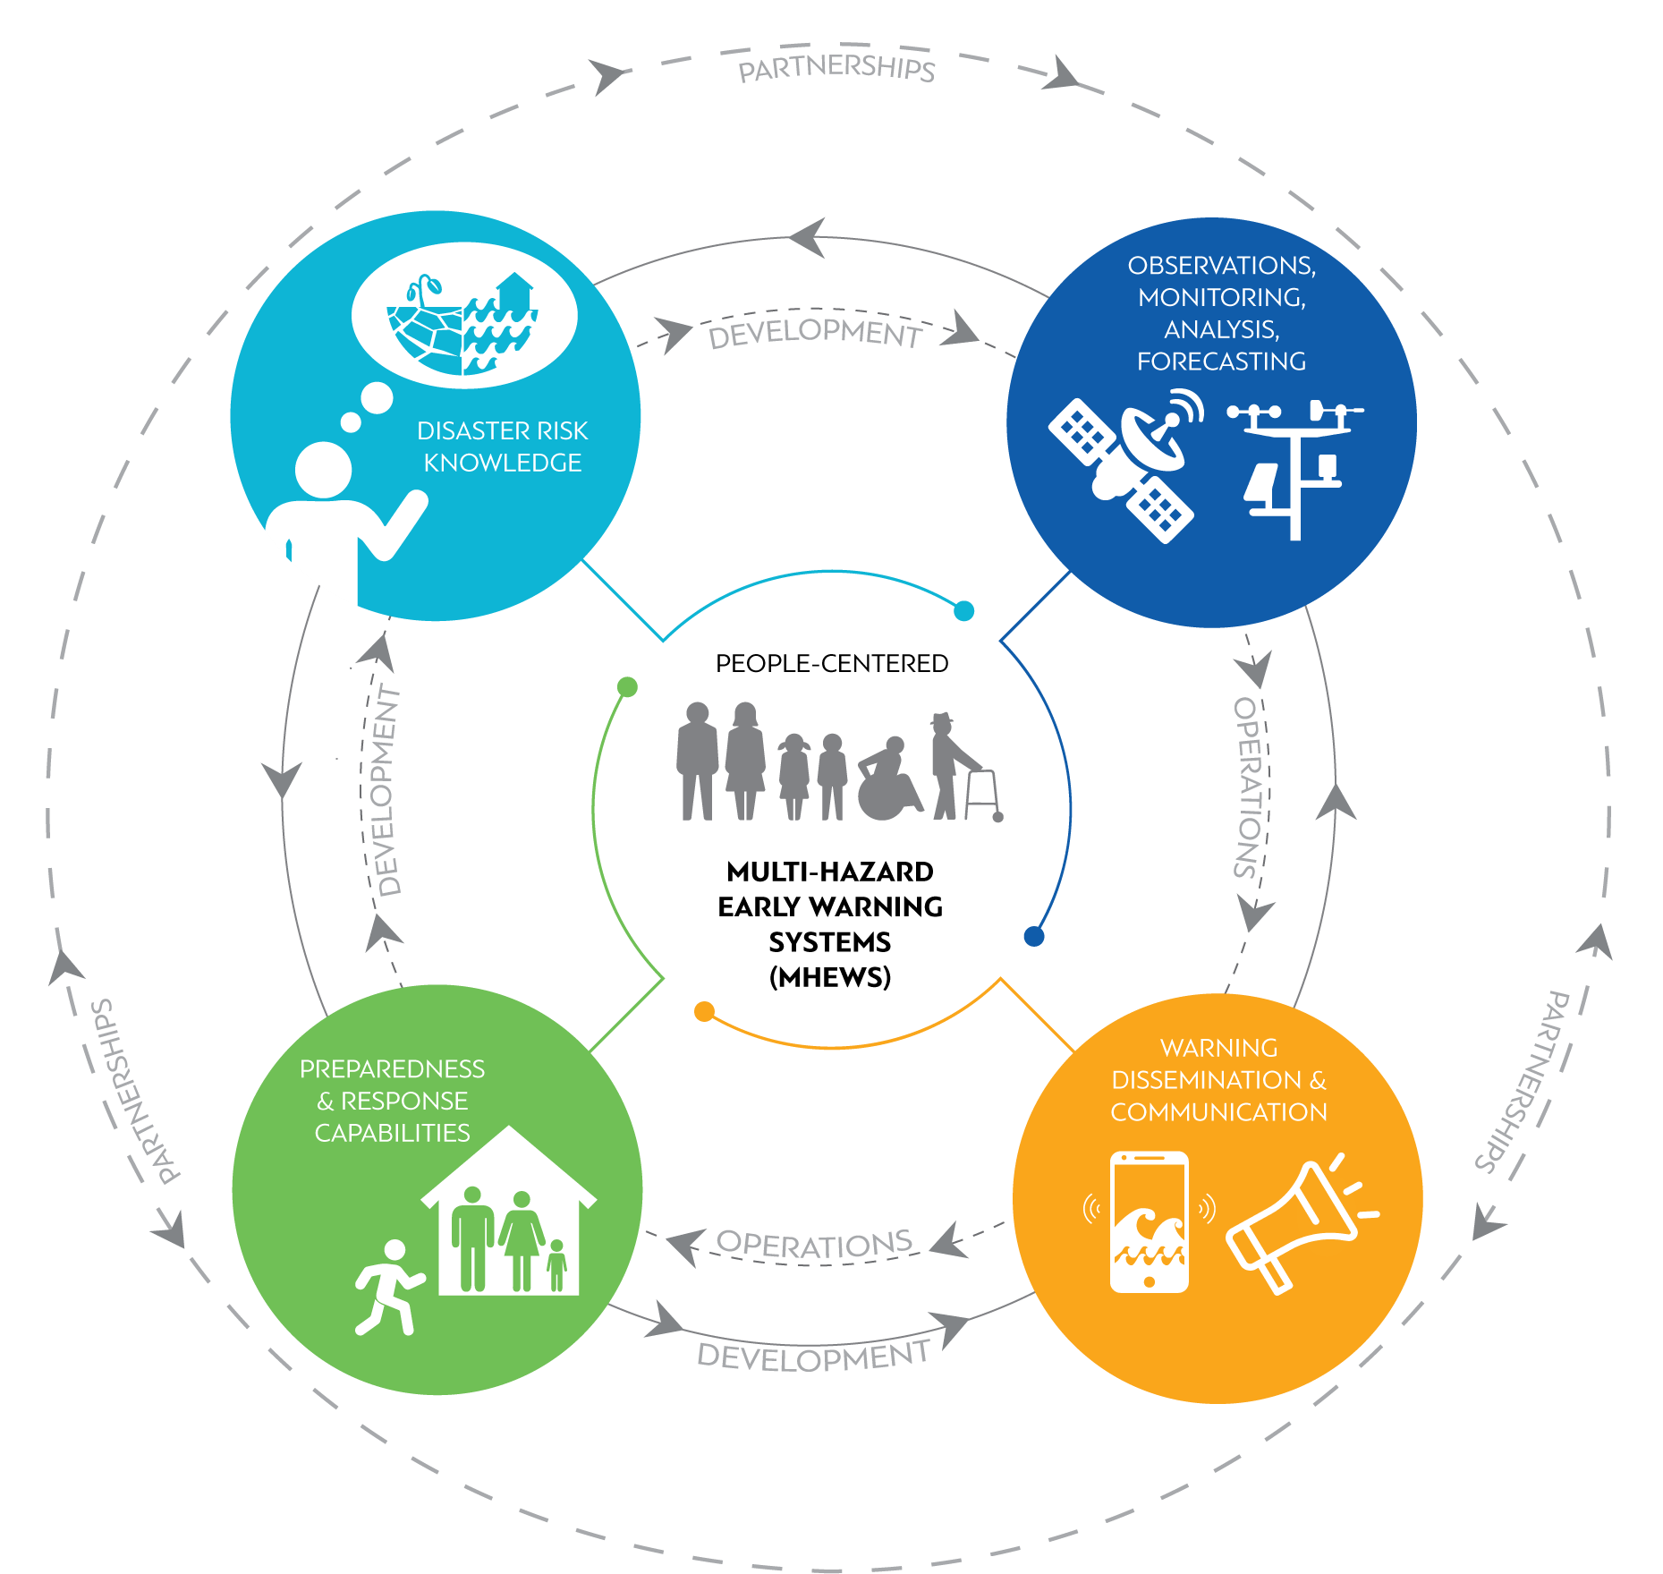
Early Warnings for All Initiative
UN SG
Announced on World Met Day 2022
Action Plan developed by WMO
Launched at COP-27 (Nov 2022)
https://public.wmo.int/en/earlywarningsforall

Slide 10
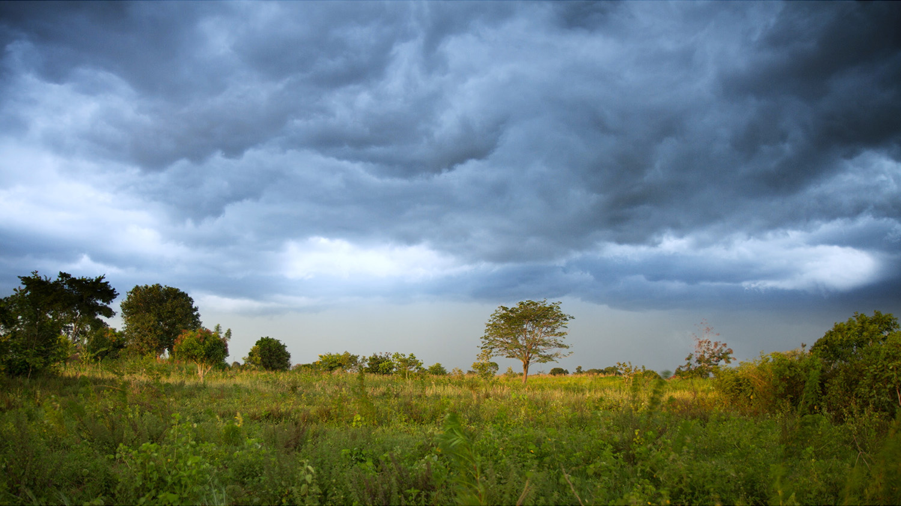
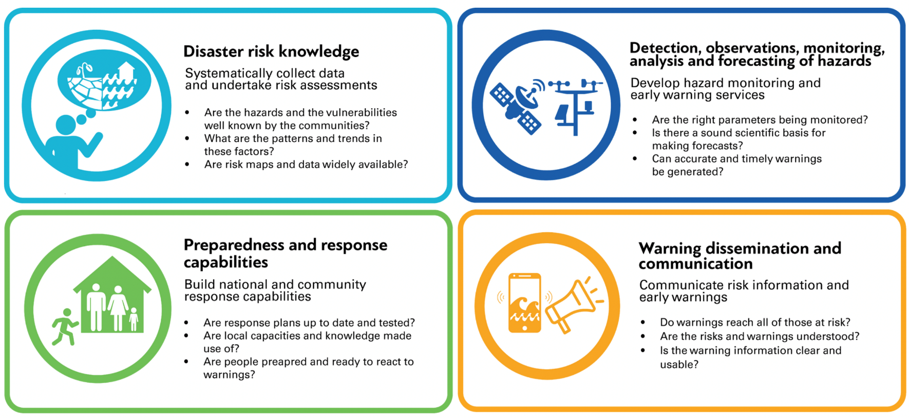
Early Warnings for All: Structure & Objectives
Notes:
The EW4All Initiative comprises four Pillars, in line with the four components of an end-to-end multi-hazard early-warning system: risk knowledge, observation and forecasting, communication and response.
Pillar 1: To be effective, EWS need to be contextualised and targeted through up-to-date, reliable and granular risk knowledge, including: assessments of hazards, vulnerabilities and exposure; applying a gender-lens and including indigenous and local knowledge. Significant shortcomings persist globally, from lack of data collection and assessments to lack of legislation and governance frameworks for risk information.
Pillar 2: In the forecasting area, many countries lack the capacity to incorporate an impact-based approach to forecasting and still have challenges in accessing, analysing and translating prediction model outputs into actionable warning messages.
Pillar 3: Considering warning dissemination and communication, the uptake of modern information technologies is lagging and even with more traditional methods (such as radio and mass media), there are still challenges in terms of inclusivity and reaching the most vulnerable.
Pillar 4: Having preparedness and response plans and capabilities, including at local government level is vital for responding to the hydro-meteorological warnings. Currently, less than half of the countries which have EWS in place have such plans and capacities available.

Slide 11

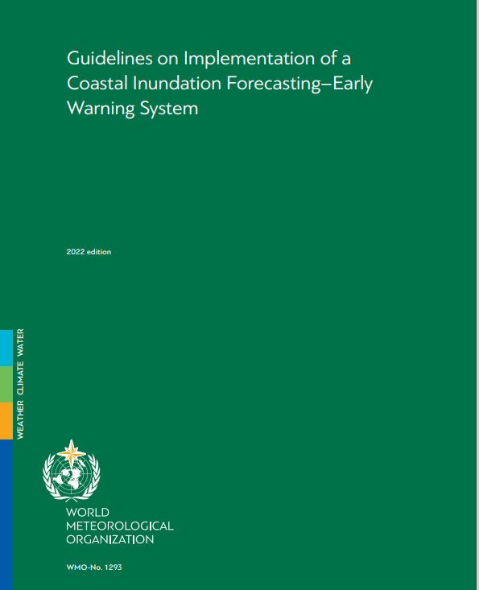
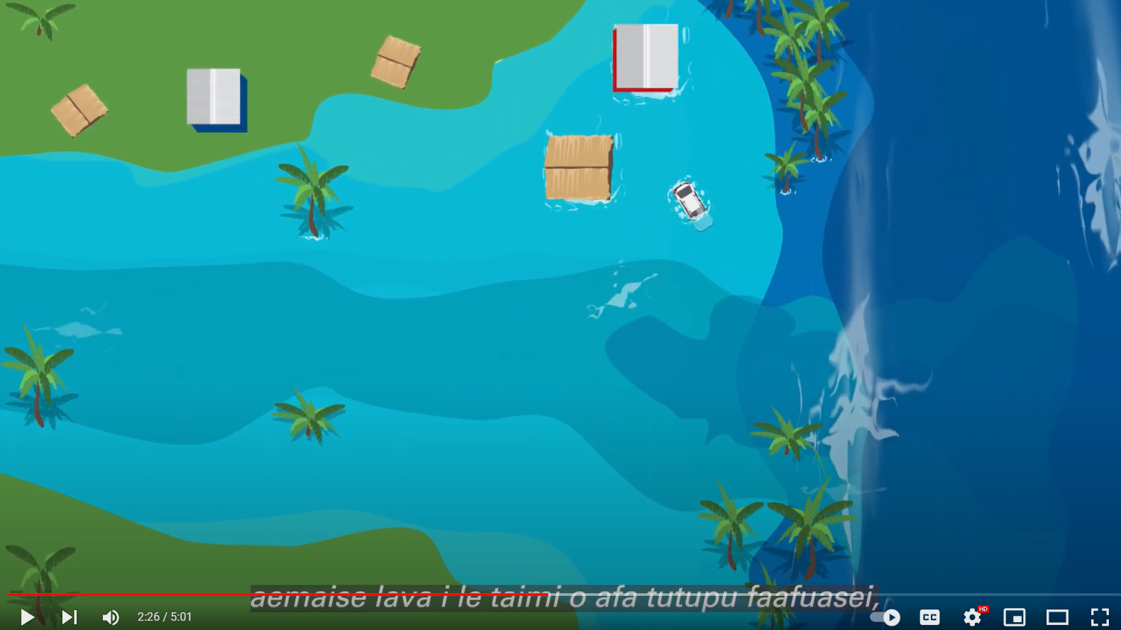
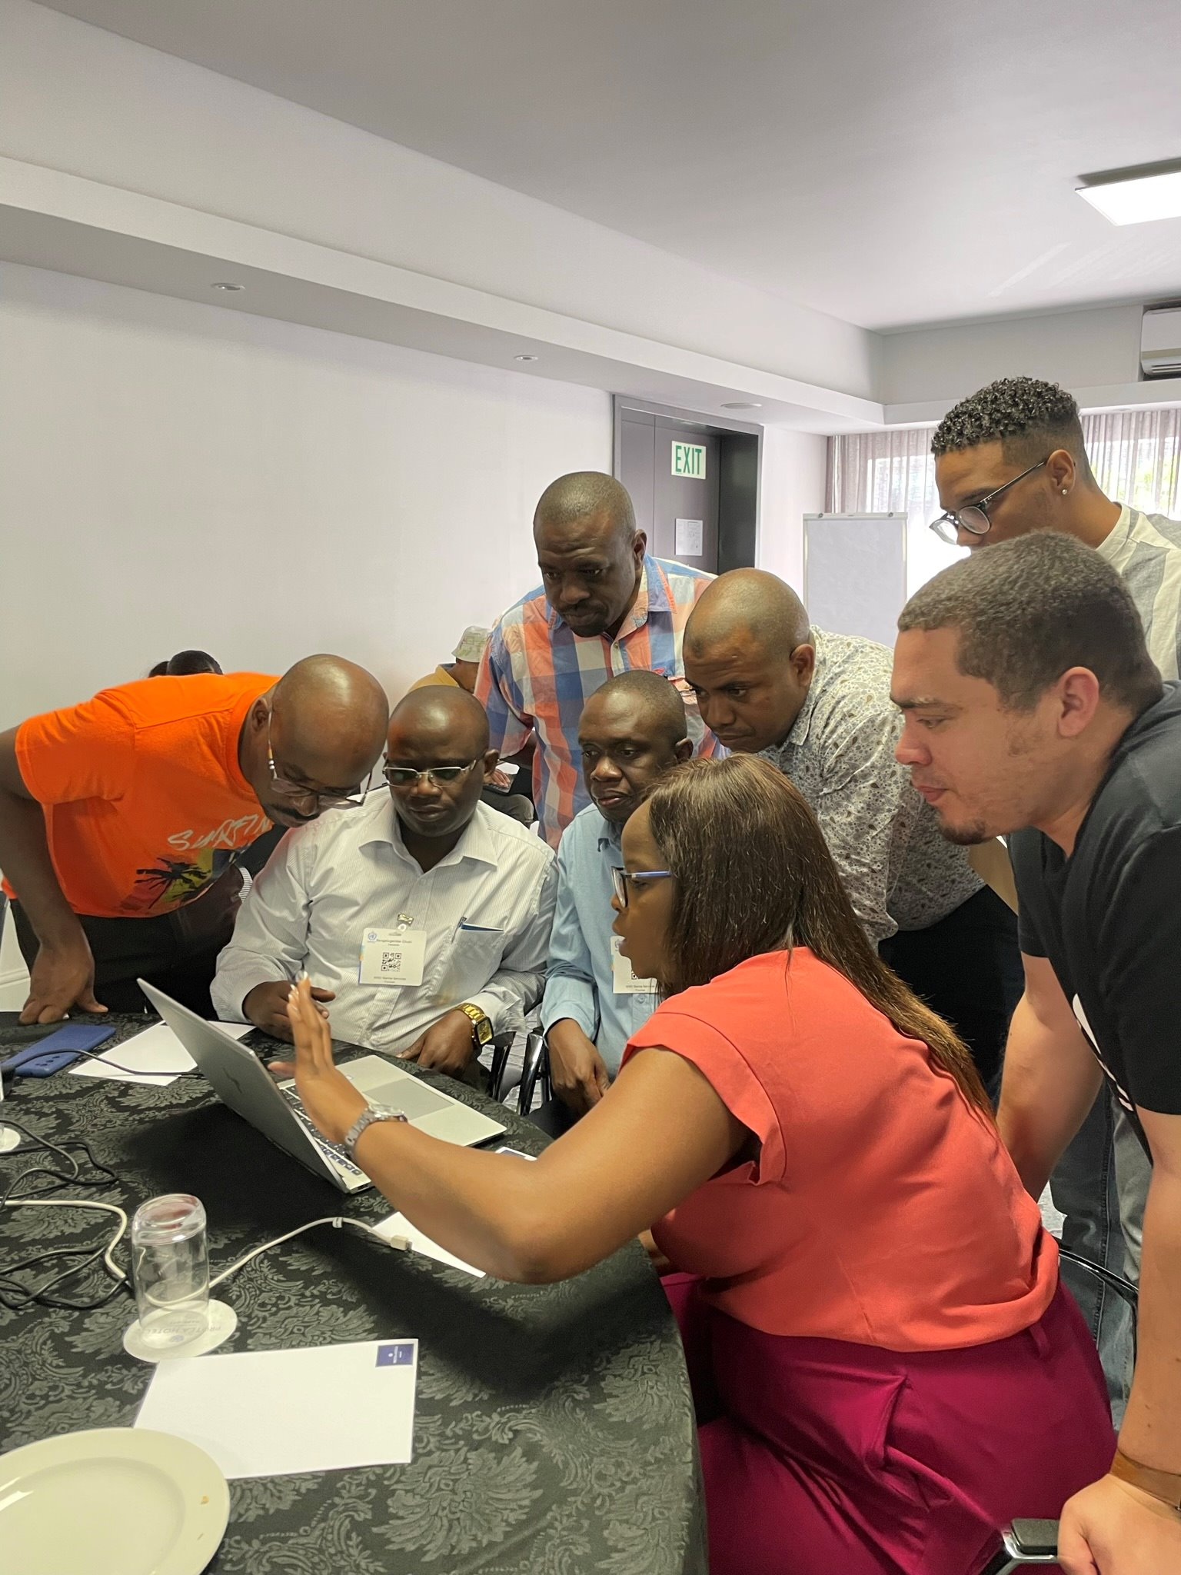
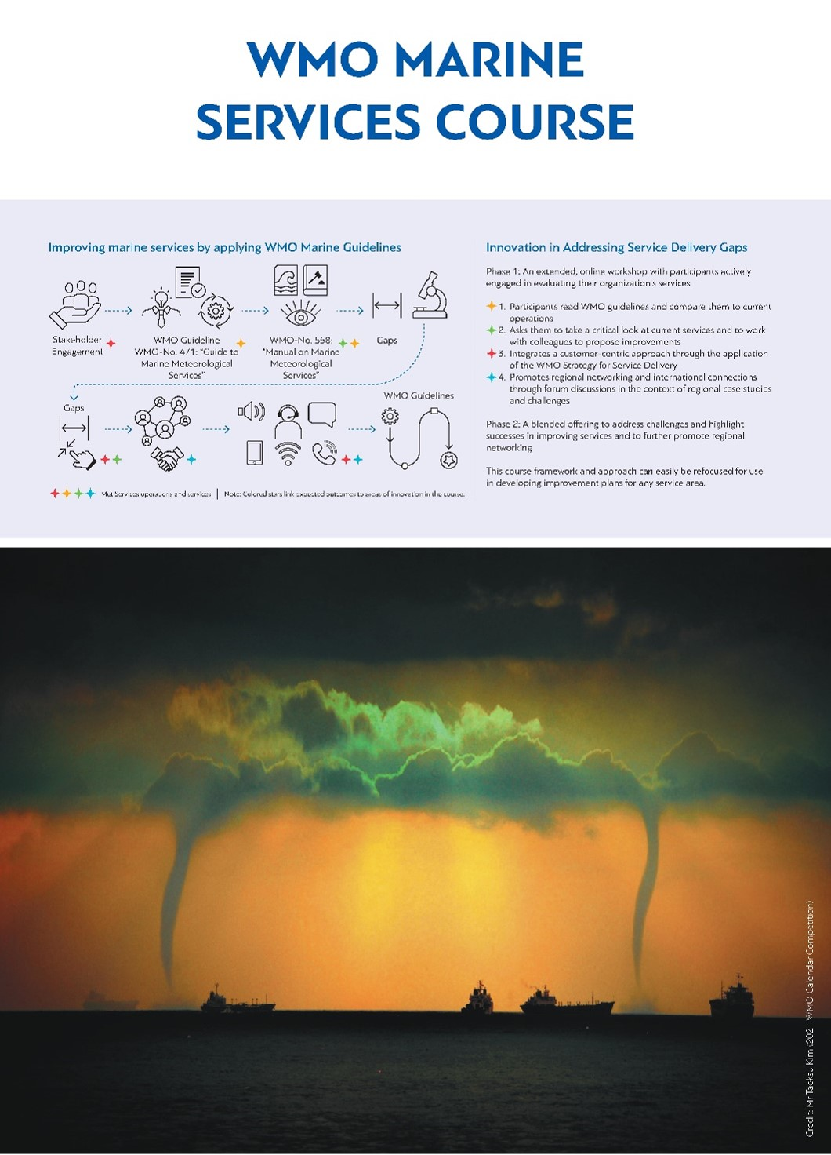
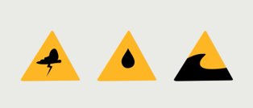
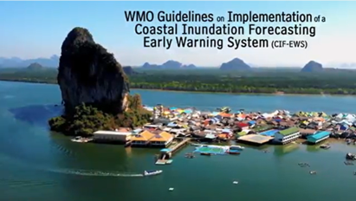
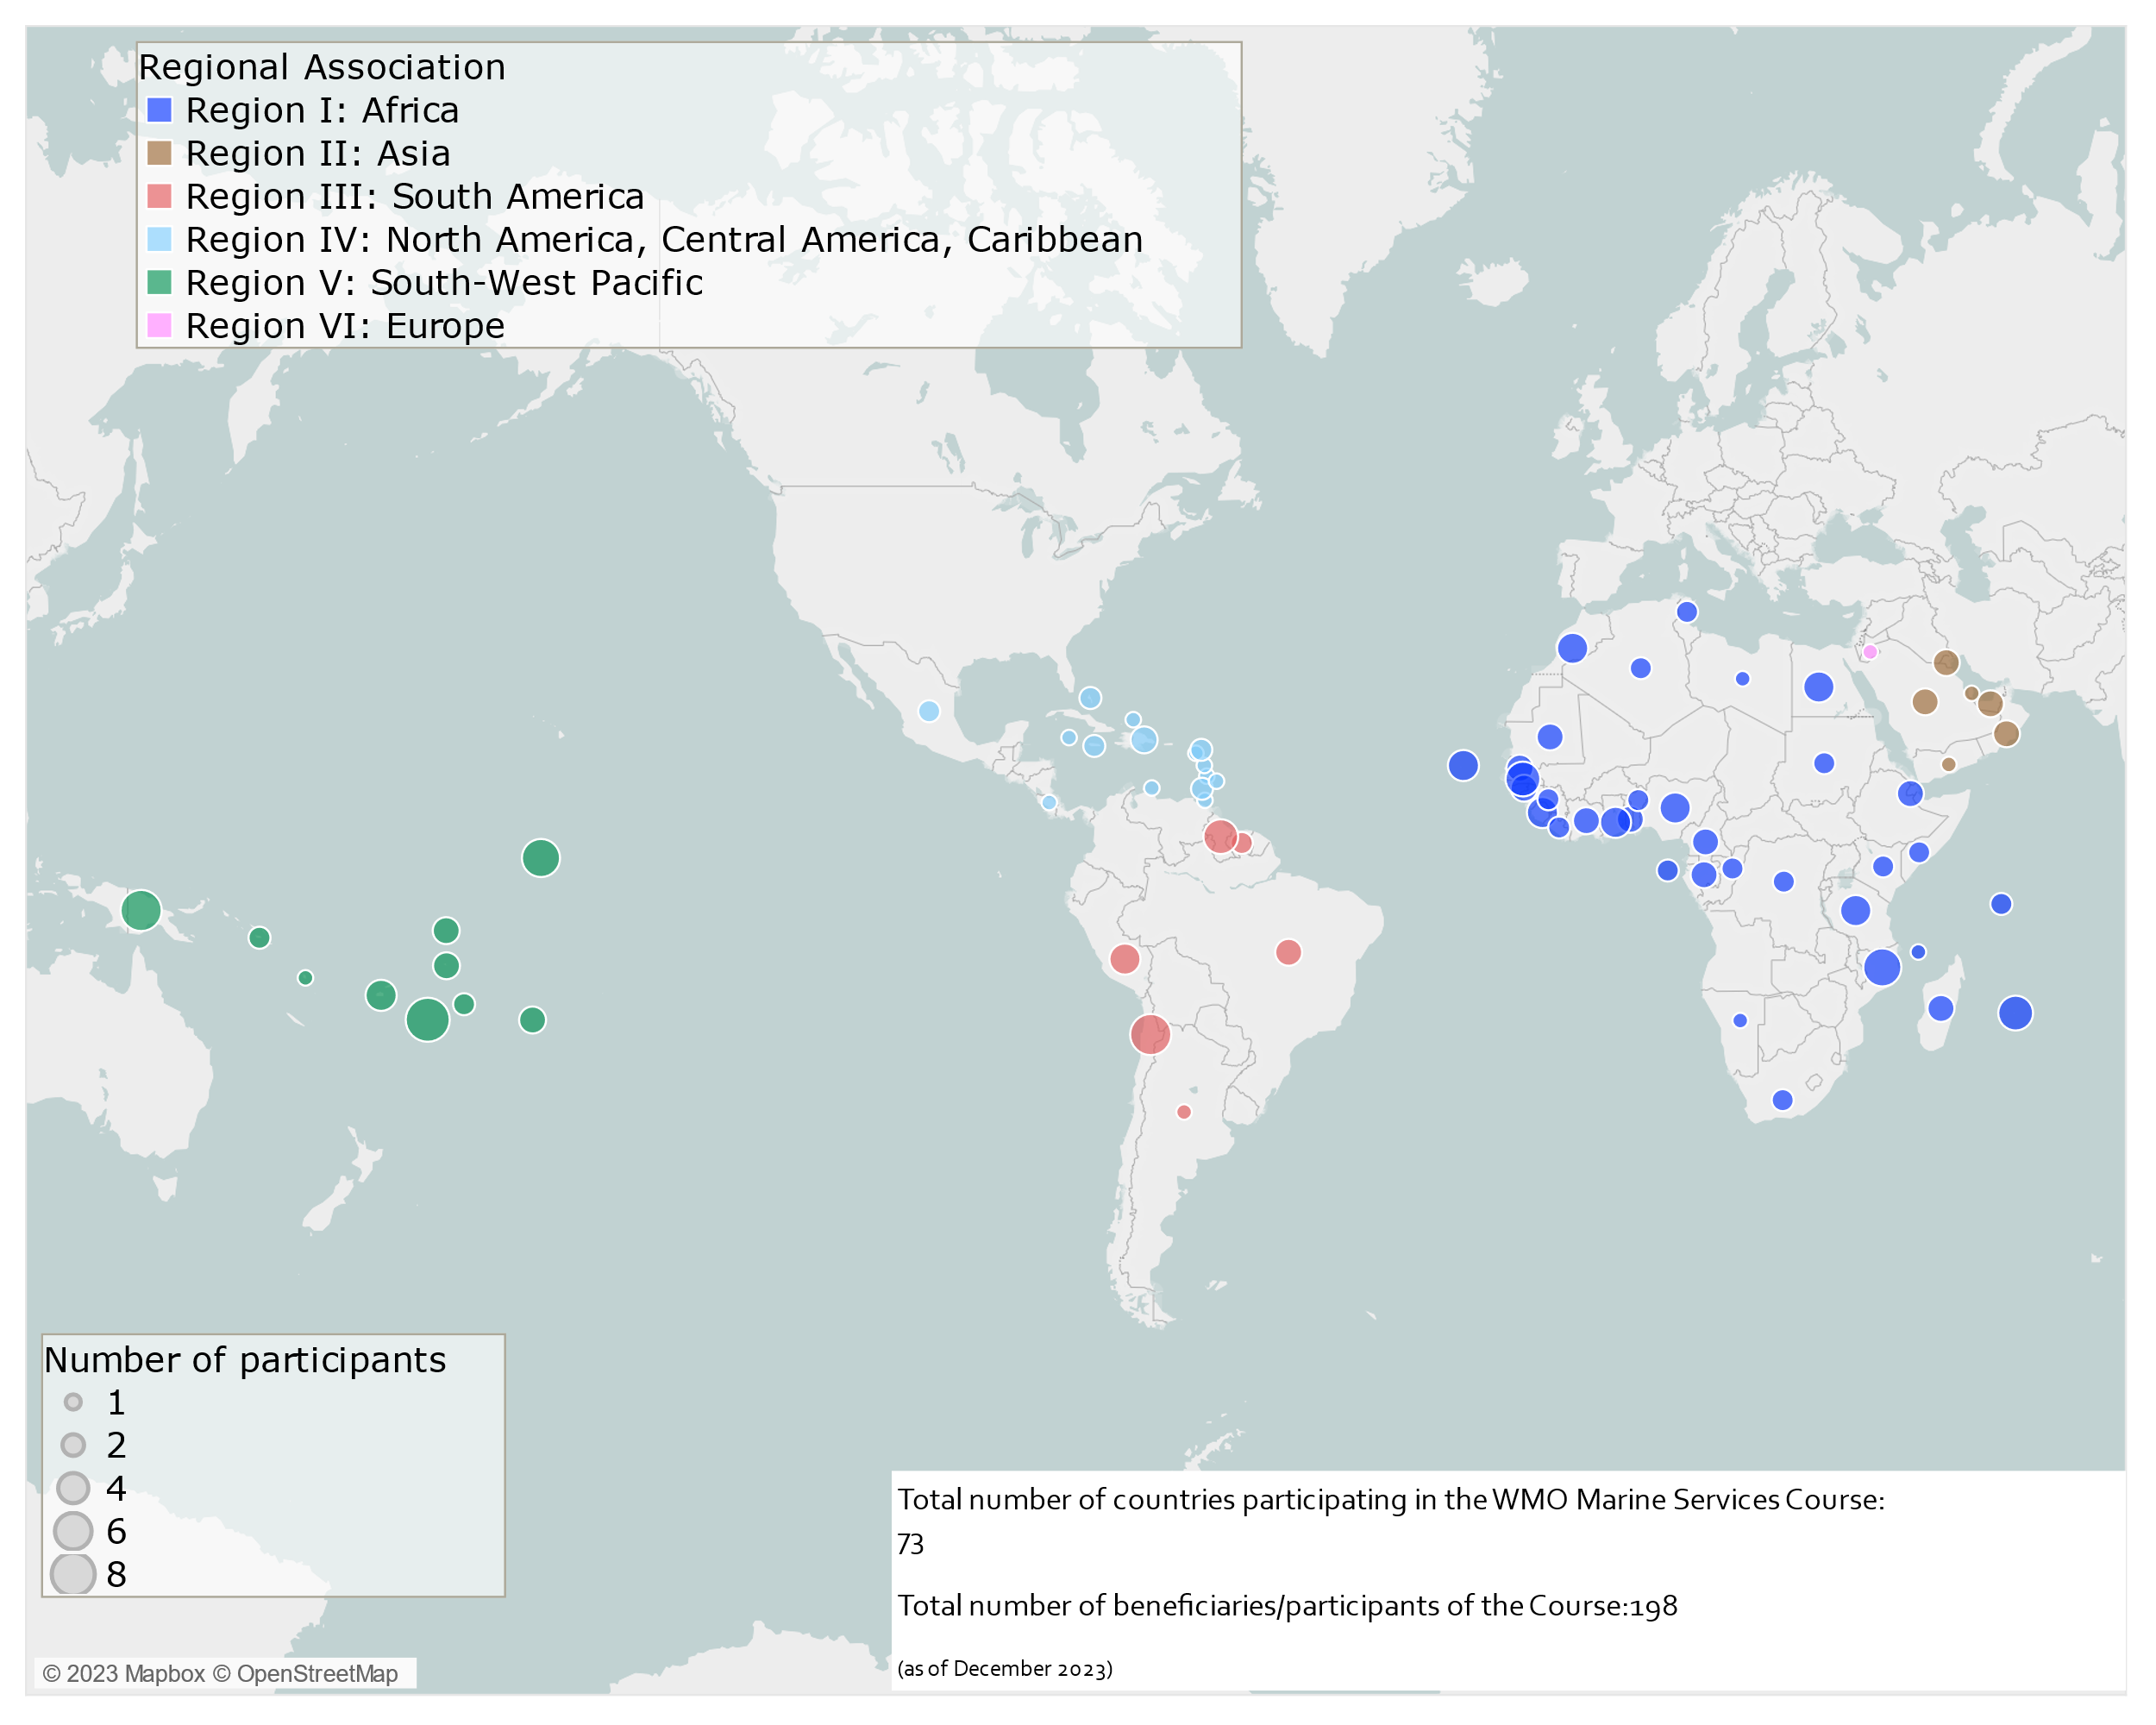
Other touchpoints
CAP – encouraging NMHS to use this, where appropriate for TEWs
Coastal Inundation (and links to MHEWS/tsunami)
  WMO 1293 Coastal Inundation Guidelines & video, published
  Awareness videos – local languages – Pacific, Caribbean: coastal inundation, value of ocean buoys
METAREAS/NAVAREAS - joint hazard response
Marine Competency Toolkit
WMO Marine Services Course:
  Completed: Pacific Islands (Tsu session), Africa (En.)
  Partially Completed – Africa (Fr). Arabic, Caribbean,
  South Am (Spanish)
  Other regions in 2024

Slide 12
Long Range Waves otherwise known as
'Meteo-tsunami'
Atmospheric forcing of a long range wave (non seismic, atypical) defined as 'tsunami-like'.
Driven by air-pressure disturbances mostly associated with fast-moving weather events.
Progressive waves limited to tsunami frequency band of wave periods (2 mins to 2 hours)
NMHS are principally responsible for providing early warnings for weather driven coastal hazards (eg storm surges, swell, waves etc) via their operational weather forecasting areas
Weather warnings, including coastal hazards, need to be easily understood by the public
Japanese terminology:
  Tsu + nami = Port and Harbours + waves (historically)
  Tsunami = technical term for long waves generated by earth movement
  Abiki = local name for long range waves driven by air pressure disturbance

Slide 13
Long Range Waves otherwise known as 'Meteo-tsunami' - status since TOWS WG 2023
Operational Framework:
WMO experts and secretariat have been contributing to the ad-hoc Task Team for Meteotsunami – the investigation continues with focus on early warnings and operational framework for such events.
Term and Definition:
WMO has concerns about the term and definition of 'meteotsunami' which is 'tsunami-like'
The situation is complicated with various opinions from different communities eg science, academic, tsunami, and operational meteorologists
WMO is committed to gathering the views of Members, and working with TOWS WG, to consider the best way forward to clarify the term and definition, while ensuring the public interest and safety at the coast is paramount.
WMO-IOC JCB
WMO has requested to the WMO-IOC JCB, that 'meteo-tsunami' is raised for discussion, to clarify the roles and responsibilities of WMO and IOC, and how best to support Members. This is likely scheduled for Q3, 2024.

Slide 14
EW4ALL - various events
WMO SERCOM-3, March 2024 (Indonesia)
WMO INFCOM-3, April 2024 (Geneva)
WMO-IOC JCB – Next week (online) and Q3 (face to face)
WMO EC-78 (self-assessment results for WMO-IOC JCB)
WMO Marine Competency – test pilots
WMO Marine Services Course
  Phase 2 Face to Face – Caribbean (English/Spanish), South America (Spanish)
  Phase 1 (online) - SE Asia (English)
2024 events of interest

Slide 15
Arigato Gozaimasu!
Thank you!

Slide 16
MHEWS System – People Centered Approach
Empower those threatened by Hazards to act in sufficient time and in appropriate manner, and must build on partnership within and across relevant sectors
  Senior Leadership Board: co-chaired by WMO and UNDRR. Key UN organizations ITU, IFRC, up to 3 private sectors representatives and funding agencies​
  Pillar implementation: initial thoughts by lead agencies of each pillar, in consultation with the partner organizations:​
    Pillar 1, Disaster Risk Knowledge & Management (UNDRR) ​
    Pillar 2, Detection, Observation, Monitoring, Analysis and Forecasting (WMO)​
    Pillar 3, Warning, Dissemination Communication (ITU) ​
    Pillar 4, Preparedness and Response Capabilities (IFRC)​
Notes:
PROPOSE TO REMOVE

Slide 17





















Early Warnings for All: Partners
Pillar 1
Led by
Pillar 2
Led by
Pillar 3
Led by
Pillar 4
Led by
Notes:
WMO and UNDRR were requested , at COP27, to co-lead the implementation of the initiative ,
4 agencies lead respective pillars, recognizing they also contribute to other pillars
Senior Leadership Board: co-chaired by WMO and UNDRR. Key UN organizations ITU, IFRC, up to 3 private sectors representatives and funding agencies

