Slide 1

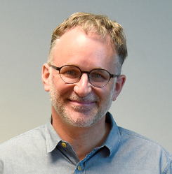
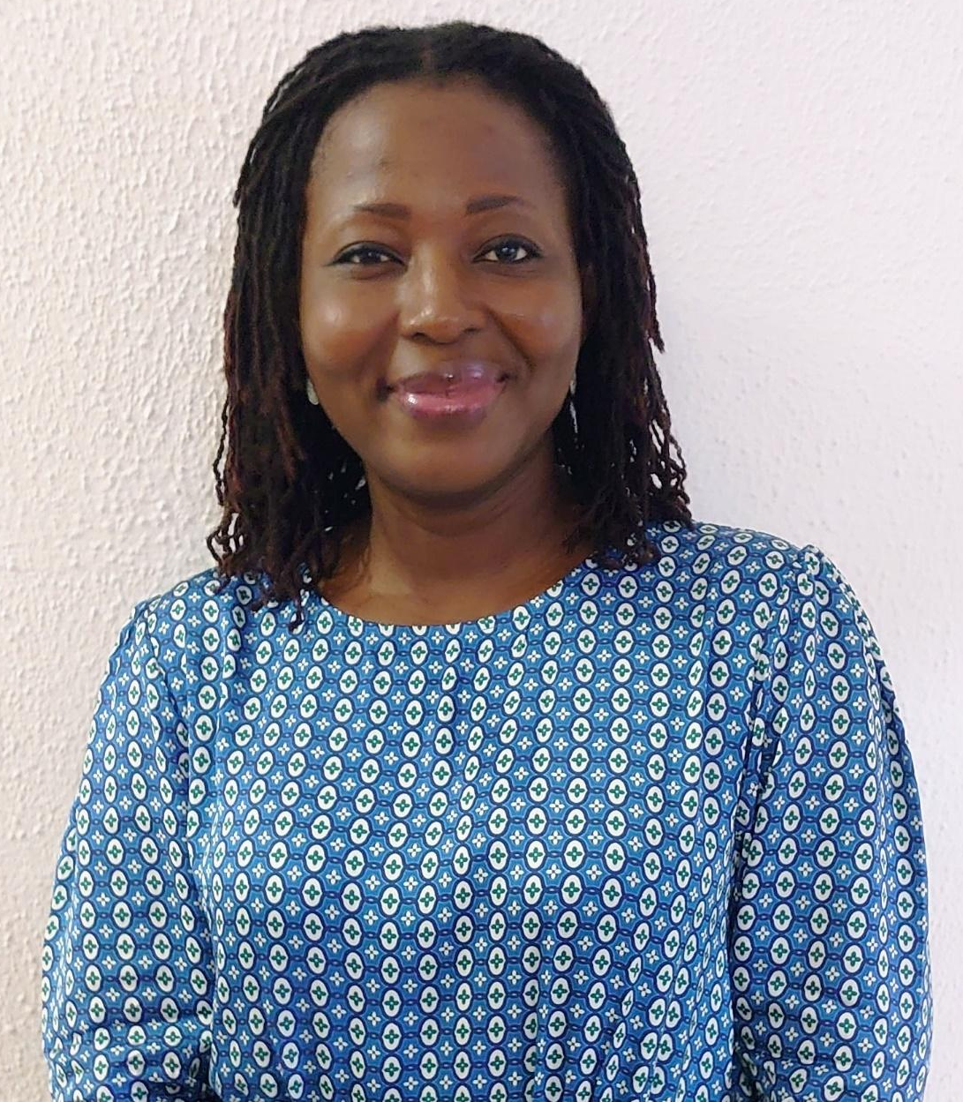
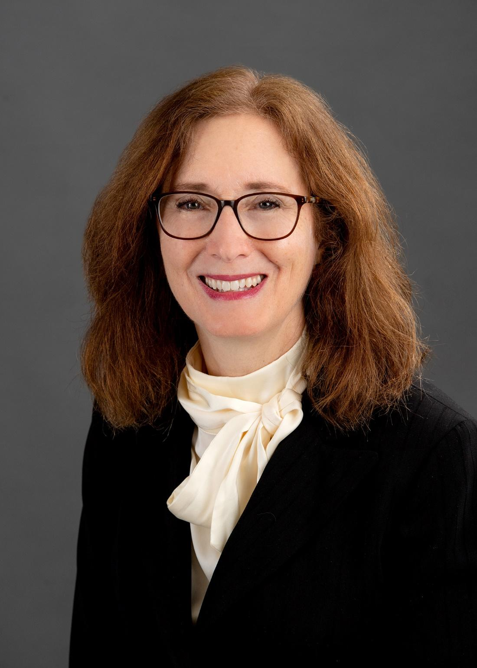
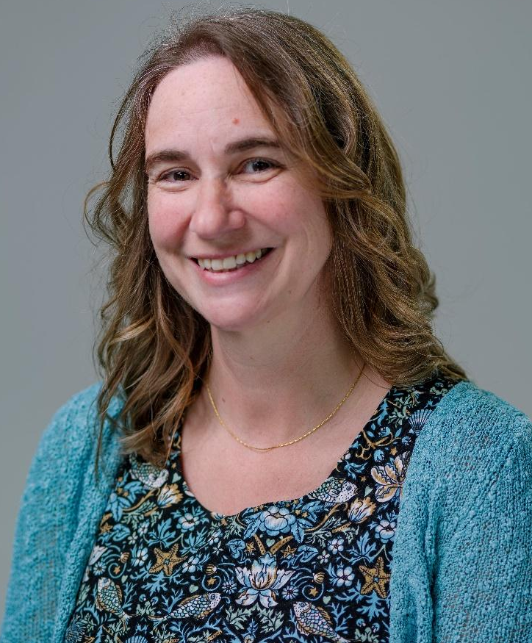
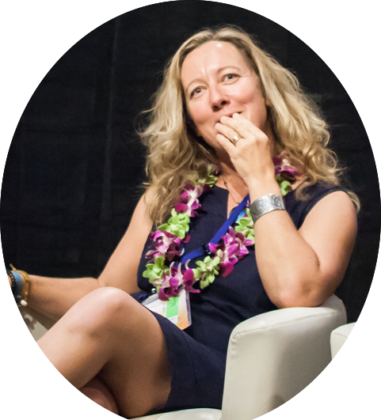
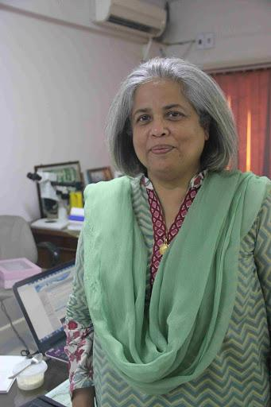
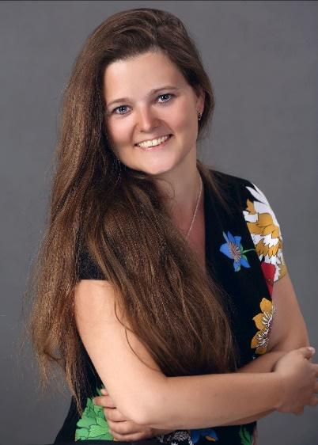
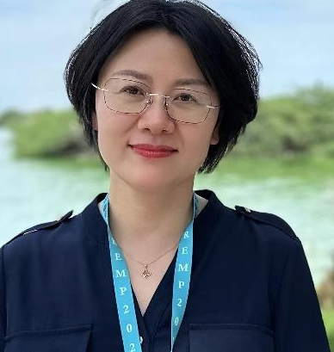
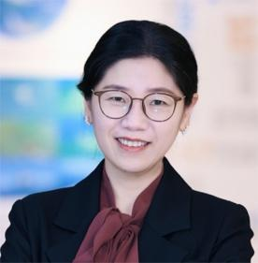
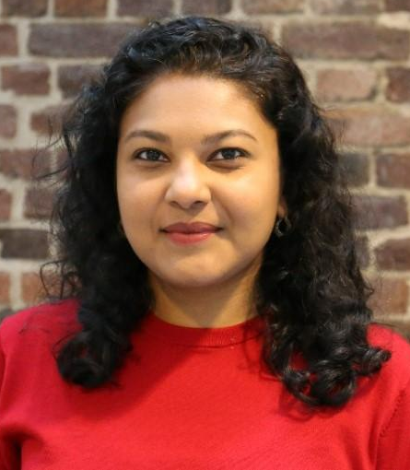
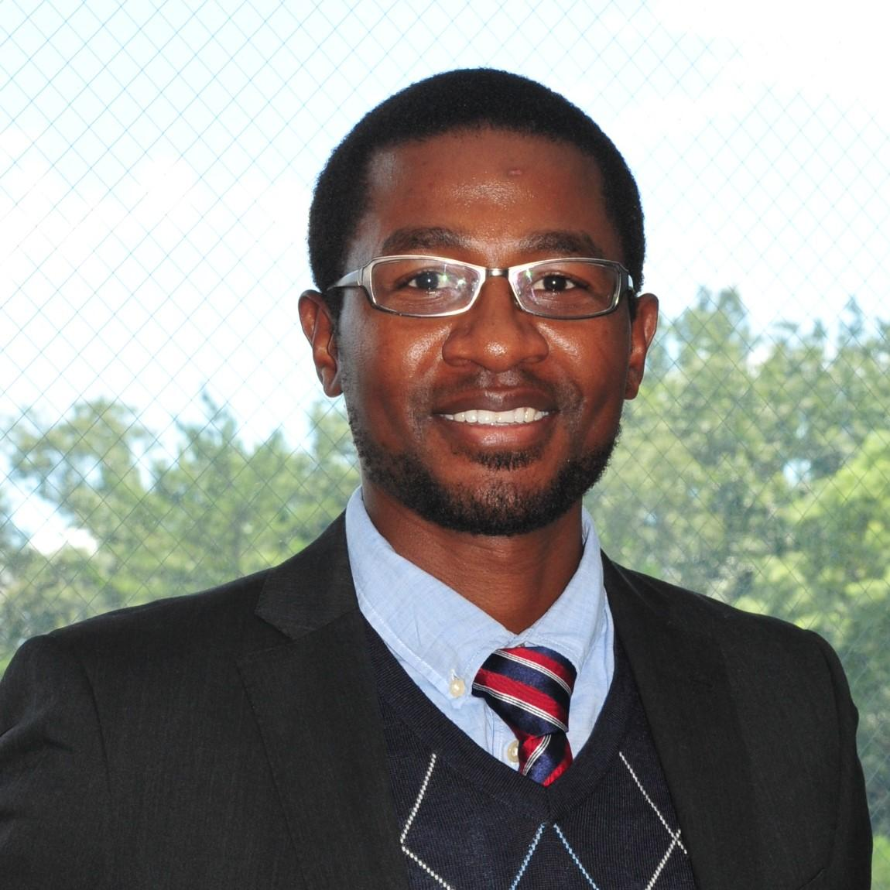

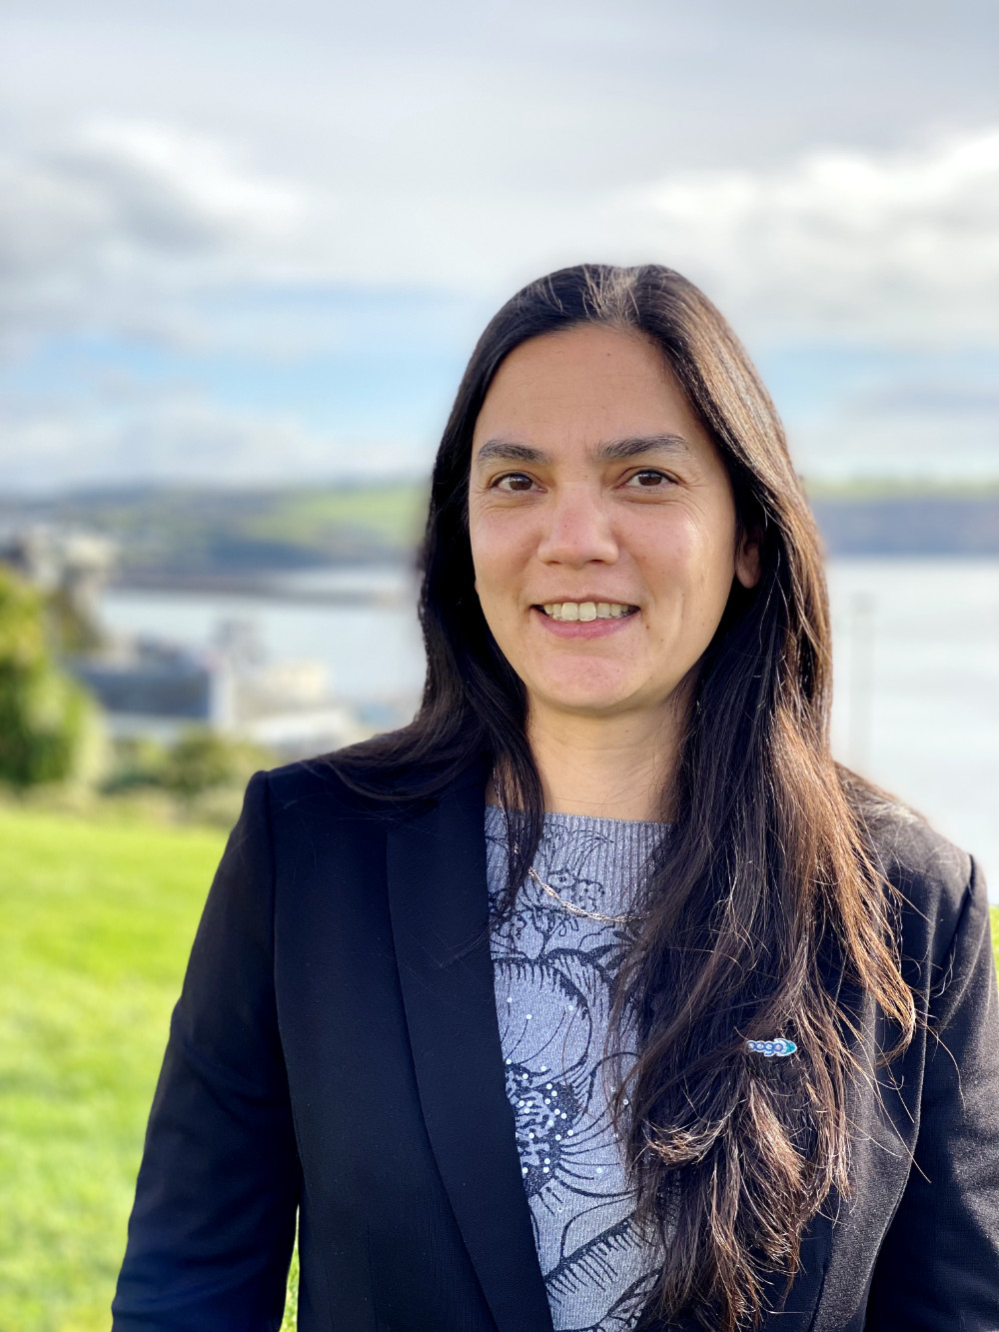
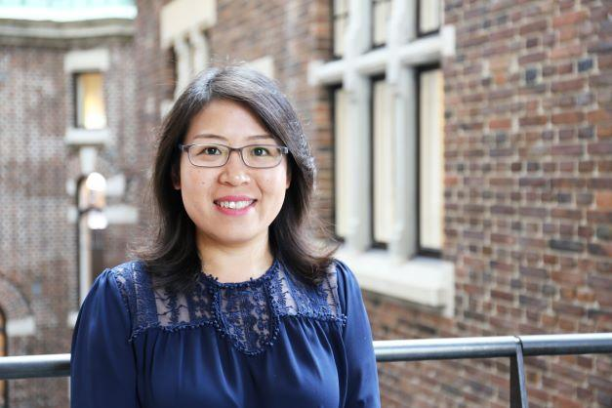
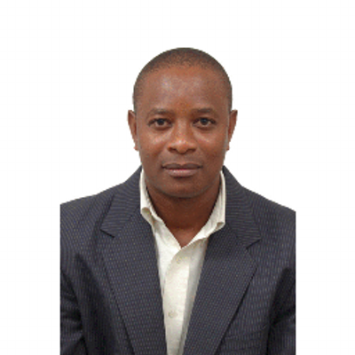
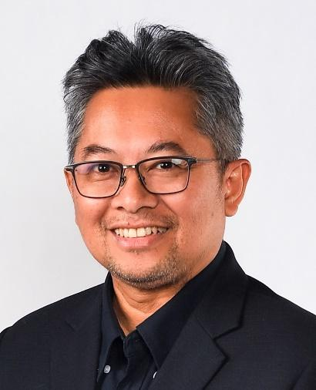
THE CO-CHAIRS
UN Ocean Decade Vision 2030 Working Group 9
Challenge 9: Skills, knowledge and technology for all
Sustainable use and development of ocean resources requires an understanding of the past, present and future state of the ocean. This understanding can only be achieved if there is equal capacity for studying and communicating the state of the ocean throughout the globe.
Brian Arbic
Univ. of Michigan, USA
Edem Mahu
Univ. of Ghana, Ghana
EXPERT MEMBERS
Kristina Alexander Harte Research Inst. for Gulf of Mexico, Texas A&M Univ., USA
Pamela Buchan Univ. of Exeter, UK
Juliet Hermes
Univ. of Cape Town, South Africa
Samina Kidwai
National Institute of Oceanography, Pakistan
Evgeniia Kostianaia
ECOP, IOC, UNESCO
Li Li
First Institute of Oceanography, China
Xin Lin
Xiamen Univ., China
Sarah Mahadeo Sasakawa Global Ocean Institute, Western Maritime Univ., Sweden
Cosmas Munga Technical Univ. of Mombasa, Kenya
Aidy M Muslim
Universiti Malaysia Terengganu, Malaysia
Sophie Seeyave Partnership for Observation of the Global Ocean (POGO)
Zhen Sun
Sasakawa Global Ocean Institute, Western Maritime Univ., Sweden
Elígio de Raús Maúre
Navagis, Inc.
Gail Sant
Univ. of Edinburgh, UK

Slide 2
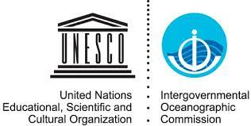
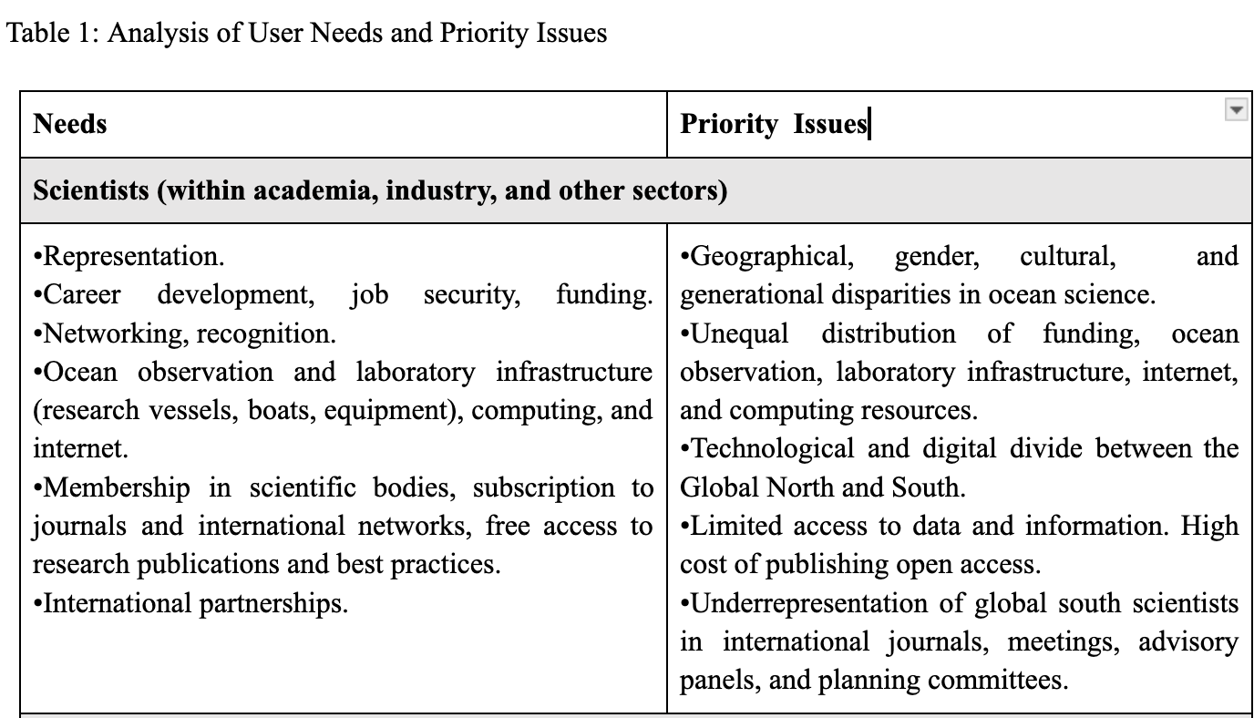
UN Ocean Decade Vision 2030 Working Group 9

Slide 3
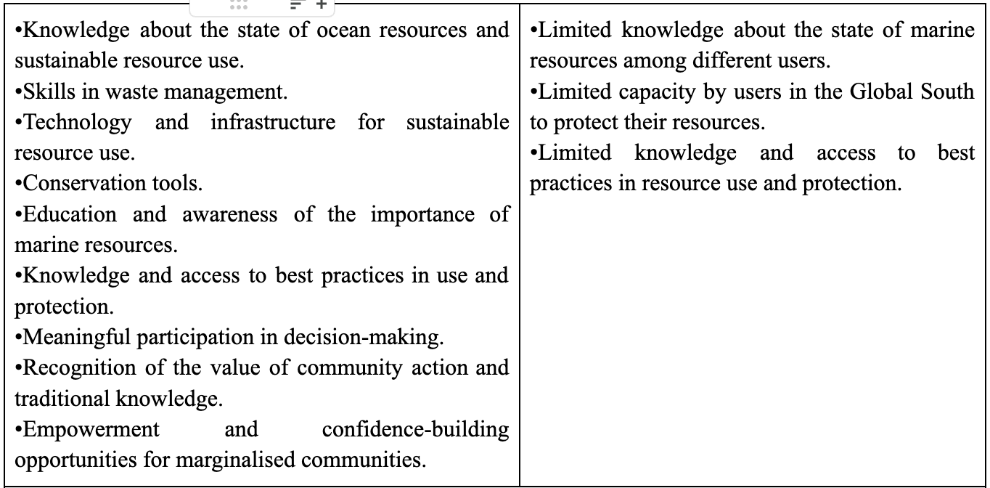
UN Ocean Decade Vision 2030 Working Group 9

Slide 4
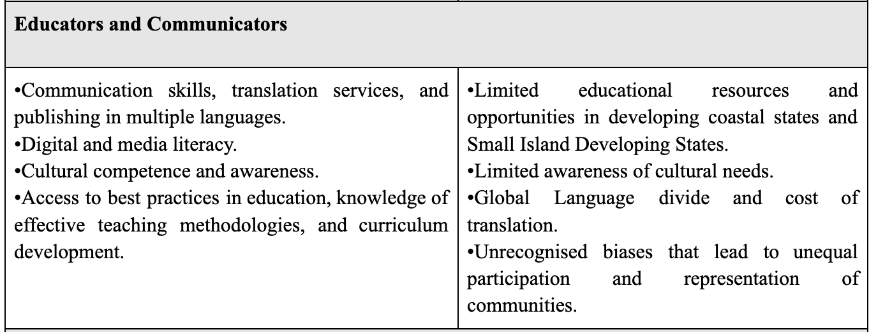
UN Ocean Decade Vision 2030 Working Group 9

Slide 5
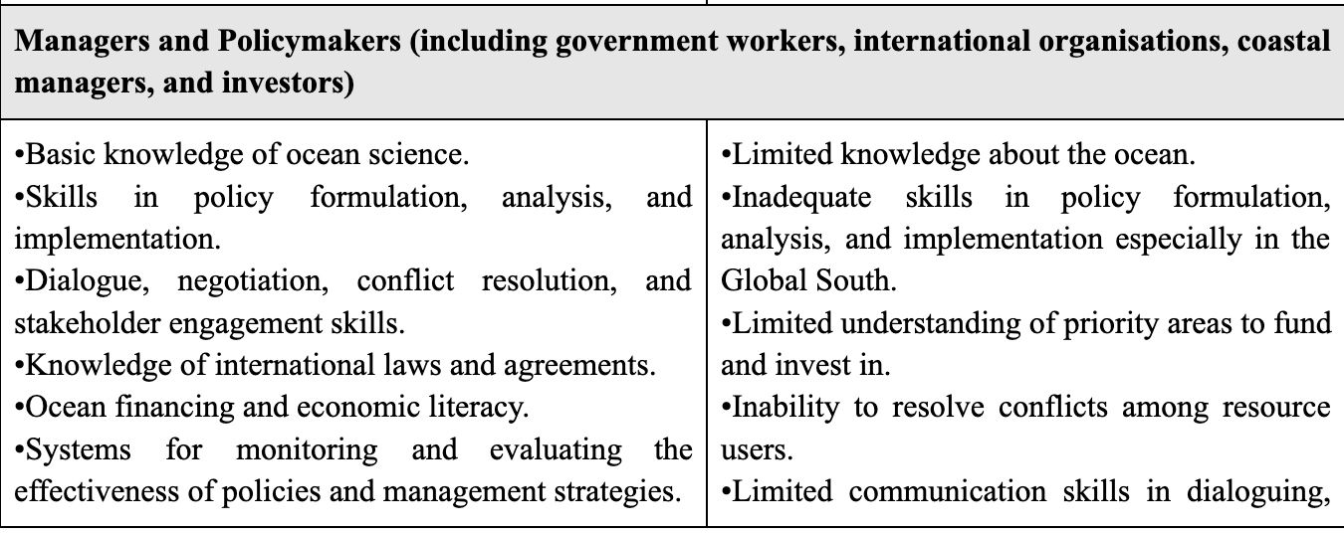
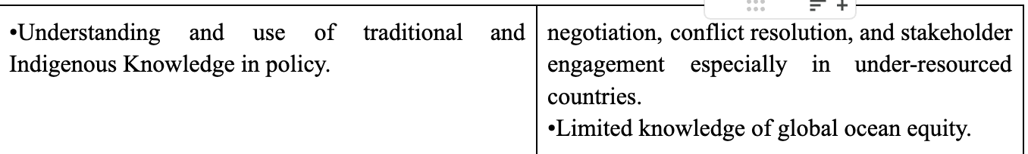
UN Ocean Decade Vision 2030 Working Group 9

Slide 6
STRATEGIC AMBITION FOR CHALLENGE 9
To comprehensively develop and build the capacities required to deliver a globally robust and inclusive science and awareness needed to understand and address all other nine (9) challenges of the Ocean Decade
SPECIFIC OBJECTIVES OF THE STRATEGIC AMBITION
Develop the skills required by various actors to study, sustainably utilize, and manage the ocean.
Promote equal representation of all groups in the science, communication, management, and policy areas of the ocean.
Create opportunities for career development, employment, networking, and recognition for scientists in the Global South.
Ensure fair and equitable distribution of infrastructure and technology required to study, sustainably exploit, and manage the ocean.
Remove barriers/restrictions on the sharing and movement of ocean data and knowledge among different users of the ocean
Encourage innovative, fit-for-purpose solutions through technology for studying and sustainably managing the ocean.
Ensure equitable distribution of funding and encourage all countries to invest in ocean science.
Encourage constructive, multi-directional partnerships to find common objectives that fulfil the needs of all parties involved.

Slide 7
UN Ocean Decade Vision 2030 Working Group 9
STRATEGIC AMBITION KEY DESIRED OUTCOMES
An increased number of skills required by scientists, resource users, educators, communicators, managers, and policy-makers to study, sustainably exploit, and manage the ocean.
Equal/balanced representation of all groups in the science, communication, management, and policy areas of the ocean
Fair and equitable access to data, information, and knowledge for all stakeholders.
Equitable distribution of resources i.e infrastructure, technology, and funding across all ocean basins
An integrated ocean science community that is based on equitable participation and multicultural values.
A paradigm shift in recognizing, researching, and accessing different forms of knowledge to foster global relationships that support sustainable ocean use and management.
Increased in the number of multilateral partnerships established between the North and South.

