Slide 1
Tsunami Ready ‘Equivalency’
At ICG/PTWS-XXIX, a ‘Task Team Tsunami Ready’ under WG3 was established to provide better coordination and governance of Tsunami Ready in the PTWS
WG3 was also recommended to ‘develop formal guidance for ICG/PTWS on the application of the proposed ‘Tsunami Ready Equivalency Approach’ that was presented in the session

Slide 2
Tsunami Ready ‘Equivalency’
The principles of a TR ‘equivalency’ approach should include:
Countries have a strong motivation to ensure that their communities at risk of tsunami are prepared for and resilient to tsunamis.
Existing national strategies are used to measure progress towards the “100% Tsunami Ready’ goal.
Reporting on progress towards global preparedness targets is consistent with the Tsunami Ready Framework (12 indicators)
Effort to track and report towards global targets is concentrated at the national level.
Supports national reporting and ICG/PTWS KPI’s.

Slide 3
Proposed approach
The approach seeks to enable reporting on tsunami preparedness in a manner compatible with TRRP, using existing national frameworks and requirements.
Implementation workflow is proposed as follows:
Define Community
Cross-Reference programme with Tsunami Ready indicators
Identify existing community reporting
Establish governance to support communities

Slide 4
Implementation Workflow
Define the most appropriate level of ‘community’
The most practical definition must be considered to be consistently applied
This will likely align closely with the most fundamental level of organisation, and / or existing reporting requirements
Notes:
Prepared for and resilient to tsunamis
Considered for a few reasons:
Anything we are missing in our existing programme
Benefits the recognition might bring in our existing system
Support of the global tsunami community, at least measurement before.
CDEM Groups are the lowest legislated entity required to undertake comprehensive DRR planning.

Slide 5
Implementation Workflow
2. Undertake a cross-reference process at the national level
Review existing resources that contribute to community preparedness outcomes (e.g. frameworks, strategies, plans, legislation)
Identify where Tsunami Ready indicators are being met as a standard approach across communities
This enables reporting against some indicators without separate assessment for each community
Notes:
Prepared for and resilient to tsunamis
Considered for a few reasons:
Anything we are missing in our existing programme
Benefits the recognition might bring in our existing system
Support of the global tsunami community, at least measurement before.
CDEM Groups are the lowest legislated entity required to undertake comprehensive DRR planning.

Slide 6
Implementation Workflow
3. Utilise existing community reporting
Some indicators need to be assessed at the community level
Existing reporting requirements should be identified to consider
Whether these are already reported on at a national level OR
Where reporting considerations could be added within existing reporting
e.g. a community response plan may also include other readiness factors such as public education
Notes:
Prepared for and resilient to tsunamis
Considered for a few reasons:
Anything we are missing in our existing programme
Benefits the recognition might bring in our existing system
Support of the global tsunami community, at least measurement before.
CDEM Groups are the lowest legislated entity required to undertake comprehensive DRR planning.

Slide 7
Implementation Workflow
4. Empower community participation through governance
A National Tsunami Ready Board should be established to enable:
Consistency in reporting across ICG/PTWS
Local communities to progression of recognition through the formal TRRP should that be preferred /appropriate
It is possible that an existing body may be able to meet the requirements to act as a NTRB
Notes:
Prepared for and resilient to tsunamis
Considered for a few reasons:
Anything we are missing in our existing programme
Benefits the recognition might bring in our existing system
Support of the global tsunami community, at least measurement before.
CDEM Groups are the lowest legislated entity required to undertake comprehensive DRR planning.

Slide 8
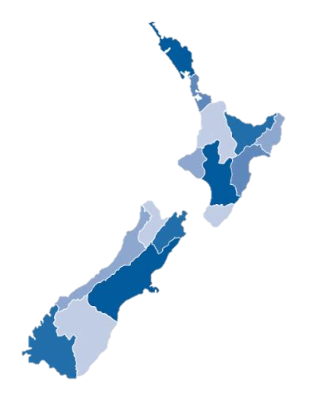
Tsunami Ready in New Zealand
New Zealand is not able to roll-out formal TR recognition as a national programme.
However, there is interest at a national level to encourage the measurement of Tsunami Ready Recognition Programme, in support of the Ocean Decade Goal of 100% of all at risk communities “Tsunami Ready”.
This would be preferentially undertaken at the Civil Defence Group Level - committees of local authorities within regional boundaries.
Notes:
Prepared for and resilient to tsunamis
Considered for a few reasons:
Anything we are missing in our existing programme
Benefits the recognition might bring in our existing system
Support of the global tsunami community, at least measurement before.
CDEM Groups are the lowest legislated entity required to undertake comprehensive DRR planning.

Slide 9
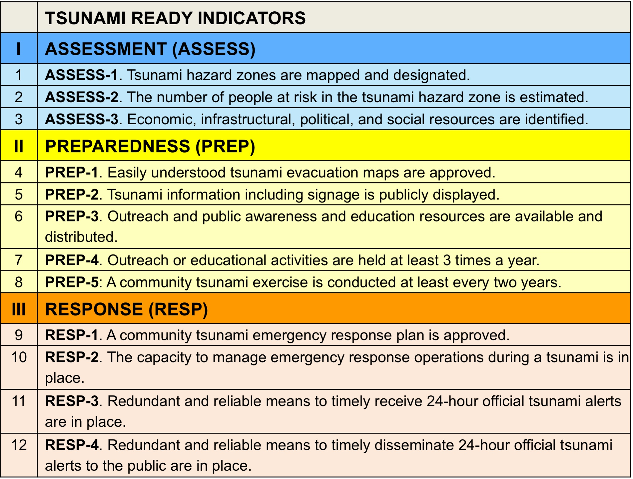
NZ: Comparison against indicators
Regionally done
Regionally done as part of risk assessment, not explicitly reported
Regionally done
Nationally supported
National exercise – but focused largely on earthquake preparedness
Regionally required / reported
National capability
Notes:
Broadly looking at the indicators, which already align in intent with existing mechanisms in NZ – many of the CDEM groups already do more than this minimum.
This affirms that the best level to apply would be regionally (CDEM Group).
Two indicators are not required under national planning – but are done by a number of Groups already.

Slide 10
NZ: The concept
Some indicators can be met “as standard” across the entire country as they are either national capability OR legislatively required to be reported in Regional Group Plans. Some work is required at the national level to describe how these cross-reference to the Tsunami Ready indicators.
Groups could then apply with supplemental information on remaining indicators, where these are optional national activities.
New Zealand’s Tsunami Reference Group (or sub set) can be designated as a NTRB
Notes:
The approach effectively is a ‘cross crediting’ approach – aligning and stating exactly how the existing national program fulfils the Tsunami Ready Programme indicators.
By having a cross-crediting framework established we can also track better nationally how ‘tsunami ready’ we are nationally, for reporting towards the Ocean Decade Goal.
Still have a lot of detail to work through and expect some smaller challenges to arise throughout, most related to this ‘translation’.
Some key issues include:
Who verifies our cross crediting?
How would the renewal period work with regards to the mismatch in timelines
The branding issue with existing brands relating to tsunami preparedness, and also mis-representing that there is a discrepancy between those Groups that chose to apply vs those that don’t.

