Slide 1
IUGG
Update
TOWS Joint TT TWO - TT DMP, 19 Feb 2024, Sendai, Japan
Agenda J8
PPT prepared by
Maria Ana Baptista, Laura Kong, Yuichiro Tanioka

Slide 2
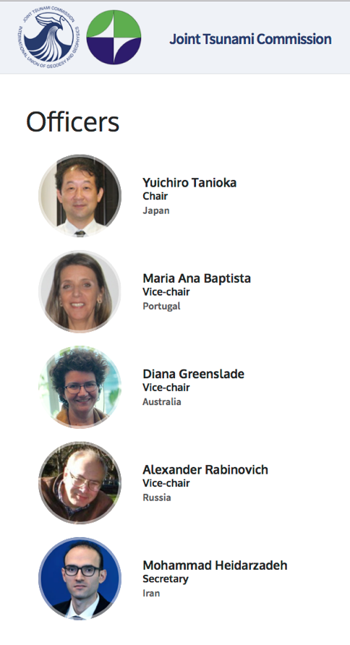
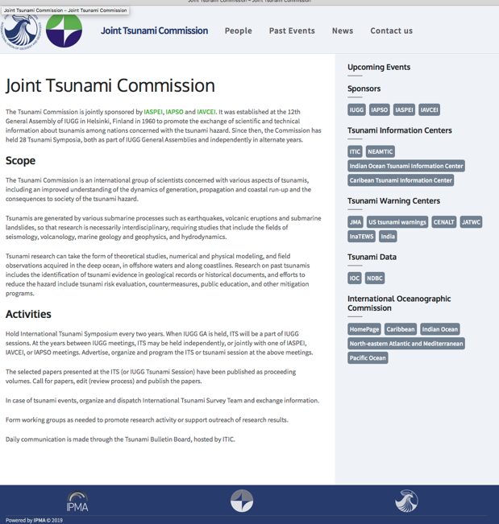
IUGG Joint Tsunami Commission
Est 12th General Assembly of IUGG, 1960
Promote the exchange of scientific and technical information about tsunamis among nations concerned with the tsunami hazard
Last Business Meeting: 2 July 2022
Working Groups
Tsunami Terminology – William Power, NZ
Science-based Tsunami Warning - Laura Kong, USA
Tsunami Magnitude - Vasily Titov, USA
GNSS Data for Tsunami Warning - Tony Song, USA
Meteotsunami - Ivica Vilibic, Croatia
Tsunami Data – Slava Gusiakov, Russia
Elected 2019
https://tsunamicommission.ipma.pt/home/

Slide 3
Meetings and Publications – 2022 - 2024
Meetings (a part of JTC members hosted and/or organized)
EGU 2024, 2023, 2022 (14-19 April 2024, Vienna: NH5.1 on tsunami science)
AGU 2023, 2022 (San Francisco) Interdisciplinary Tsunami Science
IUGG JTC - PTWS Tsunami Symposium (ICG/PTWS-XXX, Tonga, 2023)
3rd World Conference on Meteotsunamis, 13-17 Oct 2024, Turkiye
IUGG JTC - IOC 2nd Global Tsunami Symposium, 11-14 Nov 2024, Banda Aceh
Publications – Special Volumes
Tonga Volcanic Eruption 2022: Topical collection in Pure and Applied Geophysics (PAGEOPH), 13 papers published online.
Turkey-2023 Earthquake and Tsunami: Topical collection in Pure and Applied Geophysics (PAGEOPH), 3 papers published online.

Slide 4
Scientific Committee of ODTP
Meeting at UNESCO Headquarters in Paris. Altogether, 4 meetings. Latest: 25, 26 January 2024
Participation of IUGG members to the UN Ocean Decade Tsunami Programme Scientific Committee:
Alexander Rabinovich
Christa von Hillebrandt-Andrade
François Schindelé
Srinivas Kumar (SC Chair)
Helene Hebert
Laura Kong
Maria Ana Baptista
Silvia Chacon

Slide 5
2nd Global Tsunami Symposium, Nov 2024
Steering Committee
Yuchiro Tanioka, IUGG-JTC
Program Organizing Committee
Dr. Srinivasa Kumar Tummala (Chair - SC-ODTP)
Dr. Laura Kong (International Tsunami Information Centre)

Slide 6
IOC Support through Member, JTC WGs
Tsunami Generated by Volcanoes Report (TOWS ad hoc TT) – JTC Science-based Tsunami Warning WG
Meteotsunami Report (TOWS ad hoc TT) – JTC Meteotsunami WG

Slide 7
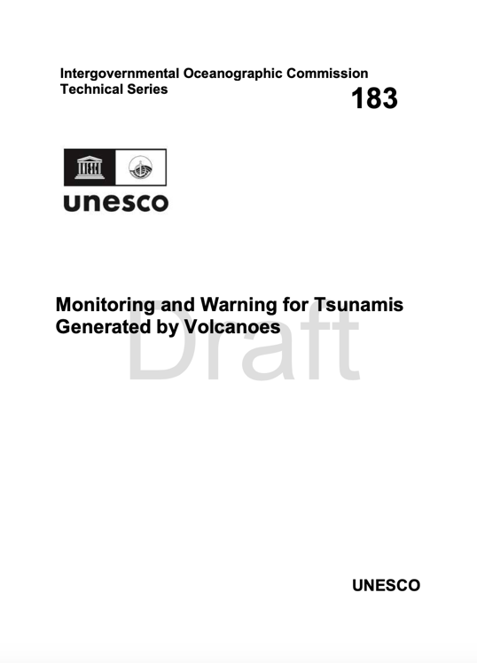
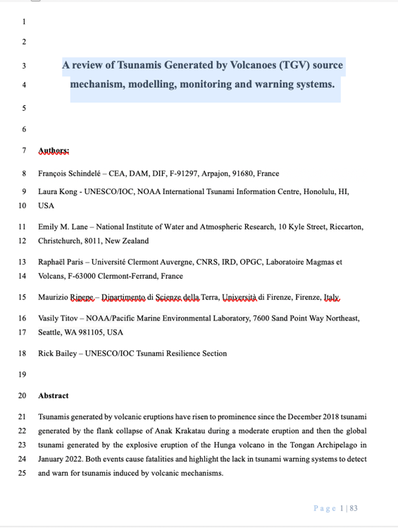
Tsunamis Generated by Volcanoes
Participation in IOC ad hoc TT Report: Monitoring and Warning for Tsunamis Generated by Volcanoes (TS 183 draft June 2023)
Paper: A review of Tsunamis Generated by Volcanoes (TGV) source mechanism, modelling, monitoring and warning systems (PAGEOPH, submitted Jan 2024)
Francois Schindelé
Laura Kong
Vasily Titov

Slide 8
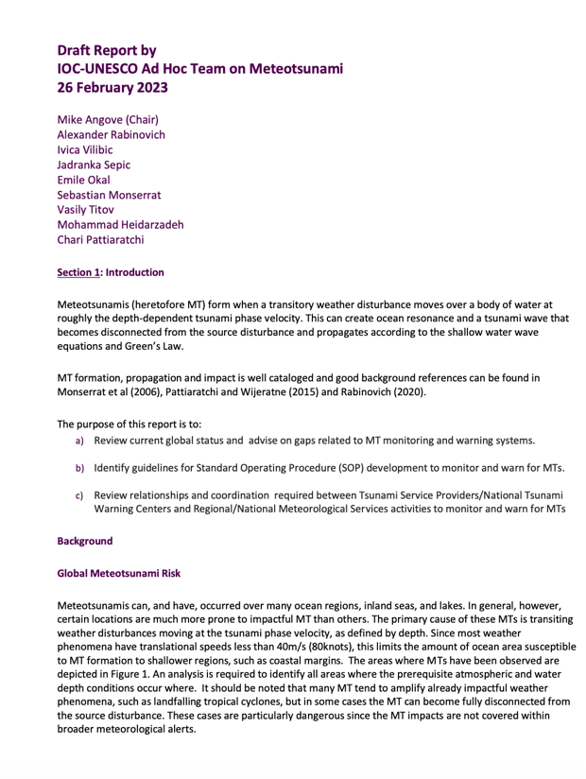
Meteo-tsunamis
Participation in TOWS ad hoc TT Report: Meteotsunamis (draft Feb 2023):
Alexander Rabinovich
Ivica Vilibic

Slide 9
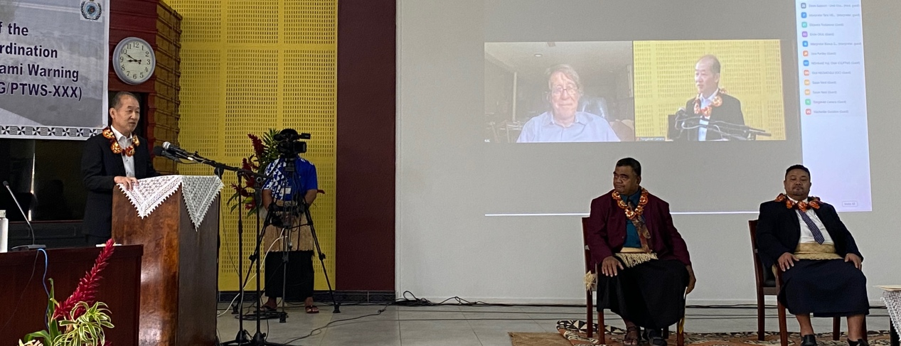
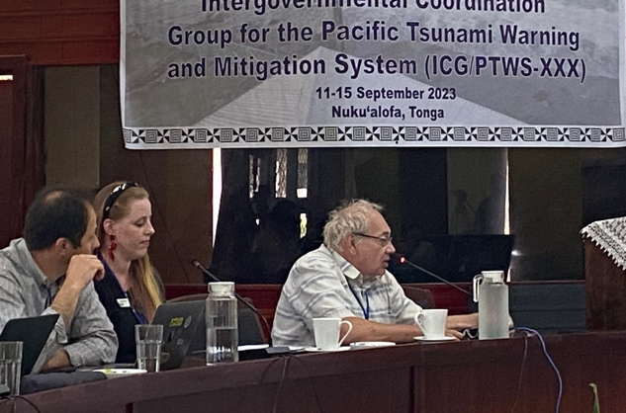
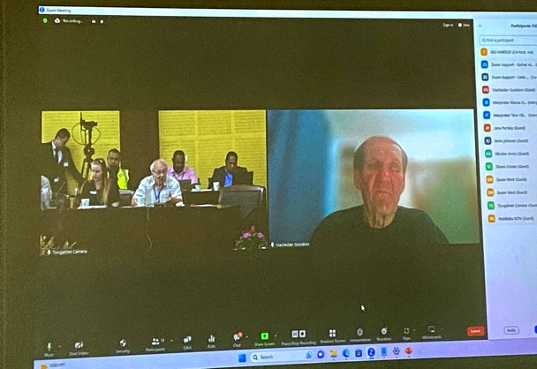
8th Joint ICG/PTWS-IUGG/JTC Technical Workshop, 11 Sept 2023
Understanding and lessons learned from the tsunami generated by the Hunga Tonga-Hunga Ha'apai volcano eruption on 15 January 2022 for development of Tsunami Warning and Mitigation System for tsunamis generated by volcanoes and other non-seismic sources
(1st Joint Workshop ICG/ITSU was 1985)
Science Committee and Speaker (remote *)
Yuchiro Tanioka
Alexander Rabinovich
Slava’ Gusiakov *
Emile Okal *
Vasily Titov
Laura Kong

Slide 10
IUGG JTC Business Meeting
Last IUGG JTC Business Meeting (hybrid), 16 Jul 2023, Berlin
Report available at
https://tsunamicommission.ipma.pt/wp-content/uploads/2023/10/IUGG-JTC-2023-Berlin-meeting-minutes-v6-YT-3.pdf

Slide 11
Next International Tsunami Syposium (ITS)
ITS 2025 in Hyderabad, India
At the JTC Business Meeting (July 2023), T. Srinivasa Kumar (Director, Indian National Centre for Ocean Information Service, INCOIS), announced their candidacy for hosting the ITS 2025 in Hyderabad, India, and made a presentation about their capabilities and facilities.
The candidacy was voted favourably by the JTC members.

