Slide 1
PTWS National Tsunami
Warning Centre (NTWC)
Competency Framework - Minimum Levels for Operations Staff
2024-25 ITIC Training Pilot
TOWS Joint TT TWO - TT DMP, 19 Feb 2024, Sendai
Agenda 6
Laura Kong, ITIC

Slide 2
PTWS NTWC Competency Development - History
PTWS-XXVII (2017, Tahiti) – Identified need
WG-SWP-IV (2016, Honiara). Develop competency guidelines for tsu operational personnel
Tonga - needs assistance to review its national tsunami warning procedures,… and establish minimum warning competency levels.
=> WG 3 (Training) - on-going need for warning & response training in SW Pacific, including introduction of competency based training. Funding required to advance.
Action: WG 2 est by mid-2018 (PTWS-XXIX, 2019), minimum competency level for NTWC operations, by identifying a) what competencies required and b) what training schemes in existence & what guidelines & principles can be adapted for this purpose. WG2 rpt to SC
Action: PICT WG ToR: 2. Develop competency guidelines for tsunami warning personnel for PICTs and report outcomes to PICT WG and WG2
PTWS-XXVII.1. Appendix 2. Budget & Programme, 2017-2019 – Identified need, but no funding
Activity | Approx. co- investment by MS and UNESCO | IOC Extra-Budgetary resources req | Year of expenditure | Status
WG2 Development of TWC Competency Training Program Workshop |  | US$25K | 2017 | Not done, no funding. Instead by email => delays.
WG2 NTWC Training (five countries not conducting TEMPP/Tsunami Ready) | Tonga – in-country pilot ITIC (USAID) – training course pilot | 5x US$25K = US$300K | 2017 2018 2019 | Not done, no funding except Tonga (2019) Competency course development by ITIC (2024-5)

Slide 3
PTWS NTWC Competency Development – History ICG/PTWS-XXVIII established WG 2 Task Team (TT) on Minimum Competency Levels for National Tsunami Warning Centre (NTWC) Operations Staff
Est. TT, PTWS-XXVIII (2019). Chairs: Ms Lara Bland (NZ), Mr Ofa Fa’anunu (Tonga).
Build from draft Framework developed by small group after 2018 PTWS WG mtg in Hawaii.
CONTENT - competency framework proposed is multi-tier system with different levels of knowledge and skills required depending on the roles.
2019 draft was incomplete – required further work to finish
October 2019 – Draft Competencies Pilot by ITIC at request of Tonga Met
Cont. TT, PTWS-XXIX (2021, virtual). Chairs: Mr Ofa Fa’anunu (Tonga), Dr Laura Kong (ITIC)
Draft PTWS NTWC Minimum Competency Framework shared with Global TOWS WG Inter-ICG TT on Tsunami Watch Operations and Disaster Management and Preparedness (2022, 2023)
Complete Draft Framework (May – July 2023)
Final TT Report (Sept 2023): Minimum Competencies, Framework, Training, Existing schemas
PTWS-XXX (2023) – MS approve Framework (final paperwork, PTWS-SC, Mar 2024)
WG 2 recommended approval – ICG/PTWS-XXX Consensus agreement
ITIC proposed to develop training and pilot, report back to PTWS-XXXI – ITIC funded 2024-25

Slide 4
2023 Report of PTWS WG2 Task Team on Minimum Competency Levels for National Tsunami Warning Centre (NTWC) Operations Staff
ICG/PTWS-XXX, Agenda 4.3 (2023)
Expert Task Team Report:
Established minimum competency levels required for NTWC operations staff.
Established framework for required competencies required by roles of a NTWC.
Established what training is required to ensure NTWC staff meets minimum competency levels.
Investigates and document what schemes are currently in existence and what guidelines and principles can be adapted for this purpose.
Task Team (Co-Chairs *): Wilfried Strauch (Nicaragua), Ofa Fa'anunu (Tonga) *, Yuelong Miao (Australia), Chip McCreery (USA), Lara Bland (NZ), Laura Kong (ITIC) *, and Ken Gledhill (NZ)
Piloting: PTWS Pacific Island Countries and Territories (PICT) WG Task Team on Capacity Development (PTWS-XXVIII.1, 2019)
Continue the development of competency framework for NTWC personnel and pilot it in Australia, Vanuatu, Fiji, Samoa and Tonga and report progress and lessons learnt to ICG/PTWS WG 1, 2, 3

Slide 5
Minimum Competencies - Summary Tier 1 CORE (Basic), Tier 2 ADV (Comprehensive, Expert)
KNOWLEDGE Science
CORE : Basic tsunami science / earthquake source knowledge
ADVANCED : Adv tsunami science / earthquake source knowledge, tsunami forecast modelling
OPERATIONS competencies
CORE
Understand / use TSP text / graphical products, core set of decision support tools. Perform all core NTWC SOPs
Identify potential regional, distant, and local source tsunami threats
ADVANCED
Understand and produce tsunami threat maps
Explain relationship of tsunami warning products to evacuation maps and routes
Use a comprehensive set of decision support tools
Advanced practical seismology (locate / characterise EQs), sea-level observations: measure & interpret records
NATIONAL AGENCY competencies - CORE
Provide national threat and impact assessment. Liaise with NDMO and response agencies. Monitor public enquiries, provide guidance. Conduct Post-event activities (e.g., post-tsu surveys).

Slide 6
Available Resources and Progress
‘Competency’ training – existing
Global Interest
ITIC Training – past, present, future

Slide 7
1. Competencies – Existing Schema
Task Team solicited Competency Information (and training) from advanced NTWCs
Profile of staff - background, experience for staff that are hired (such as degrees and specialities)
Length of NTWC training before they are officially designated as Duty Watch Standers
Training Information – syllabus (topics, length), how watchstander readiness is measured (tests, practicum, other measures), how training is accomplished (live observer, online, offline, hands-on, classroom, online, other)
Information received: USA (PTWC, USNTWC), Australia (BOM, GA), Chile (SHOA), New Zealand (GNS, NEMA), India (INCOIS, NTWC)

Slide 8
2. Global Interest and status : TOWS WG-XVI (Feb 2023)
Establishing a Global Framework
Appreciated intersessional progress
Work of the Intergovernmental Coordination Group for the Pacific Tsunami Warning and Mitigation System (ICG/PTWS) to develop a National Tsunami Warning Centre (NTWC) Competency Framework (2019), and the ITIC’s leadership to pilot training courses based on the Framework;
Instruct the regional ICGs (PTWS)
ITIC to pilot the Draft PTWS National Tsunami Warning Centre (NTWC) Competency Framework (2019) for endorsement by ICG/PTWS with the goal to develop a global framework for all ICGs to use.
=> NOW APPROVED AND PROCEEDING TO PILOT in 2024-25

Slide 9
2. Global Interest and status : TOWS WG-XV (Feb 2022)
Recommendation 13 for training competencies:
Notes with appreciation the work of the PTWS to develop a NTWC Competency Framework (2019), and the ITIC’s leadership to pilot training courses based on the Framework,
Noting the interest of other ICGs, requests the PTWS to share its document with other regions, and invite comments and feedback,
Also noting the challenges in developing and implementing a global competency framework.
Requests the TT TWO and TT DMP to continue to consider development of guidelines for a global NTWC competency framework based on the available set of documents and Pacific input, noting that implementation can be at a regional level.
=> ITIC TO REPORT ON PROGRESS. Consider development in global context applicable to all ICGs. Consider development of process for national competency certification using WMO example

Slide 10
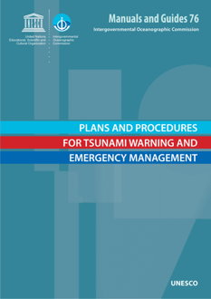
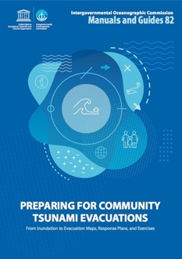
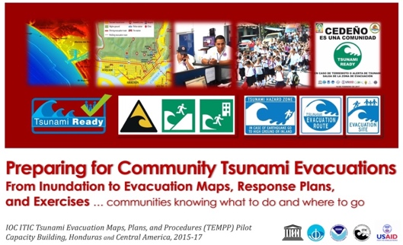
3. ITIC Existing
Standard Training based on IOC Manual and Guides
TWC / TER SOP (MG 76); Evac Planning (TEMPP, MG 82)
145+ trainings since 2005
Ocean Teacher Global Academy (OTGA) – online and hybrid. Plan: TEWS, SOPs, TEMPP, Tsunami Ready
PTWC Products training videos

Slide 11
3. ITIC Future - NTWC Competency Training
Requirements - Content and Training Modality
Knowledge – do self-paced, hybrid
Operational SOP – do self-paced, hybrid, in-person
Real-life Experience – do by shadow at Advanced Centre, e.g., PTWC or others (Australia, Chile, Japan, New Zealand, ?? …)
National Qualification / Certification – by country NOTE: IOC / ITIC does not provide certification for tsunami training and cannot certify staff
ITIC has funding for develop Training Course and Pilot in PTWS in 2024+
Concept after US NWS Weather Pacific Training Desk (small cohort for 3 weeks, incl shadow)
Competency measured (for only 1, 2, 3 above). Implementation Timeline:
Develop Implementation Concept (incl partnerships, modality, application criteria, assessment)
Develop Training Course content with PTWC shadow in 2024-25 (consult SMEs, develop e-learning modules (US COMET, IOC OTGA) and hands-on operations simulation tools)
Pilot 1 cohort from PTWS PICT in 2025

Slide 12
PTWS National Tsunami
Warning Centre (NTWC)
Competency Framework - Minimum Levels for Operations Staff
2024-25 ITIC Training Pilot
TOWS Joint TT TWO - TT DMP, 19 Feb 2024, Sendai
Agenda 6
Laura Kong, ITIC

