Slide 1

J3 WAVE Exercises
NEAMWave
Coordinated by Task Team on Tsunami Exercise ICG/NEAMTWS
co-chairs: Ceren Ozer Sozdinler (Turkiye)
Marinos Charalampakis (Greece)
MEETING OF THE INTER-ICG TASK TEAM ON DISASTER MANAGEMENT AND PREPAREDNESS
Sendai, 19–20 February 2024

Slide 2
Steps of NEAMWave
Phase A
Phase B
Emergency management activities at national level
(TWFP/NTWC – CPA)
Phase C
Detection of event and timely provision of alert messages
(TSPs)
International assistance request and provision
(CPA & ERCC)
Dissemination of exercise messages to the NEAMWave23 subscribers via e-mail, fax, GTS and optionally SMS and CAP-TSU.
Orientation workshop
Drill exercise
Table top exercise
Functional exercise
Full-scale exercise
Test of CECIS
Test of procedures for the request of international assistance

Slide 3
Objectives (1/2)
NEAMWave objectives:
● Validate and evaluate the Tsunami Service Provider (TSP) dissemination process of issuing Tsunami Messages in the NEAM region.
● Validate and evaluate the procedures for countries to receive the Tsunami Messages issued by the TSP through their National Tsunami Warning Centres (NTWC), the country Tsunami Warning Focal Points (TWFP) or the country Tsunami National Contacts (TNC).
● Test the dissemination of the warning messages to the relevant agencies that are responsible for emergency response (CPA).
● Assess the organizational decision-making process about public warnings and evacuations thus raising awareness of launching and contributing to the development of a national policy to tackle the tsunami risk.

Slide 4
Objectives (2/2)
NEAMWave objectives:
● Identify best practices (to be shared), criticalities (to be addressed by the program in the future activities) and room for improvements in the entire process (including the procedures already tested between TSPs and TWFPs/NTWCs and also the heterogeneous panorama of national capacities to handle tsunami risk).
● Test procedures for international assistance between the European Commission and participating Member States
● Potential Participation of CoastWAVE project countries in NEAMWave Exercise
Strengthening the Resilience of Coastal Communities in the North-Eastern Atlantic, Mediterranean Region to the Impact of Tsunamis and Other Sea Level-Related Coastal Hazards
Component 1: Adapt Global Tsunami Ready Standards and Guidelines and pilot Tsunami Ready within the framework of the ICG/NEAMTWS

Slide 5
Issues to take into account
● If CoastWAVE partners are willing to loose part of their independency and bind themselves in a more restricted schedule for the exercise.
● When they plan to have the CoastWAVE exercise, since the NEAMWave23 is initially planned for November.
● The level of alert they would like to simulate in the exercise. For some cases, it is very likely the alert level to be rather low, due to the possible large distance from the epicenter.
● For the secretariat: can the secretariat handle the workload of both the CoastWAVE project and the NEAMWave23 exercise? There will be some increased logistics, like checking documents for the project and the exercise…

Slide 6

Opportunity for greater synergies within Tsunami Ready recognized communities.
IOC CL 2950: “For this exercise (NEAMWave23), a key objective is the involvement of Member States that participate in the CoastWAVE project, coordinated by UNESCO and those of other non-project countries (France, Italy). This exercise will test the efficiency and the abilities of the pilot UNESCO-IOC Tsunami Ready communities to respond in a complex and realistic situation, overcoming any challenges that may arise.”
Suggested Options:
i. Conduct a functional/full-scale exercise, on the day of NEAMWave23, with the scenario provided;
ii. Conduct a functional/full-scale exercise, on a different date, with the scenario provided for NEAMWave23;
iii. Conduct a drill/table-top exercise, on the day of NEAMWave23, with the scenario provided.
Date & Time | Scenario | Region | TSPs
6 November 2023 08:00 UTC (6 hours)* | 1761 Atlantic Earthquake [8.5 Mw] | North-Eastern Atlantic [35°N, 12°E, 10 km] | IPMA - CENALT
7 November 2023 08:00 UTC (3½ hours)* | Hellenic Arc [8.1 Mw] | Eastern Mediterranean [34.52°N, 24.57°E, 10 km] | INGV – NOA – KOERI
* Duration of message dissemination by TSPs

Slide 7
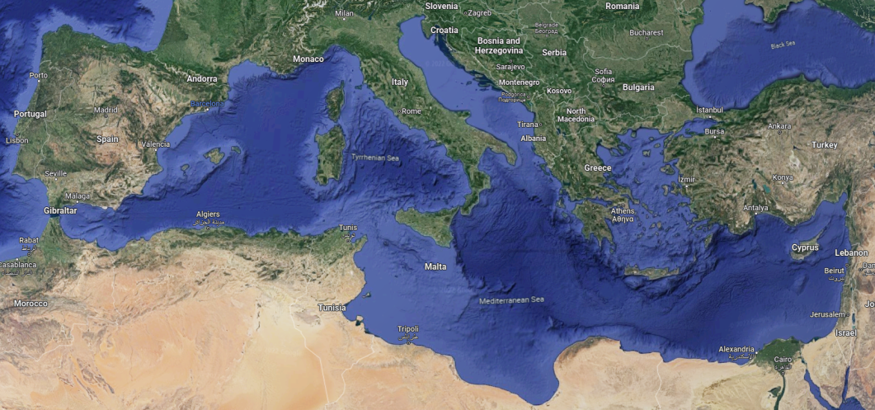
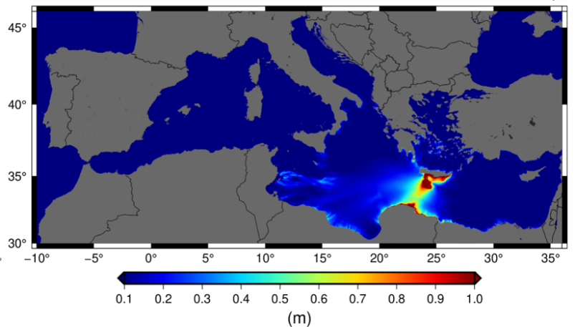
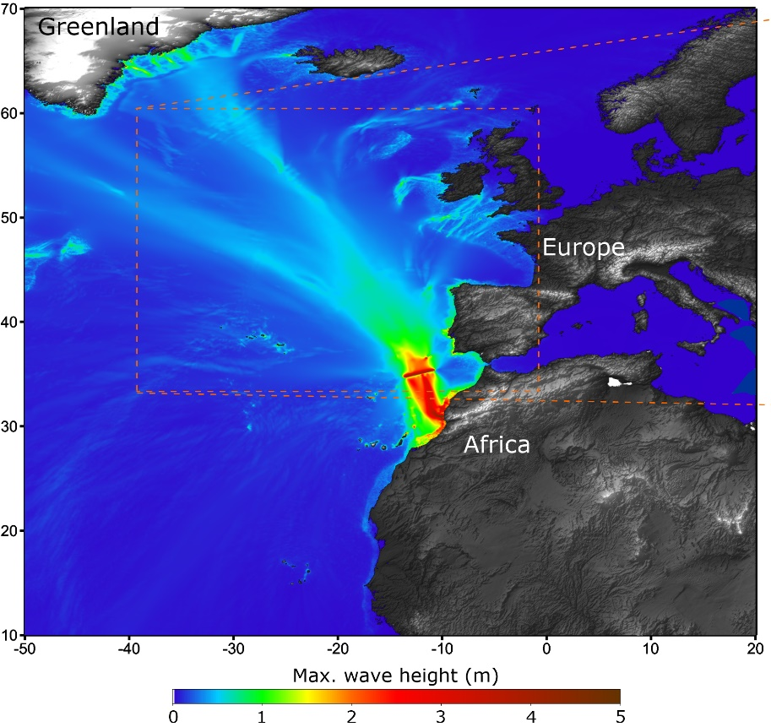
NEAMWave23 scenarios
North Eastern Atlantic
Joint scenario (Mw=8.5) by IPMA & CENALT
Eastern Mediterranean
Joint Scenario (Mw=8.1) by INGV, NOA & KOERI

Slide 8
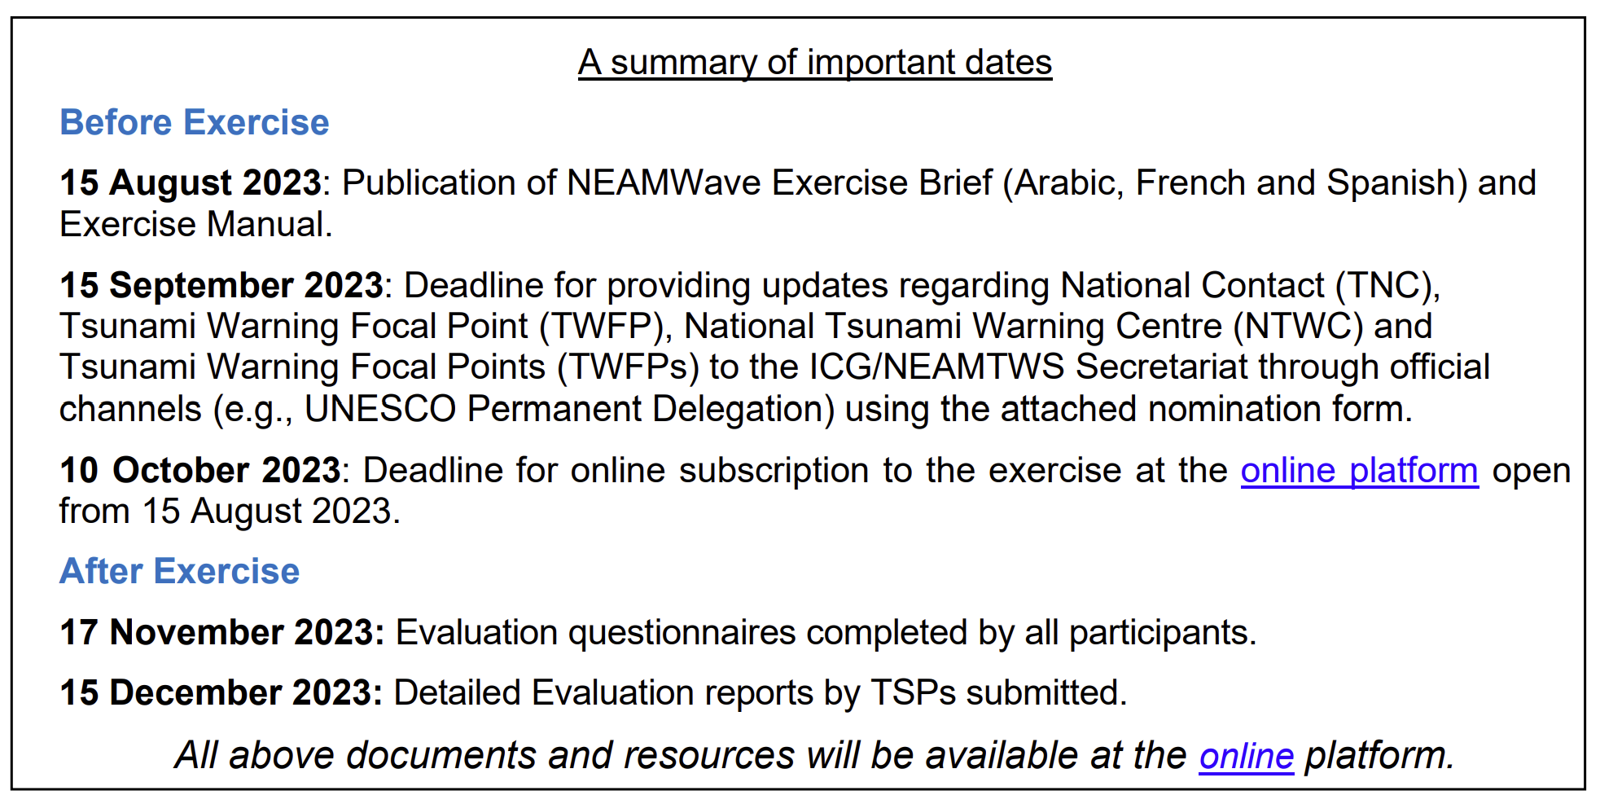
Announcements for NEAMWave23

Slide 9
Preparations for NEAMWave23
● A concept note to inform CPAs, NTWCs and other exercise actors about the general concept of NEAMWave - Done (Shared through Circular Letter and exercise online platform)
● Revision of online tools (subscription & evaluation) - Done
● Online meeting with CoastWAVE coordination team - Done

Slide 10
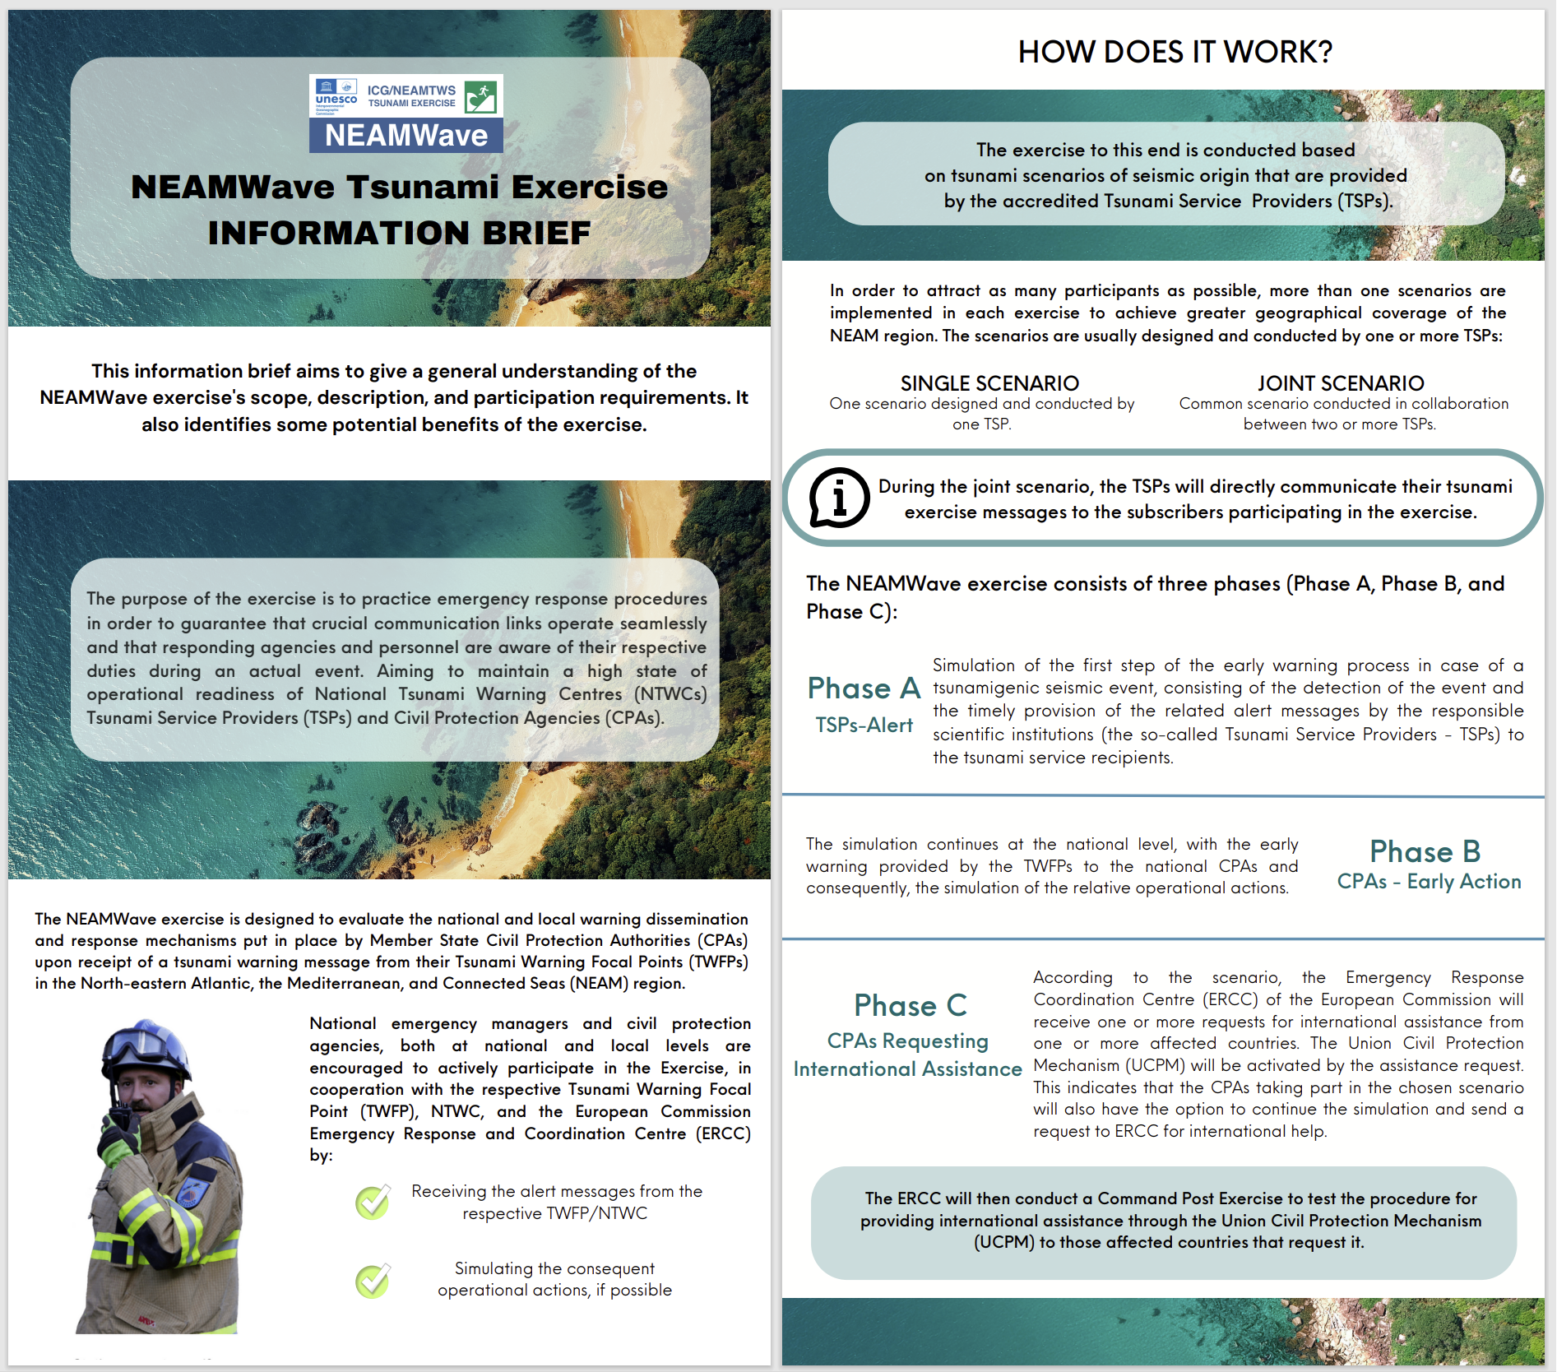
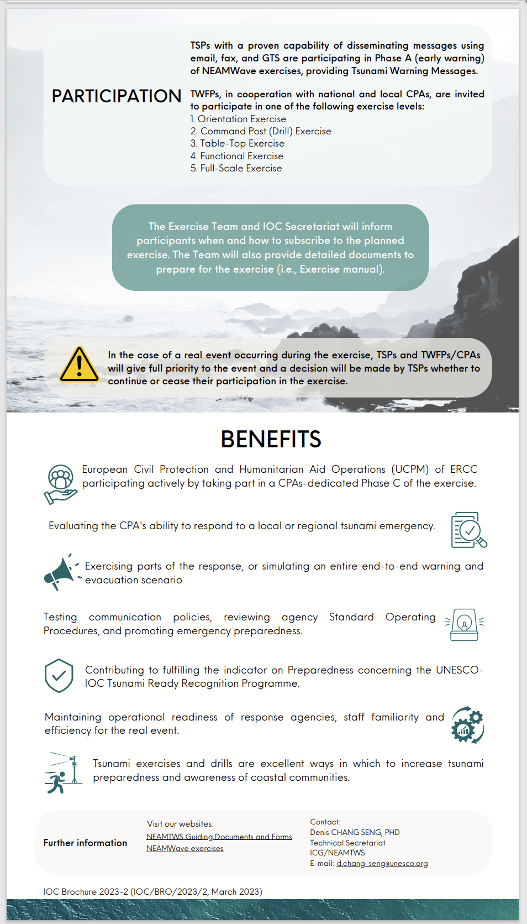
Preparations for NEAMWave23
Special thanks to Maria Camila León Duque!

Slide 11
Preparations for NEAMWave23
● A concept note to inform CPAs, NTWCs and other exercise actors about the general concept of NEAMWave - Done (Shared through Circular Letter and exercise online platform)
● Revision of online tools (subscription & evaluation) - Done
● Online meeting with CoastWAVE coordination team - Done

Slide 12
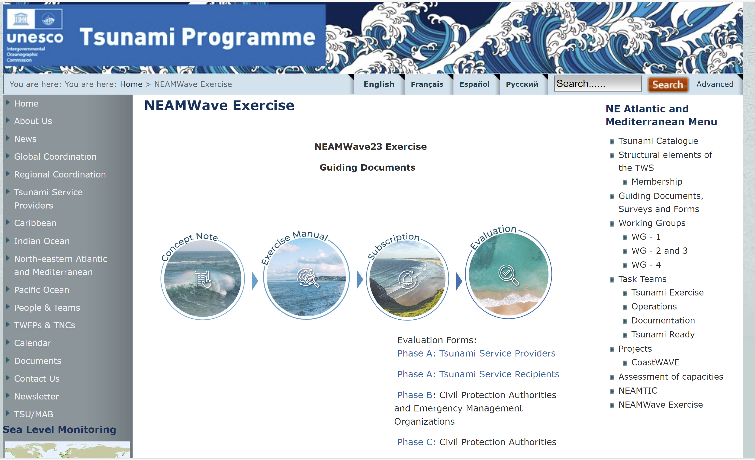
Preparations for NEAMWave23

Slide 13
Preparations for NEAMWave23
● A concept note to inform CPAs, NTWCs and other exercise actors about the general concept of NEAMWave - Done (Shared through Circular Letter and exercise online platform)
● Revision of online tools (subscription & evaluation) - Done
● Online meeting with CoastWAVE coordination team - Done

Slide 14
Participation Statistics
IOC CL 2950: “Very importantly, Member States registered as recipients of a Tsunami Service Provider are urged to also subscribe to the exercise through the online form”.

Slide 15
First comments …
Improvement of National Messages.
Promote self-protection in sectors with activity on the coast and at sea, against tsunami risk.
Usefulness or not (?) of the “old-fashioned” dissemination method, i.e. FAX messages.
The purpose of the Phase C would be served better with the participation of at least one country requesting assistance and two or more offering. These could be set as minimum criteria for the conduct of phase C.
More active involvement of the Civil Protection Authorities.

Slide 16
NEAMWave23 & Tsunami Ready
Istanbul
NE Atlantic Scenairo
(Mw=8.5) by IPMA & CENALT
Chipiona
Minturno
Samos
El Jadida
Larnaka
Malta
Eastern Mediterranean Scenario (Mw=8.1) by INGV, NOA & KOERI
Alexandria

Slide 17
NEAMWave23 & Tsunami Ready
Cyprus - Table Top Exercise of the Emergency Managers.
  Egypt – Drill Exercise (evacuation) in a middle school.
  Greece – Table Top Exercise of the Emergency Managers and Drill Exercise (evacuation) in two Middle Schools of Samos.
Italy – Drill Exercise (evacuation) in a nursery school.
Malta – Full Scale Exercise, evacuation of students visit a coastal area. It was officially classified as Functional Exercise but better fit in Full Scale.
  Morocco – Full Scale Exercise at a Port.
  Spain – Full Scale Exercise: Evacuation of a school coordinated by the operational center of the Local Police.
  Türkiye – Table Top Exercise related to the tsunami message dissemination chain.

Slide 18
Recommendations
● Disseminate / Advertise the exercise at all levels.
● Have an adequate number of meetings among the participants and the Exercise Team at all levels (national, regional, local).
● Give options for participating in the exercise, with multiple scenarios:
Have a functional/full-scale exercise, on the day of NEAMWave, with the scenario provided.
Have a functional/full-scale exercise, on a different date, with the scenario provided for the NEAMWave.
Have a orientation seminar/table-top exercise, on the day of NEAMWave, with the scenario provided (it is common to have a OSX/TTX before a FSX).
● Exercise date: decouple NEAMWave exercise from WTAD, since, fortunately, a lot of activities are organized at a national level on that date. A possible alternative date could be the October 13th, the International Day for Disaster Risk Reduction or in March, as a semi-annual complimentary activity

Slide 19
Best Practices
NEAMWave Best Practices:
1. Use online tools for the subscription and evaluation of the exercise.
2. Make only the essential changes to the exercise manual (e.g. scenarios and specific objectives), in order to sustain a general knowledge about the exercise.
3. Balance between the minimum number of scenarios and the maximum potential participating MS.
4. Use joint scenarios to strengthen the cooperation among the TSPs.
5. Organize targeted workshops for different types of participants (e.g. TSPs, CPAs etc).
6. Tailor made national messages (language) and enhanced products (maps) to users.
7. Carry out exercise in a multi-hazard crisis context and within World Tsunami Awareness Day framework.

Slide 20
Thank you for your attention!
MEETING OF THE INTER-ICG TASK TEAM ON DISASTER MANAGEMENT AND PREPAREDNESS
Sendai, 19–20 February 2024

